Slide 1
Web Application Design
SEII-Lecture 14
Dr. Muzafar Khan
Assistant Professor
Department of Computer Science
CIIT, Islamabad.

Slide 2
Recap
Patterns, effective design patterns
Describing patterns
Types of patterns
  Architecture, data, component, interface design, and webapp patterns
  Creational, structural, and behavioral patterns
Design tasks
User interface design patterns

Slide 3
WebApp Quality [1/2]
Olsina et al. criteria, 1999
Usability
  Global site understandability
  Online feedback and help features
  Interface and aesthetic features
  Special features
Functionality
  Searching and retrieving capability
  Navigation and browsing features
  Application domain-related features

Slide 4
WebApp Quality [2/2]
Reliability
  Correct link processing
  Error recovery
  User input validation and recovery
Efficiency
  Response time performance
  Page generation speed
  Graphics generation speed
Maintainability
  Ease of correction
  Adaptability
  Extensibility

Slide 5
WebApp Quality
Offutt (2002) proposed
Security
  Sensitive information
Availability
  24/7/365
  Different web browsers
Scalability
  Support for more users
Time-to-market
  Business point of view

Slide 6
Content Quality [1/2]
Tillman (2000) criteria
Can the scope and depth of content be easily determined to ensure that it meets the user's needs?
Can the background and authority of the content's authors be easily identified?
Is it possible to determine the currency of the content, the last update, and what was updated?
Are the content and its location stable (i.e., will they remain at the referenced URL)?

Slide 7
Content Quality [2/2]
Further considerations
Is content credible?
Is content unique? That is, does the webApp provide some unique benefit to those who use it?
Is content valuable to the targeted user community?
Is content well organized? Indexed? Easily accessible?

Slide 8
Design Goals of WebApp [1/2]
Simplicity
  “all things in moderation”
  Informative but compact
  Sensible use of colors
  Simple navigation
Consistency
  Text formatting, font style, color scheme
Identity
  Specific to application domains

Slide 9
Design Goals of WebApp [2/2]
Robustness
  Implicit promise to users
Navigability
  Intuitive and predictable navigation
Visual appeal
  Look and feel
Compatibility
  Different environments

Slide 10
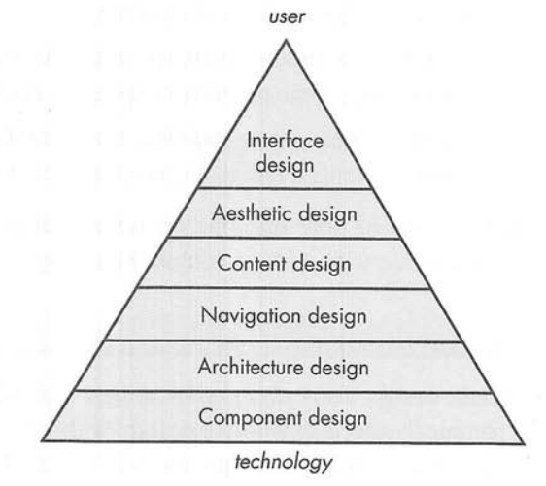
Design Pyramid for WebApps
Figure source: Software Engineering: A Practitioner’s Approach, R. S. Pressman, 7th ed., p. 379

Slide 11
Interface Design
Establish a consistent window into the content and functionality provided by the interface
Guide the user through a series of interactions with the WebApp
Organize the navigation options and content available to the user
Interaction mechanisms
  Navigation menus
  Graphic icons
  Graphic images

Slide 12
Aesthetic Design
Also called graphic design
Layout issues
  Do not be afraid of white spaces
  Emphasize content
  Organize layout elements from top-left to bottom-right
  Group navigation, content, and function geographically within the page
  Do not extend your real estate with the scrolling bar
  Consider resolution and browser window size when designing layout
Graphic designing issues

Slide 13
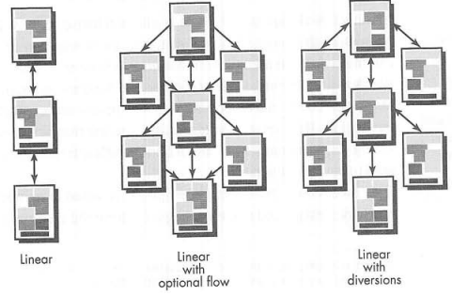
Architecture Design [1/4]
Figure source: Software Engineering: A Practitioner’s Approach, R. S. Pressman, 7th ed., p. 384

Slide 14
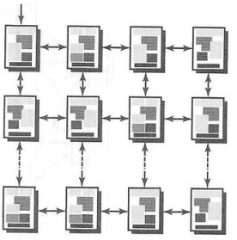
Architecture Design [2/4]
Figure source: Software Engineering: A Practitioner’s Approach, R. S. Pressman, 7th ed., p. 385

Slide 15
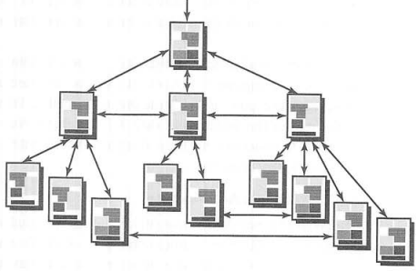
Architecture Design [3/4]
Figure source: Software Engineering: A Practitioner’s Approach, R. S. Pressman, 7th ed., p. 385

Slide 16
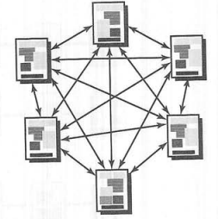
Architecture Design [4/4]
Figure source: Software Engineering: A Practitioner’s Approach, R. S. Pressman, 7th ed., p. 386

Slide 17
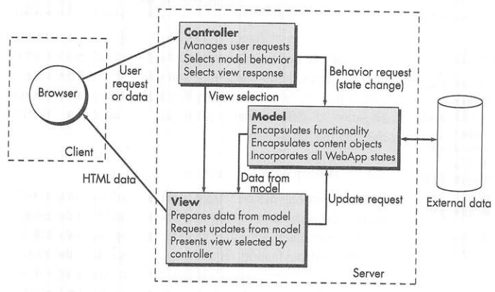
WebApp Architecture
Figure source: Software Engineering: A Practitioner’s Approach, R. S. Pressman, 7th ed., p. 387

Slide 18
Navigation Design
Navigation Semantic Unit (NSU)
  "a set of information and the related navigation structures that collaborate in the fulfillment of a subset of related user requirements“
Set of navigation elements
  Ways of Navigating (WoN)
  Navigational Nodes (NN)
Approaches
  Individual navigation link, horizontal navigation bar, vertical navigation column, tabs, and site maps

Slide 19
Summary
WebApp quality
Content quality
WebApp design

