Slide 1
Software Design
SEII-Lecture 10
Dr. Muzafar Khan
Assistant Professor
Department of Computer Science
CIIT, Islamabad.

Slide 2
Recap
Basic concepts
  Risk, positive/negative risk management, Risk utility / tolerance (risk averse, risk seeking, risk neutral)
Planning risk management
  Risk management plan, contingency and fallback plans
Identifying risks
  Brainstorming, Delphi technique, interviewing, SWOT analysis, checklists, risk registers
Performing qualitative and quantitative risk analysis
Planning risk responses
  Risk avoidance, risk acceptance, risk transference, risk mitigation, Risk exploitation, Risk sharing
Monitoring and controlling risks

Slide 3
What is Design?
Creativity
Achieving goals within constraints
Stakeholder requirements, business needs, and technical considerations
Representation or model of the software
  Software architecture, components, data structures, and interfaces

Slide 4
Goal of Design
Roman architecture critic Vitruvius said, “well-designed buildings were those which exhibited firmness, commodity, and delight”
Same for the good software
  Firmness: bug-free
  Commodity: suitable for the intended purpose
  Delight: pleasurable user experience
Model that exhibits firmness, commodity, and delight

Slide 5
Design Within the Context of SE
Technical kernel of software engineering
Independent of software process model
Last modeling activity before coding
Focus on quality
Translation of stakeholder requirements into a software product
Without design, you are at risk
Lot of rework

Slide 6
Design Process
An iterative process
Different levels of abstraction
Criteria to evaluate software design
  Design must implement all explicit and implicit requirements
  Design must be readable and understandable
  Design should provide the complete picture

Slide 7
Quality Guidelines [1/2]
Design should exhibit
  Recognizable design patterns
  Good design characteristics
  Implementation in an evolutionary fashion
Design should be modular
Design should contain distinct representations of data, architecture, interfaces, and components
Design should lead to appropriate data structures

Slide 8
Quality Guidelines [2/2]
Design should lead to independent components
Design should reduce connections complexity
Design should be derived using a repeatable method
Design should be represented using understandable notation
Application of design knowledge rather than by chance achievement

Slide 9
Quality Attributes
Different models
FURPS by HP
Functionality
  Feature set and capabilities of the program
Usability
  Human factors e.g. aesthetics and consistency
Reliability
  Frequency and severity of failure
Performance
  Processing speed and response time
Supportability
  Maintainability, compatibility

Slide 10
Evolution of Software Design
A continuing process
Top-down approach
Procedural aspects / structured programming
Object-oriented approach
Software architecture / design patterns
Aspect-oriented approach, model-driven and test-driven development

Slide 11
Design Concepts
“The beginning of wisdom for a [software engineer] is to recognize the difference between getting a program to work, and getting it right.“
These concepts help to
  Set criteria for partitioning
  Separation of data structure details from conceptual representation
  Provide criteria for quality
Followed in traditional and object-oriented software development

Slide 12
Abstraction
Modular solution
Problem-oriented technology coupled with implementation-oriented technology
Procedural abstraction
  Sequence of instructions
  Example: ‘open’ the door
Data abstraction
  Collection of data / data objects
  Example: open the ‘door’

Slide 13
Architecture [1/2]
Overall structure of the software
Provides conceptual integrity of a software
Major system elements and their interaction
Architectural patterns solve common design problems
Structure models
  Organized collection of system components
Framework models
  Repeatable frameworks for specific applications

Slide 14
Architecture [2/2]
Dynamic models
  Behavioral aspects of program architecture
Process models
  The design of business or technical process
Functional models
  Functional hierarchy of a system
Architectural Description Languages (ADL)
  Examples: Architectural Analysis and Design Language (AADL), C2, Darwin

Slide 15
Patterns
“A pattern is a named nugget of insight which conveys the essence of the proven solution to a recurring problem within a certain context amidst competing concerns.”
“A design structure that solves a particular problem within a specific context.”
Help to determine
  Whether it is applicable to the current work?
  Whether it can be reused?
  Whether it help to develop more similar patterns?

Slide 16
Separation of Concerns
Divide and conquer policy
Subdivision of the problem
Concern is a feature / behavior
Less effort and time to solve
Example: two problems with different perceived complexity
It involves other design concepts too

Slide 17
Modularity
“Modularity is the single attribute of software that allows a program to be intellectually manageable.”
Helps in separation of concerns
Components are called modules
Monolithic software has great complexity
Balanced approach required

Slide 18
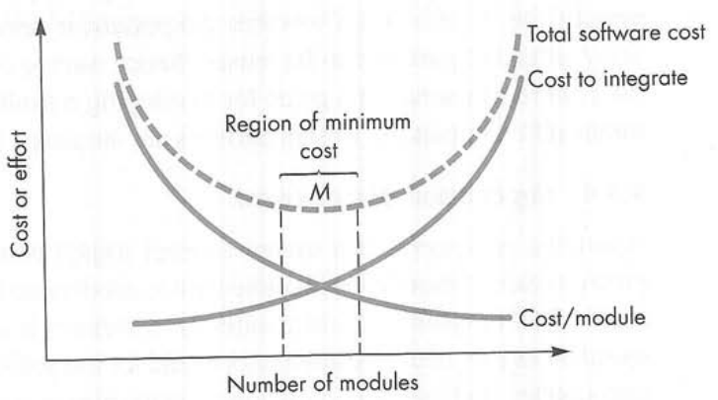
Modularity and Software Cost
Figure source: Software Engineering: A Practitioner’s Approach, R. S. Pressman, 7th ed., p. 226

Slide 19
Information Hiding
Information contained by a module should not be accessible to other modules
Independent modules lead to effective modularity
Abstraction VS hiding
Helps in software modification

Slide 20
Functional Independence
Abstraction, separation of concerns, modularity, and information hiding lead to functional independence
“single-minded” function and limited interaction with other modules
Helps in maintainability
Cohesion
  An indication of the relative functional strength
Coupling
  An indication of the relative interdependence

Slide 21
Refinement and Aspects
Refinement
  Top-down design strategy
  A process of elaboration
  Abstraction and refinement are complementary concepts
Aspects
  Different requirements / concerns
  Crosscutting concerns / aspects
  Aspect is implemented as a separate module

Slide 22
Refactoring
Reorganization technique to simplify component design without changing its function or behavior
Improved internal structure without altering external behavior
Un-used design elements, inefficient or unnecessary algorithms, poor/inappropriate data structures, or any other design failure
Easier integration, testing, and maintenance

Slide 23
Design Classes
User interface class
  Visual representation
Business domain class
  Business logic
Process class
  Lower level business abstraction
Persistent class
  Data storage
System class
  Software management

Slide 24
Characteristics of Well-formed Class
Complete and sufficient
  The complete encapsulation of all attributes and methods
Primitiveness
  Focused on one service for the class
High cohesion
  Single mindedness, small set of responsibilities
Low coupling
  Acceptable minimum level of collaboration

Slide 25
Summary
Design, goal of design, design process in SE context,
Process of design
  Quality guidelines and attributes
Evolution of software design process
  Procedural, object-oriented, aspect-oriented
Design concepts
  Abstraction, architecture, pattern, information hiding, separation of concerns, refactoring, design classes

