Slide 1
Software Engineering II
Lecture 1
Dr. Muzafar Khan
Assistant Professor
Department of Computer Science
CIIT, Islamabad.

Slide 2
Outline
Introduction
Course outline / Recommended books
Course objectives
Marks distribution / Schedule
Basic concepts of SE and PM
Project management framework
Success factors

Slide 3
What you have learned
Process models
  Traditional and agile models
Requirement engineering
  Different phases
Software Design
  Conceptual and architectural design
Modeling
  UML diagrams
Software Testing

Slide 4
Course Outline [1/2]
Topics
Software project management Basic concepts of project management Project management process groups Project management integration Project scope management Project time management Project cost management Project quality management Project communication management Project risk management
Software design Basic concepts of software design User interface design Pattern-based design Web application design

Slide 5
Course Outline [2/2]
Topics
Quality management Basic concepts of software quality Review techniques Software quality assurance Testing web applications Software configuration management Product metrics
Advanced software engineering Software process improvement Software reengineering Software reuse Component-based software engineering

Slide 6
Course Objectives
To familiarize students with the advanced topics of software engineering
To develop students’ skills for planning and managing real life software projects successfully

Slide 7
Recommended Resources
Text books
  R. S. Pressman, Software Engineering: A Practitioner’s Approach, 7th Edition, McGraw Hill Education, 2010.
  K. Schwalbe, Information Technology Project Management, 6th Edition, Thomson Course Technology, 2010.
Reference book
  I. Sommerville, Software Engineering, 9th Edition, Pearson Education, 2011.

Slide 8
Marks Distribution
Assessment Instruments | Weight
Quizzes | 10%
Assignments | 10%
Discussions | 5%
First sessional exam | 10%
Second sessional exam | 15%
Terminal exam | 50%

Slide 9
Schedule [1/2]
Assessment through | Due after lecture no.
Quiz 1 | 6
GDB 1 | 6
Assignment 1 | 7
First sessional exam | 10
Quiz 2 | 12
GDB 2 | 12
Assignment 2 | 14

Slide 10
Schedule [2/2]
Assessment through | Due after lecture no.
Quiz 3 | 18
GDB 3 | 18
Second sessional exam | 20
Assignment 3 | 21
Quiz 4 | 24
GDB 4 | 24
Assignment 4 | 28
Terminal exam | 32

Slide 11
Software
Computer applications
Set of instructions for desired output
Real time systems, information systems, games
Common characteristics
  Developed, not manufactured
  Does not “wear out”
  Custom built

Slide 12
Software Engineering
“Software engineering: (1) The application of a systematic, disciplined, quantifiable approach to the development, operation, and maintenance of software; that is, the application of engineering to software. (2) The study of approaches as in (1).” [IEEE, 1993]

Slide 13
Software Myths – Management Myths [1/2]
We already have a book that's full of standards and procedures for building software. Won't that provide my people with everything they need to know?
  Standards may exist
  Awareness & practice
  Complete & adaptable

Slide 14
Management Myths [2/2]
If we get behind schedule, we can add more programmers and catch up.
  Not a manufacturing process
  Need to trained people
  Communication problems
If I decide to outsource the software project to a third party, I can just relax and left that firm build it.
  Organization needs good management skill

Slide 15
Customer Myths
A general statement of objectives is sufficient to begin writing programs – we can fill in the details later.
  Ambiguous requirements: recipe of disaster
  Effective and continuous communication
Software requirements continually change, but change can be easily accommodated because software is flexible.
  Time of change is important

Slide 16
Practitioner’s Myths [1/2]
Once we write the program and get it to work, our job is done.
  60-80% of all effort expended after software delivery
Until I get the program "running" I have no way of assessing its quality.
  SQA practices from very beginning

Slide 17
Practitioner’s Myths [2/2]
The only deliverable work product for a successful project is the working program.
  Other work products
Software engineering will make us create voluminous and unnecessary documentation and will invariably slow us down.
  It is not about documents only
  Creating quality products
  Ultimately reduced work and faster delivery time

Slide 18
The CHAOS Report – Standish Group
1995
  365 managers, 8380 IT projects
  16.2 percent – success rate
  31 percent projects cancelled before completion
  $ 140 billion loss
2006
  35 percent – success rate
  19 percent projects cancelled
  $ 53 billion loss

Slide 19
Investment in Projects
IT projects
  $ 2.4 trillion in 2008
  8 percent increase from 2007
All projects
  $ 2.3 trillion every year in U.S.
  25% of U.S. GDP
  $ 10 trillion (the whole world)

Slide 20
What is the Lesson?
Better project management
Project Management Institute (PMI)
  1969
  About 300,000 members / many from IT field
  IS Specific Interest Group
PMI Body of Knowledge (BOK) guide
  2008 edition
Project management certification
  PMP

Slide 21
Project
Project is defined as “a temporary endeavor undertaken to create a unique product, service, or result” [PMBOK® Guide, 2008]
Key attributes
  Unique purpose
  Temporary
  Progressive elaboration
  Various resources
  Primary customer/sponsor
  Uncertainty

Slide 22
First Modern Project
Manhattan Project
  1946
  U.S. military project
  Development of atomic bomb
  Duration: 03 years
  Cost: $ 2 billion

Slide 23
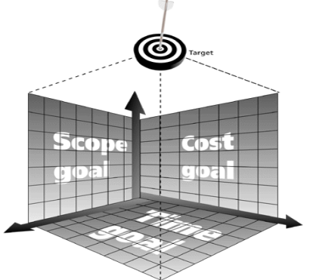
Triple Constraint
Competing goals
  Scope
  Cost
  Time
Trade-offs
Quadruple constraint
  Quality
Figure source: IT Project Management, K. Schwalbe, 6th ed., p. 9

Slide 24
Project Management
It is “the application of knowledge, skills, tools and techniques to project activities to meet project requirements.” [PMBOK® Guide, 2008]
Project managers strive
  To meet scope, time, cost, and quality goals
  Facilitate the entire process
  To meet needs and expectations of the stakeholders

Slide 25
Project Stakeholders
People involved or affected
  Project sponsor
  Project team
  Support staff
  Customers
  Users
  Suppliers
  Opponents of project

Slide 26
Program
Program is "a group of related projects managed in a coordinated way to obtain benefits and control not available from managing them individually.” [PMBOK® Guide, 2008]
  Example: multiple applications development
Program manager
  Guide project managers
  Have review meetings
  Strong skills

Slide 27
Project Portfolio Management
Emerging business strategy
Previous projects and programs
Wise investment decisions
Portfolio manager
  No previous experience of project manager
  Strong financial and analytical skill

Slide 28
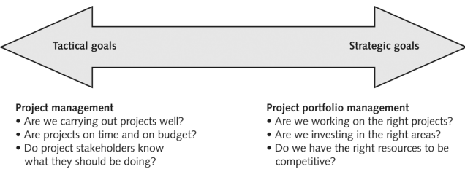
Difference between Project Management and Portfolio Management
Figure source: IT Project Management, K. Schwalbe, 6th ed., p. 18

Slide 29
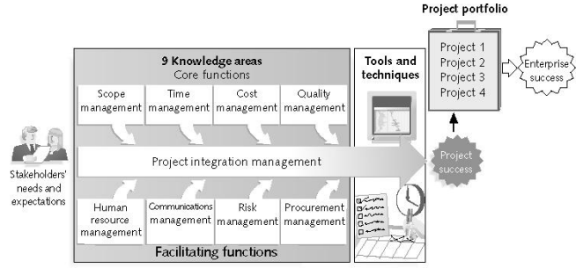
Project Management Framework
Figure source: IT Project Management, K. Schwalbe, 6th ed., p. 10

Slide 30
Project Success
To meet scope, time, and cost goals
Satisfied customers
To achieve main objectives

Slide 31
Top Factors for Project Success [CHAOS Report, 2001]
Executive support
User involvement
Experienced project manager
Clear business objectives
Minimized scope
Standard software infrastructure
Firm basic requirements
Reliable estimates
Other criteria e.g. proper planning

Slide 32
Successful Organizations and Project Managers
Organizations
  Use of an integrated toolbox
  Project leaders growth
  Streamlined project delivery process
  Project metrics
Project managers
  Project management knowledge
  Performance competency
  Personal competency
  Understanding change
  Effective use of technology

Slide 33
Suggested Skills for Project Managers
Project Management BOK
Application area knowledge, standards, and regulations
Project environment knowledge
General management knowledge and skills
Soft skills

Slide 34
Importance of People and Leadership Skills
A study conduced by Jennifer Krahn in 2006
  People skills
  Leadership
  Listening
  Integrity, ethical behavior, consistent
  Strong at building trust
  Verbal communication
  Strong at building teams
  Conflict management
  Critical thinking

Slide 35
Summary
Software/ software engineering
IT project failure / investment
Project / program
Project and portfolio management
Project management framework
Project success factors
Successful organizations and managers
Suggested skills for project managers

