Slide 1
Module 2: Information Technology Infrastructure
Chapter 4: Emerging Technologies

Slide 2
Learning Objectives
Discuss the current trends in computer hardware platforms
Discuss the current trends in computer software platforms
Identify the challenges of managing IT infrastructure and providing management solutions

Slide 3
Contemporary Hardware Platform
Emerging Mobile Digital Platform
  Smartphones evolving to become handheld computers
  Transmission of data, surfing Web, e-mail and IM, display digital content
  Low-cost light weight subnotebooks called netbooks
  Tablet computers
  Digital e-book readers
  Business computing will gradually move towards mobile devices

Slide 4
Contemporary Hardware Platform
Grid Computing
  Connecting geographically remote computers into a single network to create a virtual supercomputer
  Combines computational power of all computers in the grid
  Reason: most computer use CPU for 25% of the time for a certain work
  Special software programs control and allocate resources
  Benefits:
    Cost savings
    Speed of computing
    Agility
    Reduced power consumption

Slide 5
Contemporary Hardware Platform
Virtualization
  Process of presenting computing resources, that are accessed without restriction of geographic location or physical configuration
  Enables Single physical resource appears to users are multiple logical resources
  Enables Multiple physical resources appear as a single logical resource
  Benefit
    Computing processing storage handled using computer resources at remote locations
    Increase equipment utilization
    Conserving data center space
    Conserving energy usage
    Run legacy systems on old OS on the same server
    Centralization of hardware administration

Slide 6
Contemporary Hardware Platform
Cloud Computing
  Computer processing, storage, software and other services are obtained as a pool of virtualized resources over networks
  Main characteristics:
    ON-demand self –service
    Ubiquitous network access
    Location independent resource pooling
    Rapid elasticity
    Measured service
  Available as three services: Cloud infrastructure, cloud platform and cloud software
  Types: Public cloud and private cloud

Slide 7
Contemporary Hardware Platform
Green Computing
  Practises and technologies for designing, manufacturing, and using devices to minimize impact on environment
  Reducing power consumption
  Metrics:
    Power Usage Effectiveness
    Data Center Infrastructure efficiency
    Average Data Efficiency
Autonomic Computing
  The more computer systems become complex, more difficult to manage
  Effort to develop systems themselves, optimize and heal themselves, also protect from intruders
  E.g. firewalls and virus protection

Slide 8
Contemporary Software Platform
Linux and Open Source Software
  OSS: software produced by a community of several hundred thousands of programmers around the world
  Free, modifiable, and free to be redistributed
  Linux: operating systems based on Unix
  Applications embedded in smart phones, netbooks, consumer electronics
  IBM, HP, Dell, Oracle produce Linux-compatible version o their products
  Used in Web servers, high performance computing

Slide 9
Contemporary Hardware Platform
Service Oriented Architecture
  Web Service: set of loosely coupled software components that exchange information with each other using standard web communications standards and languages
  XML: more powerful than HTML
    Perform presentation, communication and storage of data
    Provides standard format for data exchange
  SOA: set of self contained services that communicate with one another to create a working software application
  IBM’s Websphere e-business software platform
  Microsoft's .Net platform

Slide 10
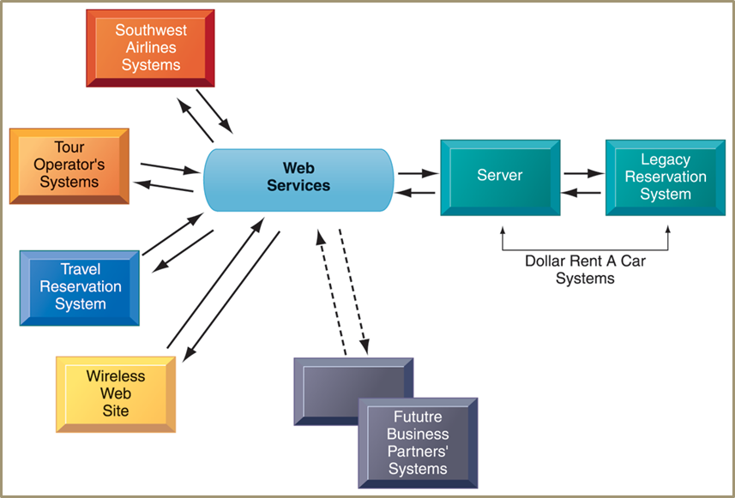
Contemporary Hardware Platform
How Dollar rent a Car uses Web services

Slide 11
Contemporary Hardware Platform
Software Outsourcing and Cloud Services
  Software package: prewritten, commercially available , e.g. SAP
  Outsourcing: enables firms to contract custom software development to outside firms, usually off shore
    Low-level maintenance, data entry, call center, and now new program development
  Cloud-based: software and data hosted on powerful servers and accessed through Internet and Web browser
    MS Word, Adobe Illustrator
  Enterprise software, other business function also available as a service
  Software as a Service (SaaS)
    Subscription or per transaction

Slide 12
Management Issues of IT infrastructure
Platform and Infrastructure issues
  Scalability: ability of a computer, product, or system to expand to serve large number of users
  New policies, procedures or legal contracts required if changing kind of infrastructure
    Response time and availability of mission critical systems
Management and Governance
  Who controls the IT infrastructure?
  How will infrastructure costs be allocated among business units?
Making Wise Investments
  How much should be spent?
  Cloud computing low-cost and flexible but issue of security and work flow

Slide 13
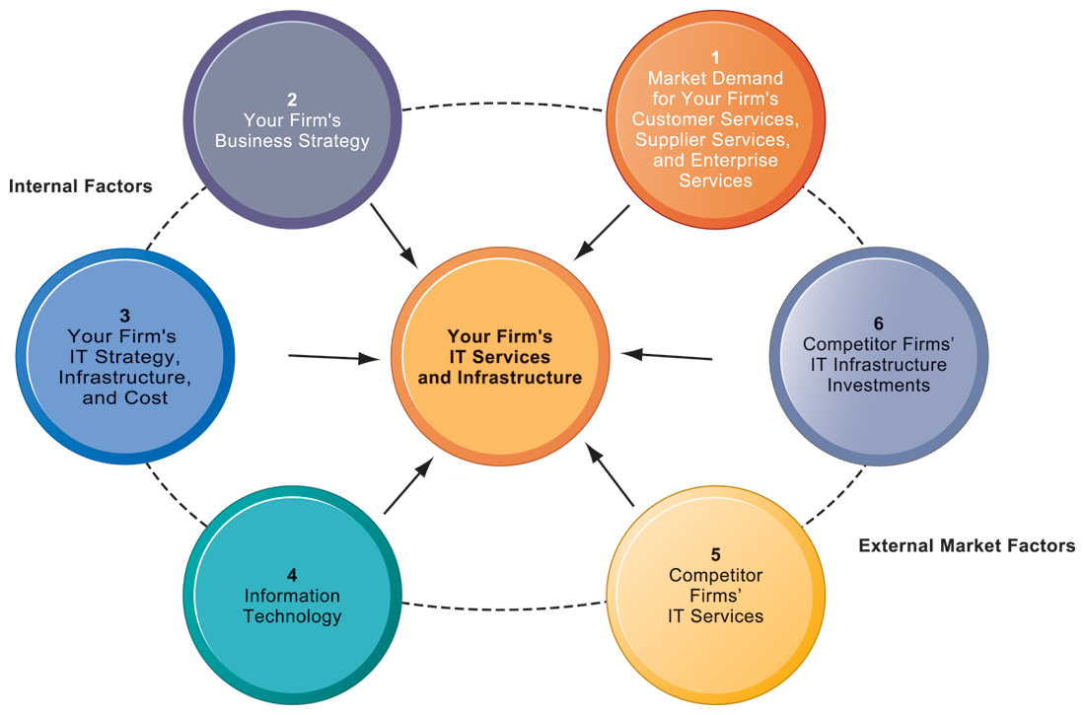
Management Issues of IT infrastructure
Competitive Forces Model

Slide 14
Case Study: Cloud Services Go Mainstream
Company: SalesForce.com
  Provides CRM and other application software solutions as ‘software as a service’
On-demand model
  Eliminates need for hardware/software investments
  Very low subscription rate
  No OS, database servers, application servers to install
  No expensive licensing and maintenance fees
Challenges
  Increased competition
  Security and reliability
  Need to expand business model
  Constant availability

Slide 15
Case Study: Cloud Services Go Mainstream
Company providing additional functionality
  Partnership with Google App
  Partnership with Apple
  Integration with Facebook
Service improvement
  SaaS to Platform as a Service
Intensified efforts
  Sales Cloud, Service Cloud, Custom Cloud
  Force.com application development platform
    Customise CRM application or built new one and run them in the cloud
  AppExchange: for small businesses

Slide 16
Case Study: Cloud Services Go Mainstream
Using Cloud Computing
  SaaS on-demand model
Challenges and meeting challenges
  Partnerships and integration
  Providing broader cloud computing ‘platform’
  Providing tools to assure customers about system reliability
  Offer PC applications so that users can work offline as well
Factors to use SalesForce.com
  Availability
  Reliability
  Security
  Long term costs and subscription costs
  Customization

Slide 17
Summary
Current trends in Computer Hardware platforms
Current Trends in Computer software platforms
Challenges of managing IT infrastructure and management solutions

