Slide 1
Module 1: Overview of Information System in Organizations
Chapter 2: How Organizations use IS

Slide 2
Topics
Organization and IS
  Organization structure
  Organization culture and change
Business Process
  How IS changes business processes
  Reengineering and continuous improvement
  User satisfaction and technology acceptance
Business Information Systems
  E-business
  Management Level
  Enterprise
  Collaboration

Slide 3
Business Information Systems
Purpose: help employees in organizations accomplish routine and special tasks
Different IS support different interests, specialities and levels in the organizations
e-commerce, m-commerce
Management Level Systems
Enterprise Systems
Collaborative Systems

Slide 4
Electronic and Mobile Commerce
E-business: refers to use of digital technology and Internet to execute the major business processes
  Accounting, finance, manufacturing, HR activities,
  E-business strategy is flexible and adaptable
E-commerce: any business transaction (buying and selling) executed electronically
  B2B, B2C, C2C
  Also offers opportunities for small businesses
M-commerce: transactions happening anywhere, anytime (using wireless communications)

Slide 5
Management Level Systems
Transaction Processing System (TPS)
Organized collection of people, procedures, software, devices and databases used to record and complete business transactions
  Sales, receipts, payroll, paying suppliers
  Purpose: answer routine questions and track flow of transactions
  Tasks predefined and highly structured
  Managers need TPS to monitor the status of internal operations

Slide 6
Management Level Systems
Management Information Systems (MIS)
Organized collection of people, procedures, software, databases and devices that provide routine information to managers ad decision makers
  Purpose: operational efficiency
  Marketing, finance, production
  Generate reports from data and information supplied by TPS
  Managers use this to monitor and control the business and predict future performances

Slide 7
Management Level Systems
Decision Support Systems (DSS)
Organized collection of people, procedures, software, databases and devices that support problem-specific decision making
  Use information from TPS and MIS, plus external sources
  Purpose: solving unique problems, solutions may not be fully predefined
  Supports decision making process by analysing data and suggesting alternatives
Executive Support Systems (ESS)
  Used by senior management
  Judgement, evaluation, insight
  Information presented through portal in the form of digital dashboard

Slide 8
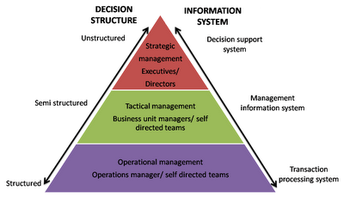
Management Level Systems

Slide 9
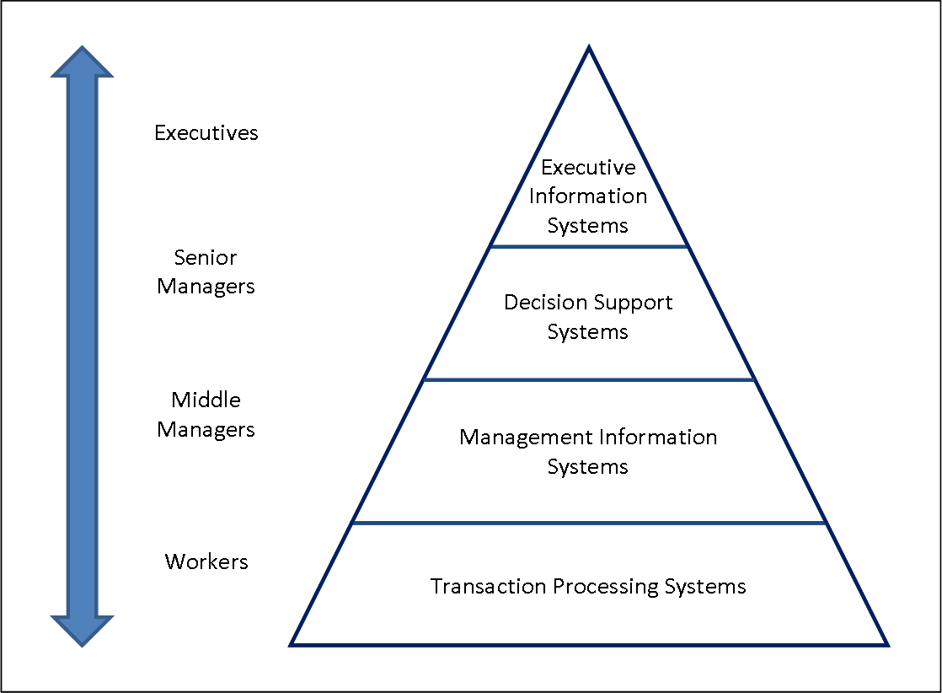
Management Level Systems

Slide 10
Case Study: Dominos Pizza Tracker
Company: Domino’s Pizza
Problem: Customers not happy with home delivery and pizza
Competitive Advantage needed
  Good Pizza
  Excellent customer service
Point of sale system – Pulse
  Captures purchase and payment data using computers, automated cash registers , scanners etc.
  Improved customer service, reduced mistakes, shorter training time

Slide 11
Case Study: Dominos Pizza Tracker
Pulse Evolution
  Think client model to thin client model
  networked stations with little processing power collect data
  Info goes to one machine for processing
  Benefit: easier to update and secure
Ordering system: Pizza Tracker
  Simulated photographic version of pizza shown while ordering
  View progress of pizza ordered online
  Improved customer relationship

Slide 12
Case Study: Dominos Pizza Tracker
Systems
  Point of sale system
  Online ordering system
Business Processes
  Purchase and payments at physical locations
  Managing online orders for pizza
Business performance
  Help in maintaining consistent and efficient management functions
  Taking and customizing orders, maintaining sales figures, compiling customer info
Online Pizza tracker
  Showing photographic version of the pizza and giving view of the progress of the pizza order

Slide 13
Enterprise Systems
Different kinds if IS in a firm work together
The challenge to get them all work together as one corporate system (information integration )
Solution: enterprise applications (systems) that span functional areas
  Executing business processes across the firm
  coordinate business processes closely

Slide 14
Enterprise Systems
Enterprise Resource Planning (ERP)
Set of integrated programs that manages the vital business operations of an entire organization
  Scope varies but usually integrates marketing/sales, finance, manufacturing business processes
  Benefit: easy adoption of improved work processes, increased access of timely data
Supply Chain Management Systems (SCM)
Customer Relationship Management Systems (CRM)
Knowledge Management Systems (KMS)

Slide 15
Collaboration Systems
Collaboration: working with others to achieve shared and explicit goals
  E.g. members in a team collaborate to complete a task
  Investments in collaborative technologies brought improvements
  Categories of Collaborative Software Tools
    E-mail and instant messaging
    Collaborative Writing
    Event Scheduling
    Audio Conferencing
    Video Conferencing
    White boarding
    Document sharing (wikis)

Slide 16
Collaboration Systems
E-mail and Instant Messaging
  Major communication and collaboration tool
  IM allows real time conversation with multiple people
Social Networking
  Corporate tool for sharing ideas and collaborating
  LinkedIn.com provides networking services to business professionals
Wikis
  Major wiki: Wikipedia
  Contribute and edit text content and graphics
  Major repository for unstructured corporate knowledge

Slide 17
Collaboration Systems
Virtual Meeting Systems
  Reason: to reduce travel costs by business professionals
  Briefing, training courses, management consulting, inspirational chats
  Telepresence: integrated audio-video technology that allows the person to give the appearance of being present at the location of meeting

