Slide 1
Management Information Systems
Revision

Slide 2
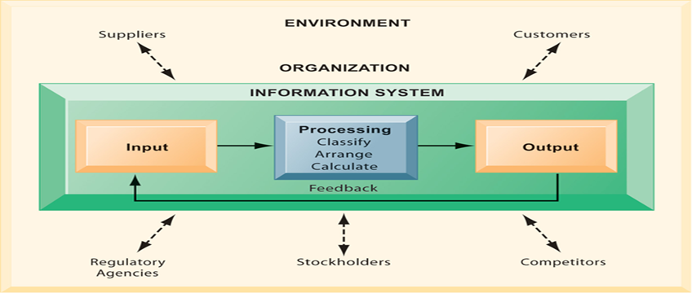
Module 1: Overview of Information Systems in Organization

Slide 3
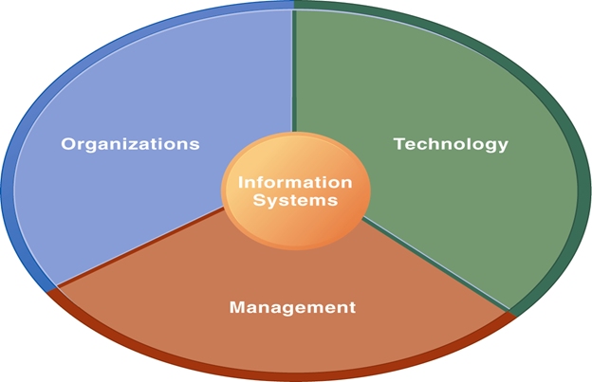
Module 1: Overview of Information Systems in Organization
Value of Information is directly linked with how it helps decision makers achieve organizational goals
Information Systems (IS) are used in organizations to achieve the business goals
Sociotechnical system is an approach to develop IS where key point is learning, training, planned change
Business need to look at IS from three dimensions: organization, management and technology

Slide 4
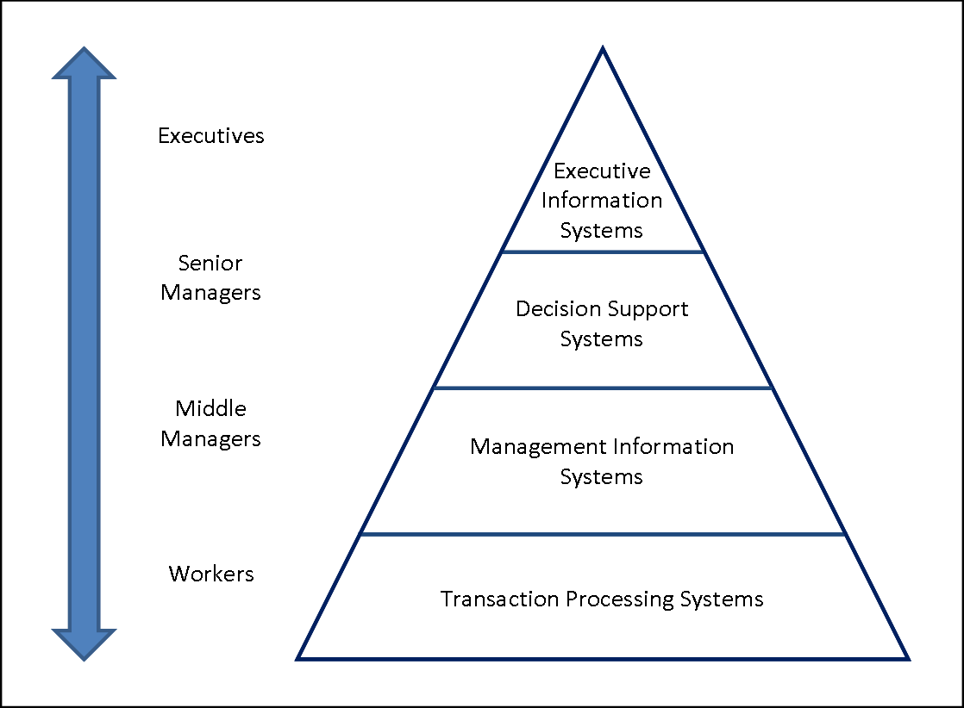
Module 1: Overview of Information Systems in Organization
Kind of IS deployed has affects on organizational structure, culture, change and business processes
Technology Acceptance Model (TAM) is believed to lead to higher acceptance of IS
Various kinds of IS are used in organizations depending on what is required

Slide 5
Module 2: Information Technology Infrastructure
IT infrastructure consists of a ‘service platform’ that encompasses hardware and software and other related services
The kind of hardware used needs to be in accordance with input, out, processing and storage requirements
System and Application software are critical is achieving organizational goals
Propriety software is effective only when it meets organizational need or achieve competitive advantage

Slide 6
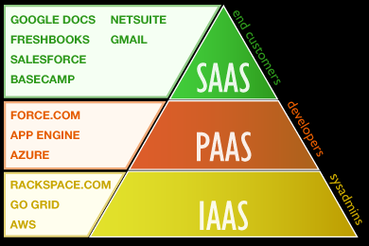
Module 2: Information Technology Infrastructure
Technologies continue to grow so businesses need to be aware of emerging technologies and trends which include grid computing and cloud computing

Slide 7
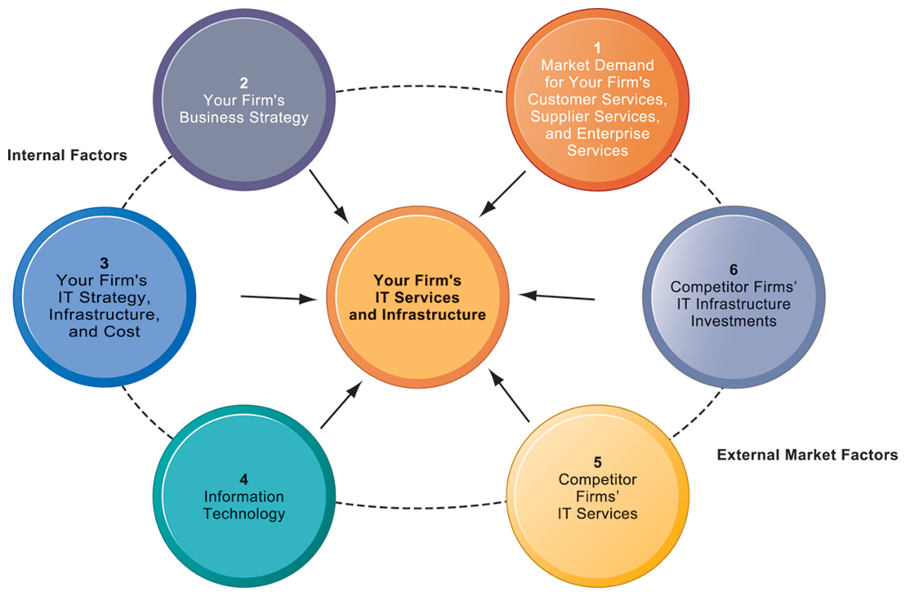
Module 2: Information Technology Infrastructure
Competitive forces Model (CFM) could be used to solve the management issues of IT infrastructure

Slide 8
Module 2: Information Technology Infrastructure
Databases play a very important role in the overall effectiveness of IS
Businesses use various techniques to maximize the value of information provided from databases (which are used to make decision and run operations)
  Data warehousing , business intelligence (data mining and OLAP), web and text mining
Maintaining data quality is the biggest challenge and data integrity should never be compromised

Slide 9
Module 2: Information Technology Infrastructure
For any kind of business networking and telecommunications support holds importance
There could be many applications e.g. creating small business networks, EDI, EFT, videoconferencing, distance learning
Number of applications of the Internet and Web in businesses e.g. VoIP, internet services, content streaming, FTP, web auctioning

Slide 10
Module 2: Information Technology Infrastructure
IS security: understanding the vulnerability of systems e.g. security breaches, hardware breakdowns, offshoring, portability of smart phones and it’s apps
Vulnerabilities increase with the use of internet and wireless communications
Malicious software, hacking techniques and computer crime greatly sabotage the systems
Business need to develop frameworks for security and control and deploy tools and techniques to enforce security policies

Slide 11
Module 3: Business Information Systems
Businesses should know the uniqueness and advantages of e-commerce while knowing the different ways to do e-commerce (business models) and how to generate revenue (revenue models)
Effective e-commerce is dependent on a successful website
  Setting objectives, building, bringing traffic and maintaining
Enterprise Systems ensure information is shared across all business functions at all levels of the organization

Slide 12
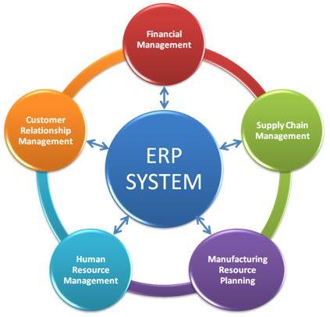
Module 3: Business Information Systems
ERP System has advantages but certain challenges as well: time to implement, implementing change and integration, change of data etc.
CRM used in businesses to provide customer satisfaction, customer acquisition and retention and meeting customer demands on time

Slide 13
Module 3: Business Information Systems
SCM systems used in businesses if the supply chain is large and complex so IS help the supply chain management in various aspects
  Tracking shipment, status of orders, rapid communication)
TPS is used in performing the fundamental business operations, where work is routine based, less complex and handle large amount of data
MIS provides managers with insight (control, plan, organize) in regular operations
  Report based output
Businesses use MIS in various functional areas

Slide 14
Module 3: Business Information Systems
Decision making is cognitive process
DSS are built in a way to provide support for various problem solving phases, decision frequencies, different structure
Business intelligence concepts are used in DSS
Special purpose DSS – ESS – used by executives to help them with strategic planning, defining vision, strategic control and crisis management
Knowing how to do things efficiently is a primary source of profit and competitive advantage

Slide 15
Module 3: Business Information Systems
KMS: the knowledge companies gather needs to be retained in knowledge management systems (create, store, share, use)
Artificial Intelligence systems form a diverse set of systems that can replicate human decision making for certain types of well-defined problems
Expert systems can be used to medical diagnosis, crisis management, plant layout, credit granting and loan analysis

Slide 16
Module 4: Systems Development
Considering IS development as a project and managing the project is important
High rate of failure among IS projects in due to the inadequate project management there fore important to have knowledge about managing IS project and causes of failure
Linking systems project plans with business plans in stressed
Also successful systems development is dependent on change management
  Behavioural and organizational impact
  Sociotechnical design

Slide 17
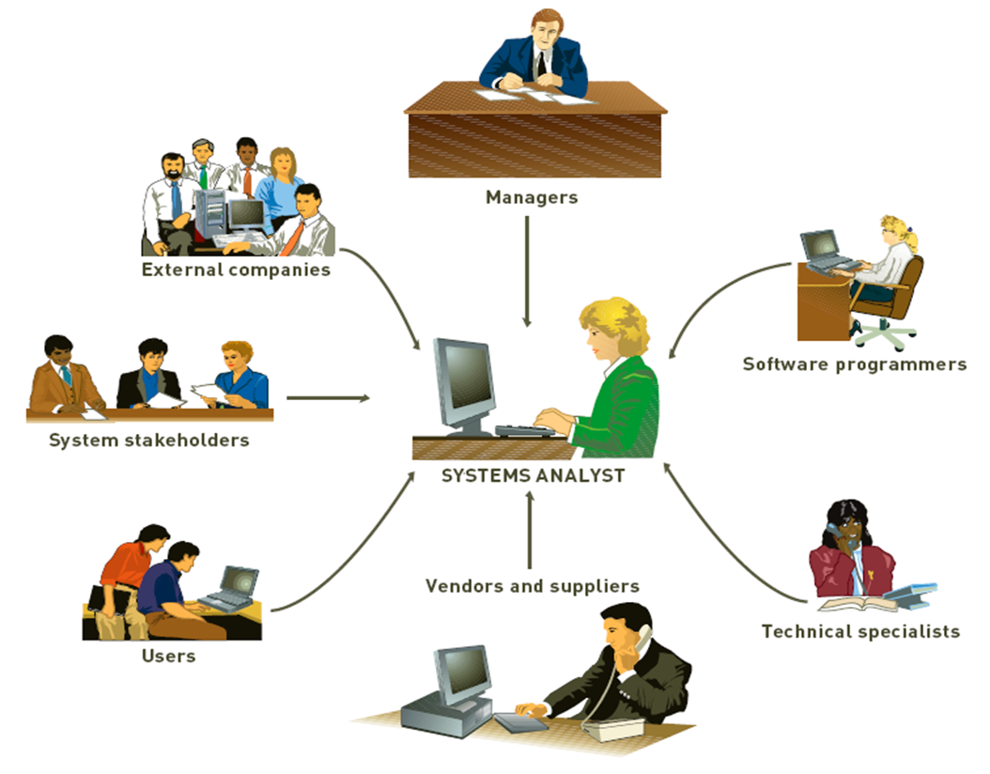
Module 4: Systems Development
Effective systems development also requires team effort and careful planning
  Long range IT use
  IS resource use
  Competitive advantage

Slide 18
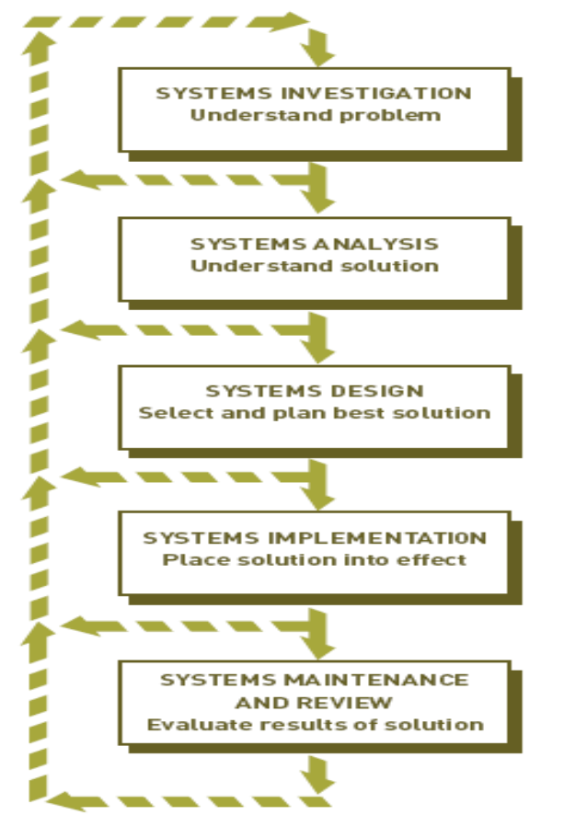
Module 4: Systems Development
Identify the problem
What the system should do to solve the problem
How should the system solve the problem
Implement the solution
Evaluate the working of the new solution

Slide 19
Module 4: Systems Development
Systems Request Form
Feasibility Analysis Report (Systems Investigation Report)
Systems Analysis Report
Systems Specifications (+ Contract)
Documentation (user and technical)

Slide 20
Module 5: IS in Business and Society
IS has ethical, social and political impacts
Moral dimensions of IS need to be considered when deploying in the organization
Computer crime is a serious and rapidly growing are of concern requiring management attention and government regulations

