Slide 1
Module 4: Systems Development
Chapter 14: Design And Implementation

Slide 2
Learning Objectives
Discuss System design and differences between logical and physical design
Describe the considerations in interface design and system security design
Describe techniques for system selection evaluation
State the purpose of system implementation and discuss the activities associated with it
List the advantages and disadvantages of purchasing versus developing software

Slide 3
Systems Implementation
Includes
  hardware acquisition,
  programming and software acquisition or development,
  user preparation,
  hiring and training of personnel,
  site and data preparation,
  installation,
  Testing
  user acceptance

Slide 4
Systems Implementation
Acquiring Hardware
  Organizations purchase, lease or rent hardware from IS vendors
  IS vendors
    General or small computer manufacturers
    Peripheral equipment manufacturers
    Computer dealers and distributors
  Pay for computing services
    Processors, storage devices, network facilities

Slide 5
Systems Implementation
Acquiring Software
  Make or buy decision to be made by the company
  Most cases it is a blend: e.g. OS are purchased or modify other off- the- shelf software
Factor | Off the Shelf | Developed
Cost | Low cost | High cost
Needs | Might not get what you need | Custom software to satisfy the need
Quality | Usually high quality | Quality varies depending on programming team
Speed | Can acquire instantly | Can take years to develop
Competitive advantage | Other organizations can have the same software and same advantages | Can develop a competitive advantage with good software

Slide 6
Systems Implementation
Externally Acquired Software
  Software as a Service (SaaS)
  Commercial off-the-shelf (COTS)
In-House Developed Software
  Chief programmer teams
  Structured programming
  CASE and object-oriented approach
  Cross-platform development
  Integrated development environment (IDEs)
  Documentation

Slide 7
Systems Implementation
Acquiring Databases and telecommunication systems
  Need of increased storage or new DBMS
  To create networks and communication methods for business
  Same hardware and software acquiring procedures happen here
User Preparation
  Readying managers, decision makers, employees, other users, and stakeholders for new systems
  Important, but often ignored area of systems implementation

Slide 8
Systems Implementation
IS personnel: Hiring and Training
  Training programs should be conducted for the IS personnel who will be using the computer system
  More detailed than user training in the technical aspects of the systems
Site Preparation
  Preparation of the location of a new system
  Larger systems may require special equipment
  Developing IS sites that are energy efficient is important
Data Preparation
  Also called data conversion
  Ensuring all files and databases are ready to be used with new computer software and systems

Slide 9
Systems Implementation
Installation
  Process of physically placing computer equipment on the site and making it operational
  Normally, manufacturer is responsible for installing computer equipment
  Someone from the organization (usually IS manager) should oversee the process
Testing
  Unit testing
  System testing
  Volume testing
  Integration testing
  Acceptance testing
  Alpha testing
  Beta testing

Slide 10
Systems Implementation
Start Up
  Process of making the final tested information system fully operational
  Various start up (also called cutover) approaches available:
  Direct Conversion
  Phase-in approach
  Pilot start-up
  Parallel start-up

Slide 11
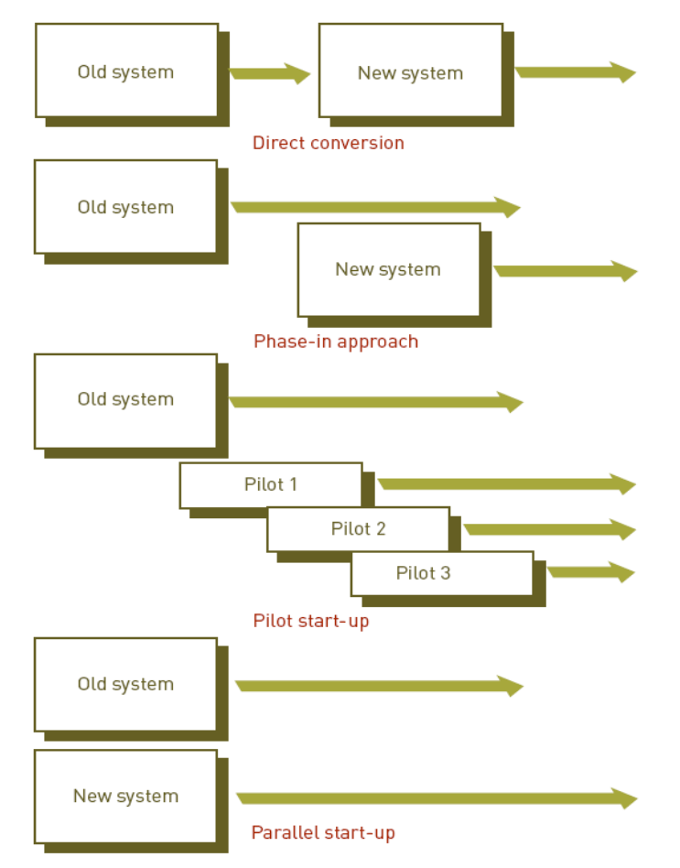
Systems Implementation

Slide 12
Systems Operation and Maintenance
Systems operation
  Use of a new or modified system to see whether it has the performance and benefits as perceived
Systems maintenance
  Checking, changing, and enhancing the system to make it more useful in achieving user and organizational goals

Slide 13
Systems Operation and Maintenance
Reasons for Maintenance
  Changes in business processes
  New requests from stakeholders, users, and managers
  Bugs or errors in program
  Technical and hardware problems
  Corporate mergers and acquisitions
  Government regulations
Types of maintenance
  Slipstream upgrade
  Patch
  Release
  Version

Slide 14
Systems Operation and Maintenance
Performing Maintenance
  Maintenance team
  Responsible for modifying, fixing, and updating existing software
  Maintenance function
  Becoming more automated

Slide 15
Systems Review
Final step of systems development
Analyzes systems to make sure that they are operating as intended
Types of Review procedures:
  Event-driven review
  Triggered by a problem or opportunity
  Time-driven review
  Performed after a specified amount of time

Slide 16
Systems Performance Measurement
Monitoring the system
  Number of errors encountered
  Amount of memory required
  Amount of processing or CPU time needed
  Other problems
System performance products
  Software that measures all components of the computer-based information system

