Slide 1
Module 1: Overview of the Information System in Organizations
Chapter 1: Introduction to Information Systems

Slide 2
Learning Objectives
Discuss why is it important to study and understand information systems
Distinguish between data, information and importance of valuable information
Discuss why organizations use Information Systems
Identify the dimensions of Information Systems

Slide 3
Information System

Slide 4
Information Concepts
Data: raw facts, such as employee number, number of hours worked in a week, inventory part numbers etc.
Alphanumeric data, Image data, Audio data, Video data
Information: collection of facts organized so that they have additional value beyond the value of facts themselves
Process: set of logically related tasks performed to achieve a defined outcome, or simply turning data into information

Slide 5
Information Concepts
However, certain rules and regulations can be set up to organize data into useful and valuable information
Knowledge: is the awareness and understanding of a set of information and the ways that information can be made useful to support a specific task or reach a decision

Slide 6
Information Concepts
Characteristics of valuable information
  Accessible
  Accurate
  Complete
  Economical
  Flexible
  Relevant
  Reliable
  Secure
  Simple
  Timely
  Verifiable
The value of information is directly linked to how it helps decision makers achieve their organization’s goals

Slide 7
System Concepts
System: is a set of elements or components that interact to accomplish goals
The relationships among the elements determine how the system works

Slide 8
Information System(IS)
Why is Information System important?
  We interact with IS personally and professionally
  Transforming businesses
  Globalization and Opportunities
IS effects all areas of the businesses
  Manufacturing
  Accounting
  Human Resources
  Marketing
  Top Management

Slide 9
Information System
Set of interrelated components
Collect, process, store, and distribute information
  →By computers and software as a tool
Support decision making, coordination, control, problem analysis and create new product
Provide solutions to changes/challenges in business environment
Another definition
  IT is an integrated Human-Machine system that combines hardware, software, databases and telecommunications networks. It collects data and processes it into information used for decision making at all levels of the organization.

Slide 10
Functions of an Information System
An information system contains information about an organization and its surrounding environment. Three basic activities—input, processing, and output—produce the information organizations need. Feedback is output returned to appropriate people or activities in the organization to evaluate and refine the input. Environmental actors, such as customers, suppliers, competitors, stockholders, and regulatory agencies, interact with the organization and its information systems.

Slide 11
Why Firms Use IS
To achieve 6 strategic business objectives
  Operational excellence
  New products, services, and business models
  Customer and supplier intimacy
  Improved decision making
  Competitive advantage
  Survival

Slide 12
Why Firms Use IS
Operational Excellence
  Achieving higher levels of efficiency and productivity in business operations, plus changes in management behaviour
  Example: Wal-Mart’s Retail Link system links suppliers to stores for in-time replacements
New Products/ Services/ Business Model
  Business model: describes how company produces, delivers, and sells product or service to create wealth
  Information systems and technology a major enabling tool for new products, services, business models
    E.g. Apple’s iPod, iTunes online music business

Slide 13
Why Firms Use IS
Customer and Supplier Intimacy
  Serving customers well leads to customers returning, which raises revenues and profits
  Intimacy with suppliers allows them to provide vital inputs, which lowers costs
    E.g. JCPenney’s information system which links sales records to contract manufacturer
Improved decision making
  Managers need right information at right time
  IS provide real-time data for making decisions
  E.g. Verizon’s Web-based digital dashboard to provide managers with real-time data on customer complaints, network performance, line outages, etc.
  Results in restoration and repairing fast and effective

Slide 14
Why Firms Use IS
Competitive Advantage
  Achieve higher sales and profit through using IS by:
    Doing things better
    Charging less for superior products
    real time responding
  Using the internet is competitive advantage
Survival
  Information technologies are necessity of doing business
    Industry-level changes, e.g. Citibank’s introduction of ATMs

Slide 15
Summary
IS instrument for creating value to firms
The value of information is directly linked to how it helps decision makers achieve the organization’s goals
Information systems must be applied thoughtfully and carefully so that society and industry can reap maximum benefits

Slide 16
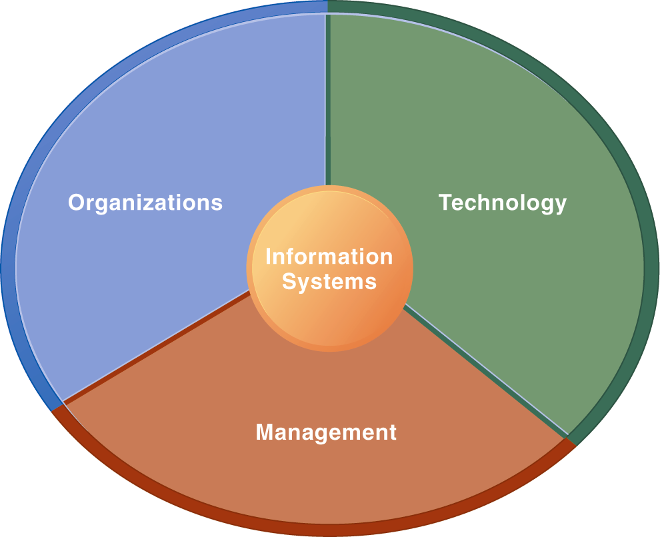
Dimensions of Information System (IS)
Using IS effectively depends on the understanding of organization , technology and management
Only computer literacy is not important, rather broader IS literacy is important to implement a productive IS and this field of MIS is to achieve it
Information System Literacy
How and Why technology is applied in business

Slide 17
Dimensions of Information System
Organization
  Key elements : People, Structure, Business Processes, Politics, Culture
  Organizational structure has different levels and specialities

Slide 18
Dimensions of Information System (IS)
Management
  Make decisions, formulate action plan and solve organizational problem
  Managers set organizational strategy for responding to business challenges
  In addition, managers must act creatively:
    Creation of new products and services
    Occasionally re-creating the organization

Slide 19
Dimensions of Information System (IS)
Technology
  Hardware: physical equipment used for input, output, processing, storage
    E.g. Event Data Readers (EDR) in vehicles
  Software: computer programs that control and coordinate the hardware
    E.g. Fab Lab – controls automatic cutter, milling machines
  Data management technology: deals with software that are used to organize data on physical storage media
  Network and telecommunications technology: contains both hardware and software that are used to link various computer devices
    E.g. investment firms use telecomm to connect with brokers and traders
  Internet: worlds largest Network
  WWW: service provided by the internet
  IT infrastructure: platform to build the IS

Slide 20
UPS Case Study
Company: United Parcel Service (UPS)
  Package delivery
  Started in 1907, now has 408,000 employees and 96000 vehicles
Process: automated package tracking system
  Scannable label attached to package
  Info from “smart” tag goes to central computer
  At centre traffic route made for drivers
  Delivery Information Acquisition Device (DIAD) access info through wireless n/w
  Through bar code info at various points goes to central computer
  Info available on UPS website

Slide 21
UPS Case Study
Inputs, Processing, Output of UPS PTS
  Info about sender, destination and time of arrival, progress data
  Info transmitted central computer to distribution centre, route calculation
  Tracking status, printed label, driver’s route
Technologies used and why
  Handheld computers, bar code scanners, wireless communications, desktop commuters, UPS data storage technology, UPS tracking software, Internet (Web site)
  Reason: high level service in low price

Slide 22
UPS Case Study
Strategic Business Objectives Achieved
  Operational Excellence
    Customers and download and print labels
    Drivers traffic route
  Customer Intimacy
    Inform about estimated time
    Package status report
  New Service
    Point Sales Order Management System (OMS)
  Competitive Advantage
    Achieved by above mentioned implementations

Slide 23
Global Challenges
Globalization has impact on organizations and its IS
Thomas Friedman “The World is Flat”
Individuals from all over the world compete with other individuals, companies and countries through Internet
Where there are International opportunities, there are challenges and obstacles as well
  Cultural and language challenges
  Time and distance challenges
  Infrastructure challenges
  Currency challenges

Slide 24
Global Challenges
  Technology transfer issue
  Product and Services challenges

Slide 25
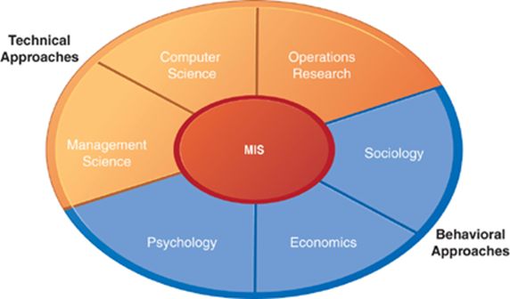
Contemporary Approaches to IS
IS is a multidisciplinary field
The study of information system deals with issues and insights contributed from technical and behavioural disciplines

Slide 26
Contemporary Approaches to IS
Technical approach
  Emphasizes mathematically based models
    Computer science theories of commutation ,data storage
    management science: models of DM and practices
    operations research: optimizing selected parameters of org.
Behavioural approach
  Behavioural issues like strategic business integration, design implementation, management
    Psychology: how decision makers use formal information
    Economics: how IS change the control and cost structures
    Sociology: how system affect individuals and groups

Slide 27
Contemporary Approaches to IS
The sociotechnical systems
  Use of computer-based information systems in business firms
  Combines work of CS, management, and operating research toward developing system solutions to real word problems
  Concerned with behavioural issues of development, use and impact of IS
main actors
  Suppliers of hardware and software
  Business firms
  Managers and employees
  Firm’s environment (legal, social, cultural context)
Key: training, learning and planned change

Slide 28
Summary
Technology usage, how it helps the business
Globalization and it’s challenges
Sociotechnical systems

