Slide 1
Module 4: Systems Development
Chapter 13: Investigation and Analysis

Slide 2
Learning Objectives
Heading 2
  type

Slide 3
Participants of Systems Development
Development team
  Determines objectives of the information system
  Delivers system that meets objectives
Project
  Planned collection of activities that achieves a goal
Project manager
  Responsible for coordinating all people and resources needed to complete a project on time
Stakeholders
  People who ultimately benefit from project
Users
  People who will interact with the system regularly

Slide 4
Participants of Systems Development
Systems development specialists
  Systems analysts: professionals who specialize in analysing and designing business systems
  Programmers: responsible for modifying or developing programs to satisfy user requirements

Slide 5
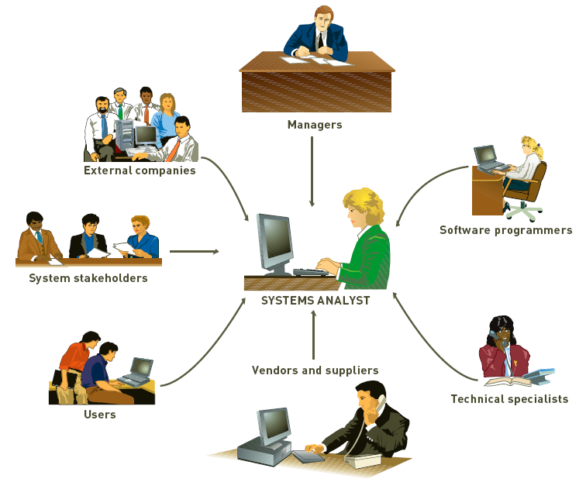
Participants of Systems Development

Slide 6
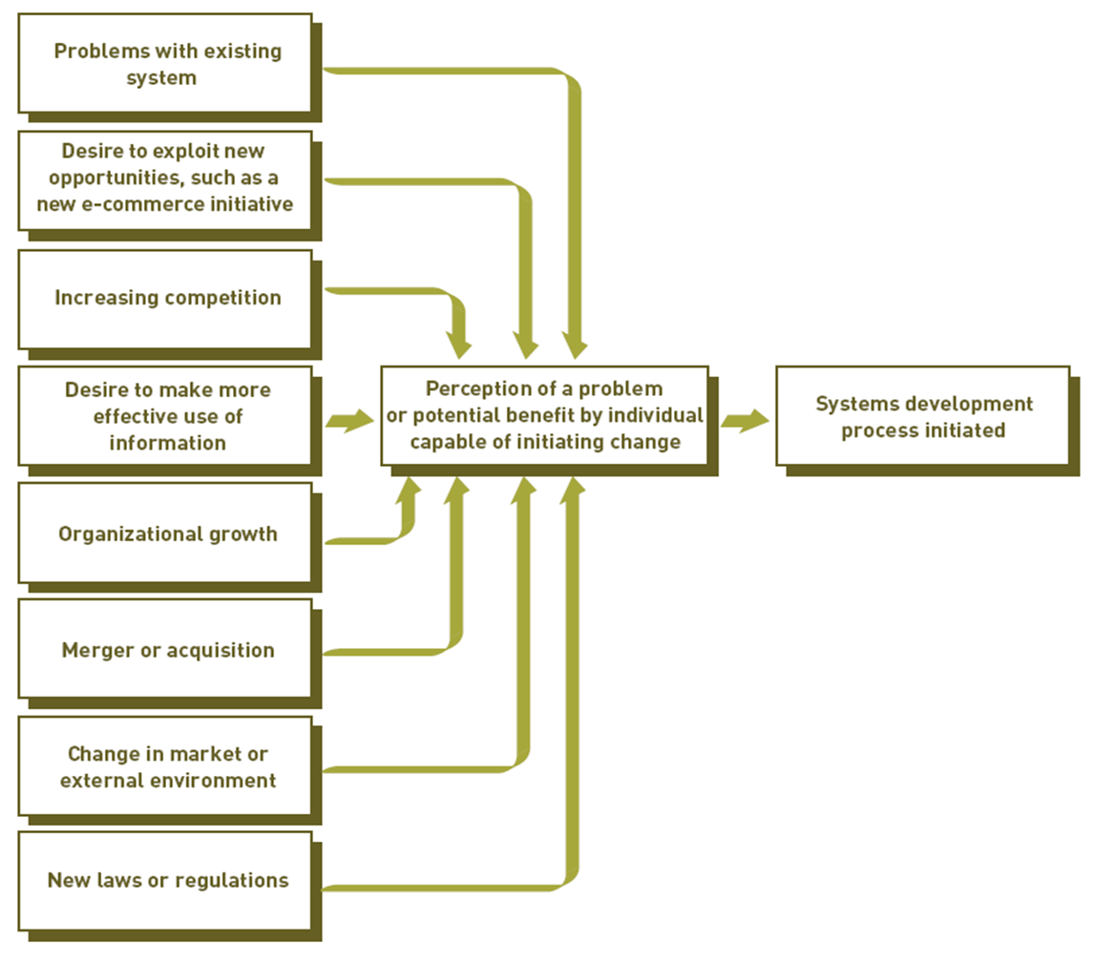
Initiating Systems Development
Typical Reasons to Initiate Systems Development

Slide 7
Initiating Systems Development
Systems development initiatives
  Arise from all levels of an organization
  Can be planned or unplanned
Number of reasons for initiating systems development projects
  Mergers, acquisitions, federal regulations, etc.

Slide 8
Information Systems Planning ad Aligning Corporate & IS goals
Information systems planning
  Translating strategic and organizational goals into systems development initiatives
Aligning organizational goals and IS goals
  Critical for successful systems development effort
  This gives a long-range view of IS used in the organization
  Also allows better use of IS resources (funds, personnel and time)

Slide 9
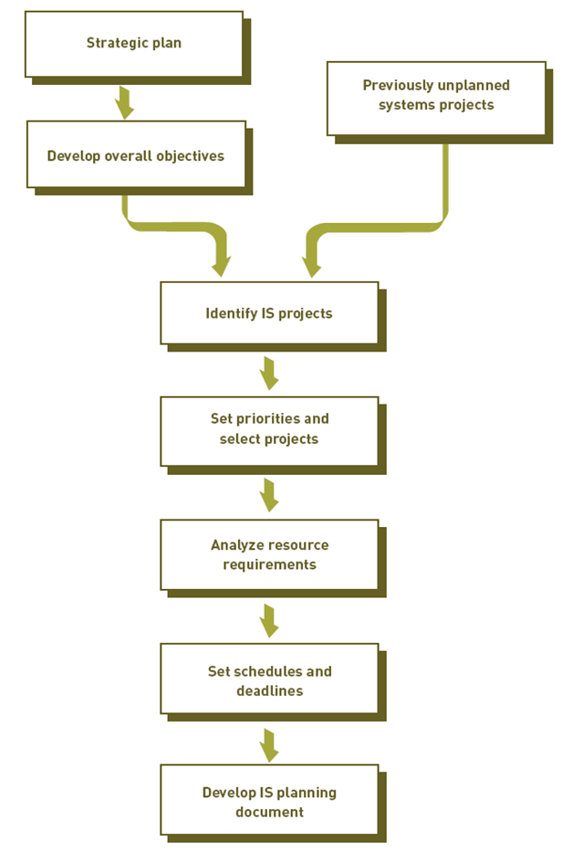
Information Systems Planning ad Aligning Corporate & IS goals

Slide 10
Information Systems Planning ad Aligning Corporate & IS goals
Developing a Competitive Advantages
  IS project are there to achieve competitive advantage
  Creative Analysis
    Investigating new approaches to existing problems
  Critical Analysis
    Unbiased and careful questioning to see if system elements are related in the most effective ways
    Questioning statements and assumptions
    Identifying and resolving objectives and orientations that conflict

Slide 11
Establishing Objectives for Systems Development
Performance objectives
  The quality or usefulness of the output
  Accuracy of the output
  The speed at which output is generated
  The scalability of the resulting system
  The risk of the system
Cost Objectives
  Development cost
  Cost related to the uniqueness of the system application
  Fixed investments in hardware and related equipment
  Ongoing operating costs of the system

Slide 12
Systems Development Lifecycles
Common systems development life cycles
  Traditional
  Prototyping
  Rapid application development (RAD)
  End-user development

Slide 13
Traditional Systems Development Lifecycle
Systems investigation
  Identifies problems and opportunities and considers them in light of business goals
Systems analysis
  Studies existing systems and work processes to identify strengths, weaknesses, and opportunities for improvement
Systems design
  Defines how the information system will do what it must do to obtain the problem’s solution

Slide 14
Traditional Systems Development Lifecycle
Systems implementation
  Creates or acquires various system components detailed in systems design, assembles them, and places new or modified system into operation
Systems maintenance and review
  Ensures the system operates as intended
  Modifies the system so that it continues to meet changing business needs

Slide 15
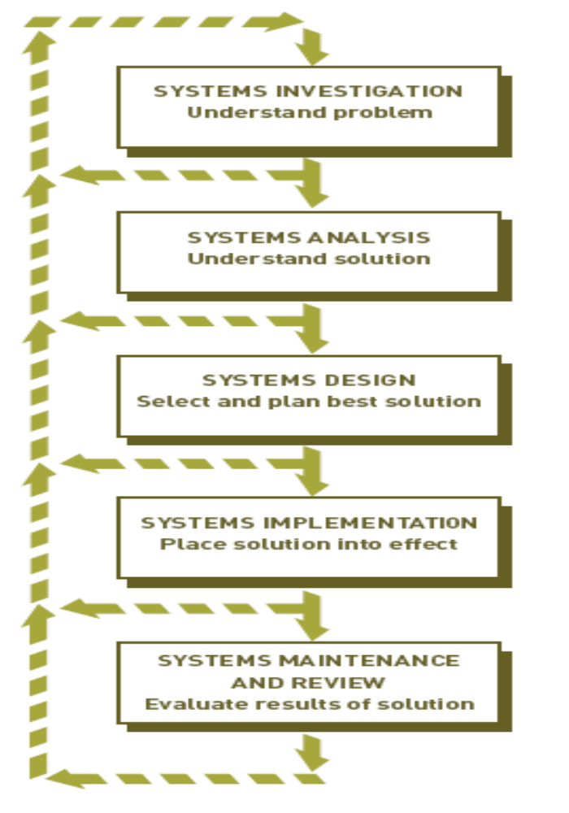
Traditional Systems Development Lifecycle

Slide 16
Prototyping
An iterative approach
Operational prototype
  Prototype that works
  Accesses real data files, edits input data, makes necessary computations and comparisons, and produces real output
Nonoperational prototype
  A mock-up, or model
  Includes output and input specifications and formats

Slide 17
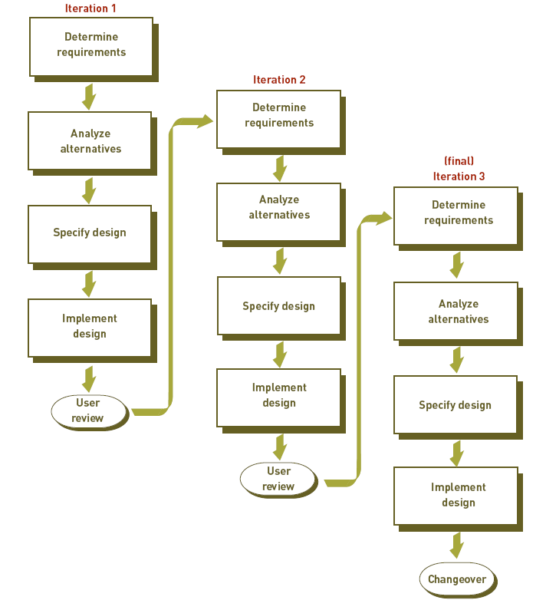
Prototyping

Slide 18
Rapid Development Cycle, Joint Development Cycle
Rapid application development (RAD)
  Employs tools, techniques, and methodologies designed to speed application development
  Makes extensive use of the joint application development (JAD)
Other approaches to rapid development
  Agile development
  Extreme programming (XP)

Slide 19
End-Use Systems Development Cycle
End-user systems development
  Systems development project in which business managers and users assume the primary effort
Disadvantages
  Some end users do not have the training to effectively develop and test a system

Slide 20
Out sourcing and On-demand Computing
Reasons Companies use them:
    Reduces costs
    Obtains state-of-the-art technology
    Eliminates staffing and personnel problems
    Increases technological flexibility

Slide 21
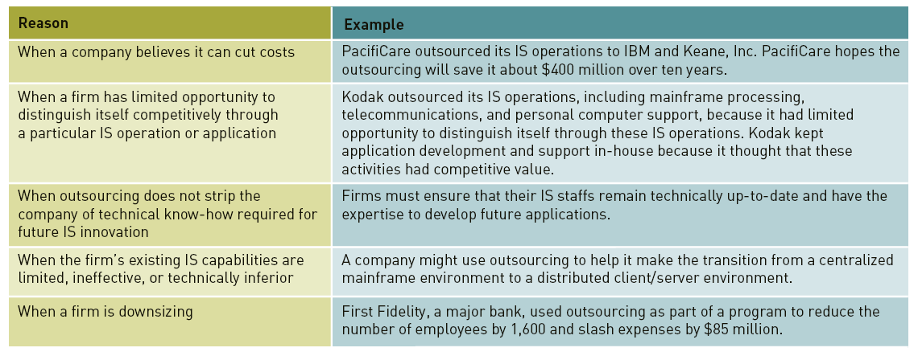
Out sourcing and On-demand Computing

Slide 22
Factors Affecting Systems Development Success
Degree of Change
Continuous Improvement versus Reengineering
Managing Change
Quality and Standards
Use of Project Management Tools
Use of CASE tools
Object Oriented Systems Development

Slide 23
Systems Investigation
Purpose: identify potential problems and opportunities
Uncovers following questions:
  What primary problems might a new or enhanced system solve?
  What opportunities might a new or enhanced system provide?
  What new hardware, software, databases, telecommunications, personnel, or procedures will improve an existing system or are required in a new system?
  What are the potential costs (variable and fixed)?
  What are the associated risks?

Slide 24
Systems Investigation
Initiating Systems Investigation
  Systems Request Form submitted by someone who wants IS department to initiate systems investigation
  Information included
    Problems in or opportunities for system
    Objectives of systems investigation
    Overview of proposed system
    Expected costs and benefits of proposed system
Participants in Investigation
  Upper and middle level managers
  Project manager
  IS personnel
  Users, stakeholders

Slide 25
Systems Investigation
Feasibility Analysis
  Technical feasibility
  Economic feasibility
  Net present value
  Legal feasibility
  Operational feasibility
  Schedule feasibility

Slide 26
Systems Investigation
The Systems Investigation Report
  Outcome of systems investigation
  Summarizes results of systems investigation
  Recommends course of action: continue, modify or drop
  Report reviewed by steering committee

Slide 27
Systems Analysis
Question: What must the IS do to solve the problem?
General Considerations:
  Clarify goals of the organization
  Assembling the participants of systems analysis
  Collecting appropriate data and requirements
  Analyzing the data and requirements
  Preparing report on existing system, new system requirements, project priorities
Participants
  Original development team
  Team Develops:
    List of objectives and activities
    Deadlines
    Statement of resources required
    Major milestones

Slide 28
Systems Analysis
Data Collection
  Identify sources of data
  Data Collection
  Structured interview
  Unstructured interview
  Direct Observation
  Questionnaires
  Statistical sampling

Slide 29
Systems Analysis
Data Analysis
  Manipulating the collected data so that it can be used
  Tools and techniques for data analysis are as follows:
Data Modeling
  Approach to modeling organizational objects and associations
  ER diagram – objects and relationships, where entities have attributes
Application Flowcharts
  Show relationships among applications or systems
  E.g. clear relationships among order processing functions
Grid Charts
  A table that shows relationships among various aspects of system development
  E.g. a chart between showing various applications using different databases

Slide 30
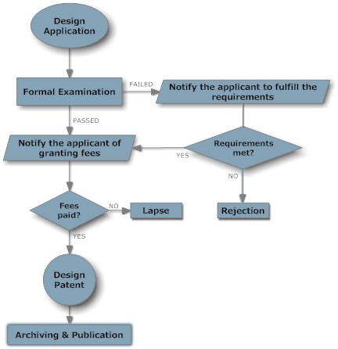
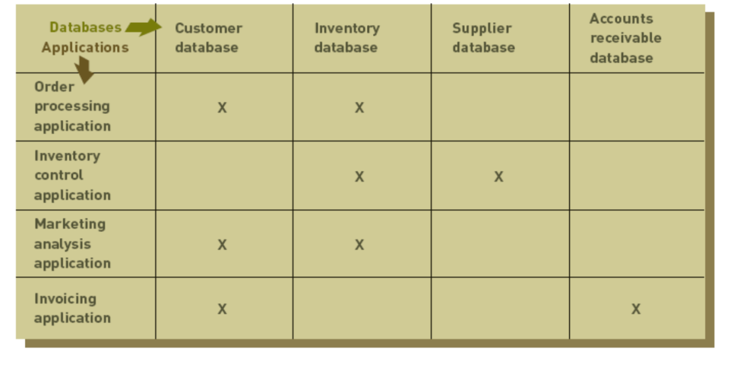
Systems Analysis

Slide 31
Systems Analysis
Activity Modeling
  Done through the use of Data-flow diagrams (DFD)
  Models objects, associations and activities by describing how data can flow between and around objects
  DFD describes activities that accomplish a business task
  Consists of four primary symbols
    Data flow
    Process symbol
    Entity symbol
    Data store

Slide 32
Systems Analysis
Requirements Analysis
  Purpose: determine user, stakeholder, and organizational needs
  capture requests of various people in detail
  Asking directly
    Works best for stable systems in which users understand system functions
  Using CSF
    Managers make list of factors that are critical to success of their field
  The IS Plan
    Translates strategic and organizational goals into systems development initiatives
  OO systems Analysis
    Object oriented approach is used to identify problems and show relationships by showing objects as classes

Slide 33
Systems Analysis
Systems Analysis Report
  Strengths and weaknesses of existing system from a stakeholder’s perspective
  User/stakeholder requirements for new system
  Organizational requirements for new system
  Description of what new information system should do to solve the problem

