Slide 1
Module 4: Systems Development
Chapter 13: Investigation and Analysis

Slide 2
Rapid Development Cycle, Joint Development Cycle
Rapid application development (RAD)
  Employs tools, techniques, and methodologies designed to speed application development
    Reduces paper based documentations
    Adapting to changing requirements easier
    All about team work
  Makes extensive use of the joint application development (JAD)
Other approaches to rapid development
  Agile development
  Extreme programming (XP)
    Change as the system is being developed

Slide 3
End-Use Systems Development Cycle
End-user systems development
  Systems development project in which business managers and users assume the primary effort
Disadvantages
  Some end users do not have the training to effectively develop and test a system

Slide 4
Out sourcing and On-demand Computing
Reasons Companies use them:
    Reduces costs
    Obtains state-of-the-art technology
    Eliminates staffing and personnel problems
    Increases technological flexibility

Slide 5
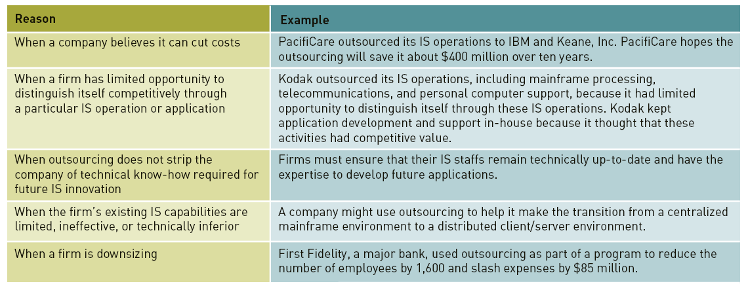
Out sourcing and On-demand Computing

Slide 6
Factors Affecting Systems Development Success
Degree of Change
Continuous Improvement versus Reengineering
Managing Change
Quality and Standards
Use of Project Management Tools
Use of CASE tools
Object Oriented Systems Development

Slide 7
Systems Investigation
Purpose: identify potential problems and opportunities
Uncovers following questions:
  What primary problems might a new or enhanced system solve?
  What opportunities might a new or enhanced system provide?
  What new hardware, software, databases, telecommunications, personnel, or procedures will improve an existing system or are required in a new system?
  What are the potential costs (variable and fixed)?
  What are the associated risks?

Slide 8
Systems Investigation
Initiating Systems Investigation
  Systems Request Form submitted by someone who wants IS department to initiate systems investigation
  Information included
    Problems in or opportunities for system
    Objectives of systems investigation
    Overview of proposed system
    Expected costs and benefits of proposed system
Participants in Investigation
  Upper and middle level managers
  Project manager
  IS personnel
  Users, stakeholders

Slide 9
Systems Investigation
Feasibility Analysis
  Technical feasibility
  Economic feasibility
    Net present value
  Legal feasibility
  Operational feasibility
  Schedule feasibility

Slide 10
Systems Investigation
The Systems Investigation Report
  Outcome of systems investigation
  Summarizes results of systems investigation
  Recommends course of action: continue, modify or drop
  Report reviewed by steering committee

Slide 11
Systems Analysis
Question: What must the IS do to solve the problem?
General Considerations:
  Clarify goals of the organization
  Assembling the participants of systems analysis
  Collecting appropriate data and requirements
  Analyzing the data and requirements
  Preparing report on existing system, new system requirements, project priorities
Participants
  Original development team
  Team Develops:
    List of objectives and activities
    Deadlines
    Statement of resources required
    Major milestones

Slide 12
Systems Analysis
Data Collection
  Identify sources of data
  Data Collection
  Structured interview
  Unstructured interview
  Direct Observation
  Questionnaires
  Statistical sampling

Slide 13
Systems Analysis
Data Analysis
  Manipulating the collected data so that it can be used
  Tools and techniques for data analysis are as follows:
Data Modeling
  Approach to modeling organizational objects and associations
  ER diagram – objects and relationships, where entities have attributes
Application Flowcharts
  Show relationships among applications or systems
  E.g. clear relationships among order processing functions
Grid Charts
  A table that shows relationships among various aspects of system development
  E.g. a chart between showing various applications using different databases

Slide 14
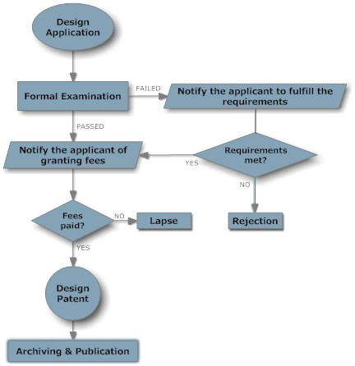
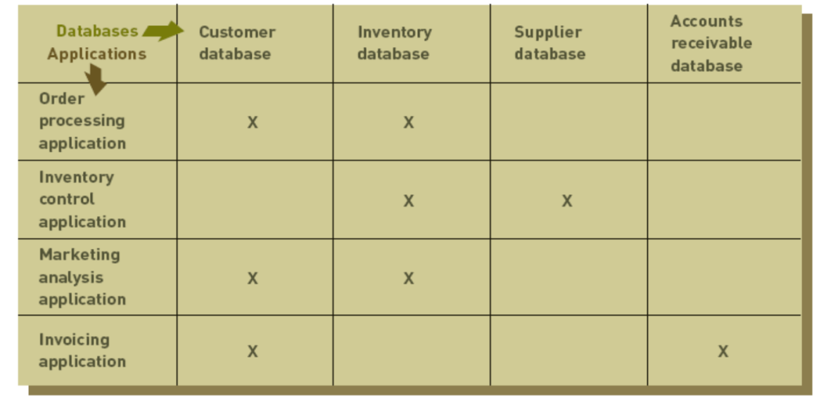
Systems Analysis

Slide 15
Systems Analysis
Activity Modeling
  Done through the use of Data-flow diagrams (DFD)
  Models objects, associations and activities by describing how data can flow between and around objects
  DFD describes activities that accomplish a business task
  Consists of four primary symbols
    Data flow
    Process symbol
    Entity symbol
    Data store

Slide 16
Systems Analysis
Requirements Analysis
  Purpose: determine user, stakeholder, and organizational needs
  capture requests of various people in detail
  Asking directly
    Works best for stable systems in which users understand system functions
  Using CSF
    Managers make list of factors that are critical to success of their field
  The IS Plan
    Translates strategic and organizational goals into systems development initiatives
  OO systems Analysis
    Object oriented approach is used to identify problems and show relationships by showing objects as classes

Slide 17
Systems Analysis
Systems Analysis Report
  Strengths and weaknesses of existing system from a stakeholder’s perspective
  User/stakeholder requirements for new system
  Organizational requirements for new system
  Description of what new information system should do to solve the problem

Slide 18
Summary
Effective systems development requires team effort as well as careful planning of the IS
Systems development often uses tools to select and analyse project requirements
Outsourcing is an option for cutting costs
Investigation concerns the feasibility at different levels
Analysis is concerned with collecting and analyzing data and requirements

