Slide 1
Module 4: Systems Development
Chapter 13: Investigation and Analysis

Slide 2
Learning Objectives
Identify key participants in Systems Development
Define the term Information Systems Planning
Discuss various types of SDLC and their differences
State purpose of Systems Investigation and the activities involved
State the purpose of Systems Analysis and identify the tools and techniques used in it

Slide 3
Participants of Systems Development
Development team
  Determines objectives of the information system
  Delivers system that meets objectives
Project
  Planned collection of activities that achieves a goal
Project manager
  Responsible for coordinating all people and resources needed to complete a project on time
Stakeholders
  People who ultimately benefit from project
Users
  People who will interact with the system regularly

Slide 4
Participants of Systems Development
Systems development specialists
  Systems analysts: professionals who specialize in analysing and designing business systems
  Programmers: responsible for modifying or developing programs to satisfy user requirements

Slide 5
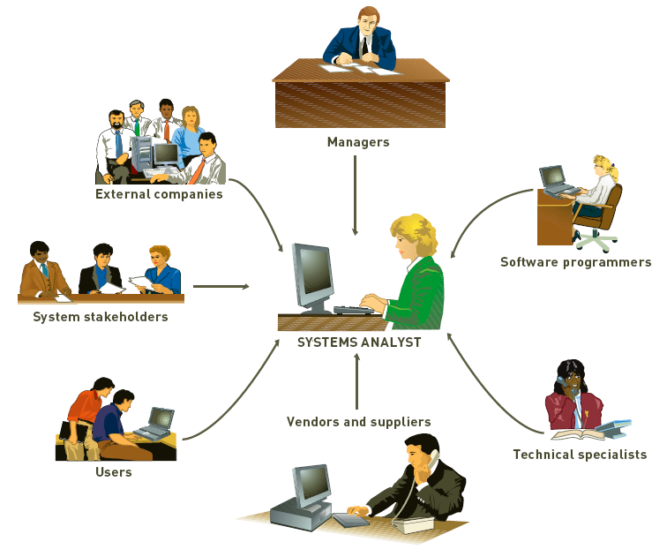
Participants of Systems Development

Slide 6
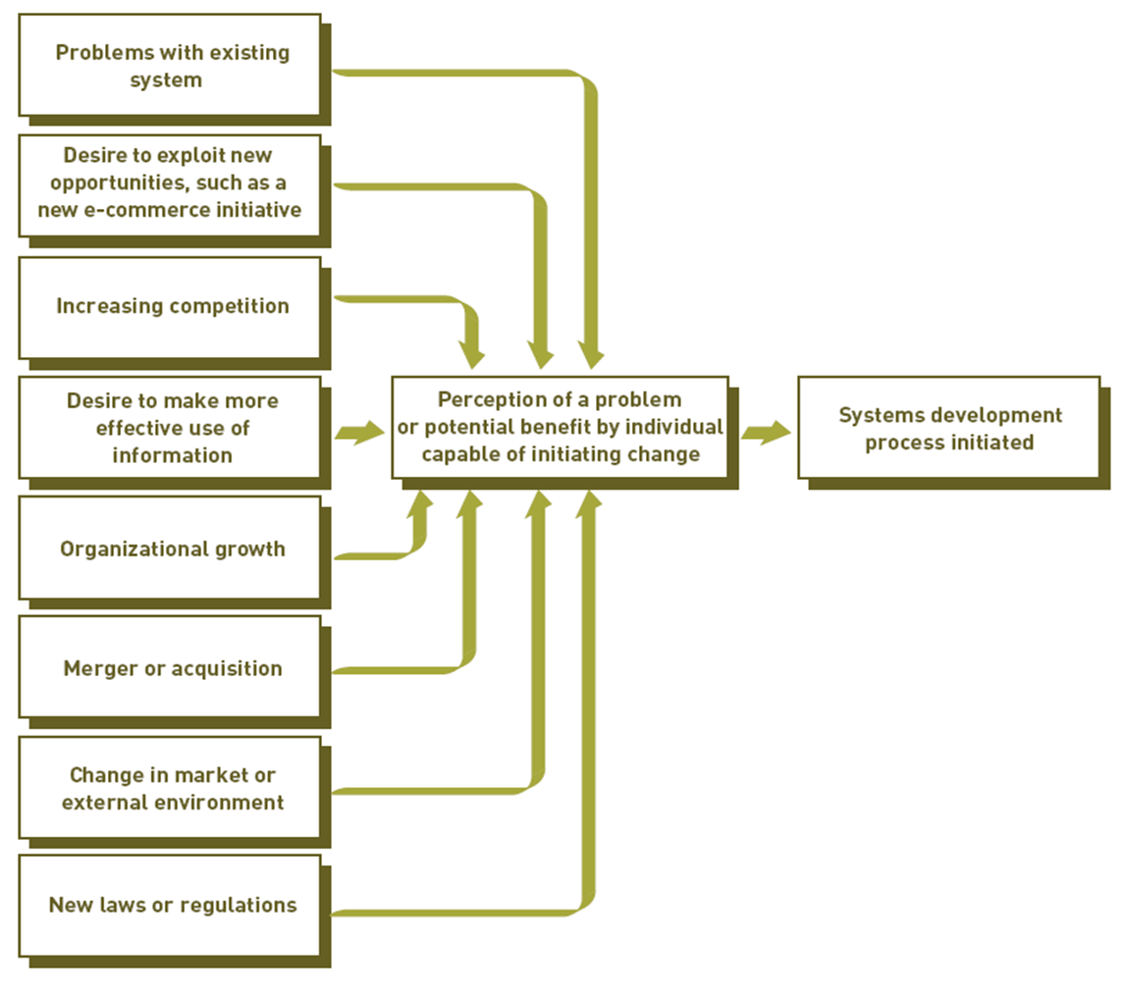
Initiating Systems Development
Typical Reasons to Initiate Systems Development

Slide 7
Initiating Systems Development
Systems development initiatives
  Arise from all levels of an organization
  Can be planned or unplanned
Number of reasons for initiating systems development projects
  Mergers, acquisitions, federal regulations, etc.

Slide 8
Information Systems Planning ad Aligning Corporate & IS goals
Information systems planning
  Translating strategic and organizational goals into systems development initiatives
Aligning organizational goals and IS goals
  Critical for successful systems development effort
  This gives a long-range view of IS used in the organization
  Also allows better use of IS resources (funds, personnel and time)

Slide 9
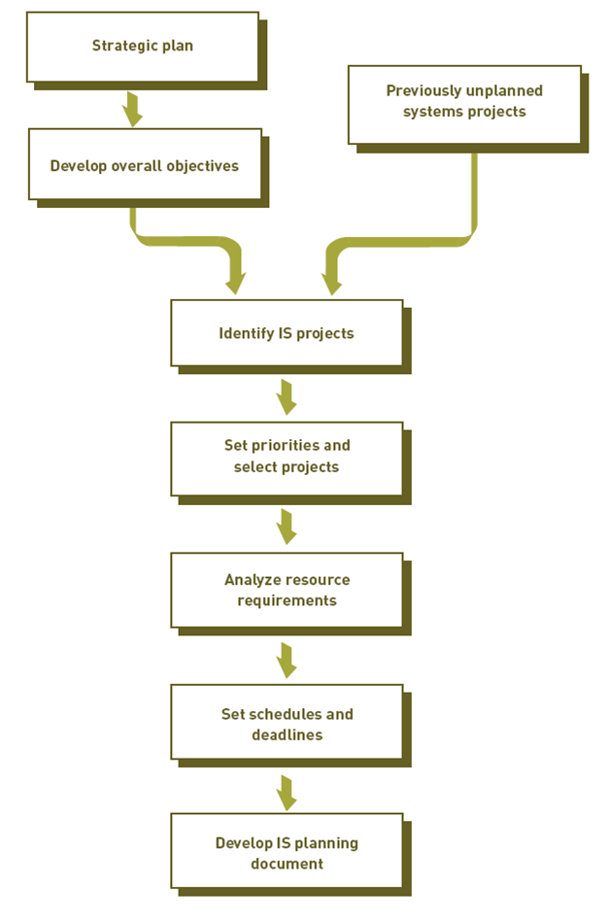
Information Systems Planning ad Aligning Corporate & IS goals

Slide 10
Information Systems Planning ad Aligning Corporate & IS goals
Developing a Competitive Advantages
  IS project are there to achieve competitive advantage
  Creative Analysis
    Investigating new approaches to existing problems
  Critical Analysis
    Unbiased and careful questioning to see if system elements are related in the most effective ways
    Questioning statements and assumptions
    Identifying and resolving objectives and orientations that conflict

Slide 11
Establishing Objectives for Systems Development
Performance objectives
  The quality or usefulness of the output
  Accuracy of the output
  The speed at which output is generated
  The scalability of the resulting system
  The risk of the system
Cost Objectives
  Development cost
  Cost related to the uniqueness of the system application
  Fixed investments in hardware and related equipment
  Ongoing operating costs of the system

Slide 12
Systems Development Lifecycles
Common systems development life cycles
  Traditional
  Prototyping
  Rapid application development (RAD)
  End-user development

Slide 13
Traditional Systems Development Lifecycle
Systems investigation
  Identifies problems and opportunities and considers them in light of business goals
Systems analysis
  Studies existing systems and work processes to identify strengths, weaknesses, and opportunities for improvement
Systems design
  Defines how the information system will do what it must do to obtain the problem’s solution

Slide 14
Traditional Systems Development Lifecycle
Systems implementation
  Creates or acquires various system components detailed in systems design, assembles them, and places new or modified system into operation
Systems maintenance and review
  Ensures the system operates as intended
  Modifies the system so that it continues to meet changing business needs

Slide 15
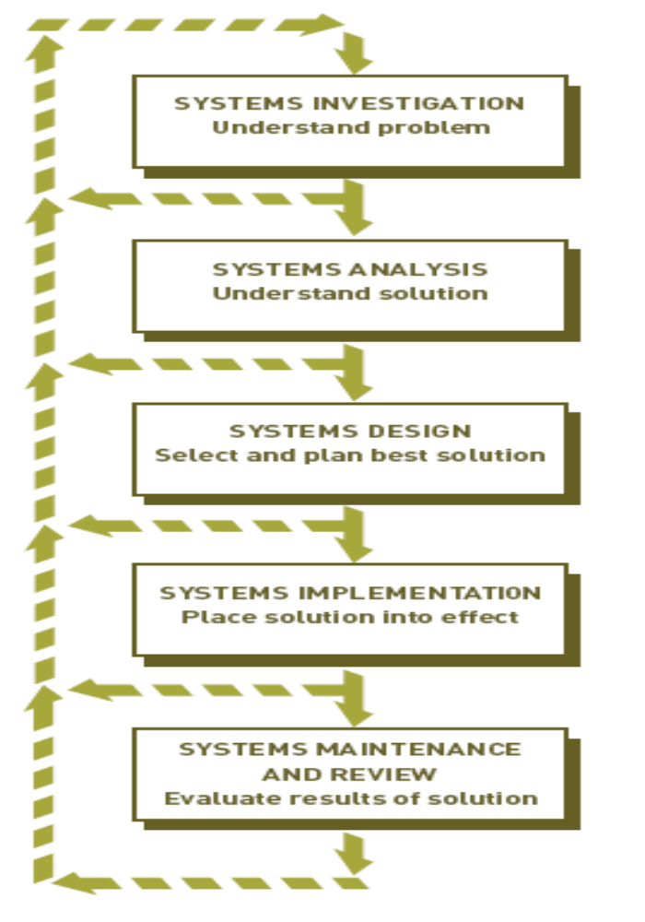
Traditional Systems Development Lifecycle

Slide 16
Prototyping
An iterative approach
Operational prototype
  Prototype that works
  Accesses real data files, edits input data, makes necessary computations and comparisons, and produces real output
Nonoperational prototype
  A mock-up, or model
  Includes output and input specifications and formats

Slide 17
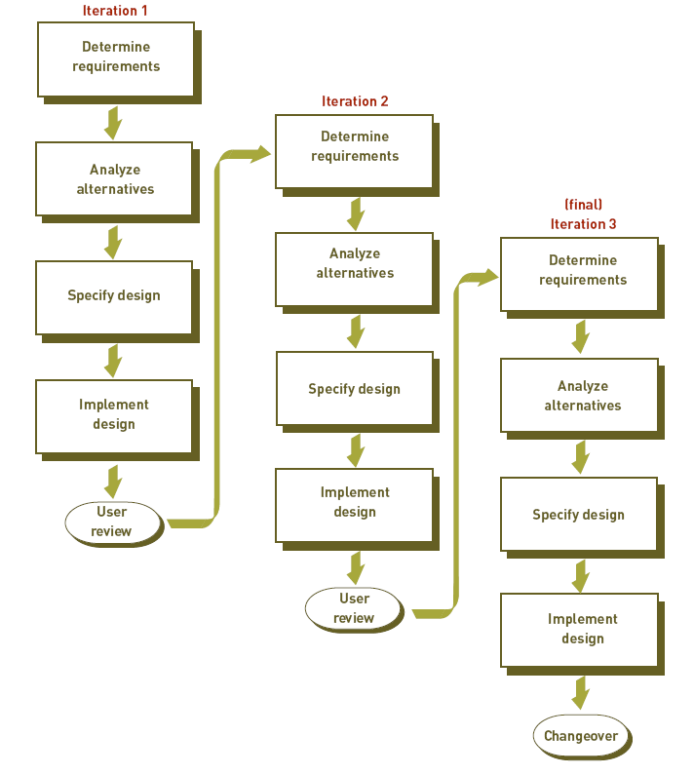
Prototyping

