Slide 1
Module 3: Business Information Systems
Chapter 10: Information and Decision Support Systems

Slide 2
Decision Support Systems
An organized collection of people procedures, software, databases and devices used to help make decisions that solve problems
Deals with decision making effectiveness for unstructured and semi-structured business problems
Benefit of DSS
  Generate higher profits
  Lower costs
  Better products and services
Sometimes used by all kinds of managers in government and non profit orgs as well

Slide 3
Characteristics of Decision Support System
Provide rapid access to information
Handle large amounts of data from different sources
Provide report and presentation flexibility
Textual and graphical representation
Support drill-down analysis
Perform complex, sophisticated analysis and comparison
Support optimization, satisficing and heuristic approaches

Slide 4
Capabilities of Decision Support System
Support for problem solving phases
  Give decision maker flexibility in getting computer support
Support for different decision frequencies
  Ad-hoc DSS: handles ‘one of a kind’ decisions
  Institutional DSS: handles repetitive decisions
  E.g. computer related problems occur multiple times
Support for different problem structures
  From highly structured problems to semi structured and unstructured
Support for various decision making levels
  Provide help to managers at different levels, that is operational, tactical and strategic decision making.

Slide 5
Components of Decision Support System

Slide 6
Components of Decision Support System
The Database
  DBMS allows qualitative analysis
  Data-driven DSS uses the company’s databases, retrieving info on inventory, sales, personnel, production, accounting
  Techniques: data mining and business intelligence
  Data-driven medical DSS allow doctors to have access to complete patient record
  Also get data from external databases

Slide 7
Components of Decision Support System
The Model Base
  perform quantitative analysis
  Model-driven DSS performs mathematical analysis by giving decision makers access to variety of models so that different scenarios can be explored
  Models and algorithms constantly revised
  Model Management Software (MMS), coordinates use of models in DSS
The User Interface
  Allows users to interact with the background DSS
  Also called dialogue manager or dashboard

Slide 8
Decision Support Systems and Business Intelligence
Business Intelligence
  Term used by vendors and IT consultants
Infrastructure for warehousing, integrating, reporting and analyzing data from business environment
  (IBM) umbrella term that combines architectures, tools, databases, analytical tools, applications and methodologies

Slide 9
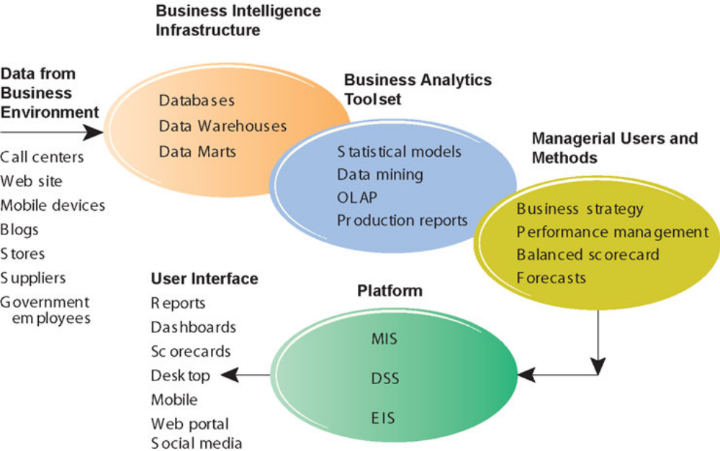
Decision Support Systems and Business Intelligence
Business Intelligence environment

Slide 10
Group Support Systems
GSS or GDSS
  DSS good for individuals but not suitable for group work
  Some strategic level managers are involved in decisions in a group setting
  GDSS characteristics include:
  Special design
    Procedures foster creative thinking, effective communications & good decision making techniques
  Ease of use
  Flexibility
    Along with supporting different decision making styles but also integrates different perspectives

Slide 11
Group Support Systems
GSS or GDSS
  Decision-making support
    Supports different techniques like brainstorming, group consensus, nominal group technique
  Parallel communication
    Comments and discussion displayed immediately
  Automated Recordkeeping
    Discussions automatically stored for future reviews and analysis
  Software include: Autodesk, LotusNotes, Office Communicator/ Net Meeting
    some software are incorporated in TPS & ERPs

Slide 12
Executive Support Systems
Specialized DSS, that includes all hardware, software, data, procedures and people used to assist senior level executives in the organization
Means of tracking critical success factors
Allow executives to ask the right questions
Apart from the drill down ability and ease of use, ESS also
  Support the need for external data
  Help with situations that have high degree of uncertainty
  Have a future orientation
  Are linked with value added business processes

Slide 13
Capabilities of Executive Support Systems
Support for defining overall vision
  Org’s major product lines, types of business to support in future
Support for strategic planning
  Determining long term objectives by analysing the strengths and weaknesses of the organization, predicting future trends
Support for strategic organizing and staffing
  Creation of depts., downsizing labour and analyses changes related to staffing
Support for strategic control
  Monitoring and managing overall operations of the org
Support for crisis management
  Handling emergencies caused by disasters
  Helps in contingency planning

Slide 14
Summary
The MIS must provide the right information to the right person at the right time, in the right format
Understanding decision making process is the key to developing effective DSS
DSS are usually used in situations with unstructured or semi structured decisions
DDSS help in achieving Decision making with collaboration
ESS perform sophisticated data analysis and high degree of specialization

