Slide 1
Module 3: Business Information Systems
Chapter 10: Information and Decision Support Systems

Slide 2
Learning Objectives
Heading 2
  type

Slide 3
Transaction Processing Systems
Used to capture and process the detailed data necessary to update records about fundamental business operations in the organization
  Order entry, inventory control, payroll, accounts payable, accounts receivable
Serves as the foundation of all other special purpose systems e.g. MIS/DSS
Processing Activities
  Data collection
  Data editing
  Data correction
  Data manipulation
  Data storage
  Document production

Slide 4
Transaction Processing Systems
Information
Special Information Systems
MIS/DSS
TPS
Data

Slide 5
Transaction Processing Methods and Objectives
Batch Processing
  business transactions are accumulated over a period of time, and then accumulated as a single batch
    Daily, weekly, biweekly
  Some delay between an event and the eventual processing of the related transaction
Online Transaction Processing (OLTP)
  Transaction is processed immediately
  Essential for businesses that require current, up-to date data
    Airlines, ticket agencies, investment firms
  Faster, more efficient
  Many companies use Internet to capture & process transaction data such as customer orders and shipping info from e-commerce apllication

Slide 6
Transaction Processing Methods and Objectives
Process data by and about transactions
Maintain a high degree of accuracy and integrity
Avoid processing fraudulent transactions
Produce timely user responses and reports
Increase labor efficiency
Help improve customer service
Help built and maintain customer loyalty
Achieve competitive advantage

Slide 7
Transaction Processing Activities

Slide 8
Transaction Processing Activities
Data Collection
  Sometimes done manually, collecting handwritten sales data/ inventory changes
  At times automated trough devices such as scanners /terminals, POS
  Source data automation: data captured at source, in digital form in timely manner
    Through UPC codes or RFID tags
    Product ID automatically determined, price retrieved from database
    Inventory database updated and reports generated for the store manager to recorder the supply
Data Editing
  Checking the data for validity and completeness
  Codes are checked against already stored codes

Slide 9
Transaction Processing Activities
Data Correction
  Re-entering data that was not scanned or typed properly
  Error messages are generated to specify problem so proper corrections can be made
  Some companies have Data Quality centers, to improve and maintain data
Data Manipulation
  Process of performing calculations and other data transformations
  Classifying data, storing data in categories, calculations, summarizing results, storing data

Slide 10
Transaction Processing Activities
Data Storage
  Updating one or more databases with new transactions
  Afterwards data is available for processing and further manipulations
  also available for reporting and decision making
Document Production
  Generating output records, documents, reports
  Hard copy (pay check) or soft copy (balance report)
  Also provide useful management information and decision support
  In addition, provide reports needed by local, state or government agencies

Slide 11
Transaction Processing Applications
Order Processing | Purchasing | Accounting
Order processing Sales configuration Shipment planning Shipment execution Inventory control Accounts receivable | Inventory control (raw material, packing material, spare parts, supplies) Purchase order supplies Receiving Accounts payable | Budget Accounts receivable Payroll Asset management General Ledger
Systems that support order processing, purchasing and accounting function for traditional TPS

Slide 12
Overview of Management Information Systems
Integrated collection of people, procedures, databases and devices that provides managers and decision makers to help achieve organizational goals
  Right information to the right people, in the right format at the right time
Provides managers with insight into regular operations
  Control, organize and plan
  E.g: summarizing profit and losses
  E.g. generating sales activity report

Slide 13
Overview of Management Information Systems
Inputs to a MIS
  Internal:
  TPS and ERP systems
  Company’s supply chain
  Data warehouses/ data marts
  Specific functional areas
  External:
  Customers, suppliers, stakeholders
  Through Internet or extranet link

Slide 14
Outputs of Management Information Systems
Scheduled Reports
  Periodic. E.g. report once per day to monitor production of new item
Key-indicator reports
  Summarizes pervious day critical activities
Demand reports
  E.g. executive wants to know status of a certain item, so request database
Exception Reports
  Generated when situation unusual or requires management action
Drill Down Reports
  Get detailed data about a certain situation

Slide 15
Characteristics of MIS
Providing reports with fixed and standard formats
Produce hard copy and soft copy reports
Use internal data stored in the computer systems
Allow users to develop their own custom reports
Require user request for reports developed by systems personnel

Slide 16
Functional Aspects of MIS
Financial MIS
  Provides financial info to executives plus decision makers
  Functions of Financial MIS include:
    Integrating financial and operational information
    Providing easy access to financial data & information
    Make financial data immediately available
    Allows multidimensional analysis of financial data (time, plant, product etc)
    Analyzing historical and current financial activity
Subsystems of financial MIS
  Profit/loss and cost systems: these systems are used to compute the revenues, profits and costs from:
    Profit centers
    Revenue centers
    Cost centers

Slide 17
Functional Aspects of MIS
  Auditing: these systems are used in all aspects of internal and external auditing, also checking whether financial statements and reports produced by financial MIS are accurate
  Uses and management of funds: these systems help in using the funds internally, such as purchasing inventory, updating equipment, hiring employees etc. and externally such as investments in other revenue generators

Slide 18
Functional Aspects of MIS
Manufacturing MIS
  Manufacturing has dramatically improved because of IS
  MIS subsystems and outputs monitor and control the flow of materials, products and services through the organization
  MIS monitors the whole process of transforming raw materials to finished goods
  E.g. auto manufacturers
Manufacturing MIS subsystems include:
  Design and Engineering
    Use computer-aided design with new or existing products
    Blue print created and constantly revised
    Results in reduction of manufacturing costs

Slide 19
Functional Aspects of MIS
Manufacturing MIS
  Master Production scheduling and inventory control
    Provides detailed plans for both short-term and long range of scheduling manufacturing facilities
    Economic order quantity (EOQ), Materials requirement Planning (MRP),
    Just-in Time Inventory
  Process Control
    Managers use technologies to control and streamline manufacturing process
    Computer assisted manufacturing (CAM)
    Computer Integrated manufacturing (CIM)
  Quality control and Testing
    A process that ensures that the finished product meets the customer’s needs
    IS are used to monitor quality and take corrective steps to eliminate quality issues

Slide 20
Functional Aspects of MIS
Marketing MIS
  Supports managerial activities in product development, distribution, pricing decisions, promotional effectiveness and sales forecasting
  Different subsystems help the managers increase sales, reduce marketing expenses and develop plans for future product & services
  Market research
    Computers used to help analyze the results of reaseach
  Product Development
    Computers help to analyze and select the appropriate mix of factors involved
  Promotion and advertising
    Internet used to promotions and advertising
  Product pricing
    Computers used to analyze pricing and revenues
  Sales analysis
    Computers can be used to give sales analysis from different dimensions

Slide 21
Functional Aspects of MIS
Human Resource MIS
  Concerned with previous, current, future employees
  Helps in workforce analysis, planning, hiring, training, job assignment
  Thus, keep the workforce costs to minimum
  HR planning
    Right no. and kind of employee in right jobs
    Planning workforce needs and supplies
  Selection and recruiting
    Through internet and resume templates
  Training and skills
    Help in evaluating and testing employees
  Salary administration
  Scheduling and Job placement

Slide 22
Types of Decisions
Structured decisions
  Repetitive and routine
  Definite procedures for handling problems
  Question: is some employee entitled to overtime pay?
Unstructured decisions
  Decision maker must provide judgement, evaluation and insight
  Decisions are novel, important and non-routine
  Question: should we enter a new market?
Semistructured decisions
  Have elements of both types of decisions
  Part of the problem has a clear cut answer
  Question: Why is the reported order fulfilment report showing a decline over a past six months?

Slide 23
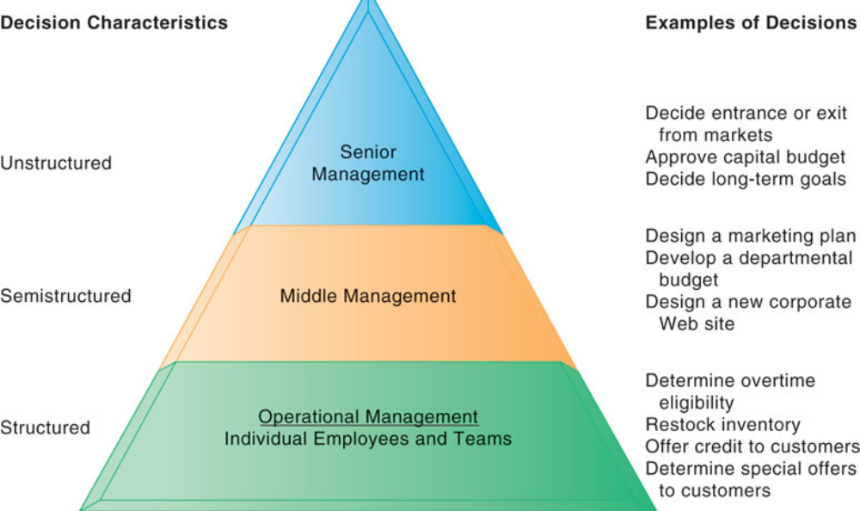
Types of Decisions

Slide 24
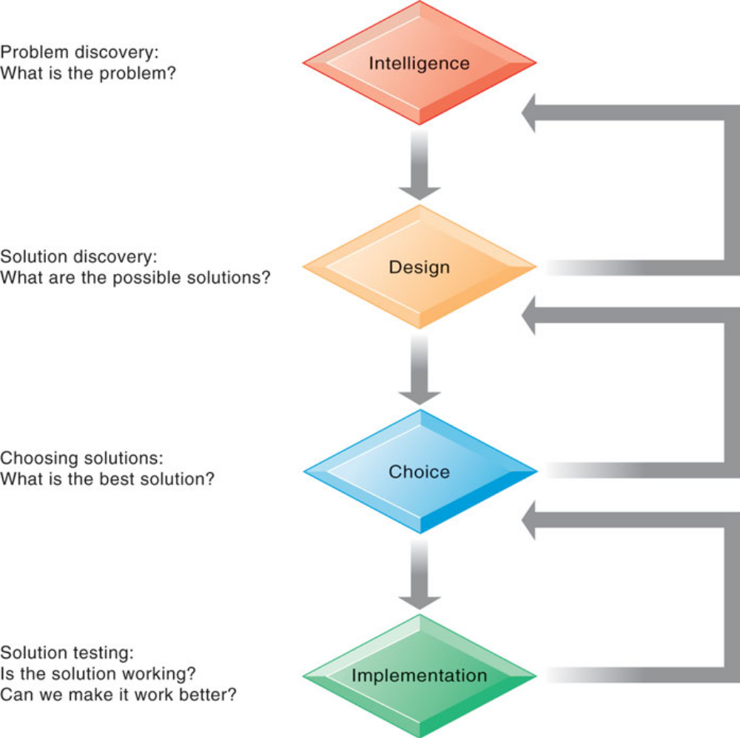
Decision Making Process

Slide 25
Decision Making Process
Intelligence
  Discovering, identifying and understanding the problem
  Why, what, where
Design
  Identifying and exploring various solutions to the problem
Choice
  Choosing among the different alternatives
Implementation
  Making the chosen alternative work
Monitoring
  Evaluate the implementation, whether anticipated results are achieved

Slide 26
Decision Making Approaches
Optimization
  Finds the best solution, helping the organizations meet the goals
Satisficing
  Finds a good, but not necessarily the best solution
Heuristics
  Rules of thumb
  Accepted guidelines and procedures to find a good solution

Slide 27
Summary

