Slide 1
Module 1: Overview of the Information System in Organizations
Chapter 1: Introduction to Information Systems

Slide 2
Learning Objectives
Discuss why is it important to study and understand information systems
Distinguish between data, information and importance of valuable information
Discuss why organizations use Information Systems
Identify the dimensions of Information Systems

Slide 3
Information System

Slide 4
Information Concepts
Data: raw facts, such as employee number, number of hours worked in a week, inventory part numbers etc.
Alphanumeric data, Image data, Audio data, Video data
Information: collection of facts organized so that they have additional value beyond the value of facts themselves
Process: set of logically related tasks performed to achieve a defined outcome, or simply turning data into information

Slide 5
Information Concepts
However, certain rules and regulations can be set up to organize data into useful and valuable information
Knowledge: is the awareness and understanding of a set of information and the ways that information can be made useful to support a specific task or reach a decision

Slide 6
Information Concepts
Characteristics of valuable information
  Accessible
  Accurate
  Complete
  Economical
  Flexible
  Relevant
  Reliable
  Secure
  Simple
  Timely
  Verifiable
The value of information is directly linked to how it helps decision makers achieve their organization’s goals

Slide 7
System Concepts
System: is a set of elements or components that interact to accomplish goals
The relationships among the elements determine how the system works

Slide 8
Information System(IS)
Why is Information System important?
  We interact with IS personally and professionally
  Transforming businesses
  Globalization and Opportunities
IS effects all areas of the businesses
  Manufacturing
  Accounting
  Human Resources
  Marketing
  Top Management

Slide 9
Information System
Set of interrelated components
Collect, process, store, and distribute information
  →By computers and software as a tool
Support decision making, coordination, control, problem analysis and create new product
Provide solutions to changes/challenges in business environment
Another definition
  IT is an integrated Human-Machine system that combines hardware, software, databases and telecommunications networks. It collects data and processes it into information used for decision making at all levels of the organization.

Slide 10
Functions of an Information System
An information system contains information about an organization and its surrounding environment. Three basic activities—input, processing, and output—produce the information organizations need. Feedback is output returned to appropriate people or activities in the organization to evaluate and refine the input. Environmental actors, such as customers, suppliers, competitors, stockholders, and regulatory agencies, interact with the organization and its information systems.

Slide 11
Why Firms Use IS
To achieve 6 strategic business objectives
  Operational excellence
  New products, services, and business models
  Customer and supplier intimacy
  Improved decision making
  Competitive advantage
  Survival

Slide 12
Why Firms Use IS
Operational Excellence
  Achieving higher levels of efficiency and productivity in business operations, plus changes in management behaviour
  Example: Wal-Mart’s Retail Link system links suppliers to stores for in-time replacements
New Products/ Services/ Business Model
  Business model: describes how company produces, delivers, and sells product or service to create wealth
  Information systems and technology a major enabling tool for new products, services, business models
    E.g. Apple’s iPod, iTunes online music business

Slide 13
Why Firms Use IS
Customer and Supplier Intimacy
  Serving customers well leads to customers returning, which raises revenues and profits
  Intimacy with suppliers allows them to provide vital inputs, which lowers costs
    E.g. JCPenney’s information system which links sales records to contract manufacturer
Improved decision making
  Managers need right information at right time
  IS provide real-time data for making decisions
  E.g. Verizon’s Web-based digital dashboard to provide managers with real-time data on customer complaints, network performance, line outages, etc.
  Results in restoration and repairing fast and effective

Slide 14
Why Firms Use IS
Competitive Advantage
  Achieve higher sales and profit through using IS by:
    Doing things better
    Charging less for superior products
    real time responding
  Using the internet is competitive advantage
Survival
  Information technologies are necessity of doing business
    Industry-level changes, e.g. Citibank’s introduction of ATMs

Slide 15
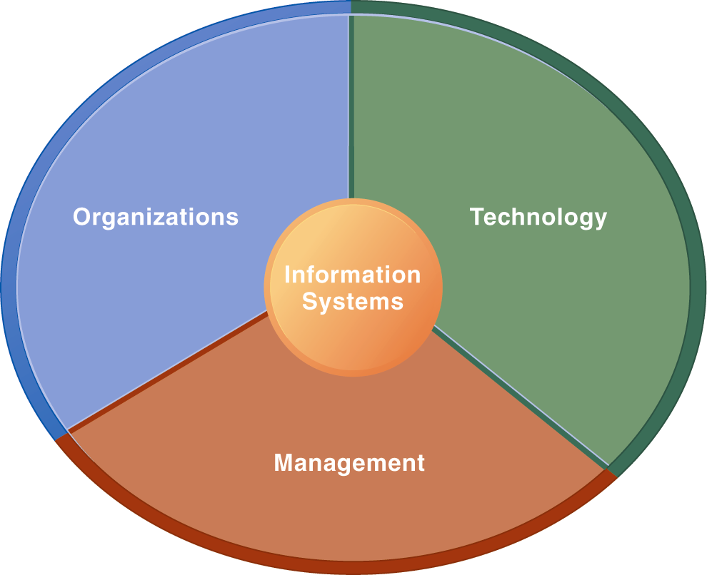
Dimensions of Information System (IS)
Using IS effectively depends on the understanding of organization , technology and management
Only computer literacy is not important, rather broader IS literacy is important to implement a productive IS and this field of MIS is to achieve it
Information System Literacy
How and Why technology is applied in business

Slide 16
Dimensions of Information System
Organization
  Key elements : People, Structure, Business Processes, Politics, Culture
  Organizational structure has different levels and specialities

Slide 17
Dimensions of Information System (IS)
Management
  Make decisions, formulate action plan and solve organizational problem
  Managers set organizational strategy for responding to business challenges
  In addition, managers must act creatively:
    Creation of new products and services
    Occasionally re-creating the organization
Technology
  Hardware: physical component
  Software: instruction control Hardware
  Data management technology
  Network and telecommunications technology
  Network: Hardware + Software link computers
  Internet: Network to provide services
  IT infrastructure: platform to build the IS

Slide 18
Summary
IS instrument for creating value to firms
The value of information is directly linked to how it helps decision makers achieve the organization’s goals
Information systems must be applied thoughtfully and carefully so that society and industry can reap maximum benefits

