Slide 1
Module 2: Information Technology Infrastructure
Chapter 6: Telecommunications, Internet and Wireless Technology

Slide 2
Learning Objectives
Identify the telecommunication media and hardware required for transmission
Identify the network types and key networking technologies (including protocols)
Discuss the principle technologies and standards for wireless networking
Describe several telecommunication applications that orgs benefit from today
Discuss how Internet works and its support for communications and e-business

Slide 3
Intro to Telecommunications
Telecommunication
  Electronic transmission of signals for communication
  The general model of telecommunication consists of
    The sending device
    The medium
    The communication device
    The receiving unit

Slide 4
Intro to telecommunications
Transmission medium
  Any material substance that carries an electronic signal to support communications between sending and receiving devices
  Divided into one or more communication channels
  Classified as simplex, half duplex, full duplex
  Characteristics:
    Bandwidth: rate at which data is exchanged (bps)
    Higher bandwidth, more channel transmits
    Broadband
    Latency: time it takes a signal to travel from one location to another
    Best combo: high bandwidth, low latency

Slide 5
Intro to telecommunications
Physical transmission medium
Media Type | Description | Advantages | Disadvantages
Twisted pair cable | Twisted pair of copper wires, insulated | Used for telephone services, widely available | Transmission speed and distance limitation
Coaxial Cable | Inner conductor wire surrounded by insulation | Cleaner and faster data transfer than twisted pair | More expensive than twisted pair
Fiber-Optic cable | Extremely thin glass strands bound together in a sheathing, uses light to transmit | Less diameter, less distortion and high transmission rate | Expensive to purchase and install

Slide 6
Intro to telecommunications
Wireless transmission medium
  Microwave
  Radio
  Infrared

Slide 7
Intro to telecommunications
Telecommunication Hardware
  Modem
    Special device that converts digital signals to analog signals (modulation) and vice versa (demodulation)
    PC modem, cable modem, DSL modem
  Hub
    Device that connect network components, sending a packet of data to all other connected devices
  Switch
    Smarter than hub, forward data to specific destination
  Network Interface Card
    Network interface device, connection medium for linking network components

Slide 8
Intro to telecommunications
Telecommunication Hardware
  Router
  WAP

Slide 9
Computer Network
A network consists of two or more connected computers
A simple network contains:
  Client computer
  Dedicated server
  Network interfaces
  Connection medium
  Network operating system
  Hub/switch

Slide 10
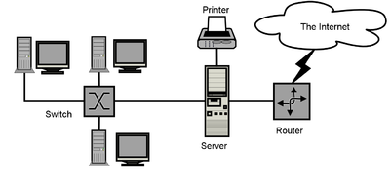
Computer Network

Slide 11
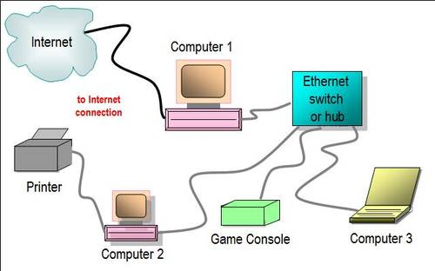
Wired Network with Hub/Switch

Slide 12
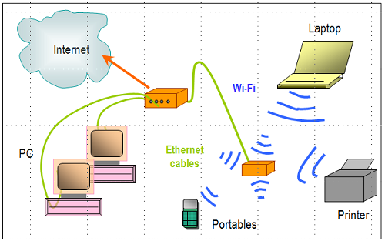
Two router Network

Slide 13
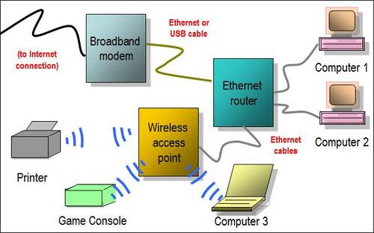
Hybrid Network

Slide 14
Computer Network
Types of Networks
  Local Area Networks (LAN): connects computer systems and devices within a small area, typically they are wired into office buildings
    Computers must be equipped with the correct interface
    Client/Server architecture: One computer is dedicated network file server, providing access to resources
    Ethernet: LAN standard for physical medium (10 Mbps)
    Fast Ethernet (100Mps), Gigabit Ethernet (1 Gbps)
    Peer-to-peer architecture: used in very small networks, different computers can exchange data by direct access and also peripheral devices. Useful for small businesses
  Metropolitan Area Networks (MAN): connects computers systems within a campus or a city
    Range of 30-90 miles

Slide 15
Computer Network
Types of Networks
  Wide Area Networks (WAN):International Networks: connects large geographical regions
    Internet – world’s largest WAN
  Mesh Networking: way to route communications among network nodes by allowing for continuous connections and reconfiguration around blocked paths
    Robust, if one node fails, others can still communicate
    Can be used to provide Internet access, secure connections to corporate netowrks and VoIP calls

Slide 16
Key Digital Networking Technologies
Client/Server computing
  Distributed computing model, some processing power on client computers
  Linked to network to server computers, sets rules for communication, provides every client with an address
Packet Switching
  Slicing digital messages into packets, sending them over communication paths, reassembling at destination
  Transmitted through routers

Slide 17
Key Digital Networking Technologies
TCP/IP Connectivity
  Protocol: set of rules and procedures concerning transmission of information between 2 points in a network
  Now only worldwide standard Transmission Control Protocol/Internet Protocol (TCP/IP) is used with any kind of hardware for networking
  TCP: handles movement of data between computers, sequencing packets and acknowledging sending
  IP: delivery of packets and reassembling during transmission

Slide 18
Wireless Communication
Advantages:
Helps businesses stay in touch with customers, suppliers, partners
Provides flexible arrangements for organizing work
Help create new products, services, sales channels
Provide easier access to remote corporate areas

Slide 19
Wireless Communication Standards
Bluetooth
  Wireless N/W standard, creates PAN
  Range: 10m, 722Kbps (2.4Ghz)
  Useful for battery powered devices (printers, Keyboard)
  FedEx: signals transmitted from handheld devices through bluetooth
Wi-Fi (802.11)
  Standard for wireless LAN and wireless Internet access
  Range: 30-5-m, 11Mbps-54Mbps (2.4Ghz)
  Use: creating ‘hotspots’
  802.11 n is the fastest ( 100Mbps) based on the MIMO( multiple input/multiple output)

Slide 20
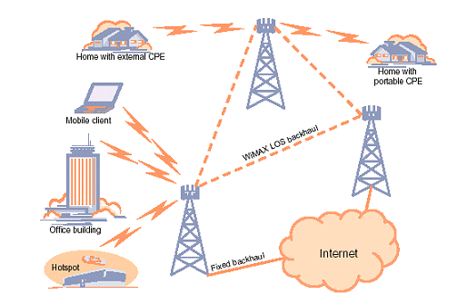
Wireless Communication Standards
WiMAX
  Worldwide Interoperability for Microwave Access)
  Range: 31 miles, 75Mbps
  Use: areas where difficult to install broadband or Wi-Fi
  Connectivity provided by WiMAX towers

Slide 21
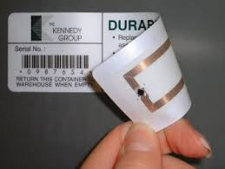
Wireless Communication Standards
RFID
  Standard for radio signals to communicate with a tag
  Use: tracking movement of goods through supply chain
  RFID Tag
    embedded microchip and antenna
    Active: battery powered, send data automatically, expensive
    Passive: powered by the signals from reader, lighter, less expensive
  RFID Reader
    Reads tag, capturing the data, decodes it and send it over the network to the computer
    Reads data in its range
  Businesses need to update H/W and S/W to accommodate large data from RFID
  SAP, Oracle offer RFID-ready versions for SCM applications

Slide 22
Cellular Network
ITU developed standard for cellular networks
  To standardize and allow global roaming
Mobile Communication standard
  Global System for Mobile Communication (GSM) and CDMA
  GPRS (General Packet Radio Service), EDGE, EVDO (Evolution Data Optimized)
  Earlier for voice and small data
  3G 144 Kbps to 2.4 Mbps
    Video, VoIP, graphics, rich media
  Next: 4G 100Mbps

Slide 23
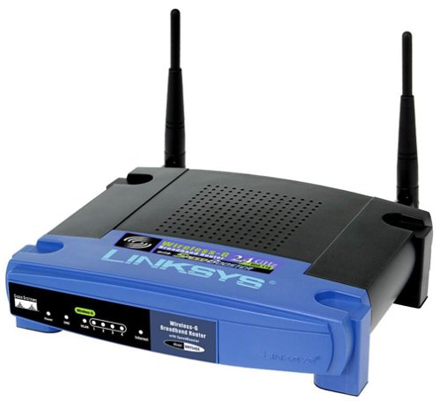
Telecommunication and Network Applications
Important Business applications include:
Linking Pcs to Mainframes/Servers
Voice Mail
  Send/receive store verbal messages
Small Business Networks
  Create small networks with few devices easily
  Either WAP with modem or a combo device (router, firewall, hub)
    Filtering and encryption
Electronic Document Distribution
  Send/receive digital documents
    Saves paper, access faster

Slide 24
Telecommunication and Network Applications
Call Centres
Telecommuting/Virtual Networks
Videoconferencing
Electronic Data Exchange
Electronic Funds Transfer
Distance Learning
Team Collaboration

Slide 25
Case Study: Delivering People More Efficiently Through Telecommunications
Crew Transportation Industry
  Shuttling crew members to train locations where they are needed
Problem:
  Slow to adopt telecomm technologies
  Van drivers could not communicate with dispatcher while in route
  Railway company not happy
RailCrewXpress
  Serving railways through technology platform
  Wireless telecommunication system that connects drivers with dispatchers and company IS
  Tracks drivers, dynamic routing change, maintains history of routes and driver times
  Data is analysed to optimize the efficiency of dispatches & routing

Slide 26
Case Study: Delivering People More Efficiently Through Telecommunications
Challenges
  Economical networking technologies
  Automatically switch between satellite and GPRS data transmission
  Intelligently decide how much info to send and when
Next milestone
  RFID scanners to be installed in vans for tracking location

Slide 27
Case Study: Delivering People More Efficiently Through Telecommunications
Advantages
  Faster and efficient communication between drivers and dispatchers
  Happier railway companies, because they get accurate ETAs
  Flexibility to accept new trip orders and reroute quickly
Real Time Monitoring
  Providing time-relevant info for quick decision-making
  View minute by minute info
  Respond quickly to changing conditions
  Analyse data for operational efficiency

Slide 28
The Internet
Extensive, public communication system
worldwide collection of networks that links billions of diverse users
World’s largest implementation of Client/Server computing
Started as ARPANET, project of DoD, U.S in 1970s
  Initial Goal: Allow scientists at different physical locations to share information and work together on military and scientific projects
  Originally 4 main computers (host)
  Now: Grown into a public , cooperative, independent network, more than 1 billion host nodes
  W3C researches and sets standards and guidelines

Slide 29
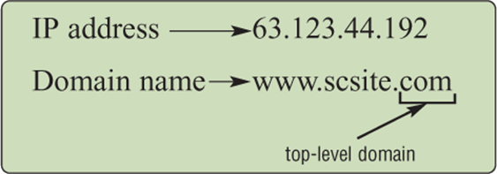
How the Internet Works
Based on the TCP/IP networking protocol
Every computer has an Internet Address
  32 bit number representing by four strings of numbers
  E.g. 207.46.250.119
  Domain Name: English name that corresponds to the 32.bit number
  DNS server holds the list of IP addresses mapped to their domain names
  International web sites outside USA, use a two letter country code, like ‘pk’ for Pakistan.

Slide 30
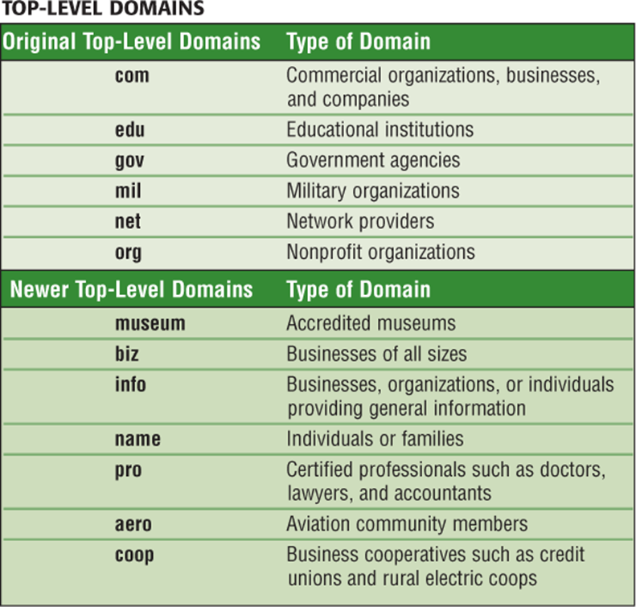
How the Internet Works

Slide 31
ISPs and Internet Architecture
Internet Service Provider (ISP) is any company that provides people and organizations access to the Internet
  Mostly provide services over broadband internet access through DSLs, cable or satellite transmission
  Some universities and businesses use the very fast T1 and T3 lines to connect to Internet
Wireless Internet Service Providers (WISP)
  Wireless Internet Service provider (WISP) is a company that provides wireless Internet access to computers and mobile devices

Slide 32
ISPs and Internet Architecture
On the internet, your computer is the client that can access data, information and services from a variety of servers
Internet data traffic is carried over transcontinental high-speed Internet backbone (45Mbps to 2.5 Gbps)
  Usually made of Fiber optics
In addition to backbone, the internet encompasses an intricate collection of regional and local communication links (telephone lines, cable television lines etc)
  These lease access to ISPs and companies

Slide 33
The World Wide Web
Developed at CERN
Most popular Internet Service
Consists of a worldwide collection of electronic documents, each document called a Web page
Collection of web pages and items associated with it constitute Web site
Web server is a computer that delivers requested Web pages to your computer
Hypertext Transfer Language (HTML): language for formatting documents and web pages and incorporating dynamic link to other documents and pictures stored on same or remote computer

Slide 34
The World Wide Web
Web Address
  a unique address of the Web page, also called a URL (Uniform Resource Locator)
a Web browser retrieves a web page using its Web address
Many addresses begin with HTTP – Hypertext Transfer Protocol
HTTP is a set of rules that defines how pages transfer over the internet
http://www.us-parks.com/grand_canyon/scenic_vistas.html
protocol
Domain name
path
Web page name

Slide 35
The World Wide Web
Search Engine
  It is a program that finds Web sites, Web pages, images, videos, news and other information
  The word or phrase entered for defining your search is called a Search text or Keyword
  The results of the search are known as hits.
  bring HTML files, Microsoft Office files, PDF files, videos, images
Search Engine Marketing
  Sponsored links for which advertisers have paid to be listed
  Fastest growing Internet advertising
  Companies optimize their sites for search engine recognition
  Search Engine Optimization (SEO): process of improving the quality & volume of web traffic to a website

Slide 36
Web 2.0
Enables people to collaborate, share information, and create new services and content online
Four features: interactivity, real-time user control, social participation and user generated content
Mashups and Widgets
  Software services that enable users and system developers to mix and match content or software components to create something new
Blogs
  Weblog is a personal Website that contains a series of chronological entries by the author
  Popular publishing tools, also have business uses

Slide 37
Web 2.0
RSS (Really Simple Syndication)
  Syndicates web site content so that it can be used in another setting
  Pulls specific content from Web sites and feeds it to user’s computer for later viewing
  News feeds, event listing, new stories, headlines, project updates, distributing corporate information etc.
Wiki
  Collaborative Web sites where visitors can add, delete or modify the site, including previous author’s work
    Motorola sales reps using Wiki for sharing sales info
Social Networking
  Build communities of friends and professional colleagues

Slide 38
Internet and Web Applications
Internet Services
  E-mail: Electronic mail is service that allows transfer of messages and files via a computer network
  Chat
  Instant Messaging
VoIP
  Voice transmission over the Internet, instead of telephone network
  Voice travels in digital form using packet switching
  Lower long distance call costs
Newsgroups
  worldwide discussion groups posted on Internet electronic bulletin boards on which people share views on a certain topic. Groups are either moderated or unmoderated, discussion through e-mail

Slide 39
Internet and Web Applications
Telnet and FTP
  Protocol that enables you to log on to other computers
  Accessing public files
  File Transfer Protocol, transferring files between host and remote computer
  Also uploading, downloading content to/from a web site
Content Streaming
  Multimedia, radio broadcasts
  Watching streamed videos
Web shopping
Web Auctions
  Matching buyers and sellers, e.g. eBay

Slide 40
Summary
Telecommunication technology lets more people send and receive all forms of data over greater distances
EDD, EDI and EFT are useful telecomm applications that have changed the way orgs do businesses
The internet provides a wide range of services, some practical for business use today
However, management issues, speed and service affect all networks

