Slide 1
Module 2: Information Technology Infrastructure
Chapter 6: Telecommunications, Internet and Wireless Technology

Slide 2
Learning Objectives
Identify the telecommunication media and hardware required for transmission
Identify the network types and key networking technologies (including protocols)
Discuss the principle technologies and standards for wireless networking
Describe several telecommunication applications that orgs benefit from today
Discuss how Internet works and its support for communications and e-business

Slide 3
Intro to Telecommunications
Telecommunication
  Electronic transmission of signals for communication
  The general model of telecommunication consists of
    The sending device
    The medium
    The communication device
    The receiving unit

Slide 4
Intro to telecommunications
Transmission medium
  Any material substance that carries an electronic signal to support communications between sending and receiving devices
  Divided into one or more communication channels
  Classified as simplex, half duplex, full duplex
  Characteristics:
    Bandwidth: rate at which data is exchanged (bps)
    Higher bandwidth, more channel transmits
    Broadband
    Latency: time it takes a signal to travel from one location to another
    Best combo: high bandwidth, low latency

Slide 5
Intro to telecommunications
Physical transmission medium
Media Type | Description | Advantages | Disadvantages
Twisted pair cable | Twisted pair of copper wires, insulated | Used for telephone services, widely available | Transmission speed and distance limitation
Coaxial Cable | Inner conductor wire surrounded by insulation | Cleaner and faster data transfer than twisted pair | More expensive than twisted pair
Fiber-Optic cable | Extremely thin glass strands bound together in a sheathing, uses light to transmit | Less diameter, less distortion and high transmission rate | Expensive to purchase and install

Slide 6
Intro to telecommunications
Wireless transmission medium
  Microwave
    High frequency, high speed signal(300MHz to 300 Ghz)
    Line of sight transmission between earth based receivers
    Satellite also operates on microwave frequency
    Amplifies a signal and broadcasts it at different frequencies
    Geostationary, LEO, VSAT
  Radio
    send/receive wirelessly (30Hz to 300 Mhz)
  Infrared
    Infrared light waves
    Line of sight
    IrDA port

Slide 7
Intro to telecommunications
Telecommunication Hardware
  Modem
    Special device that converts digital signals to analog signals (modulation) and vice versa (demodulation)
    PC modem, cable modem, DSL modem
  Hub
    Device that connect network components, sending a packet of data to all other connected devices
  Switch
    Smarter than hub, forward data to specific destination
  Network Interface Card
    Network interface device, connection medium for linking network components

Slide 8
Intro to telecommunications
Telecommunication Hardware
  Router
    Connects multiple computers
    Transmitting packets to destination
    May have built in firewall
  WAP
    Allows transferring data wirelessly or to a wired network
    High speed antennas

Slide 9
Computer Network
A network consists of two or more connected computers
A simple network contains:
  Client computer
  Dedicated server
  Network interfaces
  Connection medium
  Network operating system
  Hub/switch

Slide 10
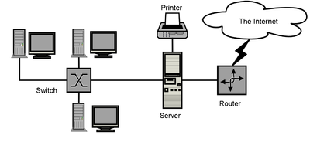
Computer Network

Slide 11
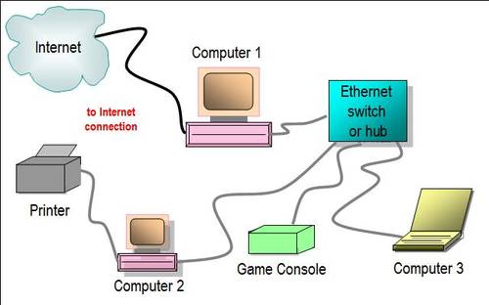
Wired Network with Hub/Switch

Slide 12
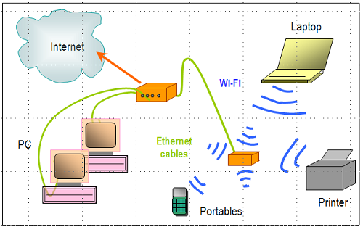
Two router Network

Slide 13
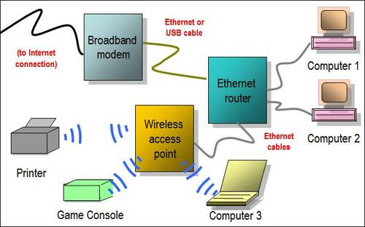
Hybrid Network

Slide 14
Computer Network
Types of Networks
  Local Area Networks (LAN): connects computer systems and devices within a small area, typically they are wired into office buildings
    Computers must be equipped with the correct interface
    Client/Server architecture: One computer is dedicated network file server, providing access to resources
    Ethernet: LAN standard for physical medium (10 Mbps)
    Fast Ethernet (100Mps), Gigabit Ethernet (1 Gbps)
    Peer-to-peer architecture: used in very small networks, different computers can exchange data by direct access and also peripheral devices. Useful for small businesses
  Metropolitan Area Networks (MAN): connects computers systems within a campus or a city
    Range of 30-90 miles

Slide 15
Computer Network
Types of Networks
  Wide Area Networks (WAN):International Networks: connects large geographical regions
    Internet – world’s largest WAN
  Mesh Networking: way to route communications among network nodes by allowing for continuous connections and reconfiguration around blocked paths
    Robust, if one node fails, others can still communicate
    Can be used to provide Internet access, secure connections to corporate networks and VoIP calls

Slide 16
Key Digital Networking Technologies
Client/Server computing
  Distributed computing model, some processing power on client computers
  Linked to network to server computers, sets rules for communication, provides every client with an address
Packet Switching
  Slicing digital messages into packets, sending them over communication paths, reassembling at destination
  Transmitted through routers

Slide 17
Key Digital Networking Technologies
TCP/IP Connectivity
  Protocol: set of rules and procedures concerning transmission of information between 2 points in a network
  Now only worldwide standard Transmission Control Protocol/Internet Protocol (TCP/IP) is used with any kind of hardware for networking
  TCP: handles movement of data between computers, sequencing packets and acknowledging sending
  IP: delivery of packets and reassembling during transmission

