Slide 1
Module 2: Information Technology Infrastructure
Chapter 5: Databases and Information Management

Slide 2
Why Learn About Database Systems, Data Centers and Business Intelligence?
What role do databases play in overall effectiveness of Information Systems?
What techniques do businesses use to maximize the value of the information provided from database?

Slide 3
Learning Objectives
Define general data management concepts and terms
Identify the advantages of database approach and describe relational database model
Identify the role and functions of DBMS
Identify current database applications
Identify the role of Business Intelligence

Slide 4
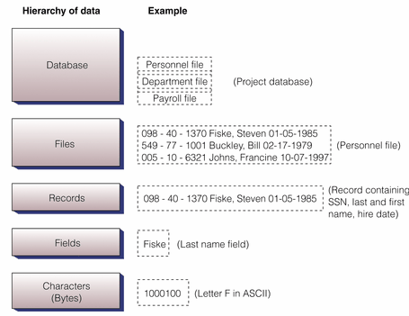
Data Management
Hierarchy of data

Slide 5
Data Management
Building blocks of hierarchy
bit (the smallest unit of data) has only two values - 1 or 0
bytes - 8 bits make up one byte, which represents one character like the letter A
field (or in a database attribute), represents a combination of bytes that make up one aspect of a business object (i.e. last name, invoice number, age)
record - a collection of related data fields (i.e. name/address/phone information for one student)
file (or in a database an entity) - a collection of related records (all students in MIS213)
database - a group of similar items (all students and faculty in Cameron School of Business)

Slide 6
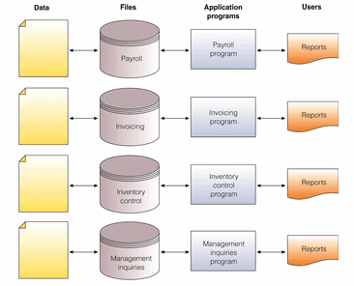
Data Management
TRADITIONAL (File Based )approach to data management

Slide 7
Data Management
PROBLEMS
  Data Redundancy
    Duplication of data, same data is stored in multiple locations
    Data inconsistency, same attributed have different names or values
    Updating problems
  Program Data Dependence
    Changes in program require changes in data
  Lack of Flexibility
    difficult and expensive process to retrieve ad-hoc reports
  Lack of Sharing
    Because data is located in different files and different departments, difficult to be shared and accessed in timely manner

Slide 8
Data Management
DATABASE Approach
Database
  Organized collection of data, or a collection of related files containing records
Entity
  Generalized class of people, places or things (objects) for which data is collected, stored and maintained
  E.g. SUPPLIER, PRODUCT
Attribute
  Specific characteristics of each entity
  E.g. SUPPLIER: Name, address
  PRODUCT: Product ID, Product Price
Database Management System (DBMS)

Slide 9
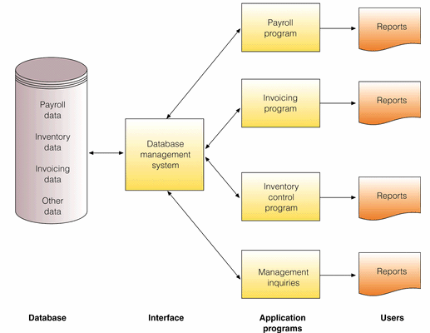
Data Management
DATABASE Approach

Slide 10
Data Management
Advantages of Database Approach
1. Reduced data redundancy | Data about a person / invoice / product is stored only one time
2. Improved data integrity | Since data is stored only once for each entity, we don't need to worry about updating multiple records for the same entity (i.e. storing home address several times for the same person)
3. Easier updating of data | Again the advantage of one storage location
4. Data and program independence | The data files are separate from the applications (HR, payroll, invoicing) and thus can be used by many applications
5. Improved strategic use of data | Accurate, complete, up-to-date data is used by decision makers
6. Improved security | Backups and access can be better controlled by passwords, ensuring privacy

Slide 11
Data Management
Some more advantages of Database Approach
  Standardization of data access
  Shared data and information resources
Disadvantages
  More complex
    DBMS could be difficult to set up and operate
  More expensive
    More expensive to purchase, additional personnel and additional hardware required
  Difficult to recover from failure
    Failure in DBMS shuts down entire database

Slide 12
Data Modeling
When building a database, following must be considered
  Content: What data should be collected and at what cost?
  Access: What data should be provided to which users and when?
  Logical Structure: How should data be arranged?
  Physical Organization: Where should data be physically located?
Logical Design
  Abstract model of how data should be structured and arranged
  Data Model : diagram of entities and their relationships
Physical Design
  Fine tunes logical design for performance and cost (improved response time, reduce storage space)

Slide 13
Data Modeling
Entity Relationship Diagram
  Use basic graphical symbols to show the organization and relation between data
  One to one
  One to many
  Many to many

Slide 14
Relational Database Model
The Relational Database Model
Relational Database
  Organize data into two-dimensional tables (relations) with columns and rows
  One table for each entity
  Fields (columns) store data representing an attribute
  Rows store data for separate records
  Key field: identifies a record
  Primary Key: A field that uniquely identifies a set of records, cannot be duplicated and distinguishes records
  Domain is the allowable values for these attributes. E.g. attribute for pay does not include negative numbers

Slide 15
Relational Database Model
The Relational Database Model

Slide 16
Relational Database Model
Manipulating Data
  For inquiries and analyzing data
  Selecting: eliminating rows according to certain criteria
  Projecting: eliminating columns in a table
  Joining; combining two or more tables
  As long as tables share at least one common attribute, tables in a relational database can be linked to provide useful information and reports

Slide 17
Relational Database Model
Dept. No. | Dept. Name | SSN
001 | Accounting | 10-10
002 | Manufacturing | 23-25
003 | Marketing | 10-45
Project | Description | Dept. No.
155 | Payroll | 001
498 | Widgets | 002
226 | Sales Manual | 003
Project
Department
SSN | Name | Hire Date | Dept. No.
10-10 | Rasheed Khan | 10-07-1997 | 001
23-25 | Haider Ali | 02-17- 1998 | 002
10-45 | Safdar Ahmed | 01-05-1985 | 003
Manager

Slide 18
Relational Database Model
Data Cleanup
  Valuable information: accurate, complete, reliable, economical, flexible, relevant, simple, timely, verifiable, accessible, secure
  Data cleanup is to develop data with these characteristics

Slide 19
Database Management Systems (DBMS)
Group of programs used as an interface between a database and application programs/users, used to create, implement, use and update a database.
  Makes physical database available for different logical views required by users
Single User DBMS
  Databases for personal computer are meant for single users
  Access, FileMaker Pro, Microsoft InfoPath
Multiuser DBMS
  Used by large mainframe computers
  Powerful, expensive, allow hundreds of people to access
  Oracle, Sybase, DB2 by IBM, Teradata database

Slide 20
Capabilities of Database Management Systems (DBMS)
Provides capabilities and tools for organizing, managing and accessing the data in the database
Data Definition language (DDL)
  Collection of instructions and commands used to define and describe data and relations in a specific database
  Basically used to define schema (description)
  Describes logical access paths and logical records in the database
  SQL: CREATE, DROP, ALTER
CREATE TABLE employees (
id INTEGER PRIMARY KEY,
first_name VARCHAR(50) NULL,
last_name VARCHAR(75) NOT NULL,
dateofbirth DATE NULL
);

Slide 21
Capabilities of Database Management Systems (DBMS)
Data Dictionary
  Detailed description of all data used in the database
  Name of data item, range of values used, type of data, amount of storage needed, notation of person who updated it, users who can access it, list of reports that use data item
NORTHWEATERN MANUFACTURING
PREPARED BY: BORDWELL
DATE: 04 AUGUST 2007
APPROVED BY: EDWARDS
VERSION: 3.1
PAGE: 1 OF 1
DATA ELEMENT NAME: PARTNO
DESCRIPTION: INVENTRY PART NUMBER
OTHER NAMES: PTNO
VALUE RANGE: 100 TO 5000
DATA TYPE: NUMERIC
POSITION: 4 POSITIONS OR COLUMNS

Slide 22
Database Management Systems (DBMS)
Data Manipulation Language
  Specific language used to access, modify, and make queries(request for specific data)
  Storing, Retrieving, Manipulating data and Generating reports
  Query By Example (QBE)
    Visual approach to developing database queries
    GUI to retrieve data
    MS Access
  Structured Query Language (SQL)
    Integral part of relational databases
    Consists of special keywords and rules
    Also includes built-in functions AVG, MAX, MIN

Slide 23
Database Management Systems (DBMS)
Data Manipulation Language
SQL Command | Description
SELECT ClientName, Debt FROM Client WHERE Debt>1000 SELECT ClientName, ClientNum, OrderNum FROM Client, Order WHERE Client.ClientNum=Order.ClientNum GRANT INSERT ON Client to Guthrie | Query displays all clients and amount they owe to the company rom database table Client, or client who owe more than $1000 Join command that combines data rom 2 tables: Client and Order. New table will be created with client name, client number and order number. Security command, that allows Guthrie to enter values or rows in Client table

Slide 24
Database Administration
Require a skilled DBA
  Expected to have clear understanding of the fundamental business of organizations
  Proficient in the use of selected DBMS
  Stay ahead of emerging technologies and new design approaches
  Role: plan, design, create, operate, secure, monitor, and maintain
  Works with users and programmers
  Database administrator: responsible for defining and implementing consistent principles for a variety of data issues

Slide 25
Database Applications
Manipulate content of a database to produce useful information
  Searching, filtering, synthesizing, and assimilating the data contained in database
Businesses use databases, not only for keeping track of employee and customer records, but also to make better decisions and run operations effectively
  Data warehouse
  Data mining
  Business intelligence
  Web mining and text mining

Slide 26
Database Applications
Data Warehouse
  Database that stores current and historical data of potential interest to decision makers throughout the company
  The data is gathered from various operational transaction system, including website transactions
  Consolidates the information from different locations and makes them available for analysis and decisions
  Provides range of standardized query tools, analytical tools and graphical reporting facilities
  Advantage: ability to relate data in innovative ways

Slide 27
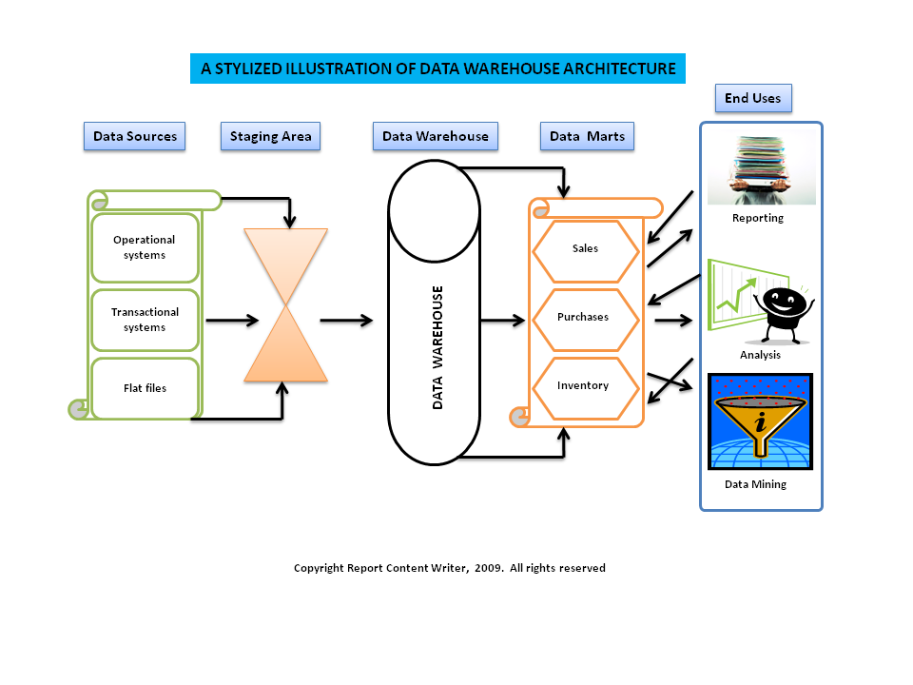
Database Applications

Slide 28
Database Applications
Data Mart
  Subset of data warehouse
  Contains summarized or highly focused portion of data about a specific area
  E.g. marketing/sales data to deal with customer information
  Useful for smaller groups who want to access detailed data
  Constructed more rapidly, requires less powerful hardware, lower cost

Slide 29
Database Applications
Business Intelligence
  Involves gathering enough of the right information in a timely manner and usable form and analyzing it so that it can have a positive effect on business strategy, tactics or operations.
  Competitive intelligence; information about competitors and the ways that knowledge effects strategy, tactics and operations
    Beneficial for responding to changing marketplace
  Tools
    Software for database querying and reporting
    Multidimensional data analysis (OLAP)
    Tools for data mining

Slide 30
Database Applications
Online Analytical Processing (OLAP)
  To answer question such as: how many washers sold in each of your sales regions and compare actual results with projected sales?
  Supports multidimensional data analysis, so users can same data in different ways/dimensions (product, pricing, region, time period)
  Enables users to obtain online answers to ad-hoc questions

Slide 31
Database Applications
Data Mining
  Provides insight into corporate data that cannot be obtained with OLAP
  Hidden patterns and relationships are found in large databases by inferring rules
  Type of information retrieved is: association, sequences, classifications, clusters, forecasts
  Extensive use in marketing to improve customer retention, cross-selling opportunities, campaign management, one-to-one marketing
  Predictive Analysis: combines historic data with assumptions about future conditions to predict outcome of events such as future product sales or such probabilities
    Find new market segments that could be profitable
  Oracle, Sybase etc. incorporate data mining functionality

Slide 32
Database Applications
Data Mining
  Provides insight into corporate data that cannot be obtained with OLAP
  Hidden patterns and relationships are found in large databases by inferring rules
  Type of information retrieved is: association, sequences, classifications, clusters, forecasts
  Extensive use in marketing to improve customer retention, cross-selling opportunities, campaign management, one-to-one marketing
  Predictive Analysis: combines historic data with assumptions about future conditions to predict outcome of events such as future product sales or such probabilities
    Find new market segments that could be profitable
  Oracle, Sybase etc. incorporate data mining functionality

