Slide 1
Module 2: Information Technology Infrastructure
Chapter 5: Databases and Information Management

Slide 2
Why Learn About Database Systems, Data Centers and Business Intelligence?
What role do databases play in overall effectiveness of Information Systems?
What techniques do businesses use to maximize the value of the information provided from database?

Slide 3
Learning Objectives
Define general data management concepts and terms
Identify the advantages of database approach and describe relational database model
Identify the role and functions of DBMS
Identify current database applications
Identify the role of Business Intelligence

Slide 4
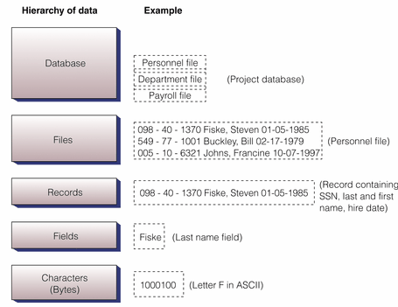
Data Management
Hierarchy of data

Slide 5
Data Management
Building blocks of hierarchy
bit (the smallest unit of data) has only two values - 1 or 0
bytes - 8 bits make up one byte, which represents one character like the letter A
field (or in a database attribute), represents a combination of bytes that make up one aspect of a business object (i.e. last name, invoice number, age)
record - a collection of related data fields (i.e. name/address/phone information for one student)
file (or in a database an entity) - a collection of related records (all students in MIS213)
database - a group of similar items (all students and faculty in Cameron School of Business)

Slide 6
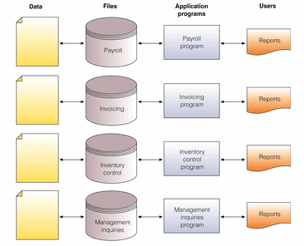
Data Management
TRADITIONAL (File Based )approach to data management

Slide 7
Data Management
PROBLEMS
  Data Redundancy
    Duplication of data, same data is stored in multiple locations
    Data inconsistency, same attributed have different names or values
    Updating problems
  Program Data Dependence
    Changes in program require changes in data
  Lack of Flexibility
    difficult and expensive process to retrieve ad-hoc reports
  Lack of Sharing
    Because data is located in different files and different departments, difficult to be shared and accessed in timely manner

Slide 8
Data Management
DATABASE Approach
Database
  Organized collection of data, or a collection of related files containing records
Entity
  Generalized class of people, places or things (objects) for which data is collected, stored and maintained
  E.g. SUPPLIER, PRODUCT
Attribute
  Specific characteristics of each entity
  E.g. SUPPLIER: Name, address
  PRODUCT: Product ID, Product Price
Database Management System (DBMS)

Slide 9
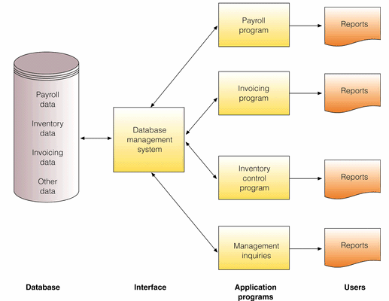
Data Management
DATABASE Approach

Slide 10
Data Management
Advantages of Database Approach
1. Reduced data redundancy | Data about a person / invoice / product is stored only one time
2. Improved data integrity | Since data is stored only once for each entity, we don't need to worry about updating multiple records for the same entity (i.e. storing home address several times for the same person)
3. Easier updating of data | Again the advantage of one storage location
4. Data and program independence | The data files are separate from the applications (HR, payroll, invoicing) and thus can be used by many applications
5. Improved strategic use of data | Accurate, complete, up-to-date data is used by decision makers
6. Improved security | Backups and access can be better controlled by passwords, ensuring privacy

Slide 11
Data Management
Some more advantages of Database Approach
  Standardization of data access
  Shared data and information resources
Disadvantages
  More complex
    DBMS could be difficult to set up and operate
  More expensive
    More expensive to purchase, additional personnel and additional hardware required
  Difficult to recover from failure
    Failure in DBMS shuts down entire database

Slide 12
Data Modeling
When building a database, following must be considered
  Content: What data should be collected and at what cost?
  Access: What data should be provided to which users and when?
  Logical Structure: How should data be arranged?
  Physical Organization: Where should data be physically located?
Logical Design
  Abstract model of how data should be structured and arranged
  Data Model : diagram of entities and their relationships
Physical Design
  Fine tunes logical design for performance and cost (improved response time, reduce storage space)

Slide 13
Data Modeling
Entity Relationship Diagram
  Use basic graphical symbols to show the organization and relation between data
  One to one
  One to many
  Many to many

Slide 14
Relational Database Model
The Relational Database Model
Relational Database
  Organize data into two-dimensional tables (relations) with columns and rows
  One table for each entity
  Fields (columns) store data representing an attribute
  Rows store data for separate records
  Key field: identifies a record
  Primary Key: A field that uniquely identifies a set of records, cannot be duplicated and distinguishes records
  Domain is the allowable values for these attributes. E.g. attribute for pay does not include negative numbers

Slide 15
Relational Database Model
The Relational Database Model

Slide 16
Relational Database Model
Manipulating Data
  For inquiries and analyzing data
  Selecting: eliminating rows according to certain criteria
  Projecting: eliminating columns in a table
  Joining; combining two or more tables
  As long as tables share at least one common attribute, tables in a relational database can be linked to provide useful information and reports

Slide 17
Relational Database Model
Dept. No. | Dept. Name | SSN
001 | Accounting | 10-10
002 | Manufacturing | 23-25
003 | Marketing | 10-45
Project | Description | Dept. No.
155 | Payroll | 001
498 | Widgets | 002
226 | Sales Manual | 003
Project
Department
SSN | Name | Hire Date | Dept. No.
10-10 | Rasheed Khan | 10-07-1997 | 001
23-25 | Haider Ali | 02-17- 1998 | 002
10-45 | Safdar Ahmed | 01-05-1985 | 003
Manager

Slide 18
Relational Database Model
Data Cleanup
  Valuable information: accurate, complete, reliable, economical, flexible, relevant, simple, timely, verifiable, accessible, secure
  Data cleanup is to develop data with these characteristics

