Slide 1
Management Information Systems
(CSC373)
3(3,0)
Introduction to the Course

Slide 2
Lecturer’s Profile
Ayisha Qureshi
Lecturer, Computer Science
CIIT, Islamabad
Masters in Information Systems
HEC, Lausanne

Slide 3
MIS
What is Management Information Systems?
  An organized approach to the study of the information needs of an organization's management at every level in making operational, tactical, and strategic decisions. Its objective is to design and implement procedures, processes, and routines that provide suitably detailed reports in an accurate, consistent, and timely manner.
  In a management information system, modern, computerized systems continuously gather relevant data, both from inside and outside an organization. This data is then processed, integrated, and stored in a centralized database (or data warehouse) where it is constantly updated and made available to all who have the authority to access it, in a form that suits their purpose.
  (business dictionary)

Slide 4
MIS
Why do business students need to study MIS?
  Information and Communication Technologies dominate the business world
  Business dynamics changing in the face of emerging technologies and new software
  Competition is increasing
  Enable students to access the problems and opportunities when using Information Technology in business
  Also understand transformational changes within and outside the industry

Slide 5
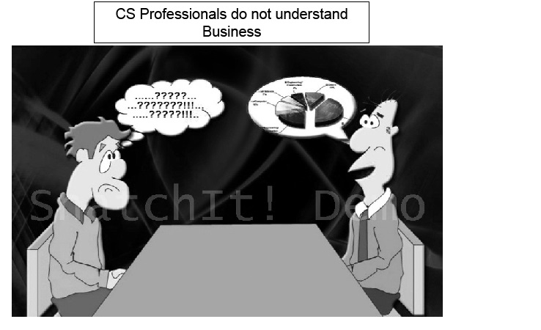
MIS
© Moez Limayem 2006

Slide 6
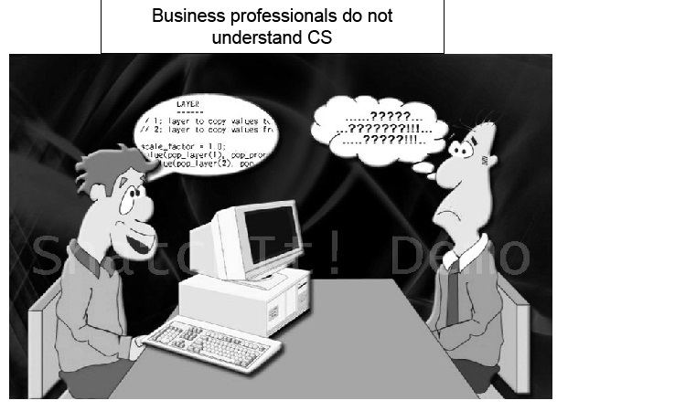
MIS
© Moez Limayem 2006

Slide 7
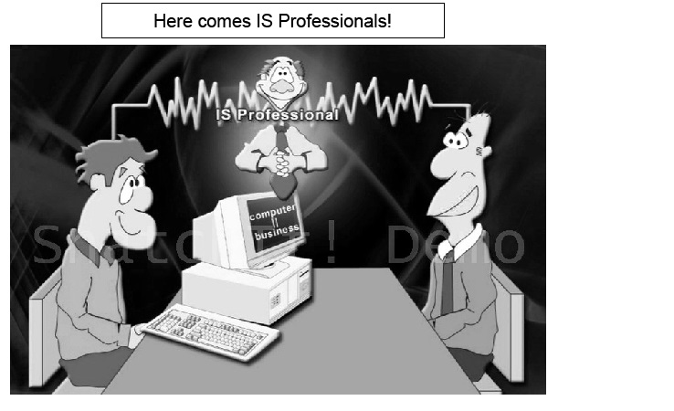
MIS
© Moez Limayem 2006

Slide 8
MIS
Careers in MIS
  Offered as Computer Science subject to business students
  Completing Masters degree in MIS has benefits
  Companies: Insurance, telecommunications, financial services, education, medical, non profit organizations
  Rise in demand for IS personnel
  Profile: data communication analysts, system analyst, consultants, quality assurance managers, database administrators, system security analyst, IS auditor
  Skills: technical skills, written verbal communication, understanding of organizations, ability to work with people/ in groups
  CISA, CISSP

Slide 9
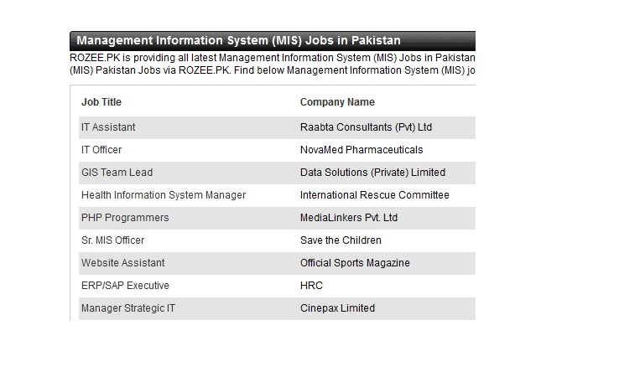
MIS

Slide 10
Learning Outcomes
Have understanding of the Information Systems and its associated concepts
Able to recognize the importance and use of various Information and Communication Technologies (ICTs)
Able to analyse decision making process
Have understanding of the various types of Information Systems
Have knowledge of the system development
Appreciate the social and ethical considerations of MIS within organizations

Slide 11
Course Contents
Module 1: Overview of Information Systems in Organizations
  Chapter 1: Introduction to Information Systems
  Chapter 2: How Businesses use Information Systems
Module 2: Information Technology Infrastructure
  Chapter 3: Hardware and Software
  Chapter 4: IT and Emerging Technologies
  Chapter 5: Telecommunications, Internet and Wireless technology
  Chapter 6: Databases and Information Management
  Chapter 7: Information System Security

Slide 12
Course Contents
Module 3: Business Information Systems
  Chapter 8: Electronic and Mobile Commerce
  Chapter 9: Enterprise Systems
  Chapter 10: Information and Decision Support Systems
  Chapter 11: Knowledge Management
Module 4: Systems Development
  Chapter 12: Managing Projects
  Chapter 13: Investigation and Analysis
  Chapter 14: Systems Development Cycle
Module 5: IS in Business and Society
  Chapter 16: Social and Ethical Issues in IS

Slide 13
Assignments
4 assignments per semester
10% of total marks
Content:
  Detailed questions
  Internet Search

Slide 14
Quiz
4 quizzes per semester
10% of total marks
Multiple choice
Content:
  Lectures
  Case Studies

Slide 15
Graded Discussion Points
Based on Case Studies
  Required to read and understand the case study
  Discuss on the discussion board
  Come up with possible answers to the case-study questions
Based on Lectures
  Any topic will be given to discuss further
Queries
  Ask related question for further understanding
5% of total marks

Slide 16
Sessional and Final Exams
Sessional: 25%
Final: 50%
All course included
Selected case studies

Slide 17
Summary
What is MIS
Need of MIS for business students
Future in MIS
Learning Objectives and Course Modules
Course Details

