Slide 1
Communication Networks
Lecture 9

Slide 2
Wireless Communication?
Any form of communication that does not require the transmitter and receiver to be in physical contact through guided media
Electromagnetic wave propagated through free-space
  Radar, RF, Microwave, IR, Optical
Simplex: one-way communication (e.g., radio, TV)
Half-duplex: two-way communication but not simultaneous (e.g., push-to-talk radios)
Full-duplex: two-way communication (e.g., cellular phones)
  Frequency-division duplex (FDD)
  Time-division duplex (TDD): simulated full-duplex

Slide 3
Why Use Wireless Communication?
Provides mobility
  A user can send and receive messages no matter where he/she is located
Added convenience / reduced cost
  Enables communications without adding expensive infrastructure
  Can easily setup temporary wireless LANs (disaster situations)
Developing nations use cellular telephony rather than laying wires to each home
Use resources only when sending or receiving signal

Slide 4
Wireless is Different Than Wired Why?
Noisy, time-varying channel
  BER varies by orders of magnitude
  Enviromental conditions affect transmission
Shared medium
  Other users create interference
  Must develop ways to share the channel
Bandwidth is limited
  TÜK, FCC determines the frequency allocation
  ISM band for unlicensed spectrum (902-928 MHz, 2.4-2.5 GHz, 5.725-5.875 GHz)
Requires intelligent signal processing and communications to make efficient use of limited bandwidth in error-prone environment

Slide 5
Modern Cellular Standards
First generation (1G) systems (analog)
  1979: NTT (Japan), FDMA, FM, 25 kHz channels, 870-940 MHz)
  1981: NMT (Sweden and Norway), FDMA, FM, 25 kHz, 450-470 MHz
  1983: AMPS (US), FDMA, FM, 30 kHz channels, 824-894 MHz
  1985: TACS (Europe), FDMA, FM, 25 kHz channels, 900 MHz
Second generation (2G) systems (digital)
  Supported voice and low-rate data (up to 9.6 kbps)
  1990: GSM (Europe), TDMA, GMSK, 200 kHz channels, 890-960 MHz
  1991: USDC/IS-54 (US), TDMA, π/4 DQPSK, 30 kHz channels, 824-894 MHz
  1993: IS-95 (US), CDMA, BPSK/QPSK, 1.25 MHz channels, 824-894 MHz and 1.8-2.0 GHz
  1993: CDPD (US) FHSS GMSK 30 kHz channels 824-894 Mhz
Enhanced 2G (2.5G) systems
  Increased data rates
  General Packet Radio System (GPRS): packet-based overlay to GSM, up to 171.2 kbps
  Enhanced Data rates for GSM Evolution (EDGE): modulation enhancements to GSM to support up to 180 kbps
3rd generation (3G) systems
  Up to 2 Mbps
  Internet, VoIP
  2004-2005: IMT-2000, 2000 MHz range - W-CDMA (UMTS), cdma2000, TD-SCMA
4th Generation

Slide 6
Underlying Concepts
Electromagnetics
  Antennas, wave propagation, channel modeling
Signals and systems
  Filtering, Fourier transforms, block-diagram design
Digital signal processing
  Equalization, spread-spectrum, source coding
Communications
  Modulation, noise analysis, channel capacity, channel coding

Slide 7
Enabling Technologies
Digital integrated circuits
RF generation devices (efficient power amps, sleep modes, improved oscillators, smart antennas)
Source coding (data compression)
Modulation (improved efficiency)
Multiple-access techniques (increase number of users)
Channel coding/forward error correction (improve probability of successful reception)
Software programmable radios

Slide 8
Protocol stack
Application
Source coding
Transport
Packet re-ordering (e.g., TCP)
Network
Routing (e.g., IP)
Data Link (MAC)
Error correction, encryption
Physical
Modulation, power control, filtering
Channel
Provides abstraction when designing layers

Slide 10
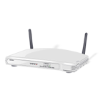
Overview of Wireless LANs
wireless transmission medium
issues of high prices, low data rates, occupational safety concerns, & licensing requirements now addressed
key application areas:
  LAN extension
  cross-building interconnect
  nomadic access
  ad hoc networking
Notes:
A wireless LAN makes use of a wireless transmission medium. Until relatively recently, wireless LANs were little used. The reasons for this included high prices, low data rates, occupational safety concerns, and licensing requirements. As these problems have been addressed, the popularity of wireless LANs has grown rapidly.
[PAHL95] lists four application areas for wireless LANs: LAN extension, cross-building interconnect, nomadic access, and ad hoc networks.

Slide 11
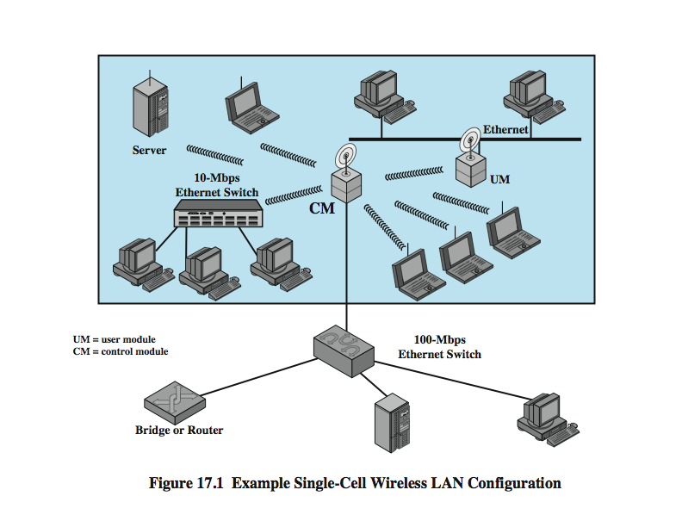
Single Cell LAN Extension
Notes:
Early wireless LAN products, introduced in the late 1980s, were marketed as substitutes for traditional wired LANs. A wireless LAN saves the cost of the installation of LAN cabling and eases the task of relocation and other modifications to network structure. However, this motivation for wireless LANs was overtaken by events. First, as awareness of the need for LANs became greater, architects designed new buildings to include extensive prewiring for data applications. Second, with advances in data transmission technology, there is an increasing reliance on twisted pair cabling for LANs. Most buildings are now wired with an abundance of data-grade cable, and many newer buildings are prewired with Category 5. Thus, the use of a wireless LAN to replace wired LANs has not happened to any great extent.
However, in a number of environments, there is a role for the wireless LAN as an alternative to a wired LAN. Examples include buildings with large open areas, such as manufacturing plants, stock exchange trading floors, and warehouses; historical buildings with insufficient twisted pair and where drilling holes for new wiring is prohibited; and small offices where installation and maintenance of wired LANs is not economical. In all of these cases, a wireless LAN provides an effective and more attractive alternative. In most of these cases, an organization will also have a wired LAN to support servers and some stationary workstations. For example, a manufacturing facility typically has an office area that is separate from the factory floor but that must be linked to it for networking purposes. Therefore, typically, a wireless LAN will be linked into a wired LAN on the same premises. Thus, this application area is referred to as LAN extension.
Stallings DCC9e Figure 17.1 indicates a simple wireless LAN configuration that is typical of many environments. There is a backbone wired LAN, such as Ethernet, that supports servers, workstations, and one or more bridges or routers to link with other networks. In addition, there is a control module (CM) that acts as an interface to a wireless LAN. The control module includes either bridge or router functionality to link the wireless LAN to the backbone. It includes some sort of access control logic, such as a polling or token-passing scheme, to regulate the access from the end systems. Note that some of the end systems are standalone devices, such as a workstation or a server. Hubs or other user modules (UMs) that control a number of stations off a wired LAN may also be part of the wireless LAN configuration.
The configuration of Figure 17.1 can be referred to as a single-cell wireless LAN; all of the wireless end systems are within range of a single control module.

Slide 12
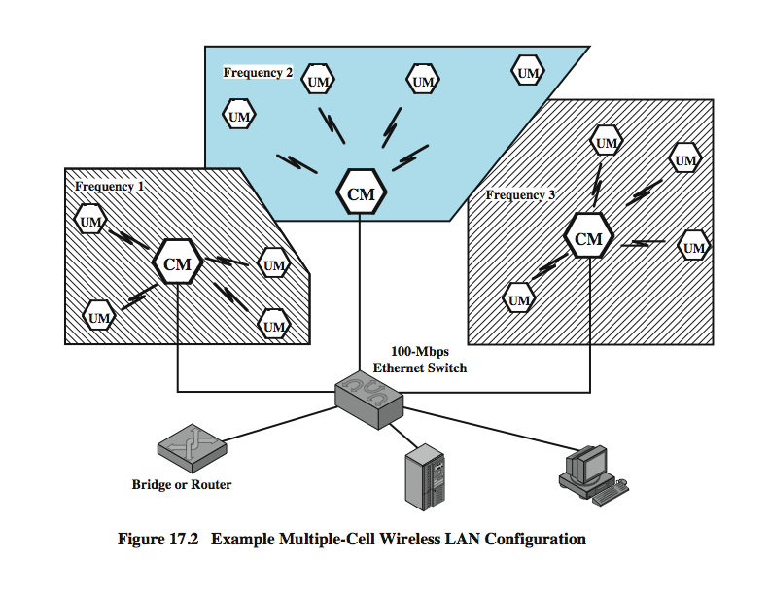
Multi Cell LAN Extension
Notes:
Another common configuration, suggested by Stallings DCC9e Figure 17.2, is a multiple-cell wireless LAN. In this case, there are multiple control modules interconnected by a wired LAN. Each control module supports a number of wireless end systems within its transmission range. For example, with an infrared LAN, transmission is limited to a single room; therefore, one cell is needed for each room in an office building that requires wireless support.

Slide 13
Nomadic Access
link LAN hub & mobile data terminal
laptop or notepad computer
enable employee to transfer data from portable computer to server
also useful in extended environment such as campus or cluster of buildings
  users move around with portable computers
  access to servers on wired LAN
Notes:
Nomadic access provides a wireless link between a LAN hub and a mobile data terminal equipped with an antenna, such as a laptop computer or notepad computer. One example of the utility of such a connection is to enable an employee returning from a trip to transfer data from a personal portable computer to a server in the office. Nomadic access is also useful in an extended environment such as a campus or a business operating out of a cluster of buildings. In both of these cases, users may move around with their portable computers and may wish access to the servers on a wired LAN from various locations.

Slide 14
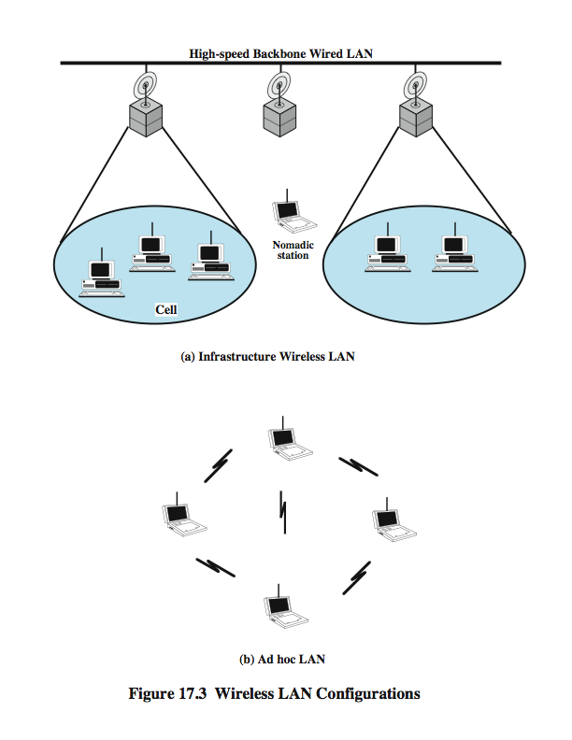
Infrastructure Wireless LAN
Notes:
Stallings DCC9e Figure 17.3 suggests the differences between a wireless LAN that supports LAN extension and nomadic access requirements and an ad hoc wireless LAN. In the former case, the wireless LAN forms a stationary infrastructure consisting of one or more cells with a control module for each cell. Within a cell, there may be a number of stationary end systems. Nomadic stations can move from one cell to another. In contrast, there is no infrastructure for an ad hoc network. Rather, a peer collection of stations within range of each other may dynamically configure themselves into a temporary network.

Slide 15
Ad Hoc Networking
temporary peer-to-peer network
Notes:
An ad hoc network is a peer-to-peer network (no centralized server) set up temporarily to meet some immediate need. For example, a group of employees, each with a laptop or palmtop computer, may convene in a conference room for a business or classroom meeting. The employees link their computers in a temporary network just for the duration of the meeting.
Stallings DCC8e Figure 17.3 suggests the differences between a wireless LAN that supports LAN extension and nomadic access requirements and an ad hoc wireless LAN. In contrast to the previous slide, there is no infrastructure for an ad hoc network. Rather, a peer collection of stations within range of each other may dynamically configure themselves into a temporary network.

Slide 16
Wireless LAN Requirements
THROUGHPUT – should make efficient use of medium
NUMBER OF NODES- hundreds of nodes across multiple cells
CONNECTION TO BACKBONE LAN – use of control modules
SERVICE AREA – coverage area of 100 to 300m
BATTERY POWER CONSUMPTION – reduce power consumption while not in use
TRANSMISSION ROBUST AND SECURITY– reliability and privacy/security
COLLOCATED NETWORK OPERATION – possible interference between LANs
LICENSE-FREE OPERATION – not having to secure a license for the frequency band used by the LAN
HANDOFF/ROAMING– enable stations to move from one cell to another
DYNAMIC CONFIGURATION- addition, deletion, relocation of end systems without disruption
Notes:
A wireless LAN must meet the same sort of requirements typical of any LAN, including high capacity, ability to cover short distances, full connectivity among attached stations, and broadcast capability. In addition, there are a number of requirements specific to the wireless LAN environment. The following are among the most important requirements for wireless LANs:
Throughput: The medium access control protocol should make as efficient use as possible of the wireless medium to maximize capacity.
Number of nodes: Wireless LANs may need to support hundreds of nodes across multiple cells.
Connection to backbone LAN: In most cases, interconnection with stations on a wired backbone LAN is required. For infrastructure wireless LANs, this is easily accomplished through the use of control modules that connect to both types of LANs. There may also need to be accommodation for mobile users and ad hoc wireless networks.
Service area: A typical coverage area for a wireless LAN has a diameter of 100 to 300 m.
Battery power consumption: Mobile workers use battery-powered workstations that need to have a long battery life when used with wireless adapters. This suggests that a MAC protocol that requires mobile nodes to monitor access points constantly or engage in frequent handshakes with a base station is inappropriate. Typical wireless LAN implementations have features to reduce power consumption while not using the network, such as a sleep mode.
Transmission robustness and security: Unless properly designed, a wireless LAN may be especially vulnerable to interference and eavesdropping. The design of a wireless LAN must permit reliable transmission even in a noisy environment and should provide some level of security from eavesdropping.
Collocated network operation: As wireless LANs become more popular, it is quite likely for two or more wireless LANs to operate in the same area or in some area where interference between the LANs is possible. Such interference may thwart the normal operation of a MAC algorithm and may allow unauthorized access to a particular LAN.
License-free operation: Users would prefer to buy and operate wireless LAN products without having to secure a license for the frequency band used by the LAN.
Handoff/roaming: The MAC protocol used in the wireless LAN should enable mobile stations to move from one cell to another.
Dynamic configuration: The MAC addressing and network management aspects of the LAN should permit dynamic and automated addition, deletion, and relocation of end systems without disruption to other users.

Slide 17
Infrastructure Wireless LAN
Notes:
Stallings DCC9e Figure 17.3 suggests the differences between a wireless LAN that supports LAN extension and nomadic access requirements and an ad hoc wireless LAN. In the former case, the wireless LAN forms a stationary infrastructure consisting of one or more cells with a control module for each cell. Within a cell, there may be a number of stationary end systems. Nomadic stations can move from one cell to another. In contrast, there is no infrastructure for an ad hoc network. Rather, a peer collection of stations within range of each other may dynamically configure themselves into a temporary network.

Slide 19
Types of Communication Networks
Traditional
  Traditional local area network (LAN)
  Traditional wide area network (WAN)
Higher-speed
  High-speed local area network (LAN)
  Metropolitan area network (MAN)
  High-speed wide area network (WAN)

Slide 20
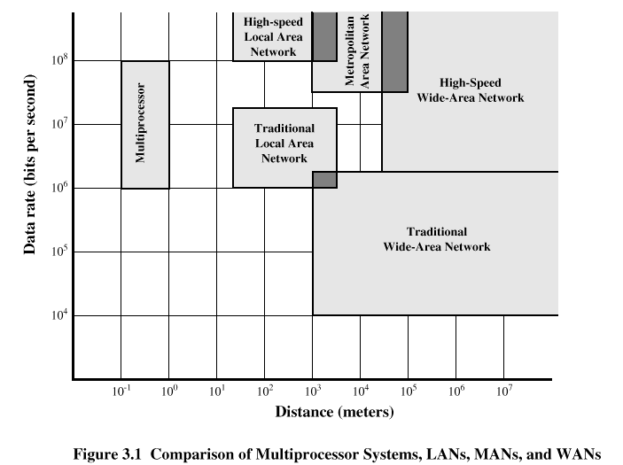
Speed and Distance of Communications Networks

Slide 21
Characteristics of WANs
Covers large geographical areas
Circuits provided by a common carrier
Consists of interconnected switching nodes
Traditional WANs provide modest capacity
  64000 bps common
  Business subscribers using T-1 service – 1.544 Mbps common
Higher-speed WANs use optical fiber and transmission technique known as asynchronous transfer mode (ATM)
  10s and 100s of Mbps common

Slide 22
Characteristics of LANs
Like WAN, LAN interconnects a variety of devices and provides a means for information exchange among them
Traditional LANs
  Provide data rates of 1 to 20 Mbps
High-speed LANS
  Provide data rates of 100 Mbps to 1 Gbps

Slide 23
Differences between LANs and WANs
Scope of a LAN is smaller
  LAN interconnects devices within a single building or cluster of buildings
LAN usually owned by organization that owns the attached devices
  For WANs, most of network assets are not owned by same organization
Internal data rate of LAN is much greater

Slide 24
Switching Terms
Switching Nodes:
  Intermediate switching device that moves data
  Not concerned with content of data
Stations:
  End devices that wish to communicate
  Each station is connected to a switching node
Communications Network:
  A collection of switching nodes

Slide 25
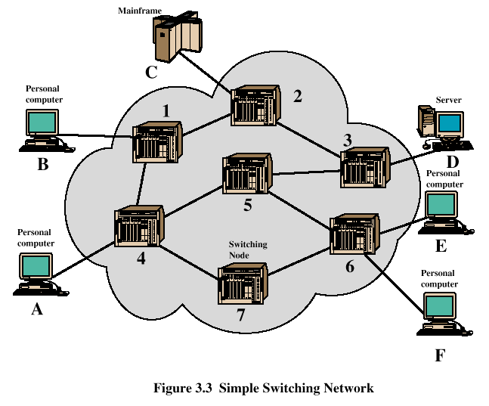
Switched Network

Slide 26
Observations of the Network
Some nodes connect only to other nodes (e.g., 5 and 7)
Some nodes connect to one or more stations
Node-node links usually multiplexed links
  Frequency-division multiplexing (FDM)
  Time-division multiplexing (TDM)
Not a direct link between every node pair

Slide 27
Techniques Used in Switched Networks
Circuit switching
  Dedicated communications path between two stations
  E.g., public telephone network
Packet switching
  Message is broken into a series of packets
  Each node determines next leg of transmission for each packet

Slide 28
Phases of Circuit Switching
Circuit establishment
  An end to end circuit is established through switching nodes
Information Transfer
  Information transmitted through the network
  Data may be analog voice, digitized voice, or binary data
Circuit disconnect
  Circuit is terminated
  Each node deallocates dedicated resources

Slide 29
Characteristics of Circuit Switching
Can be inefficient
  Channel capacity dedicated for duration of connection
  Utilization not 100%
  Delay prior to signal transfer for establishment
Once established, network is transparent to users
Information transmitted at fixed data rate with only propagation delay

Slide 30
Components of Public Telecommunications Network
Subscribers - devices that attach to the network; mostly telephones
Subscriber line - link between subscriber and network
  Also called subscriber loop or local loop
Exchanges - switching centers in the network
  A switching centers that support subscribers is an end office
Trunks - branches between exchanges

Slide 31
Circuit Switching

Slide 32
How Packet Switching Works
Data is transmitted in blocks, called packets
Before sending, the message is broken into a series of packets
  Typical packet length is 1000 octets (bytes)
  Packets consists of a portion of data plus a packet header that includes control information
At each node en route, packet is received, stored briefly and passed to the next node

Slide 33
The Use of Packets

Slide 34
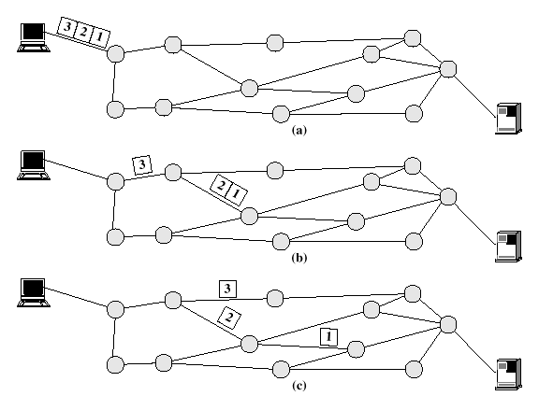
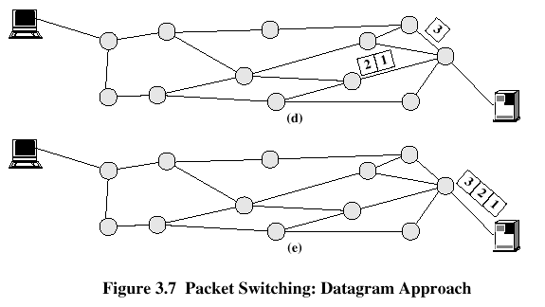
Packet Switching

Slide 35
Packet Switching Advantages
Line efficiency is greater
  Many packets over time can dynamically share the same node to node link
Packet-switching networks can carry out data-rate conversion
  Two stations with different data rates can exchange information
Unlike circuit-switching networks that block calls when traffic is heavy, packet-switching still accepts packets, but with increased delivery delay
Priorities can be used

Slide 36
Disadvantages of Packet Switching
Each packet switching node introduces a delay
Overall packet delay can vary substantially
  This is referred to as jitter
  Caused by differing packet sizes, routes taken and varying delay in the switches
Each packet requires overhead information
  Includes destination and sequencing information
  Reduces communication capacity
More processing required at each node

Slide 37
Packet Switching Networks - Datagram
Each packet treated independently, without reference to previous packets
Each node chooses next node on packet’s path
Packets don’t necessarily follow same route and may arrive out of sequence
Exit node restores packets to original order
Responsibility of exit node or destination to detect loss of packet and how to recover

Slide 38
Packet Switching Networks – Datagram
Advantages:
  Call setup phase is avoided
  Because it’s more primitive, it’s more flexible
  Datagram delivery is more reliable

Slide 39
Packet Switching Networks – Virtual Circuit
Preplanned route established before packets sent
All packets between source and destination follow this route
Routing decision not required by nodes for each packet
Emulates a circuit in a circuit switching network but is not a dedicated path
  Packets still buffered at each node and queued for output over a line

Slide 40
Packet Switching Networks – Virtual Circuit
Advantages:
  Packets arrive in original order
  Packets arrive correctly
  Packets transmitted more rapidly without routing decisions made at each node

Slide 41
Datagram versus Virtual Circuit

Slide 43
Summary
Wireless Communication…Why ?
Wired Vs. Wireless
Enabling Technologies
Wireless Protocols Layers
Wireless Lane
Types of Communication Networks
Packet Switching Vs. Circuit Switching

