Slide 1
TRANSMISSION FUNDAMENTALS
Recap Questions/Solutions
Lecture 8

Slide 2
Overview
Frequency and Period Relationship
Representation of a signal by sinusoids
Frequency and Wavelength Relationship
Amplitude, Frequency and Phase
Decomposition of a Signal
Sinusoidal Signal Period
Periodicity in Case of Linear Combination of two Signals
Signal Harmonics Elimination (higher order or lower order)
Channel Capacity Computation
Shannon Formula and Nyquist Criterion
Signal to Noise Ratio

Slide 3
Frequency Period Relationship
Q-: A signal has a fundamental frequency of 1000 Hz. What is its period?

Slide 4

Frequency Period Relationship
Note
According to Fourier analysis, any composite signal is a combination of simple sine waves with different frequencies, amplitudes, and phases.

Slide 5
Frequency Domain Concepts
Signal is made up of many frequencies
Components are sine waves
Fourier analysis can show that any signal is made up of component sine waves
Can plot frequency domain functions
Notes:
In practice, an electromagnetic signal will be made up of many frequencies. It can be shown, using a discipline known as Fourier analysis, that any signal is made up of components at various frequencies, in which each component is a sinusoid. By adding together enough sinusoidal signals, each with the appropriate amplitude, frequency, and phase, any electromagnetic signal can be constructed.

Slide 6
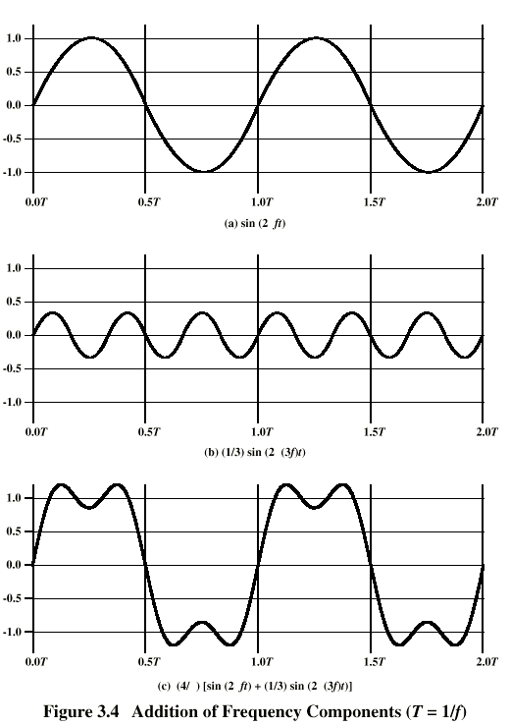
Addition of
Frequency
Components
(T=1/f)
c is sum of f & 3f (with different amplitudes)
Notes:
In Stallings DCC8e Figure 3.4c, the components of this signal are just sine waves of frequencies f and 3f, as shpwn in parts (a) and (b).

Slide 7
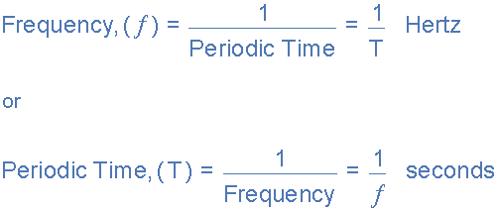
Frequency Period Relationship
Q-1: A signal has a fundamental frequency of 1000 Hz. What is its period?

Slide 8
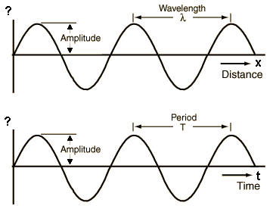
Frequency Period Relationship
Q-1: A signal has a fundamental frequency of 1000 Hz. What is its period?
Sol:
Period = 1/1000 = 0.001 s = 1 ms.

Slide 10
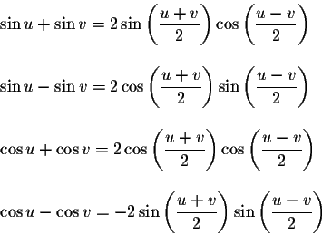
Q: Express the following in the simplest form you can:
a. sin(2π.ft - π) + sin(2π.ft + π)
b . sin 2πft + sin(2πft - π)
Sol:
a: -2 sin (2πft)

Slide 11
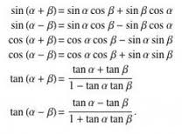
Q: Express the following in the simplest form you can:
a. sin(2π.ft - π) + sin(2π.ft + π)
b . sin 2πft + sin(2πft - π)
Sol:
b. sin (2πft) + sin (2πft – π) = 0.

Slide 13

Frequency Wavelength Relationship
Q: Sound may be modeled as sinusoidal functions. Compare the wavelength and relative frequency of musical notes. Use 330 m/s as the speed of sound and the following frequencies for the musical scale.

Slide 14
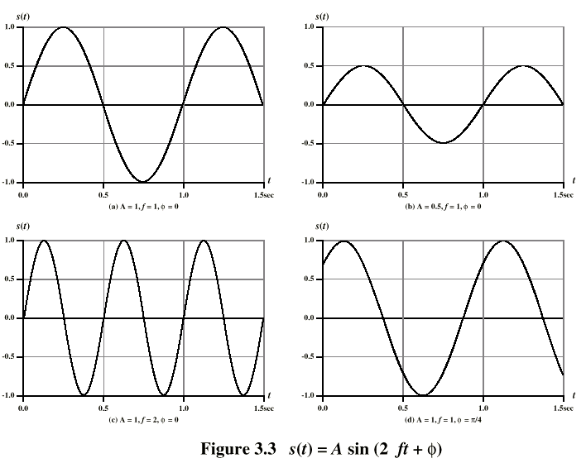
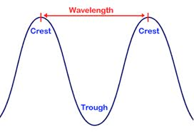
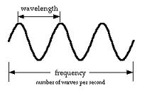
Wavelength
The relationship is λf = v, where λ is the wavelength, f is the frequency, and v is the speed at which the signal is traveling.

Slide 15
Frequency Wavelength Relationship
Q: Sound may be modeled as sinusoidal functions. Compare the wavelength and relative frequency of musical notes. Use 330 m/s as the speed of sound and the following frequencies for the musical scale.
The relationship is λf = v, where λ is the wavelength, f is the frequency, and v is the speed at which the signal is traveling.

Slide 16
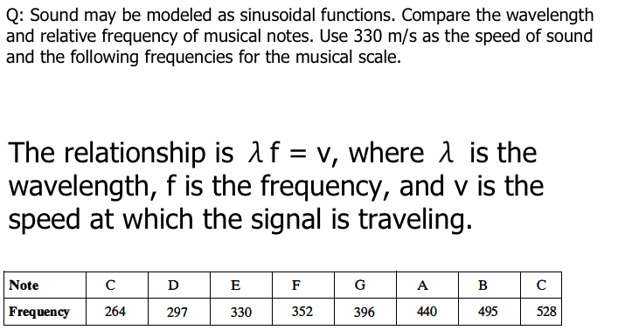
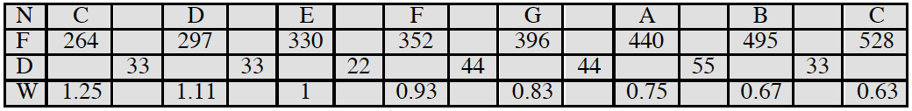
Frequency Wavelength Relationship
N = note; F = frequency (Hz); D = frequency difference; W = wavelength (m)

Slide 18
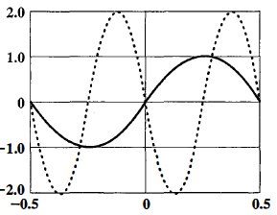
Amplitude, Frequency and Phase
Q: If the solid curve in Figure below represents sin(2πt) , what does the dotted curve represent? That is, the dotted curve can be written in the form A sin(2πft + Φ); what are A, f, and Φ?

Slide 19
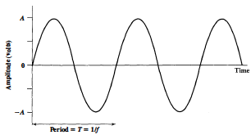
Amplitude, Frequency and Phase
Sine Wave
Peak amplitude (A)
  maximum strength of signal
  Volts
Frequency (f)
  rate of change of signal
  Hertz (Hz) or cycles per second
  period = time for one repetition (T)
  T = 1/f
Phase (φ)
  relative position in time
Notes:
The sine wave is the fundamental periodic signal. A general sine wave can be represented by three parameters:
peak amplitude (A) - the maximum value or strength of the signal over time; typically measured in volts.
frequency (f) - the rate [in cycles per second, or Hertz (Hz)] at which the signal repeats. An equivalent parameter is the period (T) of a signal, so T = 1/f.
phase (φ) - measure of relative position in time within a single period of a signal, illustrated subsequently

Slide 20
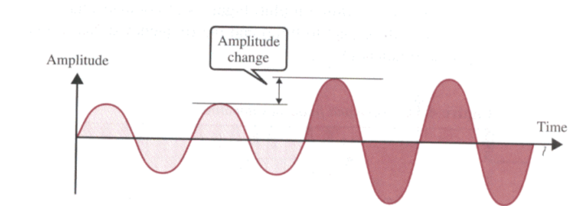
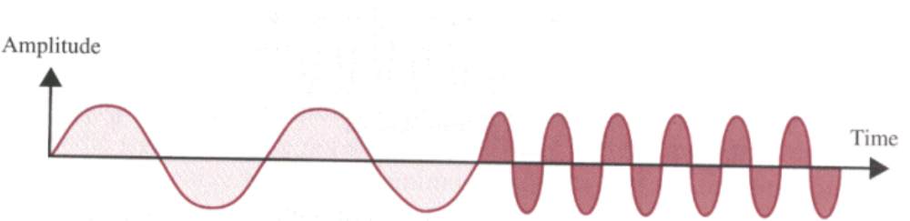
Amplitude, Frequency
Amplitude Change
Frequency Change

Slide 21
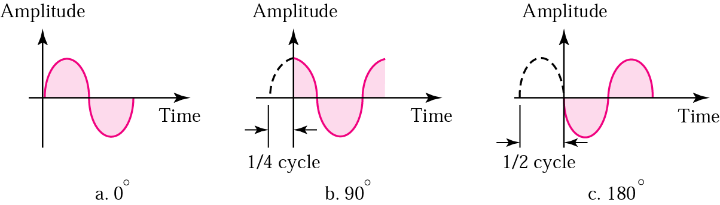
Phase
The term phase describes the position of the waveform relative to time zero.
The phase is measured in degrees or radians (360 degrees is 2π radians)

Slide 22
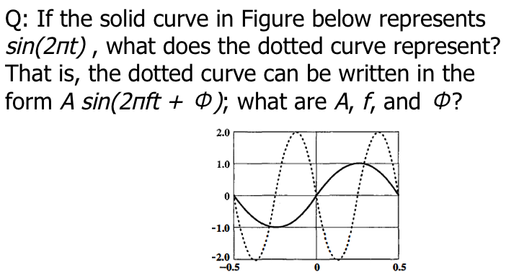
Amplitude, Frequency and Phase
A:2 sin(4πt +π ); A = 2, f = 2, φ = πt

Slide 24
Decomposition of a Signal
Q: Decompose the signal
(1 + 0.1 cos 5t) cos 100t
into a linear combination of sinusoidal function, and find the amplitude, frequency, and phase of each component.
Ans:
(1 + 0.1 cos 5t) cos 100t = cos 100t + 0.1 cos 5t cos 100t.
From the trigonometric identity
cos a cos b = 1/2[cos(a + b) + cos(a – b)],
this equation can be rewritten as the linear combination of three sinusoids:
cos 100t + 0.05 cos 105t + 0.05 cos 95

Slide 26

Sinusoidal Signal Period
Q: Find the period of the function f(t) = ( 10 cos t)²
Ans: Since
We have
cos²x = cos x cos x = ½[cos(2x) + cos(0)] = ½[cos(2x) + 1]. Then:
f(t) = (10 cos t)² = 100 cos²t = 50 + 50 cos(2t).
The period of cos(2t) is π and therefore the period of f(t) is π

Slide 28
Periodicity in Case of Linear Combination of two Signals
Q: Consider two periodic functions f₁ (t) and f₂ (t) , with periods T₁ and T₂, respectively. Is it always the case that the function f(t) = f₁( t) + f₂(t) is periodic? If so, demonstrate this fact. If not, under what conditions is f(t) periodic?

Slide 29
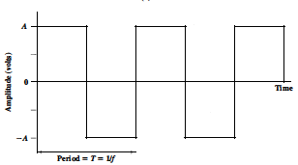
Periodic Signal (Time Domain Concepts)
Periodic signal in which the same signal pattern repeats over time
(a) Sine wave
(b) Square wave
Examples of Periodic Signals
Mathematically, a signal s(t) is defined to be periodic if and only if
where the constant T is the period of the signal ( T is the smallest value that satisfies the equation) .

Slide 30
Periodicity in Case of Linear Combination of two Signals
Suppose that we let a positive pulse represent binary 0 and a negative pulse represent binary 1. Then the waveform represents the binary stream 0101. . . . The duration of each pulse is 1/(2f); thus the data rate is 2f bits per second (bps).
What are the frequency components
of this signal
By adding together sine waves at frequencies f and 3f, we get a waveform that begins to resemble the square wave.

Slide 31
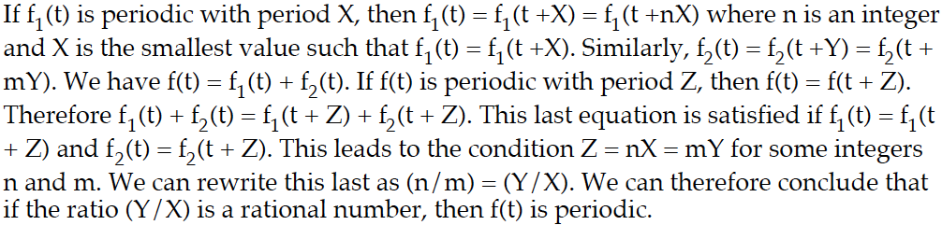
Periodicity in case of Linear Combination of two Signals
Q: Consider two periodic functions f₁ (t) and f₂ (t) , with periods T₁ and T₂ respectively. Is it always the case that the function f(t) = f₁( t) + f₂(t) is periodic? If so, demonstrate this fact. If not, under what conditions is f(t) periodic?
Ans:

Slide 33
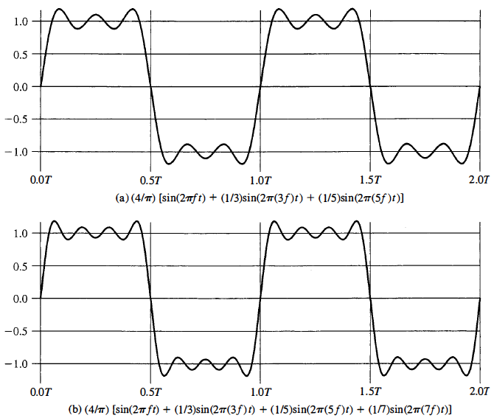
Signal Harmonics Elimination
Q: Figure shows the effect of eliminating higher-harmonic components of a square wave and retaining only a few lower harmonic components. What would the signal look like in the opposite case; that is, retaining all higher harmonics and eliminating a few lower harmonics?

Slide 34
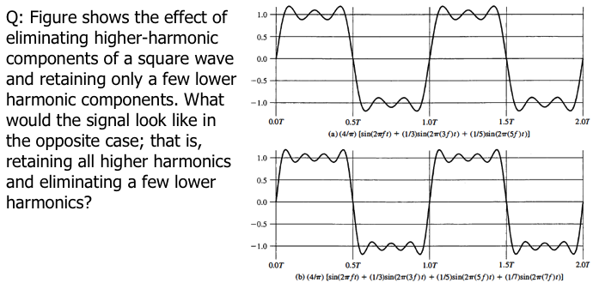
Harmonics Elimination
Ans: The signal would be a low-amplitude, rapidly changing waveform.

Slide 36
Channel Capacity
Q: What is the channel capacity for a teleprinter channel with a 300-Hz bandwidth and a signal-to-noise ratio of 3 dB

Slide 37
Channel Capacity
maximum possible data rate on a communication channel
  data rate - in bits per second
  bandwidth - in cycles per second or Hertz
  noise - on communication link
  error rate - of corrupted bits
limitations due to physical properties
want most efficient use of capacity
Notes:
The maximum rate at which data can be transmitted over a given communication channel, under given conditions, is referred to as the channel capacity. There are four concepts here that we are trying to relate to one another.
• Data rate, in bits per second (bps), at which data can be communicated
• Bandwidth, as constrained by the transmitter and the nature of the transmission medium, expressed in cycles per second, or Hertz
• Noise, average level of noise over the communications path
• Error rate, at which errors occur, where an error is the reception of a 1 when a 0 was transmitted or the reception of a 0 when a 1 was transmitted
All transmission channels of any practical interest are of limited bandwidth, which arise from the physical properties of the transmission medium or from deliberate limitations at the transmitter on the bandwidth to prevent interference from other sources. Want to make as efficient use as possible of a given bandwidth. For digital data, this means that we would like to get as high a data rate as possible at a particular limit of error rate for a given bandwidth. The main constraint on achieving this efficiency is noise.

Slide 38
Shannon Capacity Formula
considers relation of data rate, noise & error rate
  faster data rate shortens each bit so bursts of noise affects more bits
  given noise level, higher signal strength means lower errors
Shannon developed formula relating these to signal to noise ratio (in decibels)
SNR_{db}⁼10 log₁₀ (signal/noise)
Capacity C=B log₂(1+SNR)
  theoretical maximum capacity
  get lower in practice
Notes:
Consider the relationship among data rate, noise, and error rate. The presence of noise can corrupt one or more bits. If the data rate is increased, then the bits become "shorter" so that more bits are affected by a given pattern of noise. Mathematician Claude Shannon developed a formula relating these. For a given level of noise, expect that a greater signal strength would improve the ability to receive data correctly in the presence of noise. The key parameter involved is the signal-to-noise ratio (SNR, or S/N), which is the ratio of the power in a signal to the power contained in the noise that is present at a particular point in the transmission. Typically, this ratio is measured at a receiver, because it is at this point that an attempt is made to process the signal and recover the data. For convenience, this ratio is often reported in decibels. This expresses the amount, in decibels, that the intended signal exceeds the noise level. A high SNR will mean a high-quality signal and a low number of required intermediate repeaters.
The signal-to-noise ratio is important in the transmission of digital data because it sets the upper bound on the achievable data rate. Shannon's result is that the maximum channel capacity, in bits per second, obeys the equation shown. C is the capacity of the channel in bits per second and B is the bandwidth of the channel in Hertz. The Shannon formula represents the theoretical maximum that can be achieved. In practice, however, only much lower rates are achieved, in part because formula only assumes white noise (thermal noise).

Slide 39
Channel Capacity
Q: What is the channel capacity for a teleprinter channel with a 300-Hz bandwidth and a signal-to-noise ratio of 3 dB
Sol: Using Shannon's equation:
C = B log₂ (1 + SNR)
We have
W = 300 Hz (SNR)_{dB} = 3
Therefore,
SNR = 100^{0.3}
C = 300 log₂ (1 + 100^{0.3}) = 300 log₂ (2.995) = 474 bps

Slide 41
Data Rate (Given), Bandwidth???.
Q: A digital signaling system is required to operate at 9600 bps.
a. If a signal element encodes a 4-bit word, what is the minimum required bandwidth of the channel?
b. Repeat part (a) for the case of 8-bit words.

Slide 42
Two Formulas
Problem: given a bandwidth, what data rate can we achieve?
Nyquist Formula
  Assume noise free
Shannon Capacity Formula
  Assume white noise

Slide 43
Nyquist Formula
Assume a channel is noise free.
Nyquist formulation: if the rate of signal transmission is 2B, then a signal with frequencies no greater than B is sufficient to carry the signal rate.
  Given bandwidth B, highest signal rate is 2B.
Why is there such a limitation?
  due to intersymbol interference, such as is produced by delay distortion.
Given binary signal (two voltage levels), the maximum data rate supported by B Hz is 2B bps.
  One signal represents one bit

Slide 44
Nyquist Formula
Signals with more than two levels can be used, i.e., each signal element can represent more than one bit.
  E.g., if a signal has 4 different levels, then a signal can be used to represents two bits: 00, 01, 10, 11
With multilevel signaling, the Nyquist formula becomes:
  C = 2B log₂M
  M is the number of discrete signal levels, B is the given bandwidth, C is the channel capacity in bps.
  How large can M be?
    The receiver must distinguish one of M possible signal elements.
    Noise and other impairments on the transmission line will limit the practical value of M.
Nyquist’s formula indicates that, if all other things are equal, doubling the bandwidth doubles the data rate.

Slide 45
Data Rate (Given), Bandwidth???.
Q: A digital signaling system is required to operate at 9600 bps.
a. If a signal element encodes a 4-bit word, what is the minimum required bandwidth of the channel?
b. Repeat part (a) for the case of 8-bit words.
Ans: Using Nyquist's equation:
C = 2B log₂ M
We have
C = 9600 bps
a. log₂ M = 4, because a signal element encodes a 4-bit word
Therefore,
C = 9600 = 2B x 4, and
B = 1200 Hz
b. 9600 = 2B x 8, and B = 600 Hz

Slide 47
Shannon and Nyquist Channel Capacity Formulas
Q: Study the works of Shannon and Nyquist on channel capacity. Each places an upper limit on the bit rate of a channel based on two different approaches. How are the two related?

Slide 48
Shannon Capacity Formula
Now consider the relationship among data rate, noise, and error rate.
Faster data rate shortens each bit, so burst of noise affects more bits
  At given noise level, higher data rate results in higher error rate
All of these concepts can be tied together neatly in a formula developed by Claude Shannon.
  For a given level of noise, we would expect that a greater signal strength would improve the ability to receive data correctly.
  The key parameter is the SNR: Signal-to-Noise Ratio, which is the ratio of the power in a signal to the power contained in the noise.
  Typically, SNR is measured at receiver, because it is the receiver that processes the signal and recovers the data.
For convenience, this ratio is often reported in decibels
  SNR = signal power / noise power
  SNR_{db}⁼ 10 log₁₀ (SNR)

Slide 49
Shannon Capacity Formula
Shannon Capacity Formula:
  C = B log₂(1+SNR)
  Only white noise is assumed. Therefore it represents the theoretical maximum that can be achieved.
This is referred to as error-free capacity.
Some remarks:
  Given a level of noise, the data rate could be increased by increasing either signal strength or bandwidth.
  As the signal strength increases, so do the effects of nonlinearities in the system which leads to an increase in intermodulation noise.
  Because noise is assumed to be white, the wider the bandwidth, the more noise is admitted to the system. Thus, as B increases, SNR decreases.

Slide 50
Shannon and Nyquist Channel Capacity Formulas
Q: Study the works of Shannon and Nyquist on channel capacity. Each places an upper limit on the bit rate of a channel based on two different approaches. How are the two related?
Ans: Nyquist analyzed the theoretical capacity of a noiseless channel; therefore, in that case, the signaling rate is limited solely by channel bandwidth. Shannon addressed the question of what signaling rate can be achieved over a channel with a given bandwidth, a given signal power, and in the presence of noise.

Slide 52
Theoretical and Actual Channel Capacity
Q: Given the narrow (usable) audio bandwidth of a telephone transmission facility, a nominal SNR of 56dB (400,000), and a distortion level of <0.2 % ,
a. What is the theoretical maximum channel capacity (Kbps) of traditional telephone lines?
b. What is the actual maximum channel capacity

Slide 53
Putting it Altogether
spectrum
range of frequencies contained in signal
absolute bandwidth
width of spectrum
often just bandwidth
effective bandwidth
narrow band of frequencies containing most energy
dc component
component of zero frequency
Notes:
The spectrum of a signal is the range of frequencies that it contains. For the signal of Stallings DCC9e Figure 3.4c, the spectrum extends from f to 3f. The absolute bandwidth of a signal is the width of the spectrum. In the case of Stallings DCC9e Figure 3.4c, the bandwidth is 3f – f = 2f. Many signals, such as that of Figure 3.5b, have an infinite bandwidth. However, most of the energy in the signal is contained in a relatively narrow band of frequencies. This band is referred to as the effective bandwidth, or just bandwidth.
One final term to define is dc component. If a signal includes a component of zero frequency, that component is a direct current (dc) or constant component.

Slide 54
Theoretical and Actual Channel Capacity
Q: Given the narrow (usable) audio bandwidth of a telephone transmission facility, a nominal SNR of 56dB (400,000), and a distortion level of <0.2 % ,
a. What is the theoretical maximum channel capacity (Kbps) of traditional telephone lines?
b. What is the actual maximum channel capacity
Sol:
Using Shannon’s formula: C = 3000 log₂ (1+400000) = 56 Kbps
Due to the fact there is a distortion level (as well as other potentially detrimental impacts to the rated capacity, the actual maximum will be somewhat degraded from the theoretical maximum. A discussion of these relevant impacts should be included and a qualitative value discussed.

Slide 56
Signal to Noise Ratio
Q: Given a channel with an intended capacity of 20 Mbps, the bandwidth of the channel is 3 MHz. What signal-to-noise ratio is required to achieve this capacity

Slide 57
Signal to Noise Ratio(Noise)
Unwanted signals inserted between transmitter and receiver
is the major limiting factor in communications system performance

Slide 58
Signal to Noise Ratio
Q: Given a channel with an intended capacity of 20 Mbps, the bandwidth of the channel is 3 MHz. What signal-to-noise ratio is required to achieve this capacity
C = B log₂ (1 + SNR)
20 x 10⁶ = 3 x 10⁶ x log₂ (1 + SNR)
log₂ (1 + SNR) = 6.67
1 + SNR = 102
SNR = 101

Slide 60
Summary: Recap of Transmission Fundamentals via Questions and their Solutions
Frequency Period Relationship
Representation of a signal by sinusoids
Frequency Wavelength Relationship
Amplitude, Frequency and Phase
Decomposition of a Signal
Sinusoidal Signal Period
Periodicity in Case of Linear Combination of two Signals
Signal Harmonics Elimination (higher order or lower order)
Channel Capacity Computation
Shannon Formula and Nyquist Criterion
Signal to Noise Ratio

