Slide 1
TRANSMISSION FUNDAMENTALS
Review Q/A
Lecture 7

Slide 2
Overview
Transmission Media
Guided Unguided Media
Transmission Media
    Microwave Transmission
Direct Broadcast Satellite
Multiplexing
FDM TDM

Slide 3
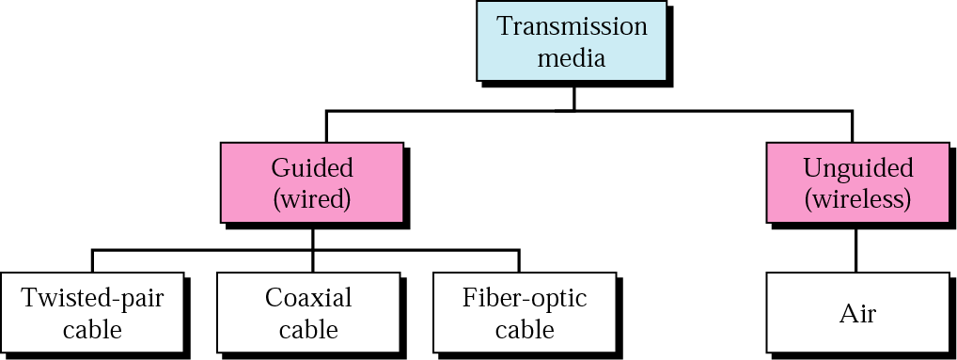
Review Question: Guided Vs. Unguided Media
Review Question: Differentiate between guided media and unguided media
Atmosphere and Outer space

Slide 4
Transmission Media
Review Question: Guided Vs. Unguided Media
The transmission medium is the physical path by which a message travels from sender to receiver.
Computers and telecommunication devices use signals to represent data.
These signals are transmitted from a device to another in the form of electromagnetic energy.
Examples of Electromagnetic energy include power, radio waves, infrared light, visible light, ultraviolet light, and X and gamma rays.
All these electromagnetic signals constitute the electromagnetic spectrum

Slide 5
Classes of Transmission Media
Review Question: Guided Vs. Unguided Media
Conducted or guided media
  use a conductor such as a wire or a fiber optic cable to move the signal from sender to receiver
Wireless or unguided media
  use radio waves of different frequencies and do not need a wire or cable conductor to transmit signals

Slide 6
Review Question: Guided Vs. Unguided Media
Review Question: Differentiate between guided media and unguided media
Atmosphere and Outer space
Review Answer: With guided media, the electromagnetic waves are guided along an enclosed physical path, whereas unguided media provide a means for transmitting electromagnetic waves through space, air, or water, but do not guide them.

Slide 8
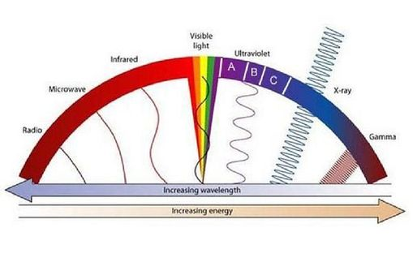
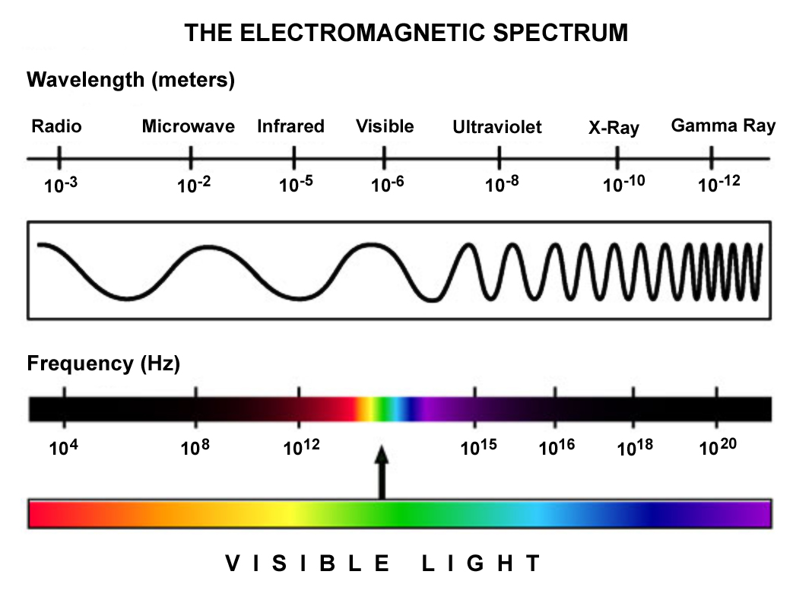
Review Question: Microwave Transmission
Review Question: What are some major advantages and disadvantages of microwave transmission?

Slide 9
Microwave Transmission Characteristics
Review Question: Microwave Transmission
Microwave transmission covers a substantial portion of the electromagnetic spectrum. Common frequencies used for transmission are in the range 2 to 40 GHz. The higher the frequency used, the higher the potential bandwidth and therefore the higher the potential data rate.
Microwave Bandwidth and Data Rates

Slide 10
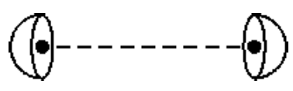
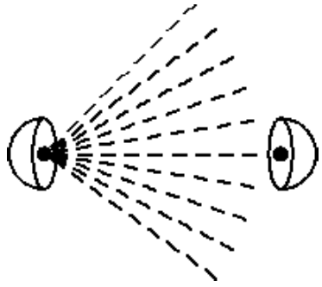
Wireless (or, Unguided) Transmission Media
Transmissions and receptions are achieved by means of an antenna and can be
Directional Point-to-point focused beams employing high frequencies.
Omnidirectional Waves propagating in all directions using signals of lower frequencies.

Slide 11

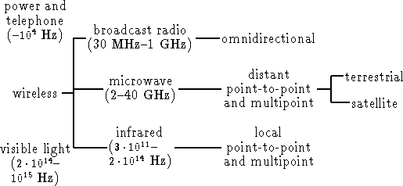
Wireless (or, Unguided) Transmission Media
Terrestrial Microwave: Microwaves bend with the curvature of the earth

Slide 12
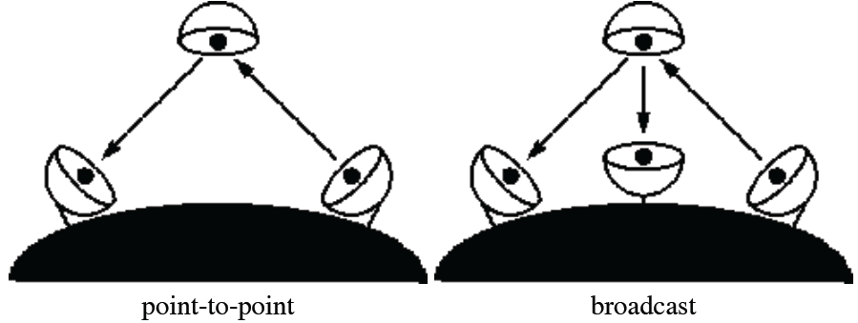
Wireless (or, Unguided) Transmission Media
Satellite Microwave: A communication satellite: Is used for link ground stations, Operates on a number of frequency bands, called transponder channels. Receives transmissions on one frequency band (uplink), and transmits on another frequency (downlink).

Slide 13
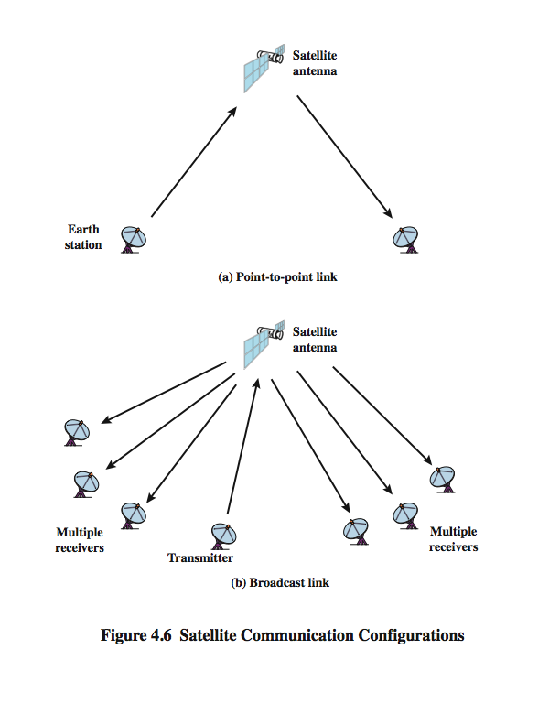
Satellite Point-to-Point Link

Slide 14
Satellite Broadcast Link

Slide 15
Microwave Transmission Characteristics
Review Question: Microwave Transmission
Review Question: What are some major advantages and disadvantages of microwave transmission?
Ans: Point-to-point microwave transmission has a high data rate and less attenuation than twisted pair or coaxial cable. It is affected by rainfall, however, especially above 10 GHz. It is also requires line of sight and is subject to interference from other microwave transmission, which can be intense in some places.

Slide 16
Advantage and Disadvantage of Microwave?
Advantages:
No cables needed
Multiple channels available
Wide bandwidth
Disadvantages:
Line-of-sight will be disrupted if any obstacle, such as new buildings, are in the way
Signal absorption by the atmosphere. Microwaves suffer from attenuation due to atmospheric conditions.
Towers are expensive to build

Slide 18
Direct Broadcast Satellite: Review Question
What is direct broadcast satellite (DBS) ?
Direct broadcast satellite (DBS) refers to satellite television (TV) systems in which the subscribers, or end users, receive signals directly from geostationary satellites. Signals are broadcast in digital format at microwave frequencies. DBS is the descendant of direct-to-home (DTH) satellite services.
A DBS subscriber installation consists of a dish antenna two to three feet (60 to 90 centimeters) in diameter, a conventional TV set, a signal converter placed next to the TV set, and a length of coaxial cable between the dish and the converter. The dish intercepts microwave signals directly from the satellite. The converter produces output that can be viewed on the TV receiver.

Slide 19
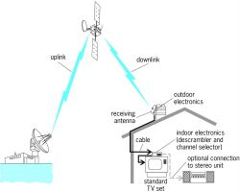
Direct Broadcast Satellite: Review Question
What is direct broadcast satellite (DBS) ?
A number of companies provide DBS and DTH service throughout the world.
The most recent application of satellite technology to television distribution is direct broadcast satellite (DBS), in which satellite video signals are transmitted directly to the home user. The dropping cost and size of receiving antennas have made DBS economically feasible, and DBS is now commonplace.

Slide 21
Satellite Uplink and Downlink: Review Question
Question: Why must a satellite have distinct uplink and downlink frequencies?
In satellite telecommunications terminology, uplink means the signal sent from Earth to the satellite
and
downlink means the signal from the satellite to earth.

Slide 22
Satellite Transmission Process
satellite
transponder
dish
dish
22,300 miles
uplink station
downlink station

Slide 23
Satellite Uplink and Downlink: Review Question
Question: Why must a satellite have distinct uplink and downlink frequencies?
Ans: A satellite must use different uplink and downlink frequencies for continuous operation in order to avoid interference
e.g. in a typical scenario Satellites use a frequency bandwidth range of 5.925 to 6.425 GHz from earth to satellite (uplink) and a range of 3.7 to 4.2 GHz from satellite to earth (downlink)
Upllnk Frequency is higher than downlink frequency

Slide 25
Broadcast Radio Vs. Microwave Review Question
Question: Indicate some significant differences between broadcast radio and microwave?
Microwave and radio waves are light waves of different lengths on the same end of the electromagnetic spectrum

Slide 26
Microwaves
These are electromagnetic waves that have a wavelength of 1mm through to 1m. They were first proved to exist in 1888 by the German scientist Heinrich Hertz.
Microwaves are used in many applcations. In communication they are used to carry the signal in wireless and Bluetooth devices. Satellite communication also uses different frequencies of microwave radiation. Satellites also use microwaves for navigation applications. The Global Positioning System (GPS) uses microwave radiation for satellite navigation systems to locate themselves. Radar systems also use microwaves to locate objects.
Microwaves are also used in cooking food. The ability of microwaves to heat food was accidentally discovered by an American engineer called Percy Spencer in the 1940s. He was testing part of radar system when he found that the chocolate bar in his pocket began to melt. He realised that the microwaves were heating up the food and could be used in the kitchen. The scientific name for this process is called dielectric heating.
Microwave radiation can damage the body - usually when the shielding on a microwave oven doesn't work properly. The escaping radiation can damage the lens in the eye causing it to lose its transparency. This is called a cataract. Basically, it is 'cooking' the proteins in the eye in the same way as a cooked egg-white changes from transparent to white.

Slide 27
Radio Waves
Radio waves have a slightly lower frequency (and a higher wavelength) than microwaves. The Ultra High Frequency (or UHF) waves are in the overlapping frequencies between microwaves and radio waves. The Very High Frequency (or VHF) waves have a lower frequency and are definitely in the radio wave spectrum. Both UHF and VHF waves are used to carry television signals. VHF has been used for many years for radio broadcasts, however, UHF signals are now being used as well in Digital Audio Broadcasting (or DAB radio).
Radio-frequency Identification (or RFID) is used in devices (often called tags) that can be tracked using suitable equipment. These tags can be used to track people, animals or used in security tags in shops.
RFID tags have been used to time the runners in races. In a marathon for example, where there are a large number of runners, it is would be impossible to time every person. But if they wear a small tag the computer can log the time that each runner takes to complete the course.
The 'chips' that are used in animal identification are RFID tags. A small tag, the size of a grain of rice, is injected under the skin of a dog, cat or horse. Each chip transmits a unique number which can be used to look up the details of that animal on a central database.
Libraries use RFID tags to keep track of the books that they own. You may have noticed a sticker placed in the inside cover of a book with a maze-like pattern in copper. This is the RFID tag.

Slide 28
Radio Vs. Microwave
Broadcast Radio Vs. Microwave Review Question
The principle difference between radio and microwave is that
radio is omnidirectional and microwave is focused.
The term "Radio" covers the FM radio and UHF and VHF
television.
Packet Radio: Uses a ground based antenna to link multiple
sites in a data transmission network.
Teletext Service: This service inserts character data in the
vertical blanking interval in a conventional TV signal.
Televisions equipped with a decoder can receive and display
the signal (Closed Caption).
Cellular Radio: A given frequency may be used by a number
of transmitters in the same area.

Slide 29
Broadcast Radio Vs. Microwave Review Question
Question: Indicate some significant differences between broadcast radio and microwave?
Broadcast is omnidirectional, does not require dish shaped antennas, and the antennas do not have to be rigidly mounted in precise alignment.

Slide 30
Multiplexing Review Question
Why is multiplexing so cost-effective?

Slide 31
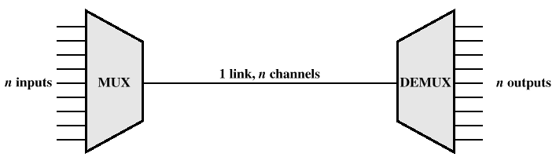
Multiplexing
In both local and wide area communications, it is almost always the case that the capacity of the transmission medium exceeds the capacity required for the transmission of a single signal. To make efficient use of the transmission system, it is desirable to carry multiple signals on a single medium. This is referred to as multiplexing

Slide 32
Reasons for Widespread Use of Multiplexing
Cost per kbps of transmission facility declines with an increase in the data rate
Cost of transmission and receiving equipment declines with increased data rate
Most individual data communicating devices require relatively modest data rate support

Slide 33
Multiplexing Techniques
Frequency-division multiplexing (FDM)
  Takes advantage of the fact that the useful bandwidth of the medium exceeds the required bandwidth of a given signal
Time-division multiplexing (TDM)
  Takes advantage of the fact that the achievable bit rate of the medium exceeds the required data rate of a digital signal

Slide 34
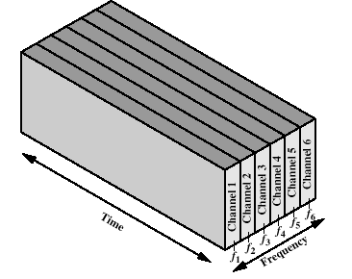
Frequency-division Multiplexing
Each signal requires a certain bandwidth centered on its carrier frequency, referred to as a channel. To prevent interference, the channels are separated by guard bands, which are unused portions of the spectrum. An example is the multiplexing of voice signals. We mentioned that the useful spectrum for voice is 300 to 3400 Hz. Thus, a bandwidth of 4 kHz is adequate to carry the voice signal and provide a guard band
Six signal sources are fed into a multiplexer that modulates each signal onto a different frequency (fi, . . . , f6). Each signal requires a certain bandwidth centered on its carrier frequency, referred to as a channel. To prevent interference, the channels are separated by guard bands, which
are unused portions of the spectrum (not shown in the figure).

Slide 35
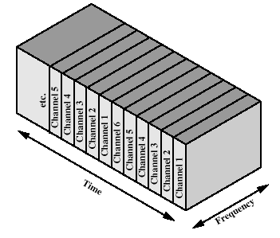
Time-division Multiplexing
TDM, referring to the fact that time slots are preassigned and fixed. Hence the timing of transmission from the various sources is synchronized. In contrast, asynchronous TDM allows time on the medium to be allocated dynamically. Unless otherwise noted, the term TDM will be used to mean synchronous TDM
TDM takes advantage of the fact that the achievable bit rate (sometimes, unfortunately, called bandwidth) of the medium exceeds the required data rate of a digital signal. Multiple digital signals can be carried on a single transmission path by interleaving portions of each signal in time.

Slide 36
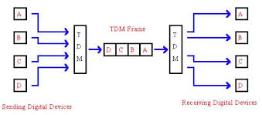
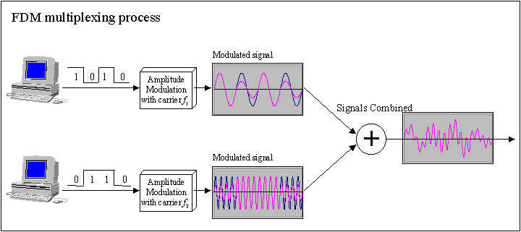
TDM and FDM

Slide 37
Multiplexing Review Question
Why is multiplexing so cost-effective?
Multiplexing is cost-effective because the higher the data rate, the more cost-effective the transmission facility.

Slide 39
Interference Avoidance By Multiplexing: Review Question
How is interference avoided by using frequency division multiplexing

Slide 40
Frequency-division Multiplexing
Each signal requires a certain bandwidth centered on its carrier frequency, referred to as a channel. To prevent interference, the channels are separated by guard bands, which are unused portions of the spectrum. An example is the multiplexing of voice signals. We mentioned that the useful spectrum for voice is 300 to 3400 Hz. Thus, a bandwidth of 4 kHz is adequate to carry the voice signal and provide a guard band
Six signal sources are fed into a multiplexer that modulates each signal onto a different frequency (fi, . . . , f6). Each signal requires a certain bandwidth centered on its carrier frequency, referred to as a channel. To prevent interference, the channels are separated by guard bands, which
are unused portions of the spectrum (not shown in the figure).

Slide 41
Interference Avoidance By Multiplexing: Review Question
How is interference avoided by using frequency division multiplexing
Interference is avoided under frequency division multiplexing by the use of guard bands, which are unused portions of the frequency spectrum between subchannels.

Slide 43
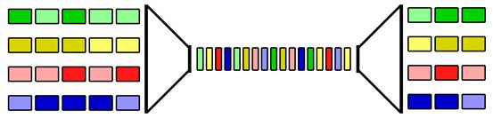
Synchronous TDM: Review Question
Explain how synchronous time division multiplexing (TDM) works

Slide 44
Synchronous TDM: Review Question
Q: Explain how synchronous time division multiplexing (TDM) works
Ans:A synchronous time division multiplexer interleaves bits from each signal and takes turns transmitting bits from each of the signals in a round-robin fashion.

Slide 45
Summary: Review Q/A with Discussion
Transmission Media
Guided Unguided Media
Transmission Media
    Microwave Transmission
Direct Broadcast Satellite
Multiplexing
FDM TDM

