Slide 1
TRANSMISSION FUNDAMENTALS
Review
Lecture 6

Slide 2
Overview
Signals for Conveying Information
    Time Domain Concepts
    Frequency Domain Concepts
    Relationship between Data Rate and Bandwidth
Analog and Digital Data Transmission
    Analog and Digital Data
    Analog and Digital Signaling
    Analog and Digital Transmission
Channel Capacity
    Nyquist Bandwidth
    Shannon Capacity Formula
Transmission Media
    Microwave Transmission

Slide 3
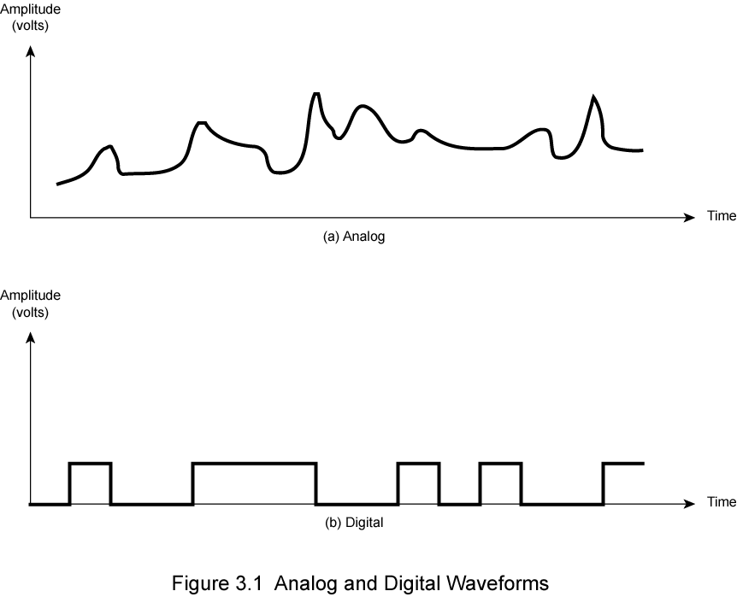
Analog and Digital
Review Question:
Differentiate between an analog and a digital electromagnetic signal.

Slide 4
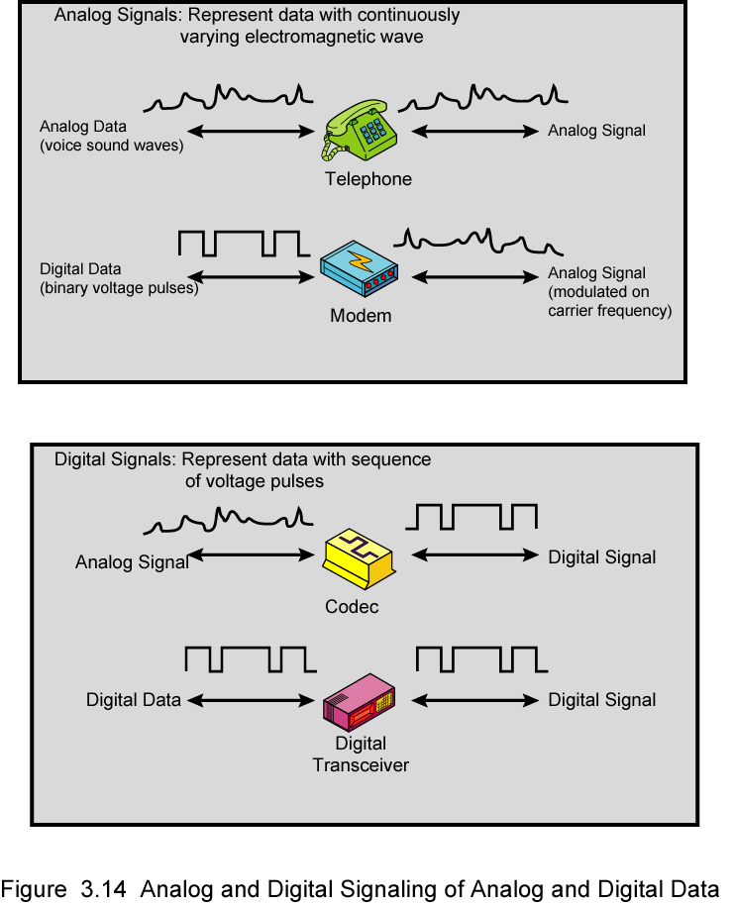
Analog Signals
Digital data, analog signal: Some transmission media, such as optical fiber and satellite, will only propagate analog signals.
Analog data, analog signal: Analog data are easily converted to an analog signal.
Notes:
Analog and Digital Signals
Stallings DCC9e Figure 3.14a shows a communications system, data are propagated from one point to another by means of electromagnetic signals. An analog signal is a continuously varying electromagnetic wave that may be propagated over a variety of media, depending on spectrum; examples are wire media, such as twisted pair and coaxial cable; fiber optic cable; and unguided media, such as atmosphere or space propagation

Slide 5
Digital Signals
Digital data, digital signal: In general, the equipment for encoding digital data into a digital signal is less complex and less expensive than digital-to analog Equipment.
Analog data, digital signal: Conversion of analog data to digital form permits the use of modern digital transmission and switching equipment for analog data.
Notes:
Data and Signals
In the foregoing discussion, we have looked at analog signals used to represent analog data and digital signals used to represent digital data. Generally, analog data are a function of time and occupy a limited frequency spectrum; such data can be represented by an electromagnetic signal occupying the same spectrum. Digital data can be represented by digital signals, with a different voltage level for each of the two binary digits.
As Stallings DCC9e Figure 3.14 illustrates, these are not the only possibilities. Digital data can also be represented by analog signals by use of a modem (modulator/demodulator). The modem converts a series of binary (two-valued) voltage pulses into an analog signal by encoding the digital data onto a carrier frequency. The resulting signal occupies a certain spectrum of frequency centered about the carrier and may be propagated across a medium suitable for that carrier. The most common modems represent digital data in the voice spectrum and hence allow those data to be propagated over ordinary voice-grade telephone lines. At the other end of the line, another modem demodulates the signal to recover the original data.
In an operation very similar to that performed by a modem, analog data can be represented by digital signals. The device that performs this function for voice data is a codec (coder-decoder). In essence, the codec takes an analog signal that directly represents the voice data and approximates that signal by a bit stream. At the receiving end, the bit stream is used to reconstruct the analog data.
Thus, Stallings DCC9e Figure 3.14 suggests that data may be encoded into signals in a variety of ways. We will return to this topic in Chapter 5.

Slide 6
Analog and Digital (Review Ans:)
Ans: A continuous or analog signal is one in which the signal intensity varies in a smooth fashion over time while a discrete or digital signal is one in which the signal intensity maintains one of a finite number of constant levels for some period of time and then changes to another constant level

Slide 7
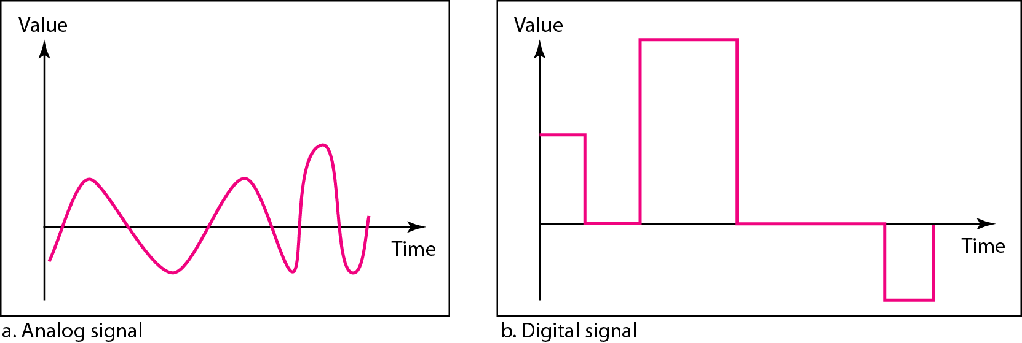
Comparison of analog and digital signals
Data can be analog or digital.
Analog data are continuous and take continuous values.
Digital data have discrete states and take discrete values.
Signals can be analog or digital.
Analog signals can have an infinite number of values in a range.
Digital signals can have only a limited number of values.

Slide 8
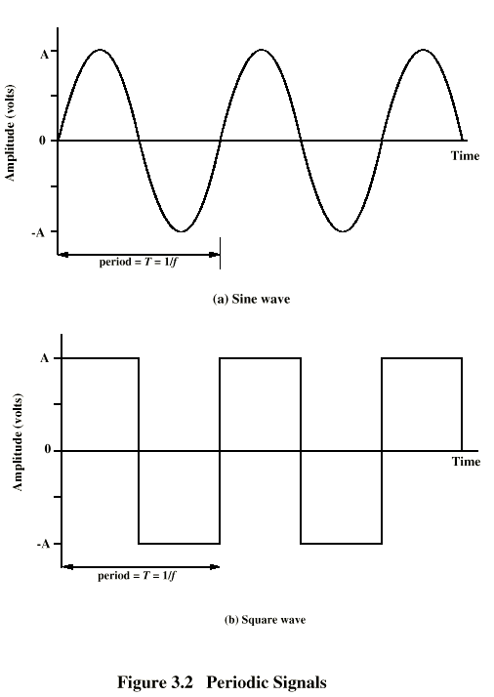
Periodic Signal (Review Question)
Review Question
What are three important characteristics of a periodic signal?
Periodic analog signals can be classified as simple or composite. A simple periodic analog signal, a sine wave, cannot be decomposed into simpler signals. A composite
periodic analog signal is composed of multiple sine waves.

Slide 9
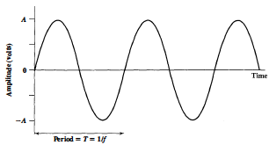
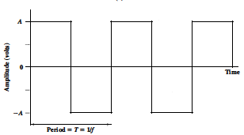
Periodic Signal (Time Domain Concepts)
Periodic signal in which the same signal pattern repeats over time
(a) Sine wave
(b) Square wave
Examples of Periodic Signals
Mathematically, a signal s(t) is defined to be periodic if and only if
where the constant T is the period of the signal ( T is the smallest value that satisfies the equation) .

Slide 11
Sine Wave
Peak amplitude (A)
  maximum strength of signal
  Volts
Frequency (f)
  rate of change of signal
  Hertz (Hz) or cycles per second
  period = time for one repetition (T)
  T = 1/f
Phase (φ)
  relative position in time
Notes:
The sine wave is the fundamental periodic signal. A general sine wave can be represented by three parameters:
peak amplitude (A) - the maximum value or strength of the signal over time; typically measured in volts.
frequency (f) - the rate [in cycles per second, or Hertz (Hz)] at which the signal repeats. An equivalent parameter is the period (T) of a signal, so T = 1/f.
phase (φ) - measure of relative position in time within a single period of a signal, illustrated subsequently

Slide 12
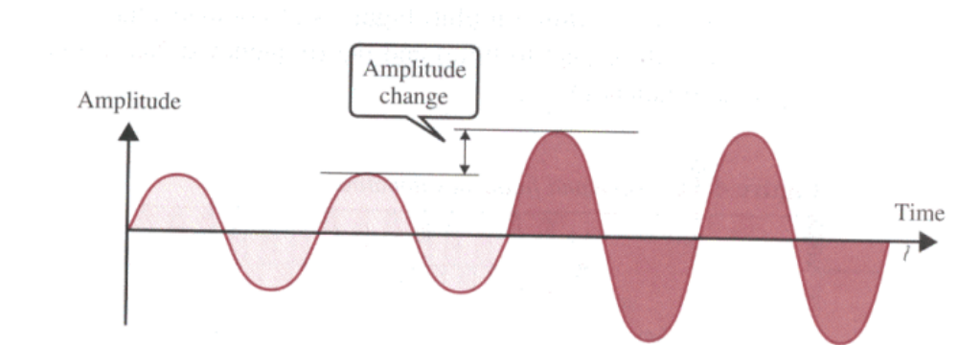
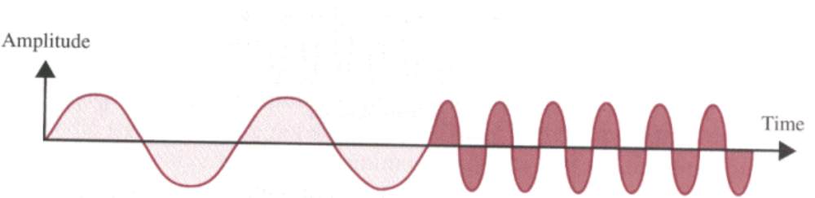
Amplitude, Frequency
Amplitude Change
Frequency Change

Slide 13
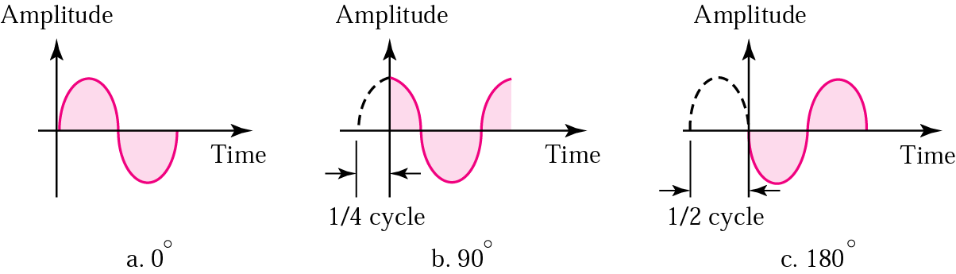
Phase
The term phase describes the position of the waveform relative to time zero.
The phase is measured in degrees or radians (360 degrees is 2π radians)

Slide 14
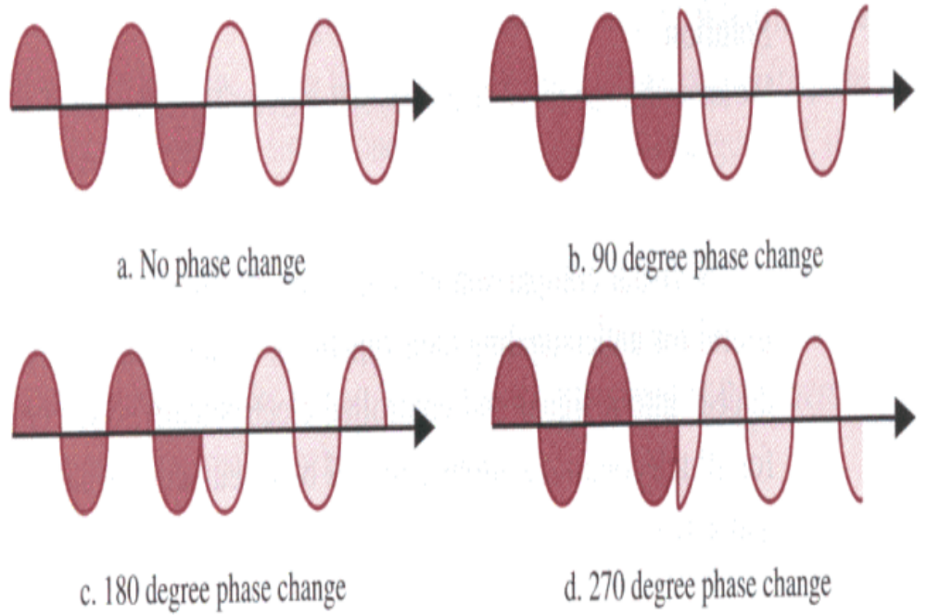
Phase Change

Slide 15
Periodic Signal (Review Ans:)
Review Question
What are three important characteristics of a periodic signal?
Amplitude, frequency, and phase are three important characteristics of a periodic signal.

Slide 16
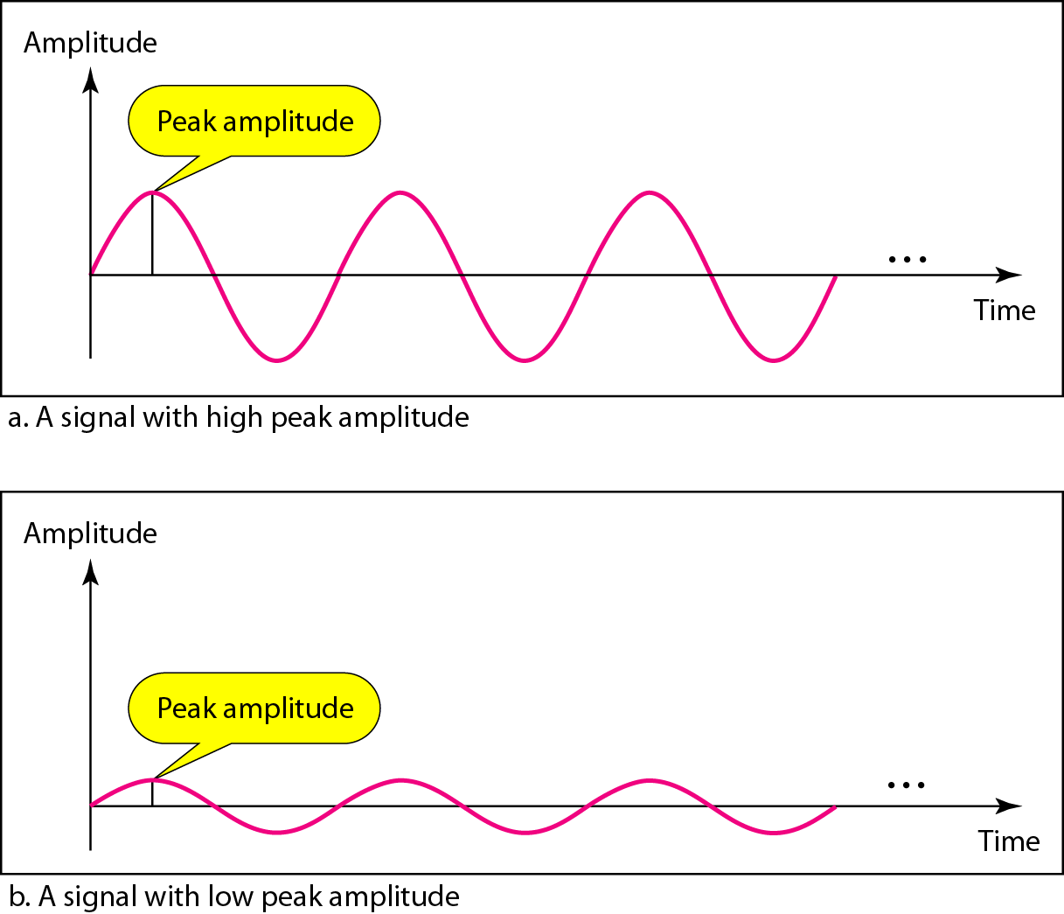
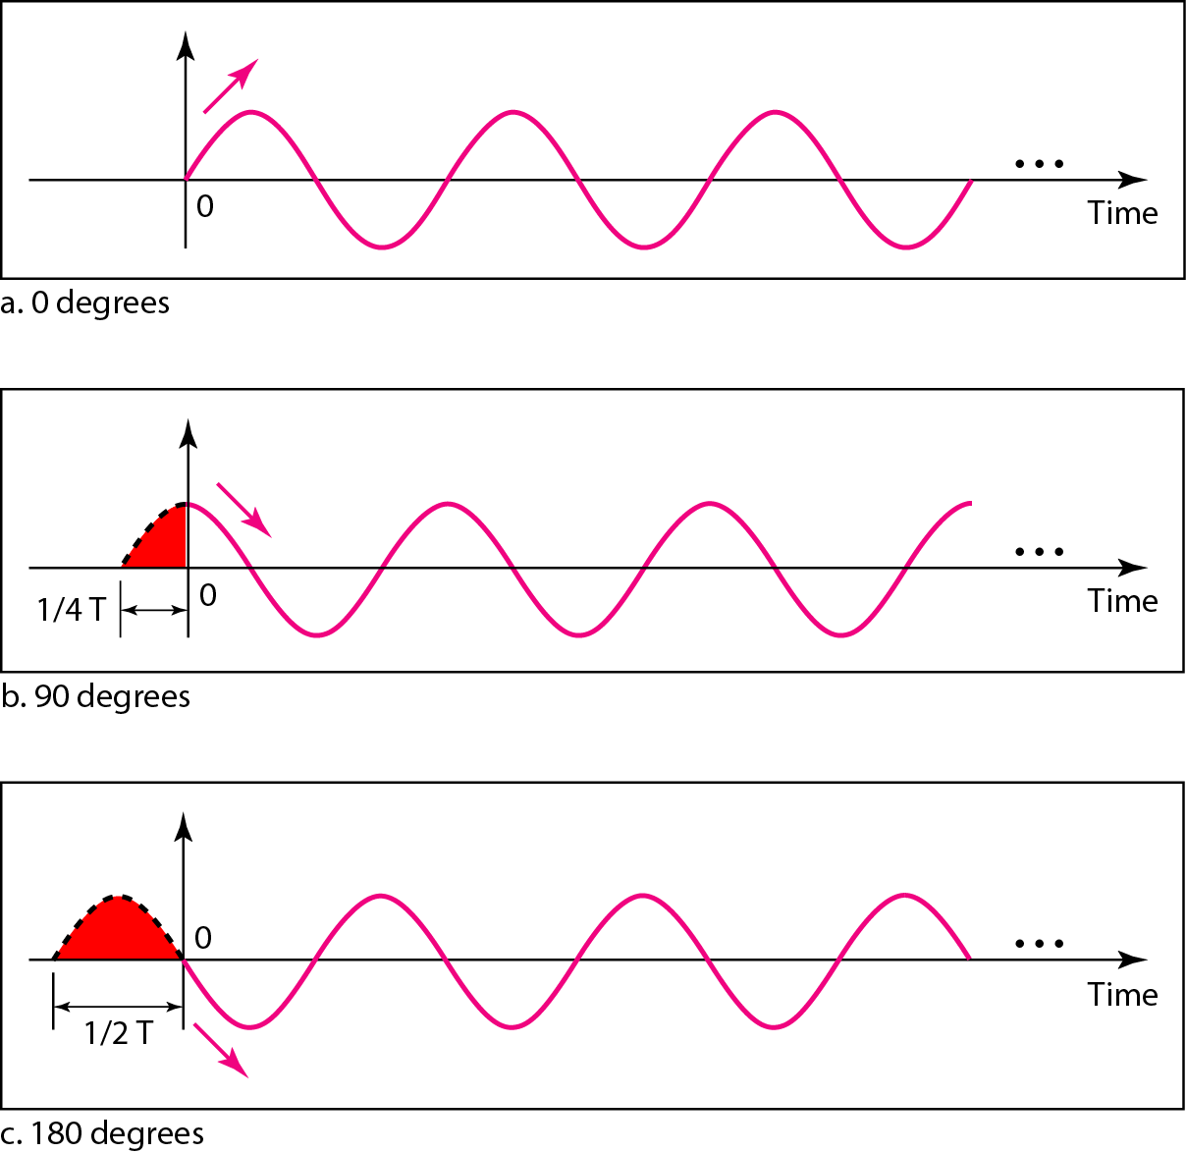
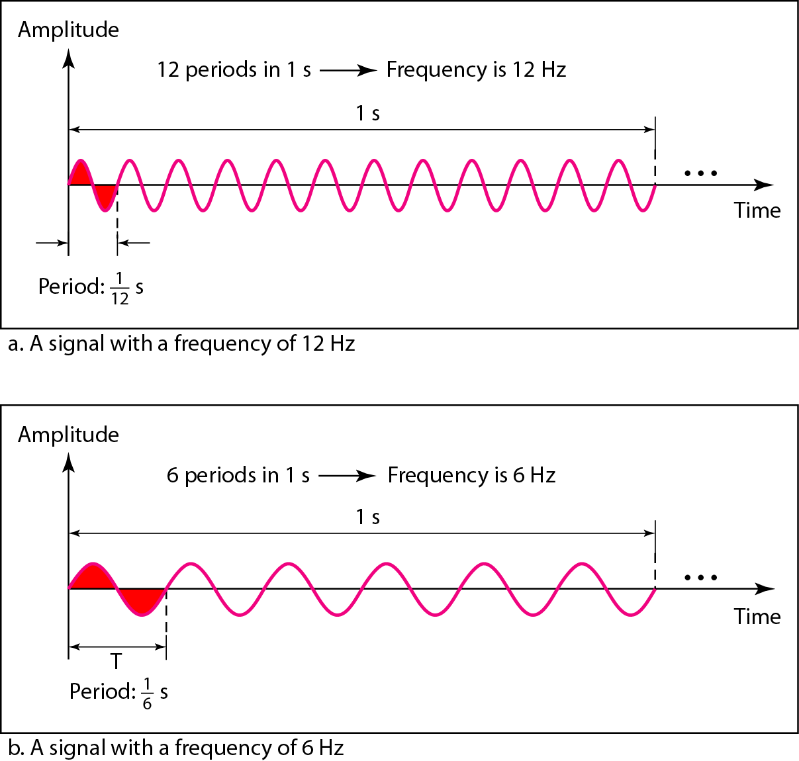
Two signals with the same phase and frequency, but different amplitudes
Three sine waves with the same amplitude and frequency, but with different phases
Two signals with the same amplitude and phase, but different frequencies

Slide 18

Periodic (Review Question )
How many radians are there in a complete circle of 360 degrees?
π radians = 180 degress
2π radians = 360 degress

Slide 19

Review Question 2
A sine wave is offset 1/6 cycle with respect to time 0. What is its phase in degrees and radians?
Solution
We know that 1 complete cycle is 360°. Therefore, 1/6 cycle is

Slide 21
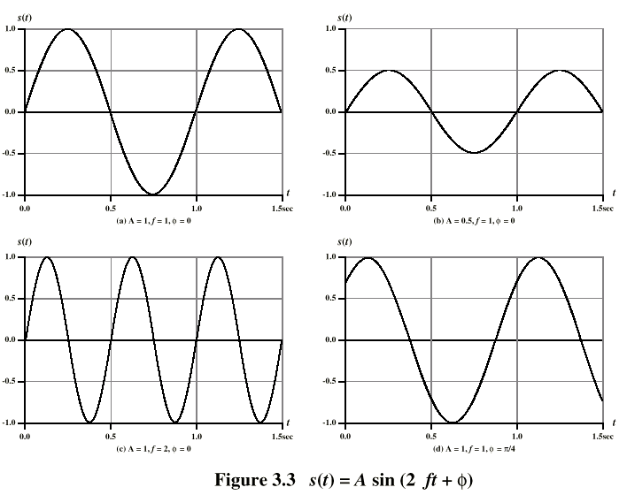
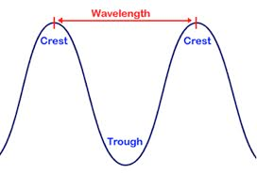
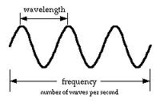
Varying Sine Waves s(t) = A sin(2πft +Φ):
Review Question
Review Question: What is the relationship between the wavelength and frequency of a sine wave?

Slide 22
Frequency and Period
Period is the amount of time it takes a signal to complete one cycle.
Frequency is the number of cycles per second.
Frequency=1/Period
Period=1/Frequency

Slide 23
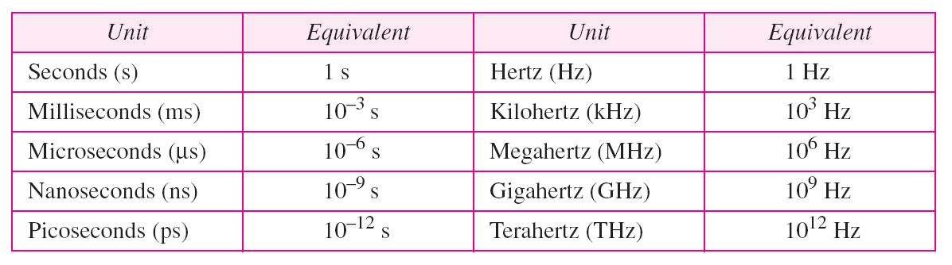
Frequency and Period
Units of period and frequency

Slide 24
Varying Sine Waves s(t) = A sin(2πft +Φ)
The peak amplitude is the maximum value or strength of the signal over time; typically, this value is measured in volts.
The frequency is the rate [in cycles per second, or Hertz (Hz)] at which the signal repeats. An equivalent parameter is the period T of a signal.
Phase is a measure of the relative position in time within a single
period of a signal,

Slide 25
Wavelength (λ)
the wavelength of a signal is the distance occupied by a single cycle
can also be stated as the distance between two points of corresponding phase of two consecutive cycles
assuming signal velocity v, then the wavelength is related to the period as λ = vT
or equivalently λf = v
especially when v=c
c = 3*108 ms-1 (speed of light in free space)

Slide 26
Wavelength: Review Question
The relationship is λf = v, where λ is the wavelength, f is the frequency, and v is the speed at which the signal is traveling.

Slide 27
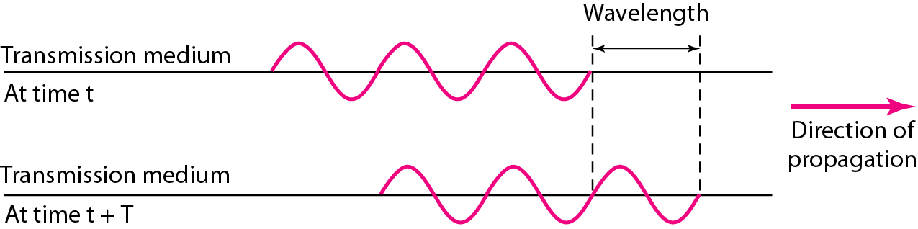
Wavelength and Period
λf = v, By putting f=1/T the equation becomes λ/T = v

Slide 29
Spectrum & Bandwidth Review Question
What is the relationship between a signal's spectrum and its bandwidth?
Maximum rate at which data can be transmitted over a given communications channel under given conditions
data rate
in bits per second
bandwidth
in cycles per second or Hertz
error rate
rate of corrupted bits
limitations due to physical properties
main constraint on achieving efficiency is noise
noise
average noise level over path

Slide 30
Frequency Spectrum and Bandwidth
The frequency spectrum of a signal is the collection of all the component frequencies it contains and is shown using a frequency-domain graph.
The bandwidth of a signal is the width of the frequency spectrum, i.e., bandwidth refers to the range of component frequencies.
To compute the bandwidth, subtract the lowest frequency from the highest frequency of the range.

Slide 31
Frequency Spectrum and Bandwidth
FREQUENCY is the number of occurrences of a repeating event per unit time. It is also referred to as temporal frequency. The period is the duration of one cycle in a repeating event, so the period is the reciprocal of the frequency.
BANDWIDTH is the difference between the upper and lower cutoff frequencies of, for example, a filter, a communication channel, or a signal spectrum, and is typically measured in hertz.

Slide 32
Spectrum & Bandwidth Review Question
What is the relationship between a signal's spectrum and its bandwidth?
The spectrum of a signal consists of the frequencies it contains; the bandwidth of a signal is the width of the spectrum.

Slide 33

Review Q:2
Spectrum & Bandwidth Review Question
If a periodic signal is decomposed into five sine waves with frequencies of 100, 300, 500, 700, and 900 Hz, what is its bandwidth? Draw the spectrum, assuming all components have a maximum amplitude of 10 V.
Solution
Let f_{h} be the highest frequency, f_{l} the lowest frequency, and B the bandwidth. Then
The spectrum has only five spikes, at 100, 300, 500, 700, and 900 Hz.

Slide 34
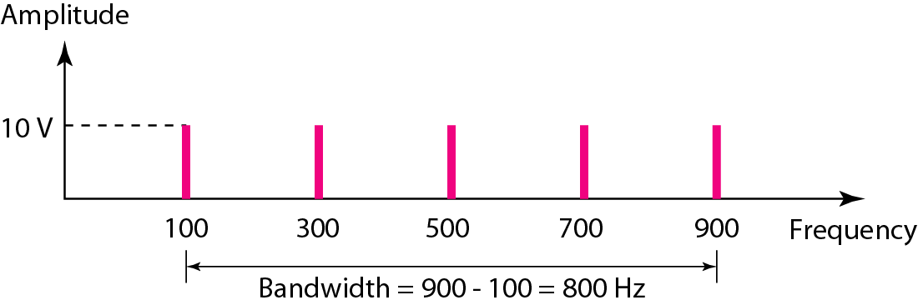
Review Q:2
Spectrum & Bandwidth Review Question

Slide 35
Review Q3:
Spectrum & Bandwidth Review Question
A periodic signal has a bandwidth of 20 Hz. The highest frequency is 60 Hz. What is the lowest frequency? Draw the spectrum if the signal contains all frequencies of the same amplitude.
Solution
Let f_{h} be the highest frequency, f_{l} the lowest frequency, and B the bandwidth. Then
The spectrum contains all integer frequencies. We show this by a series of spikes .

Slide 36
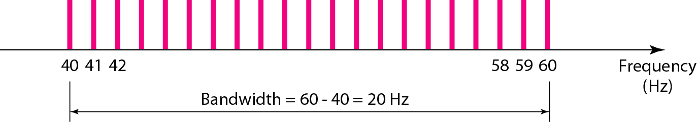
Review Q3:
Spectrum & Bandwidth Review Question

Slide 37
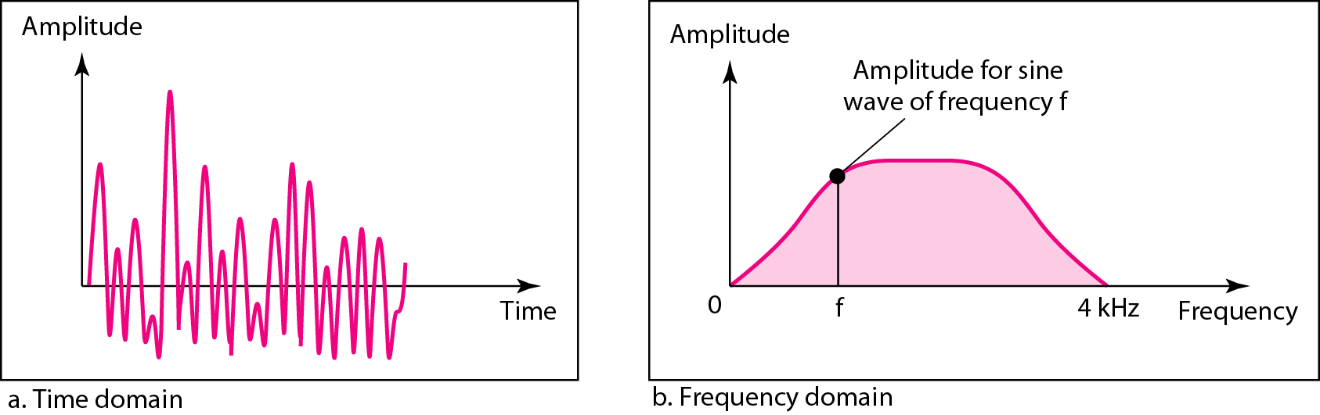
Spectrum & Bandwidth Review Question
Review Q4:
A nonperiodic composite signal has a bandwidth of 200 kHz, with a middle frequency of 140 kHz and peak amplitude of 20 V. The two extreme frequencies have an amplitude of 0. Draw the frequency domain of the signal.
Solution
The lowest frequency must be at 40 kHz and the highest at 240 kHz. Figure on next slide shows the frequency domain and the bandwidth.
The time and frequency domains of a nonperiodic signal

Slide 38
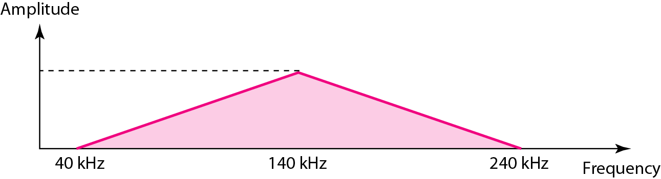
Spectrum & Bandwidth Review Question
Review Q4:
Solution
The lowest frequency must be at 40 kHz and the highest at 240 kHz

Slide 40
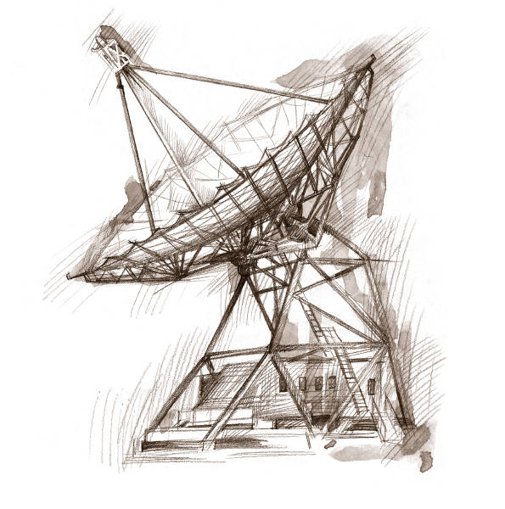
Attenuation Review Question
Transmission Impairments
Question: What is attenuation
Signal received may differ from signal transmitted causing:
  Analog - degradation of signal quality
  Digital - bit errors
Most significant impairments are
  Attenuation and attenuation distortion
  Delay distortion
  Noise

Slide 41
Attenuation Review Question
Question: What is attenuation
where signal strength falls off with distance
depends on medium
received signal strength must be:
  strong enough to be detected
  sufficiently higher than noise to receive without error
so increase strength using amplifiers/repeaters
is also an increasing function of frequency
so equalize attenuation across band of frequencies used
  e.g. using loading coils (voice grade) or amplifiers

Slide 42
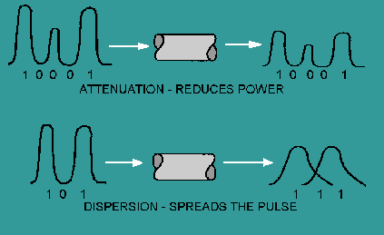
Problem
The effect of dispersion, along with attenuation, on a fiber optic signal can be seen in Figure

Slide 43
ATTENUATION
Received signal strength must be:
strong enough to be detected
sufficiently higher than noise to be received without error
Strength can be increased using amplifiers or repeaters.
Equalize attenuation across the band of frequencies used by using loading coils or amplifiers.
Signal strength falls off with distance over any transmission medium
Varies with frequency

Slide 45
Channel Capacity: Review Question
Review Question: Define channel capacity
Impairments, such as noise, limit data rate that can be achieved
For digital data, to what extent do impairments limit data rate?
Channel Capacity – the maximum rate at which data can be transmitted over a given communication path, or channel, under given conditions

Slide 46
Concepts Related to Channel Capacity
Review Question: Define channel capacity
Data rate - rate at which data can be communicated (bps)
Bandwidth - the bandwidth of the transmitted signal as constrained by the transmitter and the nature of the transmission medium (Hertz)
Noise - average level of noise over the communications path
Error rate - rate at which errors occur
  Error = transmit 1 and receive 0; transmit 0 and receive 1

Slide 47
Channel Capacity
Review Question: Define channel capacity
Maximum rate at which data can be transmitted over a given communications channel under given conditions
data rate
in bits per second
bandwidth
in cycles per second or Hertz
error rate
rate of corrupted bits
limitations due to physical properties
main constraint on achieving efficiency is noise
noise
average noise level over path
Ans: The rate at which data can be transmitted over a given communication path, or channel, under given conditions, is referred to as the channel capacity.
Notes:
We have seen that there are a variety of impairments that distort or corrupt a signal. For digital data, the question that then arises is to what extent these impairments limit the data rate that can be achieved. The maximum rate at which data can be transmitted over a given communication path, or channel, under given conditions, is referred to as the channel capacity.
There are four concepts here that we are trying to relate to one another.
Data rate: The rate, in bits per second (bps), at which data can be communicated
Bandwidth: The bandwidth of the transmitted signal as constrained by the transmitter and the nature of the transmission medium, expressed in cycles per second, or hertz
Noise: The average level of noise over the communications path
Error rate: The rate at which errors occur, where an error is the reception of a 1 when a 0 was transmitted or the reception of a 0 when a 1 was transmitted
The problem we are addressing is this: Communications facilities are expensive and, in general, the greater the bandwidth of a facility, the greater the cost. Furthermore, all transmission channels of any practical interest are of limited bandwidth. The limitations arise from the physical properties of the transmission medium or from deliberate limitations at the transmitter on the bandwidth to prevent interference from other sources. Accordingly, we would like to make as efficient use as possible of a given bandwidth. For digital data, this means that we would like to get as high a data rate as possible at a particular limit of error rate for a given bandwidth. The main constraint on achieving this efficiency is noise.

Slide 49
Factors Effecting Channel Capacity
Review Question: What key factors affect channel capacity
Communications facilities are expensive and, in general, the greater the bandwidth. Furthermore, all transmission channels of any practical interest are of limited bandwidth. The limitations arise from the physical properties of the transmission medium or from deliberate limitations at the transmitter on the bandwidth to prevent interference from other sources. Accordingly, we would like to make as efficient use as possible of a given bandwidth. For digital data, this means that we would like to get as high a data rate as possible at a particular limit of error rate for a given bandwidth. The main constraint on achieving this efficiency is noise.

Slide 50
Factors Effecting Channel Capacity
The Factors
    Bandwidth
    Noise,
    Error rate
affect channel capacity
Bandwidth: The bandwidth of the transmitted signal as constrained by the transmitter and the nature of the transmission medium, expressed in cycles per second, or hertz
Noise: The average level of noise over the communications path
Error rate: The rate at which errors occur, where an error is the reception of a 1 when a 0 was transmitted or the reception of a 0 when a 1 was transmitted

Slide 51
Summary: Review Q/A with Discussion
Signals for Conveying Information
    Time Domain Concepts
    Frequency Domain Concepts
    Relationship between Data Rate and Bandwidth
Analog and Digital Data Transmission
    Analog and Digital Data
    Analog and Digital Signaling
    Analog and Digital Transmission
Channel Capacity
Factors effecting channel capacity

