Slide 1
Wireless Transmission Media
Lecture 5

Slide 2
Overview
Wireless Transmission
Wireless Transmission Examples
  terrestrial microwave
  satellite microwave
  broadcast radio
  Infrared
Wireless Transmission Systems Comparison
Wireless Propagation Modes
Multiplexing TDM, FDM WDM

Slide 3
Wireless (Unguided Media) Transmission
transmission and reception are achieved by means of an antenna
directional
  transmitting antenna puts out focused beam
  transmitter and receiver must be aligned
omnidirectional
  signal spreads out in all directions
  can be received by many antennas

Slide 4
Wireless Examples
terrestrial microwave
satellite microwave
broadcast radio
infrared

Slide 5
Terrestrial Microwave
used for long-distance telephone service
uses radio frequency spectrum, from 2 to 40 Ghz
parabolic dish transmitter, mounted high
used by common carriers as well as private networks
requires unobstructed line of sight between source and receiver
curvature of the earth requires stations (repeaters) ~30 miles apart

Slide 6
Satellite Microwave
Applications
Television distribution
Long-distance telephone transmission
Private business networks

Slide 7
Microwave Transmission Disadvantages
line of sight requirement
expensive towers and repeaters
subject to interference such as passing airplanes and rain

Slide 8
Satellite Microwave Transmission
a microwave relay station in space
can relay signals over long distances
geostationary satellites
  remain above the equator at a height of 22,300 miles (geosynchronous orbit)
  travel around the earth in exactly the time the earth takes to rotate

Slide 9
Satellite Transmission Links
earth stations communicate by sending signals to the satellite on an uplink
the satellite then repeats those signals on a downlink
the broadcast nature of the downlink makes it attractive for services such as the distribution of television programming

Slide 10
Satellite Transmission Process
satellite
transponder
dish
dish
22,300 miles
uplink station
downlink station

Slide 11
Satellite Transmission Applications
television distribution
  a network provides programming from a central location
  direct broadcast satellite (DBS)
long-distance telephone transmission
  high-usage international trunks
private business networks

Slide 12
Principal Satellite Transmission Bands
C band: 4(downlink) - 6(uplink) GHz
  the first to be designated
Ku band: 12(downlink) -14(uplink) GHz
  rain interference is the major problem
Ka band: 19(downlink) - 29(uplink) GHz
  equipment needed to use the band is still very expensive

Slide 13
Microwave Transmission Characteristics
Microwave transmission covers a substantial portion of the electromagnetic spectrum. Common frequencies used for transmission are in the range 2 to 40 GHz. The higher the frequency used, the higher the potential bandwidth and therefore the higher the potential data rate.
Microwave Bandwidth and Data Rates

Slide 14

Microwave Transmission Characteristics
As with any transmission system, a main source of loss is attenuation. For microwave (and radio frequencies), the loss can be expressed as
where d is the distance and A is the wavelength, in the same units. Thus, loss varies as the square of the distance. In contrast, for twisted pair and coaxial cable, loss varies exponentially with distance (linear in decibels). Thus repeaters or amplifiers may be placed farther apart for microwave systems-10 to 100 km is typical. Attenuation is increased with rainfall. The effects of rainfall become especially noticeable above 10 GHz. Another source of impairment is interference. With the growing popularity of microwave, transmission areas overlap and interference is always a danger. Thus the
assignment of frequency bands is strictly regulated

Slide 15
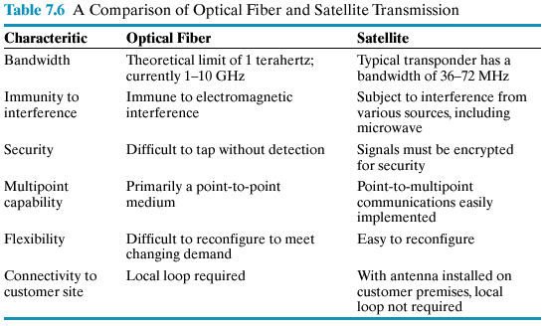
Fiber vs Satellite

Slide 16
Radio
radio is omnidirectional and microwave is directional
Radio is a general term often used to encompass frequencies in the range 3 kHz to 300 GHz.
Mobile telephony occupies several frequency bands just under 1 GHz.

Slide 17
Infrared
Uses transmitters/receivers (transceivers) that modulate noncoherent infrared light.
Transceivers must be within line of sight of each other (directly or via reflection ).
Unlike microwaves, infrared does not penetrate walls.

Slide 18
Satellite Vs. Terrestrial
Satellite communications only work when there is a line of sight from the communications satellite. So does terrestrial microwave communications. Both require parabolic antennas.
This is because apart from the limited frequency bands used by satellite communications, terrestrial and satellite microwave communications are actually using the same technology, and the only difference is the distance between sender and receiver.
Terrestrial is point to point whereas satellite is sent from earth - space - earth

Slide 19
Radio Vs. Microwave
The principle difference between radio and microwave is that
radio is omnidirectional and microwave is focused.
The term "Radio" covers the FM radio and UHF and VHF
television.
Packet Radio: Uses a ground based antenna to link multiple
sites in a data transmission network.
Teletext Service: This service inserts character data in the
vertical blanking interval in a conventional TV signal.
Televisions equipped with a decoder can receive and display
the signal (Closed Caption).
Cellular Radio: A given frequency may be used by a number
of transmitters in the same area.

Slide 20
Infrared Vs. Microwave
One important difference between infrared and microwave transmission is that the former does not penetrate walls. Thus the security and interference problems encountered in microwave systems are not present. Furthermore, there is no frequency allocation issue with infrared, because no licensing is required.
Also the presence of high amounts of electromagnetic interference (EMI) would also suggest the use of infrared systems rather than microwave
Infrared systems are advantageous if the weather is normally rainy but not foggy and there is little smog. However if the area is foggy and has a substantial amount of snow and smog then microwave systems would work better

Slide 21
Frequency Bands
A signal radiated from an antenna travels along one of three routes:
Ground wave
Sky wave
Line Of Sight(LOS)

Slide 22
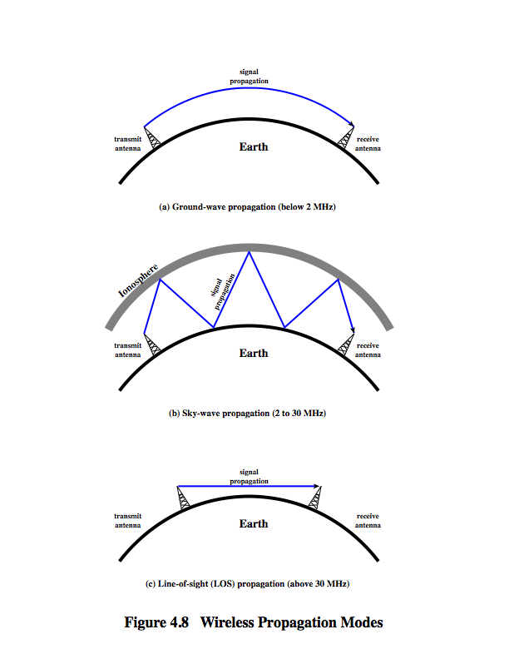
Wireless Propagation Ground Wave
Radio waves in the VLF (Very low frequency) band propagate in a ground, or surface wave. The wave is confined between the surface of the earth and to the ionosphere. The ground wave can propagate a considerable distance over the earth's surface and in the low frequency and medium frequency portion of the radio spectrum. Ground wave radio propagation is used to provide relatively local radio communications coverage, especially by radio broadcast stations that require to cover a particular locality.
  Ground wave propagation follows the contour of the earth and can propagate distances well over the visible horizon
  This effect is found in frequencies up to 2MHz
  The best known example of ground wave communication is AM radio

Slide 23
Wireless Propagation Sky Wave
Sky wave propagation is used for amateur radio, CB radio, and international broadcasts such as BBC and Voice of America
A signal from an earth based antenna is reflected from the ionized layer of the upper atmosphere back down to earth
Sky wave signals can travel through a number of hops, bouncing back and for the between the ionosphere and the earth’s surface

Slide 24
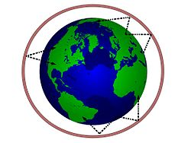
Wireless Propagation Sky Wave
In radio communication, skywave or skip refers to the propagation of radio waves reflected or refracted back toward Earth from the ionosphere, an electrically charged layer of the upper atmosphere. Since it is not limited by the curvature of the Earth, skywave propagation can be used to communicate beyond the horizon, at intercontinental distances. It is mostly used in the shortwave frequency bands.

Slide 25
Wireless Propagation Line of Sight
Line-of-sight propagation refers to electro-magnetic radiation or acoustic wave propagation. Electromagnetic transmission includes light emissions traveling in a straight line. The rays or waves may be diffracted, refracted, reflected, or absorbed by atmosphere and obstructions with material and generally cannot travel over the horizon or behind obstacles.
  Ground and sky wave propagation modes do not operate above 30 MHz - - communication must be by line of sight

Slide 26
Refraction
Velocity of electromagnetic wave is a function of the density of the medium through which it travels
  ~3 x 10⁸ m/s in vacuum, less in anything else
Speed changes with movement between media
Index of refraction (refractive index) is
  Sine(incidence)/sine(refraction)
  Varies with wavelength
Gradual bending
  Density of atmosphere decreases with height, resulting in bending of radio waves towards earth

Slide 27
Line of Sight Transmission
Free space loss
loss of signal with distance
Atmospheric Absorption
from water vapor and oxygen absorption
Multipath
multiple interfering signals from reflections
Refraction
bending signal away from receiver

Slide 28
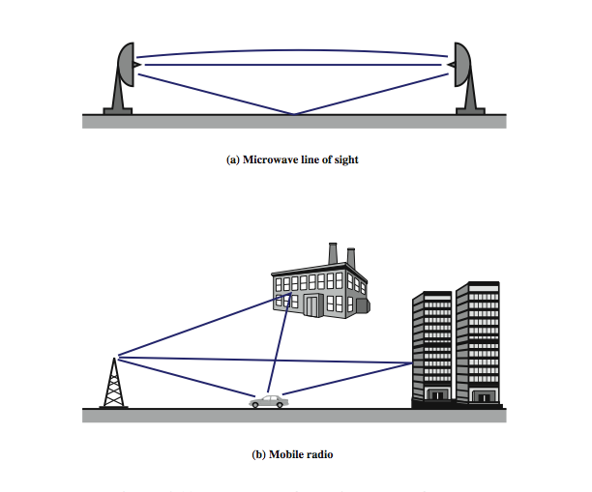
Multipath Interference
In digital radio communications (such as GSM) multipath can cause errors and affect the quality of communications. The errors are due to intersymbol interference (ISI). Equalisers are often used to correct the ISI. Alternatively, techniques such as orthogonal frequency division modulation and rake receivers may be used.

Slide 30
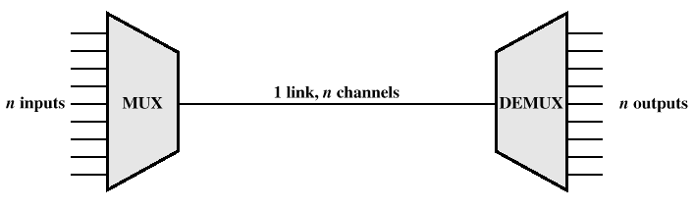
Multiplexing
In both local and wide area communications, it is almost always the case that the capacity of the transmission medium exceeds the capacity required for the transmission of a single signal. To make efficient use of the transmission system, it is desirable to carry multiple signals on a single medium. This is referred to as multiplexing

Slide 31
Reasons for Widespread Use of Multiplexing
Cost per kbps of transmission facility declines with an increase in the data rate
Cost of transmission and receiving equipment declines with increased data rate
Most individual data communicating devices require relatively modest data rate support

Slide 32
Multiplexing Techniques
Frequency-division multiplexing (FDM)
  Takes advantage of the fact that the useful bandwidth of the medium exceeds the required bandwidth of a given signal
Time-division multiplexing (TDM)
  Takes advantage of the fact that the achievable bit rate of the medium exceeds the required data rate of a digital signal

Slide 33
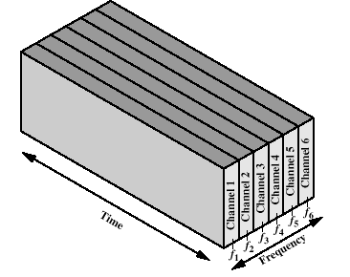
Frequency-division Multiplexing
Each signal requires a certain bandwidth centered on its carrier frequency, referred to as a channel. To prevent interference, the channels are separated by guard bands, which are unused portions of the spectrum. An example is the multiplexing of voice signals. We mentioned that the useful spectrum for voice is 300 to 3400 Hz. Thus, a bandwidth of 4 kHz is adequate to carry the voice signal and provide a guard band
Six signal sources are fed into a multiplexer that modulates each signal onto a different frequency (fi, . . . , f6). Each signal requires a certain bandwidth centered on its carrier frequency, referred to as a channel. To prevent interference, the channels are separated by guard bands, which
are unused portions of the spectrum (not shown in the figure).

Slide 34
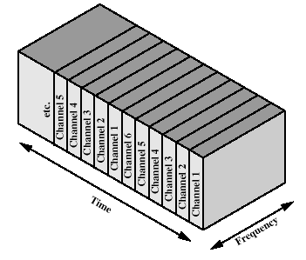
Time-division Multiplexing
TDM, referring to the fact that time slots are preassigned and fixed. Hence the timing of transmission from the various sources is synchronized. In contrast, asynchronous TDM allows time on the medium to be allocated dynamically. Unless otherwise noted, the term TDM will be used to mean synchronous TDM
TDM takes advantage of the fact that the achievable bit rate (sometimes, unfortunately, called bandwidth) of the medium exceeds the required data rate of a digital signal. Multiple digital signals can be carried on a single transmission path by interleaving portions of each signal in time.

Slide 35
Frequency multiplex
Separation of the whole spectrum into smaller frequency bands
A channel gets a certain band of the spectrum for the whole time
Advantages
  no dynamic coordination
  necessary
  works also for analog signals
Disadvantages
  waste of bandwidth
  if the traffic is
  distributed
  unevenly
  inflexible
k₁
k₂
k₃
k₄
k₅
k₆
c
f
t

Slide 36
Time multiplex
A channel gets the whole spectrum for a certain amount of time
Advantages
  only one carrier in the
  medium at any time
  throughput high even
  for many users
Disadvantages
  precise
  synchronization
  necessary
k₁
k₂
k₃
k₄
k₅
k₆
c
f
t

Slide 37
Time and frequency multiplex
Combination of both methods
A channel gets a certain frequency band for a certain amount of time
Example: GSM
Advantages
  better protection against
  tapping
  protection against frequency
  selective interference
but: precise coordination
required
k₁
k₂
k₃
k₄
k₅
k₆
c
f
t

Slide 38
Code multiplex
Each channel has a unique code
All channels use the same spectrum
at the same time
Advantages
  bandwidth efficient
  no coordination and synchronization
  necessary
  good protection against interference
  and tapping
Disadvantages
  varying user data rates
  more complex signal regeneration
Implemented using spread spectrum technology
k₁
k₂
k₃
k₄
k₅
k₆
c
f
t

Slide 39
Multiplexing
Multiplexing in 4 dimensions
  space (s_{i})
  time (t)
  frequency (f)
  code (c)
Goal: multiple use
of a shared medium
Important: guard spaces needed!
channels k_{i}
k₁
k₂
k₃
k₄
k₅
k₆
c
t
c
s₁
t
f
s₂
f
c
t
s₃
f

Slide 40
Wavelength Division Multiplexing (WDM)
multiple beams of light at different frequencies
carried over optical fiber links
commercial systems with 160 channels of 10 Gbps
lab demo of 256 channels 39.8 Gbps
architecture similar to other FDM systems
multiplexer consolidates laser sources (1550nm) for transmission over single fiber
optical amplifiers amplify all wavelengths
demultiplexer separates channels at destination
Dense Wavelength Division Multiplexing (DWDM)
use of more channels more closely spaced

Slide 41
Summary
Guided and Unguided Media
Advantages and disadvantages some of the media (TP, STP, UTP, Coaxial, Fiber)
Design factor of the underlying media
Antennas
Modes of transmission

