Slide 1
Transmission Media
Lecture 4

Slide 2
Overview
Transmission media
Transmission media classification
Transmission Media characteristics and design specifications
Guided and Unguided media
Wireless Transmission Frequencies
Antennas
Wireless Propagation

Slide 3
Transmission Media
The transmission medium is the physical path by which a message travels from sender to receiver.
Computers and telecommunication devices use signals to represent data.
These signals are transmitted from a device to another in the form of electromagnetic energy.
Examples of Electromagnetic energy include power, radio waves, infrared light, visible light, ultraviolet light, and X and gamma rays.
All these electromagnetic signals constitute the electromagnetic spectrum

Slide 4
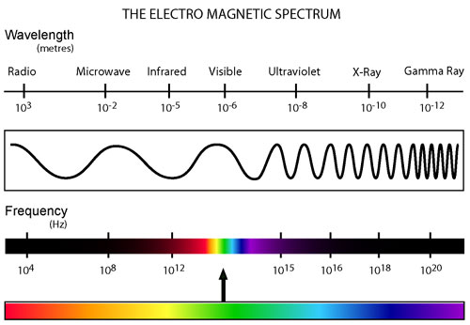
Electromagnetic Spectrum
Not all portion of the spectrum are currently usable for telecommunications
Each portion of the spectrum requires a particular transmission medium

Slide 5
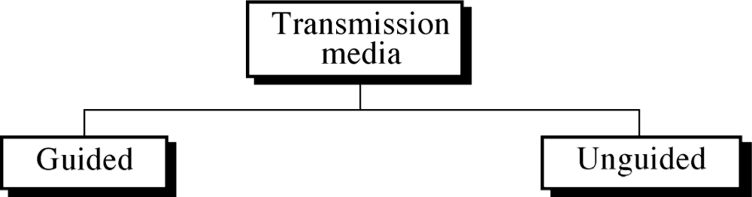
Transmission Media Classification
Guided media, which are those that provide a conduit from one device to another.
Examples: twisted-pair, coaxial cable, optical fiber.
Unguided media (or wireless communication) transport electromagnetic waves without using a physical conductor. Instead, signals are broadcast through air (or, in a few cases, water), and thus are available to anyone who has a device capable of receiving them.

Slide 6
Transmission Media Classification
Characteristics and quality determined by medium and signal
For guided, the medium is more important
For unguided, the bandwidth produced by the antenna is more important Key concerns are data rate and distance

Slide 7
Transmission Media Classification
One key property of signals transmitted by antenna is directionality.
In general, signals at lower frequencies are omnidirectional; that is, the signal propagates in all directions from the antenna.
At higher frequencies, it is possible to focus the signal into a directional beam

Slide 8
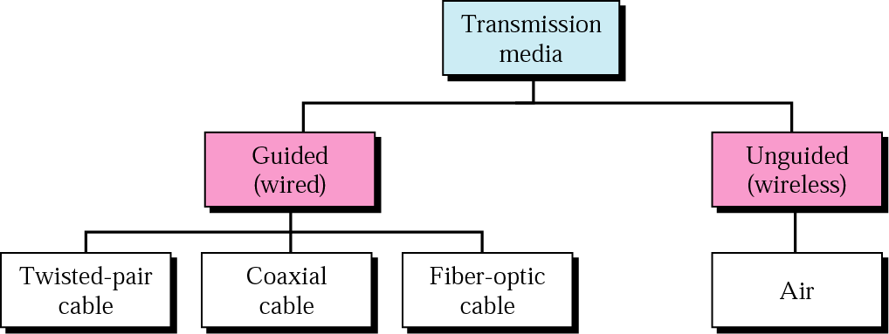
Transmission Media Classification
Atmosphere and Outer space
Signals of low frequency (like voice signals) are generally transmitted as current over metal cables. It is not possible to transmit visible light over metal cables, for this class of signals is necessary to use a different media, for example fiber-optic cable.

Slide 9
Design Factors for Transmission Media
Bandwidth: All other factors remaining constant, the greater the bandwidth of a signal, the higher the data rate that can be achieved.
Transmission impairments. Limit the distance a signal can travel.
Interference: Competing signals in overlapping frequency bands can distort or wipe out a signal.
Number of receivers: Each attachment introduces some attenuation and distortion, limiting distance and/or data rate.

Slide 10
Transmission Characteristics of Guided Media
Frequency Range
Typical Attenuation
Typical Delay
Repeater Spacing
Twisted pair (with loading)
0 to 3.5 kHz
0.2 dB/km @ 1 kHz
50 µs/km
2 km
Twisted pairs (multi-pair cables)
0 to 1 MHz
0.7 dB/km @ 1 kHz
5 µs/km
2 km
Coaxial cable
0 to 500 MHz
7 dB/km @ 10 MHz
4 µs/km
1 to 9 km
Optical fiber
186 to 370 THz
0.2 to 0.5 dB/km
5 µs/km
40 km

Slide 11
Guided Transmission Media

Slide 12
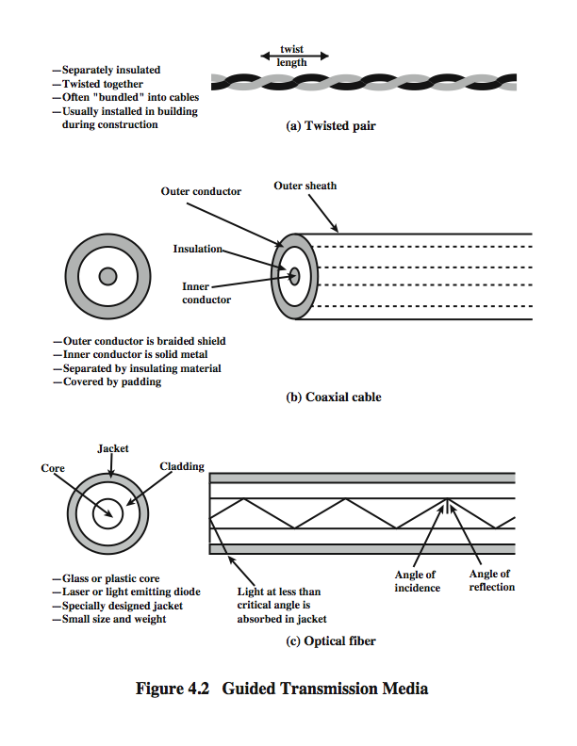
Twisted Pair
Twisted pair is the least expensive and most widely used guided transmission medium.
  Consists of two insulated copper wires arranged in a regular spiral pattern
  A wire pair acts as a single communication link
  Pairs are bundled together into a cable
  Most commonly used in the telephone network and for communications within buildings

Slide 13
Twisted Pair-Transmission Characteristics
analog
needs amplifiers every 5km to 6km
digital
can use either analog or digital signals
needs a repeater every 2km to 3km
limited:
distance
bandwidth (1MHz)
data rate (100MHz)
Susceptible to interference and noise

Slide 14
Unshielded vs. Shielded Twisted Pair
Unshielded Twisted Pair (UTP)
Ordinary telephone wire
Cheapest
Easiest to install
Suffers from external electromagnetic interference
Shielded Twisted Pair (STP)
Has metal braid or sheathing that reduces interference
Provides better performance at higher data rates
More expensive
Harder to handle (thick, heavy)
Splicing is easier

Slide 15
Twisted Pair Categories and Classes

Slide 16

(Impairments) Near End Crosstalk (TP)
Coupling of signal from one pair of conductors to another occurs when transmit signal entering the link couples back to the receiving pair – (near transmitted signal is picked up by near receiving pair)

Slide 17
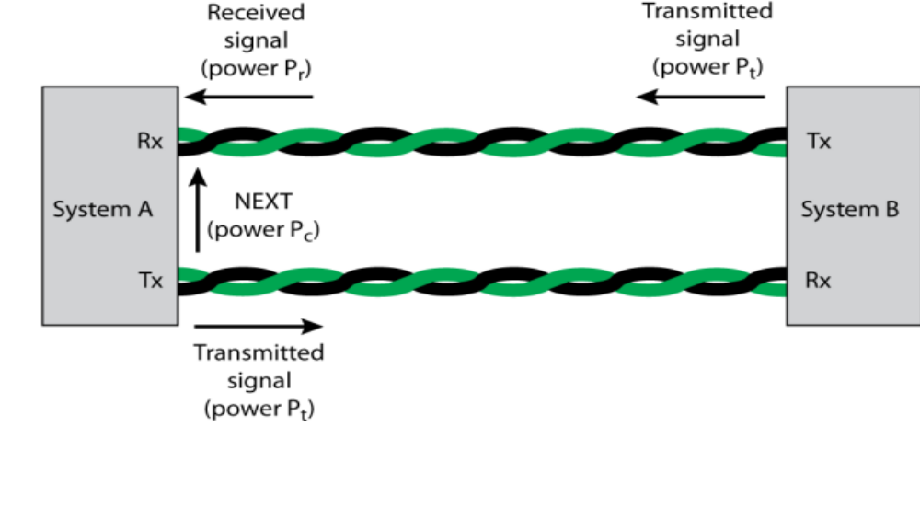
Signal Power Relationships (TP Characteristics)
Fig. illustrates the relationship between NEXT loss and insertion loss at system A. A transmitted signal from system B, with a transmitted signal power of Pt is received at A with a reduced signal power of Pr. At the same time, system A is transmitting to signal B, and we assume that the transmission is at the same transmit signal power of Pt.
Due to crosstalk, a certain level of signal from A's transmitter is induced on the receive wire pair at A with a power level of Pc; this is the crosstalk signal. Clearly, we need to have Pr > Pc to be able to intelligibly receive the intended signal, and the greater the difference between Pr and Pc, the better. Unlike insertion loss, NEXT loss does not vary as a function of the length of the link

Slide 18
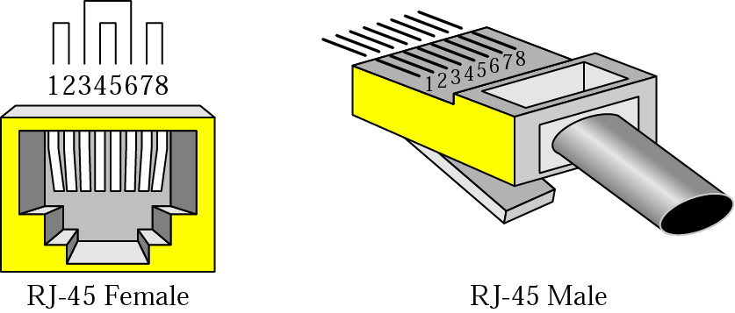
UTP Connectors
The most common UTP connector is RJ45 (RJ stands for Registered Jack).

Slide 19
Applications
Twisted-pair cables are used in telephones lines to provide voice and data channels.
The DSL lines that are used by the telephone companies to provide high data rate connections also use the high-bandwidth capability of unshielded twisted-pair cables.
Local area networks, such as 10Base-T and 100Base-T, also used UTP cables.

Slide 20
Coaxial Cable
Coaxial cable can be used over longer distances and support more stations on a shared line than twisted pair.
  It consists of a hollow outer cylindrical conductor that surrounds a single inner wire conductor
  It is a versatile transmission medium used in a wide variety of applications
  It is used for TV distribution, long distance telephone transmission and LANs

Slide 21
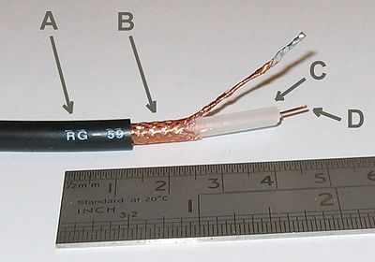
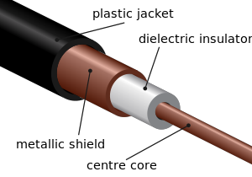
Coaxial Cable
Outer plastic sheath
Woven copper shield
Inner dielectric insulator
Copper core
Coaxial cables have numerous uses; they are used for transmitting video as well as radio signals and for high-speed internet connections. This type of cable can be made out of a number of different materials depending on the frequency and impedance of the device with which it is being used.

Slide 22
Coaxial Cable - Transmission Characteristics
Frequency characteristics superior to twisted pair
Performance limited by attenuation & noise
Analog signals
Amplifiers needed every few kilometers - closer if higher frequency
Usable spectrum extends up to 500MHz
Digital signals
Repeater every 1km - Closer for higher data rates

Slide 23
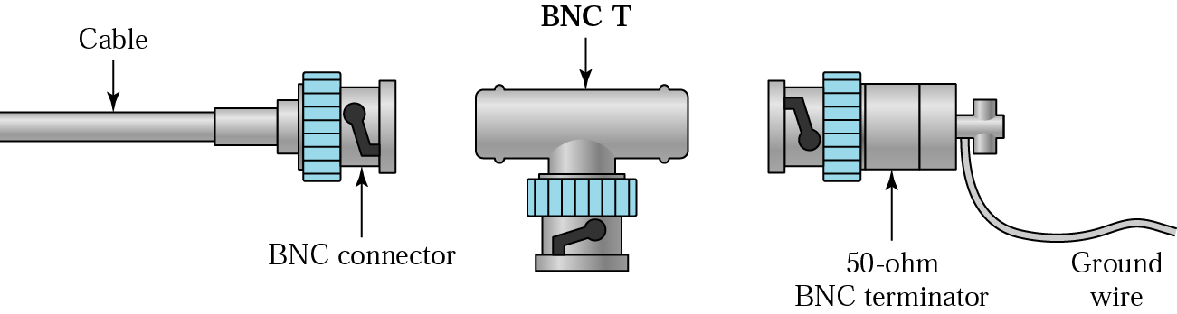
BNC Connectors
- To connect coaxial cable to devices, it is necessary to use coaxial connectors. The most common type of connector is the Bayone-Neill-Concelman, or BNC, connectors. There are three types:
The BNC connector, the BNC T connector, the BNC terminator.
Applications include cable TV networks, and some traditional Ethernet LANs like 10Base-2, or 10-Base5.

Slide 24
Coaxial Cable
Advantages :
Coaxial cable can support greater cable lengths between network devices than twisted pair cable.
Thick coaxial cable has an extra protective plastic cover that help keep moisture away.
Disadvantages :
It does not bend easily and is difficult to install.
Common applications of coaxial cable include video and CATV distribution, RF and microwave transmission, and computer and instrumentation data connections

Slide 25
Optical Fiber
An optical fiber (or optical fibre) is a flexible, transparent fiber made of high quality extruded glass (silica) or plastic, slightly thicker than a human hair. It can function as a waveguide, or “light pipe” to transmit light between the two ends of the fiber.
Optical fiber is a thin flexible medium capable of guiding an optical ray.
  Various glasses and plastics can be used to make optical fibers
  It has a cylindrical shape with three sections – core, cladding, jacket
  It is being widely used in long distance telecommunications
  Performance, price and advantages have made it popular to use

Slide 26

Optical Fiber - Benefits
Greater capacity
  Data rates of hundreds of Gbps
Smaller size and lighter weight
  Considerably thinner than coaxial or twisted pair cable
  Reduces structural support requirements
Lower attenuation
Electromagnetic isolation
  Not vulnerable to interference, impulse noise, or crosstalk
  High degree of security from eavesdropping
Greater repeater spacing
  Lower cost and fewer sources of error

Slide 27
Optical Fiber-Transmission Characteristics
Uses total internal reflection to transmit light
  Effectively acts as wave guide for 10¹⁴ to 10¹⁵ Hz (this covers portions of infrared & visible spectra)
Light sources used:
  Light Emitting Diode (LED)
    Cheaper, operates over a greater temperature range, lasts longer
  Injection Laser Diode (ILD)
    More efficient, has greater data rates
Has a relationship among wavelength, type of transmission and achievable data rate

Slide 28
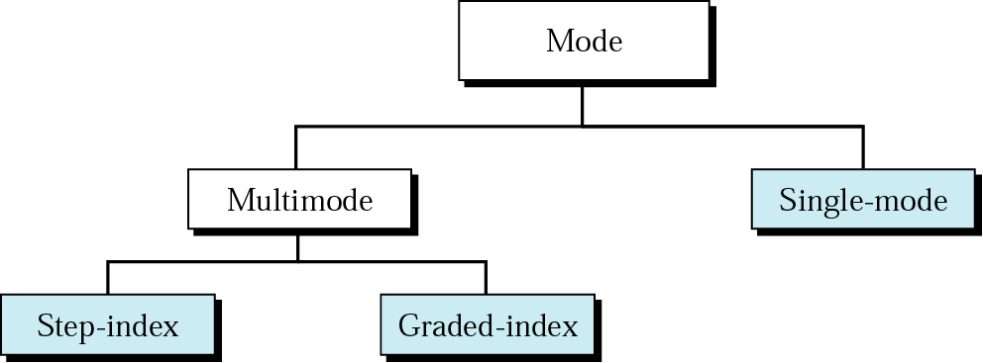
Propagation Modes (Types of Optical Fiber )
Current technology supports two modes for propagating light along optical channels, each requiring fiber with different physical characteristics:
Multimode and Single Mode.
Multimode, in turn, can be implemented in two forms: step-index or graded index.

Slide 29
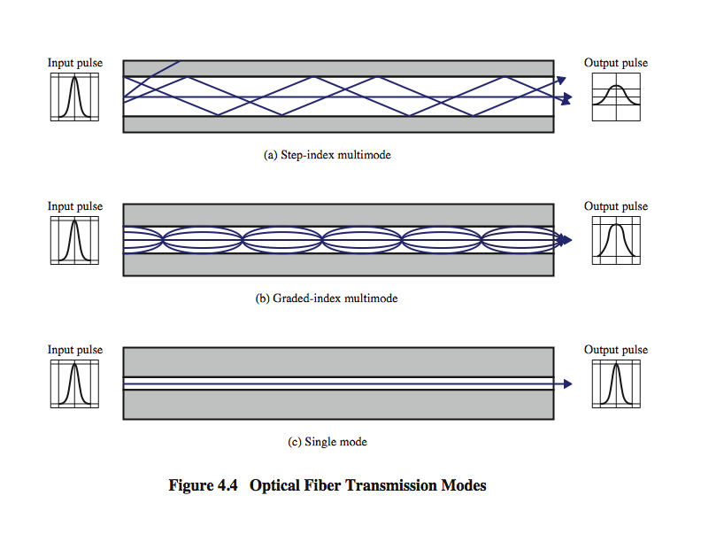
Optical Fiber Transmission Modes
Light from a source enters the cylindrical glass or plastic core. Rays at shallow angles are reflected and propagated along the fiber; other rays are absorbed by the surrounding material. This form of propagation is called step-index multimode, referring to the variety of angles that reflect
When the fiber core radius is reduced, fewer angles will reflect. By reducing the radius of the core to the order of a wavelength, only a single angle or mode can pass: the axial ray. This single-mode propagation provides superior performance for the following reason. Because there is a single transmission path with single-mode transmission, the distortion found in multimode cannot occur. Single-mode is typically used for long-distance applications
Finally, by varying the index of refraction of the core, a third type of transmission, known as graded-index multimode, is possible. This type is intermediate between the other two in characteristics. The higher refractive index (discussed subsequently) at the center makes the light rays moving down the axis advance more slowly than those near the cladding

Slide 30
Propagation Modes (Types of Optical Fiber )
Multimode: In this case multiple beams from a light source move through the core in different paths.
In multimode step-index fiber, the density of the core remains constant from the center to the edges. A beam of light moves through this constant density in a straight line until it reaches the interface of the core and cladding. At the interface there is an abrupt change to a lower density that alters the angle of the beam’s motion.
In a multimode graded-index fiber the density is highest at the center of the core and decreases gradually to its lowest at the edge.

Slide 31
Frequency Utilization for Fiber Applications
In optical fiber, based on the attenuation characteristics of the medium and on properties of light sources and receivers, four transmission windows are appropriate. The four transmission windows are in the infrared portion of the frequency spectrum, below the visible-light portion, which is 400 to 700 nm. The loss is lower at higher wavelengths, allowing greater data rates over longer distances

Slide 32
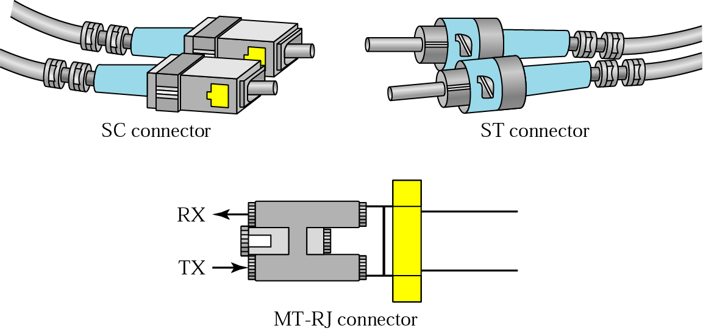
Fiber-optic cable connectors
The subscriber channel (SC) connector is used in cable TV. It uses a push/pull locking system. The straight-tip (ST) connector is used for connecting cable to networking devices. MT-RJ is a new connector with the same size as RJ45.

Slide 34
Wireless Transmission Frequencies
1GHz to 40GHz
Referred to as microwave frequencies
Highly directional beams are possible
Suitable for point to point transmissions
Also used for satellite
30MHz to 1GHz
Suitable for omnidirectional applications
Referred to as the radio range
3 x 10¹¹ to 2 x 10¹⁴
Infrared portion of the spectrum
Useful to local point-to-point and multipoint applications within confined areas

Slide 35
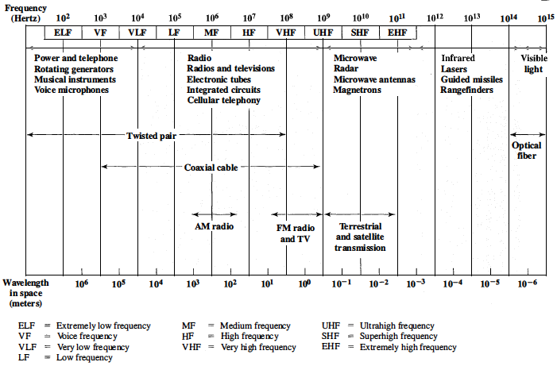
Electromagnetic Spectrum for Telecommunications
Electromagnetic Spectrum for Telecommunications

Slide 36
Antennas
An antenna (or aerial) is an electrical device which converts electric power into radio waves, and vice versa
Transmission antenna
Radio frequency energy from transmitter
Converted to electromagnetic energy by antenna
Radiated into surrounding environment
Reception antenna
Electromagnetic energy impinging on antenna
Converted to radio frequency electrical energy
Fed to receiver
Electrical conductors used to radiate or collect electromagnetic energy
Same antenna is often used for both purposes
Antennas are essential components of all equipment that uses radio. They are used in systems such as radio broadcasting, broadcast television, two-way radio, communications receivers, radar, cell phones, and satellite communications, as well as other devices such as garage door openers, wireless microphones, bluetooth enabled devices, wireless computer networks, baby monitors, and RFID tags on merchandise.

Slide 37

Radiation Pattern
Characterize the performance of an antenna
Power radiated in all directions
Does not perform equally well in all directions
An isotropic antenna is a point in space that radiates power
  In all directions equally
  with a spherical radiation pattern

Slide 38
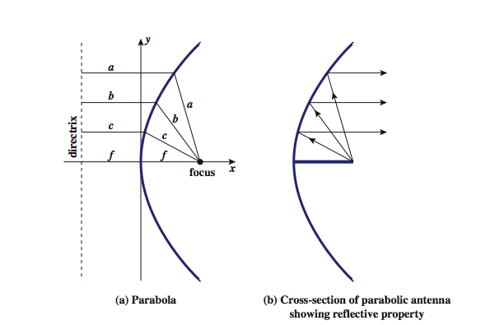
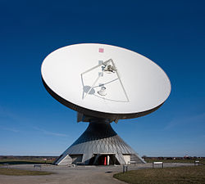
Parabolic Reflective Antenna
used in terrestrial microwave and satellite applications

Slide 39
Antenna Gain
Measure of the directionality of an antenna
Power output in particular direction verses that produced by an isotropic antenna
Measured in decibels (dB)
Results in loss in power in another direction
Effective area relates to physical size and shape
Antenna gain is a key performance figure which combines the antenna's directivity and electrical efficiency. As a transmitting antenna, the figure describes how well the antenna converts input power into radio waves headed in a specified direction. As a receiving antenna, the figure describes how well the antenna converts radio waves arriving from a specified direction into electrical power
A plot of the gain as a function of direction is called the radiation pattern.

Slide 40
Terrestrial Microwave
A system, method, technology, or service, such as Multichannel Multipoint Distribution Service, that utilizes microwave line of sight communications between sending and receiving units located on the ground or on towers, as opposed to a sender and/or receiver antenna being located on a communications satellite. Used, for instance, for telephone, TV, and/or data services. Also called Terrestrial Microwave radio.
Most common type is a parabolic dish with an antenna focusing a narrow beam onto a receiving antenna
Located at substantial heights above ground to extend range and transmit over obstacles
Uses a series of microwave relay towers with point-to-point microwave links to achieve long distance transmission

Slide 41
Terrestrial Microwave Applications
Used for long haul telecommunications, short point-to-point links between buildings and cellular systems
Used for both voice and TV transmission
Fewer repeaters but requires line of sight transmission
1-40GHz frequencies, with higher frequencies having higher data rates
Main source of loss is attenuation caused mostly by distance, rainfall and interference

Slide 42
Microwave Bandwidth and Data Rates

Slide 43
Satellite Microwave
A communication satellite is in effect a microwave relay station
Used to link two or more ground stations
Receives on one frequency, amplifies or repeats signal and transmits on another frequency
  Frequency bands are called transponder channels
Requires geo-stationary orbit
  Rotation match occurs at a height of 35,863km at the equator
  Need to be spaced at least 3° - 4° apart to avoid interfering with each other
  Spacing limits the number of possible satellites

Slide 44
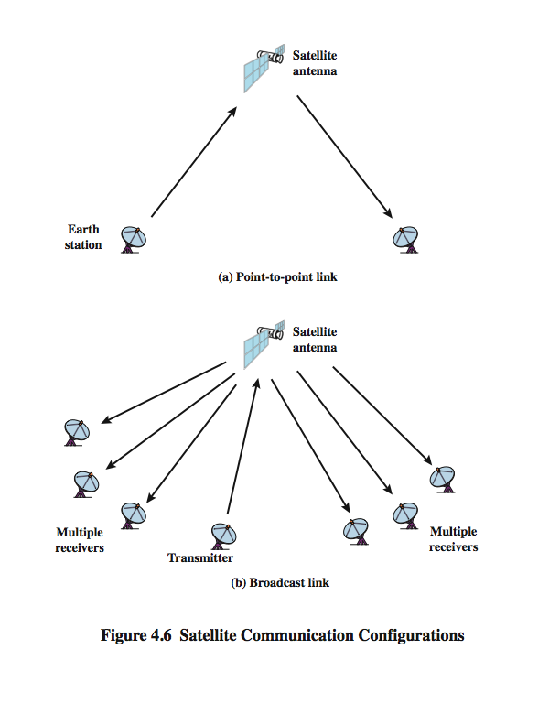
Satellite Point-to-Point Link

Slide 45
Satellite Broadcast Link

Slide 46
Satellite Microwave Applications
Uses:
Private business networks
    Satellite providers can divide capacity into channels to Lease to individual business users
  Television distribution
    Programs are transmitted to the satellite then broadcast down to a number of stations which then distributes the programs to individual viewers
    Direct Broadcast Satellite (DBS) transmits video signals directly to the home user
Global positioning
    Navstar Global Positioning System (GPS)

Slide 47
Transmission Characteristics
The optimum frequency range for satellite transmission is 1 to 10 GHz
    Lower has significant noise from natural sources
    Higher is attenuated by atmospheric absorption and precipitation
Satellites use a frequency bandwidth range of 5.925 to 6.425 GHz from earth to satellite (uplink) and a range of 3.7 to 4.2 GHz from satellite to earth (downlink)
    This is referred to as the 4/6-GHz band
    Because of saturation the 12/14-GHz band has been developed (uplink: 14 - 14.5 GHz; downlink: 11.7 - 12.2 GH

Slide 48
Broadcast Radio
Radio is the term used to encompass frequencies in the range of 3kHz to 300GHz
Broadcast radio (30MHz - 1GHz) covers
      FM radio
      UHF and VHF television
      data networking applications
Omnidirectional
Limited to line of sight
Suffers from multipath interference
      reflections from land, water, man-made objects
The principal difference between broadcast radio and microwave is that the former is omnidirectional and the latter is directional. Thus broadcast radio does not require dish-shaped antennas, and the antennas need not be rigidly mounted to a precise alignment.

Slide 49
Infrared
Achieved using transceivers that modulate noncoherent infrared light
Transceivers must be within line of sight of each other directly or via reflection
Does not penetrate walls
No licenses required
No frequency allocation issues
Typical uses:
    TV remote control
One important difference between infrared and microwave transmission is that the former does not penetrate walls. Thus the security and interference problems encountered in microwave systems are not present. Furthermore, there is no frequency allocation issue with infrared, because no licensing is required.

Slide 50
Summary
Guided and Unguided Media
Advantages and disadvantages some of the media (TP, STP, UTP, Coaxial, Fiber)
Design factor of the underlying media
Antennas

