Slide 1
Software Defined Radio
Lecture 31
Notes:
The term "software defined radio" was coined in 1995 by Stephen Blust, who published a request for information from Bell South Wireless at the first meeting of the Modular Multifunction Information Transfer Systems (MMITS) forum in 1996, organized by the USAF and DARPA around the commercialization of their SPEAKeasy II program
If the frequency is trapped then they are stuck and can not do anthing
SDR is a radio communication system where components that have been typically implemented in hardware (e.g. mixers, filters, amplifiers, modulators/demodulators, detectors, etc.) are instead implemented by means of software on a personal computer or embedded system.

Slide 3
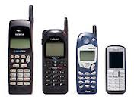
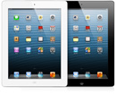
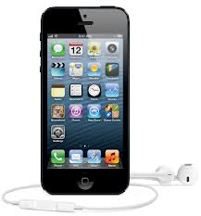
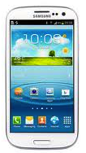
Motivations
Quad-band GSM
GPS
Bluetooth
802.11b….
GPRS
EDGE
WCDMA
LTE
Notes:
Large # of Standards and large number of independently developed Radio Boards
All Squeezed into the smart device
You see one antenna but there are actually a lot 3 or 4 or more
Cram Down the funnel of functions
New Standards
GSM use SIM cards in order to hold all of your data and to be able to connect to the network effectively. GSM is used to talk, text, and use the internet.
CDMA: Code Division Multiple Access, not as prominent as it once used to be. These do not use SIM cards, but instead the carrier ties your number and account to the phone itself to connect to the network. CDMA is used to talk, text, and use the internet.
LTE: Long Term Evolution, this is the newest form of cellular data. Often referred to as 4G, this is a new, blazing fast mobile data bandwidth. LTE is used for solely internet at the moment, however soon your cell phones may talk over LTE as well.
In the US, T-Mobile and AT&T use GSM, while Verizon and Sprint use CDMA. All four networks have LTE in the works, with Verizon having coverage in more than 200 markets already, and AT&T with only around 10 markets. The other carriers are releasing their versions of 4G soon.
GSM and CDMA are two of the major networks used in the United States. LTE (Long Term Evolution) refers to a standard for very high-speed data (like 4G and 3G.) The Global System for Mobile Communication (GSM) network is used by AT&T and T-Mobile in the US. They are normally best for people who travel internationally often. Code division multiple access (CDMA) network is the base for networks such as IS-95, CDMA2000, etc. It is used on a lot of radio communications technologies. (GSM carriers actually use WCDMA, a type of CDMA, for 3G data) It is used on Sprint and Verizon in the US.
You have the Galaxy Nexus, which is on Verizon. It is a CDMA phone and has 4G LTE (which makes it a fast phone internet wise!)

Slide 4


Motivations
First-responder communications failures
SDR will facilitate radio interoperability
Notes:
Left Hurricane Katrina
Right Hurricane Sandy
Why is it that communications always seem to fail when we need it most
First line of communication Fails

Slide 5
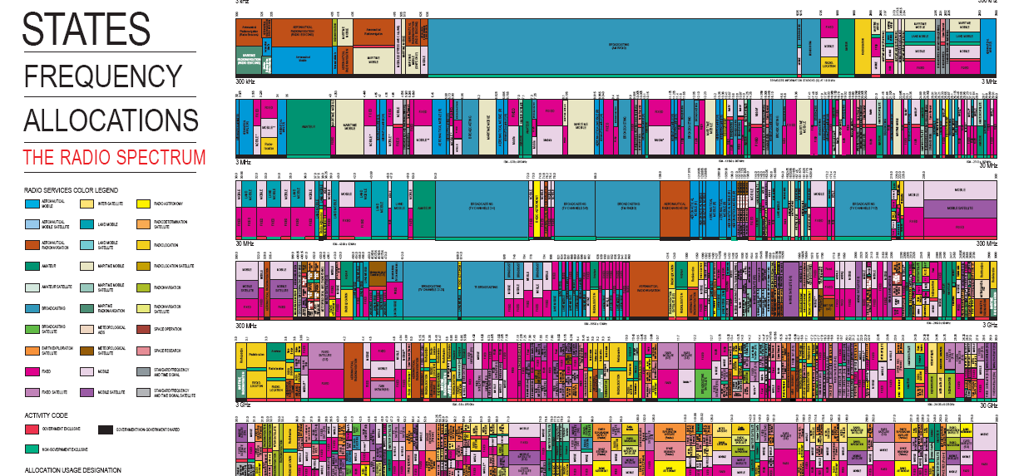
Motivations: Efficient and Effective Frequency Allocation
Courtesy: http://www.ntia.doc.gov/
Notes:
Spectrum space as a scarce resource
SDR will facilitate the Cognitive Radio Functionality implementation
SDR will enable spectrum reuse

Slide 6
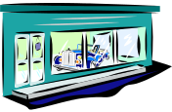

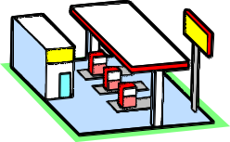



Motivations: User’s Dream
Public
hot-spot
802.11
Office
WLAN
802.11
DVB-H
DAB
?
Tomorrow’s
new standard
Fixed wireless
access
802.16
Higher Rate
Cellular Mobile
Notes:
Four A’s Any Service, Anytime, Anywhere and over Any Technology
A user’s dream: Anything, anywhere, anytime
Music, video, photos, games, data services etc.) on a range of platforms – while on the move.

Slide 7

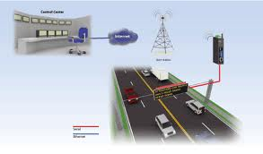
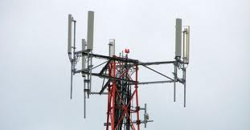
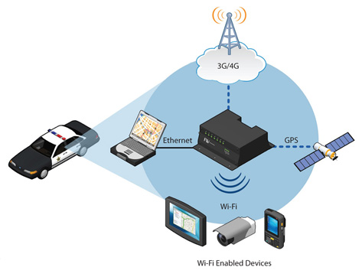
Motivation: Universal Handset
Notes:
No hope but I can at least point out
In the US, T-Mobile and AT&T use GSM, while Verizon and Sprint use CDMA. All four networks have LTE in the works, with Verizon having coverage in more than 200 markets already, and AT&T with only around 10 markets. The other carriers are releasing their versions of 4G soon.
imagine a handset that can be a CDMA, GSM, LTE, Wi-Fi, DVB-H (or other digital broadcast), Bluetooth, or whatever radio, just by firing up the appropriate code on a common hardware platform
cellular, connectivity, broadcast, and multimedia standards co-exist in a mobile phone
This concept has enormous benefits for multi-standard wireless applications, such as reduced cost-of-ownership, faster time-to-market, unprecedented flexibility, smaller form factor, and more favorable economies-of-scale when compared with classical baseband solutions.
The key attraction of SDR will be its ability to support multiple standards on the same processor by changing the software only
Apple Iphone5 don’t have WiMax support
base stations will still be built fundamentally from SDR
A handset chipset that covers the LTE/Wi-Fi bases should be less expensive than one built from SDR, and consume less power as well

Slide 8
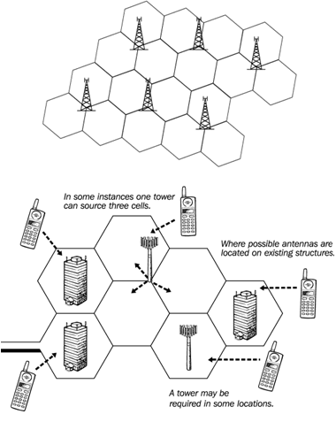
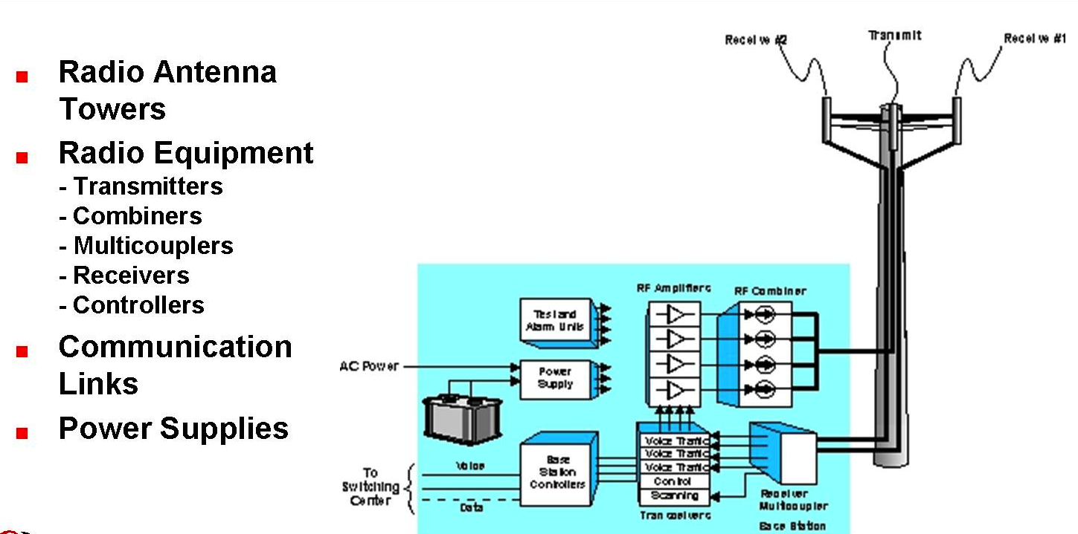
Motivation:Basestation Manufacturers
Notes:
Multistandard base stations allow operators to combine multiple access technologies such as 2G, 3G, and 4G onto a single base station platform.
Software Defined Radio (SDR) technology has been one of the key enablers for multistandard base stations with reconfigurable baseband and radio heads allowing for flexibility and ease of upgrade.
The advantages of multistandard base stations go beyond simply upgrading a base station platform, adding OPEX efficiencies such as integrated backhaul, as well as reduced power consumption and site rental costs. There are additional performance benefits with multistandard base stations using state of the art components.
One of the key benefits of multistandard base stations is their ability to operate on multiple technologies within a given spectrum band. Refarmed spectrum is seen as an important driver for multistandard base stations as operators moving from 2G to 3G to 4G look to take advantage of unused spectrum assets. 900 MHz GSM/UMTS is the best example of where multistandard base stations have been used.
The BSC controls multiple BTSs. It handles allocation of radio channels, frequency administration, power and signal measurements from the MS, and handovers from one BTS to another (if both BTSs are controlled by the same BSC). A BSC also functions as a “funneler”. It reduces the number of connections to the Mobile Switching Center (MSC) and allows for higher capacity connections to the MSC.
A BSC my be collocated with a BTS or it may be geographically separate. It may even be collocated with the Mobile Switching Center (MSC).
*The interface between the BTS and the BSC is known as the Abis Interface
*The Base Transceiver Station (BTS) and the Base Station Controller (BSC) together make up the Base Station System (BSS).

Slide 9


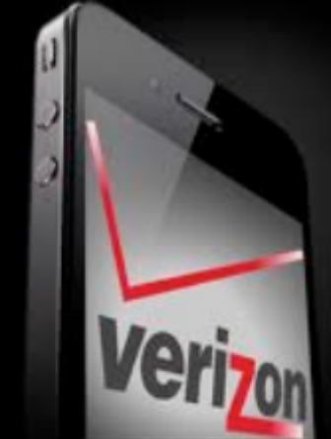

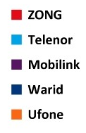
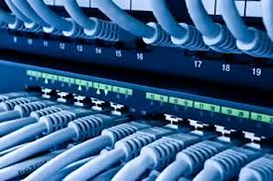


Motivations: Network Operators
Notes:
Mobile operator perspective of the potential of SDR, within the context of third generation mobile communications and beyond, describing potential use cases, business models and changes in the industry value chain
increased flexibility of spectrum management and usage.

Slide 10
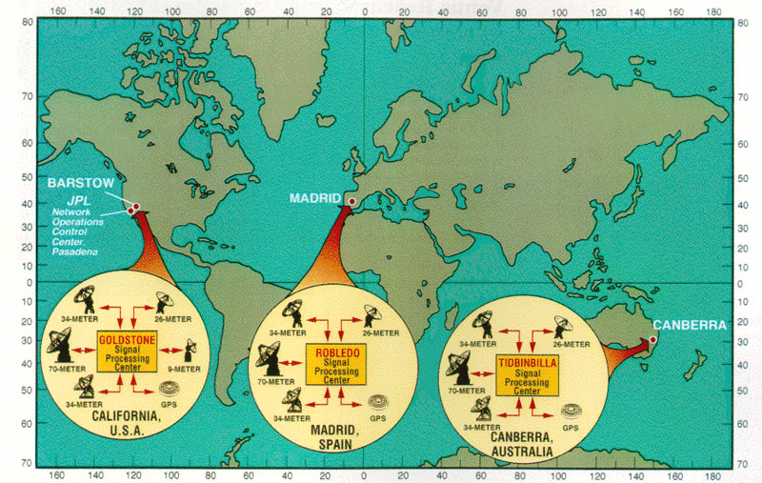
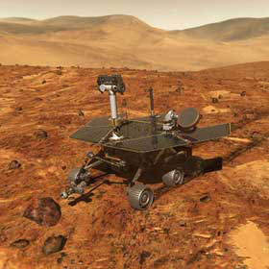
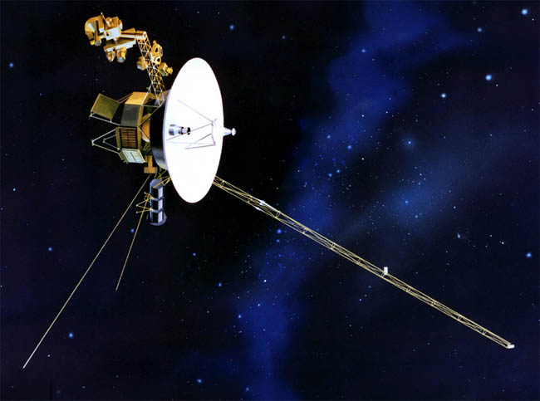
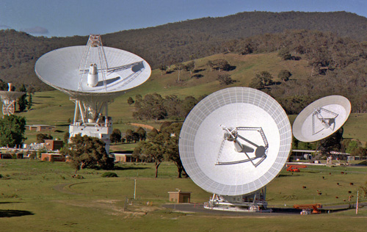

Motivation: Deep Space Communications
Notes:
SDR allows old and new protocols
Satellite ground station would like to listen to multiple spacecraft, some launched in the 1970s

Slide 11
Motivation: Subscribers, Services and Developers
International roaming
Increased personalization and choice
Required Improved and more flexible services
Distinct services and the service logic
Unified communication
Notes:
Easier international roaming
the potential to rapidly develop and introduce new, personalized and customized services,
tools for increased customer retention, new added-value services and revenue streams,
reduced costs of network evolution and enhancement,
Subscribers are forced to buy new handsets whenever a new generation of network standards is deployed

Slide 12
Motivation: Standardization
Application
Presentation
ISO
OSI
7-layer
model
IEEE 802
standards
Session
Transport
Network
Logical Link Control
Data Link
Medium Access (MAC)
Physical
Physical (PHY)
Notes:
Standardization is an important issue for telecommunications, especially wireless,
Next to standardization, national and regional regulation is the second issue of significance
when considering SDR in a global context – to a global mobile operator, common global regulation is desirable, just as are common global standards.

Slide 13
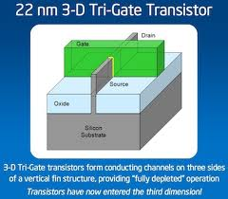
Motivation:
Silicon capability
Performance/sampling tradeoff
Myriad standards exist for terrestrial communications
Resource requirement for communication system’s proof of the concept
Business logic and time to market
Notes:
This is one of the motivational factor, my Laptop example
Complexities doubling as a result of silicon capability
Bottleneck for the DAC/AD has been replaced by a thin line
Terrestrial Communication don’t need a base station
The Solution to all these problems is motivated by SDR
Evolution of the Iphone, the speed and the time to market of the apple

Slide 14
Motivation:
Commercial wireless communication industry is currently facing problems due to constant evolution of link-layer protocol standards (2.5G, 3G, and 4G)
Existence of incompatible wireless network technologies in different countries inhibiting deployment of global roaming facilities
Problems in rolling-out new services/features due to wide-spread presence of legacy subscriber handsets
Notes:
Convergence of link layer protocols
Unification of access technologies
Unified services and Application has to be developed and launched

Slide 15
Software Defined Radio (SDR)
A Software Defined Radio (SDR) is a system where components that have been typically implemented in hardware (e.g. mixers, filters, amplifiers, modulators/demodulators, etc.) are instead implemented by means of software on a personal computer or embedded system.
Development of generic radio platforms that can be reconfigured ‘on-the-fly’, possibly by means of over-the-air downloads, to target multiple radio standards operating over a wide range of carrier frequencies
Notes:
Flexible radio systems that allow communication standards to migrate
Flexible methods for reconfiguring a radio in software
Flexible, intelligent systems that communicate via different protocols at different times
You move as close as possible near to the antenna by taking most of the functionalities into the software

Slide 16
SDR Vision
Allowing what ever type of communication is required,
  Where ever you are,
  and
  When ever you need it
A generic hardware that can be programmed to manage any radio standards
But it has yet to be realized by the end user in many markets

Slide 17
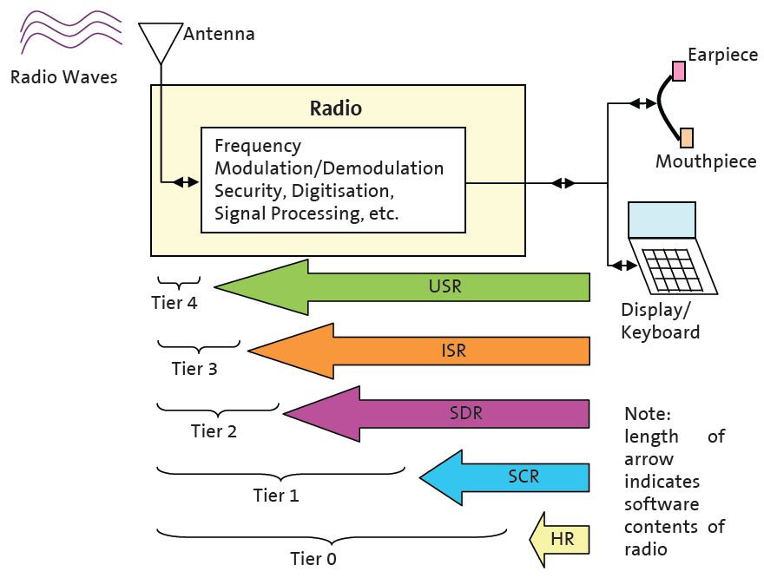
SDR (Types)
  Capable of covering substantial frequency range and of executing software to provide variety of modulation techniques, wide-band or narrow-band operation, communications security functions and meet waveform performance requirements of relevant legacy systems
  Capable of storing large number of waveforms or air interfaces, and of adding new ones by software download
  System software should be capable of applying new or replacement modules for added functionality or bug fixes without reloading entire set of software
  Separate antenna system followed by some wideband filtering, amplification, and down conversion prior to receive A/D-conversion
  The transmission chain provides reverse function of D/A-conversion, analog up-conversion, filtering and amplification
Notes:
Length of the aero represents the amount of code

Slide 18
SDR: Drivers
Key Players might be from Academia, Industry and Research.
    But Challenge, problem and/or difficulty always brings an opportunity.
Manufacturers, Operator, Regulator Authorities, Standardization Bodies etc.
all together from AIR triangle should be benefiting from this occasion
GnuRadio, OSSIE, FunCube Dongle, RTL Dongle, SDR Forum, Ettus Research …..
Notes:
There must be a driving force behind technology
Initiative is taken from the DoD
Evolution of Wireless Industry is an example
Get the software close to the antenna
Software defines the waveforms
Replace analog signal processing with digital signal processing

Slide 19

SDR: Drivers
The cellular industry
Wide area coverage.
Global roaming.
Mobile users at vehicular speeds.
Subscription-based.
Licensed bands.
The wireless LAN industry
Local coverage.
No handoff or roaming.
Fixed users.
Revenue through equipment sales.
Unlicensed bands.
The
Wireless
Internet
Notes:
You have to have a framework for PaperLess Environment Framework to have Wireless Internet

Slide 20
SDR: Drivers
Future trends of mobile communications
Notes:
SDR is the heart of LTE
The different wireless networks such as cellular, codeless, wireless local area network (WLAN) having different band of frequency requires individual software to access any call. The SDR device requires more antennas and low noise amplifier (LNA) because it is impossible for single antenna and single band pass filter to operate at all the frequency bands. Large number of antennas, filter and amplifier increased the size of the device. The SDR scan the available network and download the required software from WLAN, memory card, PC server etc.

Slide 21
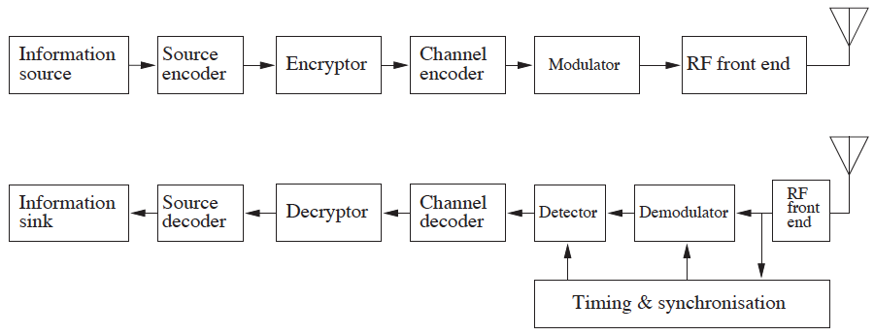
Block Diagram of a Digital Radio System
Notes:
The general idea is to replace special analog hardware components by FPGAs, DSPs and 'general purpose processors' (GPPs), and therefore allow fast-prototyping on a flexible platform.
The limitation of this system is that any change made to the RF section of the system will impact the DDC/DUC operations and will require non-trivial changes to be made in DDC/DUC ASICs.

Slide 22
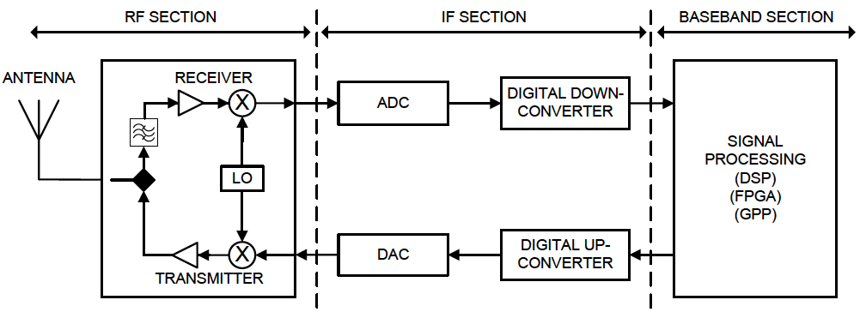
Digital Radio System
Notes:
SDR solution can implement precise signal processing and handle hardware tasks such as modulation, demodulation, and phase lock loop (PLL) synchronization at a relative low cost.
SDR applications perform demodulation, modulation and other signal-processing of a digitized source signal using software modules running on a PC or other capable device. With signal processing placed in the software domain, highly configurable and flexible DSP systems can be implemented
In comparison to that the software-defined radio (SDR) system is one in which the baseband processing as well as DDC/DUC modules are programmable. This is possible because of the availability of smart antennas, wideband RF front-end, wideband ADC/DAC technologies and ever increasing processing capacity of DSPs and general-purpose microprocessors.

Slide 23
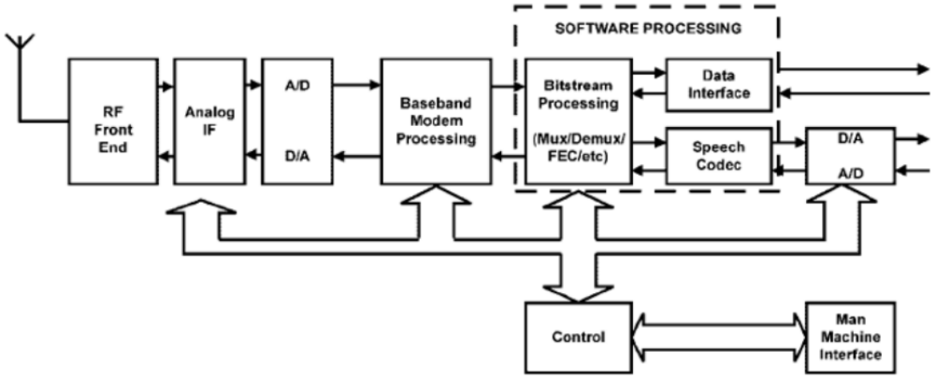
SDR: Handset Evolution
Notes:
implements channel coding, source coding and control functionality in software on DSP/μ C/programmable logic.
Cellular infrastructure systems are increasingly using programmable processing devices to create “common platform” or “multiband- multiprotocol” base stations supporting multiple cellular infrastructure standards.
Cellular handsets are increasingly utilizing System on Chip (SoC) devices that incorporate programmable “DSP Cores” to support the baseband signal/modem processing
Satellite “modems” in the commercial and defense markets make pervasive use of programmable processing devices for intermediate frequency and baseband signal processing

Slide 24
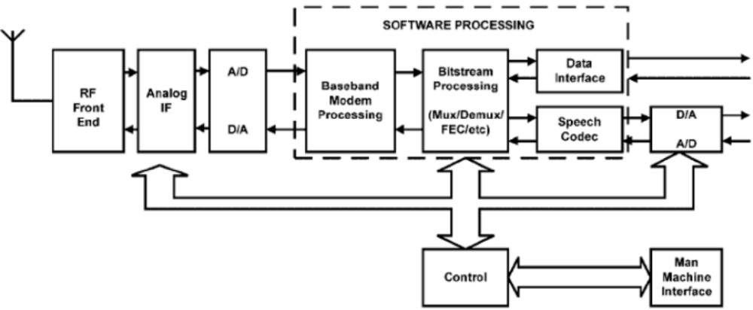
SDR: Handset Evolution
Notes:
This step allows the realization of new and adaptive modulation schemes under either self-adaptive or download control.

Slide 25
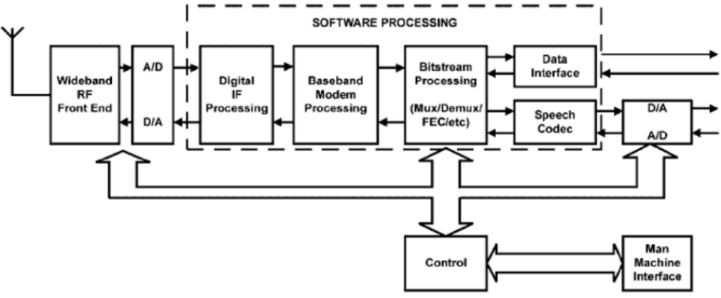
SDR: Handset Evolution
Notes:
Further extension of this, involving a major change to the overall architecture to implement the IF signal processing digitally in software, will allow a single terminal to adapt to multiple radio interface standards by software reconfigurability, i.e. reconfiguration at the lowest level of the protocol stack

Slide 26
SDR: Benefits
Ease of design
  Reduces design-cycle time, quicker iterations
Ease of manufacture
  Digital hardware reduces costs associated with manufacturing and testing radios
Multimode operation
  SR can change modes by loading appropriate software into memory
Use of advanced signal processing techniques
  Allows implementation of new receiver structures and signal processing techniques
Fewer discrete components
  Digital processors can implement functions such as synchronization, demodulation, error correction, decryption, etc.
Flexibility to incorporate additional functionality
  Can be modified in the field to correct problems and to upgrade
Notes:
The whole chain starting from the end provider. Operator, end used and app/service developer can be benefitted
This chain (Equipment Manufacturers and System Integrators, Service Providers, End Users)consists of product-based and service-based providers, with value added at each stage, ultimately resulting in SDR end products and services that meet the needs of the end users and subscribers
Reduced Cost

Slide 27
SDR: Advantages
Flexible/reconfigurable
  Reprogrammable units and infrastructure
Reduced obsolescence
  Multiband/multimode
Ubiquitous connectivity
  Different standards can co-exist
Enhances/facilitates experimentation
Brings analog and digital worlds together
  Full convergence of digital networks and radio science
  Networkable
  Simultaneous voice, data, and video
Notes:
Technological advantages

Slide 28
SDR: Facilitators
Antennas
Waveforms
Analog-to-Digital Converters (ADCs, DACs)
Digital Signal Processing
Amplifiers
Batteries
Cognition, behaviors
Design tools
Notes:
Antennas: Receive antennas are easier to achieve wide-band performance than transmit ones New fractal & plasma antennas expected in 5–10 years that will be smaller and wideband
Waveforms: Management and selection of multiple waveforms Cancellation carriers and pulse shaping are relatively new techniques (research papers 5 years)
DAC/ADC: ADC sampling speed has tripled every 6–8 years If ADC development continues then by the year 2010, ~500 MHz of bandwidth could be digitized instantaneously
Digital signal processing/FPGAs: Number of transistors doubles every 18 months When will this pace slow down? Some indicate this pace is only sustainable until 2010 More specific purpose DSPs and FPGAs
Batteries: More and more power needed (need to focus on more efficient use of power) Fuel cell development, another 5–10 years until viable for handhelds
Terrain databases: Interference prediction, environment awareness 5 years away
Cognitive science: A key aspect will be to understand how multiple CRs work with each other
Design Tools: Tools facilitate rapid design iterations Systems tools to help evaluate trade-offs

Slide 29
SDR: Issues
Wideband radio circuits (Rx): high requirements
High requirements on A/D converter
Wideband PA (Tx): linearity, bandwidth, efficiency
Higher power consumption than dedicated ASIC approach
More MIPS required
Higher cost (today)
Notes:
ADC performance, semiconductor technology
Software reliability (or the lack thereof) may define overall radio reliability, rather than hardware limitations
Even medium performance SDR tends to require more power for a given function than equipment designed specifically for purpose with optimum analogue/digital architectural partitioning
Linearity and power efficiency in transmit front ends are conflicting requirements demanding innovative solutions for present and future wireless mobile systems. The demand is greater in energy constrained mobile units, especially as signal bandwidths increase and other unit parts require a greater share of the available energy.
16 bits, 300 Ms/s)

Slide 30

SDR: Projects
GNU Radio
OSSIE
OpenBSC
USRP
High Performance SDR
O
Cisco + OpenFlow + OpenStack = Software Defined Network (SDN)
Notes:
An open Source SDR
Another opensource SDR by Viginai Tec
GSM stack being motivated by the SDR
Open Design RF front end Hardware for SDR
Tactical SDR
OsmoSDR is a 100% Free Software based small form-factor inexpensive SDR (Software Defined Radio) project.
If you are familiar with existing SDR receivers, then OsmoSDR can be thought of something in between a FunCube Dongle (only 96kHz bandwidth) and a USRP (much more expensive). For a very cheap (but inaccurate) SDR, you can use the DVB-T USB stick using the RTL2832U chip, as documented in rtl-sdr.
Software Defined Network

Slide 31
Software Defined Networking (SDN)
A technology to networking that allows centralized, programmable control planes so that network operators can control and manage directly their own virtualized networks
Separation of control and data planes,
Centralized, programmable control planes of network equipment, and
Support of multiple, isolated virtual networks

Slide 32
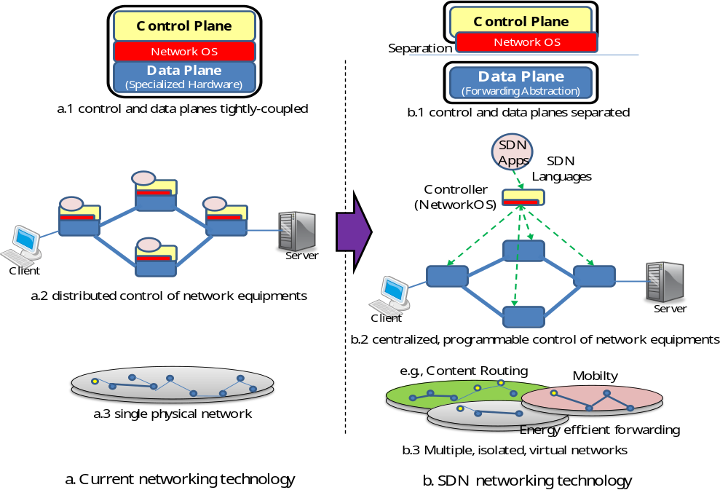
SDN
Tight coupling of data and control planes
Control and data planes detached and separated
Distributed control of equipment
Programmable centralized control of equipments
Single network (physically)
Multiple, isolated and virtualized networks
Current technique/methodology
SDN

Slide 33
Software Defined Radio

Slide 34
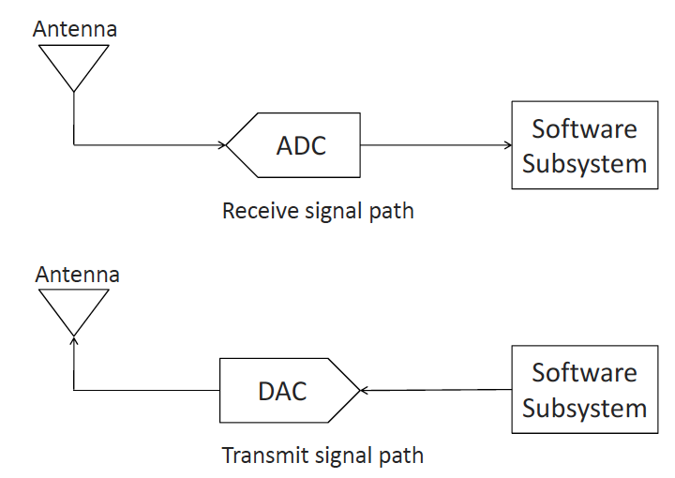
Ideal SDR
Notes:
The antenna should be capable to operate at the frequency of all radio signals of interest
The ADC and the DAC should have a sampling rate greater than two times the frequency of the signals of interest

Slide 35
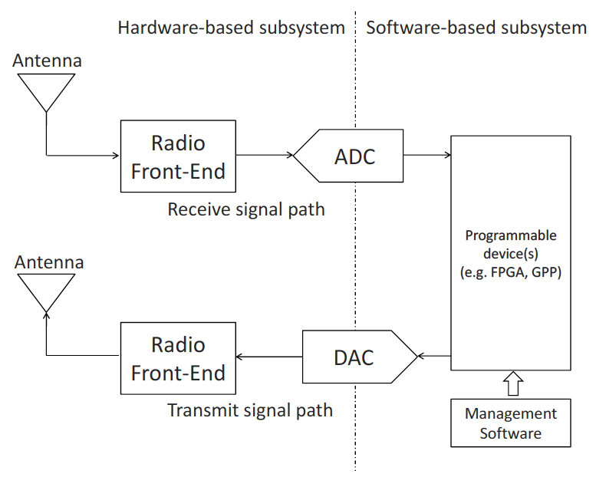
Typical SDR
Notes:
The software subsystem should have enough processing power to handle the signal processing of all radio signals of interest.
In practice ADCs and DACs are not fast enough to process a large portion of the spectrum and antennas are designed for specific frequency bands. As a result, ideal SDR are realized only for particularly simple technologies (e.g. AM radio).
In a typical SDR the hardware-defined subsystem consists of a wideband Radio FE that takes a portion of spectrum and shifts it to the IF prior to digitization. The software-defined subsystem receives the digital wideband signal, sends it to a set of digital downconverters to isolate the required carrier, and proceeds with the demodulation

Slide 36
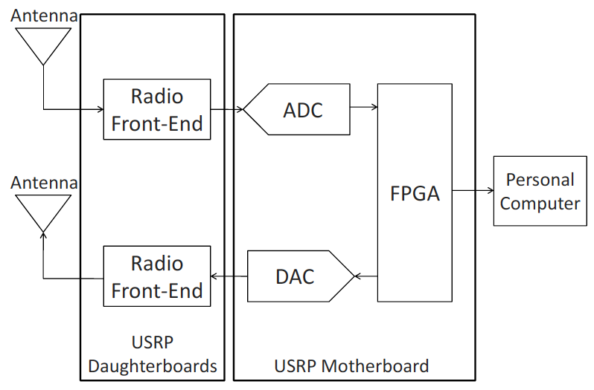
USRP
Notes:
The Universal Software Radio Peripheral (USRP) is a device developed by Ettus Research LLC [2], which turns general purpose computers into flexible SDR platforms. The core of the USRP is a motherboard with four high-speed ADCs and DACs and an Altera Cyclone EP1C12 FPGA.
The main principle behind the USRP is that the digital
Radio tasks are divided between the internal FPGA and the external host CPU. The high speed general purpose processing, like down and up conversion, decimation, and interpolation are performed in the FPGA, while waveform-specific processing, such as modulation and demodulation, are performed at the host cpu.

Slide 37
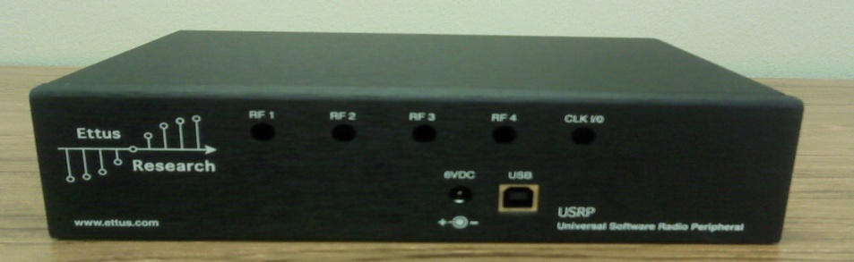
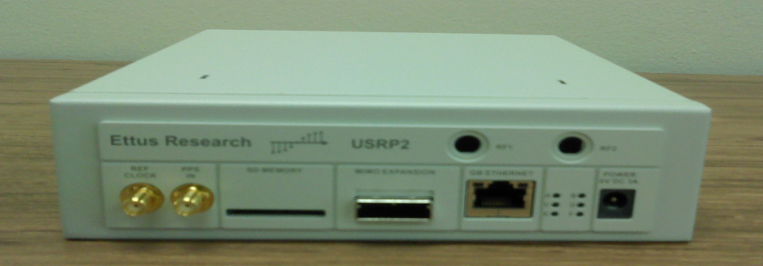
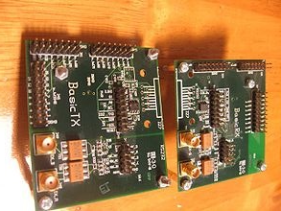
USRP in the context of SDR
USRPs are inexpensive, computer hosted hardware solutions for developing software radios through GNU radio.
Two USRP generations (USRP -1 and -2) are available

Slide 38
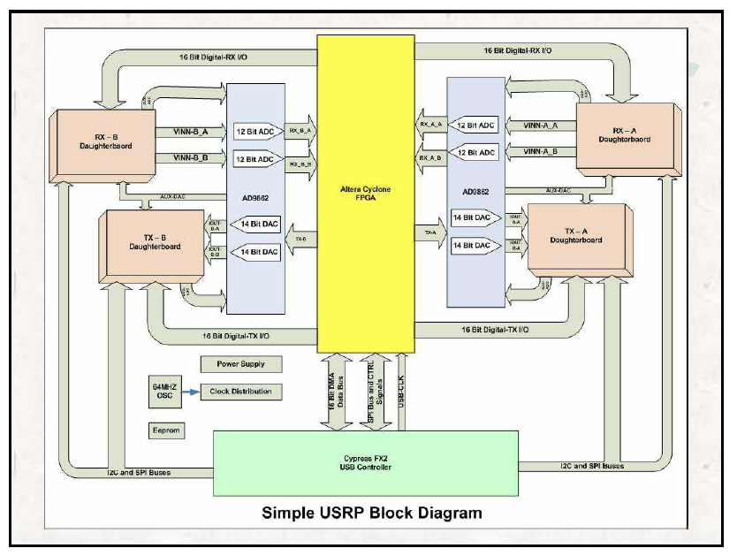
USRP Block Diagram
Notes:
Four 12-bit AD converters 64M samples/second
Thus can digitize a band as wide as 32MHz 2V peak-to-peak, input is 50 ohms differential Thus 40mW or 16dBm
If input signal is weak, it can be amplified by using Programmable gain amplifier (PGA) before ADC (0.2V p-p is enough if PGA is 20dB (max)

Slide 39
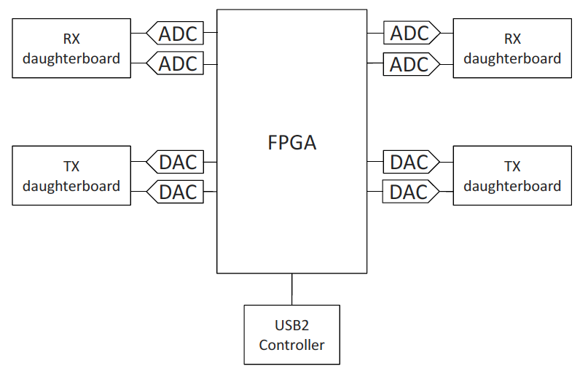
FPGA
Ethernet
Notes:
The FPGA plays a central role in the USRP design. The USRP FPGA uses Verilog hardware description language, compiled by using Quartus II web edition from Altera. This compiler is available for free, therefore customized Verilog code can be compiled and uploaded to the FPGA firmware.
The USRPmotherboard can be connected to four radio FE, namely daughterboards. Each of them has access to 2 high-speed ADCs/DACs and contains two SMA connectors
for input and output signals. Ettus Research LLC produces ten daughterboards for different applications:

Slide 40
GNURadio (Operations)
Mathematical operations (add, multiply, log, etc.)
Interleaving, delay blocks, etc.
Filters (FIR, IIR, Hilbert, etc.)
FFT blocks
Automatic Gain Control (AGC) blocks
Modulation and demodulation (FM, AM, PSK, QAM, GMSK, OFDM, etc.)
Interpolation and decimation
Trellis and Viterbi support
Notes:
After the signal has been processed by the USRP FPGA, the stream of bits finally flows through the USB connection to the host cpu. It is here that the GNUradio framework comes into play.

Slide 41
GNURadio(Sources/Sinks)
Signal generators
Noise generators
Pseudo random number generators
USRP source and sink (to transmit/receive signals via USRP)
Graphical sinks (Oscilloscope, FFT, etc.)
Audio source and sink
File source and sink (reads/writes samples from/to a file)
User Datagram Protocol (UDP) source and sink (to transport samples over a network)

Slide 42
GNURadio (Implementation)
Python Flow Graph (Functions Binder)
SWIG (Sequencing and Scheduling )
C++ Signal Processing Blocks
Giga Speed Ethernet/USB2 connection
USRP1/2
Notes:
In GNUradio the blocks are created in C++ and the graphs are built and run in Python. SWIG2 is used as interface between them. Basically, C++ is used for lowlevel programming, while Python is used on a higher level, to create graphs or higher level blocks. Creating a flow graph with Python is straightforward. By using SWIG all the blocks are accessible from the Python source code. It is important to note that GNUradio provides classes to interface with the USRP (and the developers
strongly suggest to use this device).

Slide 43
SDR and USRP Integration
Hardware Used
  USRP N200
  WBX Daughterboard for GSM Quad-band Support
  900MHZ Antennas
Software Used
  GNURadio
  OpenBTS
  Asterisk
  Smqueue

Slide 44
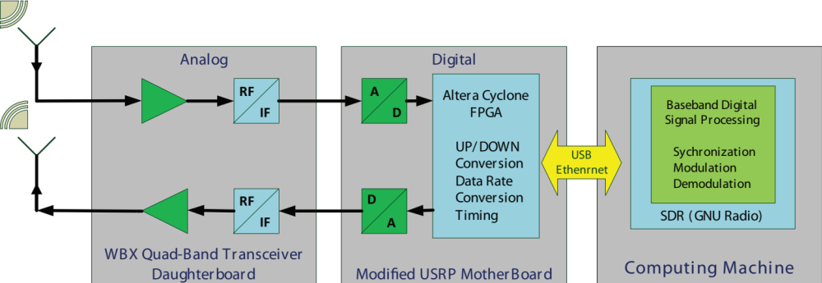
SDR and USRP Integration

Slide 45
GSM vs OpenBTS
OpenBTS is a software-based GSM access point (stack), allowing standard GSM-compatible mobile phones to make phone calls without depending on existing telecommunication providers' networks.
OpenBTS software code plays the role of the MSC and the Visitor Location Register (VLR) in processing all the calls incoming to, or originating from subscribers visiting the given switch area.
FUNCTIONS | GSM | OpenBTS
Control Functions | MSC | Asterisk
Radio Management | BSC | GNU Radio
Signaling Functions | BTS | USRP
Notes:
Still 70-80 % services are operating on GSM
GSM uses Gaussian Minimum Shift Keying, GSM air interface between the mobile station (MS) and the base station (BTS), also known as “Um”, is fairly complex
GSM-900 uses 890 to 915 MHz and for uplink and 935 to 956 MHz for downlink.

Slide 46
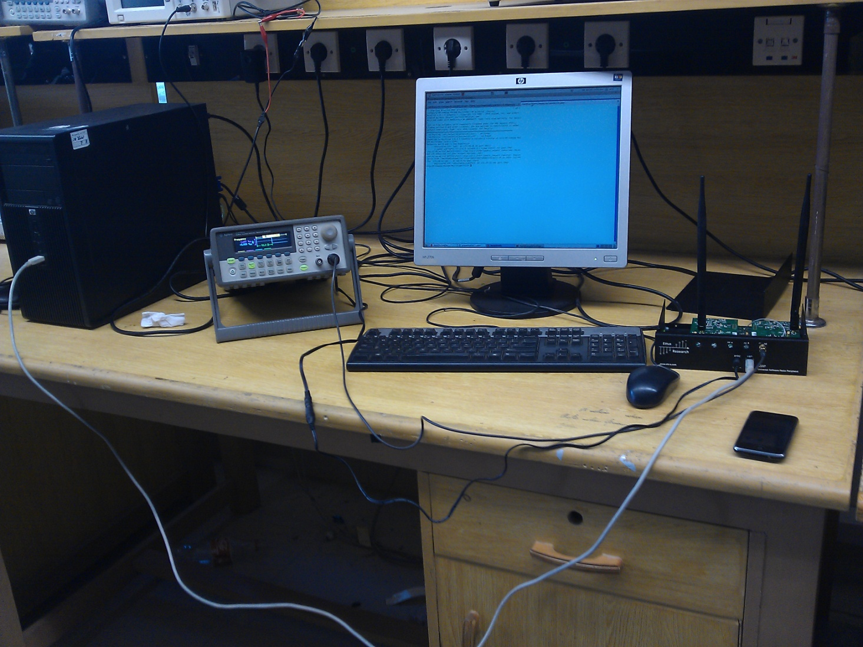
Setting up the environment
Notes:
Messages directed in downlink direction are serialized into L3 frames which are then passed down to L2. L2 processor breaks the frames into segments, wraps each segment into L2 frames and passes them down L1 according to the LAPDm state machine. L1 FEC processor encodes each L2 frame with time stamp and passes to TDM interface. The outgoing radio bursts are first sorted into a priority queue and modulated. Modulated waveform samples are then transferred to USRP over the Ethernet interface for transmission.

Slide 47
Setting up the environment:
Compatibility Issues
SIM Card Configuration
SIM is a tool kit that stores certain parameters (i.e. IMSI, PLMN) within it to identify the correct network and to camp on it. To make the test phone camp on OpenBTS the parameters stored in the SIM card must be matched to the parameters in the configuration file of OpenBTS.
Clocking Issue
Frequency accuracy is one the main issue in camping the handsets to the network. The BTS uses a single frequency source of absolute accuracy better than 0.05 ppm for both RF frequency generation and synchronization. Stock USRP has a frequency accuracy of 20 ppm.
Notes:
IMSI catcher is getimsi.py or just configure the cell phone to select the network manually, IMSI is then catched by the system

Slide 48
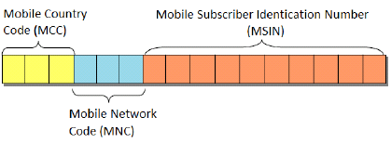
IMSI Catcher
Commercial carrier SIM cards come with a preferred network list and to ensure the handset will scan OpenBTS network, it must be set up as the first preferred network.
Alternatively, the handsets can be forced to register on the test GSM network by going into the handset general network settings options and select an operator manually.

Slide 49
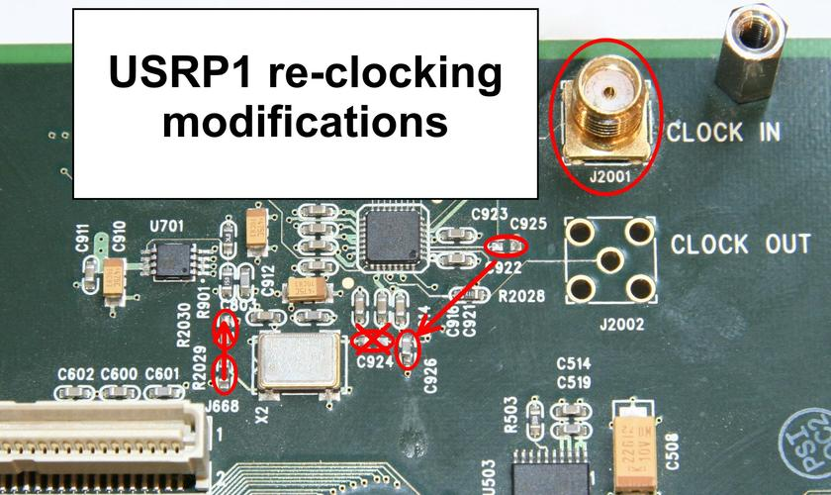
Setting up the environment
Clocking Issue
Solution
We found that providing external clock to the USRP kit may be one of the solutions by which we can camp our mobile in OpenBTS. This external clock should be 52 MHz.

Slide 50
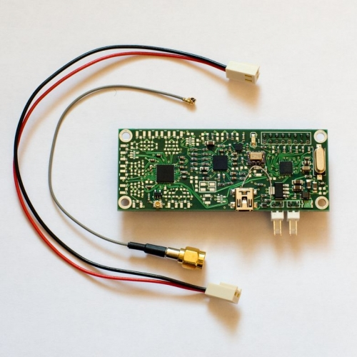
Setting up the environment
ClockTamer Circuit

Slide 51
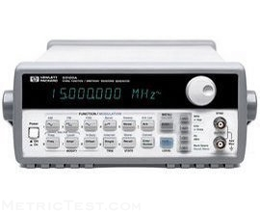
Setting up the environment
Function Generator As External Clock source

Slide 52
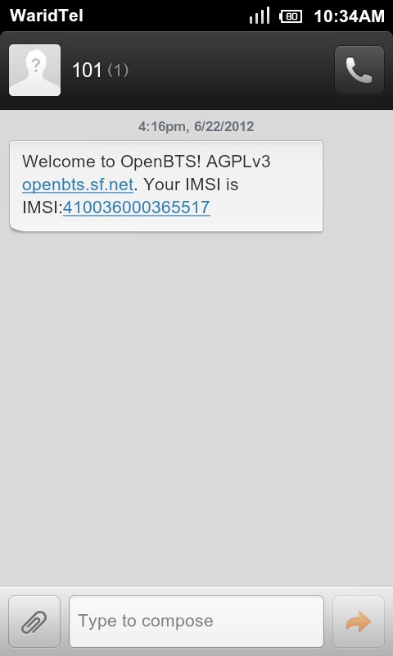
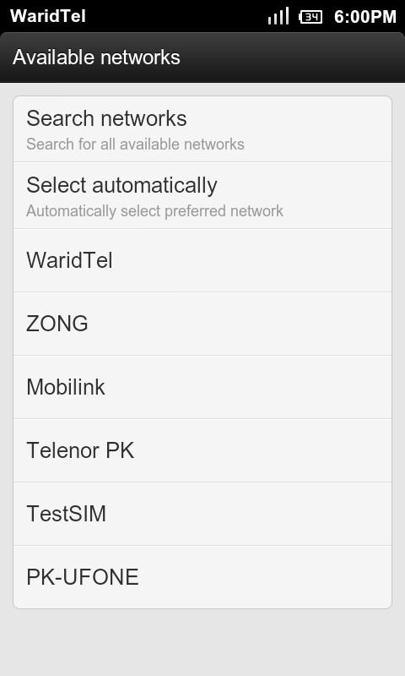
Setting up the environment
Testing

Slide 53
Other Applications
AM/FM radio transmission and reception.
Radar Interception.
Spectrum Analyzer
GSM Interception
Channel Estimation
Reception of TV signals

Slide 54
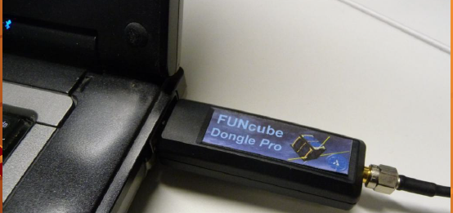
Low Cost SDR

Slide 55
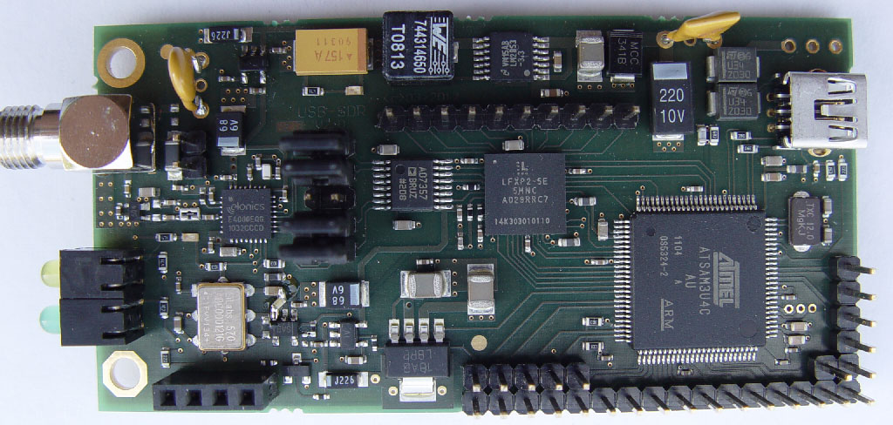
$ 20 SDR (RTL Dongle)

Slide 56
$ 20 SDR (How it works)
Input from an antenna is down sampled, filtered by The E4000 tunerchip and passed to an analog to digital converter (RTL2832U) the output is then sent to the computer by USB.
All filtering, demodulation and other processing is done by the computer.
Audible output is then played back on the computer speakers

Slide 57
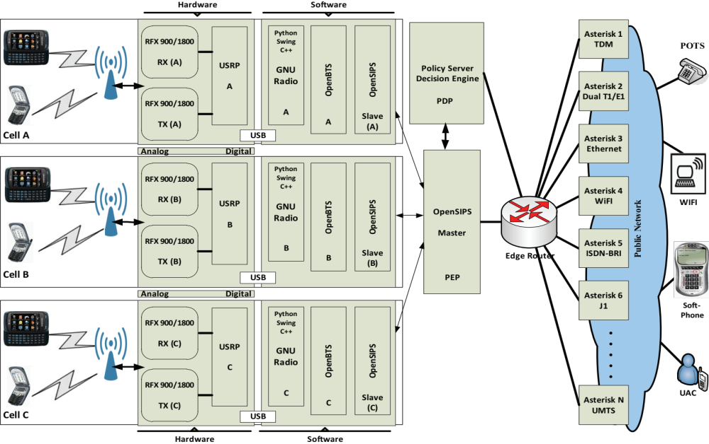
Routing Switching
Session Border Controller
Performs NAT/PAT translation
Handles ressources related CAC
Analyzes SIP/SDP
Acts as Policy Enforcement Point(PEP)
Call Server
Handles registration, user profile and service management.
Performs profile related CAC
Notes:
Master OpenSIPS is tweaked to act as SBC while Slave OpenSIPS is configured to act as Call Server.
The boards provide GSM air interface and fast analog to digital and vice versa conversion.
GNU radio is Software Defined Radio (SDR) performing Modulation and Demodulation using conventional PC rather than expensive DSP chips adding more flexibility.
OpenBTS emulates the GSM calls as SIP extensions for the OpenSIPS, the Call Server.

Slide 58

Routing Switching
We have introduced Policy Server (PS)
Decision Engine within PS provides dynamic/efficient control and management While taking into account dynamic and static info
Notes:
Policy Server has all the information about the state of the links and other resources over the platform.
An outgoing call scenario is animated due to most likely use case regarding the GSM2VoIP convergence and more desiring business model.

Slide 59
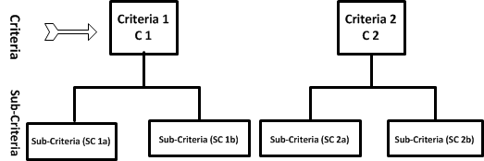
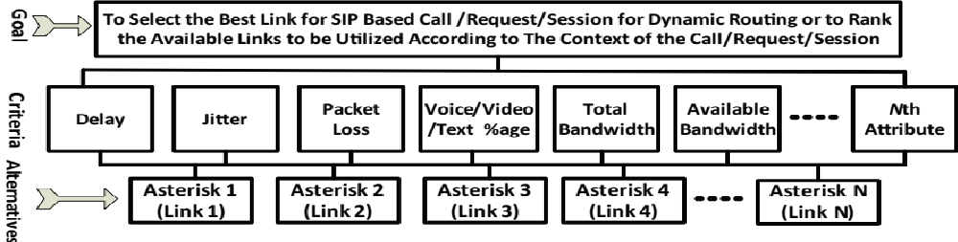
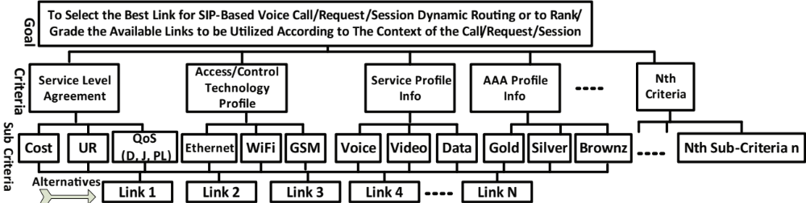
Multi Criteria Decision Making (MCDM) and the Decision Engine
Several Criteria
  Link Profiles
  User Profiles
  Business Objectives
  Attributes extracted from the context differ at service and link level.
A Multi-criteria, Multi-Attribute and Multi-objective problem has to be addressed.
The Criteria may contain
Sub-Criteria
Notes:
Link Profile may includes an SLA associated to the link
User Profile may include the authorizations and authentications and priorities and corresponding QoS level
Business Objectives may include voice is more important than video on link A. Time of the day etc.
Context includes Communication Type and User Type etc.

Slide 60
TOPSIS MCDM Method Application
Figuring out the Goals, Criteria, And Alternatives.
Goals, Criteria, Sub Criteria and Alternatives Hierarchy Construction.
Decision Matrix on the basis of the underlying Goals, Criteria, Sub-Criteria and Alternatives Hierarchy.
Utility Functions Building for the underlying method
Mathematical Step are gone through in order to rank/grade the links.
Notes:
Each Row vector in the DM represents the Alternative
Each column vector in the DM represents the Criteria

Slide 61
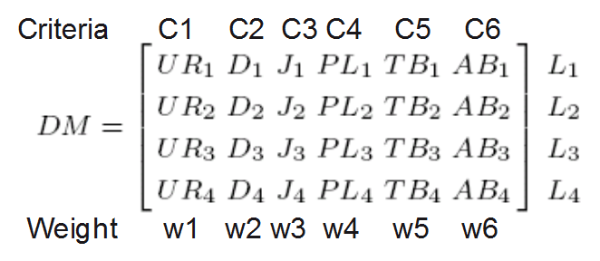

TOPSIS MCDM Method Application
Notes:
Normalization is accomplished to make the criteria parametric values unit less as they represent different attributes with different unit e.g. Bandwidth in Mega and Delay in ms etc.
Weight computation describes the relative importance of the attributes constituting the criteria and/or sub-criteria.

Slide 62
TOPSIS MCDM Method Application
 | L1 | L2 | L3 | L4 | Iteration
R Value | 0.3790 | 0.3725 | 0.8003 | 0.3692 | 1
Rank | 2 | 3 | 1 | 4 | 1
R Value | 0.3547 | 0.3567 | 0.8996 | — | 2
Rank | 3 | 2 | 1 | — | 2
R Value | 0.4875 | 0.4732 | — | 0.4725 | 3
Rank | 2 | 3 | — | 4 | 3
This Inconsistency is overcome by integrating TOPSIS with Analytical Hierarchy Process (AHP)
Notes:
TOPSIS show inconsistency when the bottom ranked link I removed from the alternatives list
TOPSIS however works fine for selecting the top ranked links
But the business objectives of the company may require to choose the bottom ranked link.
Weights computation is the root cause of this problem as the interdependence of the criteria is not taken into account.

Slide 63

TOPSIS and AHP Integration
Relative Importance of Corresponding Elements in a Class | Saaty’s Scale
Equally Important | 1
Moderately Important | 3
Strongly Important | 5
Very Strongly Important | 7
Extremely Important | 9
Intermediate Values | 2, 4, 6, 8
Reciprocal Values | 1/2, 1/3, ., 1/9
Notes:
AHP uses Pairwise comparison. It is used to determine the relative importance of each alternative in terms of each criterion. These pairwise comparison are qualified by using the Saaty’s scale.
Linguistics are mapped to the numbers using this approach (e.g. voice is more important than video, gold profile has the highest priority, number of calls on a link a as important as the reliability etc.)

Slide 64


Horizontal Handover Using the Same Decision Engine
Notes:
Same DE is used to take the HH decision without resetting/restarting the decision system
As the Cell Phone are emulated as SIP extensions by the combination of OpenBTS and OpenSIPS so the decision is HH decision is enforced by sending the Re-INVITE to both end points.

Slide 65

Demo and GSM Traffic Capture

Slide 66
Applications: OpenBTS+Gnu Radio+USRP
A GSM solution for disaster-recovery management and control while supporting communications with mobility and dynamicity support in addition to location tagging. An individual while carrying the boxed equipment to the spot can deploy the system to uplift the inter/intra communication.
Cell-Phone detection in the debris

Slide 67
Applications:
OpenBTS+GnuRadio+USRP
Entrepreneurs mostly emphasize their businesses and infrastructures in settled and developed areas.
Low cost, low power, reconfigurable and flexible communication model for those Entrepreneurs ROI (Return on Investment) for MNO's (Mobile Network Operators)
GSM to Voice over IP (GSM-2-VoIP), GSM to Conventional Telephony (GSM-2-CT)
Security Applications (Jammers)

Slide 68
Conclusions
Software Defined Radio is more than just an implementation in a software solution.
AIR triangle must go hand in hand
The true potentials of SDR has not been exploited
Civil applications should surpass the Military activities
Time to market products
Design efficient and effective solutions
Above all the concepts, techniques and technologies during the course can be realized by deploying SDR

