Slide 1
Cellular Wireless Networks
GSM
Lecture 30

Slide 2
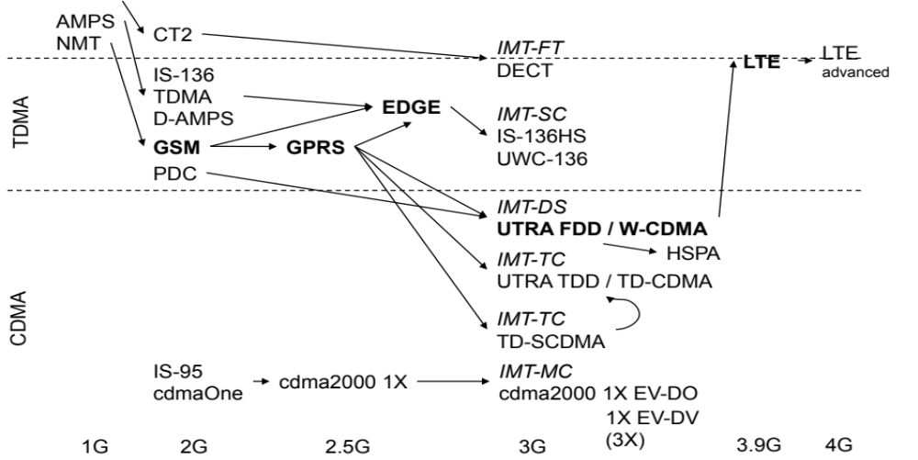
Development of Mobile Systems

Slide 3
What is GSM?
GSM, the Global System for Mobile Communications, is a digital cellular communications system
GSM provides –
    Digital Transmission
    ISDN compatibility
    Worldwide roaming in other GSM networks
    Provides a model for 3G Cellular systems (UMTS)

Slide 4
GSM Overview
GSM
  formerly: Groupe Spéciale Mobile (founded 1982)
  now: Global System for Mobile Communication
  Pan-European standard (ETSI, European Telecommunications Standardisation Institute)
  simultaneous introduction of essential services in three phases (1991, 1994, 1996) by the European telecommunication administrations (Germany: D1 and D2)
  ➔ seamless roaming within Europe possible
Today many providers all over the world use GSM
(>220 countries in Asia, Africa, Europe, Australia, America)
  more than 4,2 billion subscribers in more than 700 networks
  more than 75% of all digital mobile phones use GSM

Slide 5
Performance Characteristics of GSM
Communication
  mobile, wireless communication; support for voice and data services
Total mobility
  international access, chip-card enables use of access points of different providers
Worldwide connectivity
  one number, the network handles localization
High capacity
  better frequency efficiency, smaller cells, more customers per cell
High transmission quality
  high audio quality and reliability for wireless, uninterrupted phone calls at higher speeds (e.g., from cars, trains)
Security functions
  access control, authentication via chip-card and PIN

Slide 6
Disadvantages of GSM
There is no perfect system!!
  no end-to-end encryption of user data
  no full ISDN bandwidth of 64 kbit/s to the user, no transparent B-channel
reduced concentration while driving
electromagnetic radiation
abuse of private data possible
roaming profiles accessible
high complexity of the system
several incompatibilities within the GSM standards

Slide 7
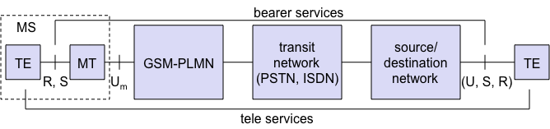
GSM: Mobile Services
GSM offers
  several types of connections
    voice connections, data connections, short message service
  multi-service options (combination of basic services)
Three service domains
  Bearer Services
  Telematic Services
  Supplementary Services

Slide 8
Nomenclature
GSM is a PLMN (Public Land Mobile Network)
  several providers setup mobile networks following the GSM standard within each country
  components
    MS (mobile station)
    BS (base station)
    MSC (mobile switching center)
    LR (location register)
  subsystems
    RSS (radio subsystem): covers all radio aspects
    NSS (network and switching subsystem): call forwarding, handover, switching
    OSS (operation subsystem): management of the network

Slide 9

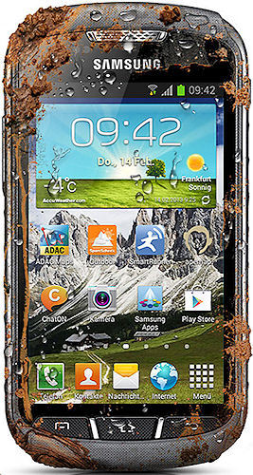
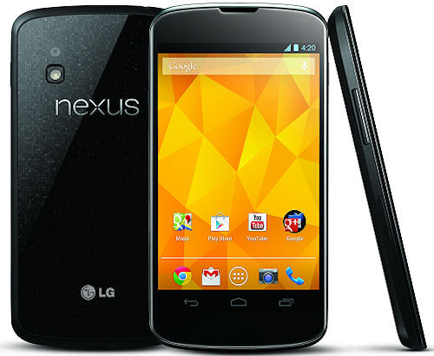
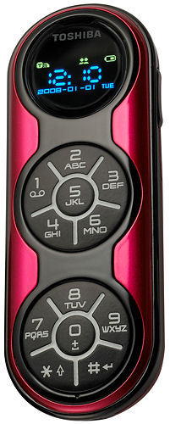
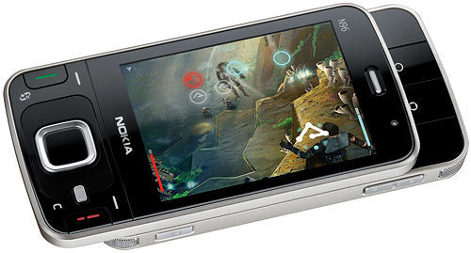
Ingredients
The visible but smallest
part of the network!

Slide 10
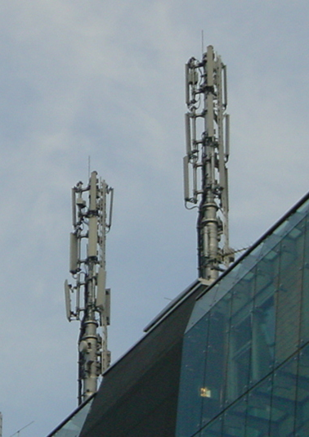
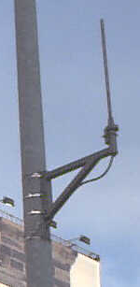
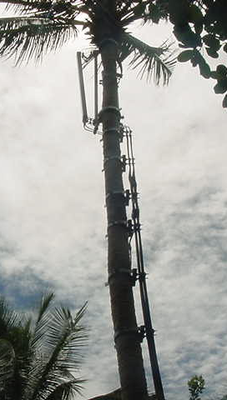
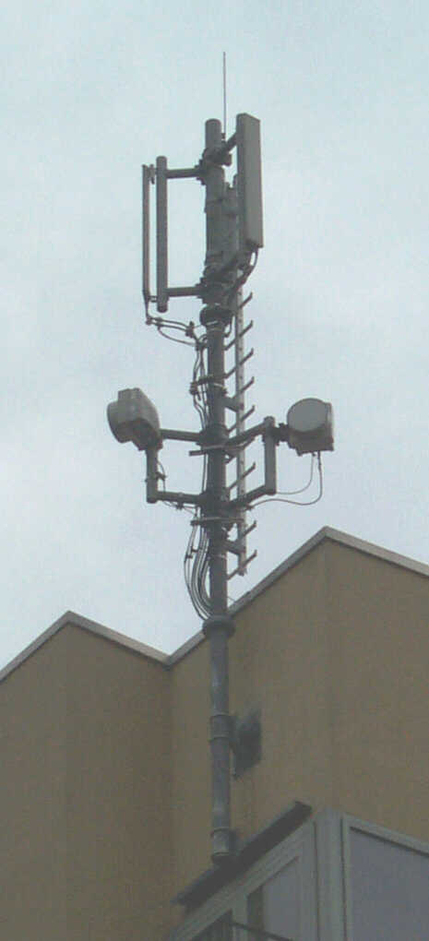
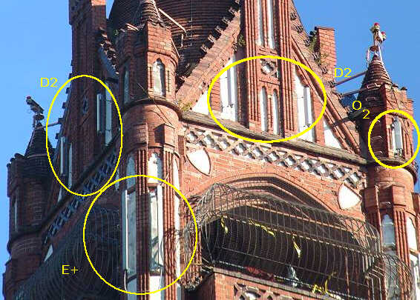
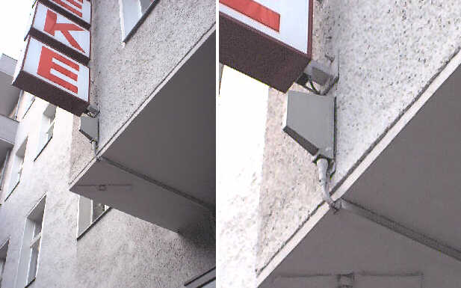
Ingredients
Still visible – cause many discussions…

Slide 11
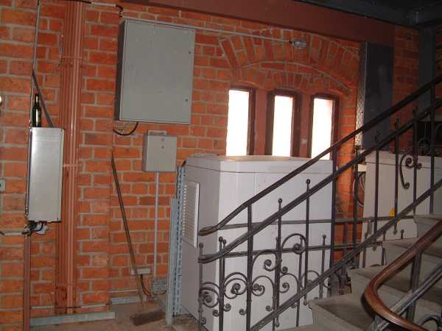
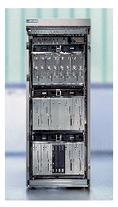
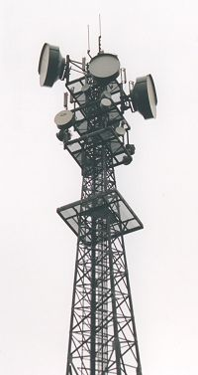
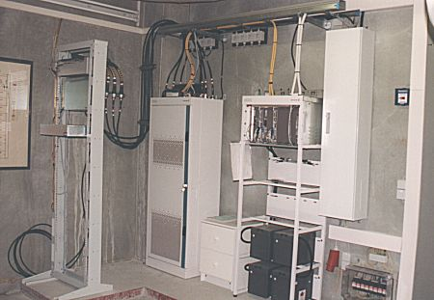
Ingredients
Base Stations
Cabling
Microwave links

Slide 12
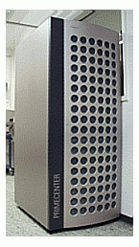
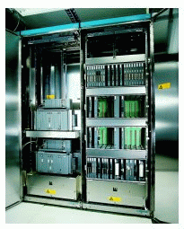
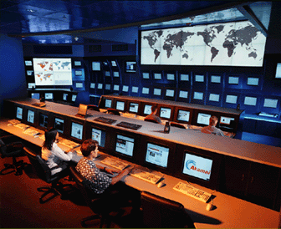
Ingredients
Not „visible“, but comprise the major part of the network (also from an investment point of view…)
Management
Data bases
Switching units
Monitoring

Slide 13
GSM
OMC, EIR,
AUC
HLR
fixed network
GMSC
NSS
with OSS
VLR
MSC
VLR
MSC
BSC
BSC
RSS

Slide 14
GSM: Elements and Interfaces
radio cell
MS
MS
BSS
U_{m}
radio cell
RSS
BTS
MS
BTS
A_{bis}
BSC
BSC
A
MSC
MSC
NSS
VLR
VLR
signaling
HLR
GMSC
ISDN, PSTN
IWF
PDN
O
OSS
EIR
AUC
OMC

Slide 15
GSM System Architecture
radio
subsystem
network and switching subsystem
fixed
partner networks
MS
MS
ISDN
PSTN
U_{m}
MSC
BTS
A_{bis}
BSC
EIR
BTS
SS7
HLR
BTS
VLR
BSC
ISDN
PSTN
BTS
A
MSC
BSS
IWF
PSPDN
CSPDN

Slide 16
System Architecture: Radio Subsystem
radio
subsystem
network and switching
subsystem
Components
  MS (Mobile Station)
  BSS (Base Station Subsystem):
  consisting of
    BTS (Base Transceiver Station):
    sender and receiver
    BSC (Base Station Controller):
    controlling several transceivers
Interfaces
  U_{m} : radio interface
  A_{bis} : standardized, open interface with
  16 kbit/s user channels
  A: standardized, open interface with
  64 kbit/s user channels
MS
MS
U_{m}
BTS
A_{bis}
BSC
MSC
BTS
A
BTS
MSC
BSC
BTS
BSS

Slide 17
System Architecture: Network and Switching Subsystem
network
subsystem
fixed partner
networks
Components
  MSC (Mobile Services Switching Center):
  IWF (Interworking Functions)
  ISDN (Integrated Services Digital Network)
  PSTN (Public Switched Telephone Network)
  PSPDN (Packet Switched Public Data Net.)
  CSPDN (Circuit Switched Public Data Net.)
Databases
  HLR (Home Location Register)
  VLR (Visitor Location Register)
  EIR (Equipment Identity Register)
ISDN
PSTN
MSC
EIR
SS7
HLR
VLR
ISDN
PSTN
MSC
IWF
PSPDN
CSPDN

Slide 18
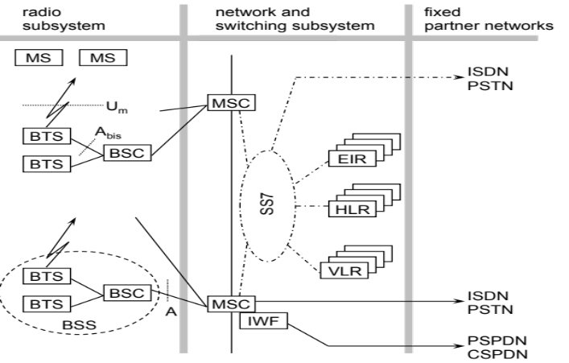
Radio Subsystem
The Radio Subsystem (RSS) comprises the cellular mobile network up to the switching centers
Components
  Base Station Subsystem (BSS):
    Base Transceiver Station (BTS): radio components including sender, receiver, antenna - if directed antennas are used one BTS can cover several cells
    Base Station Controller (BSC): switching between BTSs, controlling BTSs, managing of network resources, mapping of radio channels (U_{m}) onto terrestrial channels (A interface)
    BSS = BSC + sum(BTS) + interconnection
  Mobile Stations (MS)

Slide 19
GSM: Cellular Network
segmentation of the area into cells
possible radio coverage of the cell
idealized shape of the cell
cell
use of several carrier frequencies
not the same frequency in adjoining cells
cell sizes vary from some 100 m up to 35 km depending on user density, geography, transceiver power etc.
hexagonal shape of cells is idealized (cells overlap, shapes depend on geography)
if a mobile user changes cells handover of the connection to the neighbor cell

Slide 20
GSM Frequency Bands
Type | Channels | Uplink [MHz] | Downlink [MHz]
GSM 850 | 128-251 | 824-849 | 869-894
GSM 900 classical extended | 0-124, 955-1023 124 channels +49 channels | 876-915 890-915 880-915 | 921-960 935-960 925-960
GSM 1800 | 512-885 | 1710-1785 | 1805-1880
GSM 1900 | 512-810 | 1850-1910 | 1930-1990
GSM-R exclusive | 955-1024, 0-124 69 channels | 876-915 876-880 | 921-960 921-925
Additionally: GSM 400 (also named GSM 450 or GSM 480 at 450-458/460-468 or 479-486/489-496 MHz)
Please note: frequency ranges may vary depending on the country!
Channels at the lower/upper edge of a frequency band are typically not used

Slide 21
Base Transceiver Station and Base Station Controller
Tasks of a BSS are distributed over BSC and BTS
BTS comprises radio specific functions
BSC is the switching center for radio channels

Slide 22
Mobile Station
Terminal for the use of GSM services
A mobile station (MS) comprises several functional groups
  MT (Mobile Terminal):
    offers common functions used by all services the MS offers
    corresponds to the network termination (NT) of an ISDN access
    end-point of the radio interface (Um)
  TA (Terminal Adapter):
    terminal adaptation, hides radio specific characteristics
  TE (Terminal Equipment):
    peripheral device of the MS, offers services to a user
    does not contain GSM specific functions
  SIM (Subscriber Identity Module):
    personalization of the mobile terminal, stores user parameters
TE
TA
MT
R
S
U_{m}

Slide 23
Network and Switching Subsystem
NSS is the main component of the public mobile network GSM
  switching, mobility management, interconnection to other networks, system control
Components
  Mobile Services Switching Center (MSC)
  controls all connections via a separated network to/from a mobile terminal within the domain of the MSC - several BSC can belong to a MSC
  Databases (important: scalability, high capacity, low delay)
    Home Location Register (HLR)
    central master database containing user data, permanent and semi-permanent data of all subscribers assigned to the HLR (one provider can have several HLRs)
    Visitor Location Register (VLR)
    local database for a subset of user data, including data about all user currently in the domain of the VLR

Slide 24
Mobile Services Switching Center
The MSC (mobile services switching center) plays a central role in GSM
  switching functions
  additional functions for mobility support
  management of network resources
  interworking functions via Gateway MSC (GMSC)
  integration of several databases
Functions of a MSC
  specific functions for paging and call forwarding
  termination of SS7 (signaling system no. 7)
  mobility specific signaling
  location registration and forwarding of location information
  provision of new services (fax, data calls)
  support of short message service (SMS)
  generation and forwarding of accounting and billing information

Slide 25
Operation Subsystem
The OSS (Operation Subsystem) enables centralized operation, management, and maintenance of all GSM subsystems
Components
  Authentication Center (AUC)
    generates user specific authentication parameters on request of a VLR
    authentication parameters used for authentication of mobile terminals and encryption of user data on the air interface within the GSM system
  Equipment Identity Register (EIR)
    registers GSM mobile stations and user rights
    stolen or malfunctioning mobile stations can be locked and sometimes even localized
  Operation and Maintenance Center (OMC)
    different control capabilities for the radio subsystem and the network subsystem

Slide 27
GSM Protocol Stack
In any telecommunication system, signalling is required to coordinate the necessarily distributed functional entities of the network.
The transfer of signalling information in GSM follows the layered OSI model
Layer 1: Physical Layer
    Radio Transmission
Layer 2: Data Link Layer (DLL)
    provides error-free transmission between adjacent entities, based on the ISDN’s LAPD protocol for the U_{m} and A_{bis} interfaces, and on SS7’s Message Transfer Protocol (MTP) for the other Layer interfaces
Layer 3: Networking or Messaging Layer
    Responsible for the communication of network resources, mobility, code format and call-related management messages between various network entities

Slide 28
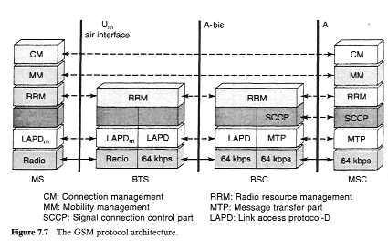
GSM Protocol Architecture
Layer 3
Layer 2
Layer 1
TDMA/FDMA

Slide 29
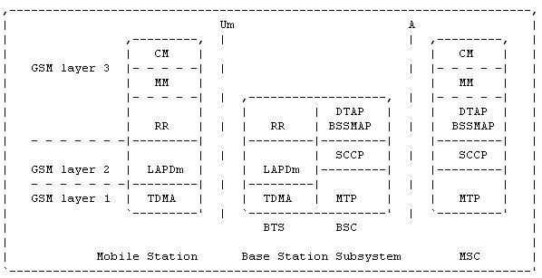
Overview of Interfaces
U_{m}
    Radio interface between MS and BTS
    each physical channel supports a number of logical channels
A_{bis}
    between BTS and BSC
    primary functions: traffic channel transmission, terrestrial channel management, and radio channel management
A
    between BSC and MSC
    primary functions: message transfer between different BSCs to the MSC

Slide 30
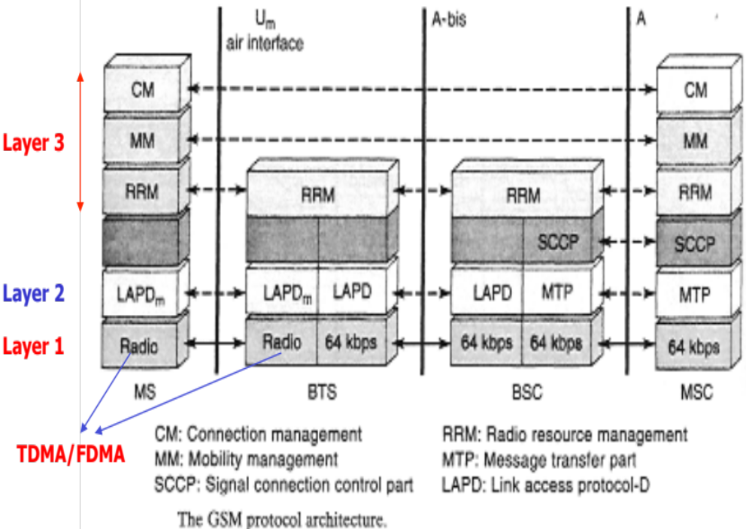
Overview of Interfaces
The data link layer (layer 2) over the radio link is based
on a modified LAPD (Link Access Protocol for the D channel) referred to as LAPDm (m like mobile).
On the A-bis interface, the layer 2 protocol is based on the LAPD from ISDN.
The Message Transfer Protocol (MTP) level 2 of the SS7 protocol is used at the A interface.

Slide 31
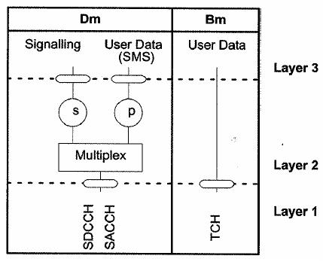
User Data and Control at Air Interface
Two types of ISDN "channels" or communication paths:
B-channel
The Bearer ("B") channel: a 64 kbps channel used for voice, video, data, or multimedia calls. D-channel
The Delta ("D") channel: a 16 kbps or 64 kbps channel used primarily for communications (or "signaling") between switching equipment in the ISDN network and the ISDN equipment

Slide 32
User Data and Control at Air Interface
In GSM:
• Bm channel for traffic / user data
• Dm channel for signaling
As in ISDN the Dm channel in GSM can be used for user data if capacity is available.
GSM’s Short Message Service (SMS) uses this.

Slide 33

Layer I:
Physical Layer
Radio transmission forms this Layer

Slide 34

Layer I:
Physical Layer
Modulation Techniques – Gaussian Minimum Shift Keying (GMSK)
Channel Coding
    Block Code
    Convolutional Code
Interleaving
    To distribute burst error
Power control methodology – to minimize the co-channel interference
Time synchronization approaches

Slide 35
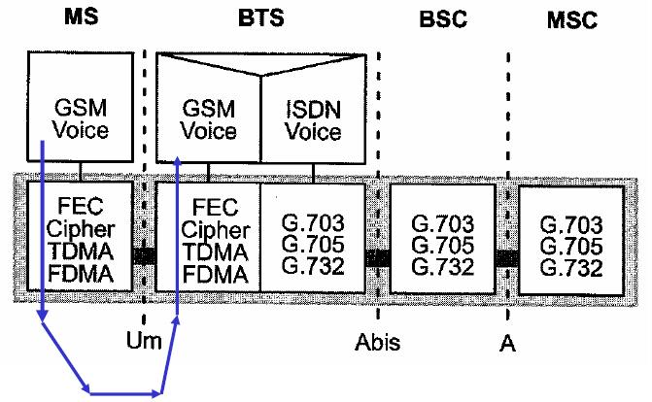
GSM Protocol Architecture for Speech – Air IF

Slide 36
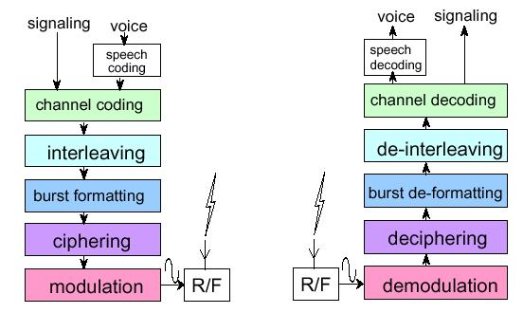
GSM Physical Layer (MS Side)
Speech in GSM is digitally coded at a rate of 13 kbps
184 bits
( 20 ms)
260 bits every 20 ms
Convolutional Encoder
456 bits every 20 ms
8 57 bits block
GMSK

Slide 37
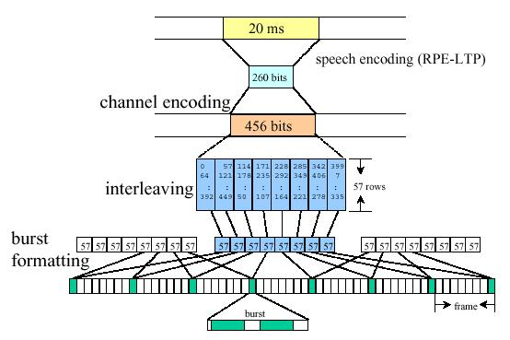
GSM Speech Transmission

Slide 38
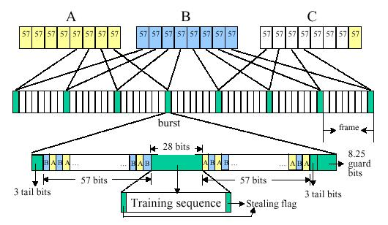
GSM Normal Burst Formatting

Slide 39
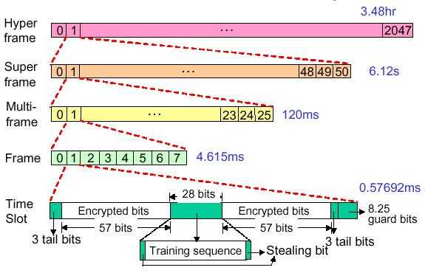
GSM Frame Hierarchy

Slide 40
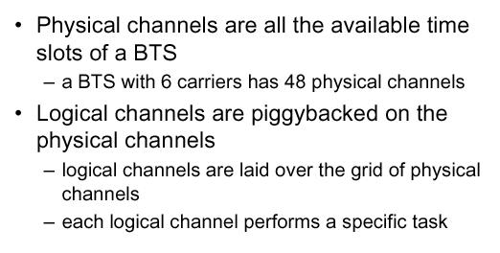
Physical Vs. Logical Channel

Slide 41
Logical Channels in GSM
Two major classes of logical channels
  Traffic Channels (TCHs)
  Control Channels (CCHs)

Slide 42
Traffic Channels in GSM
Two types of TCHs
  Full-rate traffic channel (TCH/F)
  Half-rate traffic channel (TCH/H)

Slide 43
Control Channels in GSM
Three classes of control channels
  Broadcast Channels (BCH)
  Common Control Channels (CCCH)
  Dedicated Control Channels (DCCH)

Slide 44
Layer II:
Data Link Layer (DLL)
Error-free transmission between adjacent entities

Slide 45

GSM – Layer II
Connection-based Network
  Traffic
  Signaling and Control
Signaling and control data are conveyed through Layer II and Layer III messages in GSM
Purpose of Layer II is to check the flow of packets for Layer III
DLL checks the address and sequence # for Layer III
Also manages Acks for transmission of the packets
Allows two SAPs for signaling and SMS
SMS traffic is carried through a fake signaling packet that carries user information over signaling channels
  DLL allows SMS data to be multiplexed into signaling streams

Slide 46
GSM – Layer II
Signaling packet delivered to the physical layer is 184 bits which conforms with the length of the DLL packets in the LAPD protocol used in ISDN network
The LAPD protocol is used for A and A-bis interface
The DLL for the U_{m} interface is LAPDm

Slide 47
LAPDm
The Link Access Procedure on the Dm channel (LAPDm) is the protocol used by the data link layer on the radio interface.
Functions
– organization of Layer 3 information into frames
– peer-to-peer transmission of signaling data
in defined frame formats
– recognition of frame formats
– establishment, maintenance, and
termination of one or more (parallel) data
links on signaling channels

Slide 48
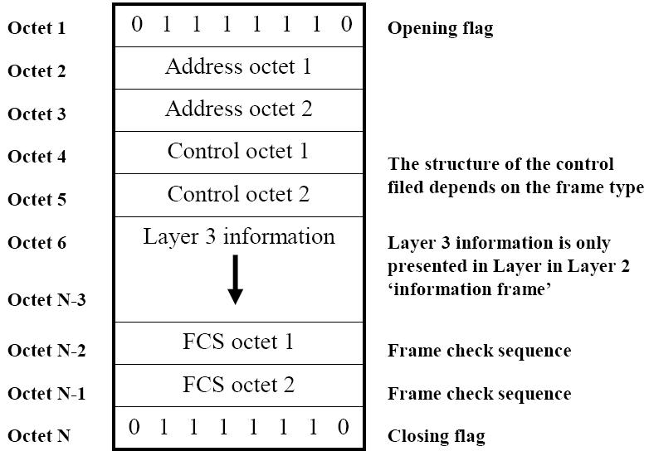
Frame format (LAPD)

Slide 49
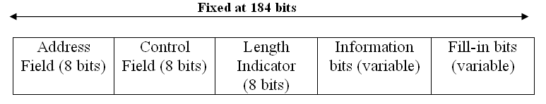
Frame format (LAPDm)
Address field: is used to carry the service access point identifier (SAPI), protocol revision type, nature of the message
SAPI: When using command/control frames, the SAPI identifies the user for which a command frame is intended, and the user transmitting a response frame
Control field: is used to carry Sequence number and to specify the types of the frame (command or response)
Length indicator: Identifies the length of the information field that is used to distinguish the information carrying filed from fill-in bits
Information Field: Carries the Layer III payload
Fill-in bits: all “1” bits to extend the length to the desired 184 bits

Slide 50
Types of Frame of LAPDm
Three types of frames for
    Supervisory functions
    Unnumbered information transfer and control functions
    Numbered information transfer

Slide 51
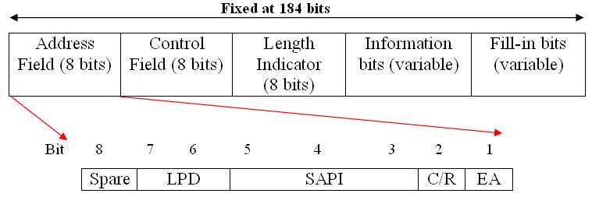
Address field format of LAPDm
Link Protocol Discriminator: is used to specify a particular recommendation of the use of LAPDm
C/R: Specifies a command or response frame
Extended Address : is used to extend the address field to more than one octet (the EA bit in the last octet of the address should be set to 1, otherwise 0)
Spare: reserved for future use

Slide 52
LAPD Vs. LAPDm
LAPDm uses no cyclic redundancy check bits for error detection
    WHY?
Error correction and detection mechanism are provided by a combination of block and convolutional coding used (in conjunction with bit interleaving) in the physical layer

Slide 53
Layer II Messages
Set asynchronous balanced mode
Disconnect
Unnumbered acknowledgement
Receiver ready
Receiver not ready
Reject
These messages are sent in peer-to-peer Layer II communications, DLL ack.
These messages do not have Layer III information bits
Fill-in bits cover the “information bits” field

Slide 54
Layer II Messages (contd…)
The Paging Channel (PCH) is 176 bits.
The DLL packet for this signaling channel only have an EIGHT bit length of the field
184 bits encoded into 456 bits
The 456 bits transmitted over 8 physical NBs
The Stand-alone Dedicated Control Channel (SDCCH) is 160 bits.
The DLL packet for this signaling channel has 3 8-bits used for address, control and length of the information field
The Slow Associated Control Channel (SACCH) is 144 bits.
The DLL packet for this signaling channel has 16 fill-in bits and 3 8-bits used for address, control and length of the information field

Slide 55
Layer III:
Networking or Messaging Layer
The layer 3 protocols are used for the communication of network resources, mobility, code format and call-related management messages between various network entities

Slide 56
Layer III
A number of mechanisms needed to establish, maintain and terminate a mobile communication session
Layer III implements the protocols needed to support these mechanisms
A signaling protocol, the registration process, is composed of a sequence of communication events or messages
Layer III defines the details of implementation of messages on the logical channels encapsulated in DLL frames

Slide 57

Layer III Message Format
Transaction Identifier (TI): to identify a protocol that consists of a sequence of message, allows multiple protocols to operate in parallel
Protocol Discriminator (PD): Identifies the category of the operation (management, supplementary services, call control)
Message Type (MT): Identifies the type of messages for a given PD
Information Elements (IE): An optional field for the time that an instruction carries some information that is specified by an IE identifier (IEI).

Slide 58
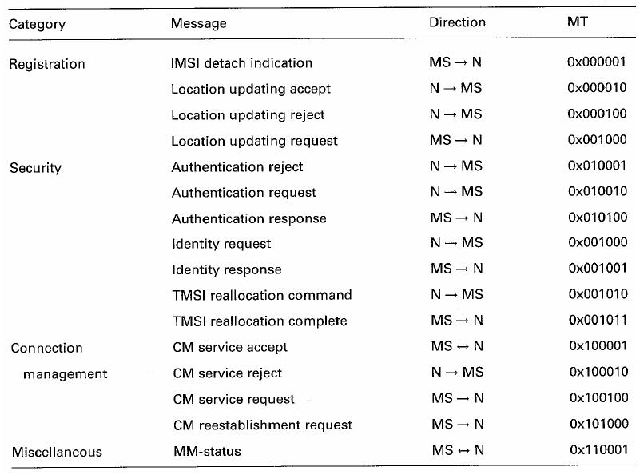
MM Message Type

Slide 59
Layer III Message
Radio Resource Management (RR),
Mobility Management (MM) and
Connection Management (CM).

Slide 60
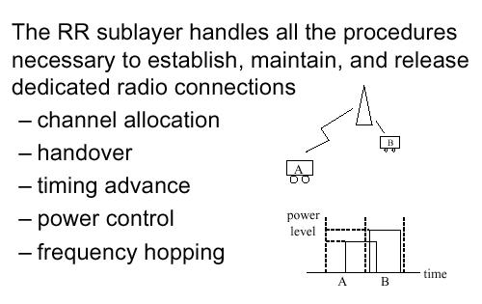
Radio Resource Management (RR)

Slide 61
Mobility Management (MM)
Assumes a reliable RR connection
Responsible for
  location management and
  Security

Slide 62
Mobility Management (MM)
Location management involves the procedures and
signaling for location updating, so that the mobile’s current
location is stored at the HLR, allowing incoming calls to
be properly routed.
Security involves the authentication of the mobile, to prevent unauthorized access to the network, as well as the encryption of all radio link traffic.
- The protocols in the MM layer involve the SIM, MSC, VLR, and
the HLR, as well as the AuC (which is closely tied with
the HLR).

Slide 63
Connection Management (CM)
The CM functional layer is divided into three sub layers.
- Call Control (CC)
- Supplementary Services
- Short Message Service
Call Control (CC) sub layer
- manages call routing, establishment, maintenance, and release, and is closely related to ISDN call control.

Slide 64
Connection Management (CM)
Supplementary Services sub layer
- manages the implementation of the various supplementary services (Call Forwarding/waiting/hold ), and also allows users to access and modify their service subscription.
Short Message Service sub layer
- handles the routing and delivery of short messages, both from and to the mobile subscriber.

Slide 66
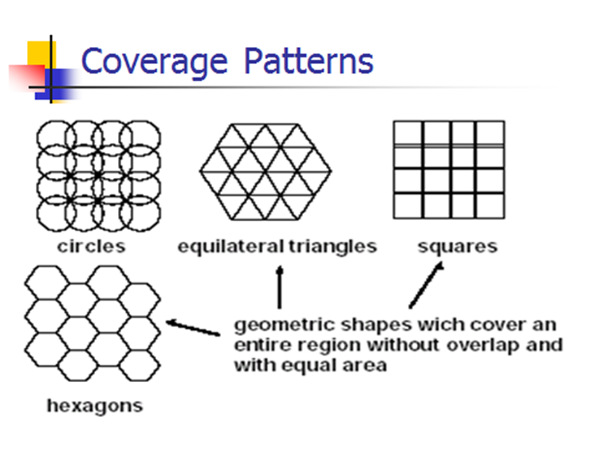
that

Slide 67
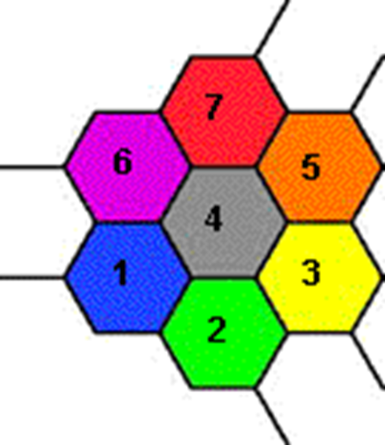
Cellular Network Organization (Cells)
Cells use low powered transmitters.
Each cell is allocated a band of frequencies, and is served by its own antenna as well as a base station consisting of a transmitter, receiver and control unit.

Slide 68
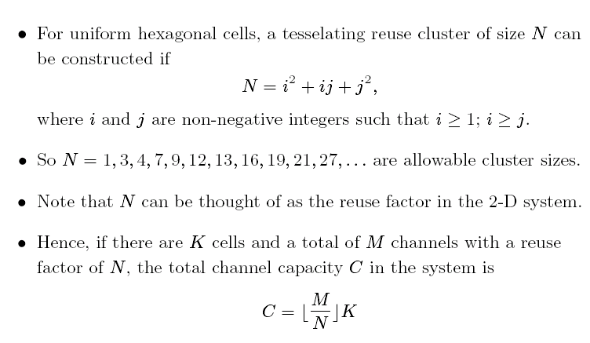
Hexagon Reuse Clusters

Slide 69
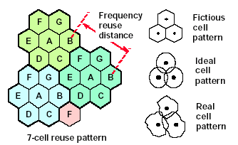
Cellular Coverage Representation

Slide 70
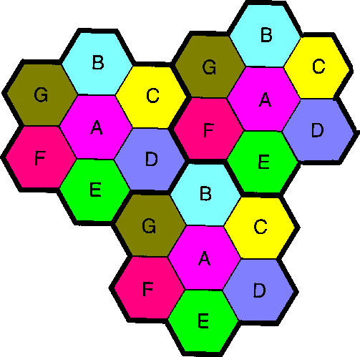
Frequency Reuse
Each colour/letter uses the same frequency band

Slide 71
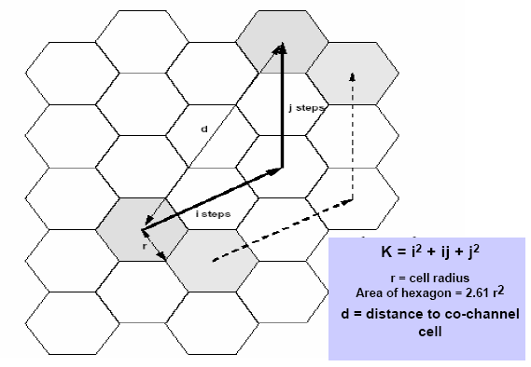

Slide 72
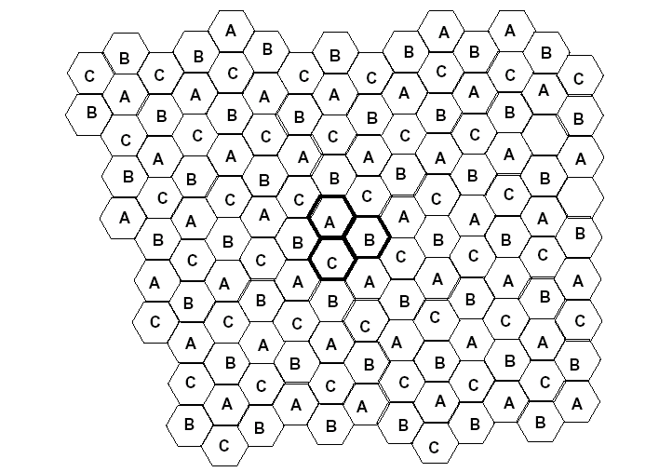
3-cell reuse pattern (i=1,j=1)

Slide 73
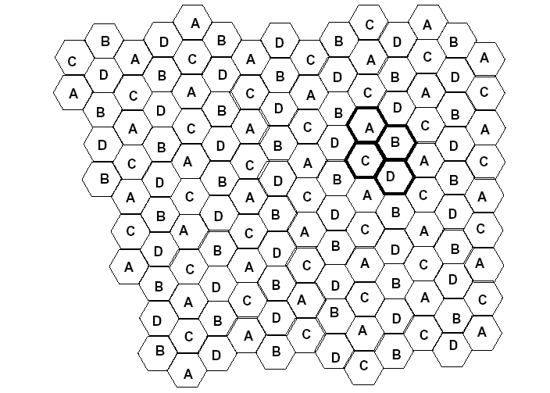
4-cell reuse pattern (i=2,j=0)

Slide 74
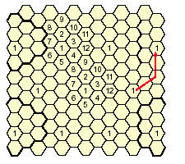
12-cell reuse pattern (i=2,j=2)

Slide 75
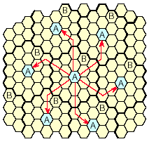
19-cell reuse pattern (i=3,j=2)

Slide 76
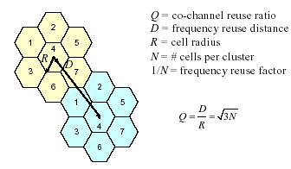
Relationship between Q and N

Slide 77
Factors limiting frequency reuse
Co-channel interference
Adjacent channel interference

Slide 78
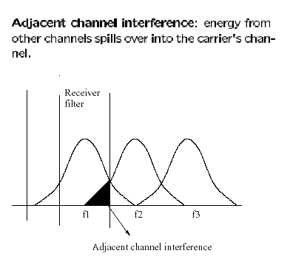
Adjacent Channel Interference
Adjacent channel interference can be controlled with transmit and receive filters

Slide 79
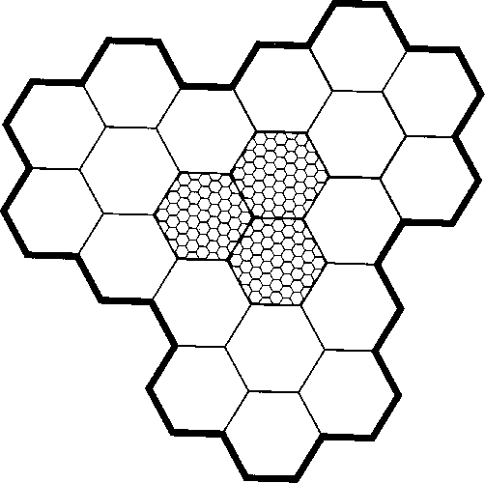
Coping with increasing capacity
Adding new channels
Frequency borrowing
  frequencies are taken from adjacent cells by congested cells

Slide 80
Coping with increasing capacity
Cell splitting
  cells in areas of high usage can be split into smaller cells
Cell sectoring
  cells are divided into a number of wedge-shaped sectors, each with their own set of channels
Microcells
  antennas move to buildings, hills, and lamp posts

Slide 81
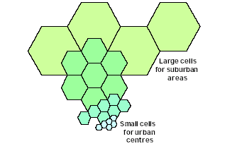
Cell Splitting

Slide 82
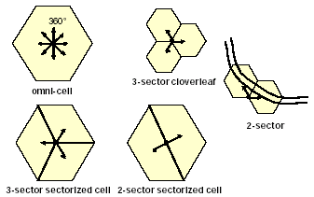
Site Configurations

Slide 83
Handoffs
Network protocols must refresh and renew paths as a mobile station host moves between cells.
Handoffs are the function of one cell handing over the communication link between itself and a mobile station as the mobile station moves out of the boundary of its region into the boundary of an adjacent cell.

Slide 84
Handoffs
This practice must preserve end-to-end connectivity in a dynamically reconfigured network topology.

Slide 85

Handoff Types (cont’d)

Slide 86

Avoiding handoff: Umbrella cells

Slide 87
Encoding: Modulation(1)
Amplitude Modulation
Frequency Modulation
Phase Modulation
are the three different methods of encoding binary information on a regular wave.

Slide 88
Encoding: Modulation(2)
When using digital signals the methods are known as Amplitude Shift Keying (ASK), Frequency Shift Keying (FSK), and Phase Shift Keying (PSK).

Slide 89
Encoding: Multiplexing(1)
Multiplexing allows many mobile users to use cellular radio transmission schemes at the same time. The different schemes are:
Frequency Division Multiplexing
Time Division Multiplexing
Code Division Multiplexing

Slide 90

Encoding: Multiplexing(2)
Frequency Division Multiplexing involves a different frequency channel given to each user

Slide 91
Encoding: Multiplexing(3)
Time Division Multiplexing involves a channel with a given number of time slots (per millisecond) where each user is assigned certain time interval.
Code Division Multiplexing gives each user a “code” for differentiation purposes. The receiver picks out each channel from the “noise” using the code. Wide frequency band is used. Does not contain single frequencies or time slots.

Slide 92

Differences between FDMA, TDMA, and CDMA.

Slide 93
Advantages of Code Division Multiplexing
better protection against interference
good security
signal difficult to jam

Slide 94
Disadvantages of
Code Division Multiplexing
pseudo-random code sequences generated by the transmitters and receivers are not always random
fast power control system needed so that strong signals don’t overpower weaker signals.

Slide 95
Analogy: Multiplexing
Lectures at a learning institute:
Frequency Division: takes place in different rooms
Time Division: taking turns in a single room
Code Division: lectures on different subjects.

Slide 97
GSM Location Services
6
2
9
BTS
Terminating
MSC
Gateway
MTSC
10
Public
Switched
Telephone
Network
(PSTN)
1
10
10
9
10
7
8
5
3
4
VLR
HLR
10
5
1. Call made to mobile unit (cellular phone)
2. Telephone network recognizes number
and gives to gateway MSC
3. MSC can’t route further, interrogates
user’s HLR
4. Interrogates VLR currently serving user
(roaming number request)
5. Routing number returned to HLR and
then to gateway MSC
6. Call routed to terminating MSC
7. MSC asks VLR to correlate call to
the subscriber
8. VLR complies
9. Mobile unit is paged
10. Mobile unit responds, MSCs convey
information back to telephone
Legend: MTSC= Mobile Telephone Service Center, BTS = Base Transceiver Station
HLR=Home Location Register, VLR=Visiting Location Register

