Slide 1
Wireless and Mobile Computing
Transmission Fundamentals
Lecture 3

Slide 2
Overview
Signals for Conveying Information
  Relationship between Data Rate and Bandwidth
Analog and Digital Data Transmission
  Analog and Digital Data
  Analog and Digital Signaling
  Analog and Digital Transmission
Channel Capacity
  Nyquist Bandwidth
  Shannon Capacity Formula

Slide 3
Data Rate and Bandwidth
any transmission system has a limited band of frequencies
this limits the data rate that can be carried on the transmission medium
square waves have infinite components and hence an infinite bandwidth
most energy in first few components
limiting bandwidth creates distortions
There is a direct relationship between data rate and bandwidth. The greater the bandwidth, the higher the information-carrying
capacity.

Slide 4
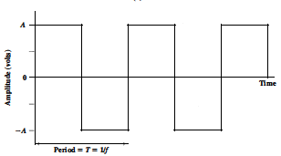
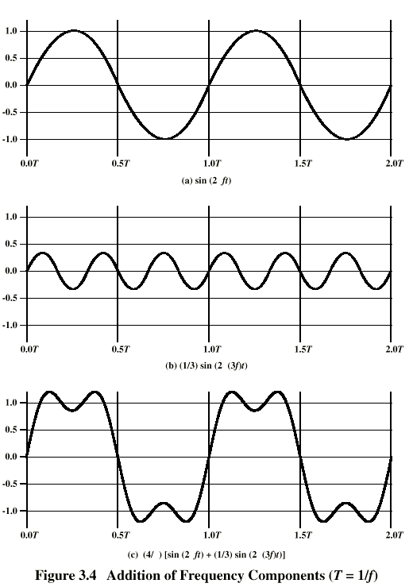
Data Rate and Bandwidth…..cont.
Suppose that we let a positive pulse represent binary 0 and a negative pulse represent binary 1. Then the waveform represents the binary stream 0101. . . . The duration of each pulse is 1/(2f); thus the data rate is 2f bits per second (bps).
What are the frequency components
of this signal
By adding together sine waves at frequencies f and 3f, we get a waveform that begins to resemble the square wave.
Square wave

Slide 5
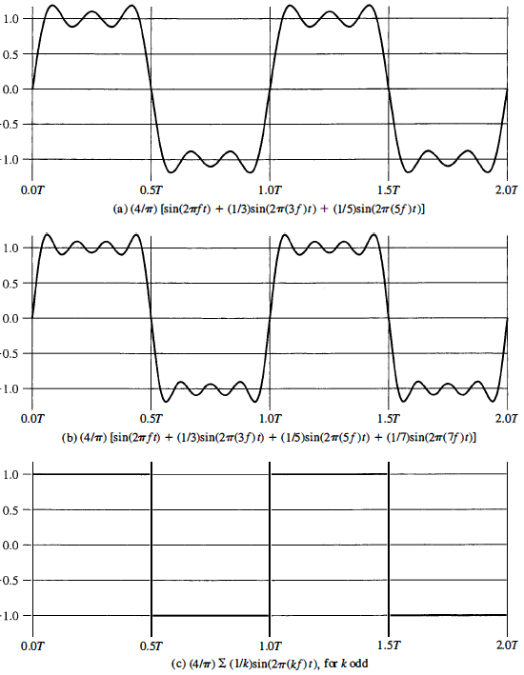

Data Rate and Bandwidth.. cont.
Let us continue this process by adding a sine wave of frequency 5f, and then adding a sine wave of frequency 7f, as shown in fig.
Additional odd multiples of f are added, suitably scaled, the resulting waveform approaches that of a square wave more and more closely.
Frequency components of the square wave with amplitudes A and -A can be expressed as follows:

Slide 6
Data Rate and Bandwidth.. cont.
This waveform has an infinite number of frequency components and hence an infinite bandwidth.
However, the peak amplitude of the k^{th} frequency component, kf, is only 1/k, so most of the energy in this waveform is in the first few frequency components.
What happens if we limit the bandwidth to just the first three frequency components? We have already seen the answer, in Figure a. As we can see, the shape of the resulting waveform is reasonably close to that of the original square wave.

Slide 7
Data Rate and Bandwidth.. cont.
Figures left and right illustrate the relationship between data rate and bandwidth. Suppose that we are using a digital transmission system that is capable of transmitting signals with a bandwidth of 4 MHz. Let us attempt to transmit a sequence of alternating 0s and 1s as the square wave of Figure c (RHS). What data rate
can be achieved?

Slide 8
Data Rate and Bandwidth.. cont.
Case I
Let us approximate our square wave with the waveform of Figure a (RHS). Although this waveform is a "distorted" square wave, it is sufficiently close to the square wave that a receiver should be able to discriminate between a binary 0 and a binary 1. If we let f = 10⁶ cycles/second = 1 MHz, then the bandwidth of the signal
is (5 X 10⁶) - 10⁶ = 4 MHz. Note that for f = 1 MHz, the period of the
fundamental frequency is T = 1/10⁶ = 10⁻⁶ = 1 μs. If we treat this waveform as a bit string of 1s and 0s, one bit occurs every 0.5 μs, for a data rate of 2 X 10⁶ = 2 Mbps. Thus, for a bandwidth of 4 MHz, a data rate of 2 Mbps is achieved.

Slide 9
Data Rate and Bandwidth.. cont.
Case II
Now suppose that we have a bandwidth of 8 MHz. Let us look again at Figure a, but now with f=2 MHz. Using the same line of reasoning as before, the bandwidth of the signal is ( 5 x 2 X 10⁶) - (2 x 10⁶) = 8 MHz. But in this case T= l/f = 0.5 μs. As a result, one bit occurs every 0.25 μs for a data rate of 4 Mbps.
Thus, other things being equal, by doubling the bandwidth we double the potential data rate.

Slide 10
Data Rate and Bandwidth.. cont.
Case III
Now suppose that the waveform of Figure c is considered adequate for approximating a square wave. That is, the difference between a positive
and negative pulse in Figure c is sufficiently distinct that the waveform can be used successfully to represent a sequence of 1s and Os. Assume as in Case II that f = 2 MHz and T = l/f = 0.5 μs, so that one bit occurs every 0.25 μs for a data rate of 4 Mbps. Using the waveform of Figure c, the bandwidth of the signal is (3 X 2 X 10⁶) - (2 X 10⁶) = 4 MHz. Thus, a given bandwidth can support various data rates depending on the ability of the receiver to discern the difference
between 0 and 1 in the presence of noise and other impairments

Slide 11
Data Rate and Bandwidth.. Cont.
Case I: Bandwidth = 4 MHz; data rate = 2 Mbps
Case II: Bandwidth = 8 MHz; data rate = 4 Mbps
Case III: Bandwidth = 4 MHz; data rate = 4 Mbps
Any digital waveform will have infinite bandwidth.
If we attempt to transmit this waveform as a signal over any medium, the transmission system will limit the bandwidth that can be transmitted.
Furthermore, for any given medium, the greater the bandwidth transmitted, the greater the cost.
Thus, on the one hand, economic and practical reasons dictate that digital information be approximated by a signal of limited bandwidth. On the other hand, limiting the bandwidth creates distortions, which makes the task of interpreting the received signal more difficult.
The more limited the bandwidth, the greater the distortion and the greater the potential for error by the receiver.

Slide 12
Data Rate and Bandwidth.. Cont.
The bandwidth that can be transmitted is limited by the transmission system (transmitter, medium, receiver)
The greater the bandwidth, the greater the cost
The narrower the bandwidth, the great the distortion (errors!)
Data rate = W bps Bandwidth = 2W Hz gives good presentation
The greater the bandwidth the higher the data rate
Keeping the same data rate:
  Greater bandwidth better quality of the received signal
The higher center frequency the higher the potential bandwidth

Slide 14

Data Transmission
quality of the signal being transmitted
characteristics of the transmission medium
The successful transmission of data depends on two factors:

Slide 15
Transmission Terminology
Data transmission occurs between transmitter and receiver over some transmission medium.
Communication is in the form of electromagnetic waves.
Guided media
twisted pair, coaxial cable, optical fiber
Unguided media (wireless)
air, vacuum, seawater

Slide 17
Data Communication Terms
Data - entities that convey meaning, or information
Signals - electric or electromagnetic representations of data
Transmission - communication of data by the propagation and processing of signals

Slide 18
Examples of Analog and Digital Data
Analog
  Video
  Audio
Digital
  Text
  Integers

Slide 19
Analog Signals
A continuously varying electromagnetic wave that may be propagated over a variety of media, depending on frequency
Examples of media:
  Copper wire media (twisted pair and coaxial cable)
  Fiber optic cable
  Atmosphere or space propagation
Analog signals can propagate analog and digital data

Slide 20
Digital Signals
A sequence of voltage pulses that may be transmitted over a copper wire medium
Generally cheaper than analog signaling
Less susceptible to noise interference
Suffer more from attenuation
Digital signals can propagate analog and digital data

Slide 21
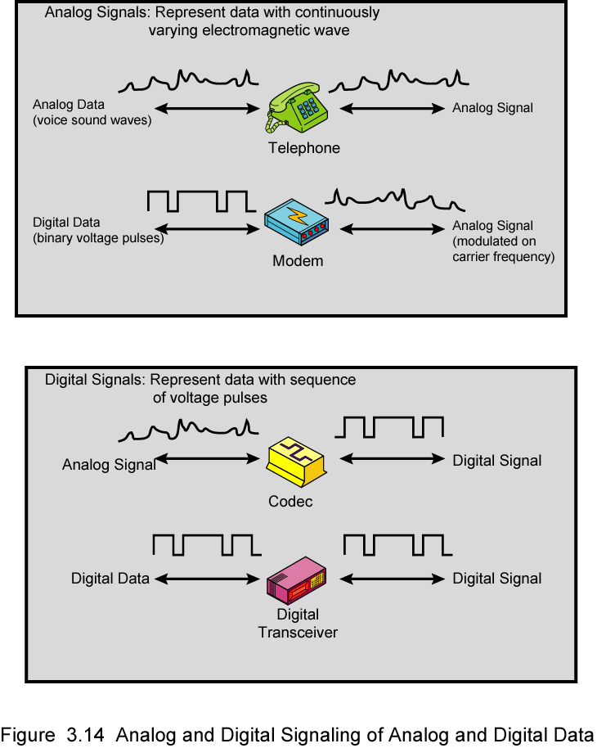
Analog Signals
Digital data, analog signal: Some transmission media, such as optical fiber and satellite, will only propagate analog signals.
Analog data, analog signal: Analog data are easily converted to an analog signal.

Slide 22
Digital Signals
Digital data, digital signal: In general, the equipment for encoding digital data into a digital signal is less complex and less expensive than digital-to analog Equipment.
Analog data, digital signal: Conversion of analog data to digital form permits the use of modern digital transmission and switching equipment for analog data.

Slide 23
Reasons for Choosing Data and Signal Combinations
Digital data, digital signal
  Equipment for encoding is less expensive than digital-to-analog equipment
Analog data, digital signal
  Conversion permits use of modern digital transmission and switching equipment
Digital data, analog signal
  Some transmission media will only propagate analog signals
  Examples include optical fiber and satellite
Analog data, analog signal
  Analog data easily converted to analog signal

Slide 24
Analog and Digital Transmission

Slide 25
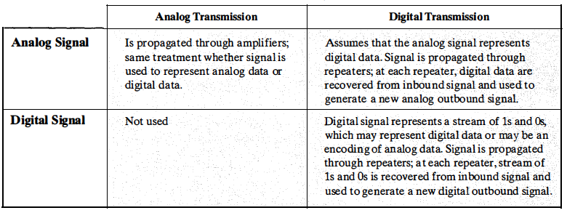
Analog Transmission
Analog transmission is a means of transmitting analog signals without regard to their content; the signals may represent analog data (e.g., voice) or digital data (e.g., data that pass through a modem).
In either case, the analog signal will suffer attenuation that limits the length of the transmission link.
To achieve longer distances, the analog transmission system includes amplifiers that boost the energy in the signal. Unfortunately, the amplifier also boosts the noise components.
With amplifiers cascaded to achieve long distance, the signal becomes more and more distorted.
For analog data, such as voice, quite a bit of distortion can be tolerated and the data remain intelligible.
However, for digital data transmitted as analog signals, cascaded amplifiers will introduce errors.
Transmit analog signals without regard to content
Attenuation limits length of transmission link
Cascaded amplifiers boost signal’s energy for longer distances but cause distortion
  Analog data can tolerate distortion
  Introduces errors in digital data

Slide 26
Digital Transmission
Digital transmission, in contrast, is concerned with the content of the signal.
It has been mentioned that a digital signal can be propagated only a limited distance before attenuation endangers the integrity of the data. To achieve greater distances, repeaters are used. A repeater receives the digital signal, recovers the pattern of ones and zeros, and retransmits a new signal. Thus, the attenuation is overcome.
The same technique may be used with an analog signal if the signal carries digital data.
At appropriately spaced points, the transmission system has retransmission
devices rather than amplifiers. The retransmission device recovers the digital data from the analog signal and generates a new, clean analog signal. Thus, noise is not cumulative

Slide 28
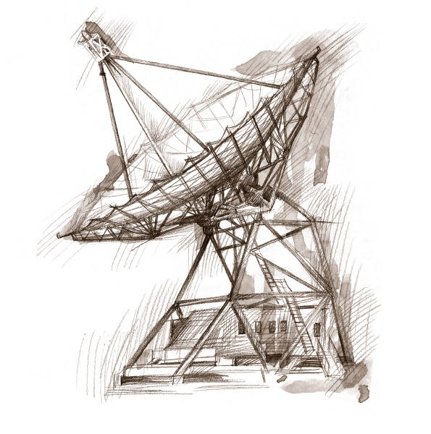
Transmission Impairments
Signal received may differ from signal transmitted causing:
  Analog - degradation of signal quality
  Digital - bit errors
Most significant impairments are
  Attenuation and attenuation distortion
  Delay distortion
  Noise

Slide 29
ATTENUATION
Received signal strength must be:
strong enough to be detected
sufficiently higher than noise to be received without error
Strength can be increased using amplifiers or repeaters.
Equalize attenuation across the band of frequencies used by using loading coils or amplifiers.
Signal strength falls off with distance over any transmission medium
Varies with frequency

Slide 30
Delay Distortion
Occurs because propagation velocity of a signal through a guided medium varies with frequency
Various frequency components arrive at different times resulting in phase shifts between the frequencies
Particularly critical for digital data since parts of one bit spill over into others causing intersymbol interference

Slide 31
Noise
Unwanted signals inserted between transmitter and receiver
is the major limiting factor in communications system performance

Slide 32


Categories of Noise
Thermal noise
due to thermal agitation of electrons
uniformly distributed across bandwidths
referred to as white noise
Intermodulation noise
produced by nonlinearities in the transmitter, receiver, and/or intervening transmission medium
effect is to produce signals at a frequency that is the sum or difference of the two original frequencies

Slide 33


Categories of Noise
Crosstalk:
  a signal from one line is picked up by another
  can occur by electrical coupling between nearby twisted pairs or when microwave antennas pick up unwanted signals
Impulse Noise:
  caused by external electromagnetic interferences
  noncontinuous, consisting of irregular pulses or spikes
  short duration and high amplitude
  minor annoyance for analog signals but a major source of error in digital data

Slide 34
About Channel Capacity
Impairments, such as noise, limit data rate that can be achieved
For digital data, to what extent do impairments limit data rate?
Channel Capacity – the maximum rate at which data can be transmitted over a given communication path, or channel, under given conditions

Slide 35
Concepts Related to Channel Capacity
Data rate - rate at which data can be communicated (bps)
Bandwidth - the bandwidth of the transmitted signal as constrained by the transmitter and the nature of the transmission medium (Hertz)
Noise - average level of noise over the communications path
Error rate - rate at which errors occur
  Error = transmit 1 and receive 0; transmit 0 and receive 1

Slide 36
Channel Capacity
Maximum rate at which data can be transmitted over a given communications channel under given conditions
data rate
in bits per second
bandwidth
in cycles per second or Hertz
error rate
rate of corrupted bits
limitations due to physical properties
main constraint on achieving efficiency is noise
noise
average noise level over path

Slide 38
Two Formulas
Problem: given a bandwidth, what data rate can we achieve?
Nyquist Formula
  Assume noise free
Shannon Capacity Formula
  Assume white noise

Slide 39
Nyquist Formula
Assume a channel is noise free.
Nyquist formulation: if the rate of signal transmission is 2B, then a signal with frequencies no greater than B is sufficient to carry the signal rate.
  Given bandwidth B, highest signal rate is 2B.
Why is there such a limitation?
  due to intersymbol interference, such as is produced by delay distortion.
Given binary signal (two voltage levels), the maximum data rate supported by B Hz is 2B bps.
  One signal represents one bit

Slide 40
Nyquist Formula
Signals with more than two levels can be used, i.e., each signal element can represent more than one bit.
  E.g., if a signal has 4 different levels, then a signal can be used to represents two bits: 00, 01, 10, 11
With multilevel signaling, the Nyquist formula becomes:
  C = 2B log₂M
  M is the number of discrete signal levels, B is the given bandwidth, C is the channel capacity in bps.
  How large can M be?
    The receiver must distinguish one of M possible signal elements.
    Noise and other impairments on the transmission line will limit the practical value of M.
Nyquist’s formula indicates that, if all other things are equal, doubling the bandwidth doubles the data rate.

Slide 41
Shannon Capacity Formula
Now consider the relationship among data rate, noise, and error rate.
Faster data rate shortens each bit, so burst of noise affects more bits
  At given noise level, higher data rate results in higher error rate
All of these concepts can be tied together neatly in a formula developed by Claude Shannon.
  For a given level of noise, we would expect that a greater signal strength would improve the ability to receive data correctly.
  The key parameter is the SNR: Signal-to-Noise Ratio, which is the ratio of the power in a signal to the power contained in the noise.
  Typically, SNR is measured at receiver, because it is the receiver that processes the signal and recovers the data.
For convenience, this ratio is often reported in decibels
  SNR = signal power / noise power
  SNR_{db}⁼ 10 log₁₀ (SNR)

Slide 42
Shannon Capacity Formula
Shannon Capacity Formula:
  C = B log₂(1+SNR)
  Only white noise is assumed. Therefore it represents the theoretical maximum that can be achieved.
This is referred to as error-free capacity.
Some remarks:
  Given a level of noise, the data rate could be increased by increasing either signal strength or bandwidth.
  As the signal strength increases, so do the effects of nonlinearities in the system which leads to an increase in intermodulation noise.
  Because noise is assumed to be white, the wider the bandwidth, the more noise is admitted to the system. Thus, as B increases, SNR decreases.

Slide 43
Example
Consider an example that relates the Nyquist and Shannon formulations. Suppose the spectrum of a channel is between 3 MHz and 4 MHz, and SNR_{dB} = 24dB. So,
B = 4 MHz – 3 MHz = 1 MHz
SNR_{dB} = 24 dB = 10 log10(SNR) → SRN = 251
Using Shannon’s formula, the capacity limit C is:
C = 10⁶ x 1og₂(1+251) ≈ 8 Mbps.
If we want to achieve this limit, how many signaling levels are required at least?
By Nyquist’s formula: C = 2Blog₂M
We have 8 x 10⁶ = 2 x 10⁶ x log₂M → M = 16.

Slide 44
Conclusion
Relationship between data rate and bandwidth
Transmission Terminologies
Transmission impairments
      Attenuation/delay distortion/noise
Channel capacity
      Nyquist/Shannon

