Slide 1
Wireless and Mobile Computing ns-2 Architecture
Lecture 29

Slide 2
Overview
material in this lecture is based on,
  ns-2 documentation
  UCB ns-2 tutorial workshop,
ns2 Goals
ns2 Languages
ns2 Models
ns2 Components
ns2 Research
ns2 Platform
Directory Structure
Class Hierarchy
Duality (Split Model)
ns2 Applications
ns2 Agents
Visualization Tool
Node
Link
Packet
Addressing Routing
Wireless Node

Slide 3
ns-2
Developed by UC Berkeley
Maintained by USC
Popular simulator in scientific environment
Other popular network simulators
  QualNet: based on GloMoSim
  GloMoSim, OPNET, OMNeT++ etc.

Slide 4
ns-2 Goals
To support research and education
Protocol design, traffic studies, etc.
Protocol comparison;
New architecture designs are also supported
To provide collaborative environment
Freely distributed, open source;
Increase confidence in result
People are using it for NoC communication behavior and topology simulations

Slide 5
ns-2 Languages (OTcl)
OTcl: short for MIT Object Tcl,
  an extension to Tcl/Tk for object-oriented programming.
Used to build the network structure and topology which is just the surface of your simulation;
Easy to configure your network parameters;
Not enough for research schemes and protocol architecture adaption.

Slide 6
ns-2 Languages (C++)
C++: Most important and kernel part of the NS2
To implement the kernel of the architecture of the protocol designs;
From the packet flow view, the processes run on a single node;
To change or “comment out” the existing protocols running in NS2;
Details of your research scheme.

Slide 7
Two Languages (why?)
  2 requirements of the simulator
  Detailed simulation of Protocol: Run-time speed;
  Varying parameters or configuration: easy to use.
  C++ is fast to run but slower to code and change;
  OTcl is easy to code but runs slowly.

Slide 8
ns-2 Models
Traffic models and applications:
Web, FTP, telnet, constant-bit rate, real audio
Transport protocols:
unicast: TCP (Reno, Vegas, etc.), UDP
Multicast: SRM
Routing and queueing:
Wired routing, ad hoc rtg and directed diffusion
queueing protocols: RED, drop-tail, etc
Physical media:
Wired (point-to-point, LANs), wireless (multiple propagation models), satellite

Slide 9
Models Protocols
Wired Networking
      Routing: Unicast, Multicast, and Hierarchical Routing, etc.
      Transportation: TCP, UDP, others;
      Traffic sources: web, ftp, telnet, cbr, etc.
      Queuing disciplines: drop-tail, RED, etc.
      QoS: IntServ and Diffserv Wireless Networking
Ad hoc routing and mobile IP
      Routing Protocol: AODV, DSDV, DSR, etc.
      MAC layer Protocol: TDMA, CDMA(?), IEEE Mac 802.x, etc.
      Physical layers: different channels(?), directional attena
Sensor Networks

Slide 10
ns-2 Main Components
NS2: the simulator itself,
NAM: Network animator. Visualized trace tool.
Pre-processing:
  Traffic and topology generators
Post-processing:
  Simple trace analysis, often in Awk, Perl(mostly), or Tcl

Slide 11
ns-2 Research
Intserv/Diffserv (QoS)
Multicast: Routing, Reliable multicast
Transport: TCP Congestion control
Application: Web caching Multimedia
Wireless and Mobile communication
Sensor Networks:
Network on Chip

Slide 12
Platforms
Linux Unix variants
  Ubuntu
  FreeBSD
  and other linux/unix flavors
Solaris
Windows (All versions) via Cygwin
Mac OS X (All versions) via Macports

Slide 14
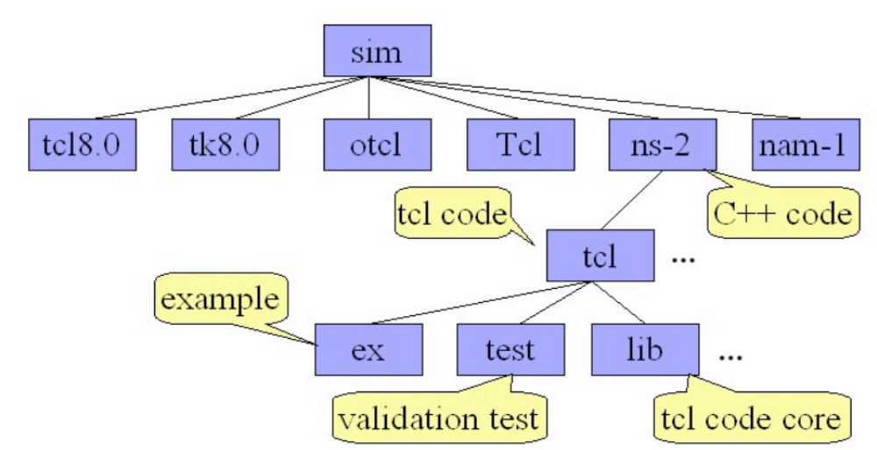
ns-2 Directory Structure

Slide 15
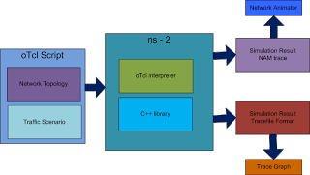
ns-2 Directory Structure

Slide 16
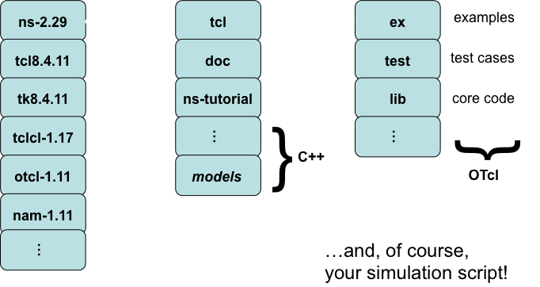
Components

Slide 17
Components
ns-2, the simulator itself
  Specify simulation, generate traces
  Depends on Tcl/Tk, OTcl, TclCL
nam, the network animator
  Animate traces from simulation
  GUI for constructing simple simulations
Pre-processing
  Traffic, topology generation
Post-processing
  Analyse trace output with awk, etc
Notes:
what does it do?
-- tcp, higher protocols, packets, links, queuing disciplines
-- visualizer (NAM)
-- trace playback
-- error models
what does it not do?
-- routing, ip, L2, routing

Slide 18
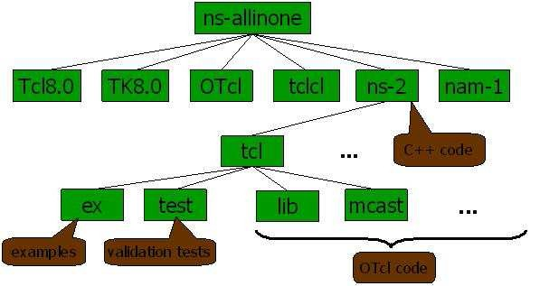
Directory Structure/Components

Slide 19
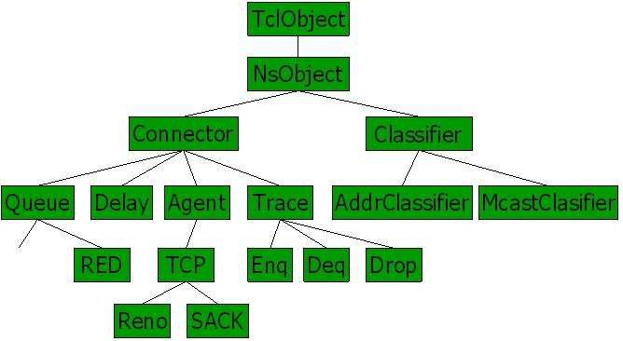
ns- Class Hierarchy

Slide 21
Using ns
Define
problem
Simulation
model
Extend
simulator
Post-process
results
Execute
simulation

Slide 22
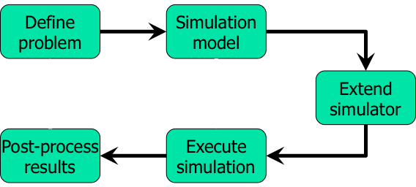
Using ns
Create simulation
  Describe network, protocols, sources, sinks
  Interface via OTcl which controls C++
Execute simulation
  Simulator maintains event list (packet list), executes next event (packet), repeats until done
  Events happen instantly in virtual time but could take arbitrarily long real time
  Single thread of control, no locking, races, etc
Post-process results
  Scripts (awk, perl, python) to process text output
  No standard library but some available on web
Notes:
basic structure
-- setup simulation
-- objects -> events -> schedule -> repeat
-- trace files -> post processing -> graphs
-- (example trace)
Model world as events
Simulator has list of events
Process: take next one, run it, until done
Each event happens in an instant of virtual (simulated) time, but takes an arbitrary amount of real time
Ns uses simple model: single thread of control => no locking or race conditions to worry about (very easy)

Slide 23
Split Object Model
Split Object Model with shared class hierarchy
  Control (OTcl) vs. Data (C++)
TclCL provides ‘glue library’ to “easily” share functions, variables, etc
  OTcl into C++: command(), tcl.result()
  C++ into OTcl: tcl.eval()
Not all classes are mirrored exactly
OTcl
TclCL
C++
OTcl script
describing
simulation
23
Notes:
split object model
-- C++, otcl
some basic syntax?

Slide 24
otcl and C++: The Duality
Pure C++
objects
Pure OTcl
objects
C++/OTcl split objects
C++
OTcl
ns

Slide 25
Languages
C++ for data
  Per-packet processing, the core of ns
  Fast to run, detailed, complete control
OTcl for control
  Simulation description
  Periodic or triggered actions
  Manipulating existing C++ objects
  Faster to write and change

Slide 26
C++/otcl Linkage

Slide 27
TclObject
Basic hierarchy in ns for split objects
Mirrored in both C++ and otcl
Example
  set tcp [new Agent/TCP]
  $tcp set window_ 200
  $tcp advance 10

Slide 28
TclObject: Hierarchy and Shadowing
TclObject
otcl class
hierarchy
C++ class
hierarchy
TclObject
Agent
Agent
Agent/TCP
TcpAgent
_o123
*tcp
Agent/TCP otcl
shadow object
Agent/TCP C++
object

Slide 29
TclClass
Static class TcpClass : public TclClass {
public:
  TcpClass() : TclClass(“Agent/Echo”) {}
  TclObject* create(int, const char*const*) {
    return (new EchoAgent());
  }
} class_echo;
mirroring
C++
OTcl
TclObject
TclObject
NsObject
??
Agent
Agent
EchoAgent
Agent/Echo

Slide 31
Basic Tcl
# Variables:
set x 10
set x
puts “x is $x”
# Functions and expressions:
set y [pow x 2]
set y [expr x*x]
# Control flow:
if {$x > 0} { return $x } else {
return [expr -$x] }
while { $x > 0 } {
puts $x
incr x –1
}
for {set i 0} {$i<10} {incr i} {
puts “$\i == $i”
}
# Procedures:
proc pow {x n} {
if {$n == 1} { return $x }
set part [pow x [expr $n-1]]
return [expr $x*$part]
}
# Files:
set file [open “nstrace.txt” w]
set line [gets $file]
puts –nonewline $file “hello!”
close $file

Slide 32
Basic OTcl
Class Person
# constructor:
Person instproc init {age} {
$self instvar age_
set age_ $age
}
# method:
Person instproc greet {} {
$self instvar age_
puts “age $age_: Hello!”
}
# subclass:
Class Child -superclass Person
Child instproc greet {} {
$self instvar age_
puts “age $age_ kid: Wassup!”
}
set a [new Person 45]
set b [new Child 15]
$a greet
$b greet

Slide 33
C++/OTcl Linkage
OTcl creates objects in the simulator
  Objects are shared between OTcl and C++ by default
  Access the OTcl interpreter via class Tcl
  Tcl &tcl = Tcl::instance();
  tcl.eval(…); tcl.evalc(“”); tcl.evalf(“”,…);
  tcl.result(…); res = tcl.result();
  ns2 also keeps hashtable of every TclObject
  tcl.enter()/.lookup()/.remove()
Variables are, by default, unshared
  Pure C++ or OTcl variables
  Bindings can be established by the compiled constructer
  bind(); bind_delay();
  { bind(“rtt_”, &t_rtt_); t_rtt_ = 10; }
Evaluate strings in interpreter
Return results to interpreter
Access results from interpreter
Couple C++ object instance variable t_rtt_ with OTcl object instance variable rtt_

Slide 34
C++/OTcl Linkage
Commands and methods
  For all TclObject, ns creates cmd{} instance procedure to access compiled methods
  Consider $o distance? <agentaddr>
    Invokes distance?{} instance procedure of $o
  If this doesn’t exist, call parent TclObject unknown{} method
  …which calls $o cmd distance? <agentaddr>
  …which calls C++ <T>::command() method

Slide 35
C++/OTcl Linkage
Header management
struct hdr_ping {
char ret; double send_time; double rcv_time; int seq;
static int offset_; // required by PacketHeaderManager
inline static int& offset() { return offset_; }
inline static hdr_ping* access(const Packet* p) { return (hdr_ping*) p->access(offset_); }
};
class PingAgent : public Agent {
public:
PingAgent();
int seq; // a send sequence number like in real ping
virtual int command(int argc, const char*const* argv);
virtual void recv(Packet*, Handler*);
};
PingAgent::PingAgent() : Agent(PT_PING), seq(0) { bind("packetSize_", &size_); }
int PingAgent::command(int argc, const char*const* argv) {
if (argc == 2) {
if (strcmp(argv[1], "send") == 0) {
Packet* pkt = allocpkt();
hdr_ping* hdr = hdr_ping::access(pkt);
hdr->ret = 0; hdr->seq = seq++;
hdr->send_time = Scheduler::instance().clock();
send(pkt, 0); // Agent::send()
return (TCL_OK);
} else if { /* etc */ } else { /* etc */ }
}
return (Agent::command(argc, argv));
}
Constructor,
with bound variable
send method invoked in simulation; result returned

Slide 36

From Network to Simulation
Application, Agent & Node
App₁
App₂
App₁
App₂
App₁
App₂
Agent₁
Agent₂
Agent₁
Agent₂
Agent₁
Agent₂
Node
Node
Node
Link
Link
Link
Node
Link
Node
Link
Node
Link
Link
Link
Node
Link
Node
Node
Node
Agent₁
Agent₂
Agent₁
Agent₂
Agent₁
Agent₂
App₁
App₂
App₁
App₂
App₁
App₂

Slide 37
Class Hierarchy (partial)
TclObject
Receive packets and transmit to target_
Basis for Agents and Links (~Queue + Delay)
NsObject
Connector
Classifier
Queue
Delay
Agent
Trace
AddressClassifier
DropTail
RED
TCP
Enq
Deq
Drop
Table of n slots each pointing to a TclObject
classify() identifies destination slot for packet
AddressClassifier, PortClassifier found within Nodes
Reno
SACK

Slide 39
Applications
Application
  Assumes attached to a TCPAgent
  start(), stop(), send(), recv()
  E.g. class TelnetApp
  [ns-2.20/apps/telnet.h]
    Schedule agent_->sendmsg() calls based on exponential interarrival timer
TrafficGenerator
  Assumes attached to a UDPAgent
  init(), next_interval()
  E.g. class POO_Traffic
  [ns-2.29/tools/pareto.cc]
    Schedule bursts of packets (Pareto on-off source)
An agent acts as a bridge which connects an application and a low-level network. Based on the user demand provided by an application, a sending agent constructs packets and transmits them to a receiving agent through a low-level network

Slide 40
Application
n0
n1
dst_addr_=1
dst_port_=0
dst_addr_=0
dst_port_=0
Port Classifier
Port Classifier
Application/FTP
Addr Classifier
0
Agent/TCP
Addr Classifier
0
Agent/TCPSink
agents_
agents_
0
1
dmux_
Link n0-n1
dmux_
entry_
1
entry_
0
classifier_
classifier_
Link n1-n0

Slide 41
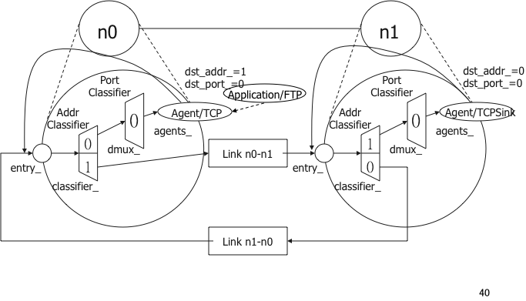
Application
Application
• Indicate user demand
• Two NS2 Application
1. Traffic generator
– Conform to a predefined schedule
– E.G., CBR
2. Simulated applications
– Create demand as if the application is
running
– E G FTP

Slide 42
Application
Functions of Class Application
• 2 main protected functions
• No implementation
• To be overridden by the derived classes
• start(): the application
• stop(): stop the application

Slide 43
Application
File Transfer Protocol
• Need no input file
• Tell the attached agent of the file size
• Implemented in OTcl domain only.
• Application Application/FTP
Simulated Applications
No predefined schedule
Act as if the application is running
Example: FTP and Telnet

Slide 44
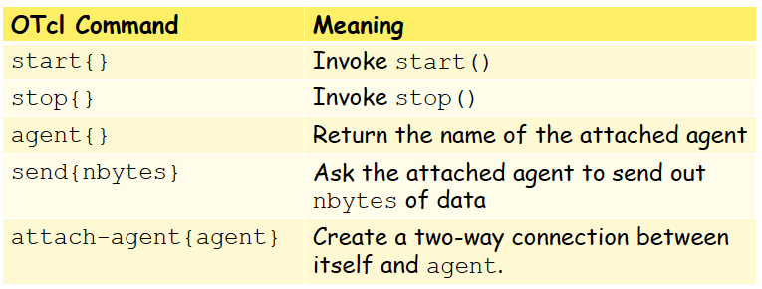
Application
File Transfer Protocol

Slide 46
Agents
TCP/UDP stacks
  timeout(), send(), etc
    Allocate and schedule packets
  recv(), etc
    Callback to app_ to notify of data
Subtype of Connector
  class Agent : public Connector
  [ns-2.29/common/agent.h,
  …/tcl/lib/ns-agent.tcl]
  class TcpAgent : public Agent
    class FullTcpAgent : public TcpAgent
  class UdpAgent : public Agent
An agent is an NsObject which is responsible for creating and destroying packets. There are two main types of NS2 agents: routing agents and transport layer agents

Slide 47
Agents: Creating Connection(UDP)
UDP
  set udp [new Agent/UDP]
  set null [new Agent/Null]
  $ns attach-agent $n0 $udp
  $ns attach-agent $n1 $null
  $ns connect $udp $null
47

Slide 49
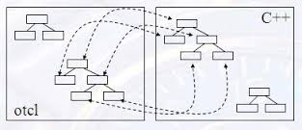
Languages
NS is an OTcl script interpreter with network simulation object libraries. But NS in not only written in OTcl but also in C++. For efficiency reasons, NS exploits a split-programming model. This is because the developers of NS have found that separating the data path implementation from the control path implementation will reduce packet and event processing time.
Task such as low-level event processing and packet forwarding requires high performance and are modified infrequently, therefore the event scheduler and the basic network component objects in the data path are implemented in a compiled language that is C++.
On the other hand, task such as dynamic configuration of network objects and characteristics of traffic sources undergo frequent change, therefore the definition, configuration and control of the simulation is expressed using a flexible and interactive scripting language that is Tcl.
The compiled C++ objects are made available also to the OTcl interpreter through an OTcl
Linkage that creates a matching OTcl object for each of the C++ objects. In this way, the controls of the C++ objects are given to Otcl.

Slide 50
Languages
OTcl, short for MIT Object Tcl, is an extension to Tcl/Tk scripting language for object-oriented programming developed at MIT. OTcl is used to express the definition, configuration and control of the simulation in NS. In NS, an OTcl script creates an event scheduler, sets up the network topology with nodes and likes between them, creates traffic, inserts errors and sets tracing options
The OTcl linkage is implemented using tclcl
Tcl is a scripting language

Slide 52
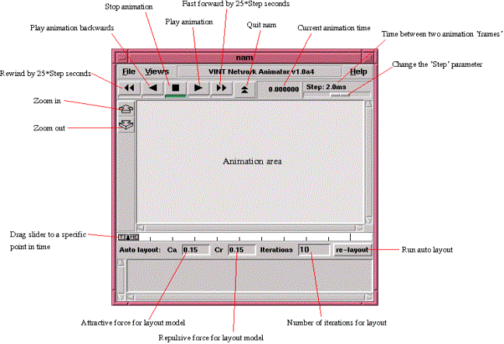
Visualization Tool (Network Animator (nam))

Slide 53
Getting started with nam
Turn on nam tracing in your Tcl script
  As easy as turning on normal tracing
    $ns namtrace $file
Specify link orientation (or node position for wireless)
  $ns duplex-link-op $node1 $node2 orient left
Execute nam
  exec nam $filename

Slide 54
Advanced nam capabilities
Node options — color, shape, label
  $node color red
  $node shape hexagon
  $node label “my text”
  $node label-color blue
  $node label-at up
Link options
  $ns duplex-link-op $n1 $n2 color green
  $ns duplex-link-op queuePos right
  $ns duplex-link-op $n1 $n2 label “my text”
  $ns duplex-link-op $n1 $n2 label-color blue
  $ns duplex-link-op $n1 $n2 label-at down

Slide 55
Advanced nam capabilities
Packet colors
  $ns color $n blue
  $agent set fid_ $n
Annotation
  $ns at $time “$ns trace-annotate $text”
Control playback
  $ns set-animation-rate 3ms

Slide 56
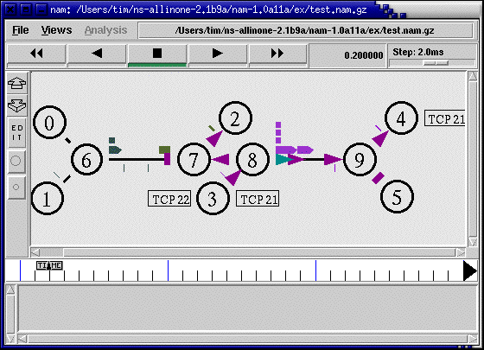
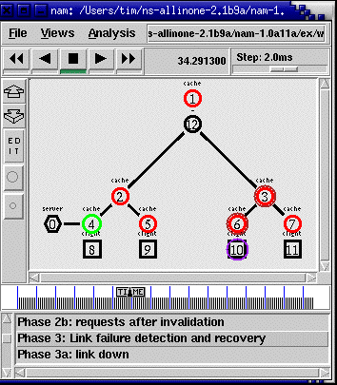
The nam user interface

Slide 57
The nam editor
Create simple scenarios graphically
Good for those who don’t want to learn Tcl, but only a limited subset of ns is available

Slide 58
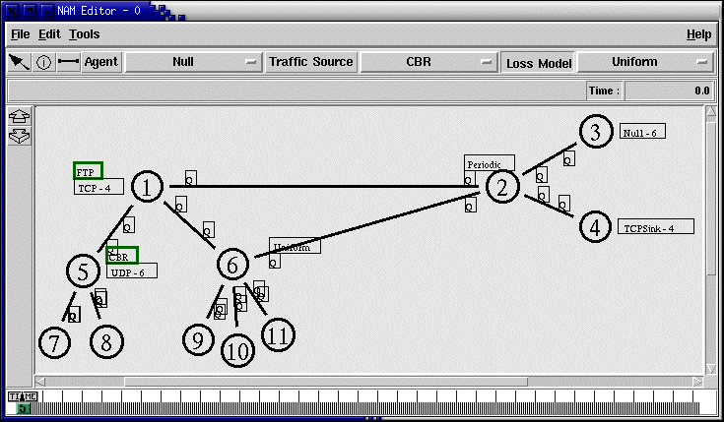
The nam editor

Slide 60
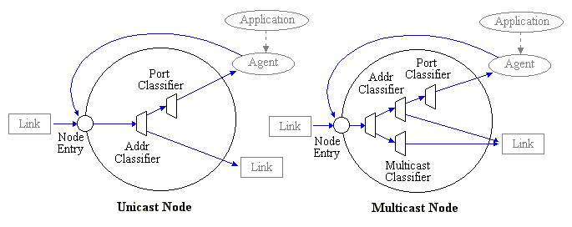
Node
A node is a compound object composed of a node entry object and of classifiers.
NS has two types of nodes, unicast nodes and multicast nodes.
A unicast node consists of an address classifier and a port classifier while a multicast node consists of a classifier that classify multicast packets from unicast packets and a multicast classifier that performs multicast routing.

Slide 61
Nodes
agents_
Addressable entity built from classifiers
  Distributes incoming data to agents
  Distributes outgoing data to links
Simplest unicast case has address and port classifiers, others may have more
Agent
dmux_
Agent
Agent
classifier_
entry_
Link
Link
Node, LanNode, etc derived from ParentNode
[ns-2.29/common/{parentnode,node}.h]
61

Slide 62
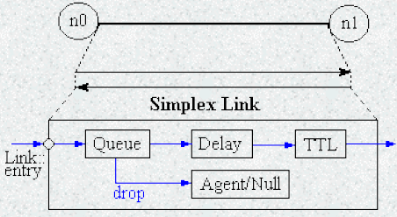
Link
Another compound object in NS that is made up of subclasses of NsObject is a Link. When a user creates a duplex-link, two simplex links in both directions are created. Moreover, the links has a Queue object, Delay object, TTL object and a Null Agent.
An output queue of a node is actually implemented as a part of simplex link object. Packets dequeued from a queue are passed to the Delay object that simulates the link delay, and packets dropped at a queue are sent to a Null Agent and are freed there.
Finally, the TTL object calculates Time To Live parameters for each packet received and updates the TTL field of the packet.

Slide 63
Links
An OTcl amalgam of C++ objects
[ns-2.29/tcl/lib/ns-link.tcl]
  class SimpleLink –superclass Link
  Simulator instproc duplex-link { n1 n2 bw delay type args }
More complex links may have complex link delay/bw characteristics…
[ns-2.29/link/delay.h]
  class LinkDelay : public Connector
…and multiple queue_ elements
[ns-2.29/queue/{queue.h,red.h,…}]
  class Queue : public Connector
  class RedQueue : public Queue
head_
enqT_
queue_
deqT_
link_
ttl_
rcvT_
drophead_
drpT_
Tracing

Slide 64
Links
n0
n1
$ns duplex-link $n0 $n1 5Mb 2ms DropTail
head_
enqT_
queue_
deqT_
link_
ttl_
rcvT_
drophead_
drpT_
Tracing

Slide 65
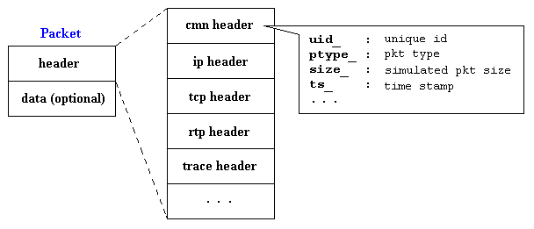
Packet
NS packet is composed of a stack of headers, and an optional data space
Common header that is commonly used by any objects as needed, IP header,
TCP header, RTP header (UDP uses RTP header) and trace header, is defined, and the offset of each header in the stack is recorded
A stack composed of all registered headers is created when a packet is allocated by an agent, and a network object can access any header in the stack of a packet it processes using the corresponding offset value.
Usually, a packet only has the header stack (and a data space pointer that is null). Although a packet can carry actual data (from an application) by allocating a data space, very few application and agent implementations support this

Slide 66
Packets
Derived from base class Event
  Other derived class is at-event (OTcl)
Packets are set of headers plus data
        foreach cl [ PacketHeader info subclass ] { puts "$cl [$cl set hdrlen_]" }
  Default is to include all headers of all types in all packets, giving >3kB per-packet!
    Turn off unnecessary headers before creating simulator object (common always required)
        foreach cl [PacketHeader info subclass] { puts $cl }
      remove-packet-header AODV ARP …, or
      remove-all-packet-headers
      add-packet-header IP TCP …
% foreach cl [ PacketHeader info subclass ] { puts "$cl [$cl set hdrlen_]" }
PacketHeader/LRWPAN 216
PacketHeader/XCP 64
PacketHeader/Lms 56
PacketHeader/PGM 16
PacketHeader/PGM_SPM 8
PacketHeader/PGM_NAK 16
PacketHeader/Pushback 4
PacketHeader/NV 8
PacketHeader/LDP 40
PacketHeader/MPLS 20
PacketHeader/rtProtoLS 8
PacketHeader/Ping 32
PacketHeader/TFRC 56
PacketHeader/TFRC_ACK 64
PacketHeader/Diffusion 192
PacketHeader/RAP 24
PacketHeader/AODV 808
PacketHeader/SR 720
PacketHeader/TORA 32
PacketHeader/IMEP 512
PacketHeader/ARP 32
PacketHeader/MIP 32
PacketHeader/IPinIP 4
PacketHeader/LL 32
PacketHeader/Mac 40
PacketHeader/Encap 4
PacketHeader/HttpInval 4
PacketHeader/MFTP 64
PacketHeader/SRMEXT 8
PacketHeader/SRM 16
PacketHeader/aSRM 8
PacketHeader/mcastCtrl 20
PacketHeader/CtrMcast 12
PacketHeader/rtProtoDV 4
PacketHeader/GAF 8
PacketHeader/Snoop 24
PacketHeader/SCTP 8
PacketHeader/TCPA 16
PacketHeader/TCP 80
PacketHeader/IVS 32
PacketHeader/RTP 12
PacketHeader/Message 64
PacketHeader/Resv 16
PacketHeader/TCP_QS 12
PacketHeader/UMP 16
PacketHeader/Src_rt 76
PacketHeader/IP 28
PacketHeader/Common 104
PacketHeader/Flags 9

Slide 67
Packet Format
ts_
cmn header
header
ptype_
ip header
data
uid_
tcp header
size_
rtp header
iface_
trace header
...

Slide 68
Agent TCP sends packet to the entry of Node n0
Packet is sent to the head classifier classifier_ (which is of class DestHashClassifier ) of Node n0
The DestHashClassifier object classifier_ examines the header of packet . In this case, the packet is destined to the Node n1 . Therefore, it forwards the packet to the link head of the connecting SimpleLink object
The link head forwards the packet to the connecting Queue object.
The Queue object enqueues the packet. If not blocked, it will forward the head of the line packet to the connecting LinkDelay object and set its status to blocked
Upon receiving a packet, the LinkDelay object schedules the two following events: Packet departure event and Packet arrival event
The TTLChecker object receives the packet, and decrements the TTL field of the packet header. If the TTL field of the packet is non-positive, the TTLChecker object will drop the packet. Otherwise, it will forward the packet to the entry of Node n1
Node n1 forwards the packet to the head classifier (classifier_ ). Since the packet is destined to itself, the packet is forwarded to the demultiplexer (dmux_ )
The demultiplexer forwards the packet to the agent null installed in the demultiplexer.
Packet Flow
n0
n1
dst_addr_=1
dst_port_=0
dst_addr_=0
dst_port_=0
Port Classifier
Port Classifier
Application/FTP
Addr Classifier
0
Agent/TCP
Addr Classifier
0
Agent/TCPSink
0
1
Link n0-n1
entry_
1
entry_
0
Link n1-n0

Slide 69
A Simple Topology
Application
n0
n1
Agent
Agent
0
0
0
1
1
0
head_
enqT_
queue_
deqT_
link_
ttl_
rcvT_
drophead_
drpT_
Link
n1 – n0

Slide 70
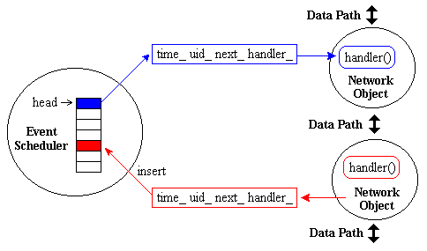
Event Scheduler
To drive the execution of the simulation, to process and schedule simulation events, NS makes use of the concept of discrete event schedulers
Each Network Object has an event scheduler.
If an network object issues an event, it has also to handle the event later at scheduled time.
In NS, there are two different types of event schedulers – real-time and non-real-time schedulers. There are three implementations (List, Heap and Calendar) for non-real-time schedulers; the default is Calendar

Slide 72
Example Script
n0
n1
set ns [new Simulator]
set n0 [$ns node]
set n1 [$ns node]
set ftp [new Application/FTP]
$ftp attach-agent $tcp
$ns at 0.2 "$ftp start"
$ns at 1.2 ”exit"
$ns run
$ns duplex-link $n0 $n1 1.5Mb 10ms DropTail
set tcp [$ns create-connection TCP $n0 TCPSink $n1 0]

Slide 73
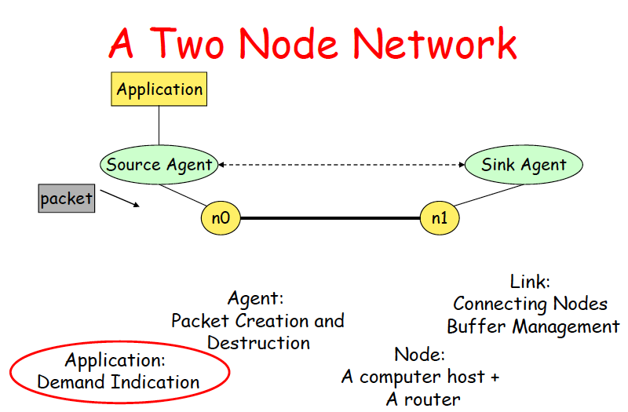
Example Script

Slide 75
Addressing
Two modes: default and hierarchical
[ns-2.29/tcl/lib/ns-address.tcl]
  Default: 32 bits address, 32 bits port, 1 bit multicast
  Hierarchical: default and specific
    Default: 3 levels, 10/11/11 bits per level
    Specific:
    $ns set-address-format hierarchical <nlevels> <bits in level1>+
Nodes are automatically assigned addresses
  But if you want to generate e.g. simulations with subnet structure, do it yourself

Slide 76
Routing
Links have assigned weights
  Default to 1
    $ns cost $n0 $n1 $cost
Three supported types:
  Static
    Simple Dijkstra, computed at start-of-day
  Session
    Simple Dijkstra, computed at each topology change
  Distance Vector (DV)
    RIP-like: periodic & triggered updates, split horizon, poison reverse
  Link state “highly experimental”
  [ns-2.29/linkstate/]

Slide 77
Routing
For dynamic (“session”) routing, need a failure model: there are four
  $ns rtmodel Trace <config_file> $n0 $n1
  $ns rtmodel Exponential {<params>} $n0 $n1
  $ns rtmodel Deterministic {<params>} $n0 $n1
  $ns rtmodel-at <time> up|down $n0 $n1
You can also define your own

Slide 78
Routing
Unicast
  $ns rtproto <type>
  <type>: Static, Session, DV, cost, multi-path
Multicast
  $ns multicast (right after [new Simulator])
    or set ns [new Simulator –multicast on]
  $ns mrtproto <type>
  <type>: CtrMcast, DM, ST, BST (centralized,dense mode, shared tree
78

Slide 79
Routing
n0
n1
Port Classifier
Addr Classifier
Node entry
0
n1 entry_
dmux_
head_
entry_
1
enqT_
queue_
deqT_
link_
ttl_
classifier_
drophead_
drpT_

Slide 80
Routing (cont.)
n0
n1
Port Classifier
Port Classifier
Addr Classifier
Addr Classifier
0
1
dmux_
Link n0-n1
dmux_
entry_
1
entry_
0
classifier_
classifier_
Link n1-n0

Slide 82
Maths
Support classes [ns-2.29/tools/]
class Integrator
  Simple linear interpolation integrator
class Samples
  Tracks set of sample points (count, sum, sum², mean, var)
class Random, <type>RandomVariable
  Wrapper around RNG
  Uniform, exponential, pareto, normal, lognormal generators
class RNG
  Implementation of pseudo-random number generator with a period of 2³¹-2
  MRG32k3a proposed in P. L’Ecuyer, “Good parameters and implementations for combined multiple recursive random number generators,” Operations Research, 47(1):159—164, 1999.

Slide 83
Tracing
Packet tracing and event tracing
  Objects that are inserted between nodes
  Insert from OTcl using trace{} method
    $ns trace-all $file, or
    [$ns link $n0 $n1] trace $file
Monitoring
  Record counters of interest for all packets or on a per-flow basis
…or roll your own

Slide 84
Tracing
ns and nam trace file formats
  ns also supports show_tcphdr_ variable controlling display of TCP flags
ns format
op | ts | prevhop | nexthop | type | size | flags | flowid | src | dst | seqno | pktid
+ | 1.102 | 0 | 1 | tcp | 40 | –––––– | 0 | 0.0 | 1.0 | 1 | 1
Enque [+], dequeue [-], receive [r], drop [d]
Types are
Flags are
  ECN-CE [E], -ECT [N], -CE [C], -CWR [A]; plus
  priority [P] and TCP fast start [F]

Slide 86
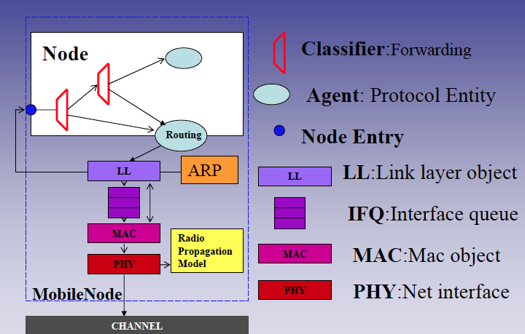
Wireless Node

Slide 87
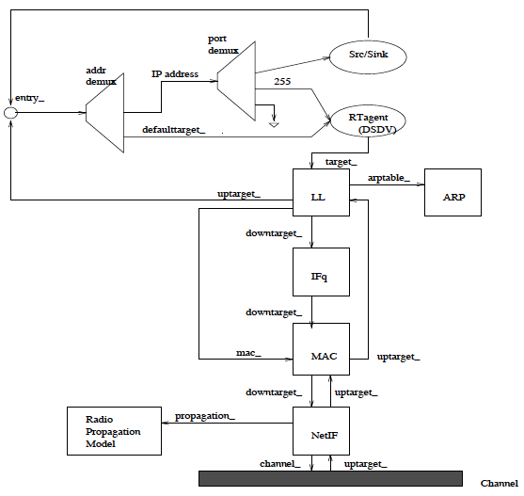
Wireless Node

Slide 88
Summary
Duality (Split Model)
ns2 Applications
ns2 Agents
Visualization Tool
Node
Link
Packet
Addressing Routing
Wireless Node
ns2 Goals
ns2 Languages
ns2 Models
ns2 Components
ns2 Research
ns2 Platform
Directory Structure
Class Hierarchy

