Slide 1
Cellular Wireless Networks
Lecture 28

Slide 2
Ovierview
Principles of Cellular Networks
Cellular Geometries
Frequency Reuse
Increasing Capacity
Macrocell and Microcell
Operation of Cellular System
Call Stages
Design Factors
Impairments
Ist Generation Cellular Networks
2nd Generation Cellular Networks
3rd and 4th Generation

Slide 3
Principles of Cellular Networks
Developed to increase capacity for mobile radio telephone service
Prior to cellular radio:
  mobile service was only provided by one high powered transmitter/receiver
  typically supported about 25 channels
  had a radius of about 80km

Slide 4
Cellular Network Organization
key for mobile technologies
based on multiple low power transmitters
area divided into cells
  in a tiling pattern to provide full coverage
  each with own antenna
  each with own range of frequencies
  served by base station
    consisting of transmitter, receiver, and control unit
  adjacent cells use different frequencies to avoid crosstalk
    cells sufficiently distant can use same frequency band

Slide 5
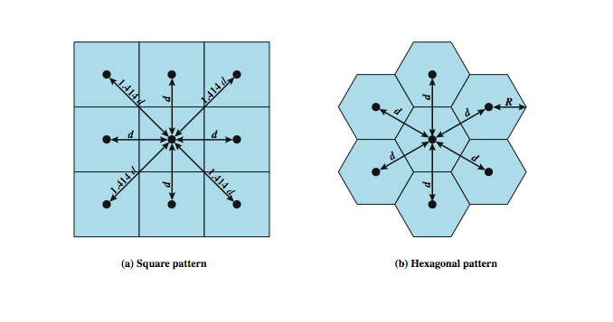
Cellular Geometries
Notes:
The first design decision to make is the shape of cells to cover an area. A matrix of square cells would be the simplest layout to define (Stallings DCC9e Figure 14.1a). However, this geometry is not ideal. If the width of a square cell is d, then a cell has four neighbors at a distance d and four neighbors at a distance d. As a mobile user within a cell moves toward the cell's boundaries, it is best if all of the adjacent antennas are equidistant. This simplifies the task of determining when to switch the user to an adjacent antenna and which antenna to choose. A hexagonal pattern provides for equidistant antennas (Stallings DCC9e Figure 14.1b). The radius of a hexagon is defined to be the radius of the circle that circumscribes it (equivalently, the distance from the center to each vertex; also equal to the length of a side of a hexagon). For a cell radius R, the distance between the cell center and each adjacent cell center is d = R.
In practice, a precise hexagonal pattern is not used. Variations from the ideal are due to topographical limitations, local signal propagation conditions, and practical limitation on sitting antennas.
A wireless cellular system limits the opportunity to use the same frequency for different communications because the signals, not being constrained, can interfere with one another even if geographically separated. Systems supporting a large number of communications simultaneously need mechanisms to conserve spectrum.

Slide 6
Frequency Reuse
object is to share nearby cell frequencies without interfering with each other
allows multiple simultaneous conversations
10 to 50 frequencies per cell
power of base transceiver controlled
allow communications within cell on given frequency
limit escaping power to adjacent cells

Slide 7
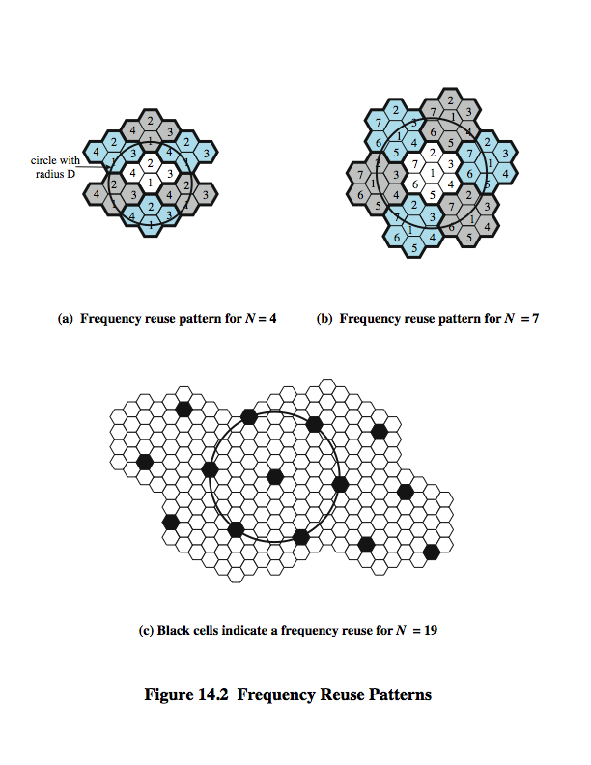
Frequency
Reuse
Patterns
D = minimum distance between centers of cells that use the same band of frequencies (called cochannels)
R = radius of a cell
d = distance between centers of adjacent cells (d = R)
N = number of cells in a repetitious pattern (each cell in the pattern uses a unique band of frequencies), termed the reuse factor
Notes:
The essential issue is to determine how many cells must intervene between two cells using the same frequency so that the two cells do not interfere with each other. Various patterns of frequency reuse are possible. Stallings DCC9e Figure 14.2 shows some examples. If the pattern consists of N cells and each cell is assigned the same number of frequencies, each cell can have K/N frequencies, where K is the total number of frequencies allotted to the system. For AMPS (Section 14.2), K = 395, and N = 7 is the smallest pattern that can provide sufficient isolation between two uses of the same frequency. This implies that there can be at most 57 frequencies per cell on average.
In characterizing frequency reuse, the following parameters are commonly used:
D = minimum distance between centers of cells that use the same band of frequencies (called cochannels)
R = radius of a cell
d = distance between centers of adjacent cells (d = R)
N = number of cells in a repetitious pattern (each cell in the pattern uses a unique band of frequencies), termed the reuse factor

Slide 8
Increasing Capacity
add new channels
  not all channels used to start with
frequency borrowing
  taken from adjacent cells by congested cells
  assign frequencies dynamically
cell splitting
  non-uniform topography and traffic distribution
  use smaller cells in high use areas
Notes:
In time, as more customers use the system, traffic may build up so that there are not enough frequencies assigned to a cell to handle its calls. A number of approaches have been used to cope with this situation, including the following:
Adding new channels: Typically, when a system is set up in a region, not all of the channels are used, and growth and expansion can be managed in an orderly fashion by adding new channels.
Frequency borrowing: In the simplest case, frequencies are taken from adjacent cells by congested cells. The frequencies can also be assigned to cells dynamically.
Cell splitting: In practice, the distribution of traffic and topographic features is not uniform, and this presents opportunities for capacity increase. Cells in areas of high usage can be split into smaller cells. Generally, the original cells are about 6.5 to 13 km in size. The smaller cells can themselves be split; however, 1.5-km cells are close to the practical minimum size as a general solution (but see the subsequent discussion of microcells).

Slide 9
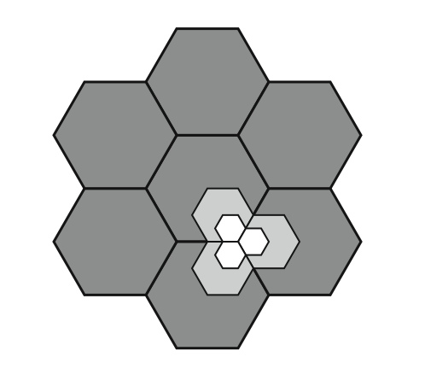
Cell Splitting

Slide 10
Increasing Capacity
Cell sectoring
cell divided into wedge shaped sectors (3–6 per cell)
Microcells
as cells become smaller antennas move from tops of hills and large buildings to tops of small buildings and sides of large buildings
each with own channel set
directional antennas at base station
use reduced power to cover a much smaller area
good for city streets, roads, inside large buildings

Slide 11
Typical Parameters for Macrocells and Microcells

Slide 12
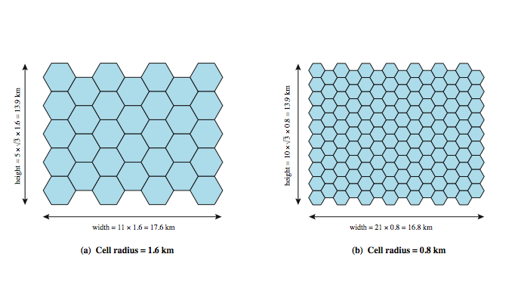
Frequency Reuse Example

Slide 13
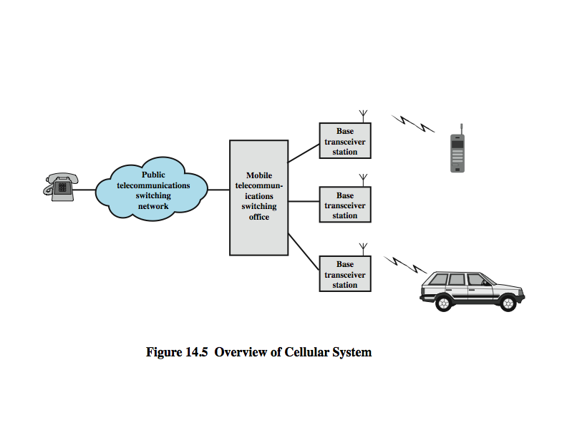
Operation of Cellular System

Slide 14
Cellular System Channels
Two types of
channels between mobile unit
and base
station (BS)
Control Channels
establish relationship between mobile unit and nearest BS
Traffic Channels
carry voice and data
set up and maintain calls
Notes:
The use of a cellular system is fully automated and requires no action on the part of the user other than placing or answering a call. Two types of channels are available between the mobile unit and the base station (BS): control channels and traffic channels. Control channels are used to exchange information having to do with setting up and maintaining calls and with establishing a relationship between a mobile unit and the nearest BS. Traffic channels carry a voice or data connection between users.

Slide 15
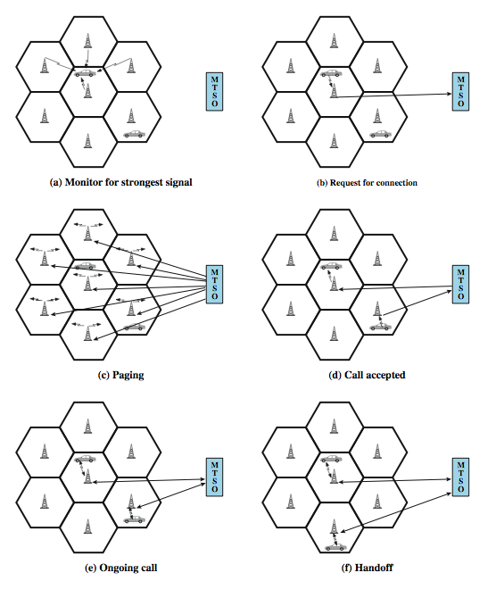
Call Stages
Notes:
Stallings DCC9e Figure 14.6 illustrates the steps in a typical call between two mobile users within an area controlled by a single MTSO:
Mobile unit initialization: When the mobile unit is turned on, it scans and selects the strongest setup control channel used for this system (Figure 14.6a). Cells with different frequency bands repetitively broadcast on different setup channels. The receiver selects the strongest setup channel and monitors that channel. The effect of this procedure is that the mobile unit has automatically selected the BS antenna of the cell within which it will operate. Then a handshake takes place between the mobile unit and the MTSO controlling this cell, through t15he BS in this cell. The handshake is used to identify the user and register its location. As long as the mobile unit is on, this scanning procedure is repeated periodically to account for the motion of the unit. If the unit enters a new cell, then a new BS is selected. In addition, the mobile unit is monitoring for pages, discussed subsequently.
Mobile-originated call: A mobile unit originates a call by sending the number of the called unit on the preselected setup channel (Figure 14.6b). The receiver at the mobile unit first checks that the setup channel is idle by examining information in the forward (from the BS) channel. When an idle is detected, the mobile may transmit on the corresponding reverse (to BS) channel. The BS sends the request to the MTSO.
Paging: The MTSO then attempts to complete the connection to the called unit. The MTSO sends a paging message to certain BSs depending on the called mobile number (Figure 14.6c). Each BS transmits the paging signal on its own assigned setup channel.
Call accepted: The called mobile unit recognizes its number on the setup channel being monitored and responds to that BS, which sends the response to the MTSO. The MTSO sets up a circuit between the calling and called BSs. At the same time, the MTSO selects an available traffic channel within each BS's cell and notifies each BS, which in turn notifies its mobile unit (Figure 14.6d). The two mobile units tune to their respective assigned channels.
Ongoing call: While the connection is maintained, the two mobile units exchange voice or data signals, going through their respective BSs and the MTSO (Figure 14.6e).
Handoff: If a mobile unit moves out of range of one cell and into the range of another during a connection, the traffic channel has to change to one assigned to the BS in the new cell (Figure 14.6f). The system makes this change without either interrupting the call or alerting the user.

Slide 16
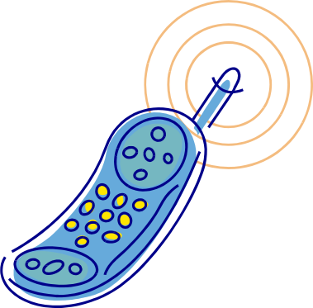
Other Functions
call blocking
  after repeated attempts, if all traffic channels are busy, a busy tone is returned
call termination
  when a user hangs up channels at the BS are released
call drop
  when BS cannot maintain required signal strength
calls to/from fixed and remote mobile subscriber
  MTSO connects to the PSTN

Slide 17
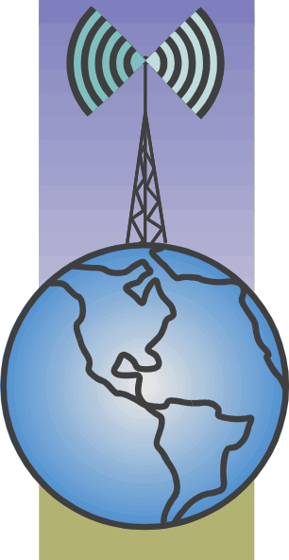
Mobile Radio
Propagation Effects
signal strength
  strength of signal between BS and mobile unit needs to be strong enough to maintain signal quality
  not too strong so as to create co-channel interference
  must handle variations in noise
fading
  time variation of received signal
  caused by changes in transmission path(s)
  even if signal strength is in effective range, signal propagation effects may disrupt the signal
Notes:
Mobile radio communication introduces complexities not found in wire communication or in fixed wireless communication. Two general areas of concern are signal strength and signal propagation effects.
Signal strength: The strength of the signal between the base station and the mobile unit must be strong enough to maintain signal quality at the receiver but no so strong as to create too much co-channel interference with channels in another cell using the same frequency band. Several complicating factors exist. Human-made noise varies considerably, resulting in a variable noise level. For example, automobile ignition noise in the cellular frequency range is greater in the city than in a suburban area. Other signal sources vary from place to place. The signal strength varies as a function of distance from the BS to a point within its cell. Moreover, the signal strength varies dynamically as the mobile unit moves.
Fading: Even if signal strength is within an effective range, signal propagation effects may disrupt the signal and cause errors. Fading is discussed subsequently in this section.

Slide 18
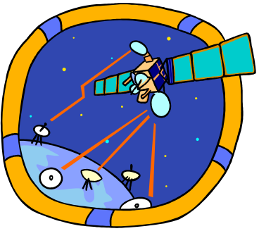
Design Factors
propagation effects:
  desired maximum transmit power level at BS and mobile units
  typical height of mobile unit antenna
  available height of the BS antenna
propagation effects are difficult to predict
  use model based on empirical data
    Widely used model by Okumura et al & refined by Hata
      detailed analysis of Tokyo area
      produced path loss information for an urban environment
  Hata's model is an empirical formulation that takes into account a variety of conditions
Notes:
In designing a cellular layout, the communications engineer must take account of these various propagation effects, the desired maximum transmit power level at the base station and the mobile units, the typical height of the mobile unit antenna, and the available height of the BS antenna. These factors will determine the size of the individual cell. Unfortunately, as just described, the propagation effects are dynamic and difficult to predict. The best that can be done is to come up with a model based on empirical data and to apply that model to a given environment to develop guidelines for cell size. One of the most widely used models was developed by Okumura et al [OKUM68] and subsequently refined by Hata [HATA80]. The original was a detailed analysis of the Tokyo area and produced path loss information for an urban environment. Hata's model is an empirical formulation that takes into account a variety of environments and conditions
The Okumura/Hata model is considered to be among the best in terms of accuracy in path loss prediction and provides a practical means of estimating path loss in a wide variety of situations [FREE07].

Slide 19
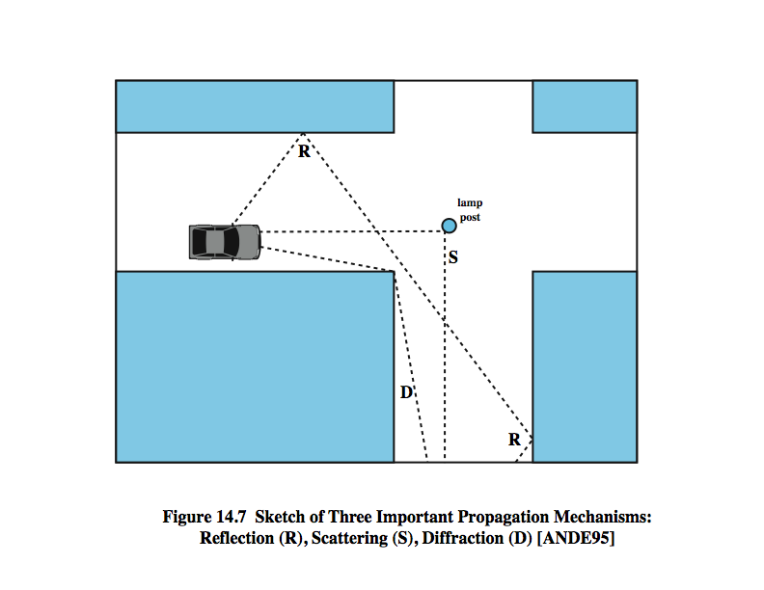
Multipath Propagation

Slide 20
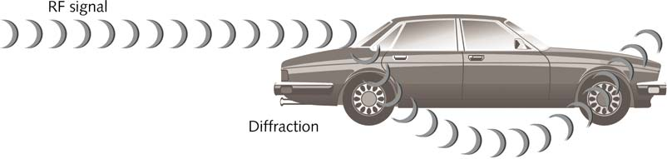
Diffraction
Diffraction is a change in the direction and/or intensity of a wave as it passes by the edge of an obstacle.
Diffraction occurs because the RF signal slows down as it encounters the obstacle and causes the wave front to change directions
Diffraction is often caused by buildings, small hills, and other larger objects in the path of the propagating RF signal.

Slide 21
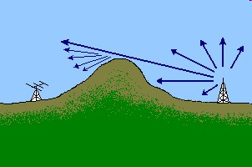
Diffraction
Diffraction - occurs at the edge of an impenetrable body that is large compared to wavelength of radio wave

Slide 22
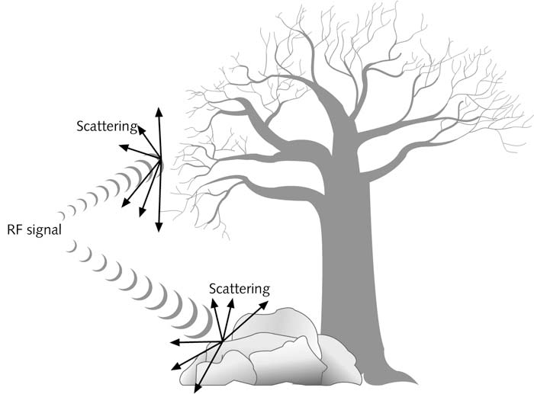
Scattering
Scattering happens when an RF signal strikes an uneven surface causing the signal to be scattered. The resulting signals are less significant than the original signal.
Scattering = Multiple Reflections

Slide 23
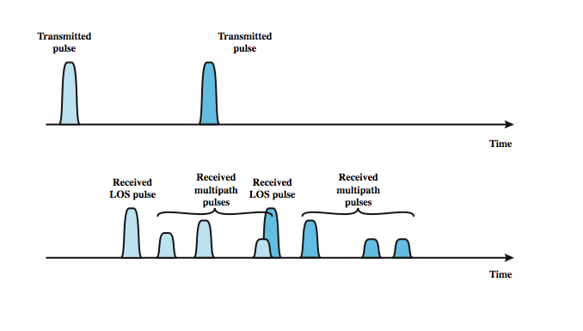
Effects of Multipath Propagation

Slide 24
Types of Fading
fast fading
rapid changes in strength over half wavelength distances
slow fading
slower changes due to user passing different height buildings, gaps in buildings, etc.
flat fading
affects all frequencies in same proportion simultaneously
selective fading
different frequency components affected differently
Notes:
Fading effects in a mobile environment can be classified as either fast or slow. Referring to Stallings DCC9e Figure 14.7, as the mobile unit moves down a street in an urban environment, rapid variations in signal strength occur over distances of about one-half a wavelength. At a frequency of 900 MHz, which is typical for mobile cellular applications, a wavelength is 0.33 m. Changes of amplitude can be as much as 20 or 30 dB over a short distance. This type of rapidly changing fading phenomenon, known as fast fading, affects not only mobile phones in automobiles, but even a mobile phone user walking down an urban street.
As the mobile user covers distances well in excess of a wavelength, the urban environment changes, as the user passes buildings of different heights, vacant lots, intersections, and so forth. Over these longer distances, there is a change in the average received power level about which the rapid fluctuations occur. This is referred to as slow fading.
Fading effects can also be classified as flat or selective. Flat fading, or nonselective fading, is that type of fading in which all frequency components of the received signal fluctuate in the same proportions simultaneously. Selective fading affects unequally the different spectral components of a radio signal. The term selective fading is usually significant only relative to the bandwidth of the overall communications channel. If attenuation occurs over a portion of the bandwidth of the signal, the fading is considered to be selective; nonselective fading implies that the signal bandwidth of interest is narrower than, and completely covered by, the spectrum affected by the fading.

Slide 25
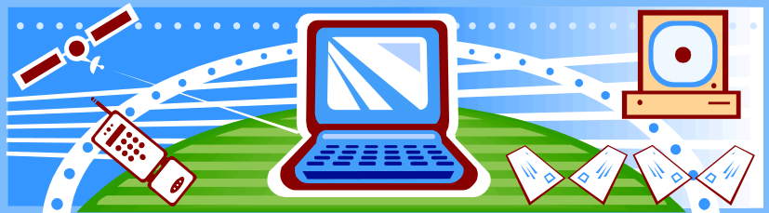
Error Compensation Mechanisms
forward error correction
  applicable in digital transmission applications
  typically, ratio of total bits to data bits is 2-3
adaptive equalization
  applied to transmissions that carry analog or digital information
  used to combat intersymbol interference
  involves gathering the dispersed symbol energy back together into its original time interval
Notes:
The efforts to compensate for the errors and distortions introduced by multipath fading fall into three general categories: forward error correction, adaptive equalization, and diversity techniques. In the typical mobile wireless environment, techniques from all three categories are combined to combat the error rates encountered.
Forward error correction is applicable in digital transmission applications: those in which the transmitted signal carries digital data or digitized voice or video data. Typically in mobile wireless applications, the ratio of total bits sent to data bits sent is between 2 and 3. This may seem an extravagant amount of overhead, in that the capacity of the system is cut to one-half or one-third of its potential, but the mobile wireless environment is so difficult that such levels of redundancy are necessary. Chapter 6 discusses forward error correction.
Adaptive equalization can be applied to transmissions that carry analog information (e.g., analog voice or video) or digital information (e.g., digital data, digitized voice or video) and is used to combat intersymbol interference. The process of equalization involves some method of gathering the dispersed symbol energy back together into its original time interval. Equalization is a broad topic; techniques include the use of so-called lumped analog circuits as well as sophisticated digital signal processing algorithms.

Slide 26
Error Compensation Mechanisms
diversity
  based on fact that individual channels experience independent fading events
  use multiple logical channels between transmitter and receiver
  send part of signal over each channel
  doesn’t eliminate errors, but reduces
  space diversity involves physical transmission paths
  more commonly refers to frequency or time diversity
  most important example of frequency diversity is spread spectrum

Slide 27
First Generation Analog
original cellular telephone networks
analog traffic channels
early 1980s in North America
Advanced Mobile Phone Service (AMPS)
also common in South America, Australia, and China
replaced by later generation systems
Notes:
The original cellular telephone networks provided analog traffic channels; these are now referred to as first-generation systems. Since the early 1980s the most common first-generation system in North America has been the Advanced Mobile Phone Service (AMPS) developed by AT&T. This approach is also common in South America, Australia, and China. Although gradually being replaced by second-generation systems, AMPS is still in common use. In this section, we provide an overview of AMPS.

Slide 28
AMPS Parameters

Slide 29
Operation
AMPS-capable phone has numeric assignment module (NAM) in read-only memory
  NAM contains number of phone
  serial number of phone
  when phone turned on, transmits serial number and phone number to MTSO
  MTSO has database of mobile units reported stolen
  MTSO uses phone number for billing
  if phone is used in remote city, service is still billed to user's local service provider

Slide 30
AMPS Call Sequence
subscriber initiates call keying in number
MTSO validates telephone number and checks user authorized to place call
MTSO issues message to user's phone indicating traffic channels to use
MTSO sends ringing signal to called party
when called party answers, MTSO establishes circuit and initiates billing information
when one party hangs up MTSO releases circuit, frees radio channels, and completes billing information
Notes:
When a call is placed, the following sequence of events occurs [COUC07]:
1. The subscriber initiates a call by keying in the telephone number of the called party and presses the send key.
2. The MTSO verifies that the telephone number is valid and that the user is authorized to place the call; some service providers require the user to enter a PIN (personal identification number) as well as the called number to counter theft.
3. The MTSO issues a message to the user's cell phone indicating which traffic channels to use for sending and receiving.
4. The MTSO sends out a ringing signal to the called party. All of these operations (steps 2 through 4) occur within 10 s of initiating the call.
5. When the called party answers, the MTSO establishes a circuit between the two parties and initiates billing information.
6. When one party hangs up, the MTSO releases the circuit, frees the radio channels, and completes the billing information.

Slide 31
AMPS Control Channels
21 full-duplex 30-kHz control channels
  transmit digital data using FSK
  data transmitted in frames
control information can be transmitted over voice channel during conversation
  mobile unit or the base station inserts burst of data
    turn off voice FM transmission for about 100 ms
    replacing it with an FSK-encoded message
  used to exchange urgent messages
    change power level
    handoff
Notes:
Each AMPS service includes 21 full-duplex 30-kHz control channels, consisting of 21 reverse control channels (RCCs) from subscriber to base station, and 21 forward channels from base station to subscriber. These channels transmit digital data using FSK. In both channels, data are transmitted in frames.
Control information can be transmitted over a voice channel during a conversation. The mobile unit or the base station can insert a burst of data by turning off the voice FM transmission for about 100 ms and replacing it with an FSK-encoded message. These messages are used to exchange urgent messages, such as change power level and handoff.

Slide 32
Second Generation CDMA
provide higher quality signals, higher data rates for support of digital services, with overall greater capacity
key differences include:
  digital traffic channels
  encryption
  error detection and correction
  channel access
    time division multiple access (TDMA)
    code division multiple access (CDMA)

Slide 33
Code Division Multiple Access (CDMA)
have a number of 2nd generation systems
  for example IS-95 using CDMA
each cell allocated frequency bandwidth
  orthogonal chipping codes provide multiple access
bandwidth is split in two
half for reverse, half for forward
uses direct-sequence spread spectrum (DSSS)
Notes:
CDMA for cellular systems can be described as follows. As with FDMA, each cell is allocated a frequency bandwidth, which is split into two parts, half for reverse (mobile unit to base station) and half for forward (base station to mobile unit). For full duplex communication, a mobile unit uses both reverse and forward channels. Transmission is in the form of direct-sequence spread spectrum (DS-SS), which uses a chipping code to increase the data rate of the transmission, resulting in an increased signal bandwidth. Multiple access is provided by assigning orthogonal chipping codes (defined in Chapter 9) to multiple users, so that the receiver can recover the transmission of an individual unit from multiple transmissions.

Slide 34
CDMA
CDMA allows multiple users to transmit over the same wireless channel using spread spectrum. Each user uses a different spreading code. The receiver picks out one signal by matching the spreading code.

Slide 35
Code Division Multiple Access (CDMA)
A multiplexing technique used with spread spectrum
Given a data signal rate D
Break each bit into k chips according to a fixed chipping code specific to each user
Resulting new channel has chip data rate kD chips per second
Can have multiple channels superimposed

Slide 36
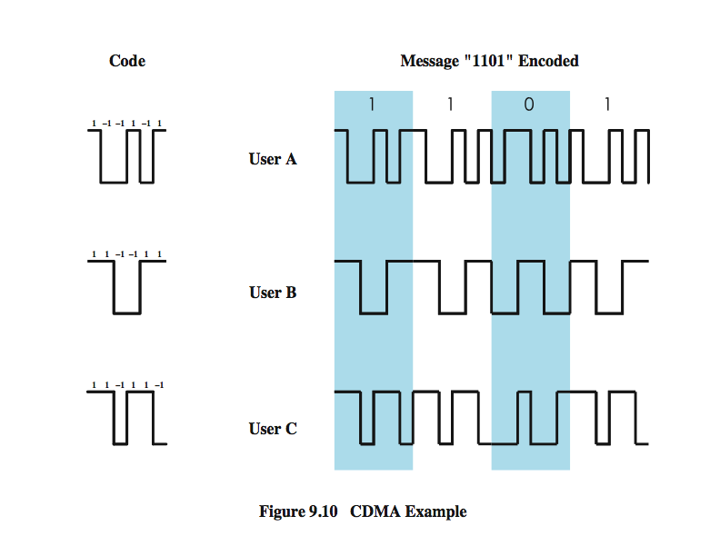
CDMA Example
Notes:
As an illustration we consider a simple example with k = 6. It is simplest to characterize a chipping code as a sequence of 1s and –1s. Figure 9.10 shows the codes for three users, A, B, and C, each of which is communicating with the same base station receiver, R. Thus, the code for user A is c_{A} = <1, –1, –1, 1, –1, 1>. Similarly, user B has code c_{B} = <1, 1, –1, –1, 1, 1>, and user C has c_{C} = <1, 1, –1, 1, 1, –1>. We now consider the case of user A communicating with the base station. The base station is assumed to know A’s code. For simplicity, we assume that communication is already synchronized so that the base station knows when to look for codes. If A wants to send a 1 bit, A transmits its code as a chip pattern <1, –1, –1, 1, –1, 1>. If a 0 bit is to be sent, A transmits the complement (1s and –1s reversed) of its code, <–1, 1, 1, –1, 1, –1>.
At the base station the receiver decodes the chip patterns. If the decoder is linear and if A and B transmit signals s_{A} and s_{B}, respectively, at the same time, then S_{A} (s_{A} + s_{B}) = S_{A} (s_{A}) + S_{A} (s_{B}) = S_{A} (s_{A}) since the decoder ignores B when it is using A’s code. The codes of A and B that have the property that S_{A} (c_{B}) = S_{B} (c_{A}) = 0 are called orthogonal. Using the decoder, S_{u}, the receiver can sort out transmission from u even when there may be other users broadcasting in the same cell. In practice, the CDMA receiver can filter out the contribution from unwanted users or they appear as low-level noise. However, if there are many users competing for the channel with the user the receiver is trying to listen to, or if the signal power of one or more competing signals is too high, perhaps because it is very near the receiver (the “near/far” problem), the system breaks down.

Slide 37
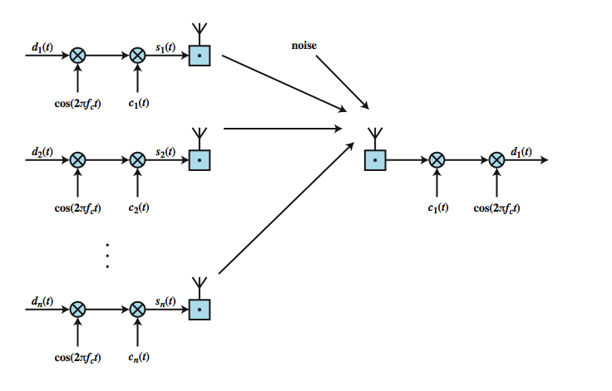
CDMA for DSSS

Slide 38
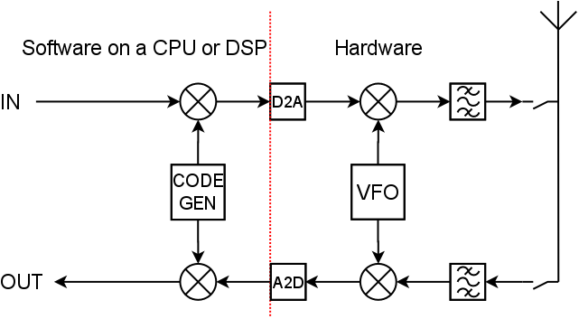
CDMA Transceiver Block Diagram

Slide 39
CDMA
An example?

Slide 40
Multiplication
1
x
1
=
1
1
x
-1
=
-1
-1
x
1
=
-1
-1
x
-1
=
1

Slide 41
CDMA example
Low-Bandwidth Signal:
High-Bandwidth Spreading Code:
...repeated...

Slide 42
CDMA example
Low-Bandwidth Signal:
High-Bandwidth Spreading Code:
Mix is a simple multiply
… and transmit.

Slide 43
CDMA example
To Decode / Receive, take the signal:

Slide 44
CDMA example
To Decode / Receive, take the signal:
Multiply by the same Spreading Code:
… to get ...
… which you should recognise as...

Slide 45
CDMA example
To Decode / Receive, take the signal:
Multiply by the same Spreading Code:
… to get ...

Slide 47
W-CDMA Parameters
Notes:
Stallings DCC9e Table 14.5

Slide 48
CDMA Advantages
frequency diversity
  noise bursts and fading have less effect
multipath resistance
  chipping codes have low cross and autocorrelation
privacy
  inherent in use of spread-spectrum
graceful degradation
  more users means more noise and more errors
  leads to slow signal degradation until unacceptable

Slide 49
CDMA Disadvantages
self-jamming
  some cross correlation between users
  Unless all of the mobile users are perfectly synchronized, the arriving transmissions from multiple users will not be perfectly aligned on chip boundaries. Thus the spreading sequences of the different users are not orthogonal and there is some level of cross correlation
near-far problem
  signals closer to receiver are received with less attenuation than signals farther away
  transmissions more remote might be difficult to recover
Notes:
Two drawbacks of CDMA cellular should also be mentioned:
Self-jamming: Unless all of the mobile users are perfectly synchronized, the arriving transmissions from multiple users will not be perfectly aligned on chip boundaries. Thus the spreading sequences of the different users are not orthogonal and there is some level of cross correlation. This is distinct from either TDMA or FDMA, in which for reasonable time or frequency guardbands, respectively, the received signals are orthogonal or nearly so.
Near-far problem: Signals closer to the receiver are received with less attenuation than signals farther away. Given the lack of complete orthogonality, the transmissions from the more remote mobile units may be more difficult to recover.

Slide 50
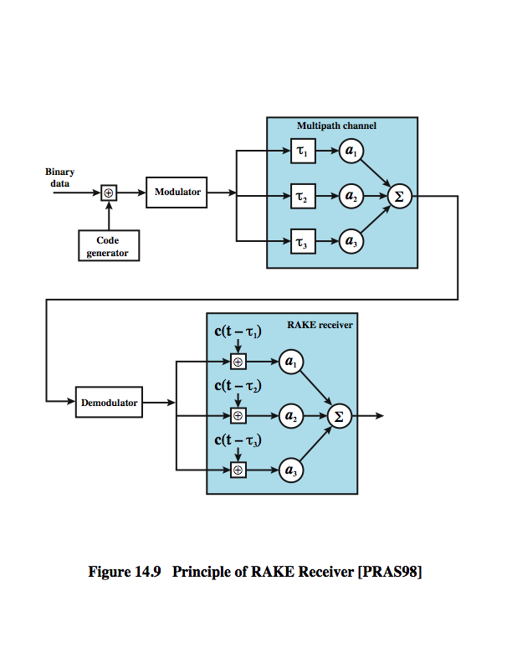
RAKE Receiver
In a multipath environment, which is common in cellular systems, if the multiple versions of a signal arrive more than one chip interval apart from each other, the receiver can recover the signal by correlating the chip sequence with the dominant incoming signal. The remaining signals are treated as noise. However, even better performance can be achieved if the receiver attempts to recover the signals from multiple paths and then combine them, with suitable delays. This principle is used in the RAKE receiver.
Notes:
In a multipath environment, which is common in cellular systems, if the multiple versions of a signal arrive more than one chip interval apart from each other, the receiver can recover the signal by correlating the chip sequence with the dominant incoming signal. The remaining signals are treated as noise. However, even better performance can be achieved if the receiver attempts to recover the signals from multiple paths and then combine them, with suitable delays. This principle is used in the RAKE receiver.
Stallings DCC9e Figure 14.9 illustrates the principle of the RAKE receiver. The original binary signal to be transmitted is spread by the exclusive-OR (XOR) operation with the transmitter's chipping code. The spread sequence is then modulated for transmission over the wireless channel. Because of multipath effects, the channel generates multiple copies of the signal, each with a different amount of time delay (τ1, τ2, etc.), and each with a different attenuation factors (a1, a2, etc.). At the receiver, the combined signal is demodulated. The demodulated chip stream is then fed into multiple correlators, each delayed by a different amount. These signals are then combined using weighting factors estimated from the channel.

Slide 51
RAKE Receiver
The original binary signal to be transmitted is spread by the exclusive-OR (XOR) operation with the transmitter's chipping code. The spread sequence is then modulated for transmission over the wireless channel. Because of multipath effects, the channel generates multiple copies of the signal, each with a different amount of time delay (τ1, τ2, etc.), and each with a different attenuation factors (a1, a2, etc.). At the receiver, the combined signal is demodulated. The demodulated chip stream is then fed into multiple correlators, each delayed by a different amount. These signals are then combined using weighting factors estimated from the channel.

Slide 53
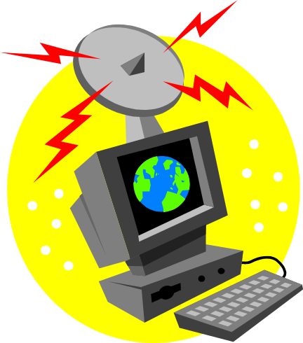
IS-95
second generation CDMA scheme
primarily deployed in North America
transmission structures different on forward and reverse links
Notes:
The most widely used second-generation CDMA scheme is IS-95, which is primarily deployed in North America. Here we describe the transmission structure on the forward link; the reverse link is similar.

Slide 54
IS-95 Channel Structure

Slide 55
IS-95 Forward Link
Pilot (channel 0)
allows mobile unit to acquire timing information
Synchronization (channel 32)
1200-bps channel used by mobile station to obtain identification information about the cellular system
Paging
(channels 1 to 7)
contain messages for one or more mobile stations
Traffic (channels 8 to 31 and 33 to 63)
supports 55 traffic channels
Notes:
The forward link supports four types of channels:
Pilot (channel 0): A continuous signal on a single channel. This channel allows the mobile unit to acquire timing information, provides phase reference for the demodulation process, and provides a means for signal strength comparison for the purpose of handoff determination. The pilot channel consists of all zeros.
Synchronization (channel 32): A 1200-bps channel used by the mobile station to obtain identification information about the cellular system (system time, long code state, protocol revision, etc.).
Paging (channels 1 to 7): Contain messages for one or more mobile stations.
Traffic (channels 8 to 31 and 33 to 63): The forward channel supports 55 traffic channels. The original specification supported data rates of up to 9600 bps. A subsequent revision added a second set of rates up to 14,400 bps.
Note that all of these channels use the same bandwidth. The chipping code is used to distinguish among the different channels. For the forward channel, the chipping codes are the 64 orthogonal 64-bit codes derived from a 64 × 64 matrix known as the Walsh matrix (discussed in [STAL05]).

Slide 56
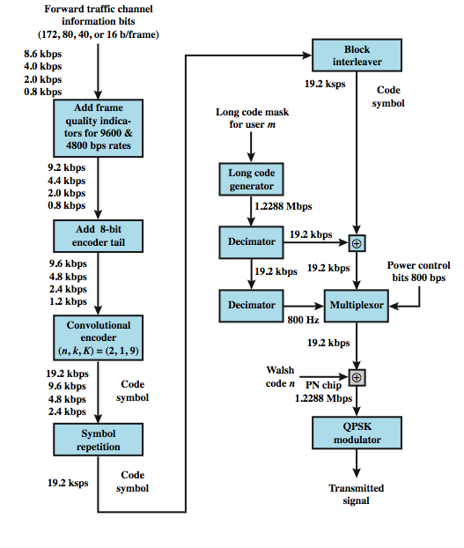
Forward Link Processing
Notes:
Stallings DCC9e Figure 14.11 shows the processing steps for transmission on a forward traffic channel using rate set 1. For voice traffic, the speech is encoded at a data rate of 8550 bps. After additional bits are added for error detection, the rate is 9600 bps. The full channel capacity is not used when the user is not speaking. During quiet periods the data rate is lowered to as low as 1200 bps. The 2400-bps rate is used to transmit transients in the background noise, and the 4800 bps rate is used to mix digitized speech and signaling data.
The data or digitized speech is transmitted in 20-ms blocks with forward error correction provided by a convolutional encoder with rate 1/2, thus doubling the effective data rate to a maximum of 19.2 kbps. For lower data rates, the encoder output bits (called code symbols) are replicated to yield the 19.2-kbps rate. The data are then interleaved in blocks to reduce the effects of errors by spreading them out.

Slide 57
Forward Link - Scrambling
after interleaver data are scrambled
  serves as a privacy mask
  prevents sending of repetitive patterns
  reduces probability of users sending at peak power at same time
scrambling done by long code
  pseudorandom number from 42-bit shift register
  initialized with user's electronic serial number
  output at a rate of 1.2288 Mbps

Slide 58
Forward Link - Power Control
inserts power control information in traffic channel
  controls the power output of antenna
  robs traffic channel of bits at rate of 800 bps
    inserted by stealing code bits
  800-bps channel carries information directing mobile unit to adjust output level
  power control stream multiplexed to 19.2 kbps
Notes:
The next step in the processing inserts power control information in the traffic channel, to control the power output of the antenna. The power control function of the base station robs the traffic channel of bits at a rate of 800 bps. These are inserted by stealing code bits. The 800-bps channel carries information directing the mobile unit to increment, decrement, or keep stable its current output level. This power control stream is multiplexed into the 19.2 kbps by replacing some of the code bits, using the long code generator to encode the bits.

Slide 59
Forward Link - DSSS
spreads 19.2 kbps to 1.2288 Mbps
using one row of Walsh matrix
  assigned to mobile station during call setup
  if 0 presented to XOR, 64 bits of assigned row sent
  if 1 presented, bitwise XOR of row sent
final bit rate 1.2288 Mbps
bit stream modulated onto carrier using QPSK
  data split into I and Q (in-phase and quadrature) channels
  data in each channel XORed with unique short code
Notes:
The next step in the process is the DS-SS function, which spreads the 19.2 kbps to a rate of 1.2288 Mbps using one row of the 64 × 64 Walsh matrix. One row of the matrix is assigned to a mobile station during call setup. If a 0 bit is presented to the XOR function, then the 64 bits of the assigned row are sent. If a 1 is presented, then the bitwise XOR of the row is sent. Thus, the final bit rate is 1.2288 Mbps. This digital bit stream is then modulated onto the carrier using a QPSK modulation scheme. Recall from Chapter 5 that QPSK involves creating two bit streams that are separately modulated (see Stallings DCC9e Figure 5.11). In the IS-95 scheme, the data are split into I and Q (in-phase and quadrature) channels and the data in each channel are XORed with a unique short code. The short codes are generated as pseudorandom numbers from a 15-bit-long shift register.

Slide 60
Third Generation (3G)
Systems
high-speed wireless communications to support multimedia, data, and video in addition to voice
3G capabilities:
    voice quality comparable to PSTN
    144 kbps available to users over large areas
    384 kbps available to pedestrians over small areas
    support for 2.048 Mbps for office use
    symmetrical and asymmetrical data rates
    packet-switched and circuit-switched services
    adaptive interface to Internet
    more efficient use of available spectrum
    support for variety of mobile equipment
    allow introduction of new services and technologies

Slide 61
3G Driving Forces
trend toward universal personal telecommunications
universal communications access
GSM cellular telephony with subscriber identity module, is step towards goals
personal communications services (PCSs) and personal communication networks (PCNs) also form objectives for third-generation wireless
technology is digital using time division multiple access or code-division multiple access
PCS handsets low power, small and light
Notes:
More generally, one of the driving forces of modern communication technology is the trend toward universal personal telecommunications and universal communications access. The first concept refers to the ability of a person to identify himself or herself easily and use conveniently any communication system in an entire country, over a continent, or even globally, in terms of a single account. The second refers to the capability of using one’s terminal in a wide variety of environments to connect to information services (e.g., to have a portable terminal that will work in the office, on the street, and on airplanes equally well). This revolution in personal computing will obviously involve wireless communication in a fundamental way.

Slide 62
Typical Mobile Device Capacity Demands

Slide 63
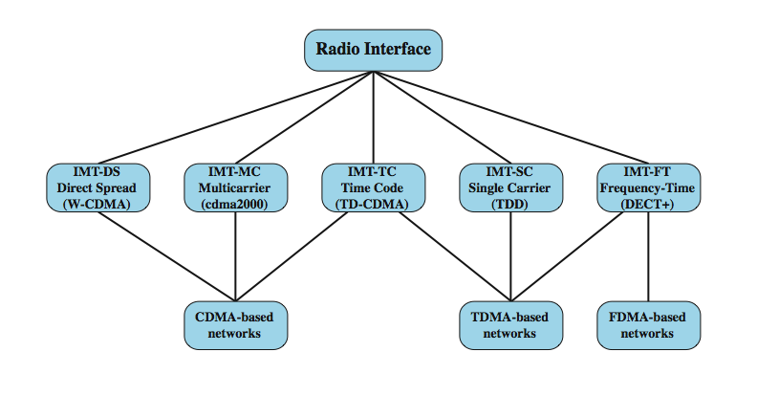
IMT-2000 Terrestrial Radio Alternative Interfaces

Slide 64
CDMA Design Considerations – Bandwidth and Chip Rate
dominant technology for 3G systems is CDMA
chip rate
  given bandwidth, chip rate depends on desired data rate, need for error control, and bandwidth limitations
  chip rate of 3 Mbps or more is reasonable
CDMA schemes:
bandwidth (limit channel to 5 MHz)
5 MHz reasonable upper limit on what can be allocated for 3G
5 MHz is enough for data rates of 144 and 384 kHz
Notes:
The dominant technology for 3G systems is CDMA. Although three different CDMA schemes have been adopted, they share some common design issues. [OJAN98] lists the following:
Bandwidth: An important design goal for all 3G systems is to limit channel usage to 5 MHz. There are several reasons for this goal. On the one hand, a bandwidth of 5 MHz or more improves the receiver's ability to resolve multipath when compared to narrower bandwidths. On the other hand, available spectrum is limited by competing needs, and 5 MHz is a reasonable upper limit on what can be allocated for 3G. Finally, 5 MHz is adequate for supporting data rates of 144 and 384 kHz, the main targets for 3G services.
Chip rate: Given the bandwidth, the chip rate depends on desired data rate, the need for error control, and bandwidth limitations. A chip rate of 3 Mcps or more is reasonable given these design parameters.

Slide 65
CDMA Design Considerations – Multirate
provision of multiple fixed-data-rate channels to user
different data rates provided on different logical channels
logical channel traffic can be switched independently through wireless fixed networks to different destinations
flexibly support multiple simultaneous applications
efficiently use available capacity by only providing the capacity required for each service
use TDMA within single CDMA channel
use multiple CDMA codes
Notes:
Multirate: The term multirate refers to the provision of multiple fixed-data-rate logical channels to a given user, in which different data rates are provided on different logical channels. Further, the traffic on each logical channel can be switched independently through the wireless and fixed networks to different destinations. The advantage of multirate is that the system can flexibly support multiple simultaneous applications from a given user and can efficiently use available capacity by only providing the capacity required for each service. Multirate can be achieved with a TDMA scheme within a single CDMA channel, in which a different number of slots per frame are assigned to achieve different data rates. All the subchannels at a given data rate would be protected by error correction and interleaving techniques (Figure 14.13a). An alternative is to use multiple CDMA codes, with separate coding and interleaving, and map them to separate CDMA channels (Stallings DCC9e Figure 14.13b).

Slide 66
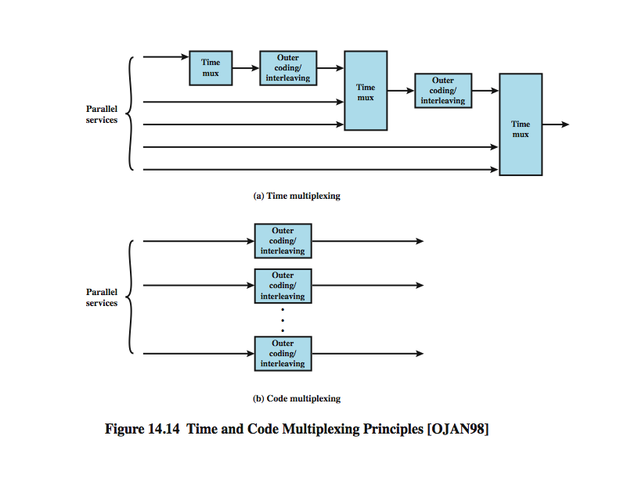
CDMA Multirate
Time and Code Multiplexing

Slide 67
Fourth Generation (4G) Systems
rapid increase in data traffic on wireless networks
  more terminals accessible to the Internet
  permanent connections to e-mail
  multimedia services
  support for real time services

Slide 68
4G Development
  Both based on use of orthogonal frequency division multiple access (OFDMA)
Two candidates have emerged for 4G standardization:
Long Term Evolution (LTE)
developed by the Third Generation Partnership Project (3GPP), a consortium of North American, Asian, and European telecommunications standards organizations
IEEE 802.16 committee

Slide 69
Wireless Network Generations

Slide 70
Advantages of OFDM
frequency selective fading only affects some subcarriers and not the whole signal
More important, OFDM overcome intersymbol interference (ISI) in a multipath environment
equalizers, which are complex devices whose complexity increases with the number of symbols over which ISI is present..
OFDM
fading does not affect the whole signal
overcame intersymbol interference (ISI) in multipath environment
not necessary to deploy equalizers

Slide 71
OFDM Quadrature Phase
Shift Keying (QPSK)
symbol represents 2 bits
Example of OFDM/QPSK scheme:
  occupies 6 MHz made up of 512 individual carriers, with a carrier separation of a little under 12kHz
  data are transmitted in bursts
  bursts consist of a cyclic prefix followed by data symbols
  cyclic prefix absorbs burst transients
  waveform from multipath signal is gone, resulting in no ISI

Slide 72
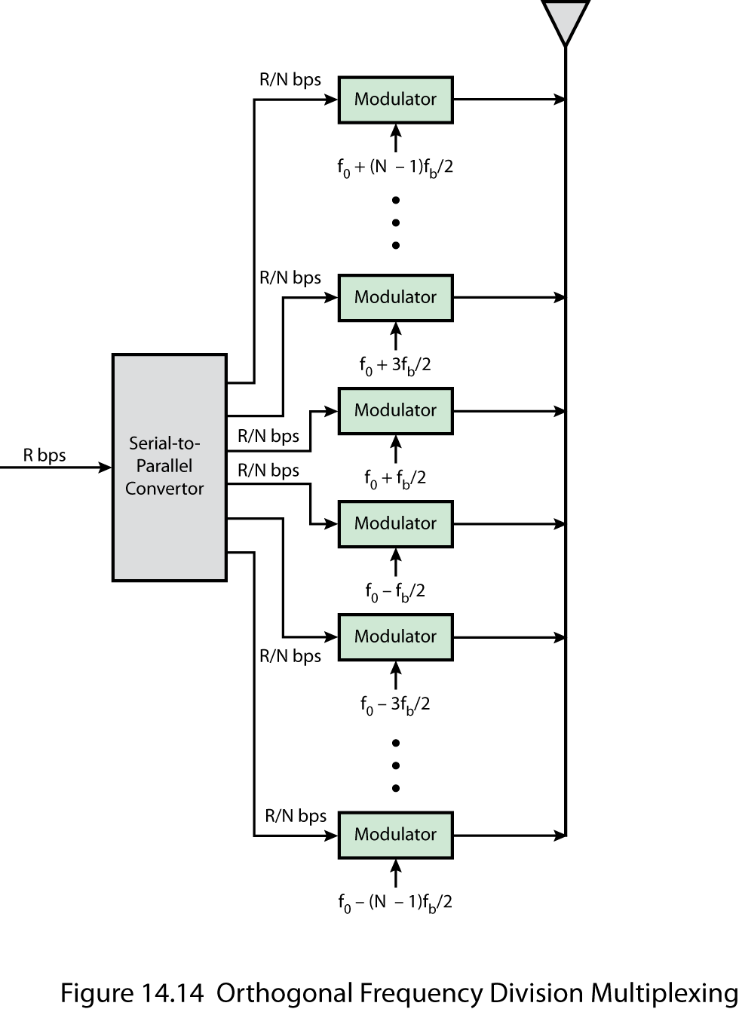
(OFDMA)

Slide 73
Summary
principles of wireless cellular networks
  cellular network organization
operation of wireless cellular networks
first-generation analog
second-generation CDMA
  RAKE receiver
  IS – 95
3G systems
4G systems
  OFDM and OFDMA

