Slide 1
Wireless and Mobile Computing
Simulations
Lecture 27

Slide 2
Overview
Motivation:
Learn fundamentals of evaluating network performance via simulation
Overview:
What is ns-2?
Getting ns?
How to use ns-2?
Adding your own stuff?
Documentation
Bug-Fixing
fundamentals of discrete event simulation
ns-2 simulation

Slide 4
Network Simulation
Motivation:
Learn fundamentals of evaluating network performance via simulation
Overview:
Fundamentals of discrete event simulation
ns-2 simulation

Slide 5
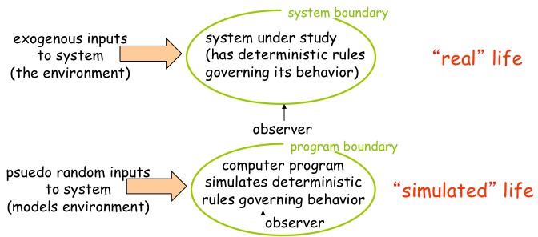
What is simulation?

Slide 6
Why Simulation?
Real-system not available, is complex/costly or dangerous (e.g: space simulations, flight simulations)
Quickly evaluate design alternatives (eg: different system configurations)
Evaluate complex functions for which closed form formulas or numerical techniques not available
Simulation is a flexible methodology we can use to analyze the behavior of a present system or proposed business activity, new product, manufacturing line or plant expansion, and so on (analysts call this the 'system' under study). By performing simulations and analyzing the results, we can gain an understanding of how a present system operates, and what would happen if we changed it -- or we can estimate how a proposed new system would behave. Often -- but not always -- a simulation deals with uncertainty, in the system itself, or in the world around it.

Slide 7
Simulations Types
Discrete Simulations
Monte Carlo Simulation
Discrete Event Simulation, In the field of simulation, a discrete-event simulation (DES), models the operation of a system as a discrete sequence of events in time. Each event occurs at a particular instant in time and marks a change of state in the system. Between consecutive events, no change in the system is assumed to occur; thus the simulation can directly jump in time from one event to the next.
Monte Carlo methods rely on random sampling of values for uncertain variables, that are "plugged into" the simulation model and used to calculate outcomes of interest.

Slide 8
Simulation: Advantages/Drawbacks
Advantages:
  Sometimes cheaper
  Find bugs (in design) in advance
  Generality: over analytic/numerical techniques
  Detail: can simulate system details at arbitrary level
Drawbacks:
  Caution: does model reflect reality
  Large scale systems: lots of resources to simulate (especially accurately simulate)
  May be slow (computationally expensive – 1 min real time could be hours of simulated time)
  Art: determining right level of model complexity
  Statistical uncertainty in results

Slide 9
The Evaluation Spectrum
Numerical models
Simulation
Emulation
Prototype
Operational system

Slide 10
Programming a Simulation
What ‘s in a simulation program?
Simulated time: internal (to simulation program) variable that keeps track of simulated time
System “state”: variables maintained by simulation program define system “state”
  e.g., may track number (possibly order) of packets in queue, current value of retransmission timer
Events: points in time when system changes state
  Each event has associate event time
    e.g., arrival of packet to queue, departure from queue
    precisely at these points in time that simulation must take action (change state and may cause new future events)
  Model for time between events (probabilistic) caused by external environment
Notes:
Read

Slide 11
Simulator Structure
Simulation program maintains and updates list of future events: event list
Need:
Well defined set of events
For each event: simulated system action, updating of event list
Notes:
Read

Slide 12
Simulator Block Diagram*
initialize event list
get next (nearest future)
event from event list
time = event time
process event
(change state values, add/delete
future events from event list)
update statistics
n
done?
Notes:
Basic block diagram: read

Slide 14
NS2 Outline
What is ns-2?
Getting ns?
How to use ns-2?
Adding you own stuff?
Documentation
Bug-Fixing

Slide 15
What is NS2?
Network Simulator
A package of tools that simulates behavior of networks
  Create Network Topologies
  Log events that happen under any load
  Analyze events to understand the network behavior
Notes:
Read

Slide 16
What is NS2?. Cont. ….
ns -2 stands for Network Simulator version 2.
ns -2:
    Is a discrete event simulator for networking research
    Work at packet level.
    Provide substantial support to simulate bunch of protocols like TCP, UDP, FTP, HTTP and DSR.
  Simulate wired and wireless network.
  Is primarily Unix based but can also be used with Windows via Cygwin.
  Use TCL as its scripting language.
ns -2 is a standard experiment environment in research community.
NS2 is also being used for Network on Chip Simulations
e.g. flit arrival rate, latency, jitter evaluation and topology comparison

Slide 17
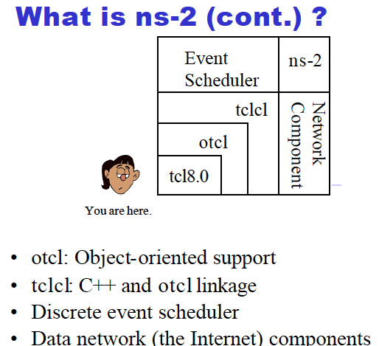

Slide 18
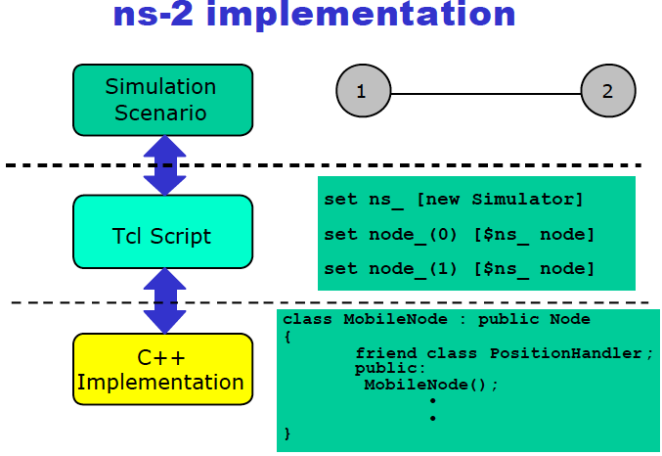

Slide 19
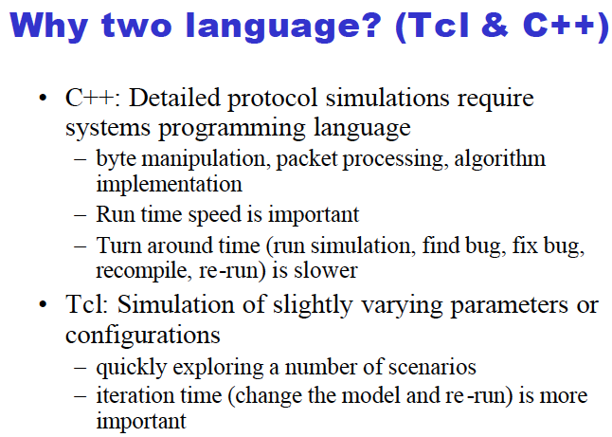

Slide 20
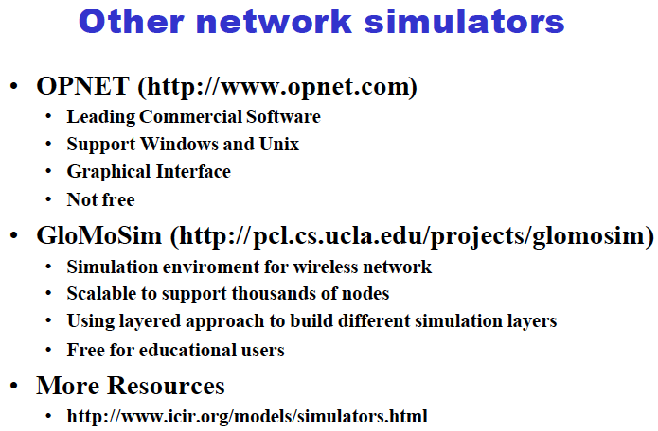

Slide 21
What is it?
What is it?
Where and How to get it?
How to use ns-2?
Adding you own stuff?
Documentation
Bug-Fixing
NS-2 for Wireless and Mobile Communication

Slide 22
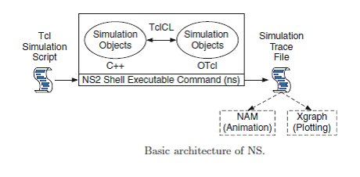
Basic ns2 Architecture
What is NS2?. Cont. ….

Slide 23
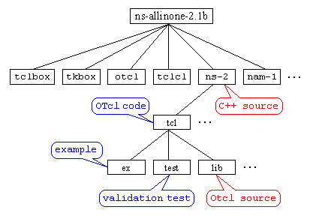
What is NS2?. Cont. ….

Slide 24
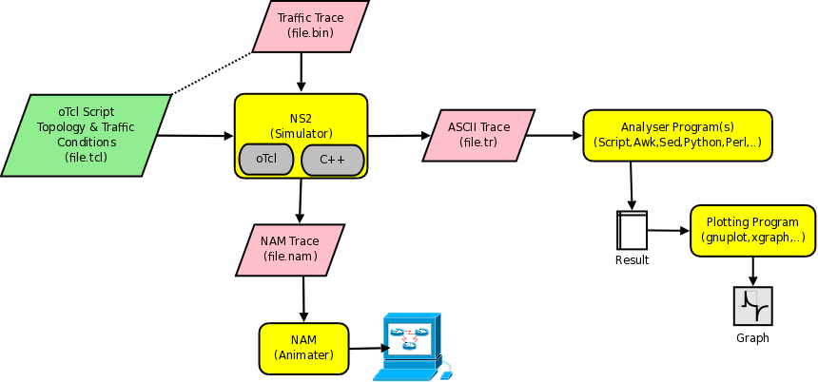
How Stuff Works
What is NS2?. Cont. ….

Slide 25
Outline
What is it?
Where and How to get it?
How to use ns-2?
Adding you own stuff?
Documentation
Bug-Fixing

Slide 26
How Do we get NS2?
http://www.isi.edu/nsnam/ns/tutorial/nsbasic.html
http://www.isi.edu/nsnam/ns/ns-build.html
Notes:
Read
Installing NS2 is non-trivial on the cs machines because of various dependencies, so its been already done for us.

Slide 27
Outline
What is ns-2?
Where and How to get it?
How to use ns-2?
Adding you own stuff?
Documentation
Bug-Fixing
Notes:
Our major section is devoted to this part, which is how to use the simulator

Slide 28
How Do We use it?
Creating a Simple Topology
Getting Traces
Using NAM
Notes:
We’ll look at how to create topologies, how to get the traces and then how to use NAM to visualise our network

Slide 29
Basics of using NS2
Define Network topology, load, output files in Tcl Script
To run,
  $ ns simple_network.tcl
Internally, NS2 instantiates C++ classes based on the tcl scripts
Output is in form of trace files
Notes:
Read

Slide 30
A simple Example – Creating the topology
Bandwidth:1Mbps
Latency: 10ms
n1
n2
Notes:
So lets start by creating a topology is NS2, we’re just defining stuff, no packets are going through yet

Slide 31
Creating the topology
#create a new simulator object
set ns [new Simulator]
#open the nam trace file
set nf [open out.nam w]
$ns namtrace-all $nf
#define a 'finish' procedure
proc finish {} {
global ns nf
$ns flush-trace
#close the trace file
close $nf
#execute nam on the trace file
exec nam out.nam &
exit 0
}

Slide 32
Creating the topology (Contd)
#create two nodes
set n0 [$ns node]
set n1 [$ns node]
#create a duplex link between the nodes
$ns duplex-link $n0 $n1 1Mb 10ms DropTail

Slide 33
Creating Topologies (Example)
5Mbps,
10ms
300Kbps,
100ms
n1
n5
n3
500Kbps,
50ms
n4
n2
n6
2Mbps,
20ms
300Kbps,
100ms
Notes:
NS2 lets us create topologies with different nodes, different types of links in betweeb them

Slide 34
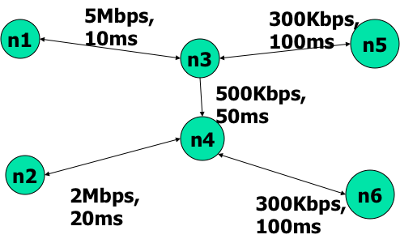
Creating Topologies (Example)
Nodes
  Set properties like queue length, location
  Protocols, routing algorithms
Links
  Set types of link – Simplex, duplex, wireless, satellite
  Set bandwidth, latency etc.
Done through tcl Scripts

Slide 36
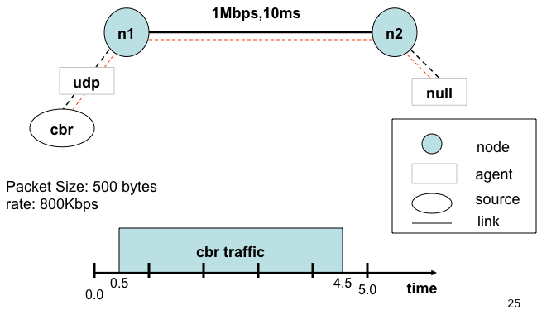
Adding Traffic

Slide 37
Putting it together..
#create a udp agent and attach it to node n0
set udp0 [new Agent/UDP]
$ns attach-agent $n0 $udp0
#Create a CBR traffic source and attach it to udp0
set cbr0 [new Application/Traffic/CBR]
$cbr0 set packetSize_ 500
$cbr0 set interval_ 0.005
$cbr0 attach-agent $udp0
#create a Null agent(a traffic sink) and attach it to node n1
set null0 [new Agent/Null]
$ns attach-agent $n1 $null0
#Connect the traffic source to the sink
$ns connect $udp0 $null0
#Schedule events for CBR traffic
$ns at 0.5 "$cbr0 start"
$ns at 4.5 "$cbr0 stop"
#call the finish procedure after 5 secs of simulated time
$ns at 5.0 "finish"
#run the simulation
$ns run

Slide 39
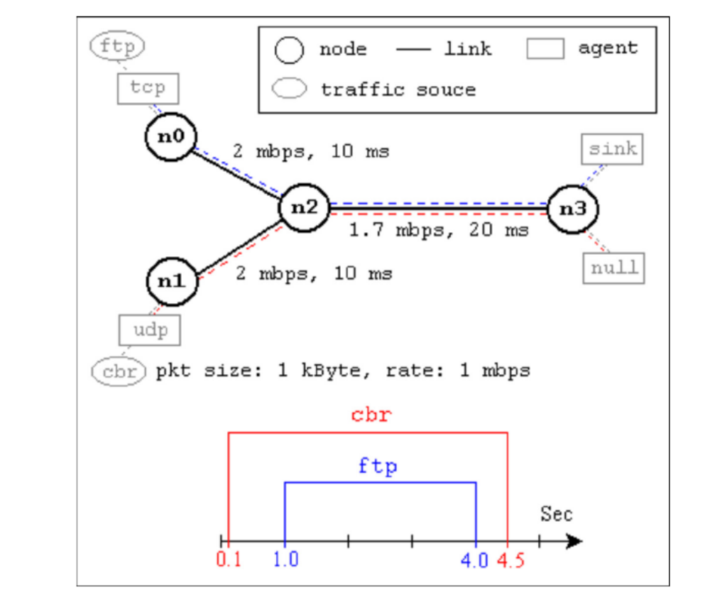
A second Scenario * (from NS by Example)
Taken from NS by Example by Jae Chung
and
Mark Claypool

Slide 40
A second Example (From NS by Example)
#Create a simulator object
set ns [new Simulator]
#Define different colors for data flows (for NAM)
$ns color 1 Blue
$ns color 2 Red
#Open the NAM trace file
set nf [open out.nam w]
$ns namtrace-all $nf
#Define a 'finish' procedure
proc finish {} {
global ns nf
$ns flush-trace
#Close the NAM trace file
close $nf
#Execute NAM on the trace file
exec nam out.nam &
exit 0
}

Slide 41
A Second Scenario (Contd.)
#Create four nodes
set n0 [$ns node]
set n1 [$ns node]
set n2 [$ns node]
set n3 [$ns node]
#Create links between the nodes
$ns duplex-link $n0 $n2 2Mb 10ms DropTail
$ns duplex-link $n1 $n2 2Mb 10ms DropTail
$ns duplex-link $n2 $n3 1.7Mb 20ms DropTail
#Set Queue Size of link (n2-n3) to 10
$ns queue-limit $n2 $n3 10

Slide 42
A Second Scenario (Contd.)
#Give node position (for NAM)
$ns duplex-link-op $n0 $n2 orient right-down
$ns duplex-link-op $n1 $n2 orient right-up
$ns duplex-link-op $n2 $n3 orient right
#Monitor the queue for link (n2-n3). (for NAM)
$ns duplex-link-op $n2 $n3 queuePos 0.5
Notes:
$ns duplex-link-op node1 node2 ...: The next couple of lines are used for the NAM display. To see the effects of these lines, users can comment these lines out and try the simulation.

Slide 43
A Second Scenario (Contd.)
#Setup a TCP connection
set tcp [new Agent/TCP]
$tcp set class_ 2
$ns attach-agent $n0 $tcp
set sink [new Agent/TCPSink]
$ns attach-agent $n3 $sink
$ns connect $tcp $sink
$tcp set fid_ 1
#Setup a FTP over TCP connection
set ftp [new Application/FTP]
$ftp attach-agent $tcp
$ftp set type_ FTP
To create agents or traffic sources, we need to know the class names these objects (Agent/TCP, Agent/TCPSink, Application/FTP and so on).
This information can be found in the NS documentation.
But one shortcut is to look at the "ns-2/tcl/libs/ns-default.tcl" file.
Notes:
et tcp [new Agent/TCP]: This line shows how to create a TCP agent. But in general, users can create any agent or traffic sources in this way. Agents and traffic sources are in fact basic objects (not compound objects), mostly implemented in C++ and linked to OTcl. Therefore, there are no specific Simulator object member functions that create these object instances. To create agents or traffic sources, a user should know the class names these objects (Agent/TCP, Agnet/TCPSink, Application/FTP and so on). This information can be found in the NS documentation or partly in this documentation. But one shortcut is to look at the "ns-2/tcl/libs/ns-default.tcl" file. This file contains the default configurable parameter value settings for available network objects. Therefore, it works as a good indicator of what kind of network objects are available in NS and what are the configurable parameters.
$ns attach-agent node agent: The attach-agent member function attaches an agent object created to a node object. Actually, what this function does is call the attach member function of specified node, which attaches the given agent to itself. Therefore, a user can do the same thing by, for example, $n0 attach $tcp. Similarly, each agent object has a member function attach-agent that attaches a traffic source object to itself.
$ns connect agent1 agent2: After two agents that will communicate with each other are created, the next thing is to establish a logical network connection between them. This line establishes a network connection by setting the destination address to each others' network and port address pair.

Slide 44
A Second Scenario (Contd.)
#Setup a UDP connection
set udp [new Agent/UDP]
$ns attach-agent $n1 $udp
set null [new Agent/Null]
$ns attach-agent $n3 $null
$ns connect $udp $null
$udp set fid_ 2
#Setup a CBR over UDP connection
set cbr [new Application/Traffic/CBR]
$cbr attach-agent $udp
$cbr set type_ CBR
$cbr set packet_size_ 1000
$cbr set rate_ 1mb
$cbr set random_ false

Slide 45
A Second Scenario (Contd.)
#Schedule events for the CBR and FTP agents
$ns at 0.1 "$cbr start"
$ns at 1.0 "$ftp start"
$ns at 4.0 "$ftp stop"
$ns at 4.5 "$cbr stop"
#Detach tcp and sink agents (not really necessary)
$ns at 4.5 "$ns detach-agent $n0 $tcp ; $ns detach-agent $n3 $sink"
#Call the finish procedure after 5 seconds of simulation time
$ns at 5.0 "finish"
#Print CBR packet size and interval
puts "CBR packet size = [$cbr set packet_size_]"
puts "CBR interval = [$cbr set interval_]"
#Run the simulation
$ns run

Slide 47
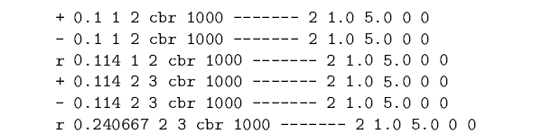
Observing Network Behavior
Observe behavior by tracing “events”
  Eg. packet received, packet drop etc.
Src Dst IP Address, Port
time

Slide 49
Visualization Tool: nam
Visualization tool: nam
Replay events from a nam trace file
The nam trace file can be huge when simulation time is long or events happen intensively. Be careful!
Run nam:
– $nam –a nam_trace_file.nam
– In ns-2 script:
Proc finish{} {
……
exec nam –a nam_trace_file.nam & exit

Slide 50
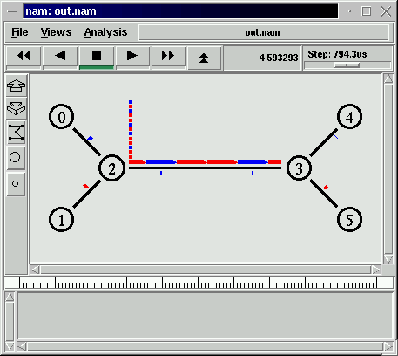
Visualization Tool: nam

Slide 51
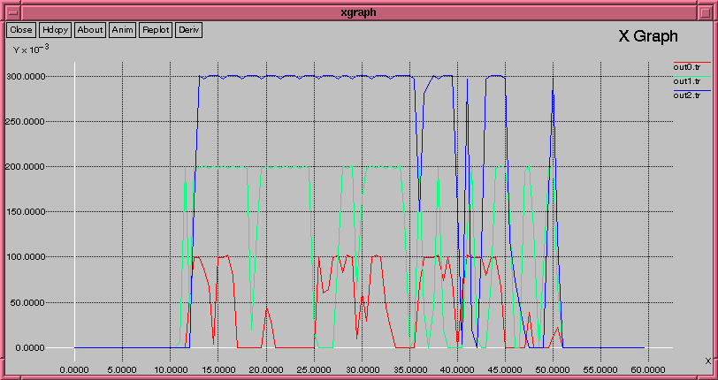
X Graph

Slide 53
Outline
What is it?
Where and How to get it?
How to use ns-2?
Adding you own stuff?
Documentation
Bug-Fixing

Slide 54
How can I add to NS2?
Adding Protocols to NS2 is possible
  Need to create the C++ class
  Need to create the OTcl Linkage
More info at:
  http://www.isi.edu/nsnam/ns/tutorial/index.html
  Tutorial about how to add a simple protocol to NS2

Slide 55
Outline
What is it?
Where and How to get it?
How to use ns-2?
Adding you own stuff?
Documentation
Bug-Fixing

Slide 56
Documentation – NS2 Documentation
NS2 Manual
  Information about Otcl interpreter, C++ class hierarchy, parameters for various protocols
  http://www.isi.edu/nsnam/ns/doc/index.html
  Very detailed, useful when looking for something specific, like:
    What are the shadowing models available for wireless? How do I select them?
    How do I make my routing strategy to be Distance Vector routing?

Slide 57
Documentation – NS2 documentation
NS2 Tutorial by Marc Greis
  http://www.isi.edu/nsnam/ns/tutorial/index.html
  Good starting point for understanding the overall structure of NS2
  Examples:
    What is the relation between c++ classes and Otcl classes?
    basic info on instantiating NS2 instance, tcl scripting

Slide 58
Documentation – NS2 Documentation
NS2 for beginners
  http://www-sop.inria.fr/maestro/personnel/Eitan.Altman/COURS-NS/n3.pdf
  More detailed than Marc Greis’ Tutorial
  More info on getting it up and running – rather than internals
  Examples:
    What does each line of a tcl script do?
    Most common examples of trace formats that are useful

Slide 59
Documentation – Tcl Documentation
Tcl Tutorial
  http://www.tcl.tk/man/tcl8.5/tutorial/tcltutorial.html
Tcl Manual
  All commands and their explanation
  http://www.tcl.tk/man/tcl8.6/TclCmd/contents.htm

Slide 60
Outline
What is it?
Where and How to get it?
How to use ns-2?
Adding you own stuff?
Documentation
Bug-Fixing
NS-2 for Wireless and Mobile Communication

Slide 61
Bug-Fixing – When things go wrong..
Googling for the problem! ☺
  Extensive NS2 mailing lists
  Chances are that other people have had the same problem are very high
  Responsive forums

Slide 62
Bug-Fixing – When things go wrong..
NS2 in-built examples
  Extensive inbuilt examples
    “diffing” with the examples helps a lot
  Sometimes a good idea to start from a script that does something similar

Slide 63
Bug-Fixing – When things go wrong..
Taking a look at the code
  Everyone adds to NS2 ☺
  May not always confirm to the norms
    IP TTL set to 32 instead of 256 ☺

Slide 64
Bug-Fixing Questions
What is the expected behaviour of the network?
Have I connected the network right?
Am I logging trace information at the right level? Can I change it to narrow down on the problem?
Has anyone else out there had the same problem?
Is there something similar in examples that I can look at, and build upon?
Does the code really do what the protocol says? Are all the default parameters correct?
Is Tcl being picky here? ☺

Slide 65
What is it?
Where and How to get it?
How to use ns-2?
Adding you own stuff?
Documentation
Bug-Fixing

Slide 66
Summary
Learn fundamentals of evaluating network Performance via simulation
Fundamentals of discrete event simulation
ns-2 simulation
What is ns-2?
How do I get it?
How do I use ns-2?
How do I add to it?
Documentation
Bug-Fixing

