Slide 1
Wireless and Mobile Computing
Transmission Fundamentals
Lecture 2

Slide 2
Transmission Fundamentals
Signals for Conveying Information
      Time Domain Concepts
      Frequency Domain Concepts
      Relationship between Data Rate and Bandwidth

Slide 3
Signals for Conveying Information
Electromagnetic signals used as a means to transmit information.
      An electromagnetic signal is a function of time
      But it can also be expressed as a function of frequency i-e the signal consists of components of different frequencies
Frequency domain view of a signal is far more important to an understanding of data transmission than a time domain view.

Slide 4
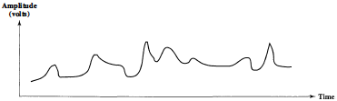
Time Domain Concepts
A time domain electromagnetic signal can be either analog or digital.
Analog Signal
    An analog signal is one in which the signal intensity varies in a smooth fashion over time
      no breaks or discontinuities in the signal
Analog
Analog signal might represent speech

Slide 5
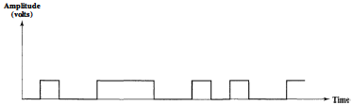
Time Domain Concepts….. cont.
Digital signal is one in which the signal intensity maintains a constant level for some period of time and then changes to another constant level
Digital Waveforms
Digital signal might represent binary 1s and 0s

Slide 6
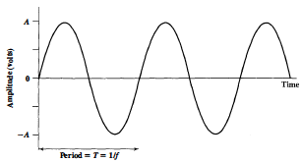
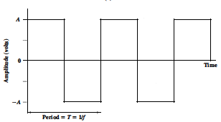
Time Domain Concepts….. cont.
Periodic signal in which the same signal pattern repeats over time
(a) Sine wave
(b) Square wave
Examples of Periodic Signals
Mathematically, a signal s(t) is defined to be periodic if and only if
where the constant T is the period of the signal ( T is the smallest value that satisfies the equation) .

Slide 7
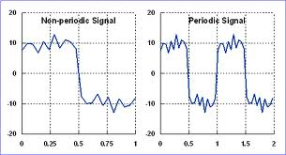
Time Domain Concepts….. cont.
Aperiodic signal: A signal that does not exhibit a pattern or repeating cycle.
Both the Analog and Digital can be periodic or aperiodic. but in data communication periodic analog signals and aperiodic digital signals are used.

Slide 8
Time Domain Concepts….. cont.
  Analog signal
    Signal intensity varies smoothly with no breaks
  Digital signal
    Signal intensity maintains a constant level and then abruptly changes to another level
  Periodic signal
    Signal pattern repeats over time
  Aperiodic signal
    Pattern not repeated over time

Slide 9
Sine Wave
(periodic continuous signal)
A general sine wave can be represented by three parameters
  Peak amplitude (A)
    Maximum strength of signal
    Typically measured in volts
  Frequency (f)
    Rate at which the signal repeats
    Hertz (Hz) or cycles per second
    Period (T) is the amount of time for one repetition
    T = 1/f
  Phase (φ)
    Relative position in time within a single period of signal

Slide 10
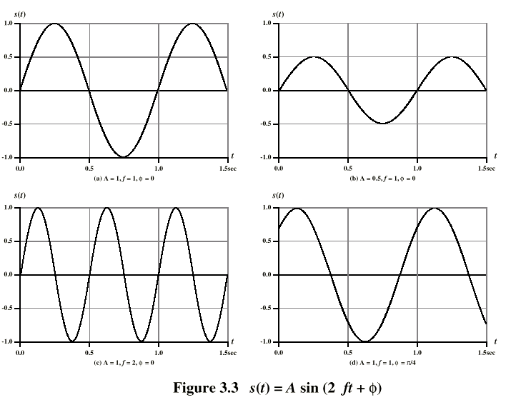
Varying Sine Waves s(t) = A sin(2πft +Φ)
The peak amplitude is the maximum value or strength of the signal over time; typically, this value is measured in volts.
The frequency is the rate [in cycles per second, or Hertz (Hz)] at which the signal repeats. An equivalent parameter is the period T of a signal.
Phase is a measure of the relative position in time within a single
period of a signal,

Slide 11
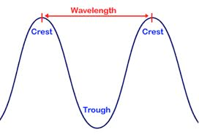
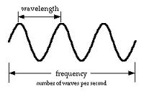
Wavelength (λ)
the wavelength of a signal is the distance occupied by a single cycle
can also be stated as the distance between two points of corresponding phase of two consecutive cycles
assuming signal velocity v, then the wavelength is related to the period as λ = vT
or equivalently λf = v
especially when v=c
c = 3*108 ms-1 (speed of light in free space)

Slide 12
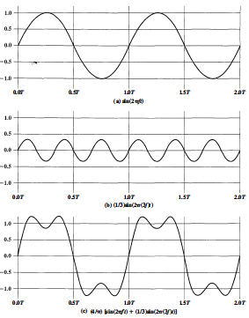
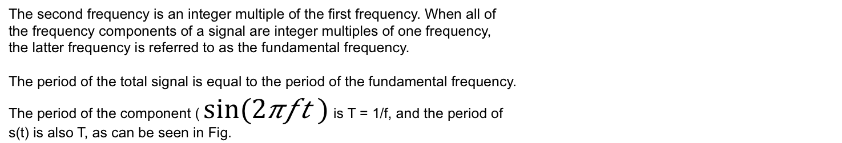
Frequency Domain Concepts
Signals are made up of many frequencies
An electromagnetic signal can be represented by
Fourier analysis can show that any
signal is made up of components at
various frequencies, in which each
component is a sinusoid
can plot frequency domain functions
Components of the signal are sine waves
The second frequency is an integer multiple of the first frequency. When all of
the frequency components of a signal are integer multiples of one frequency,
the latter frequency is referred to as the fundamental frequency.
The period of the total signal is equal to the period of the fundamental frequency.
The period of the component ( $sin⁡(2πft )$ is T = 1/f, and the period of
s(t) is also T, as can be seen in Fig.

Slide 13
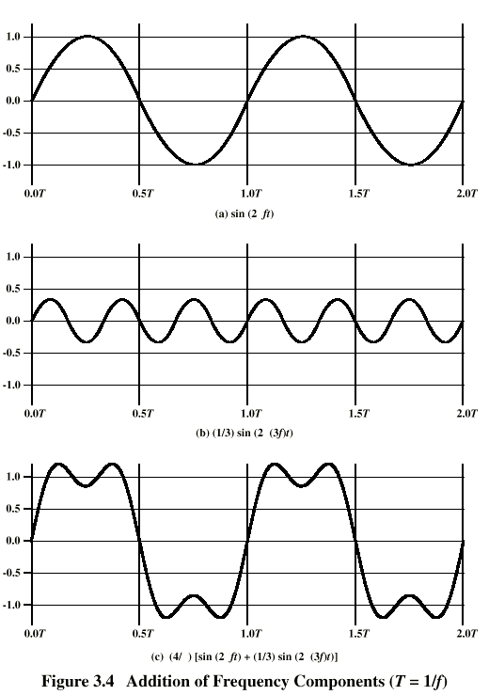
Frequency Domain Concepts …cont.
Addition of frequency components
(T=1/f)
Addition of frequency components (T=1/f)
fig. c is sum of f & 3f
Notes:
In Stallings DCC9e Figure 3.4c, the components of this signal are just sine waves of frequencies f and 3f, as shown in parts (a) and (b).

Slide 14
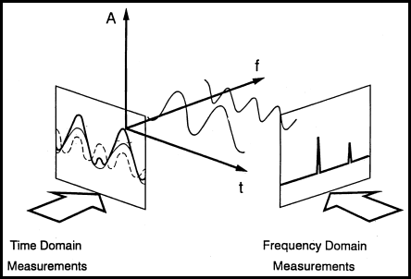
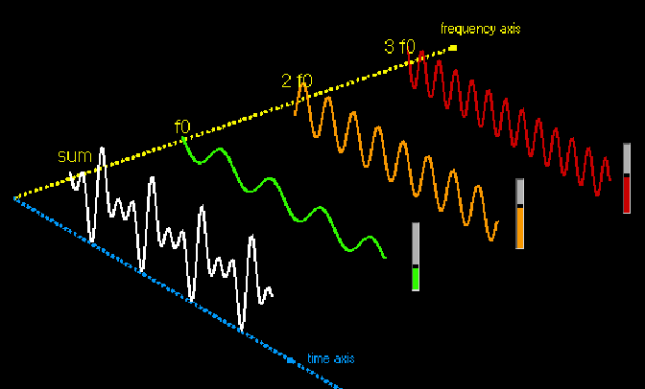
Frequency Domain Concepts …cont.
Signal is made up of components at various frequencies, in which each component is a sinusoid. By adding together enough sinusoidal signals, each with the appropriate amplitude, frequency, and phase, any electromagnetic signal can be constructed
OR
Any electromagnetic signal can be shown to consist of a collection of
periodic analog signals (sine waves) at different amplitudes, frequencies, and phases.

Slide 15
Frequency/Time Domain
Frequency domains can be obtained through the transformation from one (Time or Spatial) domain to the other (Frequency) via Fourier Transform (FT)
    e.g.
    Fourier Transform (FT)—MPEG Audio
    Related Discrete Cosine Transform (DCT)— Heart of JPEG and MPEG Video, (alt.) MPEG Audio.

Slide 16
Frequency/Time Domain
1D Example
Lets consider a 1D (e.g. Audio) example to see what the different domains mean:
Consider a complicated sound such as the noise of a car horn. We can describe this sound in two related ways:
      Sample the amplitude of the sound many times a second, which gives an approximation to the sound as a function of time.
      Analyse the sound in terms of the pitches of the notes, or frequencies, which make the sound up, recording the amplitude of each frequency

Slide 17
Frequency/Time Domain
An 8 Hz Sine Wave
In this example
A signal that consists of a sinusoidal wave at 8 Hz.
8 Hz means that wave is completing 8 cycles in 1 second
The frequency of that wave (8 Hz).
From the frequency domain we can see that the composition of our signal is
– one wave (one peak) occurring with a frequency of 8 Hz
– with a magnitude/fraction of 1.0 i.e. it is the whole signal.

Slide 18
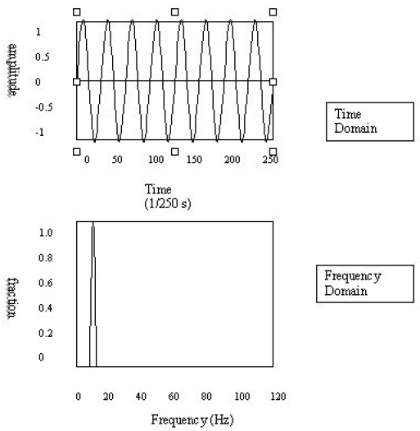
Frequency/Time Domain
An 8 Hz Sine Wave

Slide 19
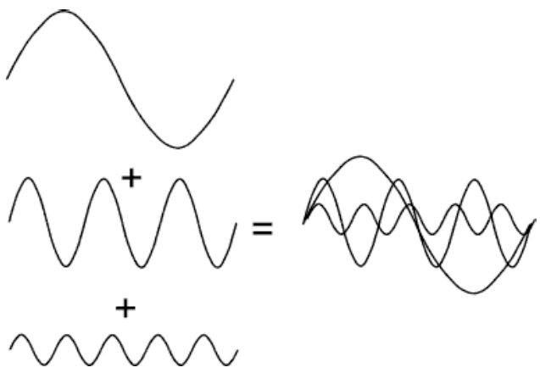
Frequency/Time Domain
Summing Sine Waves
Digital signals are composite signals made up of many sinusoidal frequencies

Slide 20
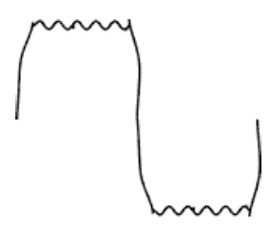
Frequency/Time Domain
Summing Sine Waves to give a Square(ish) Wave
We can take the previous example a step further:
A 200Hz digital signal (square(ish) wave) may be a composed
of 200, 600, 1000, 1400, 1800, 2200, 2600, 3000, 3400 and
3800 sinusoidal signals which sum to give:

Slide 21
Spectrum
The spectrum of a signal is the range of frequencies that it contains
The frequency spectrum can be generated via a Fourier transform of the signal, and the resulting values are usually presented as amplitude and phase, both plotted versus frequency.
A source of light can have many colors mixed and in different amounts (intensities). A rainbow, or prism, sends the different frequencies of white light in different directions, making them individually visible at different angles. A graph of the intensity plotted against the frequency (showing the amount of each color) is the frequency spectrum of the light. When all the visible frequencies are present in equal amounts, the perceived color of the light is white, and the spectrum is a flat line.

Slide 22
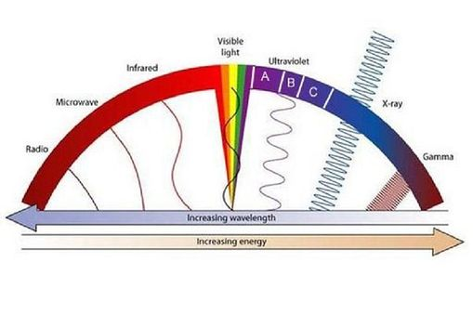
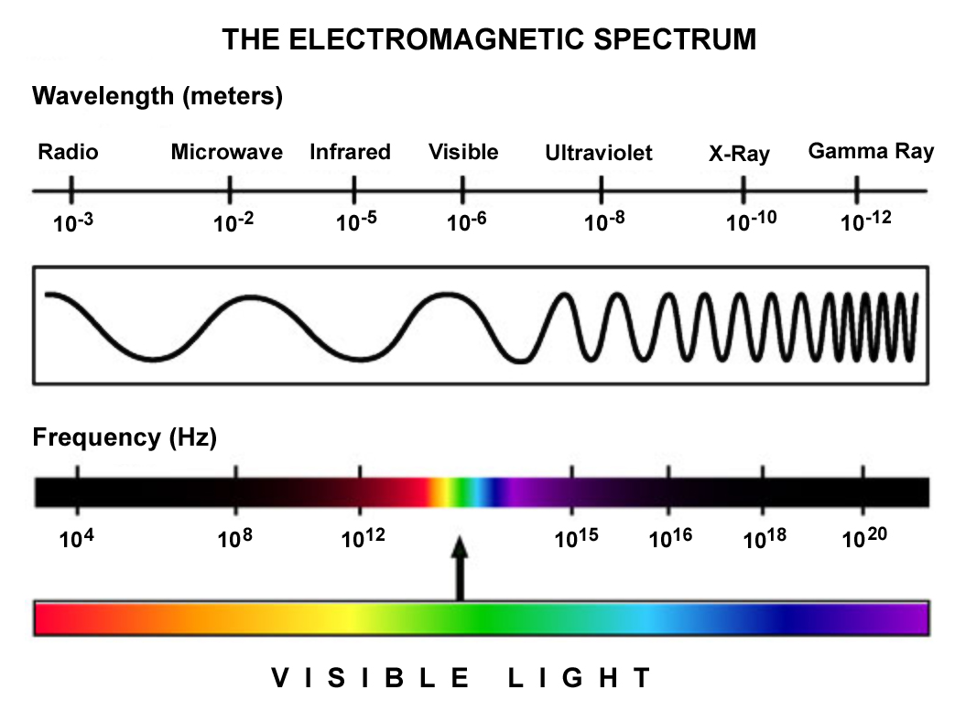
Visible Light Spectrum

Slide 23
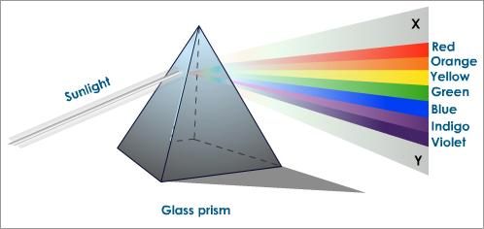
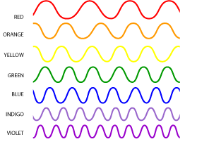
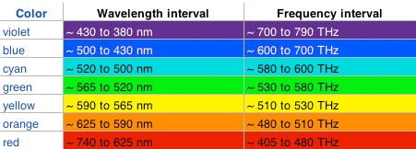
Visible Light Spectrum

Slide 24
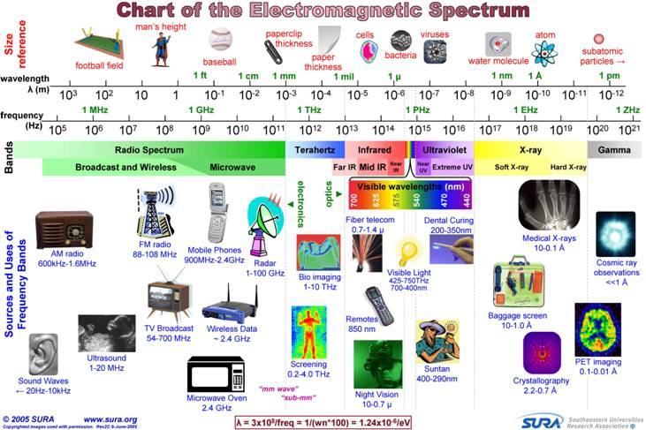
Electromagnetic Spectrum

Slide 25
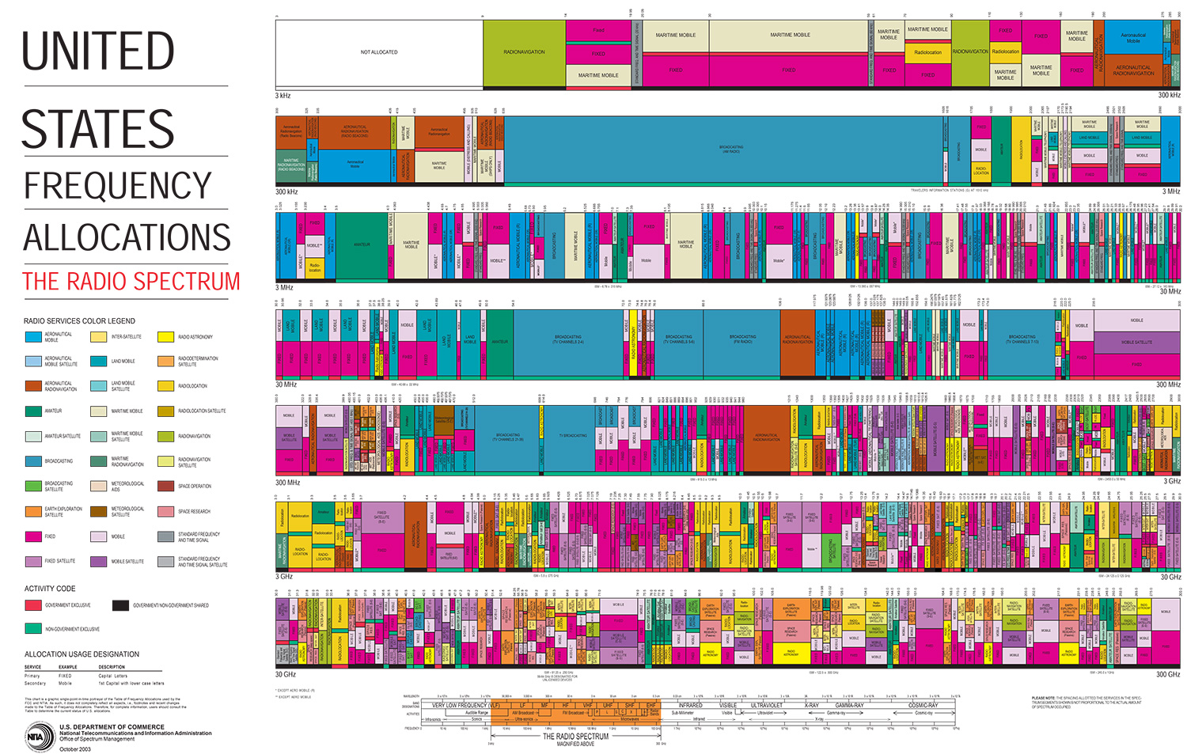
Spectrum Allocation

Slide 26
Spectrum Bandwidth
Spectral bandwidth of signals is very important because of croweded RF bands
Absolute bandwidth of a signal is the width of the spectrum
Absolute Bandwidth: is f₂ – f₁, where the spectrum is zero outside the interval f₁ < f < f₂ along the positive frequency axis.
Bandlimited
|X(f)|
Absolute Bandwidth
B
0
2B
Bandwidth is
3f - f = 2f.

Slide 27
Effective Bandwidth
Many signals have an infinite bandwidth, but with most of the energy contained in a relatively narrow band of frequencies. This band is referred to as the effective bandwidth, or just bandwidth.

Slide 28
DC component
Any periodic waveform with a frequency has three components:
  A DC component (Also called the average value)
  A sinusoidal component equal to the fundamental frequency
  Integer multiples of the fundamental frequency

Slide 29
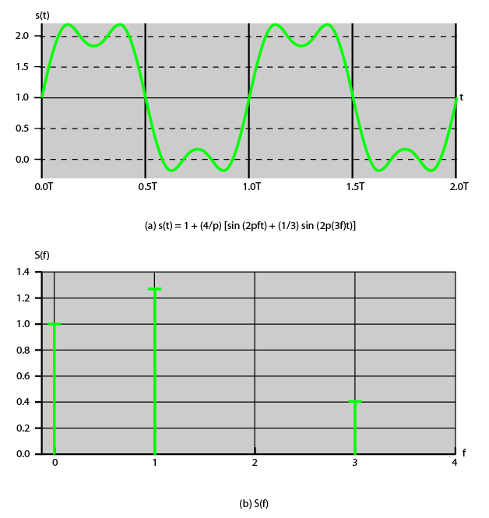
Signal with dc Component
Notes:
For example, Stallings DCC9e Figure 3.6 shows the result of adding a dc component to the signal of Stallings DCC9e Figure 3.4c. With no dc component, a signal has an average amplitude of zero, as seen in the time domain. With a dc component, it has a frequency term at f = 0 and a nonzero average amplitude.

Slide 30
Putting it Alltogather
spectrum
range of frequencies contained in signal
absolute bandwidth
width of spectrum
often just bandwidth
effective bandwidth
narrow band of frequencies containing most energy
dc component
component of zero frequency
Notes:
The spectrum of a signal is the range of frequencies that it contains. For the signal of Stallings DCC9e Figure 3.4c, the spectrum extends from f to 3f. The absolute bandwidth of a signal is the width of the spectrum. In the case of Stallings DCC9e Figure 3.4c, the bandwidth is 3f – f = 2f. Many signals, such as that of Figure 3.5b, have an infinite bandwidth. However, most of the energy in the signal is contained in a relatively narrow band of frequencies. This band is referred to as the effective bandwidth, or just bandwidth.
One final term to define is dc component. If a signal includes a component of zero frequency, that component is a direct current (dc) or constant component.

Slide 31
Conclusion
Electromagnetic signals are used as a means of conveying information in wireless communication hence enabling the mobile computing.
Time domain signal representation
Frequency domain concepts
Spectrum of the signal

