Slide 1
Communication Networks
Review Question/Answer
Lecture 11

Slide 2
Overview
LANs WANs Differentiation
Path Reliability
Circuit Switching Driven example network
Circuit Switching Routing Types
Semi-Permanent Connection Type
ISDN Review Question
Datagram and Virtual Circuit Operational Differentiation
Limitations of Circuit Switching for Data Transmission
Virtual Channel and Virtual Path Difference

Slide 3
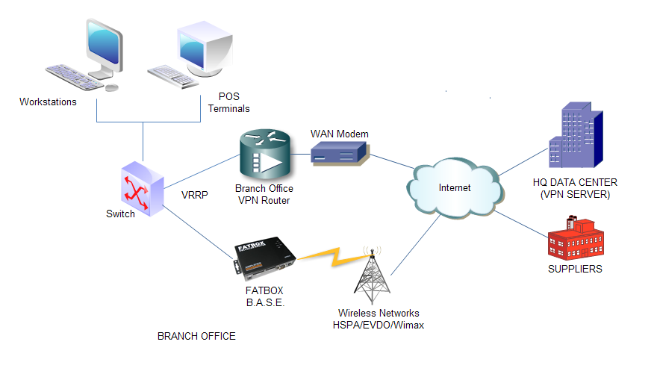
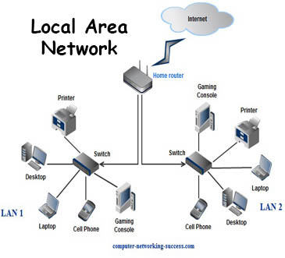
WANs and LANs
Q:-Differentiate between WANs and LANs

Slide 4
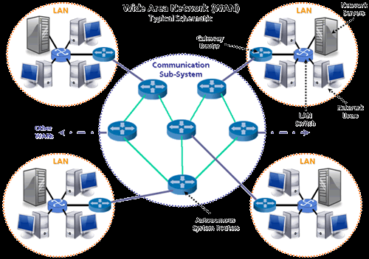
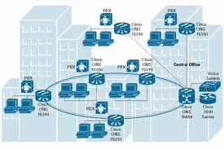
High Speed WANs and LANs
Scope of High Speed LANs and WANs (backbone)
WANs and LANs scope in case of wireless communication (Mobility)

Slide 5

Overview of Wireless LANs
wireless transmission medium
issues of high prices, low data rates, occupational safety concerns, & licensing requirements now addressed
key application areas:
  LAN extension
  cross-building interconnect
  nomadic access
  ad hoc networking

Slide 6
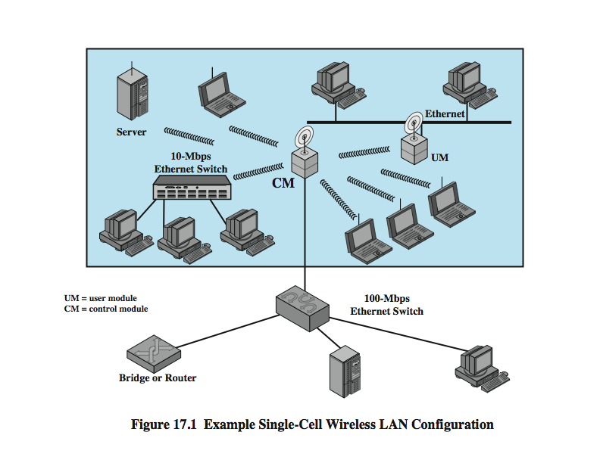
Single Cell LAN Extension

Slide 7
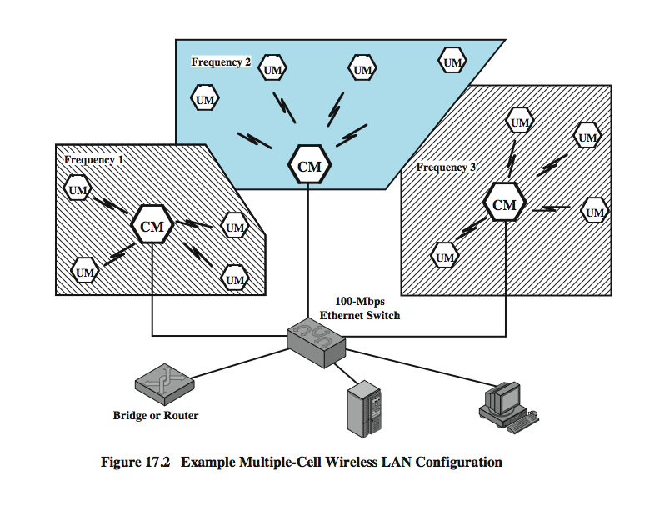
Multi Cell LAN Extension

Slide 8
Cross-Building Interconnect
used to connect wired or wireless LANs in nearby buildings
point-to-point wireless link used
not a LAN per se
connect bridges or routers

Slide 9
Nomadic Access
also useful in extended environment such as campus or cluster of buildings
  users move around with portable computers
  access to servers on wired LAN
link LAN hub & mobile data terminal
laptop or notepad computer
enable employee to transfer data from portable computer to server

Slide 10
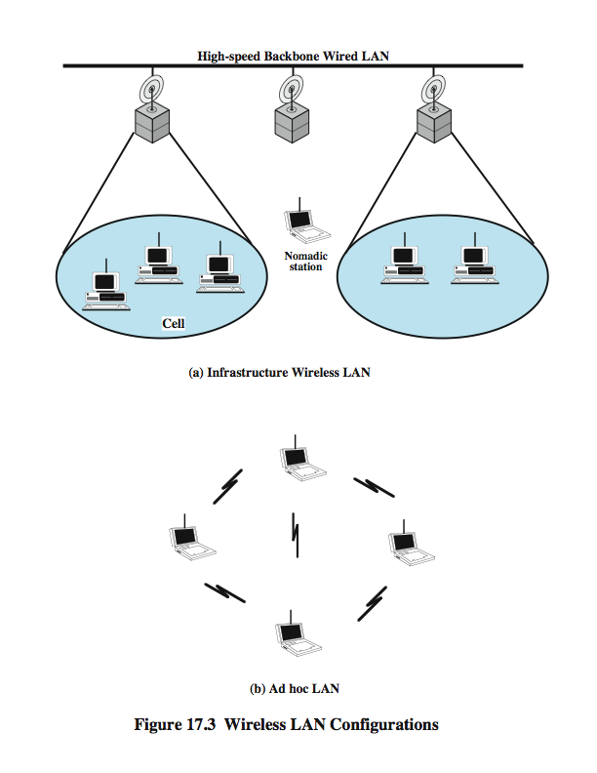
Infrastructure Wireless LAN

Slide 11
Ad Hoc Networking
temporary peer-to-peer network

Slide 12
Wireless LAN Requirements
THROUGHPUT – should make efficient use of medium
NUMBER OF NODES- hundreds of nodes across multiple cells
CONNECTION TO BACKBONE LAN – use of control modules
SERVICE AREA – coverage area of 100 to 300m
BATTERY POWER CONSUMPTION – reduce power consumption while not in use
TRANSMISSION ROBUST AND SECURITY– reliability and privacy/security
COLLOCATED NETWORK OPERATION – possible interference between LANs
LICENSE-FREE OPERATION – not having to secure a license for the frequency band used by the LAN
HANDOFF/ROAMING– enable stations to move from one cell to another
DYNAMIC CONFIGURATION- addition, deletion, relocation of end systems without disruption

Slide 13
Wireless LANs
spread spectrum LANs
mostly operate in ISM (industrial, scientific, and medical) bands
OFDM LANs
orthogonal frequency division multiplexing
superior to spread spectrum
no Federal Communications Commission (FCC) licensing is required in USA
operate in 2.4 GHz or 5 GHz band
infrared (IR) LANs
individual cell of IR LAN limited to single room
IR light does not penetrate opaque walls

Slide 14
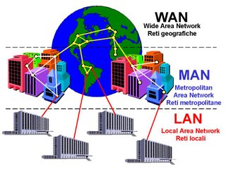
WAN MAN and LAN
Q:-Differentiate between WANs and LANs
Ans:- Wide area networks (WANs) are used to connect stations over very large areas that may even be worldwide while local area networks (LANs) connect stations within a single building or cluster of buildings. Ordinarily, the network assets supporting a LAN belong to the organization using the LAN. For WANs, network assets of service providers are often used. LANs also generally support higher data rates than WANs.

Slide 15
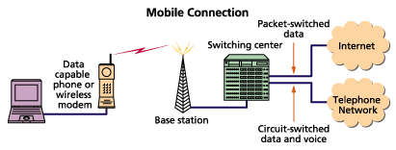
Wide-Area Wireless Computing
Q:-Differentiate between WANs and LANs
Ans:- Wide area networks (WANs) are used to connect stations over very large areas that may even be worldwide while local area networks (LANs) connect stations within a single building or cluster of buildings. Ordinarily, the network assets supporting a LAN belong to the organization using the LAN. For WANs, network assets of service providers are often used. LANs also generally support higher data rates than WANs.

Slide 17
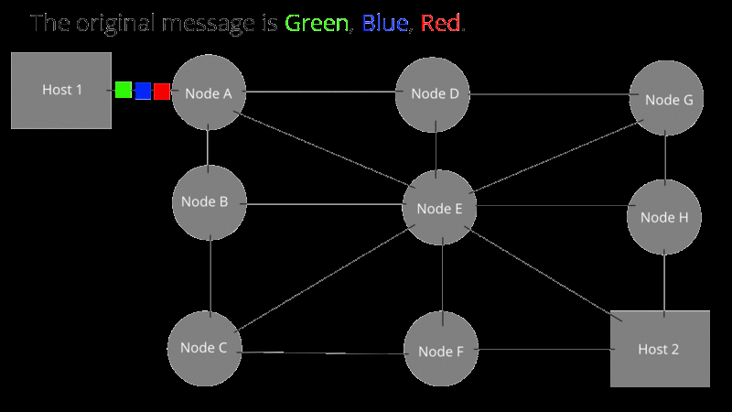
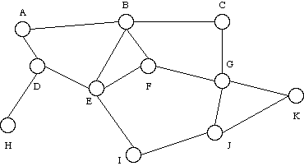
Q:-Why is it useful to have more than one possible path through a network for each pair of stations?

Slide 18
More than one Path
Packet 2
Karachi
Lahore
Packet 1
Islamabad
Q:-Why is it useful to have more than one possible path through a network for each pair of stations?
Ans:-It is advantageous to have more than one possible path through a network for each pair of stations to enhance reliability in case a particular path fails.

Slide 20
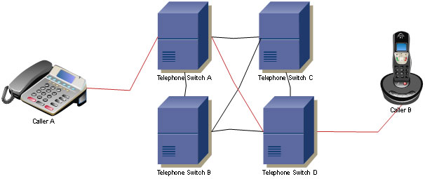
Review Question
Q:- What is the principal application that has driven the design of circuit-switching networks?

Slide 21
Switching Techniques
Data transmitted through a network of intermediate switching nodes, which are not concerned with content
End devices receiving data are stations; switching devices are nodes
A collection of nodes is a communication network
A switched communication network routes data from one station to another through nodes

Slide 22
Switched Network Characteristics
Some nodes connect only to other nodes for switching of data; other nodes have one or more stations attached as well.
Node-station links are generally dedicated point-to-point links; ode-node links are usually multiplexed links
Usually, the network is not fully connected; however, it is desirable to have more than one possible path through the network for each pair of stations to enhance reliability

Slide 23
Types of Switched Networks
Two different technologies
  Circuit switching
  Packet switching
Differ in the way the nodes switch information from one link to another between source and destination

Slide 24
Circuit-Switching Stages
Circuit establishment
Data transfer
  point-to-point from endpoints to node
  internal switching/multiplexing among nodes
Circuit disconnect

Slide 25
Circuit Establishment
Station requests connection from node
Node determines best route, sends message to next link
Each subsequent node continues the establishment of a path
Once nodes have established connection, test message is sent to determine if receiver is ready/able to accept message

Slide 26
Data Transfer
Point-to-point transfer from source to node
Internal switching and multiplexed transfer from node to node
Point-to-point transfer from node to receiver
Usually a full-duplex connection throughout

Slide 27
Circuit Disconnect
When transfer is complete, one station initiates termination
Signals must be propagated to all nodes used in transit in order to free up resources

Slide 28
Circuit Switching Characteristics
Channel capacity is dedicated for the duration of a connection, even if no data are being transferred
Once the circuit is established, the network is effectively transparent to the users, resulting in negligible delays
Developed to handle voice traffic but is now also used for data traffic

Slide 29
Circuit Switching Applications
Public Telephone Network (PSTN)
Private Branch Exchanges (PBX)
Private Wide Area Networks (often used to interconnect PBXs in a single organization)
Data Switch

Slide 30
Public Switched Telephone Network (PSTN)
Subscribers
Subscriber Line
(“local loop”)
  Connects subscriber to local telco exchange
Exchanges
(“end office”)
  Telco switching centers
  >19,000 in US
Trunks
  Connections between exchanges
  Carry multiple voice circuits using FDM or synchronous TDM
  Managed by IXCs (inter-exchange carriers)

Slide 31
Control Signaling
Manage the establishment, maintenance, and termination of signal paths
Includes signaling from subscriber to network, and signals within network
For a large public telecommunications network, a relatively complex control signaling scheme is required

Slide 32
Signaling Functions
Audible communication with the subscriber
Transmission of the number dialed
Information between switches that a call cannot be completed
Information between switches that a call has ended and the path can be disconnected
Telephone ring signal
Transmission of billing information
Transmission of equipment and trunk status information
Transmission of system failure diagnostic information
Control of special equipment (e.g. satellite channel equipment)

Slide 33
Types of Control Signals
Supervisory
Address
Call Information
Network Management

Slide 34
Supervisory Signals
Binary character (true/false; on/off)
Deal with the availability of the called subscriber and of the needed network resources
Used to determine if a needed resource is available and, if so, to seize it.
Also used to communicate the status of requested resources.

Slide 35
Address Signals
Identify a subscriber
Initially generated by a calling subscriber when dialing a telephone number
Resulting address may be propagated through the network to support the routing function and to locate and ring the called subscriber's phone

Slide 36
Call Information Signals
Provide information to the subscriber about the status of a call
In contrast to internal signals (which are analog or digital electrical messages), these are audible tones that can be heard by the caller or an operator with the proper phone set

Slide 37
Network Management Signals
Used for the maintenance, troubleshooting, and overall operation of the network
These signals cover a broad scope, and it is this category that will expand most with the increasing complexity of switched networks

Slide 38
In-Channel Signaling
Traditionally, control signals were carried on the same channel as the call to which the control signals relate
Drawbacks
  Information transfer rate limited
  Delay between entering a number and establishing a connection

Slide 39
Common-Channel Signaling
Control signals are carried over paths completely independent of the voice channels
One independent control signal path can carry the signals for a number of subscriber channels (i.e. is a “common control channel” for these channels)

Slide 40
Softswitch Architecture
A general-purpose computer running specialized software that turns it into a smart phone switch
Cost significantly less and can provide more functionality
Can convert digitized voice bits into packets, opening transmission options (e.g. voice over IP)
Physical switching function: media gateway (MG)
Call processing logic: media gateway controller (MGC)

Slide 41
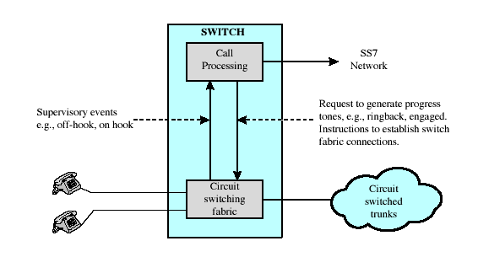
Traditional Circuit Switching Illustration

Slide 42
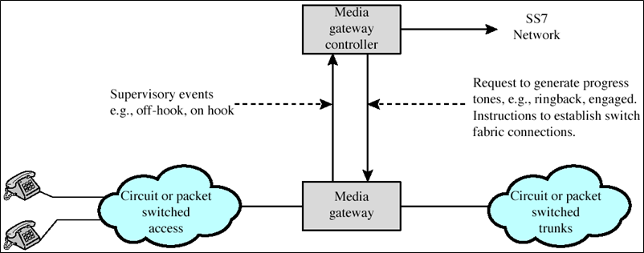
Softswitch Architecture Illustration

Slide 43
Review Answer
Q:- What is the principal application that has driven the design of circuit-switching networks?
Ans:- Telephone Communications.

Slide 45
Review Question (Routing)
Q:- Distinguish between static and alternate routing in a circuit-switching network.

Slide 46
Routing in Circuit Switched Networks
Routing
  The process of selecting the path through the switched network.
Two Requirements
  Efficiency --ability to handle expected load of traffic using the smallest amount of equipment.
  Resilience--ability to handle surges of traffic that exceed the expected load of traffic.

Slide 47
Routing in Circuit-Switched Networks
Many connections will need paths through more than one switch
Need to find a route based on
  Efficiency
  Resilience
Public telephone switches are a tree structure
  Static routing uses the same approach all the time
Dynamic routing allows for changes in routing depending on traffic conditions
  Uses a peer structure for nodes

Slide 48
Routing in Circuit Switched Networks
Traditionally Circuit Switched Networks routing has been static hierarchical tree structure with additional high usage trunks.
But today, a dynamic approach is used, to adjust to current traffic conditions.

Slide 49
Alternate Routing
Alternative routing is a form of routing in circuit-switching networks
Possible routes between end offices are predefined
Originating switch selects appropriate route
Routes are listed in preference order
Different sets of routes may be used at different times

Slide 50
Routing in Circuit Switched Networks
Alternate Routing
  Approach where possible routes between end offices are predefined.
  The alternate routes are sequentially tried, in order of preference, until a call is completed.
Fixed Alternate Routing--only one set of paths provided.
Dynamic Alternate Routing--different sets of preplanned routes are used for different time periods

Slide 51
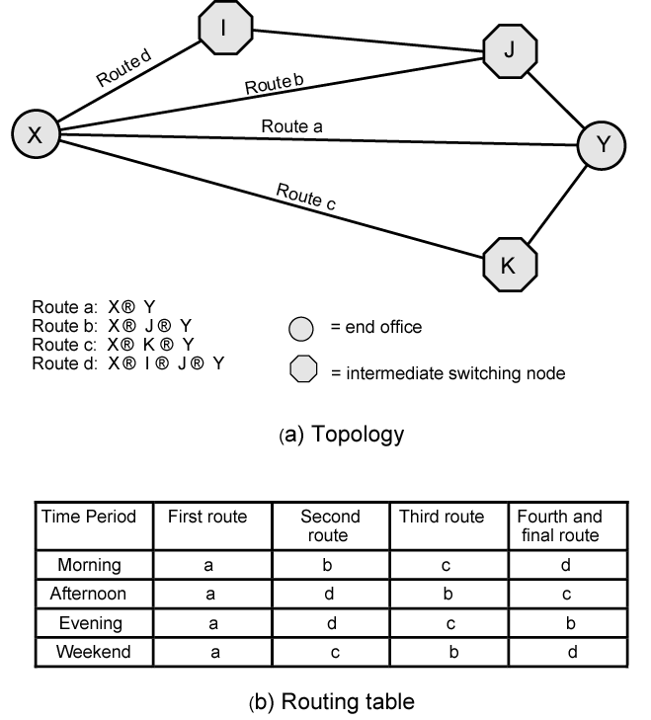
Alternate
Routing
Diagram
Switch X has 4 possible routes to destination switch Y.
Direct route is tried first.
If this trunk is unavailable (busy, out of service), the other routes will be tried in a particular order depending on the time period.
Eg, during weekday mornings, route b is tried next.

Slide 52
Review Answer (Routing)
Q:- Distinguish between static and alternate routing in a circuit-switching network.
Ans:- Static routing involves the use of a predefined route between any two end points, with possible backup routes to handle overflow. In alternate routing, multiple routes are defined between two end points and the choice can depend on time of day and traffic conditions.

Slide 54
Review Question:
Semi-Permanent Connection
Q:- What is a semipermanent connection?

Slide 55
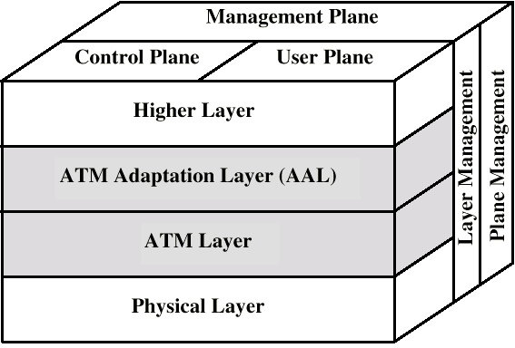
Protocol Architecture (diag)

Slide 56
Reference Model Planes
User plane
  Provides for user information transfer
Control plane
  Call and connection control
Management plane
  Plane management
    whole system functions
  Layer management
    Resources and parameters in protocol entities

Slide 57
ATM Logical Connections
Virtual channel connections (VCC)
Analogous to virtual circuit in X.25
Basic unit of switching
Between two end users
Full duplex
Fixed size cells
Data, user-network exchange (control) and network-network exchange (network management and routing)
Virtual path connection (VPC)
  Bundle of VCC with same end points

Slide 58
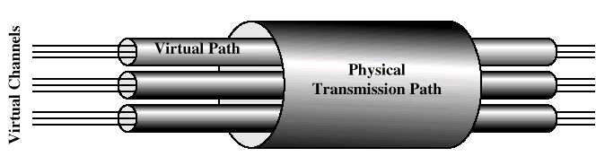
ATM Connection Relationships

Slide 59
Advantages of Virtual Paths
Simplified network architecture
Increased network performance and reliability
Reduced processing
Short connection setup time
Enhanced network services

Slide 60
VP/VC Characteristics
Quality of service
Switched and semi-permanent channel connections
Call sequence integrity
Traffic parameter negotiation and usage monitoring
VPC only
  Virtual channel identifier restriction within VPC

Slide 61
Review Answer:
Semi-Permanent Connection
Q:- What is a semi-permanent connection?
Ans:-This is a connection to another user set up by prior arrangement, and not requiring
a call establishment protocol. It is equivalent to a leased line.

Slide 63
Review Question: ISDN Data Rates
Q:- What data rates are offered for ISDN primary access

Slide 64
ISDN
Known as the Integrated Services Digital Network (ISDN)
Data, audio, image and video transmission
It is a switched digital telecommunication line that can be delivered over regular copper wires
Possible to provide end-to-end digital communications

Slide 65
ISDN Basic Characteristics
B Channels
64 Kbps
Data
Data
D Channel
16-64 Kbps
Data
Signaling

Slide 66
ISDN Service Connections
There are two different types of ISDN services that are widely available
One is known as the Basic Rate Interface or BRI
  Used for home or SOHO connection
The other is known as the Primary Rate Interface or the
  Used in large businesses

Slide 67
BRI Characteristics
2 B Channels
1 D Channel

Slide 68
Channels in BRI Service
B channels are known as bearer channels
  Carry information
D channel is known as the Delta channel
  Used for signaling purposes
2B + D channel service

Slide 69
The B Channel
64k bps per channel
The two B channels can be inverse multiplexed or boded together
  Achieve a maximum aggregate communication speed of 128 Kbps

Slide 70
The D Channel
16 Kbps
Entire bandwidth is not used for signaling purpose
Excess of 9.6 Kbps is available for packet switched data transmission applications
Excess bandwidth usage
  Climate control, security alarm system etc.

Slide 71
PRI Service
More sophisticated service compared to BRI
PRI service offers 23 B channels and 1 D channel

Slide 72
Properties of B Channels in PRI
Each B channel operates at a speed of 64K bps
The B channels are used for carrying data
B channels can be combined together to increase the aggregate communication speed

Slide 73
Properties of D Channel in PRI
Each D channel operates at a speed of 64 Kbps
  Considerably faster than the D channel in BRI
23 B channels share a D channel for signaling purpose

Slide 74
Review Question: ISDN Data Rates
Q:- What data rates are offered for ISDN primary access
Ans:-
PRI channels are delivered over a T1 line
T1 speed
  1.544M bps
Aggregate speed of PRI from all 23 B channels and the single D Channel is computed as follows:
  23 * 64 K+ 1* 64K + = 1.536 Mbps
In North America and Japan, 23B+D Primary Rate Access operates at 1.544 Mbps and offers 23 B channels plus 1 64-Kbps D channel
In most of the rest of the world, 30B+D Primary Rate Access operates at 2.048 Mbps and offers 30 B channels plus 1 64-Kbps D channel (located in time-slot 16)

Slide 76
Review Question
Datagram Vs. Virtual Circuit Operation
Q:-Explain the difference between datagram and virtual circuit operation.

Slide 77
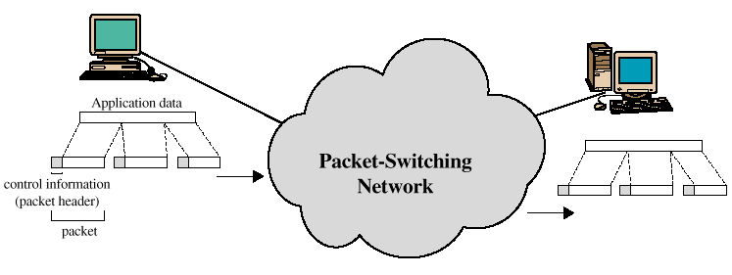
Packet Switching
Around 1970, research began on a new form of architecture for long distance communications: Packet Switching.

Slide 78
Introduction
Packet Switching refers to protocols in which messages are divided into packets before they are sent. Each packet is then transmitted individually and can even follow different routes to its destination. Once all the packets forming a message arrive at the destination, they are recompiled into the original message.

Slide 79
Packet Switching Operation
Data are transmitted in short packets. Typically an upper bound on packet size is 1000 octets.
If a station has a longer message to send it breaks it up into a series of small packets. Each packet now contains part of the user's data and some control information.
The control information should at least contain:
  Destination Address
  Source Address
Store and forward - Packets are received, stored briefly (buffered) and past on to the next node

Slide 80
Advantages
Line efficiency
  Single node to node link can be shared by many packets over time
  Packets queued and transmitted as fast as possible
Data rate conversion
  Each station connects to the local node at its own speed
  Nodes buffer data if required to equalize rates
Packets are accepted even when network is busy
  Delivery may slow down
Priorities can be used

Slide 81
Switching Technique - Virtual Circuits and Datagrams
Station breaks long message into packets
Packets sent one at a time to the network
Packets handled in two ways
  Datagram
  Virtual circuit

Slide 82
Datagram Packet Switching
In datagram approach each packet is treated independently with no reference to packets that have gone before. No connection is set up.
Packets can take any practical route
Packets may arrive out of order
Packets may go missing
Up to receiver to re-order packets and recover from missing packets
More processing time per packet per node
Robust in the face of link or node failures.

Slide 83
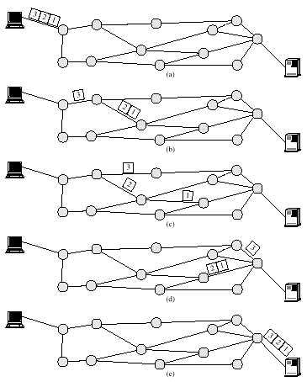
Packet Switching Datagram Approach

Slide 84
Virtual Circuit Packet Switching
In the Virtual Circuit approach a pre-planned route is established before any packets are sent.
There is a call set up before the exchange of data (handshake).
All packets follow the same route and therefore arrive in sequence.
Each packet contains a virtual circuit identifier instead of destination address
More set up time
No routing decisions required for each packet - Less routing or processing time
Susceptible to data loss in the face of link or node failure
Clear request to drop circuit
Not a dedicated path

Slide 85
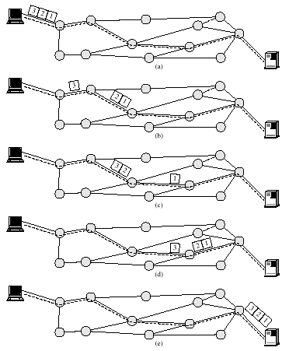
Packet Switching Virtual Circuit Approach

Slide 86
Virtual Circuits vs. Datagram
Virtual circuits
  Network can provide sequencing and error control
  Packets are forwarded more quickly
    No routing decisions to make
  Less reliable
    Loss of a node looses all circuits through that node
Datagram
  No call setup phase
    Better if few packets
  More flexible
    Routing can be used to avoid congested parts of the network

Slide 87
Packet switching - datagrams or virtual circuits
Interface between station and network node
  Connection oriented
    Station requests logical connection (virtual circuit)
    All packets identified as belonging to that connection & sequentially numbered
    Network delivers packets in sequence
    External virtual circuit service
    e.g. X.25
    Different from internal virtual circuit operation
  Connectionless
    Packets handled independently
    External datagram service
    Different from internal datagram operation

Slide 88
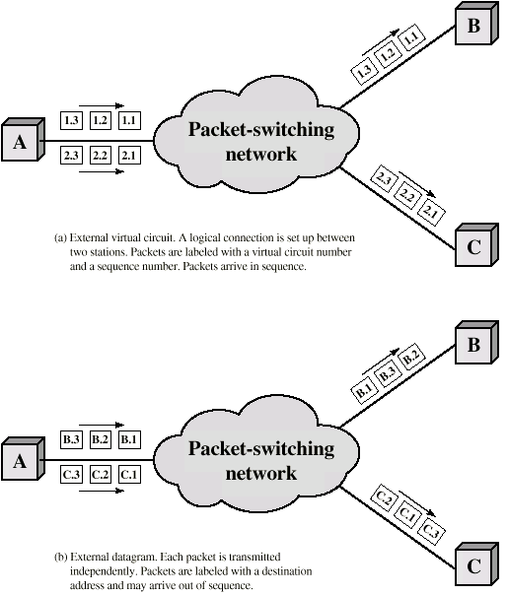
External
Virtual
Circuit and
Datagram
Operation

Slide 89
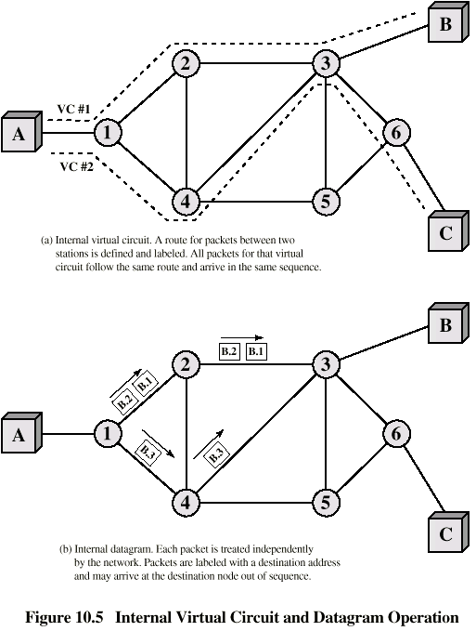
Internal
Virtual
Circuit and
Datagram
Operation

Slide 90
Review Ans
Datagram Vs. Virtual Circuit Operation
Q:-Explain the difference between datagram and virtual circuit operation.
Ans:-In the datagram approach, each packet is treated independently, with no reference to packets that have gone before. In the virtual circuit approach, a preplanned route is established before any packets are sent. Once the route is established, all the packets between a pair of communicating parties follow this same route through the network.

Slide 92
Review Question:
Limitations of Circuit Switching for Data Transmission
Q:-What are some of the limitations of using a circuit-switching network for data transmission?

Slide 93
Circuit Switching (e.g., Phone Network)
Establish: source creates circuit to destination
  Node along the path store connection info
  Nodes may reserve resources for the connection
Transfer: source sends data over the circuit
  No destination address, since nodes know path
Teardown: source tears down circuit when done

Slide 94
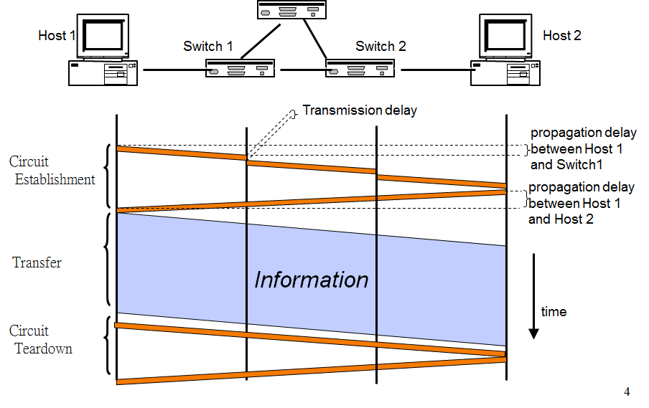
Timing in Circuit Switching

Slide 95
Review Ans:
Limitations of Circuit Switching for Data Transmission
Q:-What are some of the limitations of using a circuit-switching network for data transmission?
Ans:- It is not efficient to use a circuit switched network for data since much of the time a typical terminal-to-host data communication line will be idle. Secondly, the connections provide for transactions at a constant data rate, which limits the utility of the network in interconnecting a variety of host computers and terminals.

Slide 96
Review Ans:
Limitations of Circuit Switching for Data Transmission
Moreover circuit switching is designed for voice
But for data, the shortcomings are:`
Resources dedicated to a particular call
Much of the time a data connection is idle
Data rate is fixed
  Both ends must operate at the same rate

Slide 98
Review Question
Virtual Channel and Virtual Path
Q:-What is the difference between a virtual channel and a virtual path?

Slide 99
Review Question
Virtual Channel and Virtual Path
Q:-What is the difference between a virtual channel and a virtual path?
Ans:-A virtual channel is a logical connection similar to virtual circuit in X.25 or a logical channel in frame relay. In ATM, virtual channels that have the same endpoints can be grouped into virtual paths. All the circuits in virtual paths are switched together; this offers increased efficiency, architectural simplicity, and the ability to offer enhanced network services.

Slide 100
Summary
LAN WAN difference
Reliability via having more than one path
Conventional PSTN network: A circuit-switching driven design
More bits and pieces of ATM: semi-permanent connection
ISDN data rates showing different schools of thoughts of US and EU
Datagram Vs. Virtual Channel
What if data has to be transmitted on circuit switched network
VCC Vs. VPC

