Slide 1
Communication Networks
Lecture 10

Slide 2
Overview
Circuit Switching Vs. Packet Switching
Pro and Cons of Ckt. Switching and Pkt. Switching
Classifications of Packet Switching Techniques
Datagram and Virtual Circuit.
Comparison of the three techniques
Combination of Circuit Switching and Packet Switching
Asynchronous Transfer Mode Introduction
ATM Protocol
ATM QoS mechanisms

Slide 3
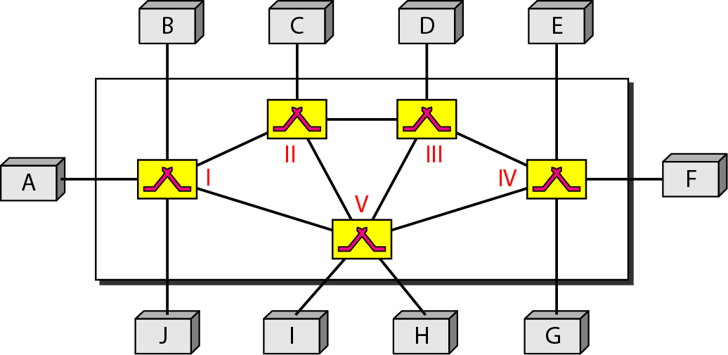
Switched Network
Figure Switched network

Slide 4
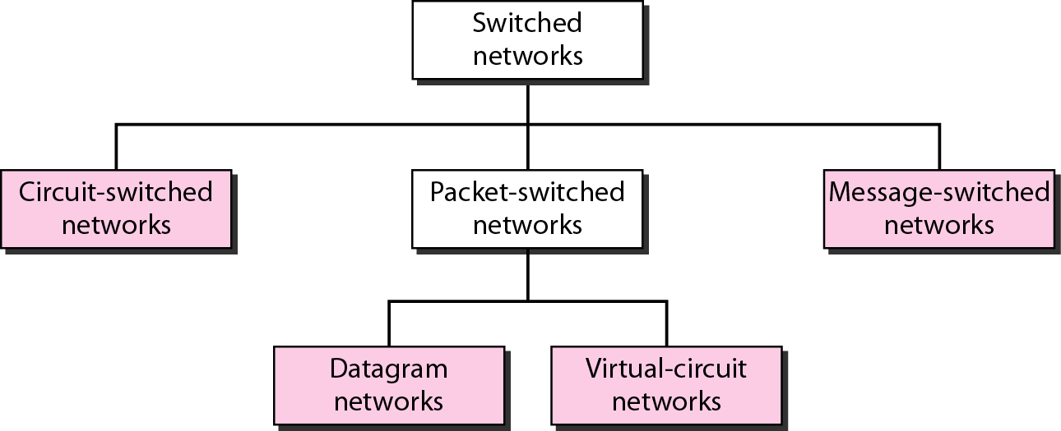
Switching Technologies
Figure Taxonomy of switched networks

Slide 5
CIRCUIT-SWITCHED NETWORKS
A circuit-switched network consists of a set of switches connected by physical links. A connection between two stations is a dedicated path made of one or more links. However, each connection uses only one dedicated channel on each link. Each link is normally divided into n channels by using FDM or TDM.

Slide 6
Circuit Switching: Multiplexing a Link
Time-division
  Each circuit allocated certain time slots
Frequency-division
  Each circuit allocated certain frequencies
frequency
time
time

Slide 7
Communication Path
A path is a route for data to travel between two nodes in a network
Dynamic path
  In this case, the path often changes from packet to packet
  Example: Packet Switching
Static path
  Path is initially established and it remains unchanged for the duration of the communication session
  Example: Circuit Switching

Slide 8
Circuit Switching Network
Established Circuit
Switch
Karachi
Lahore
Circuit established and maintained for
entire duration of communication.

Slide 9
Defining Characteristics of Circuit Switching
Establish (switch) a path (circuit) between two nodes of communication
Maintain the circuit for the full duration of communication session

Slide 10
Advantages of Circuit Switching
Continuity assured in the order of transmission
Audio can be transmitted without streaming provided adequate bandwidth is available
  Otherwise streaming is necessary
The overhead is low in switching a circuit

Slide 11
Disadvantages of Circuit Switching
Inefficient use of the paths that are available within a network
  This may lead to circuit saturation
Users can be locked out of the network
Multiple sessions cannot easily be implemented although it is possible to have multiple sessions

Slide 12
Circuit Saturation
Established Circuit
Karachi
Lahore
Islamabad
Saturation point.

Slide 13
Areas of Applications
Voice/Video communications
  Telephone network
Both analog and digital telecommunication lines can be circuit switched
ISDN

Slide 14
More on ISDN
ISDN has two B channels and one D channel
  B channel is used for data and D channel is used for monitoring and control of the data transmission
B channels are circuit switched and the D channels are packet switched

Slide 15
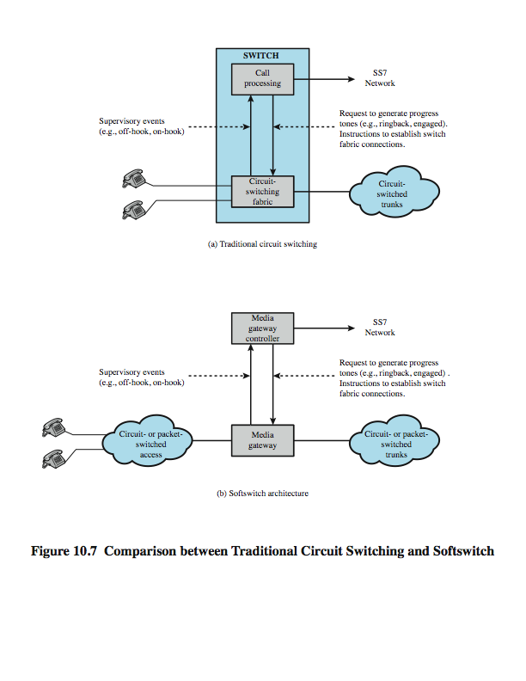
Traditional Circuit Switching
Switching at the physical layer in the traditional telephone network uses the circuit-switching approach.
Notes:
Stallings DCC8e Figure 10.7a contrasts the the softswitch architecture with that of a traditional telephone network circuit switch.

Slide 16
Softswitch
Notes:
The latest trend in the development of circuit-switching technology is generally referred to as the softswitch. In essence, a softswitch is a general-purpose computer running specialized software that turns it into a smart phone switch. Softswitches cost significantly less than traditional circuit switches and can provide more functionality. In particular, in addition to handling the traditional circuit-switching functions, a softswitch can convert a stream of digitized voice bits into packets. This opens up a number of options for transmission, including the increasingly popular voice over IP (Internet Protocol) approach.
In any telephone network switch, the most complex element is the software that controls call processing. This software performs call routing and implements call-processing logic for hundreds of custom calling features. Typically, this software runs on a proprietary processor that is integrated with the physical circuit-switching hardware. A more flexible approach is to physically separate the call processing function from the hardware switching function. In softswitch terminology, the physical switching function is performed by a media gateway (MG) and the call processing logic resides in a media gateway controller (MGC).
Stallings DCC8e Figure 10.7b illustrates the softswitch architecture. In the latter case, the MG and MGC are distinct entities and may be provided by different vendors.

Slide 18
Packet Switching Network
Packet 2
Karachi
Lahore
Packet 1
Islamabad

Slide 19
Salient Points of Packet Switching
Path
  Each packet may take a different path to its destination
  Best path is heuristically determined at each node
Packet switching
  Path may be switched among packets
  Hence, the term packet switching

Slide 21
Questions
What are the major advantages and disadvantages of packet switching?
Could the Internet be called a packet switching network?
How does packet switching help in supporting multiple communication sessions?
How does a web server support multiple access to its contents? Explain in terms of packets that travel from the web server to their various destinations.

Slide 22
Questions (continued)
What are the implications of packet switching to the transmission of audio and video in real time?
How are the above problems addressed in streaming?

Slide 23
Major Advantages
Better utilization of the network segments in terms of the usage of the network paths
Ability to engage in multiple communication sessions

Slide 24
Dynamic Assignment of Paths
Karachi
Lahore
Multan
Islamabad

Slide 25
Support for Multiple Communication Sessions
Session 1
Session 2
Karachi
Lahore
Multan
Islamabad

Slide 26
Disadvantage or a Concern
Packets may not arrive at their destination in the order in which they were originally transmitted
The above possibility exists because of the different paths that are taken by the different packets

Slide 27
Order of Arrival of Packets
Packet 2
Karachi
Packet 1
Lahore
Islamabad
Packet 2 may arrive earlier than Packet 1.

Slide 28
Packet Assembly
Packets are assembled to preserve the order of transmission
Packets arriving earlier are held in a buffer
The order of arrival is critical and in certain cases the order is time sensitive as well

Slide 29
Transmission of Audio and Video in Packet Switching
Transmission of audio and video are time sensitive
  Timely arrival of packet is important
The process that would ensure the orderly and timely arrival of data packets is known as streaming
Streaming also compresses the data to minimize bandwidth requirements thus ensuring that the packets have adequate bandwidth to travel to the destination in the order in which they are supposed to arrive at the destination

Slide 30
Buffering in Streaming
Streamed audio or video is often buffered to ensure that the audio or video is played continuously

Slide 31
Advantages And Disadvantages
Advantages
  Efficient use of the network paths
  Engage in multiple sessions
Disadvantages
  Additional hardware and software resources are required to assemble and route the packets
  If real-time continuity is stipulated then the data must be subjected to a process known as streaming

Slide 32
Special Concerns
Audio and video transmission
  Streaming is used
Voice Over IP (VoIP) is designed deploy telephony over the Internet

Slide 33
Newer Advancements for Real Time Transmission of Information
Faster Internet speed
Better technology
  IPv6
  Better streaming technologies

Slide 34
Questions
What are the major advantages and disadvantages of packet switching?
Could the Internet be called as a packet switching network?
How does packet switching help in supporting multiple communication sessions?
How does a web server support multiple access to its contents? Explain in terms of packets that travel from the web server to their various destinations on the Internet.

Slide 35
Questions (continued)
What are the implications of packet switching to the transmission of audio and video in real time?
  Relate the above to Voice over IP transmission.
How are the above problems addressed in streaming?

Slide 36
Internet: An Application of Packet Switching
Internet
Server
Packet N1
Karachi
Ramp
Packet M1
Lahore
Islamabad
Server in Lahore supports multiple access to the web
over a packet switched connection.

Slide 37
Support for Multiple Sessions
Session LA
Session MU
Packet 2
Karachi
Lahore
Packet 1
Islamabad
Multan
Packets are displayed on different sessions on the screen.

Slide 38
Applications Using Multiple-Sessions
Sharing
Collaboration
Multiple access to an Internet server
etc.

Slide 39
Comparison
Packet Switching Circuit Switching
_______________________________________________
Efficient use of network Inefficient use
High overhead Low overhead
Computer data Audio and video
Audio and video
transmissions are,
however, possible
Multiple sessions possible Multiple sessions
are easily implemented are possible, however it requires additional hardware and software

Slide 41
Switching Technologies
Figure Taxonomy of switched networks

Slide 42
Packet Switching
Circuit switching was designed for voice
Packet switching was designed for data
Transmitted in small packets
Packets contains user data and control info
  User data may be part of a larger message
  Control info includes routing (addressing) info
Packets are received, stored briefly (buffered) and past on to the next node

Slide 43
Packet Switching Technique
A station breaks long message into packets
Packets are sent out to the network sequentially, one at a time
How will the network handle this stream of packets as it attempts to route them through the network and deliver them to the intended destination?
  Two approaches
    Datagram approach
    Virtual circuit approach

Slide 44
Datagram
Each packet is treated independently, with no reference to packets that have gone before.
  Each node chooses the next node on a packet’s path.
Packets can take any possible route.
Packets may arrive at the receiver out of order.
Packets may go missing.
It is up to the receiver to re-order packets and recover from missing packets.
Example: Internet

Slide 45
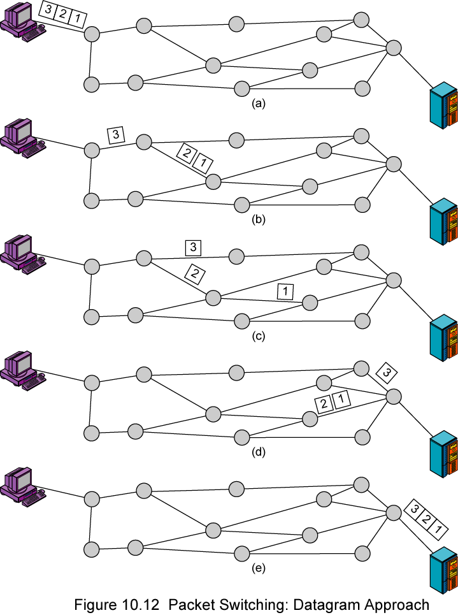
Datagram

Slide 46
Virtual Circuit
In virtual circuit, a preplanned route is established before any packets are sent, then all packets follow the same route.
Each packet contains a virtual circuit identifier instead of destination address, and each node on the preestablished route knows where to forward such packets.
  The node need not make a routing decision for each packet.
Example: X.25, Frame Relay, ATM

Slide 47
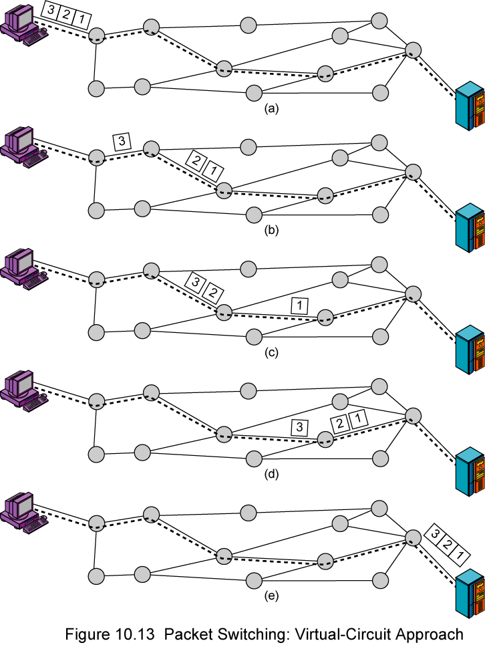
Virtual Circuit
A route between stations is set up prior to data transfer.
All the data packets then follow the same route.
But there is no dedicated resources reserved for the virtual circuit! Packets need to be stored-and-forwarded.

Slide 48
Virtual Circuits v Datagram
Virtual circuits
  Network can provide sequencing (packets arrive at the same order) and error control (retransmission between two nodes).
  Packets are forwarded more quickly
    Based on the virtual circuit identifier
    No routing decisions to make
  Less reliable
    If a node fails, all virtual circuits that pass through that node fail.
Datagram
  No call setup phase
    Good for bursty data, such as Web applications
  More flexible
    If a node fails, packets may find an alternate route
    Routing can be used to avoid congested parts of the network

Slide 49
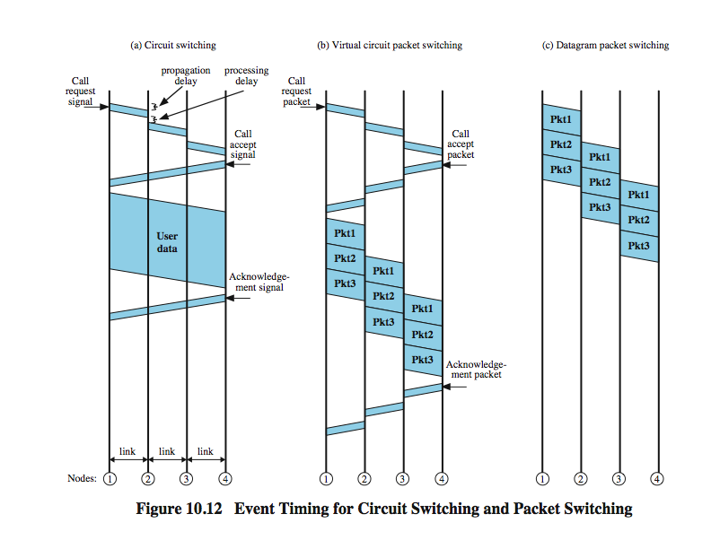
Event Timing
Notes:
.

Slide 50
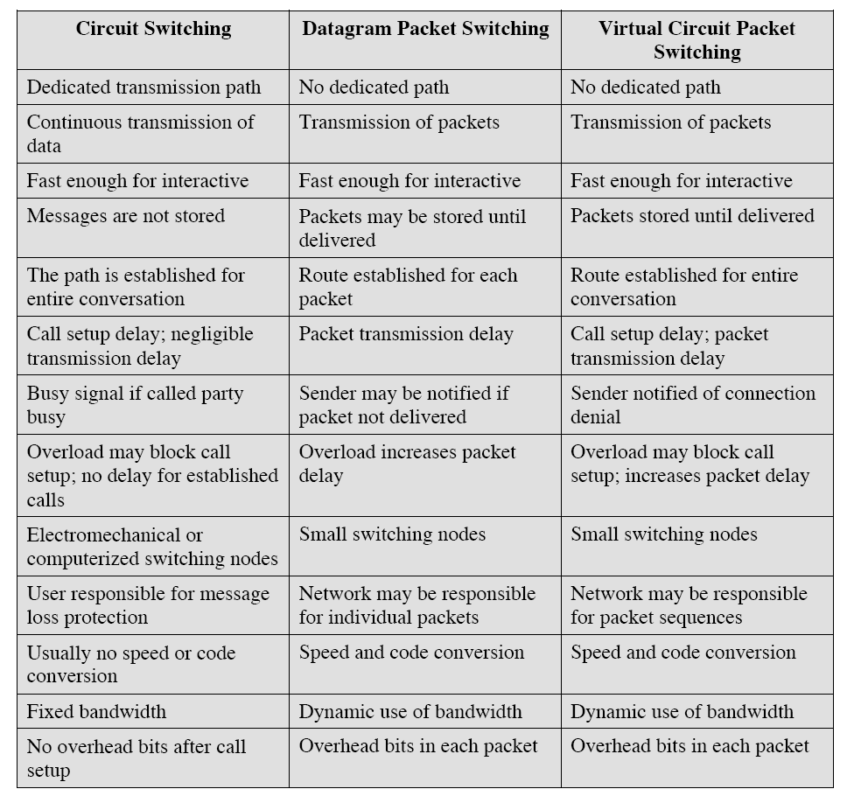
Comparison of communication switching techniques

Slide 52
Issue
Originally Circuit Switching is developed for Voice traffic while Packet Switching is developed for data traffic But what if ???
Traffic Integration
  Voice, video and data traffic
  Multimedia became the ‘buzz word’
    One-way batch Web traffic
    Two-way batch voice messages
    One-way interactive Mbone broadcasts
    Two-way interactive video conferencing
Quality of Service guarantees (e.g. limited jitter, non-blocking streams)
LAN Interoperability
Mobile and Wireless nodes

Slide 53
WHAT’S ATM?
ATM is Asynchronous Transfer Mode.
ATM is a connection-oriented, high-speed, low-delay switching and transmission technology that uses short and fixed-size packets, called cells, to transport information.
ATM is originally the transfer mode for implementing Broadband ISDN (B-ISDN) but it is also implemented in non-ISDN environments where very high data rates are required

Slide 54
ATM Defined
“ATM is a cell-switching and multiplexing technology that combines the benefits of circuit switching (guaranteed capacity and constant transmission delay) with those of packet switching (flexibility and efficiency for intermittent traffic)” –CISCO.
It utilizes fixed length cells to carry the information

Slide 55
Circuit Switching and Packet Switching
ATM is circuit switched because it establishes virtual circuits for communication
At the same time, the virtual circuits are established over packet switched networks
As such, it combines the benefits of circuit switched and packet switched technologies

Slide 56
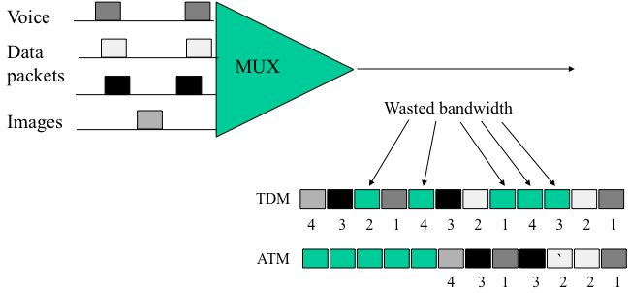
ATM Usage and Bandwidth
In theory, ATM can be deployed from small LANs to very large WANs
  At present, it is used mostly on backbones, but this may change in the future with declining prices for ATM equipment
ATM deployments can operate at speeds starting in the Mbps range scaling up to Gpbs range
  Speed wise, it is very scalable

Slide 57
ATM’s Efficiency
It is an asynchronous technology and it uses the links based on the need for information to be transmitted
ATM is based on fixed length cells and the cells are small compared to many other forms of transmission such as frame relay etc.

Slide 58
ATM Cell Basics
ATM carries information based on fixed length cells
  Compare this to the other packet switching technologies such as Frame Relay etc. where each packet may be of a different length
The length of each cell is 53 Bytes
  First 5 bytes are used as the cell header
  Next 48 bytes are used as the payload carrying the data

Slide 59
ATM Cell Format
5 Bytes
48 Bytes
Header
Payload (Data)

Slide 60
Fixed Length Cell Advantage
Delay or latency is significantly reduced
  ATM is therefore suited for voice and video transmission
Fixed length cells make it easier to switch data across multiple networks
  ATM networks are built based on switches and not routers
Fixed length cell is similar to container based road transportation
  Some parallels can be drawn with respect to the advantage of fixed length transportation based on the benefits of container transportation

Slide 61
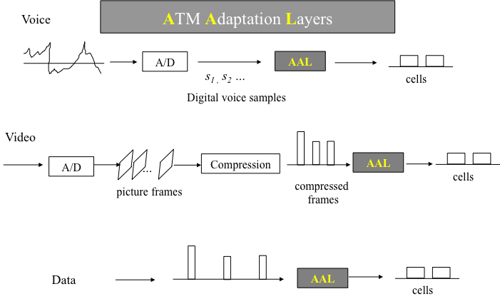
ATM Protocol AAL
ATM Adaptation Layer (AAL) – the protocol for packaging data into cells is collectively referred to as AAL.
Must efficiently package higher level data such as voice samples, video frames and datagram packets into a series of cells.

Slide 62
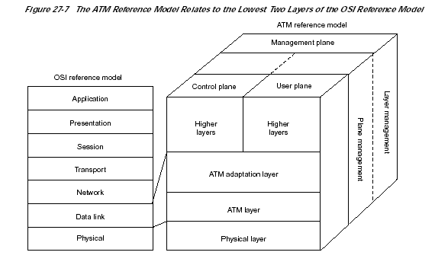
ISO-OSI and ATM Models

Slide 63
ATM Quality of Service (QoS)
ATM’s advantage over competing technologies is that it is able to offer a specified QOS
For example, ATM providers can guarantee to their customers that the end-to-end latency will not exceed a specified level

Slide 64
QoS Offered by ATM
Constant Bit Rate (CBR)
Variable Bit Rate (VBR)
Unspecified Bit Rate (UBR)
Available Bit Rate (ABR)

Slide 65
Constant Bit Rate (CBR)
Highest grade service (Grade A)
A constant bandwidth is available for the virtual channel
Suitable for voice-over-IP (Transfer fixed rate uncompressed video), and other traffic that requires steady, guaranteed throughput

Slide 66
Variable Bit Rate (VBR)
Second in the level of service (Grade B)
It is divide into to categories
  Variable Bit Rate Non-Real Time (VBR-NRT)
  Variable Bit Rate Real Time (VBR-RT)

Slide 67
Variable Bit Rate Non-Real Time VBR-NRT
Provides bandwidth only as needed
Traffic that is not very sensitive to cell-delay or latency is handled by this service
An example use would be to send multimedia e-mail

Slide 68
Variable Bit Rate Real Time VBR-RT
Again, this is similar to VBR-RT in providing bandwidth as needed
But VBR-RT is designed for applications where cell-delay or latency cannot be accommodated

Slide 69
Sample Applications for VBR-RT
Voice with speech activity detection
  Telephony
Compressed interactive video
  Video conferencing

Slide 70
Available Bit Rate (ABR)
Third in the level of service (Grade C)
Bandwidth is adjusted based on the amount of traffic in the network
Suitable for data traffic such as file transfer and Email that are basically not time sensitive

Slide 71
Unspecified Bit Rate (UBR)
Fourth in the level of service (Grade D)
Dose not offer any fixed values for the traffic parameters

Slide 72
QoS Enforcement
Traffic contract
Traffic shaping
Traffic policing

Slide 73
How Stuff Works
User Applications
User Applications
Voice Video Data
Voice Video Data
BISDN
Services
BISDN
Services
Segmentation
Reassembly
Multiplexing
Demultiplexing
Workstation
Workstation
ATM Network
H
H
H
H
H
H
H
H
H
H
H
H
H
H

Slide 74
Summary
Circuit Switching and Packet Switching; the backbone of Wireless Communication Infrastructure
Pros and Cons of Ckt Switching and Pkt Switching
Requirement of Convergence of Voice, Video and Data Services and Merger of Ckt. Switching And Packet Switching
ATM Flexibility to support from Mbs to Gbs an ideal candidate for LANS and backbone for Wireless Infrastructure
QoS requirements for ATM
    Constant Bit Rate (CBR)
    Variable Bit Rate (VBR)
    Unspecified Bit Rate (UBR)
    Available Bit Rate (ABR)

