Slide 1
Web application architecture

Slide 2
Summary of the previous lecture
System modeling
Requirement Modeling
  use-case diagram, activity diagram
Content modeling
  class diagram, state machine diagram
Navigation modeling
Presentation modeling

Slide 3
Outline
Software system architecture
Specifics of web application architecture
Layered web architecture
  2-layered architecture
  3-layered architecture
  N-layered architecture

Slide 4
1. Software system architecture
The architecture of a computer system is the high-level (most general) design on which the system is based
Architectural features include:
  Components
  Collaborations (how components interact)
  Connectors (how components communicate)

Slide 5
1. Software system architecture…
Key attributes of an architecture
  architecture describes structure
  architecture forms the transition from analysis to implementation
  different viewpoints (conceptual, runtime, process and implementation)
  makes a system understandable

Slide 6
1. Software system architecture…
Factors influence the system architecture
Functional Requirements
Clients
Users
Other Stakeholders
Quality considerations with
Performance
Scalability
Reusability
Other?
Architecture

Slide 7
1. Software system architecture…
Factors influence the system architecture
Architecture
Experience with
Existing Architecture
Patterns
Project Management
Other?
Technical Aspects
Operating System
Middleware
Legacy Systems
Other?

Slide 8
2. Specifics in web application architecture
A number of architectures for specific requirement in several application domain have been developed
For web application architecture, usually we consider
  layering aspect: to implement the principle of ‘separation of concerns’
  data aspects: to support processing of structured and non-structured data

Slide 9
2. Specifics in web application architecture…
For web applications quality requirements are more demanding as compared to desktop applications
  performance, security, scalability, and availability etc.
Need specific technical infrastructures both for the development and the operation of web applications

Slide 10
2. Specifics in web application architecture
we have to consider
  web infrastructure architecture (WPA)
  web application architecture (WAA)
Web application architecture (WAA) depends on the problem domain of the application, therefore we focus on web platform architecture (WPA)

Slide 11
2. 1 Components of a web application architecture
Client:
  generally a browser (user agent) is controlled by a user to operate the web application
  the client’s functionality can be expanded by installing plug-ins
Firewall:
  a piece of software regulating the communication between insecure networks(e.g., the Internet) and secure networks (e.g., corporate LANs)
  this communication is filtered by access rules

Slide 12
2. 1 Components of a web application architecture
Proxy:
  A proxy is typically used to temporarily store web pages in a cache
Web server:
  A Web server is a piece of software that supports various Web protocols like HTTP, and HTTPS, etc., to process client requests

Slide 13
2. 1 Components of a web application architecture
Database server:
  this server normally supplies data in structured form, e.g., in tables
Legacy application:
  A legacy application is an older system that should be integrated as an internal or external component

Slide 14
2. 1 Components of a web application architecture
Media server:
  This component is primarily used for content streaming of non-structured bulk data (e.g., audio or video)
Application server:
  An application server holds the functionality required by several applications

Slide 15
2. 1 Components of a web application architecture
Client
Firewall
proxy
Web-server
CGI support
Browser
HTML, XML
Plug -In
Database server
Application server
Media server
Legacy application

Slide 16
3. Layered architecture for web applications
Presentation tier:
  Every web application needs to communicate with external entities, human users or other computers
    allows these entities to interact with the system
    implemented as a GUI interface
  How the data should appear to the user

Slide 17
3. Layered architecture for web applications
Application tier:
  Web applications do more than information delivery, they perform data processing (Business Logic & calculation) behind the results being delivered
  This tier is often referred to as
    Services
    Business logic

Slide 18
3. Layered architecture for web applications
Data layer:
  Web applications needs data to work with
  Data can reside in databases or other information repositories
  Deals with and implements different data sources of Information Systems

Slide 19
3.1 two-layer web architecture
Presents architecture in two layers:
  Layer 1: Client platform, hosting a web browser
  Layer 2: server platform, hosting all server software components
Also called client/server architecture
Client directly send request to the server
  Server respond to the client request
    Static or dynamic requests

Slide 20
3.1 two-layer web architecture
Client
Client
Server
Web/App Server
Services
Database
Dynamic HTML
Static HTML

Slide 21
3.1 two-layer web architecture
Advantage:
  Inexpensive (single platform)
Disadvantages:
  Interdependency (coupling) of components
  No redundancy
  Limited scalability
Typical application:
  10-100 users
  Small company or organization

Slide 22
3.2 three-layer web architecture
Usually implemented in 3 layers
  Layer 1: Data
  Layer 2: Application
  Layer 3: presentation
Additionally, security mechanism (Firewall) and caching mechanism (Proxies) can be added

Slide 23
3.1 three-layer web architecture
Client
Firewall
Proxy
Web Server
Presentation Layer
Application Server
(Business Logic, Connectors,
Personalization, Data Access)
Business Layer
Backend
(Legacy Application,
Enterprise Info System)
DBMS
Data Layer

Slide 24
3.2 three-layer web architecture
Advantages:
  Improved performance
  Decreased coupling of software components
  Improved scalability
Disadvantages:
  No redundancy
Typical Application:
  100-1000 users
  Small business or regional organization, e.g., specialty retailer, small college

Slide 25
3.3 N-layer web architecture
A multitier (N-layer) architecture is an expansion of the 3-layer architecture, in one of several different possible ways
  Replication of the function of a layer
  Specialization of function within a layer

Slide 26
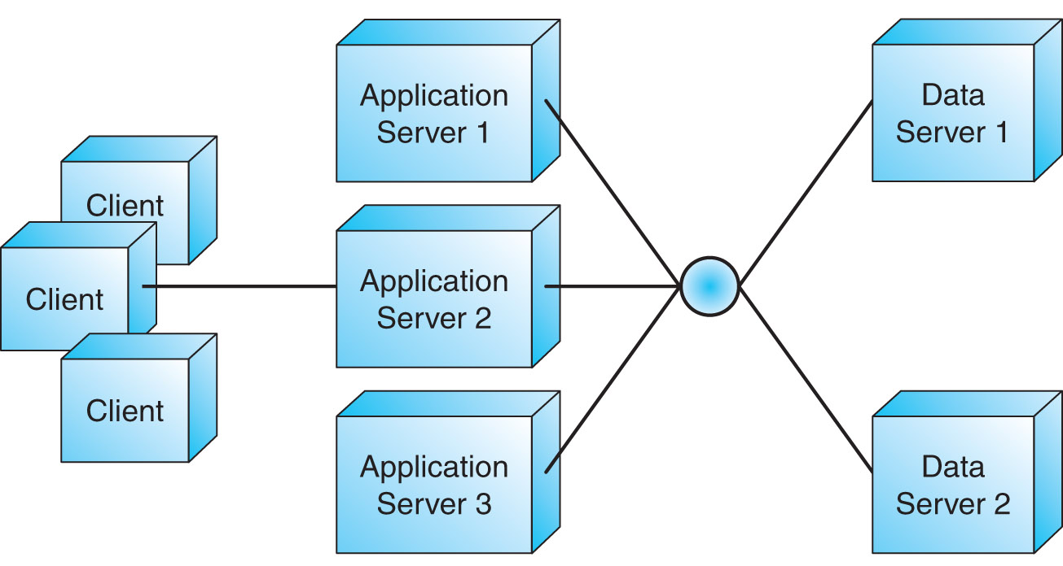
3.3 N-layer web architecture…
Replication:
Application and data servers are replicated
Servers share the total workload

Slide 27
3.3 N-layer web architecture…
Specialization:
Servers are specialized
Each server handles a designated part of the workload, by function

Slide 28
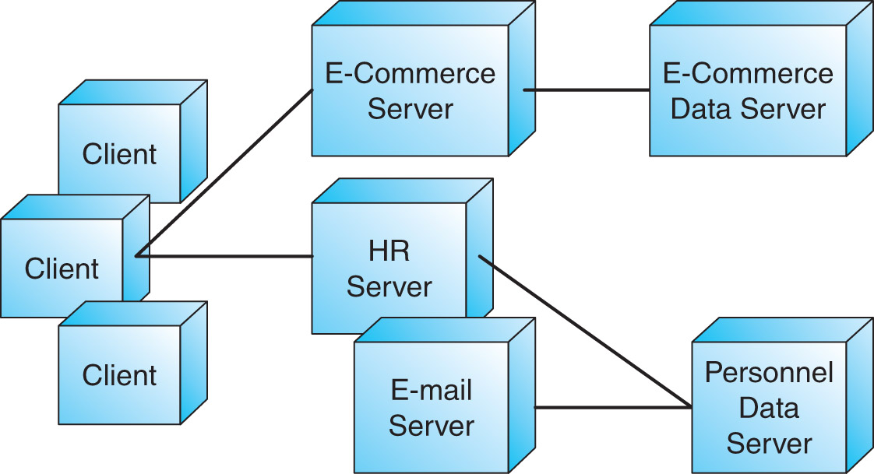
3.3 N-layer web architecture…

Slide 29
3.3 N-layer web architecture…
Advantages:
  Decoupling of software components
  Flexibility to add/remove platforms in response to load
  Scalability
  Redundancy
Disadvantages:
  Higher costs (maintenance, design, electrical load, cooling)
Typical Application:
  1000+ users
  Large business or organization

Slide 30
3.4 Comparison of layered architecture
large e-commerce, business, or organization
small e-commerce, regional business or organization
local business or organization
N-Tier
1000
3-Tier
users
100
2-Tier
10
capacity
scalability
redundancy
cost

Slide 31
3.5 example
Client
Web Server
Presentation Layer
Application Server
(Business Logic, Connectors,
Personalization, Data Access)
Business Layer
Media
Server
DBMS
Data Layer

Slide 32
Summary
Software system architecture
Specifics of web application architecture
Layered web architecture
  2-layered architecture
  3-layered architecture
  N-layered architecture

Slide 33
References
Chapter 4, Kappel, G., Proll, B. Reich, S. & Retschitzegger, W. (2006). Web Engineering, Hoboken, NJ: Wiley & Son
Web-based application development,
Ralph F Grove , J and B publishers,
(www.jbpub.com)

