Slide 1
Modeling web applications

Slide 2
Summary of the previous lecture
System modeling
Requirement Modeling
  use-case diagram
  activity diagram

Slide 3
Outline
Requirement modeling
  use-case diagram
  activity diagram
Content modeling
Navigation modeling
Presentation modeling

Slide 4
1. Content modeling
The information provided by a web application is one of the most important factors for the success of that application
Content modeling aims at modeling the information requirements of a web application
  diagraming the structural and behavioral aspects of the information
  ignores the navigational information

Slide 5
1. Content modeling
Key models
  Class diagram: to model the structural aspects of information
  State machine diagram: to model behavioral aspects of information

Slide 6
1.1 Class diagram
Class diagram describes the structure of a system by
  system’s classes
  class attributes
  operations (methods)
  relationship among objects

Slide 7
1.1 Class diagram…
Elements of a class diagram:
class:
  class is represented by a rectangle with three compartments
    name
    attributes
    methods
Class name
Attributes
Methods

Slide 8
1.1 Class diagram…
Elements of a class diagram:
Adding attributes:
  an attribute describes a piece of information that an object owns
    specified by name
    kind (data type)
    visibility (+, - , #)
    default value
    visibility name : type= default value
      + name : string = ‘ali’ {maximum 25 characters}
users
+ name : String
+ email : String
+ password : String
methods

Slide 9
1.1 Class diagram…
Elements of a class diagram:
Adding methods (functions):
  behaviors (things objects can do or can be done with them)
    name
    arguments
    visibility (+, - , #)
    return value
    visibility name (argument_name:type): return_value
      + userLogin(email:string, password:string):null
users
attributes
- register(name:string, email:string,password:string):bool
- login(email:string, password:string):bool

Slide 10
1.1 Class diagram…
Elements of a class diagram:
Association
  relationship between classes
    name of relationship
    direction of relationship
person
owns
car

Slide 11
1.1 Class diagram…
Elements of a class diagram:
Association multiplicity
  How many objects participating in the relation
person
1 .. 1
owns
0..*
car

Slide 12

1.1 Class diagram…
Elements of a class diagram:
Aggregation relation
  class has features of another class plus some own features

Slide 13

1.1 Class diagram…
Elements of a class diagram:
Composition relation

Slide 14
1.1 Class diagram…
users
1..1
Video Sharing
0..*
- name : string
-email : string
-password : string
-introduction : string
1..1
-register
-login
0..*
user
uploads
0..*
Register user
video
-videoID : int
+videoTITLE : string
+videoDES : string
+upload()
+search()
0..*

Slide 15
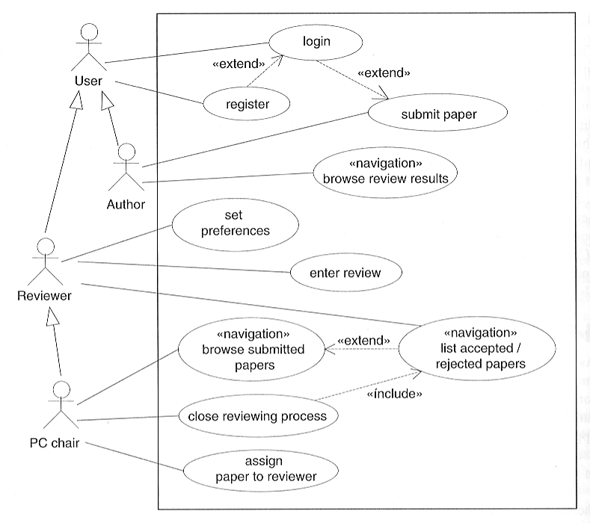
1.1 Class diagram…
Use-case diagram : Conference Paper Submission System
Source: Web Engineering – Kappel et al.

Slide 16
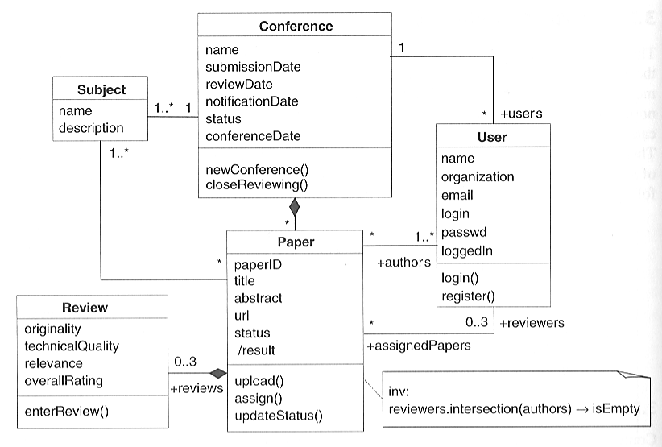
1.1 Class diagram…
Conference Paper Submission System
Source: Web Engineering – Kappel et al.

Slide 17
1.2 State machine diagrams
For dynamic Web applications, they depict important states and events of objects, and how objects behave in response to an event (transitions)
Show the life-cycle of an object
Used only for state-dependent objects

Slide 18
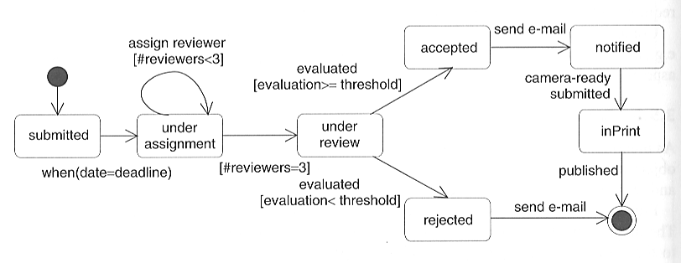
1.2 State machine diagram..
Second state
Fourth state
Third state
First state
Source: Web Engineering – Kappel et al.
Fifth state

Slide 19
2. Navigation Modeling
Models how web-pages are linked together
  defines the structure of the hypertext
    Which classes of the content model can be visited by navigation
  Content to navigation
  http://uwe.pst.ifi.lmu.de/teachingTutorialNavigation.html

Slide 20
2. Navigation Modeling…
UWE navigation modeling
  navigationClass
  menu
  Index
  query
  processClass
  Processlink
  Navigation link
  External link

Slide 21
2. Navigation Modeling
Online video sharing:
Home page
  video list
  search video
  upload video
    register
    login
      upload

Slide 22
2. Navigation modeling…
<<navigationClass>>
Video Sharing
<<processlink>>
<<menu>>
mainMenu
<<navigationlink>>
<<query>>
searchVideo
<<navigationLink>>
<<navigationClass>>
uploadVideo
<<processLink>>
<<index>>
videolist
<<processlink>>
<<processlink>>
<<navigationlink>>
<<processClass>>
register
<<processClass>>
login
<<processClass>>
upload
<<processlink>>

Slide 23
3. Presentation Modeling
Purpose: To model the look & feel of the Web application at the page level
The design should aim for simplicity and self-explanation
Describes presentation structure:
  Composition & design of each page

Slide 24
3. Presentation Modeling…
Levels:
Presentation Page
  page container
Presentation Unit
  A fragment of the page logically defined by grouping related elements

Slide 25
3. Presentation Modeling…
Levels:
Presentation Element
  A unit’s informational components
  Text, images, buttons, fields

Slide 26
3. Presentation Modeling…
<<page>>
User registration page
<<presentationUnit>>
Logo
<<image>>
logo
<<text>>
title
<<presentationUnit>>
<<textinput>>
name
<<textinput>>
email
<<textinput>>
password
<<button>>
submit

Slide 27
Summary
Content modeling
  class diagram
  state machine diagram
Navigation modeling
Presentation modeling

Slide 28
References
Chapter 3, Kappel, G., Proll, B. Reich, S. & Retschitzegger, W. (2006). Web Engineering, Hoboken, NJ: Wiley & Sons
Chapter 5, Sommerville, Software Engineering,
ISBN-10: 0-13-703515-2 , PEARSON
  http://uwe.pst.ifi.lmu.de

