Slide 1
CONNECTIONS: web application

Slide 2
Summary of the previous lecture
Deleting records in MySQL using PHP
Updating records in MySQL using PHP

Slide 3
Outline
User registration (already discussed)
User login (already discussed)
Send Message
Inbox
Out Box
Sign-Out

Slide 4
1. User registration
User registration form:
  Home page
Action page:
  Retrieve user’s input
  Validate input
  Connection with DB
  Insert record into users table

Slide 5
2. User login
User login form:
  Home page
Action page:
  Retrieve user’s input
  Connection with DB
  Select record from users table where user email and password are same as user’s input

Slide 6
2. User login…
If one row is selected then:
  Session variables are registered
    $_SESSION[‘name’];
    $_SESSION[‘email’];
    $_SESSION[‘password’];
  Redirect to user’s page
Redirect to index page with error message

Slide 7
3. Send message
Create a table in connections database as:
  Table Name: messages
  No. of fields: 4
    message_Id int 5
    s_Email varchar 50
    r_Email varchar 50
    message varchar 500

Slide 8
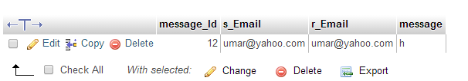
3. Send message…
Table fields

Slide 9
3. Send message…
Form to send message:
  Receiver email: data-list of users
  Message: text-area
  Submit button
Action page:
  Retrieve receiver email and message from post array
  Retrieve sender email from $_SEESION[‘email’]
  Insert data into messages table

Slide 10
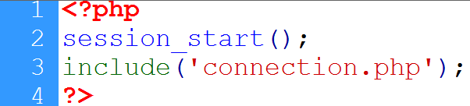
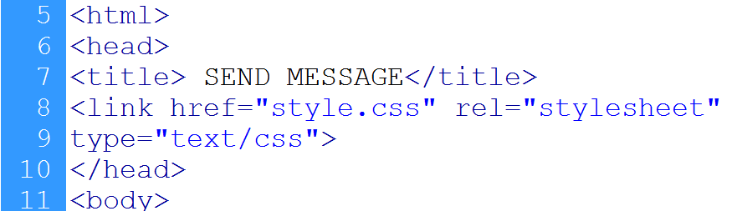
3. Send message…
Session starts
DB connection
HTML page starts

Slide 11
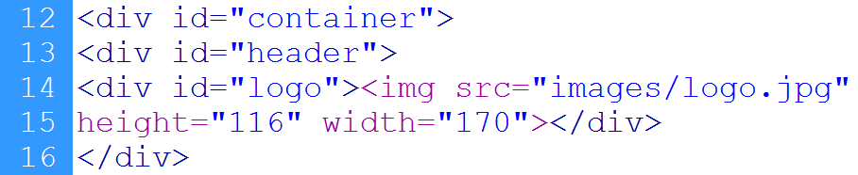
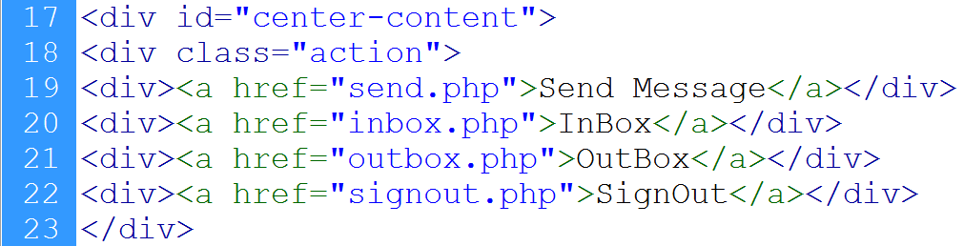
3. Send message…
header
links

Slide 12
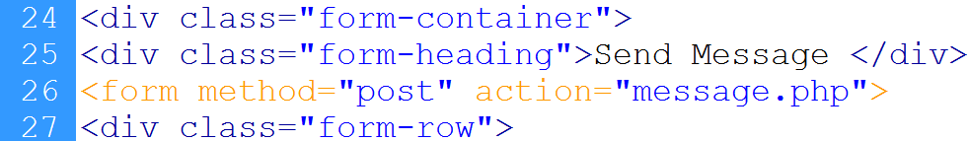
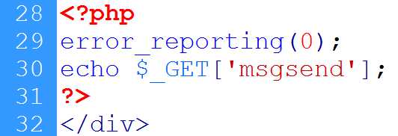
3. Send message…
Form starts
First row shows the message from action page

Slide 13
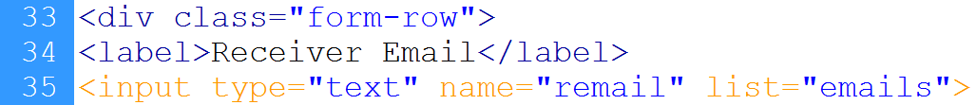
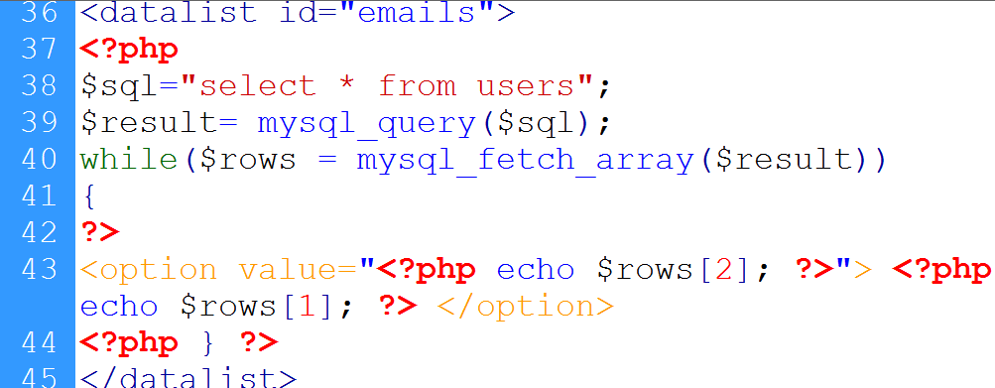
3. Send message…
Input field
List attribute
Datalist starts
Selects users
Loop starts
Sets options
Loop ends
Datalist ends

Slide 14
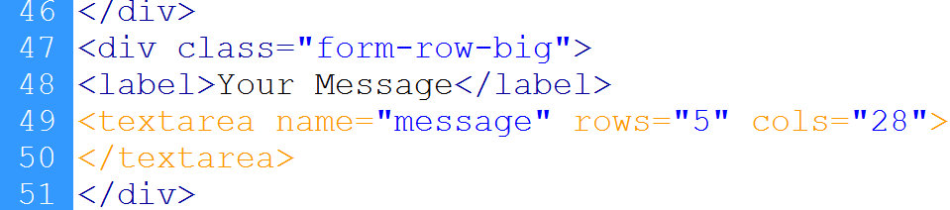
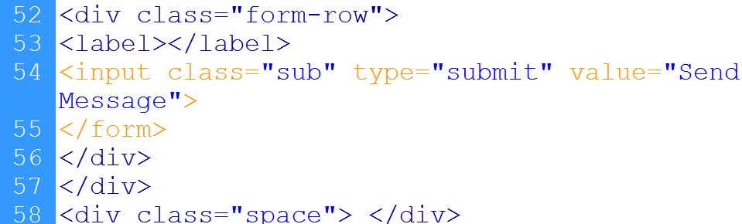
3. Send message…
Textarea for message
Submit button
Form ends

Slide 15
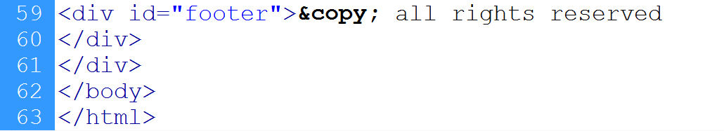
3. Send message…
Footer div

Slide 16
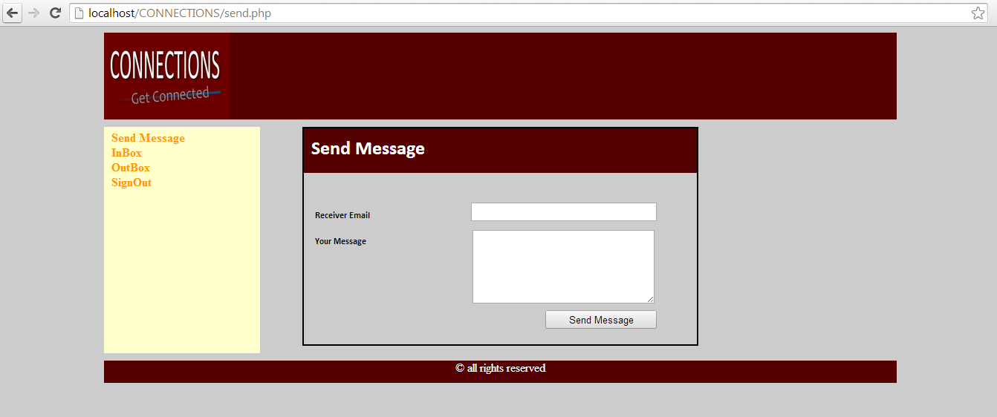
3. Send message…
header
form
actions
footer

Slide 17
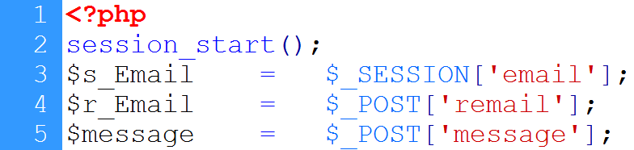
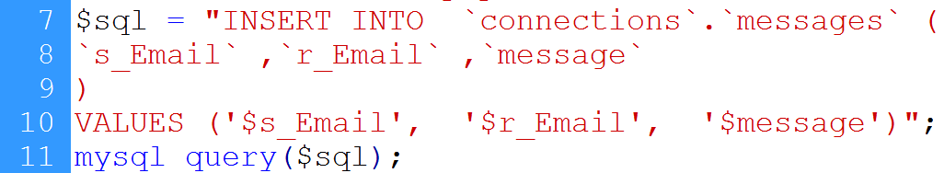
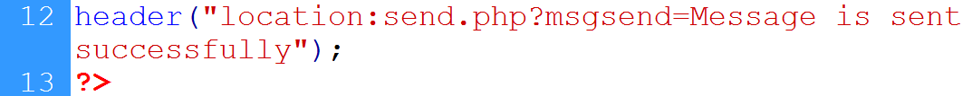
3. Send message…
Session starts
Sender’s email from session
User’s input
DB Connection
Insertion Instruction
Query executed
redirection

Slide 18
4. Inbox page
Session starts
DB connection
Retrieve receiver id from session
Select messages against user’s id
Display structure
Display all messages

Slide 19
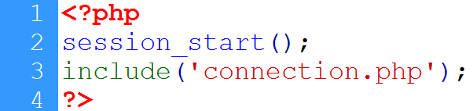
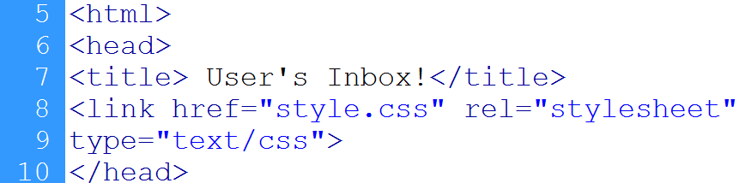
4. Inbox page
Session starts
DB connection
CSS is included

Slide 20
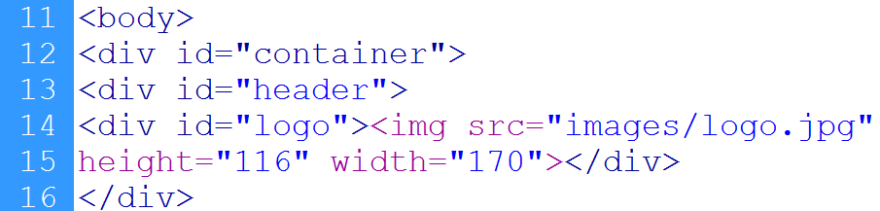
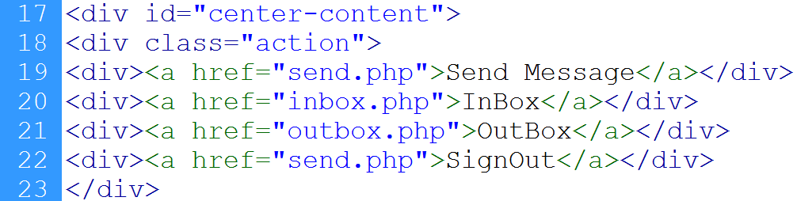
4. Inbox page…
Header and logo
Action box

Slide 21
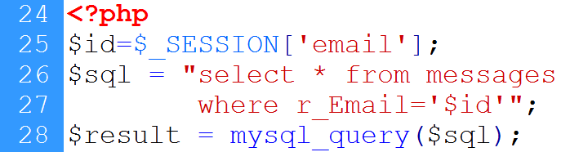
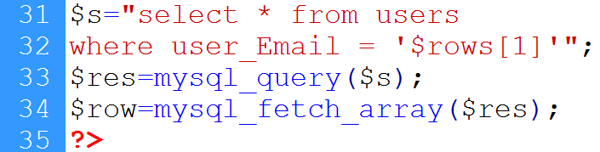
4. Inbox page…
User’s id
Messages received by user
Instruction executed
Message is fetched
Sender’s information

Slide 22
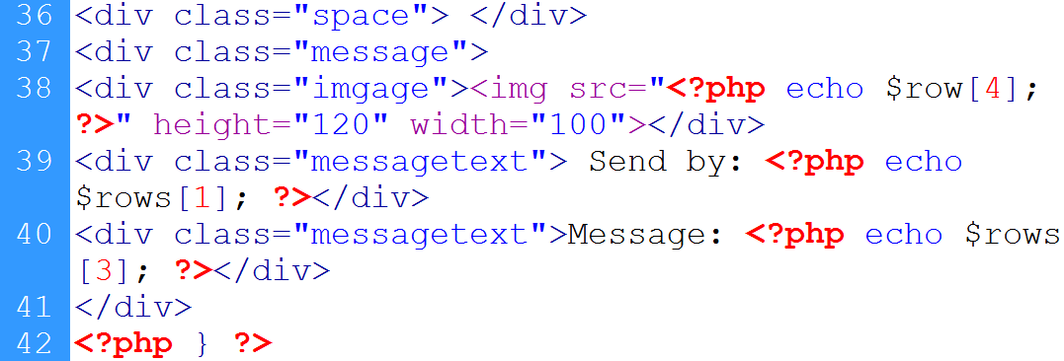
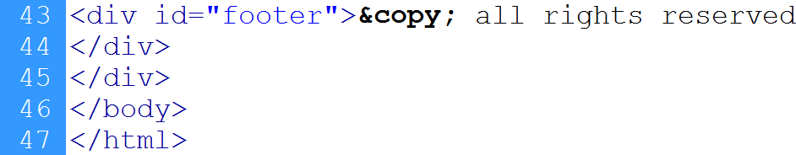
4. Inbox page…
Sender’s picture
Sender’s email
Loop ends
message
Footer

Slide 23
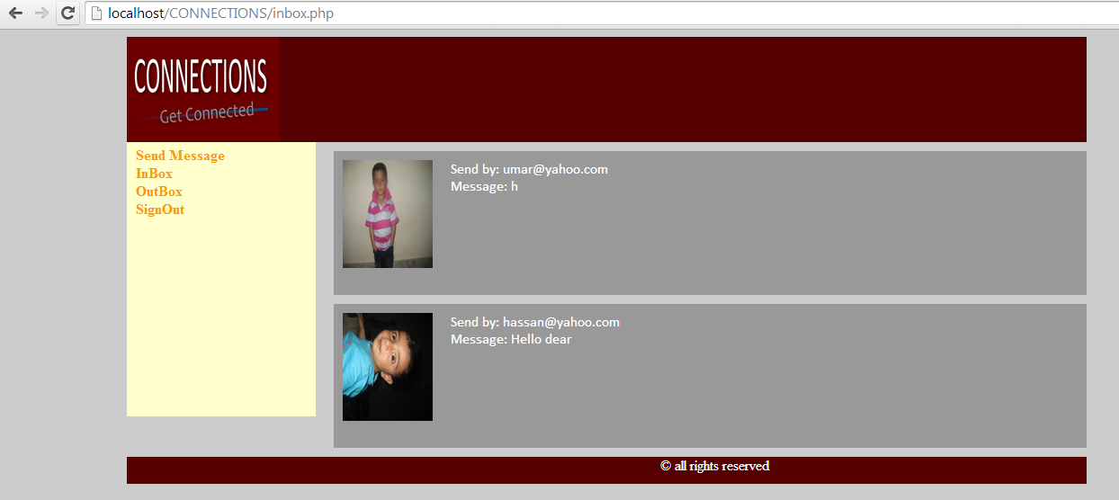
4. Inbox page…
message
Sender pic

Slide 24
5. Outbox page
Session starts
DB connection
Retrieve receiver id from session
Select messages sent against user’s id
Display structure
Display all messages

Slide 25
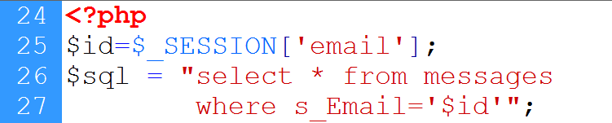
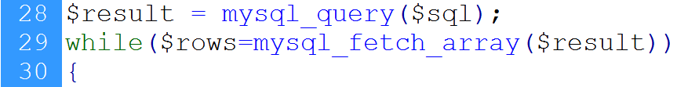
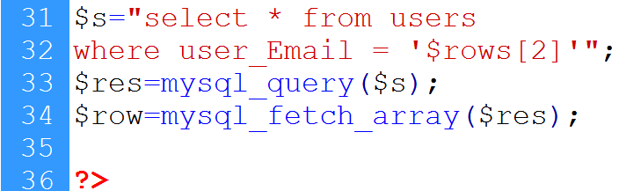
5. Outbox page…
Messages sent by the user
Messages are fetched
Receiver’s info

Slide 26
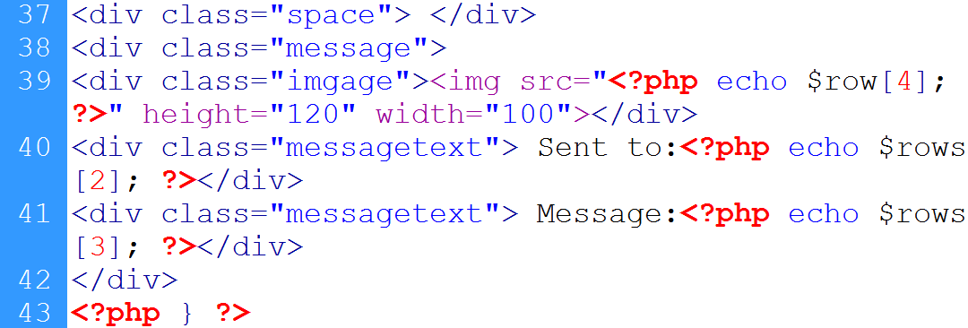
5. Outbox page…
Messages are displayed

Slide 27
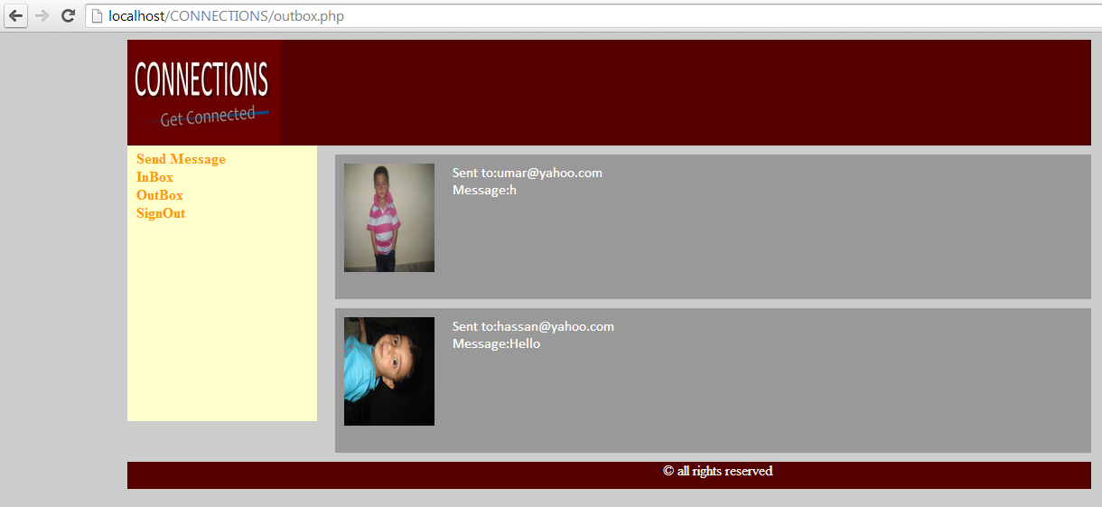
5. Outbox page…

Slide 28
6. Sign-Out
Starts session
Destroy session
Redirect

Slide 29
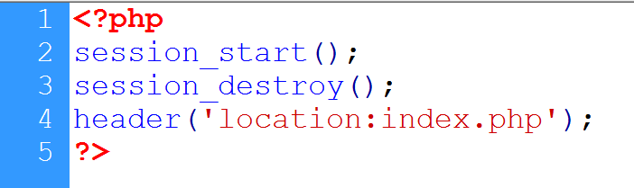
6. Sign-Out…
Session starts
Session destroys
redirection

Slide 30
Summary
User registration (already discussed)
User login (already discussed)
Send Message
Inbox
Out Box
Sign-Out

Slide 31
References
Chapter 30, “Beginning PHP and MySQL” by W. Jason Gilmore, Apress publisher, 4th edition; 2010, ISBN-13 (electronic): 978-1-4302-3115-8.

