Slide 1
Web Project Management

Slide 2
Summary of the previous lecture
Development Process model
  software development process activities
Requirement for a web development process model
Rational unified process model (RUP)
  suitability for web application development

Slide 3
Outline
Project management
Project manager: tasks/responsibilities
Traditional vs. web project management

Slide 4
1. Project Management
Project management is the process of planning, organizing, motivating and controlling resources and procedures to develop a software/web project
Is essential part of software/web engineering
Projects need to be managed
  to ensure budget and time constraints

Slide 5
1. Project Management…
Project manager’s job is to ensure
  project meets budget and timing constraints
  high quality product is delivered
Good management does not guarantee the project success
Bad management usually results in project failure
  schedule delays
  budget overrun
  low customer’s acceptance

Slide 6
1. Project Management…
Project management goals are
  deliver software on time
  meet budget constraints
  fulfill customer’s expectation
  maintain a happy and well-functioning team

Slide 7
2. Project Manager’s tasks
Project planning
Risk management
People management
Reporting
Proposal writing

Slide 8
2. Project Manager’s tasks…
Project planning:
Project managers are responsible for
  cost estimation
  project scheduling
  resource allocation
Monitoring
  work is carried out according to standards
  progress is according to budget and schedule

Slide 9
2. Project Manager’s tasks…
Project planning:
At proposal stage:
  are resources available to complete the project
  what price to ask (effort, s/w,h/w, travelling)
At startup stage:
  who will work
  decide about the increments and allocate resources
  refine estimates as more information is available

Slide 10
2. Project Manager’s tasks…
Project planning:
During development process:
  when project plan needs to be changed
  can make more accurate estimates about time and cost

Slide 11
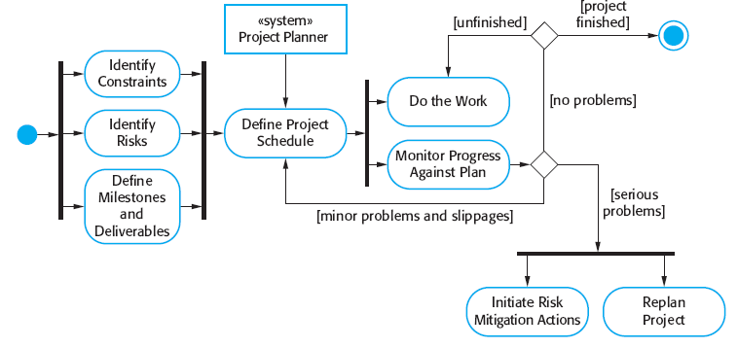
2. Project Manager’s tasks…
Project planning:
Source: ‘software engineering’ by Sommerville

Slide 12
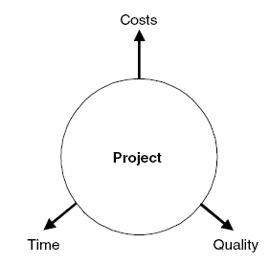
2. Project Manager’s tasks…
Conflicting areas:
Project requires to have a well balanced between budget, time and quality
  change in one can influence others
time
quality
cost
Source: Web Engineering – Kappel et al.

Slide 13
2. Project Manager’s tasks…
Risk management:
Project managers are responsible for
  anticipation of risks
    can affect schedule or quality
  taking actions to avoid these risks

Slide 14
2. Project Manager’s tasks…
Risk management:
Risk categories:
Project risks: affect the project schedule or resources
  experienced developer leaves the job
Product risks: affect the quality and performance of the product
  a purchased component does not work as expected

Slide 15
2. Project Manager’s tasks…
Risk management:
Risk categories:
Business risks: affect the organization developing or procuring the product
  a competitor introduced a new product

Slide 16
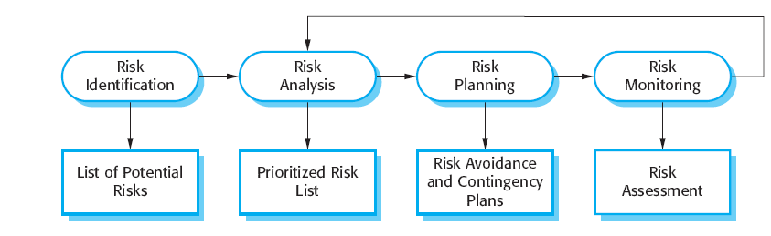
2. Project Manager’s tasks…
Risk management:
Source: ‘software engineering’ by Sommerville

Slide 17
2. Project Manager’s tasks…
People management:
Project managers responsible for
  choosing people
  establishing ways of working
Characteristics of web development team
  multidisciplinary: experts from diverse fields
  Parallelism: parallel work on large task
  Small size: due to budget constraints/short development cycles

Slide 18
2. Project Manager’s tasks…
People management:
PM solves conflicts if members are working as group
  must be solved early to meet time constraints
  due to short development time, even suboptimal solution is acceptable

Slide 19
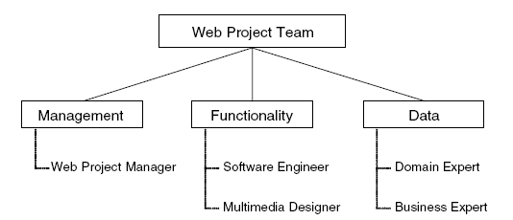
2. Project Manager’s tasks…
People management:
Web team composition
roles
people
Source: Web Engineering – Kappel et al.

Slide 20
2. Project Manager’s tasks…
Reporting:
Project mangers are responsible for reporting
  on progress of a project to customers and managers of the company
Proposal writing:
write proposal to win a project
  critical task

Slide 21
2. Project Manager’s tasks…
Golden rules for Web project managers:
Take care of ethics in the team
Stress the importance of different application knowledge for the project
Solve conflicts quickly. Make sure no team member is a winner or a loser all the time
Explain to each team member his or her roles and responsibilities continuously
Identify parallel developments

Slide 22
2. Project Manager’s tasks…
Golden rules for Web project managers:
Distribute documentation tasks to team members fairly according to their scope
Promote and coordinate the continuous use of tools from the very beginning of the project
Translate costs and values into different project areas
Promote the continuous involvement of the customer in the project
Always keep an eye on the project progress and the project objective

Slide 23
3. Traditional vs. web project management
Main objective:
  Create a quality product at lowest possible cost!
  Create a usable product in shortest possible time!
Project size:
  Medium to large (10 to 100 people and more)
  Usually small (6 +/− 3 people)
Duration:
  12 to 18 months on average
  3 to 6 months on average

Slide 24
3. Traditional vs. web project management
Cost
  several million dollars
  several thousand dollars
Development approach
  based on requirements; structured into phases; incremental; documentation-driven
  Agile methods
Technologies
  OO methods
  web technologies

Slide 25
3. Traditional vs. web project management
Product
  Code-based; poor reusability; complex applications
  High reusability; standard components; many standard applications
Staff profile
  Professional software developers with several years of experience
  Multimedia designers; Web programmers (Java, etc.); PR/marketing people

Slide 26
Summary
Project management
Responsibilities/tasks of a Project manager
  Planning
  Risk management
  People management
  Reporting
  Proposal writing
Traditional vs. web engineering

Slide 27
References
Chapter 9, Kappel, G., Proll, B. Reich, S. & Retschitzegger, W. (2006). Web Engineering, Hoboken, NJ: Wiley & Sons
Chapter 22, Sommerville, Software Engineering,
ISBN-10: 0-13-703515-2 , PEARSON

