Slide 1
Introduction to PHP (Part-2)

Slide 2
Summary of the previous lecture
Setting the environment
Overview of PHP
Constants and Variables in PHP

Slide 3
Outline
Operators in PHP
Conditional Statements in PHP
Looping Statements
Arrays in PHP

Slide 4
1. Operators in PHP
Arithmetic Operators:
  +, - ,*, /, %
Assignment Operators:
  =
  += ($a +=$b ), *= , /=
  .= ($a .= $b)

Slide 5
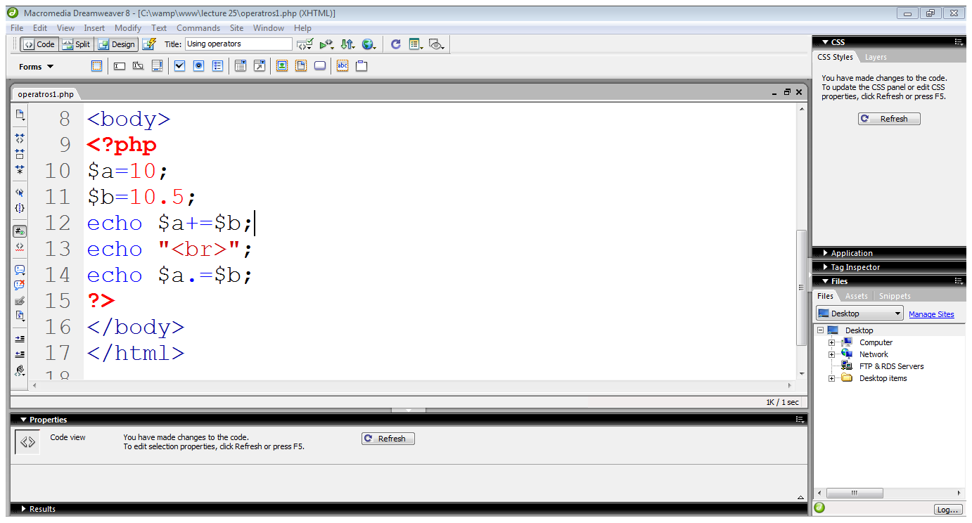
1. Operators in PHP…
Adds $b in $a
Concatenates $b with $a

Slide 6
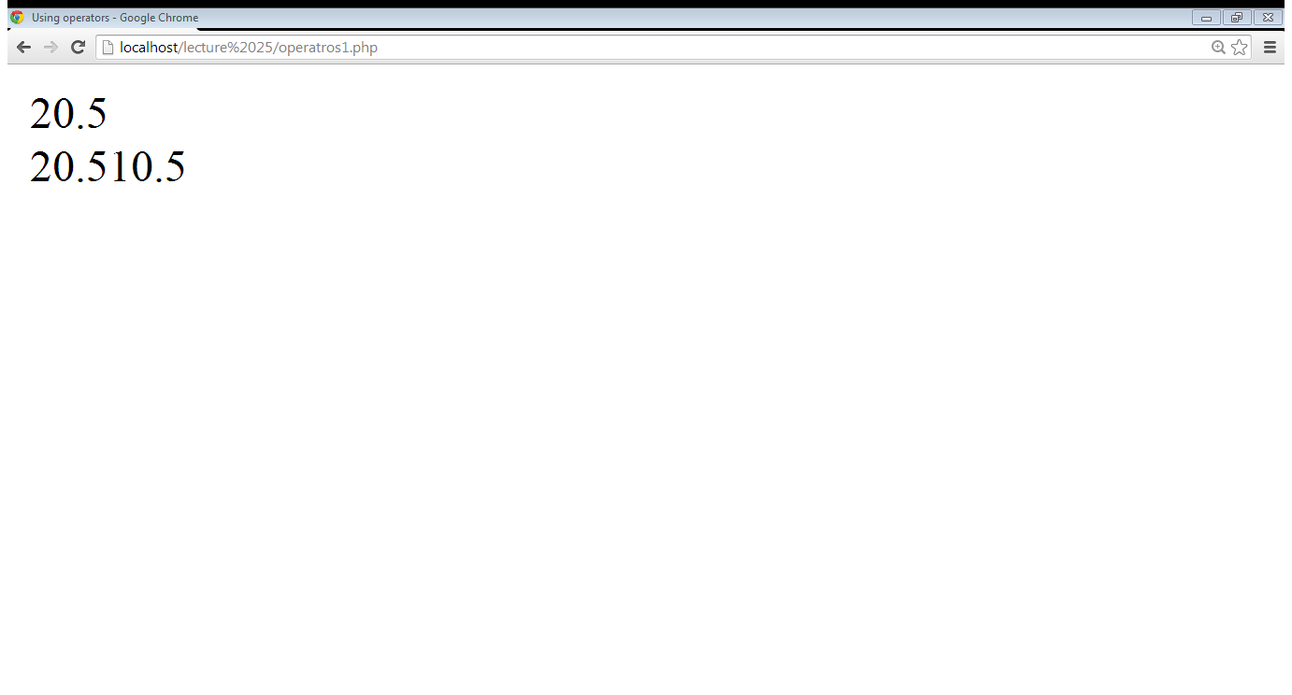
1. Operators in PHP…

Slide 7
1. Operators in PHP…
String Operators:
  . , .=
  $a=“abcd”.”efgh”; $a=abcdefgh
  $a.=“ijk”; $a=abcdefghijk
Increment/decrement Operators:
  ++,--
  $b=$a++
  $b=++$a

Slide 8
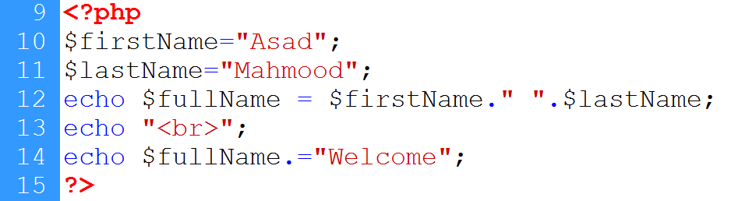
1. Operators in PHP…
First variable
Second variable
Concatenation
Using .=

Slide 9
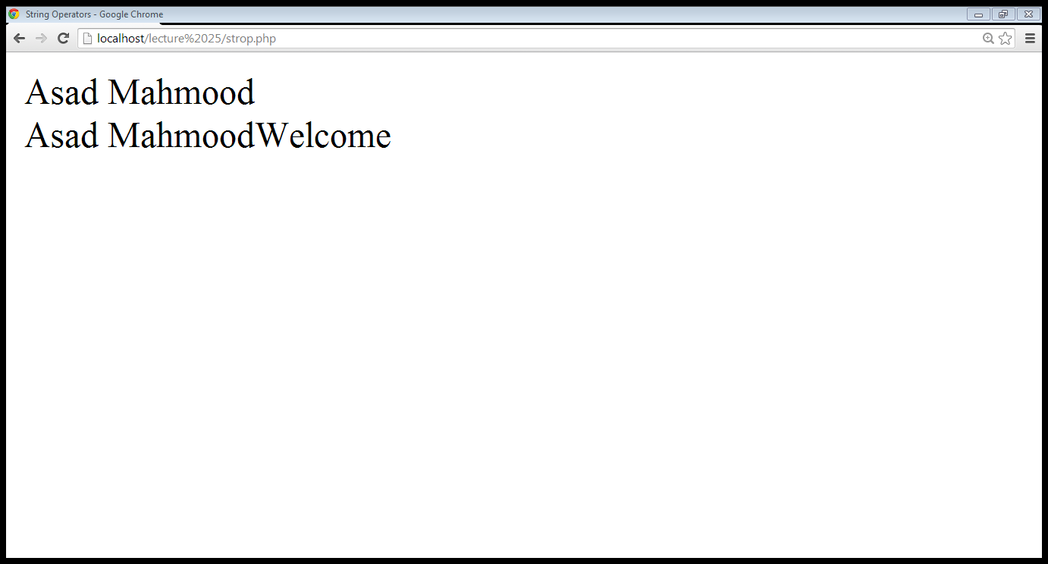
1. Operators in PHP…

Slide 10
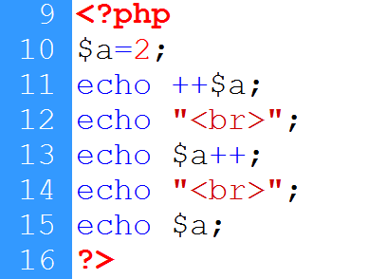
1. Operators in PHP…
Variable declared
Incremented before display
Incremented after display
Displaying incremented value

Slide 11
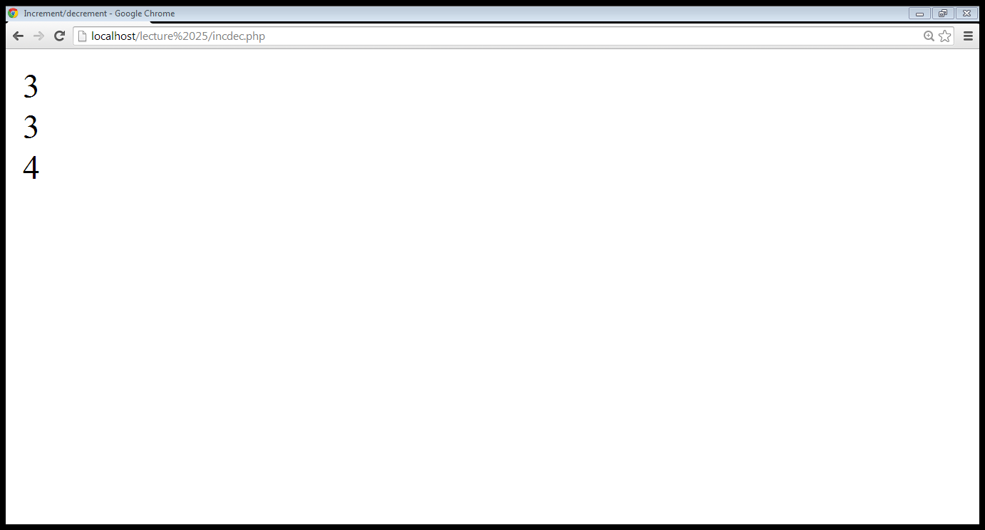
1. Operators in PHP…

Slide 12
1. Operators in PHP…
Logical Operators:
  AND, OR, NOT, XOR
  &&, ||, !
Equality Operators:
  ==, !=, ===
Comparison Operators:
  >, <, <=, >=

Slide 13
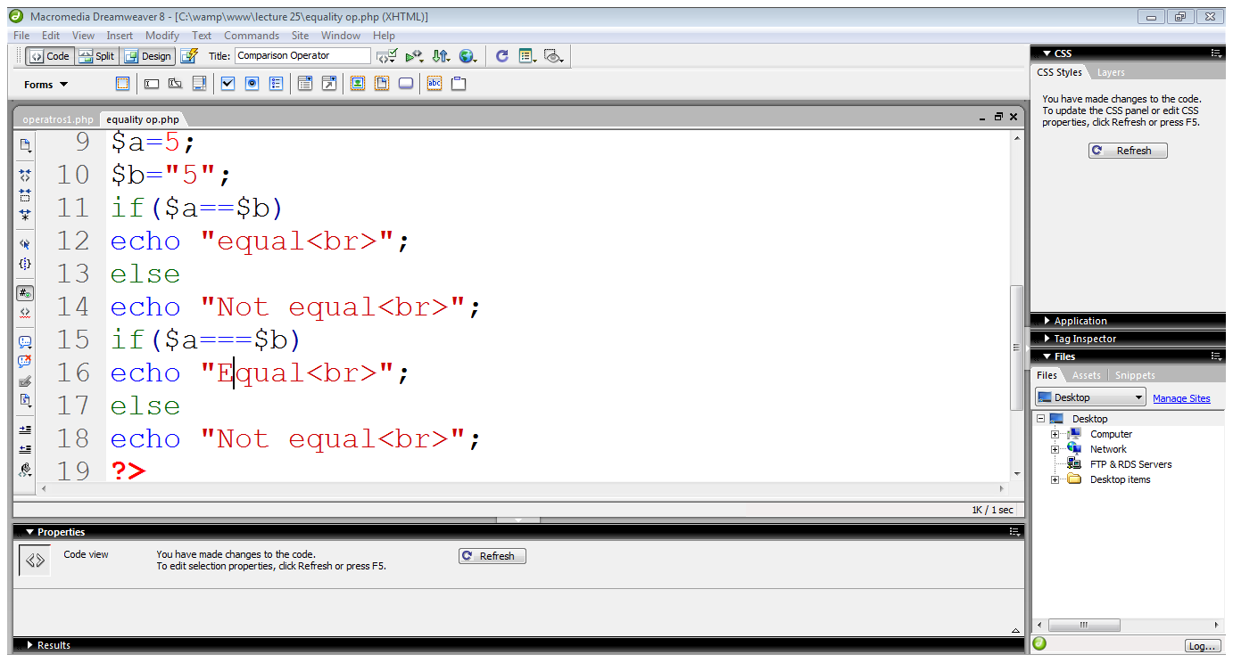
1. Operators in PHP…
Integer value
String value
Compares only values
Strict comparison

Slide 14
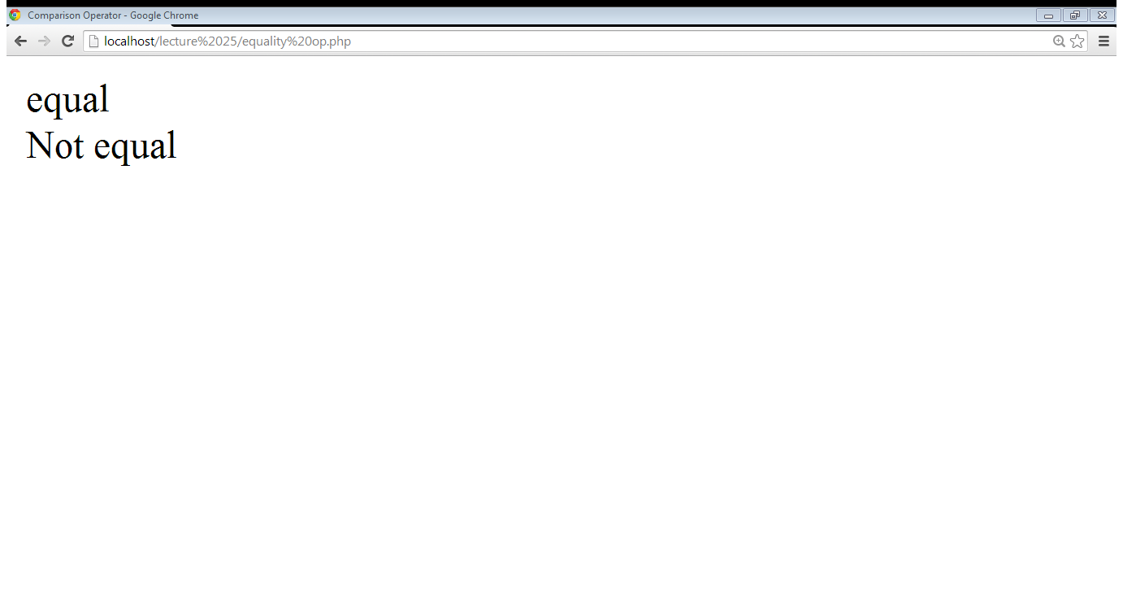
1. Operators in PHP…

Slide 15
2. Conditional Statements
if statement:
    if(condition)
    {
    }
if-else statement:
    if(condition)
    { }
    else
    { }

Slide 16
2. Conditional Statements…
switch statement:
    switch(variable)
    {
    case option:
    action
    break;
    .
    .
    }

Slide 17
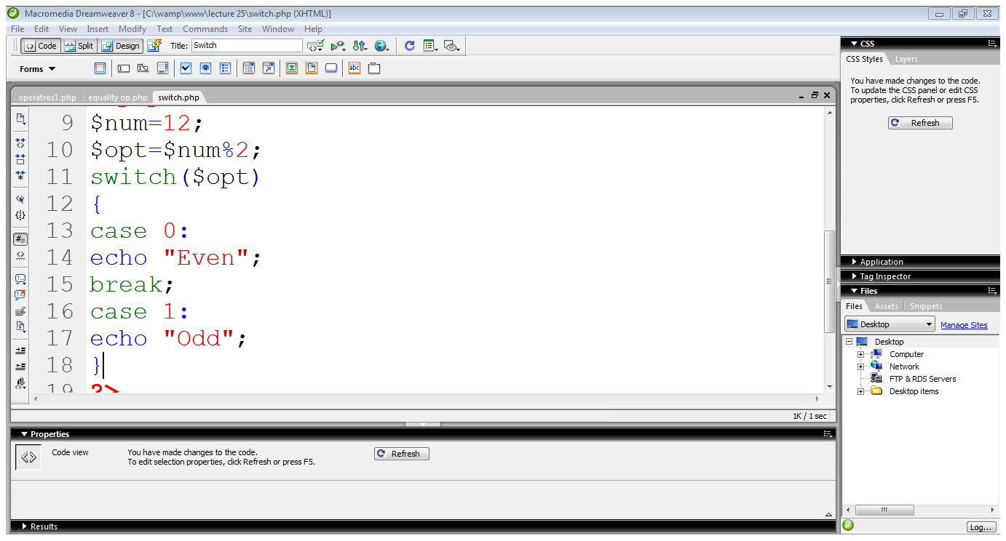
2. Conditional Statements…
Switch starts
case 0
Case 1

Slide 18
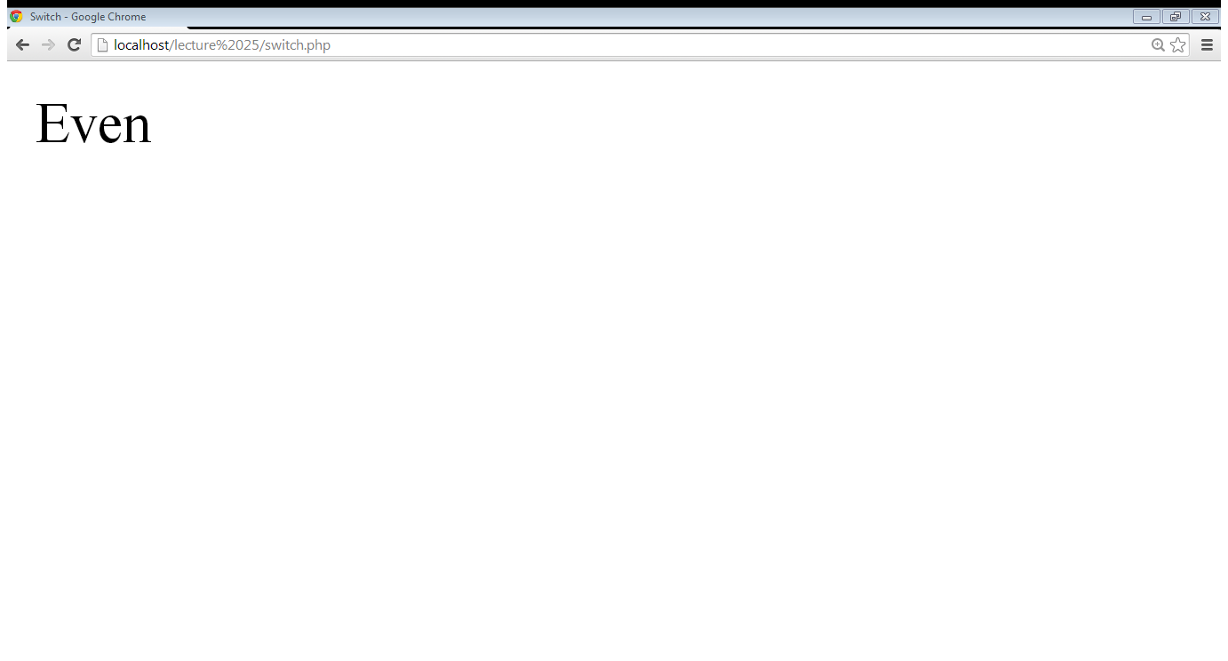
2. Conditional Statements…

Slide 19
3. Looping Statements
for loop
while loop
do-while loop
foreach loop

Slide 20
3. Looping Statements
for loop
  for($a=0; $a<10; $a++)
  {
  statements
  }
while loop
  while(condition)
  {
  Statements
  Increment/decrement
  }

Slide 21
3. Looping Statements…
do-while loop
  do
  {
  Statements
  Increment/decrement
  }
  While(condition)
foreach loop
  is used to read an entire array

Slide 22
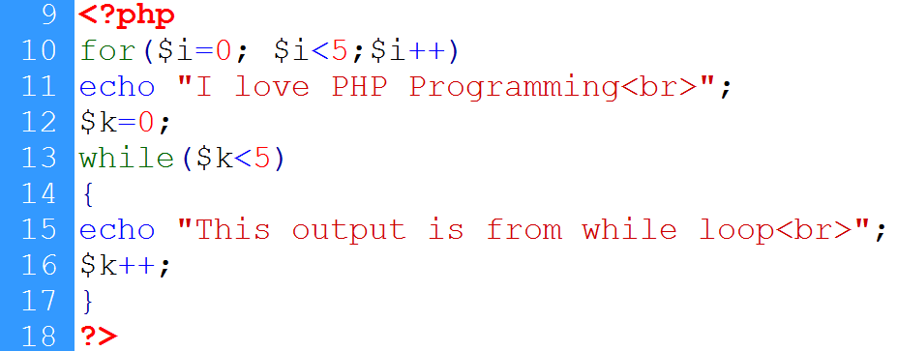
3. Looping Statements…
For loop
While loop

Slide 23
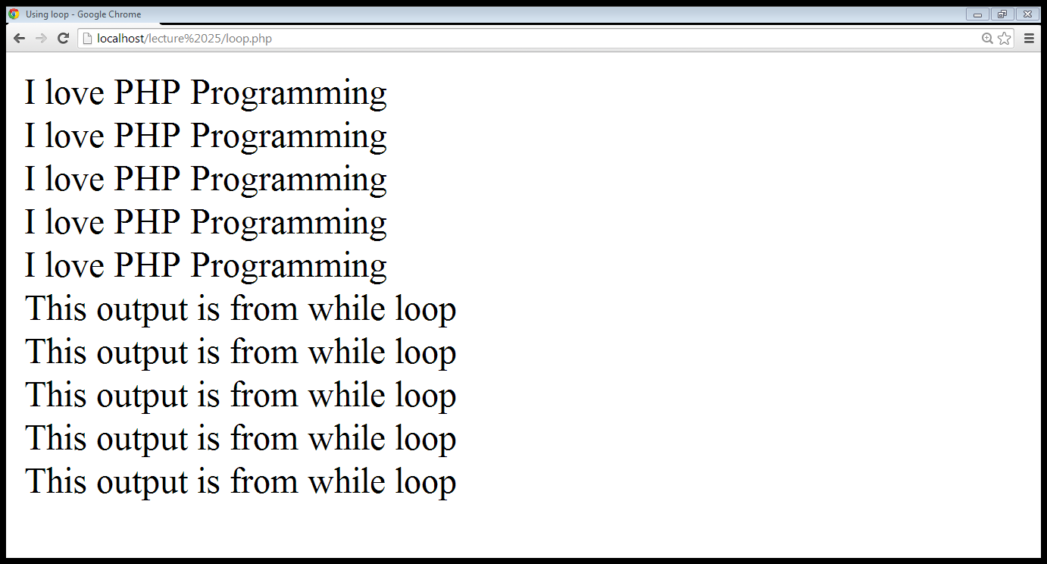
3. Looping Statements…
Output from for loop
Output from while loop

Slide 24
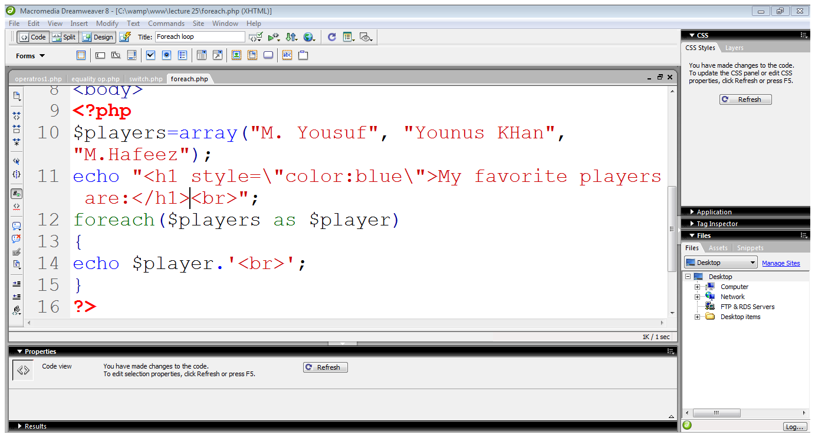
3. Looping Statements…
Array is declared
Foreach loop starts
Using obtained value

Slide 25
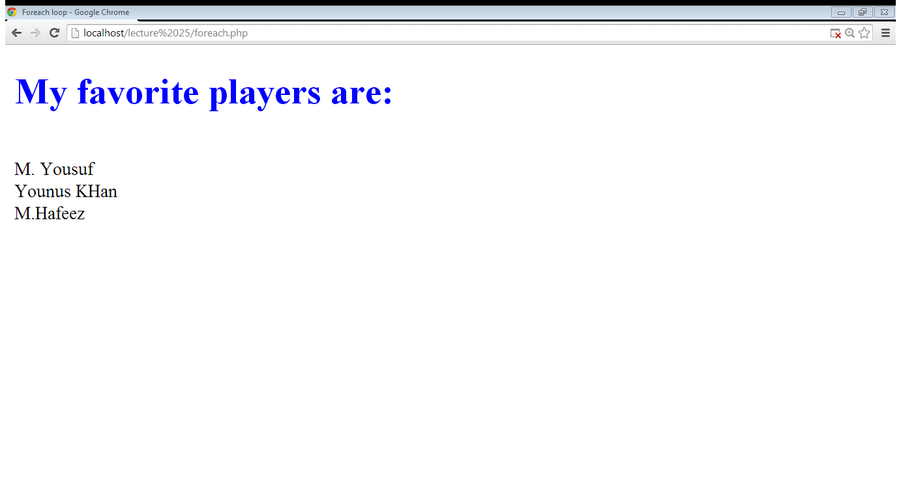
3. Looping Statements…

Slide 26
4. Arrays in PHP
An array is traditionally defined as a group of items that share certain characteristics
Each item consists of two components:
  the key and a value
PHP doesn’t require that you assign a size to an array at creation time
Declaring an array:
  $array-name[key]=value

Slide 27
4. Arrays in PHP…
Declaring an array:
  $array-name[key]=value
  $players[0]=“Muhammad Yousuf”;
Adding element in an array:
  $players[1]=“Younus Khan”;
Accessing element in an array
  echo $players[0];

Slide 28
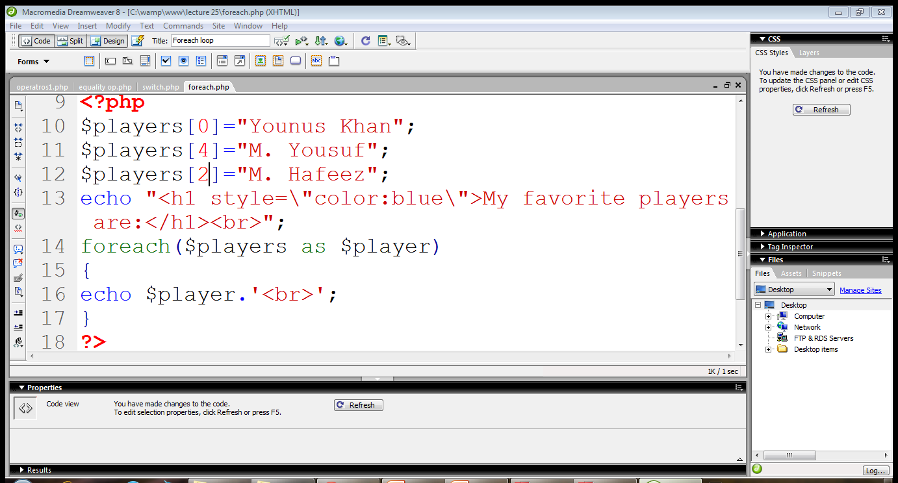
4. Arrays in PHP…
Declaring array
Adding elements
Foreach loop

Slide 29

4. Arrays in PHP…

Slide 30
4. Arrays in PHP…
Associative arrays:
  $array-name[‘element-name’]=value
  $players[‘yousuf’]=“Muhammad Yousuf”;
Adding element in an array:
  $players[‘younus’]=“Younus Khan”;
Accessing element in an array:
  echo $players[‘yousuf’];

Slide 31
4. Arrays in PHP…
The array(); can also be used to create an array
  $array_name=array(item_1,item_2,…item_n);
  $players=array(“M.Yoursuf”,”Imran Khan”);
  $players=array(“Yousuf”=>“M.Yoursuf”,”imran”=>”Imran Khan”);

Slide 32
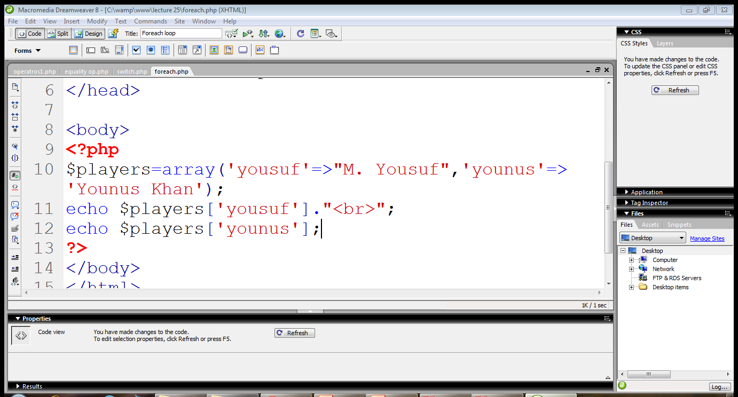
4. Arrays in PHP…
Associative array is created using array()
Accessing elements by name

Slide 33
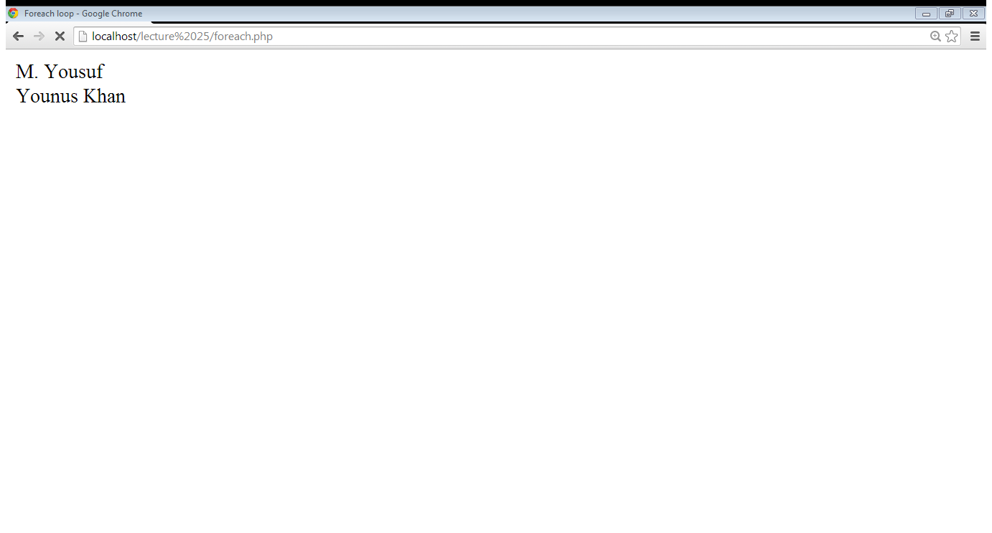
4. Arrays in PHP…

Slide 34
4. Arrays in PHP…
Sorting arrays:
  sort()
  rsort()

Slide 35
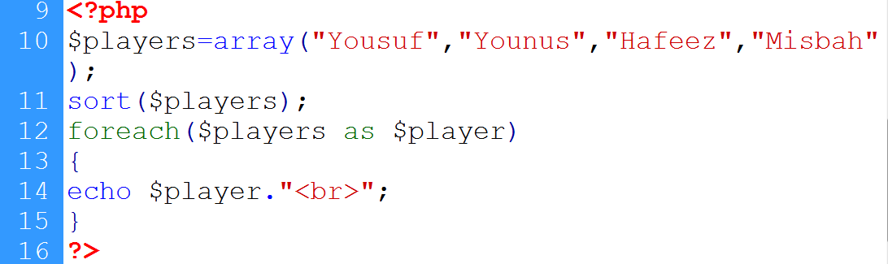
4. Arrays in PHP…
Array is created
Array is sorted
Array is displayed

Slide 36
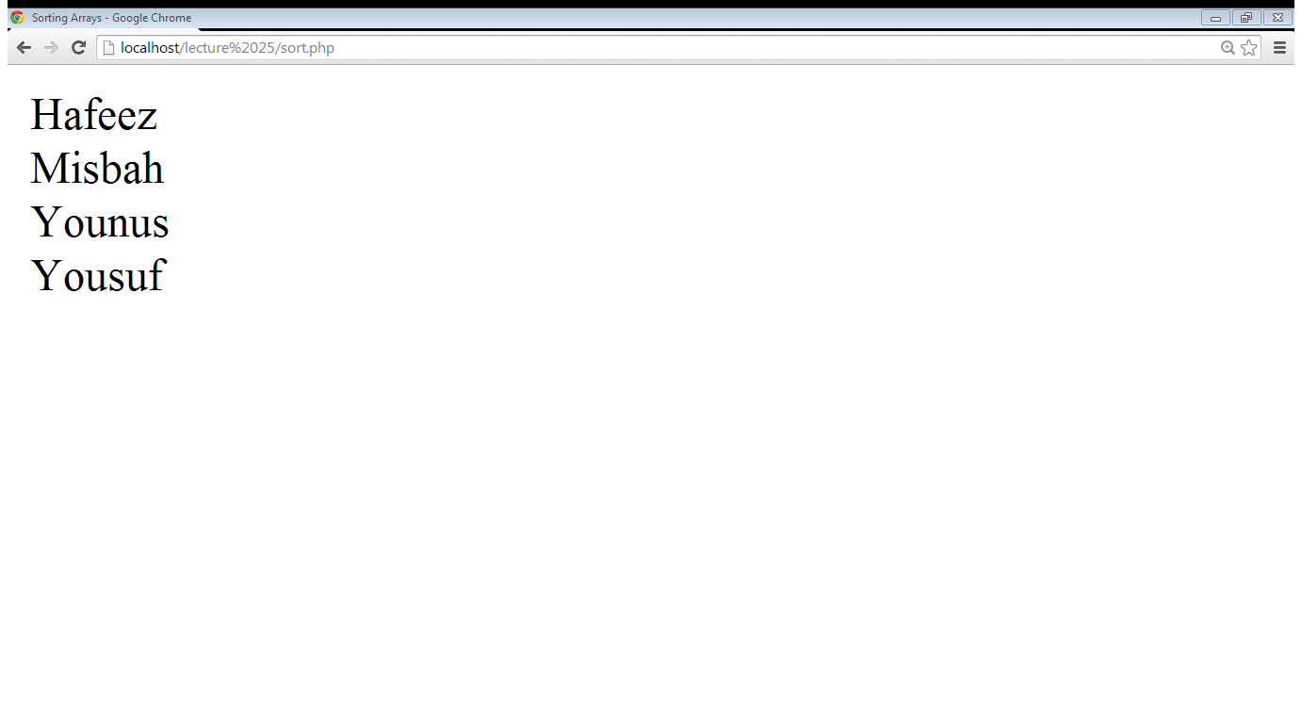
4. Arrays in PHP…

Slide 37
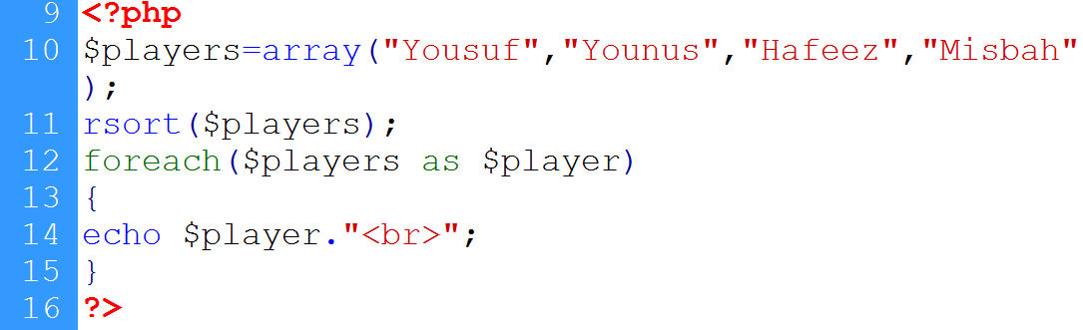
4. Arrays in PHP…
rsort() is used

Slide 38
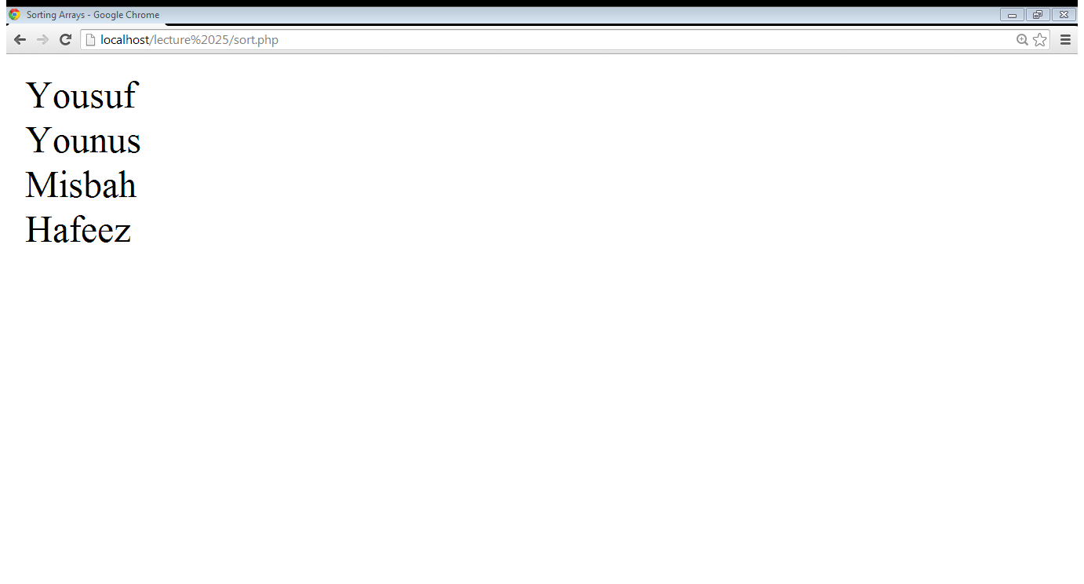
4. Arrays in PHP…

Slide 39
Summary
Operators in PHP
Conditional statements
Looping statements
Arrays in PHP

Slide 40
References
Chapter 2, “Beginning PHP6,Apache,Mysql web development” by Matt Doyle, Wrox publishers, 2009, ISBN: 0470413964
Chapter 5, “Beginning PHP and MySQL” by W. Jason Gilmore, Apress publisher, 4th edition; 2010, ISBN-13 (electronic): 978-1-4302-3115-8.

