Slide 1
Introduction to PHP (Part-1)

Slide 2
Outline
Setting the environment
Overview of PHP
Constants and Variables in PHP

Slide 3
1. Setting the environment
A web server
PHP
MySql
http://www.wampserver.com/en/
Editor
  Macromedia Dreamweaver /Adobe Dreamweaver
WAMP Server

Slide 4

1. Setting the environment ….
Checking WAMP status:
MSVCR100.dll is missing
  Install Microsoft Visual C++ 2010 SP1 Redistributable Package
Port conflict with skype
WAMP is working properly

Slide 5
2. PHP: an Overview
PHP: Hypertext Preprocessor
Originally called “Personal Home Page Tools”
Used to create dynamic web pages
Popular server-side scripting technology
Open-source
      Anyone may view, modify and redistribute source code
Platform independent

Slide 6
2. PHP: an Overview…
Interpreted language, scripts are parsed at run-time rather than compiled beforehand
Compatible with many popular databases
Popular server-side scripting technology
Structurally similar to C/C++
Supports procedural and object-oriented paradigm

Slide 7
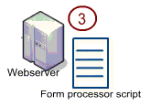

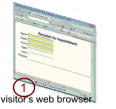
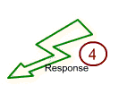
2. PHP: an Overview…

Slide 8
2.1 How PHP Fits with HTML
Embedding PHP in HTML code
HTML can also be written inside the PHP code
PHP can also be written as a standalone program with no HTML at all

Slide 9
2.2 Basic Rules of PHP syntax
PHP code is denoted in the page with opening and closing tags, as follows:
      <?php and ?>
      <? or ?>
      <script language=“PHP”>…… </script>
PHP statements end with a semicolon
Comments can be added as
  // for one line comment
  /* and */ for multiple lines comment

Slide 10
2.3 Writing and executing PHP code
Open a notepad or dreamweaver file
Write PHP code
Save file with .php extension
Save all the files in one directory
Copy this directory in
  C:\wamp\www\

Slide 11
2.3 Writing and executing PHP code…
Start WAMP server
Go to localhost either by typing localhost in address bar of the browser or by clicking the WAMP sever icon in the toolbar and selecting localhost
Select your web directory from the list of project on the WAMP server home page
Select the file to execute

Slide 12
2.4 Writing output to the browser
echo(): is used to write output on the browser
  echo(“Welcome to PHP”);
  echo “Welcome to PHP”;
print(): can also be used to write out put on the browser
  print(“Welcome to PHP”);
  print “Welcome to PHP”;
printf(): can also be used for writing output

Slide 13
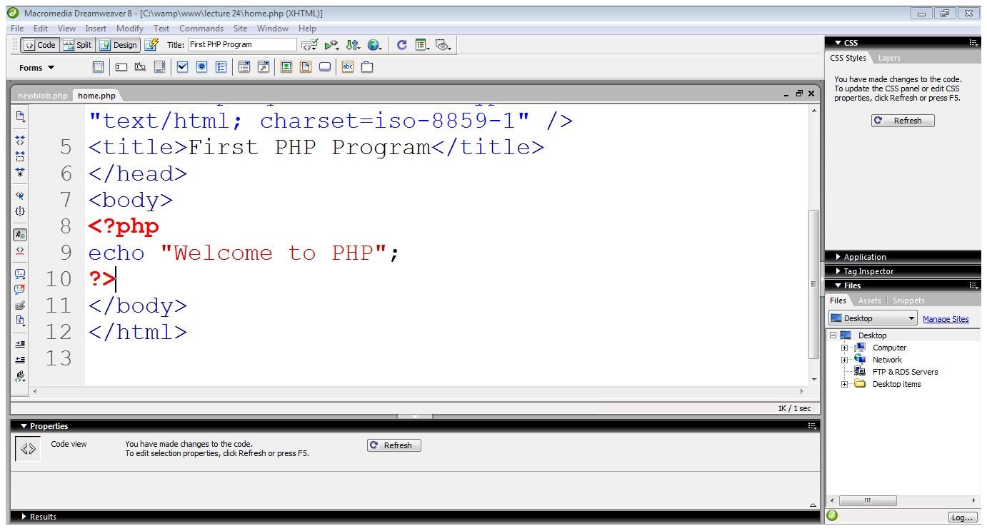
2.5 First PHP program
PHP block starts
Writing on browser
Ending PHP block

Slide 14
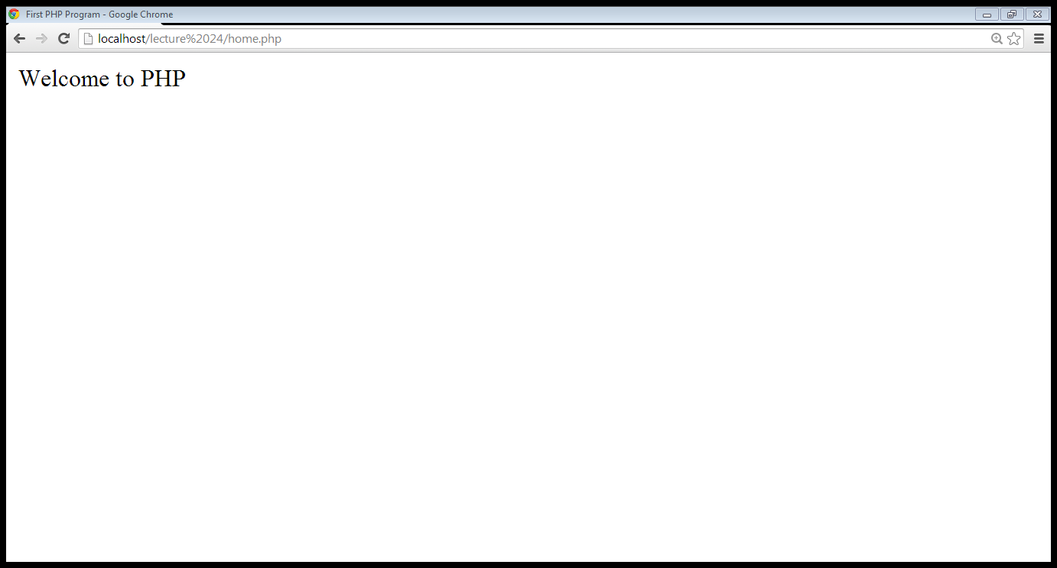
2.5 First PHP program…
Out put from the PHP code

Slide 15
2.6 Integrating HTML with PHP
echo statement outputs whatever it’s told to the browser
It can output not only plain text but also HTML tags
  echo “<h1> Welcome to the PHP</h1>”;

Slide 16
2.6 Integrating HTML with PHP…
Using quotation marks:
  echo “<h1 style=“color:red”> Welcome to PHP</h1>”;
  echo “<h1 style=‘color:red’> Welcome to PHP</h1>”;
  echo “<h1 style=\“color:red\”> Welcome to PHP</h1>”;

Slide 17
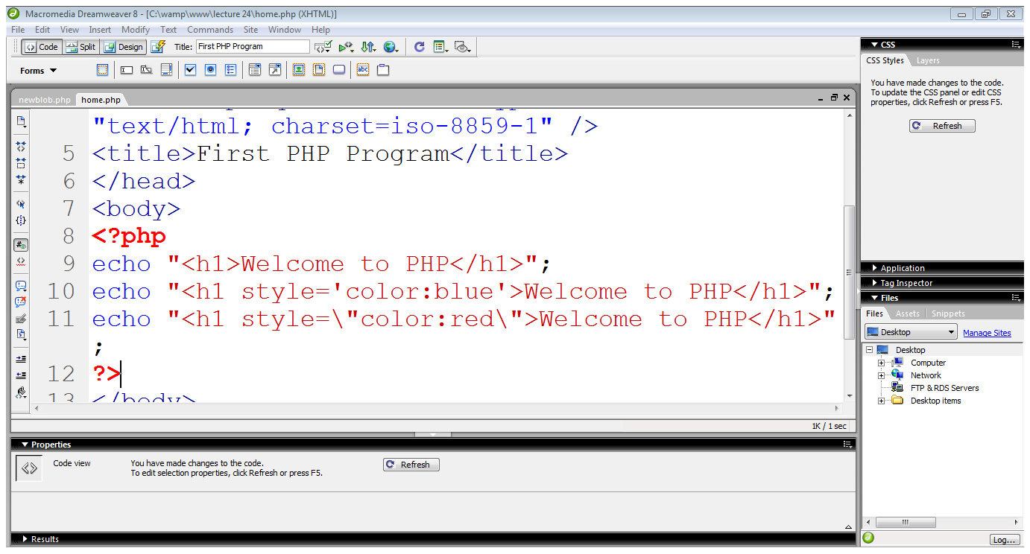
2.6 Integrating HTML with PHP…
Using heading
Arranging quotations
Using escape character

Slide 18
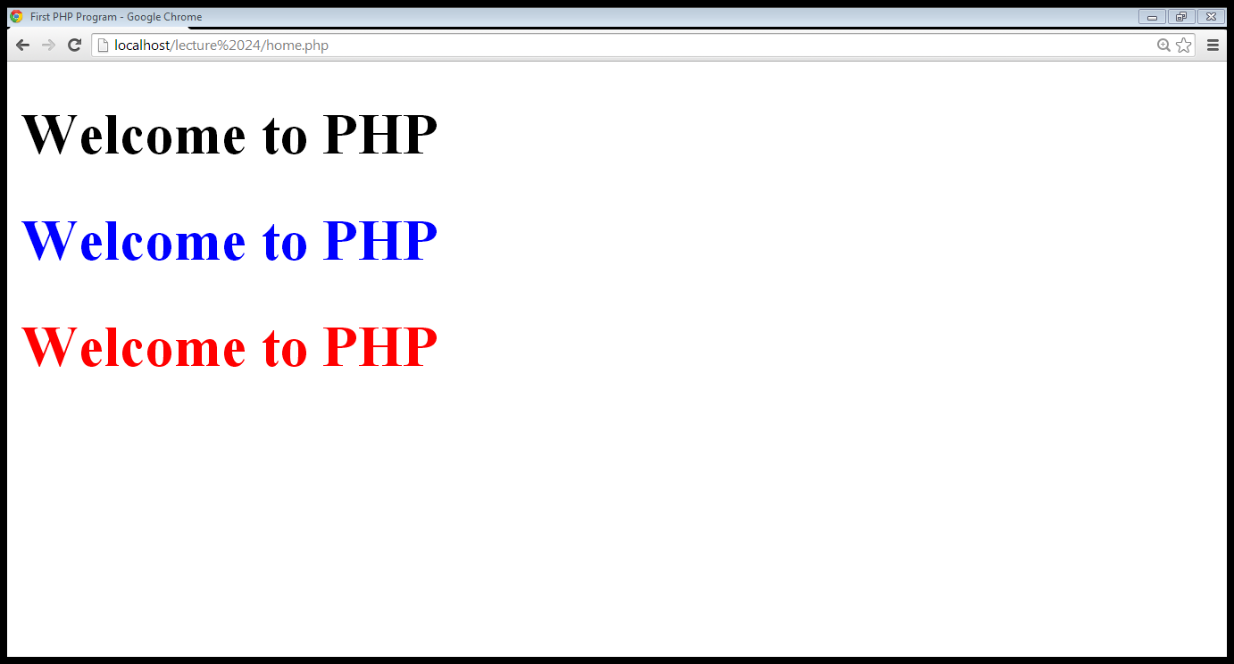
2.6 Integrating HTML with PHP…

Slide 19
3. Using CONSTANS and Variables

Slide 20
3.1 CONSTANTS
A constant is a placeholder for a value that you reference within your code that is formally defined before using it
must begin with a letter or an underscore
are case sensitive
typically they are named using all capital letters
PHP function define() is used to assign a value to a constant

Slide 21
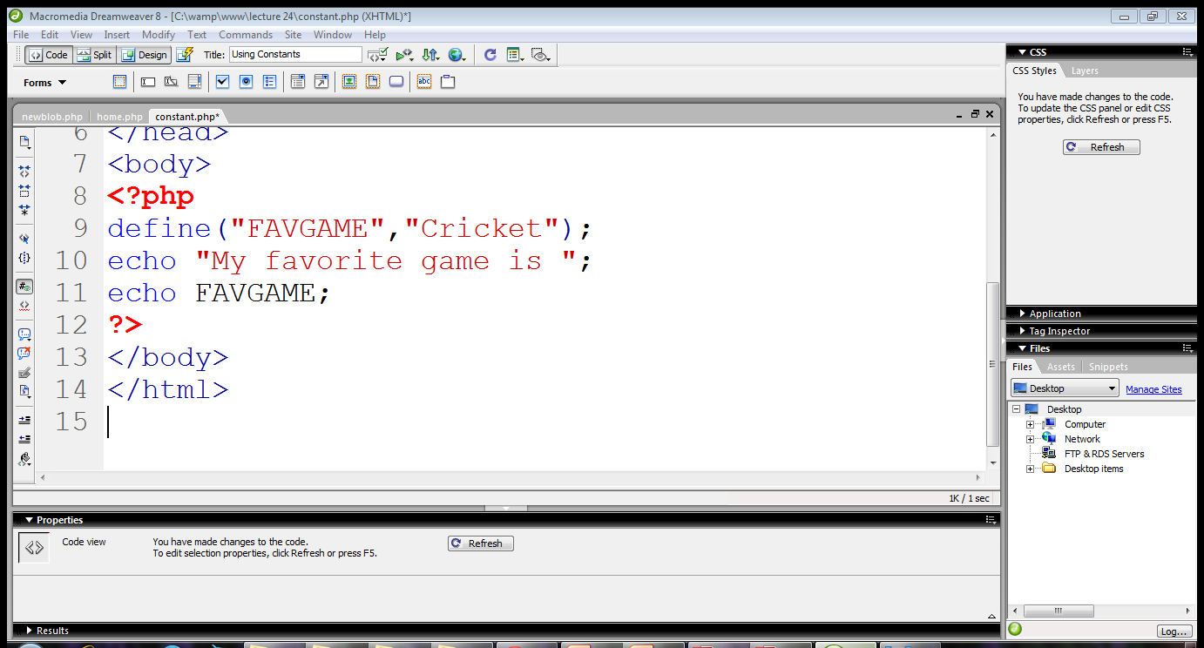
3.1 CONSTANTS…
Constant name
Value of constant
Displaying the value

Slide 22
3.2 Variables
Begin with $ sign
First character must be a letter or underscore
Remaining characters may be letters, numbers or underscores
Don’t need to declare or initialize
Case sensitive
Data types does not require to be declare explicitly
Supports
  Float, integer, boolean, string, array, object

Slide 23

3.2 Variables…
Variable declared
Initial value
Displaying variable’s value

Slide 24
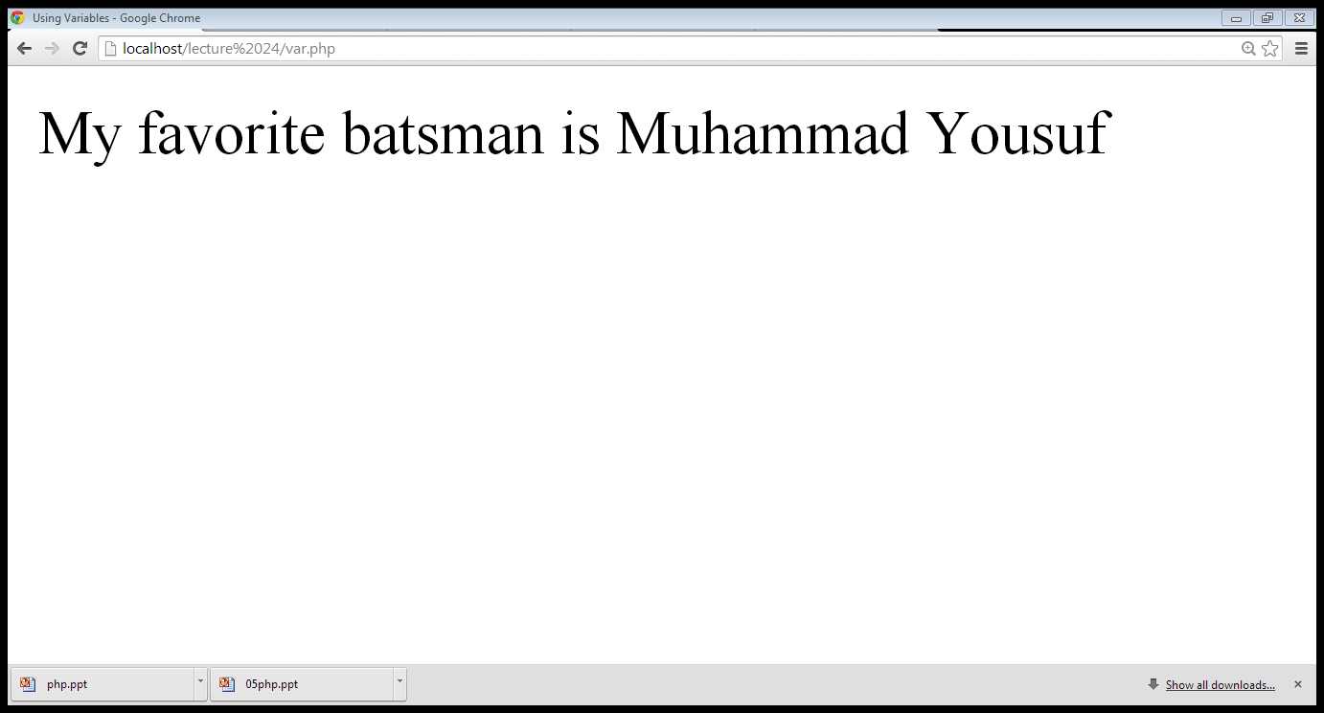
3.2 Variables…

Slide 25
3.2 variables…
The gettype() function returns the type of the provided variable
The settype() function converts a variable to the type specified by type

Slide 26
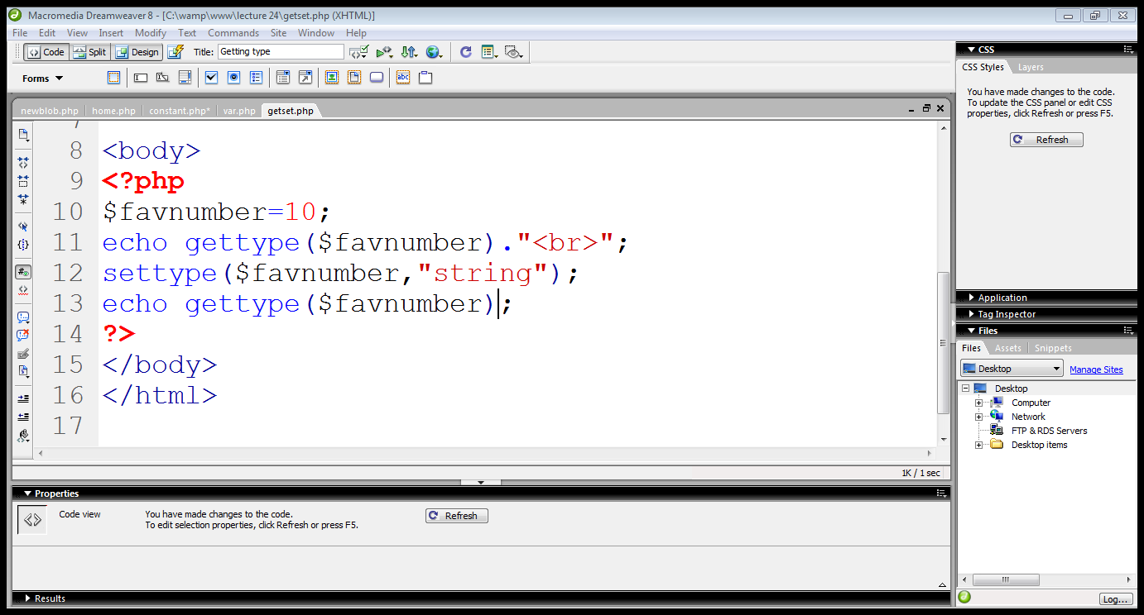
3.2 Variables…

Slide 27
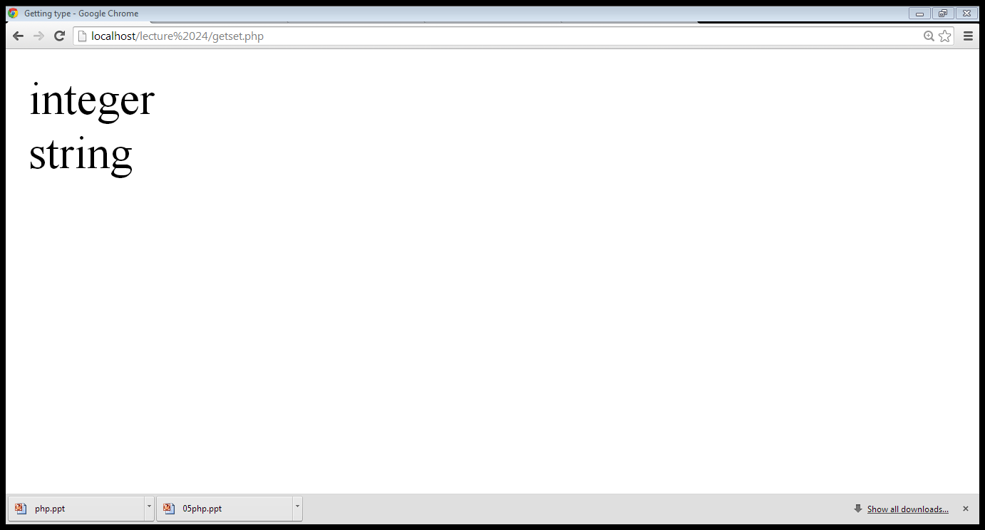
2.2 Variables…

Slide 28
2.2.1 Type determination
A number of functions are available for determining a variable’s type
  boolean is_name(mixed var)
is_array()
is_bool()
is_float()
is_integer()
is_null()
is_numeric()
is_string()

Slide 29
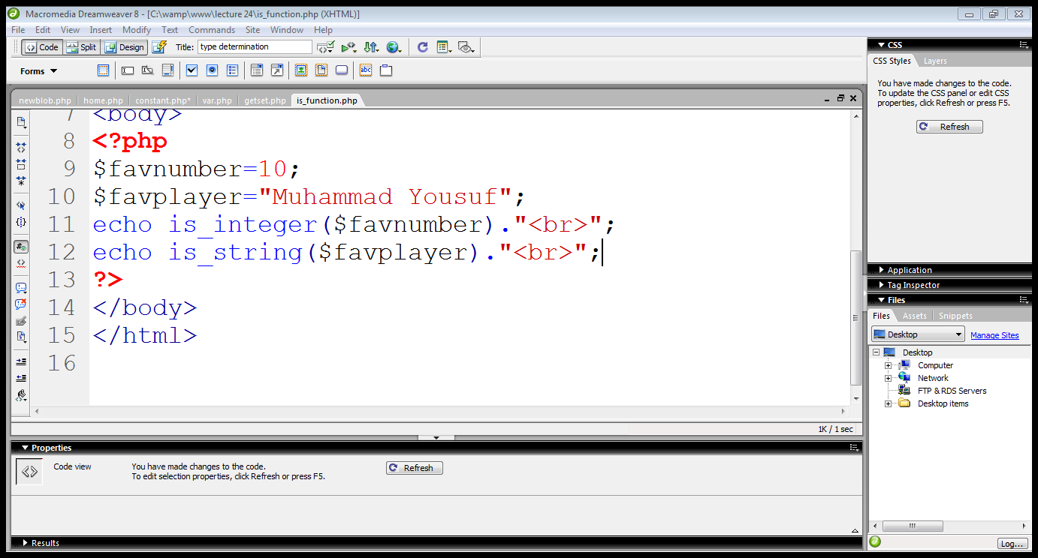
2.2.1 Type determination…

Slide 30
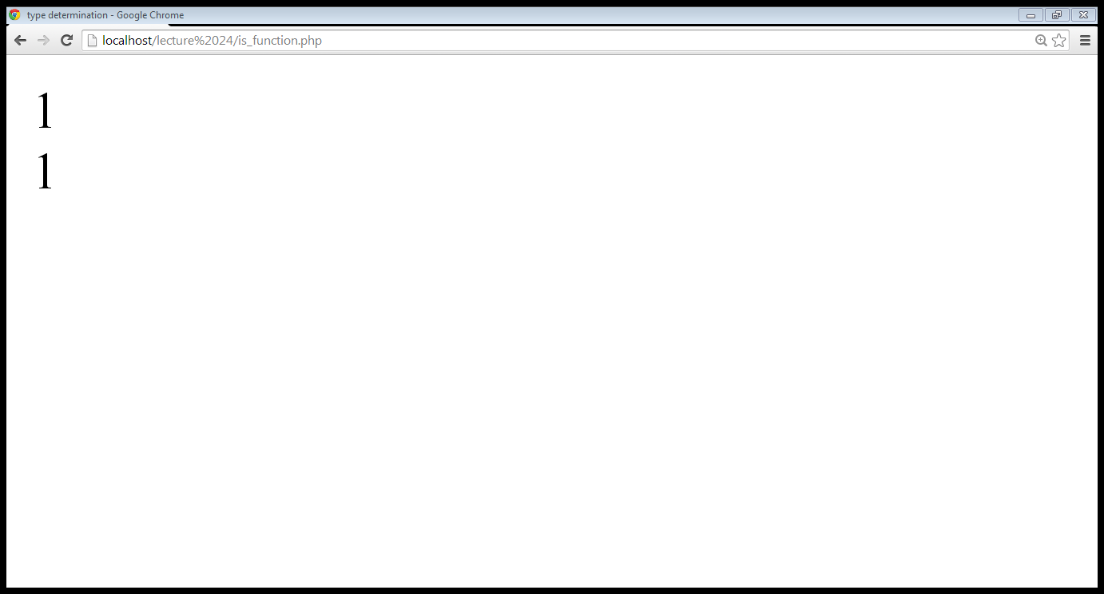
2.2.1 Type determination…

Slide 31
Summary
Setting the environment
PHP overview
PHP constants and variables

Slide 32
References
Chapter 2, “Beginning PHP6,Apache,Mysql web development” by Matt Doyle, Wrox publishers, 2009, ISBN: 0470413964
Chapter 3, “Beginning PHP and MySQL” by W. Jason Gilmore, Apress publisher, 4th edition; 2010, ISBN-13 (electronic): 978-1-4302-3115-8.

