Slide 1
History, Navigator, Screen and Form Objects

Slide 2
Summary of the previous lecture
Controlling the background dynamically
  Bgcolor
  Text
  background
Working with images
  Image rollover
  Image preview
  Image slide show
Date object
  Digital clock

Slide 3
Outline
History object
Navigator object
Screen object
Form object

Slide 4
1. The History object
The history object contains the URLs visited by the user (within a browser window)
The history object is part of the window object and is accessed through the window.history property
Used to move forward and backward through the visitor’s browsing history

Slide 5
1. The History object…
History object properties:
Length: Returns the number of URLs in the history list
History object methods:
back(): Loads the previous URL in the history list
forward(): Loads the next URL in the history list
go(): Loads a specific URL from the history list

Slide 6
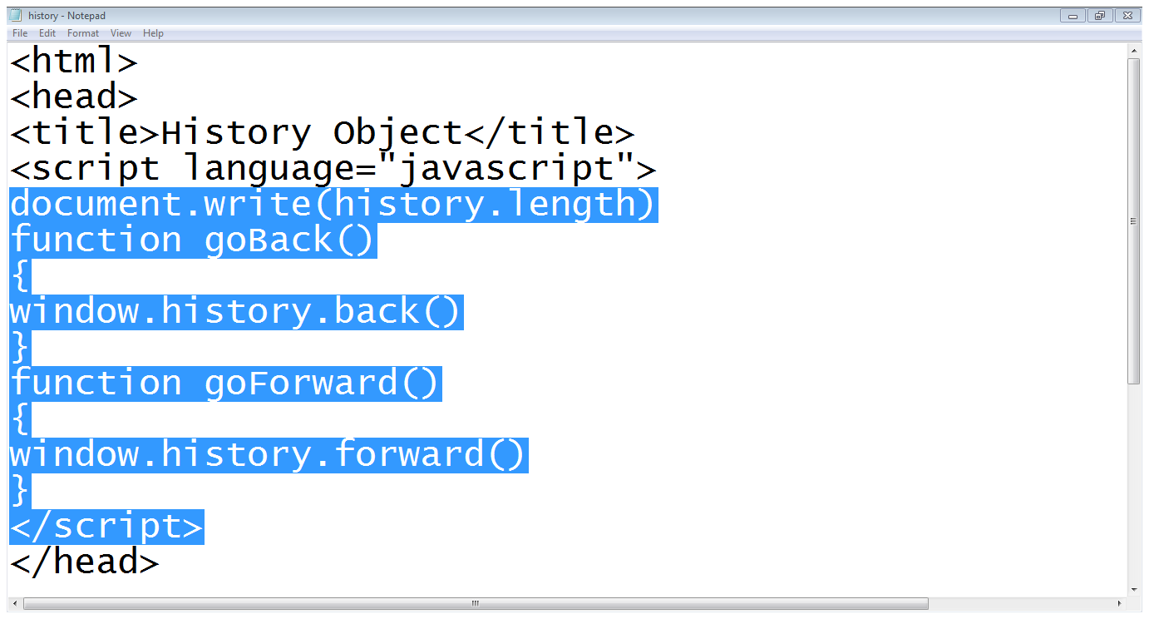
1. The History object…
Writes history length on webpage
Go back function
Go forward functions

Slide 7
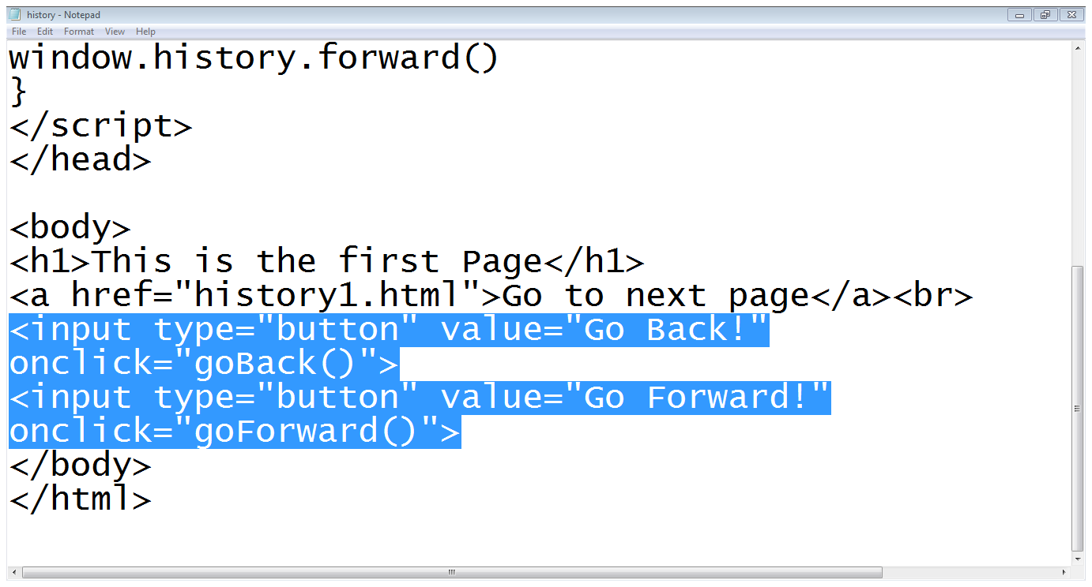
1. The History object…
Body contents
Call to goforward
Call to go back

Slide 8
2. The Navigator object
The navigator object contains information about the browser
provides several properties that assist in the detection of various elements of the visitor’s browser and environment

Slide 9
2. The Navigator object…
Navigator object properties:
  appCodeName: Returns the code name of the browser
  appName: Returns the name of the browser
  appVersion: Returns the version information of the browser
Navigator object methods:
  javaEnabled(): Specifies whether or not the browser has Java enabled

Slide 10
2.1 Detecting Users browser
Used to write browser specific code
Can also be used to restrict users to use a specific browser

Slide 11
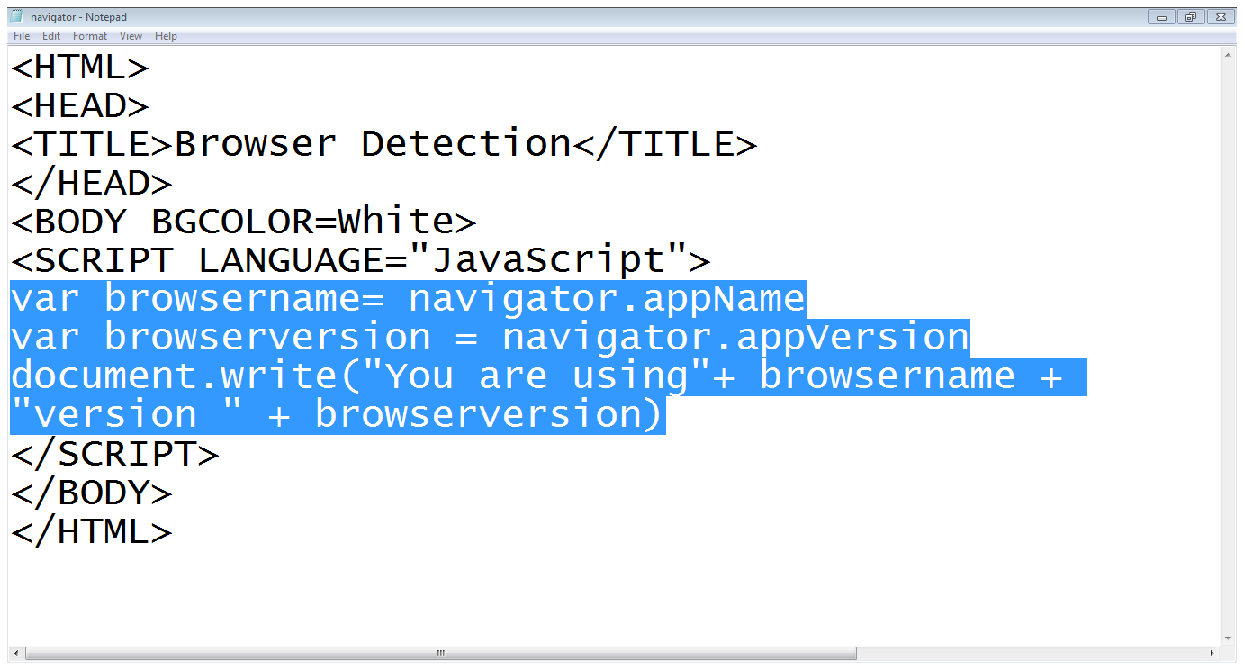
2.1 Detecting Users browser…
Finding browser name
Finding browser version
Writing browser information

Slide 12
3. The Screen object
The screen object contains information about the visitor's screen
You might need this information to determine which images to display or how large the page can be

Slide 13
3. The Screen object…
The screen object properties:
availHeight: Returns the height of the screen (excluding the Windows Taskbar)
availWidth: Returns the width of the screen (excluding the Windows Taskbar)
colorDepth: Returns the bit depth of the color palette for displaying images

Slide 14
3. The Screen object…
height: Returns the total height of the screen
width: Returns the total width of the screen

Slide 15
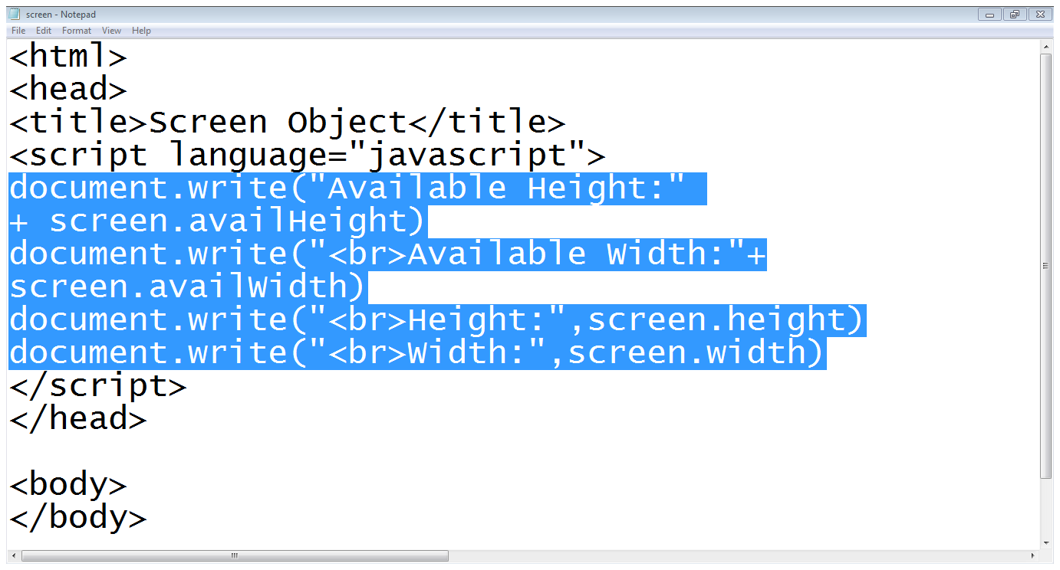
3. The Screen object…
Finding available height
Finding available height
Finding actual width
Finding actual height

Slide 16
4. Form Object
The Form object represents an HTML form
For each <form> tag in an HTML document, a Form object is created
The browser crates a ‘forms array’ which keeps the number of form objects in the HTML program
The first form object in the HTML file being held as array index [0], the second as index [1] and so on

Slide 17
4. Form Object…
The ‘forms array’ also holds information about each element used within <FORM> and </FORM> tags
elements array keeps information about form elements

Slide 18
4. Form Object…
<body>
<form name=“form1”>
</form>
<form name=“form2”>
</form>
</body>
forms
0
1
form1
form2

Slide 19
4.1 Accessing form elements
<body>
<form name=“form1”>
<input type=“text” name=“name”>
<input type=“text” name=“email”>
</form>
</body>
document.forms[0].name.value
or
document.form1.elements[0].value
document.forms[0].email.value
or
document.form1.elements[1].value

Slide 20
4.2 Setting form elements
<body>
<form name=“form1”>
<input type=“text” name=“name”>
<input type=“text” name=“email”>
</form>
</body>
document.forms[0].name.value = “ali”
or
document.form1.element[0].value = “ali”
document.forms[0].email.value = “ali@gmail.com”
or
document.form1.elements[1].value = “ali@gmail.com”

Slide 21
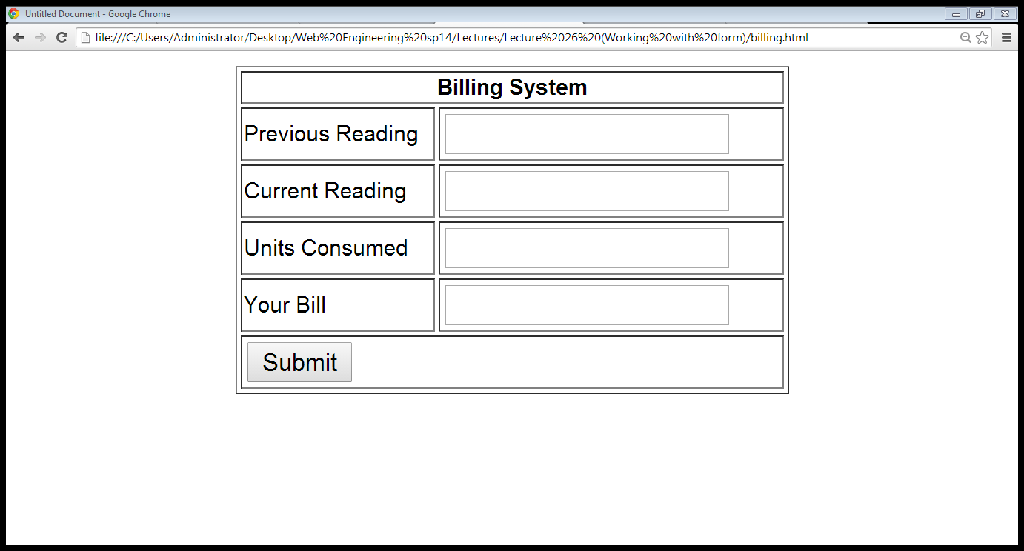
4.2 Setting form elements
Previous reading
Current reading
Consumed=current - previous
Bill= consumed*5

Slide 22
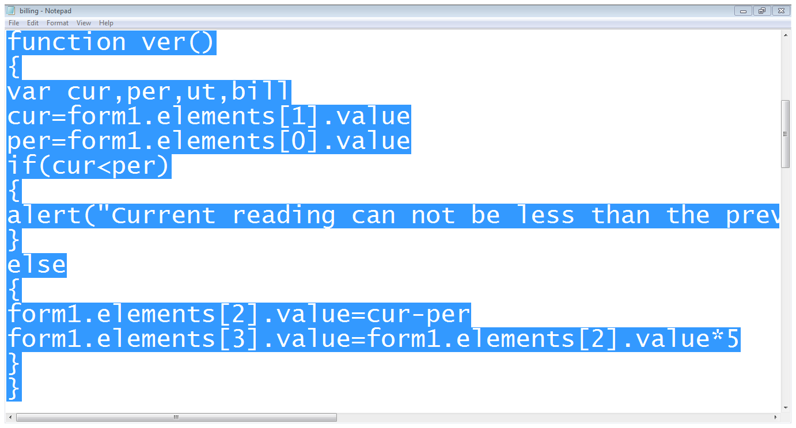
4.2 Setting form elements
Variables declared
Getting the value of elements
Setting values

Slide 23
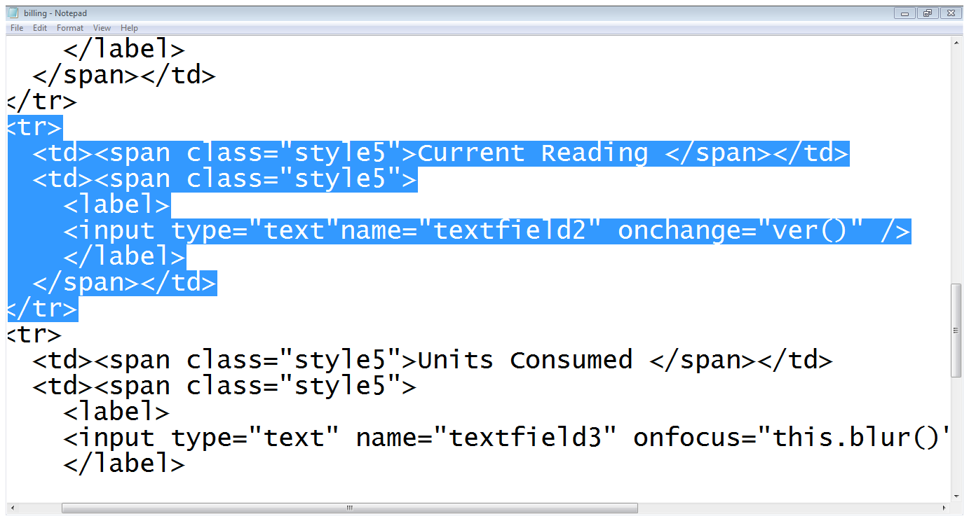
4.2 Setting form elements
Current reading field
Calling the function

Slide 24
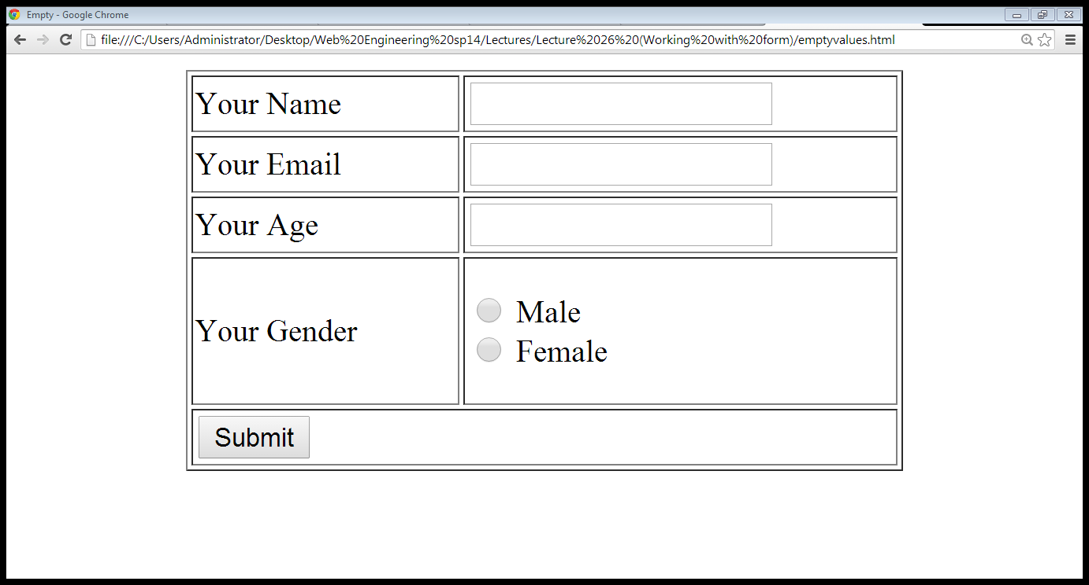
4.3 Validating form data
Must fill
Valid email

Slide 25
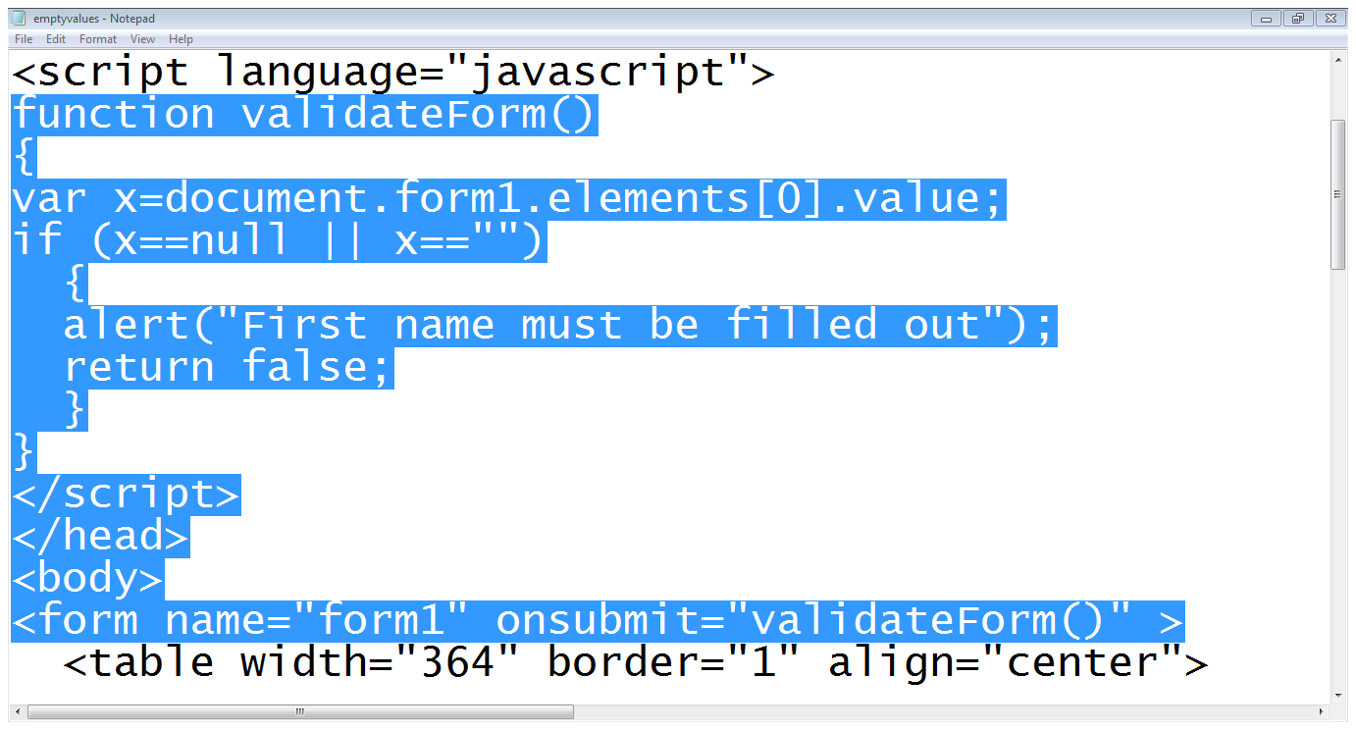
4.3 Validating form data…
Getting first element value
Checking for emptiness
Calling the function

Slide 26
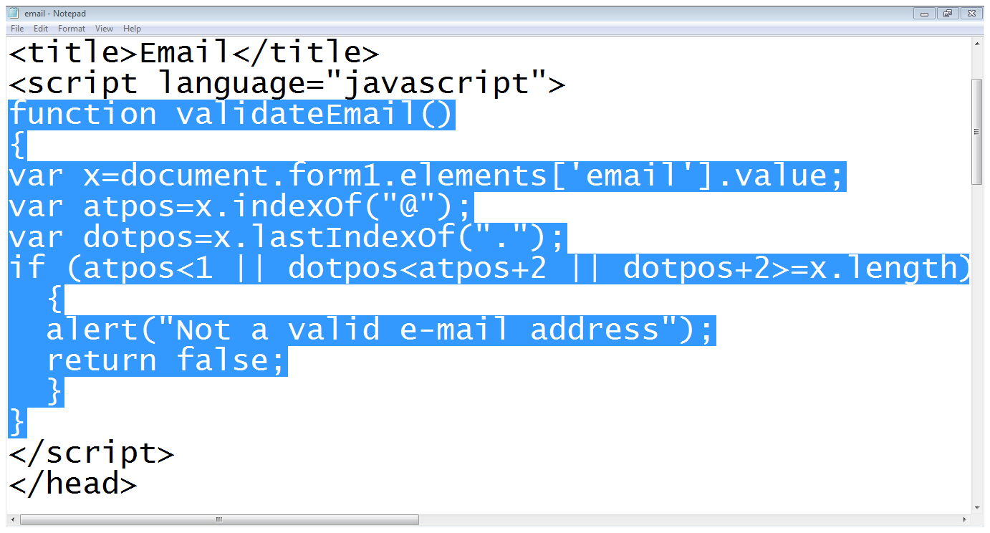
4.3 Validating form data…
Getting value of email
Finding position of ‘@’
Finding last position of ‘.’
Checking conditions

Slide 27
Summary
The history object
The navigator object
The screen object
The form object

Slide 28
References
Chapter 11. Beginning HTML, XHTML,CSS, and JavaScript, by Jon Duckett, Wiley Publishing; 2009, ISBN: 978-0-470-54070-1.
Chapter 6,11. Learn JavaScript, by Chuck Easttom, Wordware Publishing; 2002, ISBN 1-55622-856-2

