Slide 1
The web application development
process

Slide 2
Summary of the last lecture
Web engineering extends Software Engineering to Web applications
Why web engineering?
Web applications
Categories of web applications
Characteristics of web applications

Slide 3
Outline
Development Process model
  software development process activities
Requirement for a web development process model
Rational unified process model (RUP)
  suitability for web application development

Slide 4
1. Process model
A set of related activities that leads to the production of a software product
  development of software from scratch
  extending and modifying existing systems
Common activities
  Software specification
  Designing and implementation
  System validation
  System evolution

Slide 5
1.1 Process activities
Software specification:
The functionality of the software and constraints on its operation must be defined
  critical stage (can lead to problems in design and implementation)
Activities:
  Feasibility study
  Requirement elicitation and analysis
  Requirement specification
  Requirement validation

Slide 6
1.1 Process activities…
Software design and implementation:
Design is the description of
  System structure
  Data models
  Interface between components
Implementation: Converting a system specification into an executable system

Slide 7
1.1 Process activities…
System validation:
Intended to show that the system
  confirms its specification
  meets customer’s expectations
Development testing
  tested by the people developed the components
System testing
  finding component integration errors
Acceptance testing
  System is tested by the customer’s provided data

Slide 8
1.1 Process activities…
Software evolution:
Software is flexible as compared to hardware
  Changes can be made to the system during development or after the development

Slide 9
1.2 Common approaches
The waterfall approach
Iterative approach
Reuse oriented approach

Slide 10
2. Requirements for a web application development process
Evolving from informational medium to application medium
Existing approaches are over-pragmatic
  lead to short development time
Web engineering does not have its own mature development process model
SE development process models are adopted

Slide 11
2. Requirements for a web application development process…
Handling Short development cycles
  Development time is short
    Normally does not exceed six month
  Immediate delivery mechanism
    Capture share in the market
  Leaves less freedom for systematic development process

Slide 12
2. Requirements for a web application development process…
Handling changing requirement
  Requirements often emerge during development
    as developer understand the unknown business
  Integrate changes rapidly to remain in competition
  User involvement is more critical
    due to emerging and unstable requirements

Slide 13
2. Requirements for a web application development process…
Reuse and integration
  to meet time constraints developer try to reuse components
    Leads to integration issues
  Development can not be isolated from the development of other applications within the organization

Slide 14
2. Requirements for a web application development process…
Adapting to web application’s complexity level
  process depends upon the level of complexity
  process is adapted dynamically
    for low complexity, it should be like lightweight process
    for high complexity, it should be like heavyweight process

Slide 15
3. Rational unified process
RUP is a heavyweight, phase oriented, incremental and iterative process
Described in three perspectives
  Dynamic perspective: phases
  Static perspective: activities in phases
  Practice perspective: good engineering practices

Slide 16
3. Rational unified process
RUP phases:
  Inception: Define the business case for the project
Goals:
  Business case
    Identify and interact with external entities
    Asses the business contribution
Artifacts:
  business case

Slide 17
3. Rational unified process
RUP phases:
  Elaboration: establish understanding with the problem
Goals:
  Establish software scope
  Discriminating critical use-cases
  Estimating cost, schedules and risks
Artifacts:
  development plan, use-case model, architectural description

Slide 18
3. Rational unified process
RUP phases:
  Construction: involves system design, programming and testing
Goals:
  Develop the design
  Implement the design
  Validate the system
Artifacts:
  System, training material

Slide 19
3. Rational unified process
RUP phases:
  Transition: Installing the system in real environment
Goals:
  Testing in real environment
  training
  Bug fixing, performance enhancements
Artifacts:
  A documented system working correctly

Slide 20
3. Rational unified process
RUP activities (workflows):
  Requirements
  analysis
  design
  implementation
  test

Slide 21
3. Rational unified process
RUP good practices:
  Develop software iteratively
  Manage requirements
  Use component-based architectures
  Visually model software-using UML
  Verify software quality
  Control changes to software

Slide 22
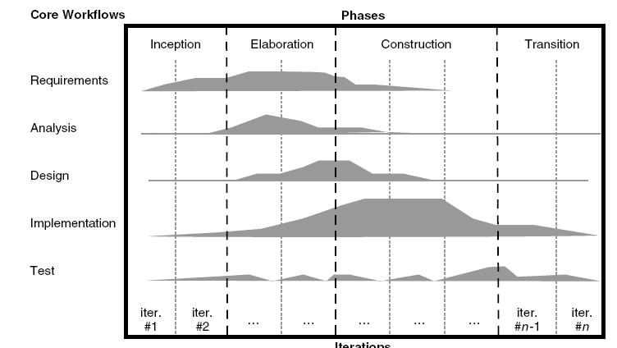
3. Rational unified process…
phases
activities

Slide 23
3.1 RUP for web application
Inception phase:
Definition is problematic for web application
  no concrete view of the system at beginning
  has target group but needs are unknown
Elaboration phase:
  due to short development time, first version has priority over clearly defined end-product

Slide 24
3.1 RUP for web application…
Construction phase:
  exists in web development process
Transition phase:
  is meaningful for web application development

Slide 25
3.1 RUP for web application…
Handling short development cycles:
  Conflicting
    short cycle means concession in modeling and documentation while RUP is heavyweight
Handling changing requirements:
  Conflicting with time constraints
    require concrete vision at the end of inception phase which require more time in web application due to evolving requirements

Slide 26
3.1 RUP for web application…
Parallel development of different releases:
  can be met with RUP
    RUP only allow parallel development in construction phase
Reuse and integration:
  Conflicting
    It requires coordination with development processes of other applications RUP does not describe this

Slide 27
3.1 RUP for web application…
Adapting to a Web application’s complexity level:
  RUP can be adopted for later stages when complexity of web application is understood

Slide 28
Summary
Development Process model
  software development process activities
  conventional software development approaches
Requirement for a web development process model
Rational unified process model (RUP)
  suitability for web application development

Slide 29
References
Chapter 10, Kappel, G., Proll, B. Reich, S. & Retschitzegger, W. (2006). Web Engineering, Hoboken, NJ: Wiley & Sons
Chapter 2, Sommerville, Software Engineering,
ISBN-10: 0-13-703515-2 , PEARSON

