Slide 1
CSS properties

Slide 2
Summary of the previous lecture
CSS basics
CSS writing option
CSS rules
Id,s and Classes

Slide 3
Outline
Font properties
Controlling text with CSS
Styling links
Styling background
Styling tables

Slide 4
1. CSS properties
CSS works by allowing you to associate rules with the elements that appear in a web page
These rules govern how the content of those elements should be rendered

Slide 5
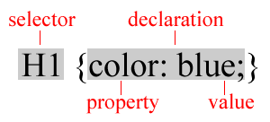
1. CSS properties…
A rule consists of
  A selector: element or elements the declaration applies to
  Declaration: how the elements referred to in the selector should be styled
    property: which is the property of the selected element
    value: which is a specification for this property

Slide 6
1. CSS properties…
To control the presentation of an element, you need to know the corresponding properties
Properties with related functionalities are grouped together
  Example:
    Properties to control the presentation of text

Slide 7
2. Font properties
Several properties allow you to control the appearance of text in your documents
These properties directly affect the font and its appearance

Slide 8
2. Font properties…
Common font properties:
  font-family
  font-size
  font-weight
  font-style
  font-variant

Slide 9
2. Font properties…
font-family:
  Specifies the typeface or family of font that should be used
Common values:
  Arial, Courier/Courier New, Georgia, Times/Times New Roman and Verdana
Example:
  H1{font-family:arial}

Slide 10
2. Font properties…
font-size:
  Specifies the size of a font
Common values:
  In pixels (12px,20px etc.)
  Absolut size (small, medium, lage, x-large etc.)
Example:
  H1{font-size:20px}

Slide 11
2. Font properties…
font-weight:
  Specifies whether the font should be bold or normal
Common values:
  Normal, bold, bolder, lighter
  100, 200, 300, 400, 500, 600, 700, 800, 900
  Example:
  H1{font-weight:bold}

Slide 12
2. Font properties…
font-style:
  Specifies whether the font should be normal, italic or oblique
Common values:
  Normal, italic, oblique
  Example:
  H1{font-style:italic}

Slide 13
2. Font properties…
font-variant:
  Specifies whether the font should be normal or small-caps (smaller version of upper case)
Common values:
  Normal, small-caps
  Example:
  H1{font-variant:small-caps}

Slide 14
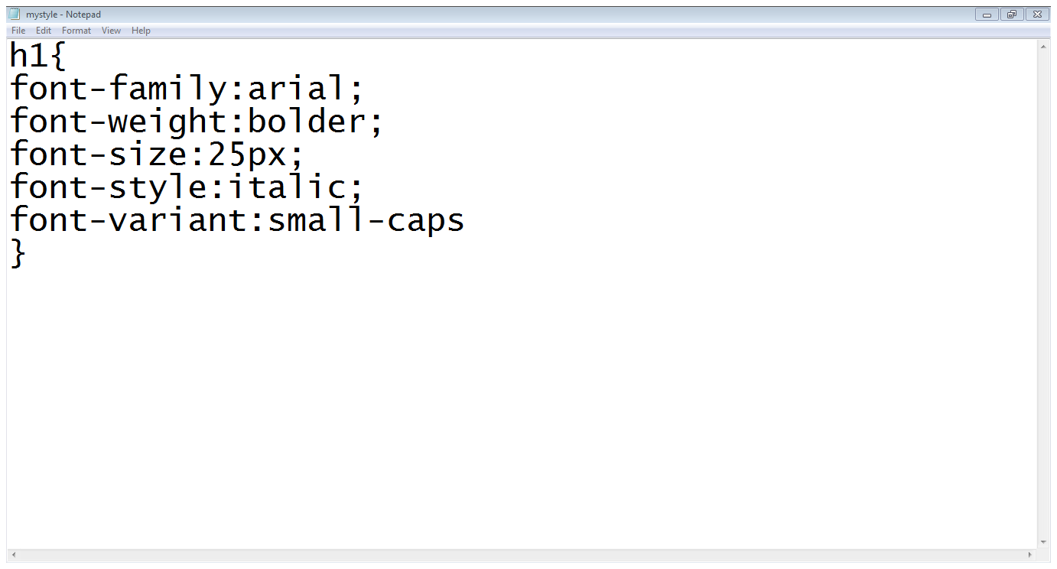
2. Font properties…
selector
Font properties
End of CSS rule

Slide 15
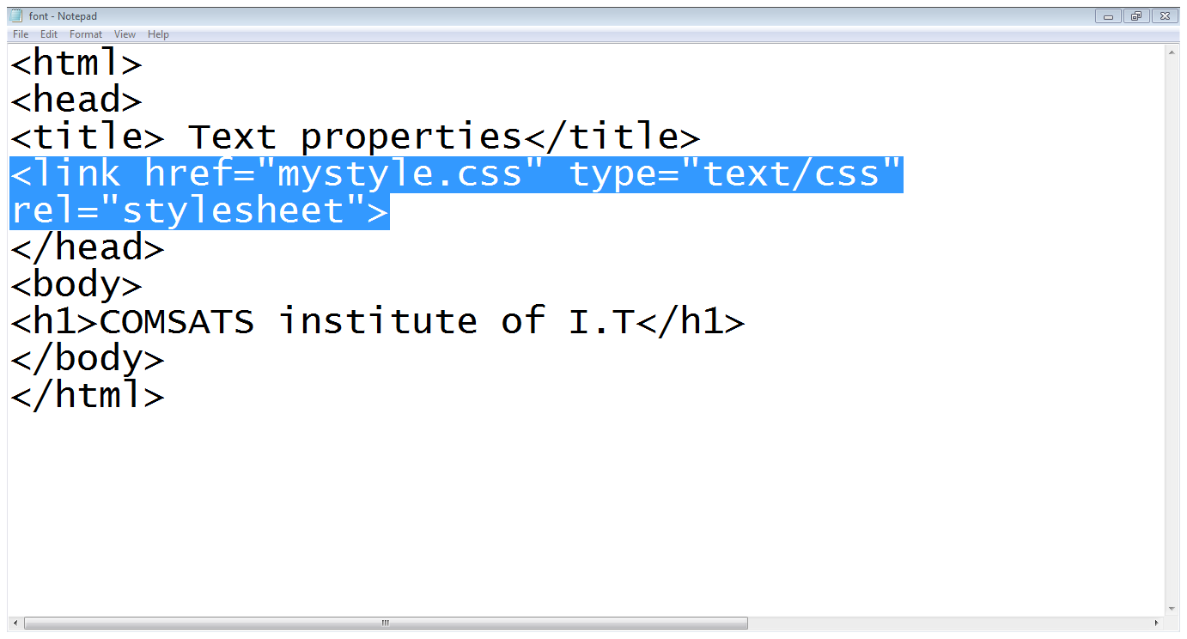
2. Font properties…
Including stylesheet
Using h1 tag

Slide 16

2. Font properties…

Slide 17
3. Text properties
color
text-align
vertical-align
text-decoration
text-transform
word-spacing
letter-spacing

Slide 18
3. Text properties
color:
  specifies the color of the text
  P{color : green}
text-align:
  horizontal alignment of the text
  Left, right, center or justify
vertical-align:
  Vertical alignment of the text
  Sub, super, top, middle, bottom

Slide 19
3. Text properties
text-decoration:
  specifies the whether the text should be underline, overline, line-through or blinking
text-transform:
  text should be lowercase, uppercase or capitalized
letter-spacing:
  Specifies the space between letters
  H1{letter-spacing:3px}

Slide 20
3. Text properties
word-spacing:
  Specifies the space between words
  H1{word-spacing:4px}

Slide 21
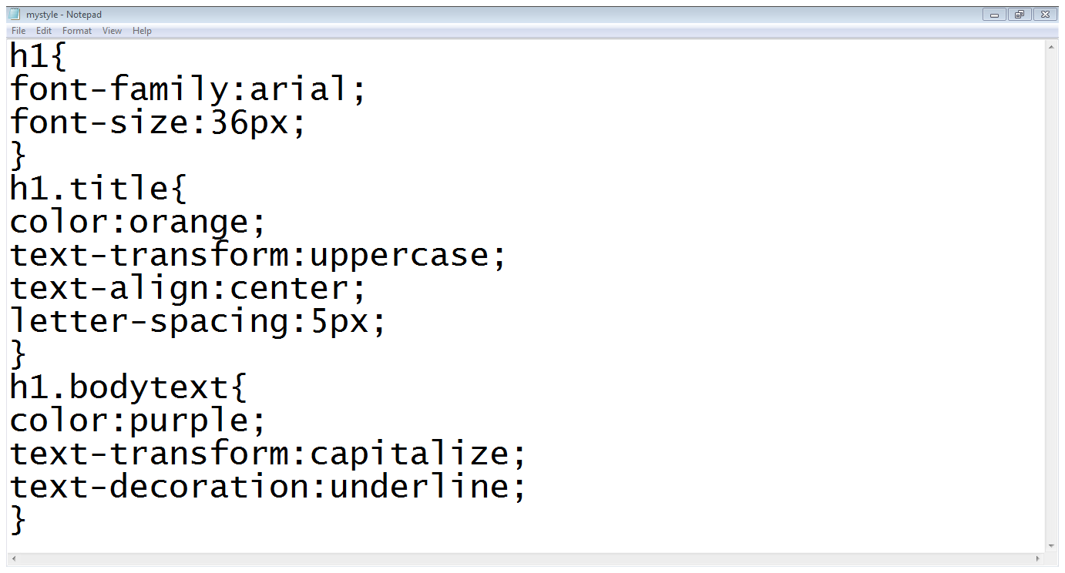
3. Text properties
Basic properties
Class declaration
Class properties
Second class properties

Slide 22
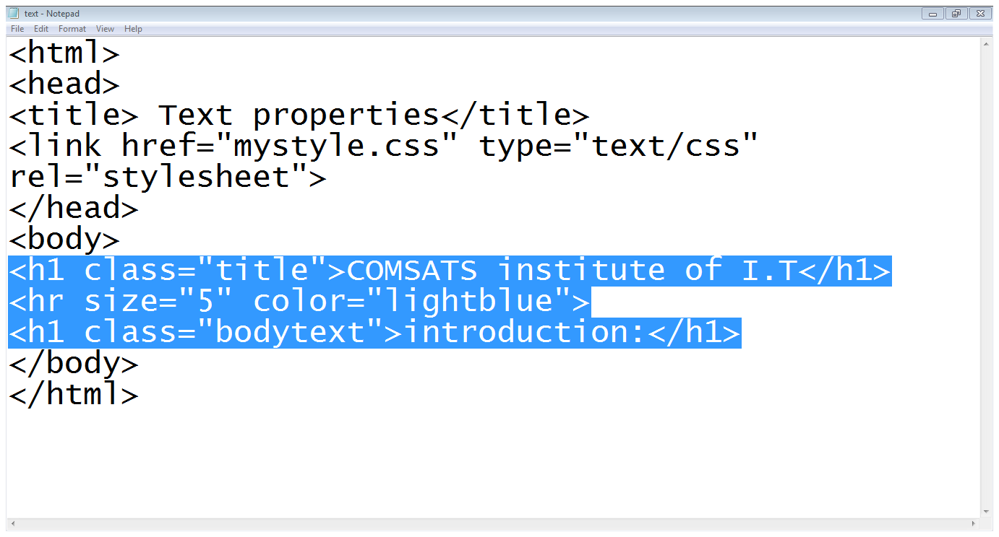
3. Text properties
Title class
Bodytext class
Horizontal line

Slide 23

3. Text properties

Slide 24
3. Styling Links
color :
  Changes the color of the links
background-color :
  Highlights the link, as if it had been highlighted with a highlighter pen
text-decoration :
  Underline, strike through, over-line, blink

Slide 25
3. Styling links…
Pseudo-classes of links:
Link:
  Styles for links in general
Visited:
  Styles the links which are already visited
Hover:
  Styles when some on hovering over a link
Active:
  Styles the links when a links is being clicked

Slide 26
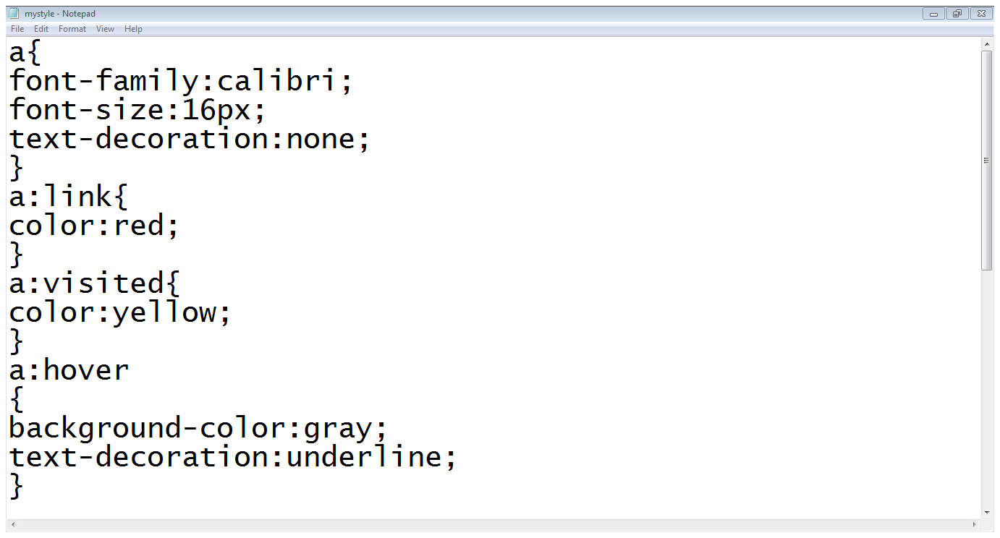
3. Styling links…
a tag style
Link settings
Visited settings
Hover settings

Slide 27
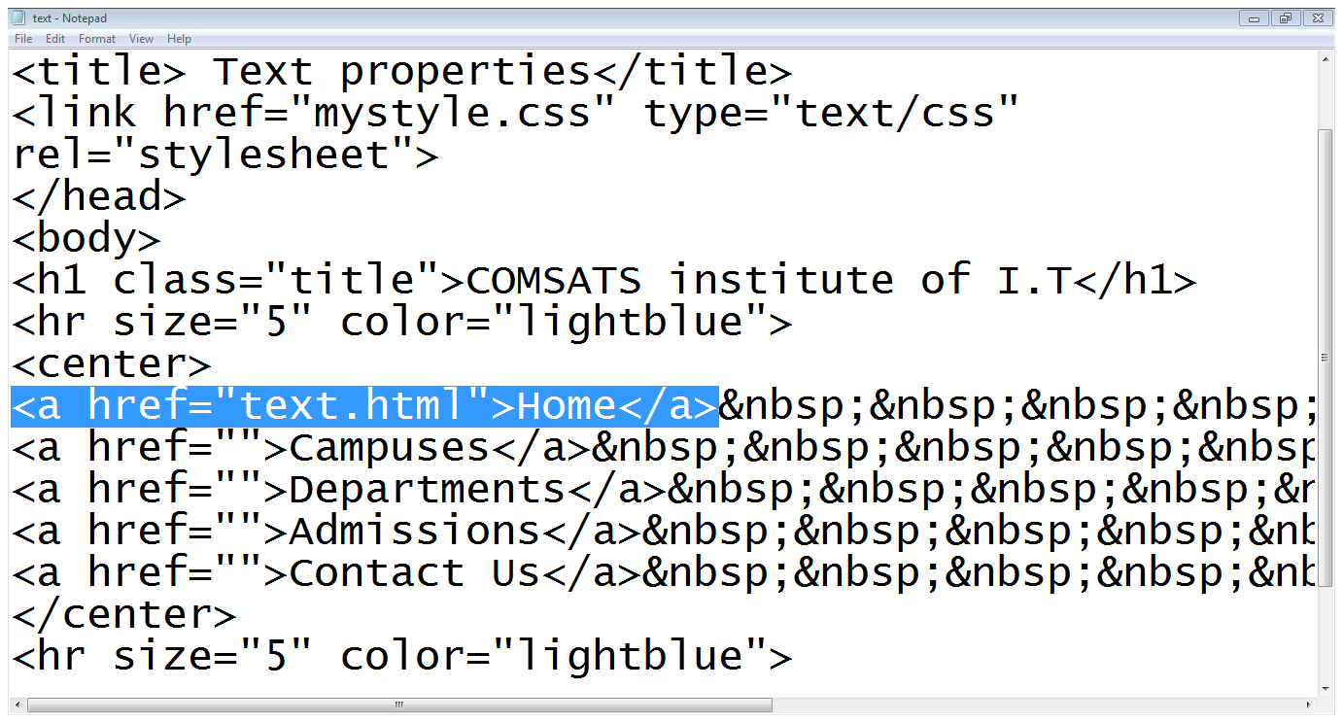
3. Styling links…
Link added

Slide 28
4. Styling Background
background-color:
  Specifies the background color
background-image:
  Specifies the background image
background-repeat:
  Specifies whether the image should repeat or not
background-position:
  Where an image should be positioned

Slide 29
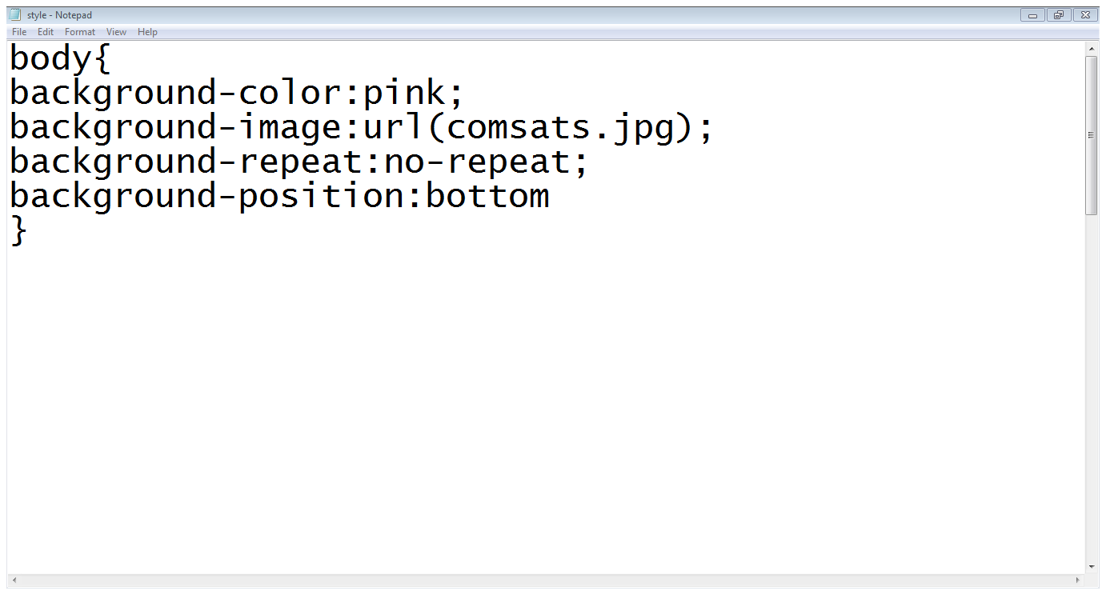
4. Styling Background…

Slide 30
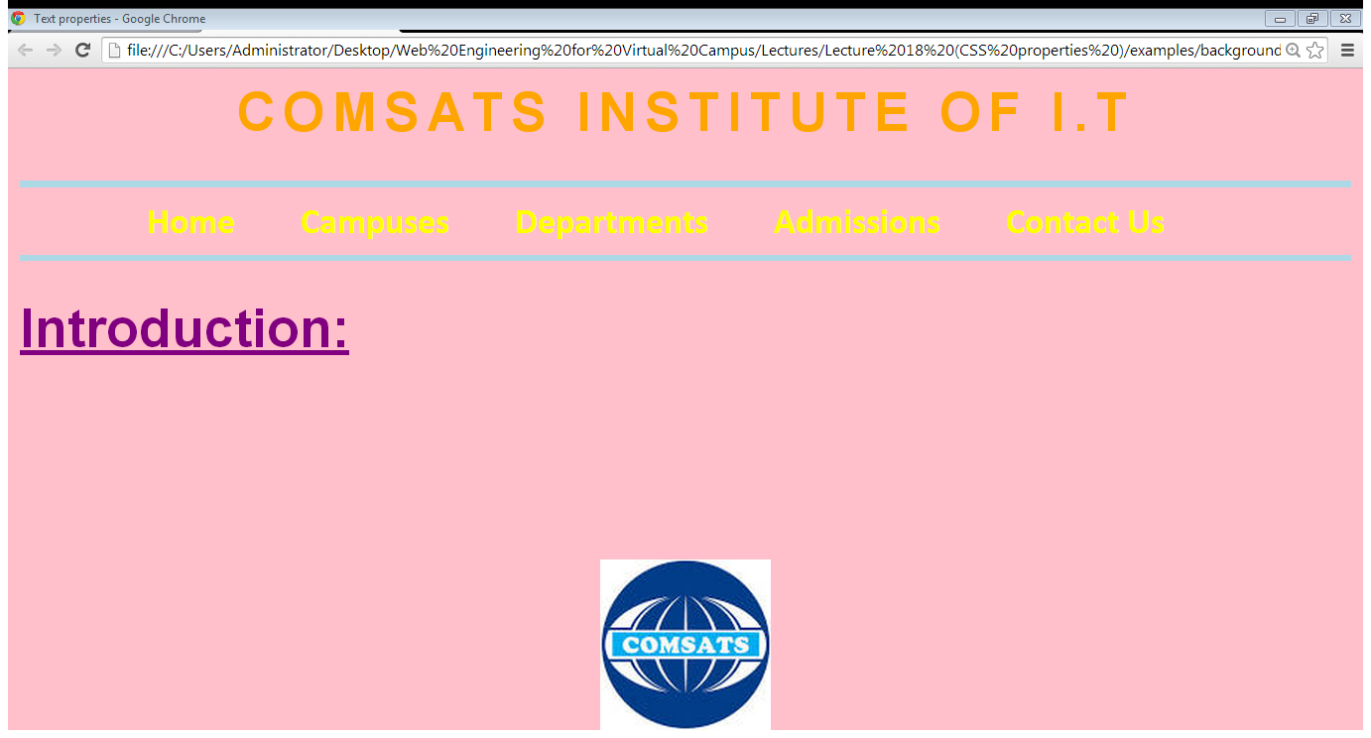
4. Styling Background…

Slide 31
5. Styling tables
text and font
vertical – align
width
height
background - color
background - image

Slide 32
5. Styling tables
border :
  border-style (solid, dashed, doted, double etc.)
  border-color
  border-bottom (solid, dashed, doted, double etc.)
padding
  Padding-left
  Padding-right
  Padding-top
  padding-bottom

Slide 33
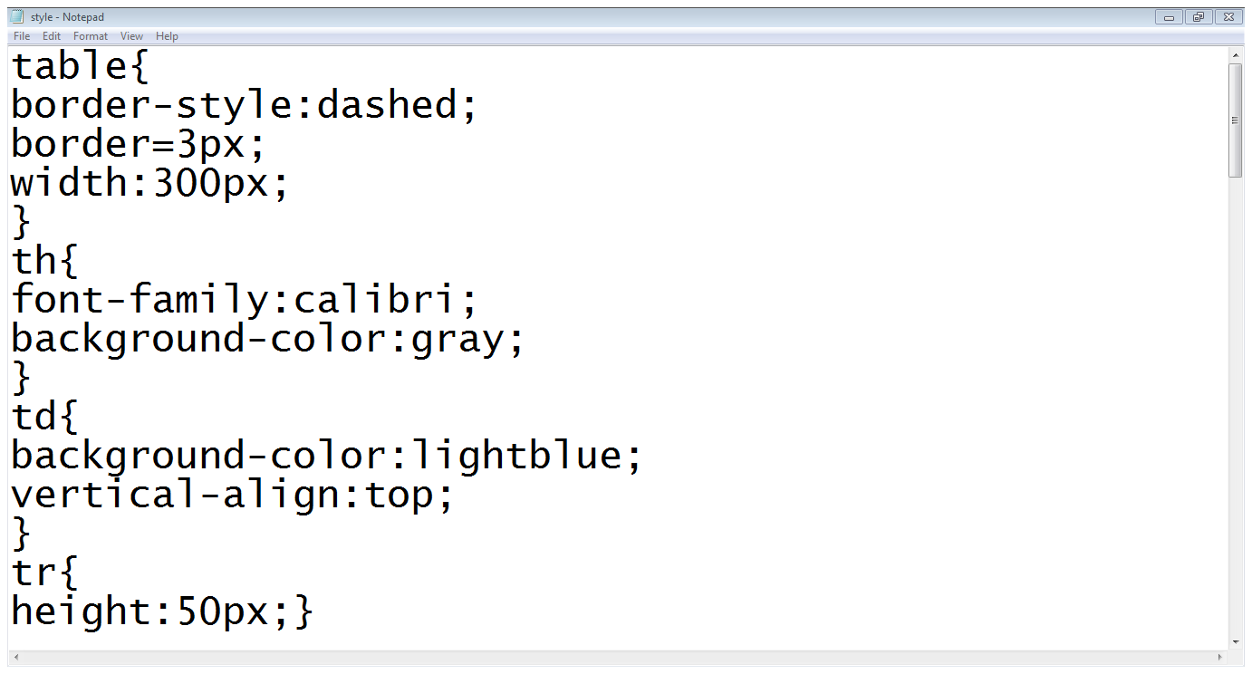
5. Styling tables…
Table settings
Th settings
Td settings
Tr settings

Slide 34
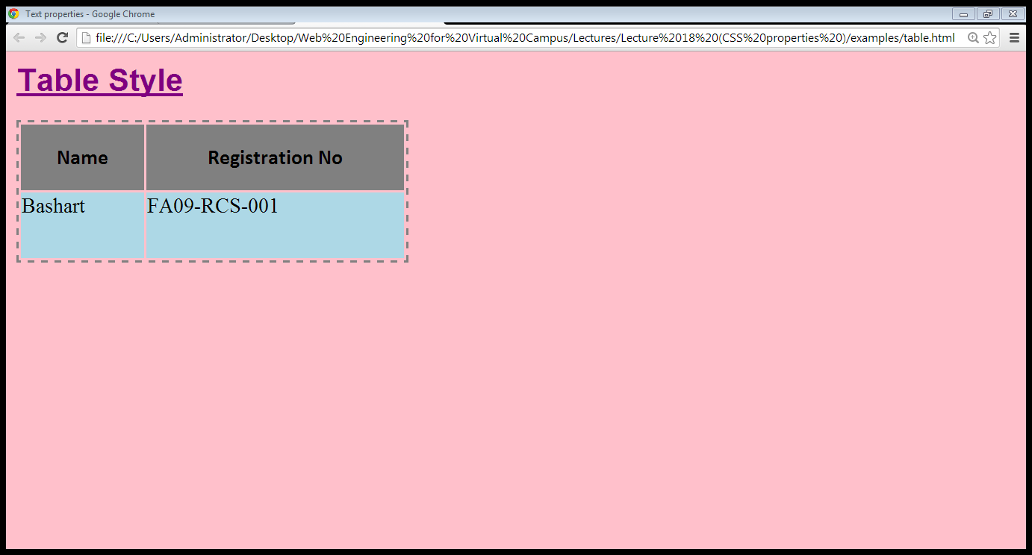
5. Styling tables…

Slide 35
Summary
Font properties
Controlling text with CSS
Styling links
Styling background
Styling tables

Slide 36
References
Chapter 7,8. Beginning HTML, XHTML,CSS, and JavaScript, by Jon Duckett, Wiley Publishing; 2009, ISBN: 978-0-470-54070-1.

