Slide 1
Tables in HTML

Slide 2
Summary of the previous lecture
Adding images to web page
Using images as links
Image map
Adding audio and video to web page

Slide 3
Outline
How to create tables
Page lay-out using tables

Slide 4
1. Creating HTML tables
Tables display information in rows and columns
Tables are commonly used to display all manner of data that fits in a grid such as train schedules, television listings, financial reports etc.

Slide 5
1. Creating HTML tables…
In HTML <table> tag is used to start a table while </table> tag indicates the end of the table
    <table>
    Table Structure
    </table>
<tr> tag starts a row of the table and </tr> ends the row
<td> is used to create a cell inside the row while </td> ends the cell

Slide 6
1. Creating HTML tables…
The contents of the cell are written between <td> and </td> tags
<th> tag is used to declare the cell of the heading row of the table

Slide 7
1. Creating HTML tables…
<table border=“1”>
<tr>
<td> Name </td>
<td> Registration No. </td>
</tr>
<tr>
<td>Ali</td>
<td>FA13-BCS-001</td>
</tr>
</table>
Name
Registration No.
Ali
FA13-BCS-001

Slide 8
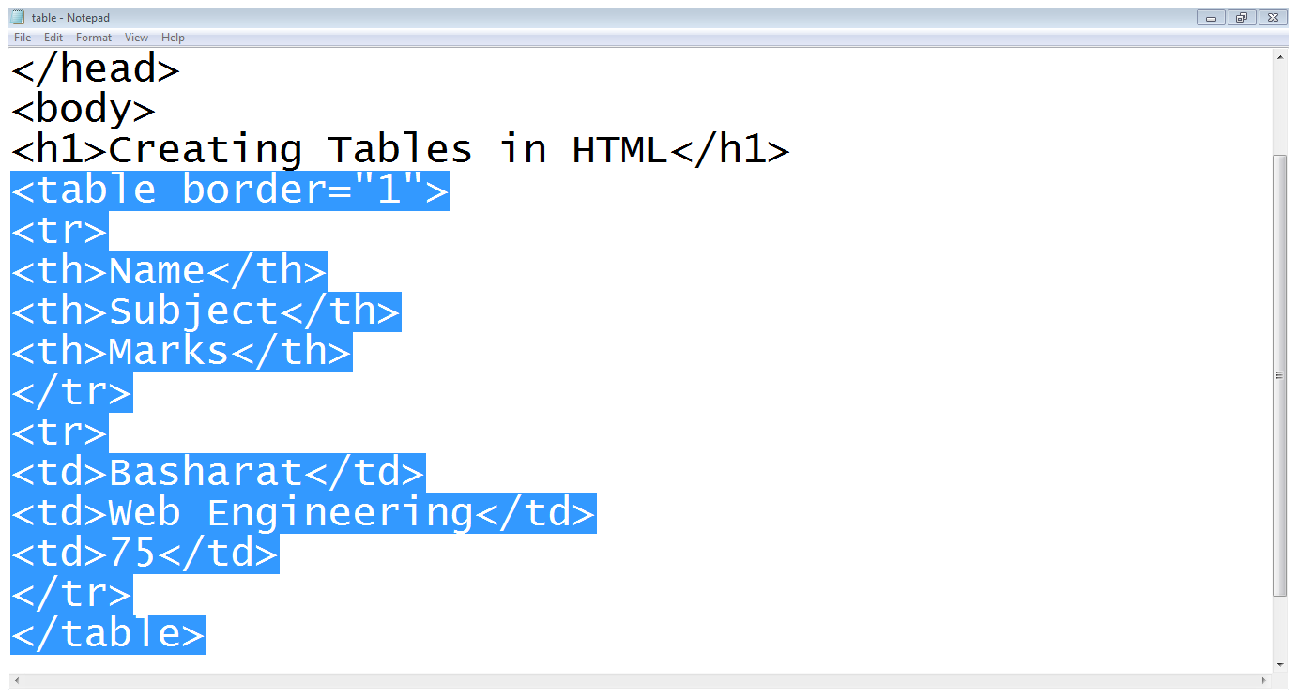
1. Creating HTML tables…

Slide 9
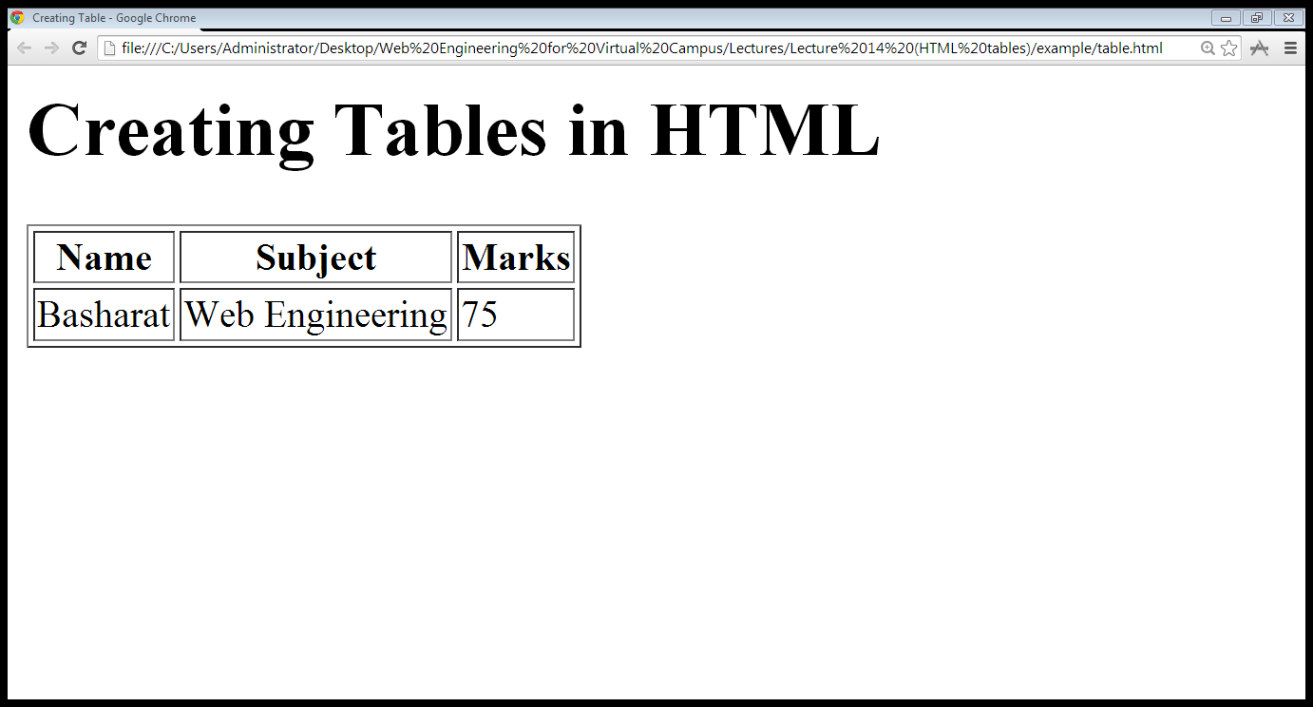
1. Creating HTML tables…

Slide 10
1.1 Table Attributes
Table level attributes
Row level attributes
Cell level attributes

Slide 11
1.1.1 Table Attributes
The Border Attribute: Indicates the presence of the border around the table
      <table border=“1”>
The align Attribute:
      <table align= “center, right or left”>
The bgcolor Attribute: sets the background color
of the table
      <table bgcolor=“gray”>
The background Attribute: sets the specified
image at the background of the table
      <table background=“image-title”>

Slide 12
1.1.1 Table Attributes…
The height and width Attributes:
The cellpadding Attribute: The cellpadding attribute is used to create a gap between the edges of a cell and its contents
      <table cellpadding=“50”>
The cellspacing Attribute: The cellspacing attribute is used to create a space between the borders of each cell

Slide 13
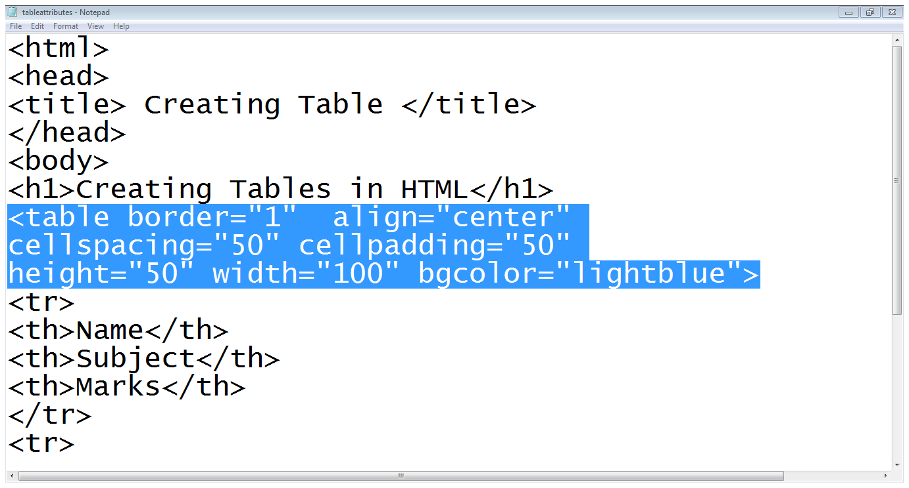
1.1.1 Table Attributes…

Slide 14
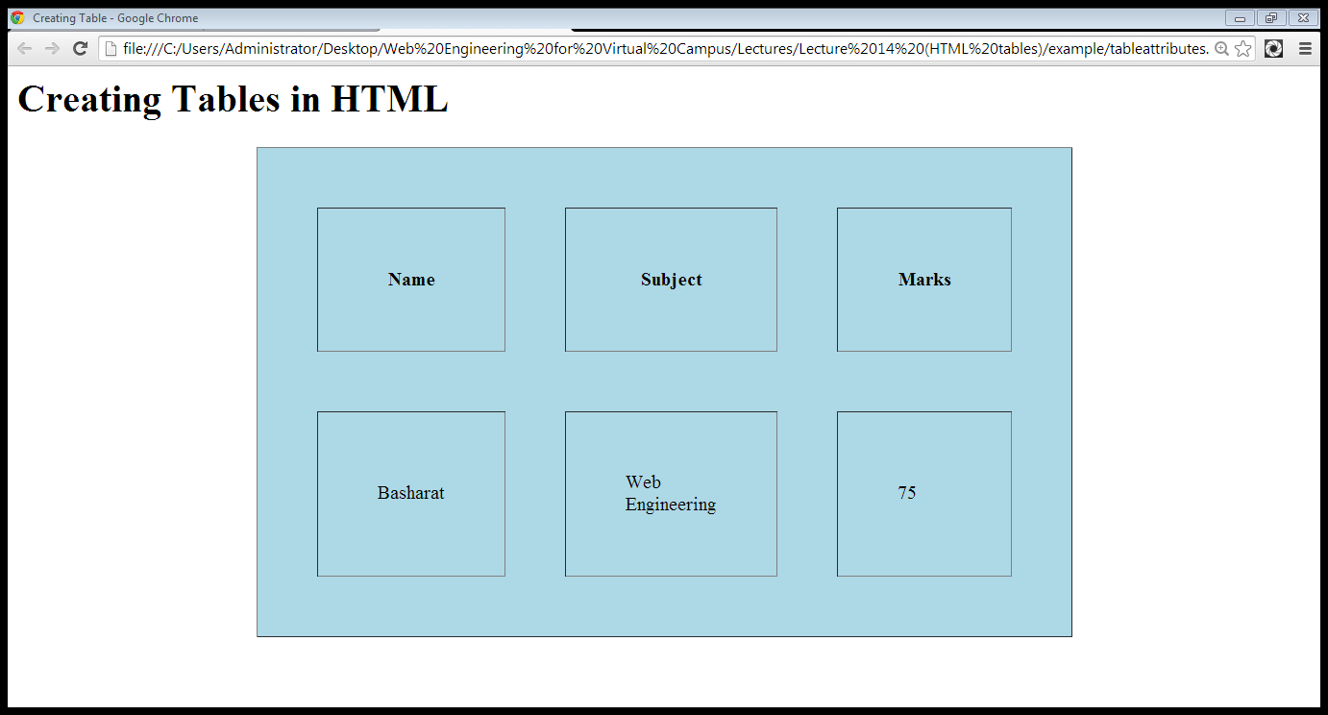
1.1.1 Table Attributes…
cellspacing
cellpadding
Height
Width

Slide 15
1.1.2 Row level attributes
The align Attribute:
  <tr align=“center,right or left”>
The bgcolor Attribute:
    <tr bgcolor=“gray”>
The background Attribute:
    <tr background=“image-name”>
The height and width Attributes:
    <tr height=“20” widht=“20”>
The valign Attributes:
    <tr valign=“top, middle or bottom”>

Slide 16
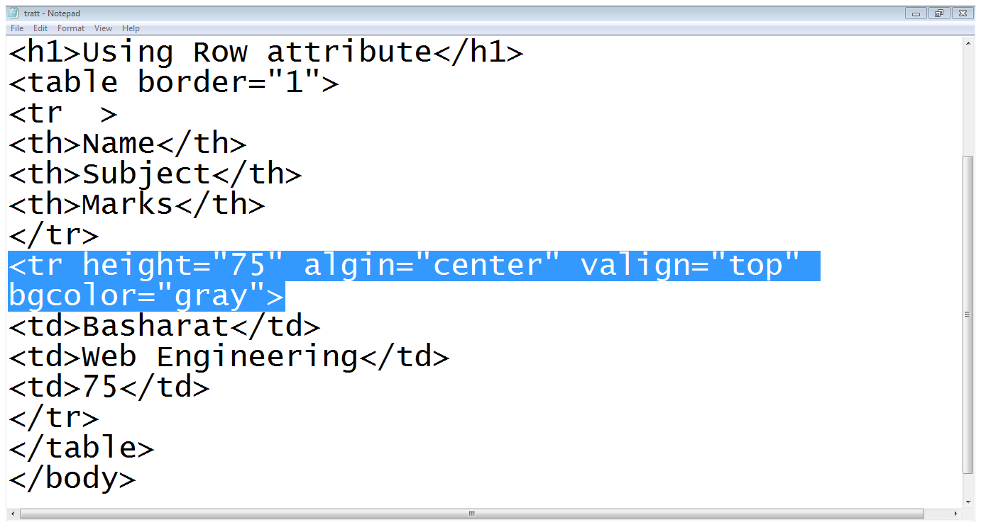
1.1.2 Row level attributes…

Slide 17
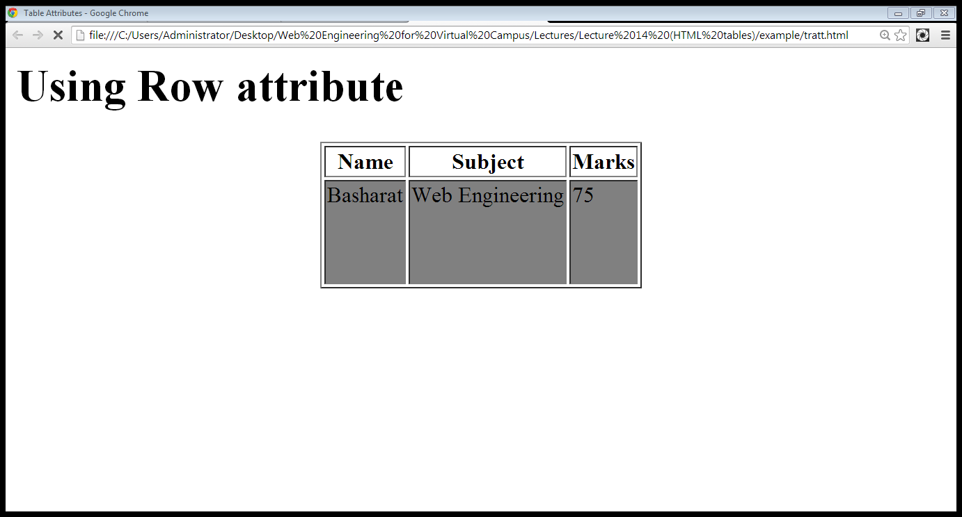
1.1.2 Row level attributes…
Vertical Align
Row Height

Slide 18
1.1.3 Cell level attributes
The align Attribute:
  <td align=“center,right or left”>
The bgcolor Attribute:
The valign Attributes:
The rowspan Attributes: used when a cell should span across more than one rows
The colspan Attribute: used when a cell should span across more than one column

Slide 19
1.1.3 Cell level attributes…
<table border=“1”>
<tr>
<td rowspan=“2”>Name</td>
<td colspan=“2”>Subjects</td>
</tr>
<tr>
<td >OOP</td>
<td >DB</td>
</tr>
<tr>
<td >ALi</td>
<td >75</td>
<td >80</td>
</tr>
</table>
Name
Subjects
OOP
DB
ALi
75
80

Slide 20
1.2 Adding caption to the table
<caption> tag is used to add a caption of the table
We usually add caption before the first row of the table

Slide 21
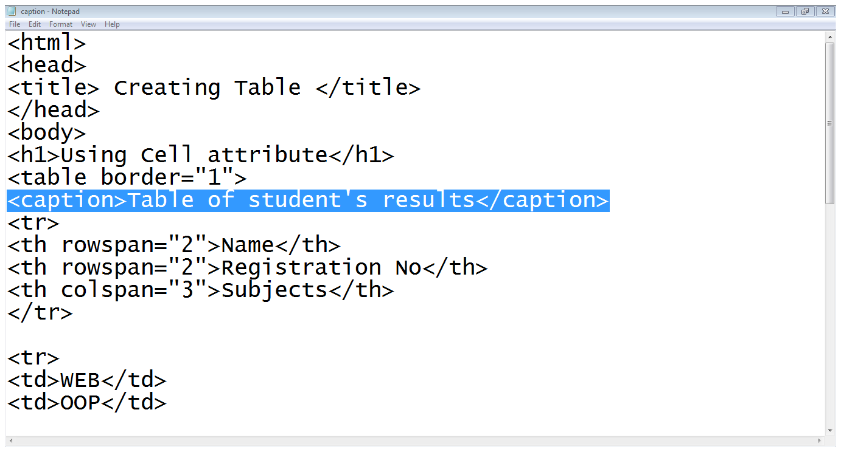
1.2 Adding caption to the table…

Slide 22
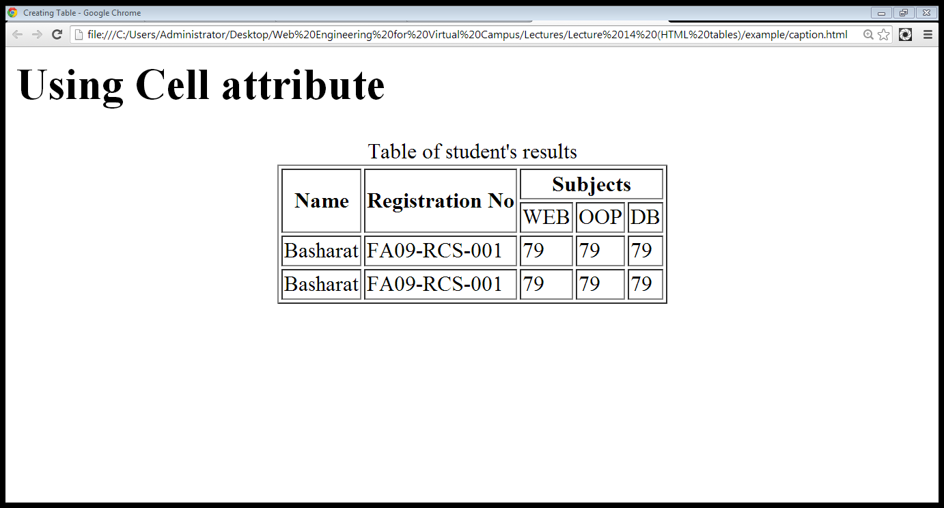
1.2 Adding caption to the table…
Caption

Slide 23
2. Page Layout using Tables
We can use tables to define the structure of the web page

Slide 24
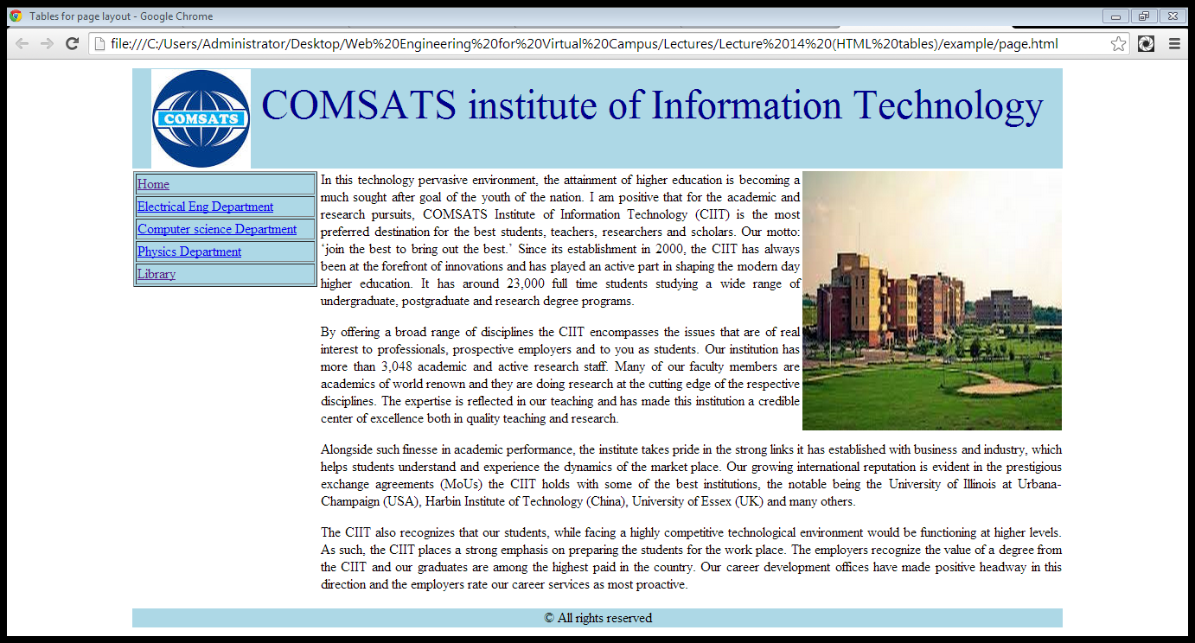
2. Page Layout using Tables
Header
Links
Body
Footer

Slide 25
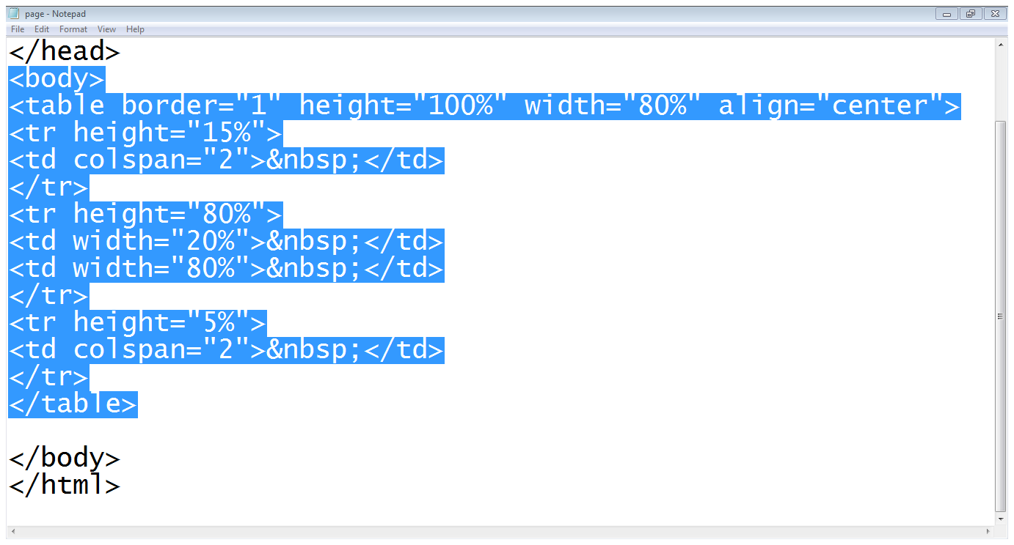
2. Page Layout using Tables…
Header
Footer
Body and links
Example: Step 1 (Structure of the page)

Slide 26
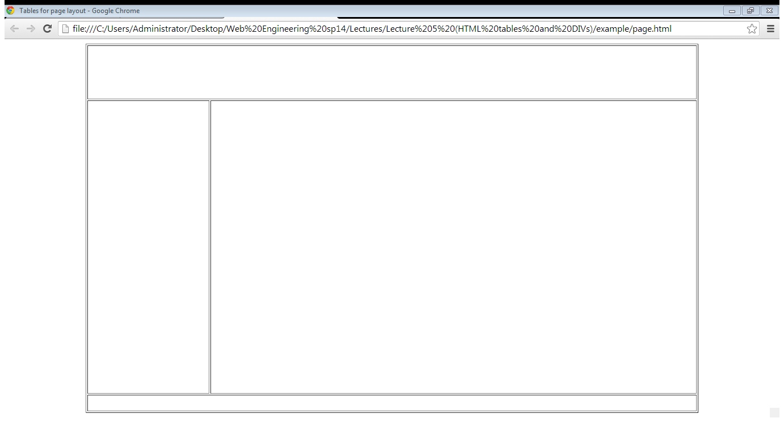
2. Page Layout using Tables…
Example: Step 1 (Structure of the page)

Slide 27
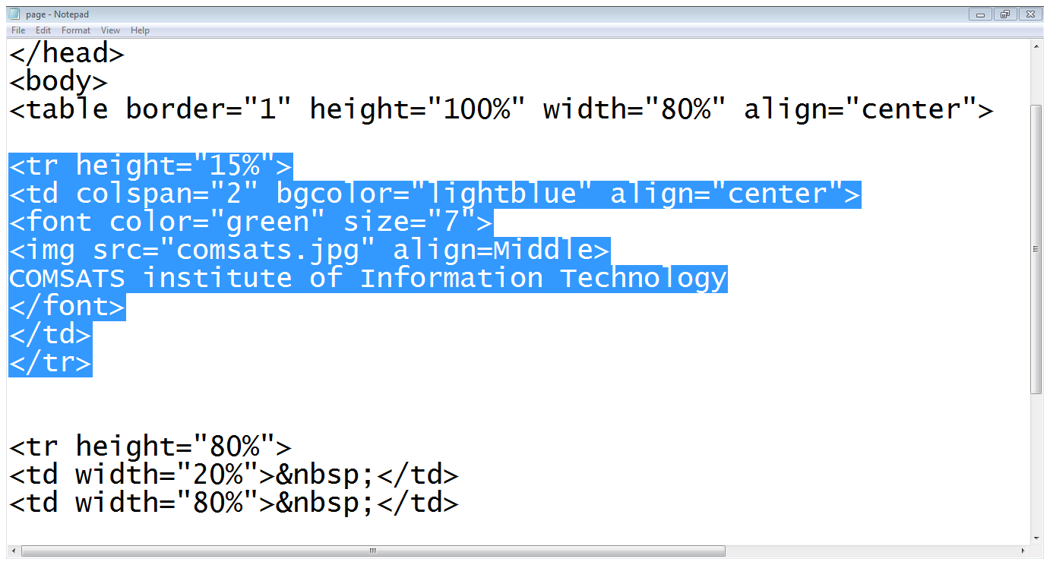
2. Page Layout using Tables…
Example: Step 2 (Header section)
Adding Logo
Title

Slide 28
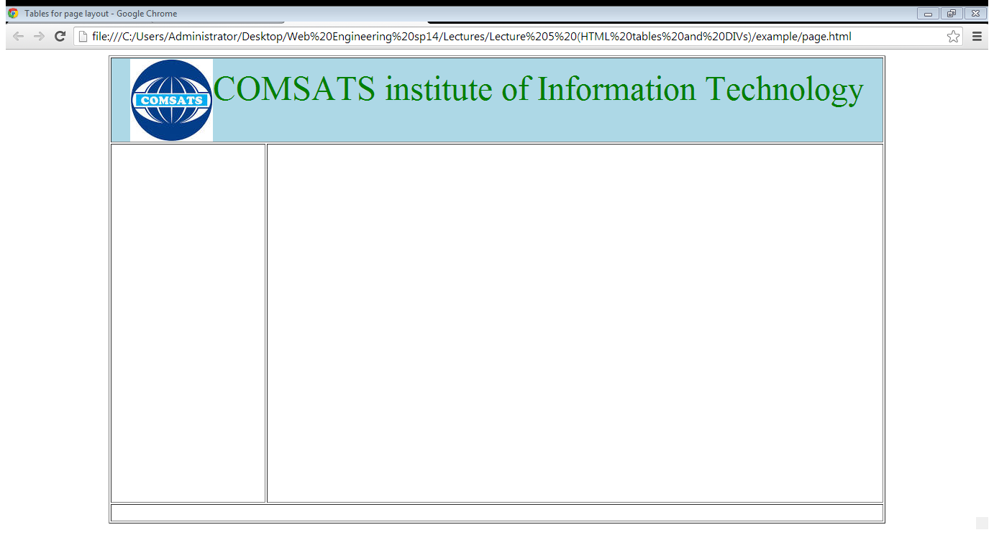
1.5. Page Layout using Tables…
Example: Step 2 (Header section)

Slide 29
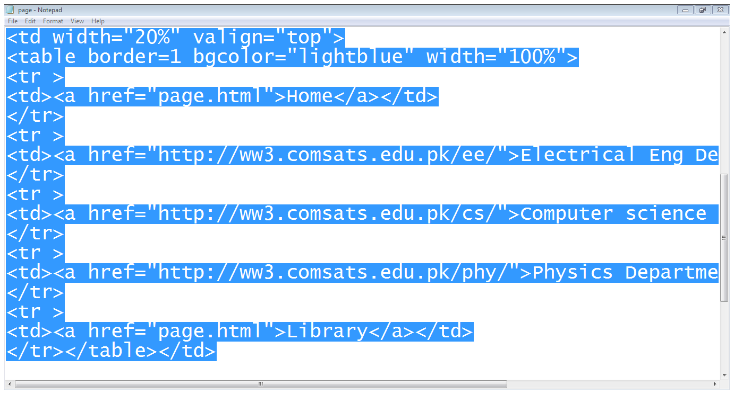
2. Page Layout using Tables…
Links table
Example: Step 3 (Links section)

Slide 30
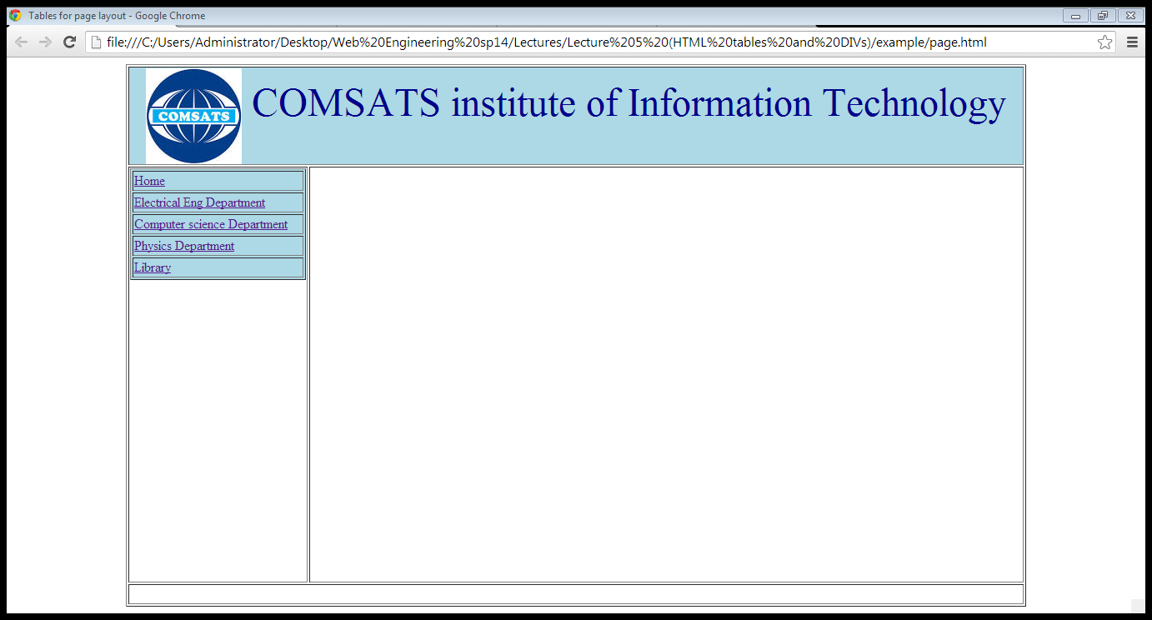
2. Page Layout using Tables…
Example: Step 3 (Links section)

Slide 31
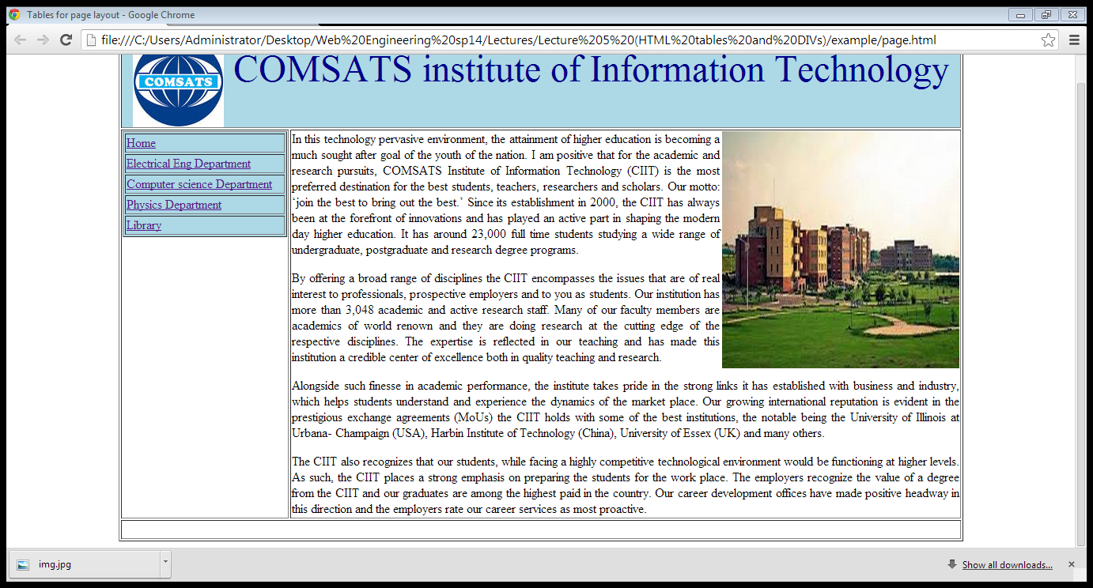
2. Page Layout using Tables…
Example: Step 4 (body section)

Slide 32
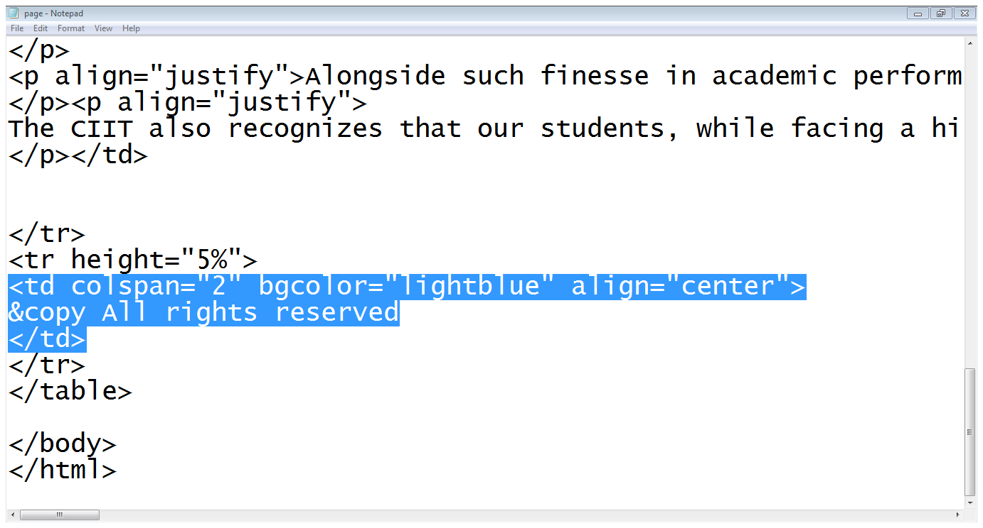
2. Page Layout using Tables…
Footer
Example: Step 5 (footer section)

Slide 33
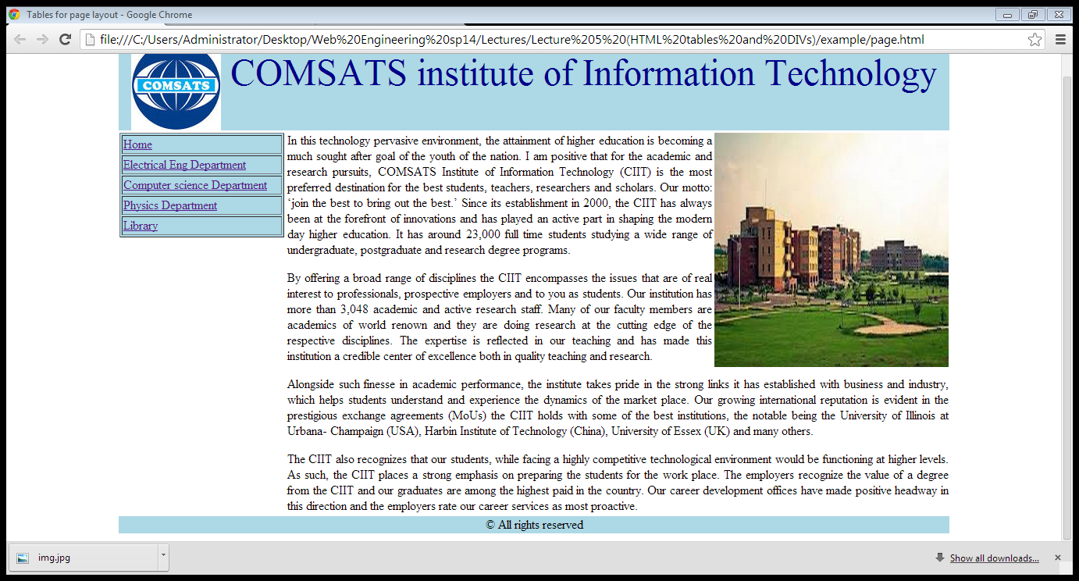
2. Page Layout using Tables…
Example: Step 5 (footer section)

Slide 34
Summary
Creating tables in HTML
Table attributes
Page lay-out using tables

Slide 35
References
Chapter 4, Beginning HTML, XHTML,CSS, and JavaScript, by Jon Duckett, Wiley Publishing; 2009, ISBN: 978-0-470-54070-1.

