Slide 1
Lecture 1
Introduction to Web Engineering

Slide 2
Scope
Introduction to the Course
What is web engineering?
Web applications
The case for web engineering
Categories of web applications
Characteristics of web applications

Slide 3
1. Introduction to the Course
This course aims:
to introduce the methods and techniques used in Web-based application development
to develop practical web applications

Slide 4
1.1 Web engineering methods and techniques
This modules includes the following topics:
Web application development approaches
  Process models (RUP, XP etc.)
Web application development activities
  Requirement engineering
  Web application modeling
  Web application architectures
  Technologies and tools
  Testing web applications
  Maintenance

Slide 5
1.2 Web application development
Computers in 1950’s
  massive devices
  low processing power
  no networking
Advanced Research Projects Agency (ARPA)- 1958
ARPANet:
  Lawrence Roberts publishes overall plan for ARPAnet -1966
  ARPA funded a research project to connect computers -1968
  first connection -1969

Slide 6
1.2 Web application development…
The Internet is a network of interconnected networks
Even if part of its infrastructure was destroyed, data could flow through the remaining networks

Slide 7
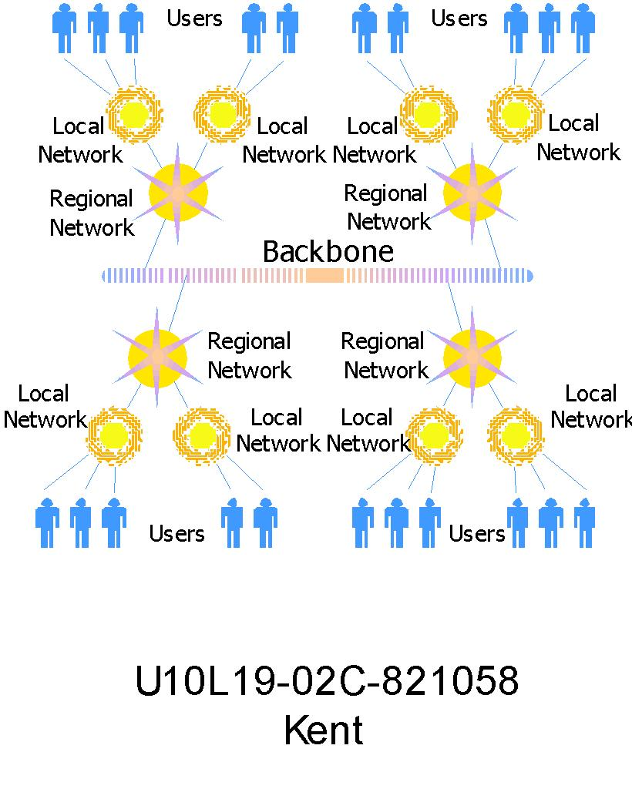
1.2 Web application development…

Slide 8
1.2 Web application development…
World-wide-web (WWW)
  a system of interlinked hypertext documents that are accessed via the Internet with a browser
one can view web pages that may contain text, images, videos, and other multimedia and navigate between them via hyperlinks

Slide 9
1.2 Web application development…
5. User receives file displayed by the browser
4. Server sends requested files to browser to be interpreted
Browser
1. User sends request
3. Server accepts
and processes
request from
browser
2. Browser interprets user’s
selection and makes request from appropriate server

Slide 10
1.2 Web application development…
Hyper-text Markup Language (HTML)
Cascading Style-sheets (CSS)
Client-side Scripting Language (JavaScript)
Serve-side Scripting Language (PHP)
Database Language (MySql)

Slide 11
1.3 Books
Web Engineering, by Gerti Kappel, Birgit Proll, Siegfried Reich, Werner Retschitzegger, John Wiley & Sons; 1st Edition 2006, ISBN: 3-89864-234-8
Beginning HTML, XHTML,CSS, and JavaScript, by Jon Duckett, Wiley Publishing; 2009, ISBN: 978-0-470-54070-1.
Beginning PHP programming, by Matt Doyle, Wrox publishers, 2009, ISBN: 0470413964
Reference books:
Head First HTML with CSS & XHTML (Head First) by Elisabeth Freeman and Eric Freeman, O'Reilly Media; 1 edition (December 1, 2005), ISBN: 059610197X
Beginning PHP and MySQL by W. Jason Gilmore, Apress publisher, 4th edition; 2010, ISBN-13 (electronic): 978-1-4302-3115-8.

Slide 12
2. Web engineering
Software Engineering is the science and art of building significant software systems that are:
  on time
  on budget
  with acceptable performance
  with correct operation

Slide 13
2. Web engineering…
Web engineering is the process used to create high quality Web-based applications (WebApps)
Web engineering draws heavily on the principles and management activities found in software engineering processes
Web engineering extends Software Engineering to Web applications

Slide 14
2. Web engineering…
“The application of systematic and quantifiable approaches to cost-effective analysis, design, implementation, testing, operation, and maintenance of high-quality Web applications”

Slide 15
3. Web applications
WWW has massive and permanent influence on our lives
  Economy, Industry, education, healthcare, entertainment
Why?
  global and permanent
  Comfortable and uniform access

Slide 16
3. Web applications…
WWW started as an informational medium
Evolved into application medium
  Interactive, data intensive services
Distinguishing factors
  How it is used?
  Technologies and standards for development

Slide 17
3. Web applications…
A Web application is a system that utilizes W3C standards & technologies to deliver Web-specific resources to clients (typically) through a browser
Technology + interaction
  Web site with no software components (such as static HTML pages)?

Slide 18
4. The case for web engineering
Application development on the Web remains largely ad hoc
  unplanned, one-time events
  Individual experience
  Little or no documentation for code/design
Short-term savings lead to long-term problems in operation, maintenance, usability, etc.
  lack of performance, reliability, user-freindliness and scalability
Because Web apps are so interdependent, the problem is compounded.

Slide 19
4. The case for web engineering…
Root Causes of poor design
  Development as an authoring activity
  Development is “easy”
  Techniques that should not be used are misapplied
  Techniques that should be used are not

Slide 20
4. The case for web engineering…
Top project drawbacks (Cutter, 2000):
  84% - Failure to meet business objectives
  79% - Project schedule delays
  63% - Budget overrun
  53% - Lack of functionality
Web Engineering’s solution:
  Clearly defined goals & objectives
  Systematic, phased development
  Careful planning
  Iterative & continuous auditing of the entire process

Slide 21
5. Categories of web applications
Document-centric web
Interactive and transactional web applications
Workflow-based web applications
Collaborative and social web applications
Portal-oriented web applications
Ubiquitous web applications

Slide 22
5.1 Document-centric web sites
originator to Web applications
Static HTML documents
Manual updates
Pros
  Simple, stable, short response times
Cons
  High management costs for frequent updates & large collections
  More prone to inconsistent/redundant info
Example: static home pages

Slide 23
5.2 Interactive & transactional
Not only read-only content but also allow content modification
Come with the introduction of HTML forms
Simple interactivity
Dynamic page creation
  Web pages and links to other pages generated dynamically based on user input
Content updates -> Transactions
  Database connectivity
  Increased complexity
Examples: news sites, booking systems, online banking

Slide 24
5.3 Workflow-based applications
Designed to handle business processes across departments, organizations & enterprises
Automates processes consisting of serious of steps
Business logic defines the structure
High complexity; autonomous entities
Examples: B2B & e-Government

Slide 25
5.4 Collaborative & social web
Unstructured, cooperative environments
  Support shared information workspaces to create, edit and manage shared information
  Interpersonal communication is paramount
Classic example: Wikis
The Social Web
  Unrecognizability traditionally characterized WWW
  Moving towards communities of interest
  Examples: Blogs, facebook, twitter etc.

Slide 26
5.5 Web portals
One specially-designed at a website which brings information together from diverse sources in a uniform way
Each information source gets its dedicated area
Specialized portals
  Business portals
  Marketplace portals
  Community portals

Slide 27
5.6 Ubiquitous web applications
Customized services delivered anywhere via multiple devices
Still an emerging field

Slide 28
5.7 Categories of Web Applications (development history vs complexity)
Ubiquitous
Social Web
Collaborative
Workflow
Based
Complexity
Transactional
Portal
Oriented
Interactive
Doc-Centric
Development History

Slide 29
6. Characteristics of Web Applications
How do Web applications differ from traditional applications?
3 dimensions
  Product-based
  Usage-based
  Development-based

Slide 30
6.1 Product-based characteristics
Product-related characteristics constitute the “building blocks” of a Web application
Content
  Document character & multimedia
  Quality demands: current, exact, consistent, reliable
Navigation Structure (Hypertext)
  Non-linearity
  Potential problems: Disorientation & cognitive overload
User interface (Presentation)
  Appearance
  Self-explanation

Slide 31
6.2 Usage-based characteristics
Much greater diversity compared to traditional non-Web applications
  Users vary in numbers, cultural background, devices, h/w, s/w, location etc
Social Context (Users)
  Spontaneity - scalability
  Heterogeneous groups
Technical Context (Network & Devices)
  Quality-of-Service
Natural Context (Place & Time)
  Globality
  Availability

Slide 32
6.3 Development-based characteristics
The Development Team
  Multidisciplinary – print publishing, s/w development, marketing & computing, art & technology
Technical Infrastructure
  Lack of control on the client side
Integration
  Internal – with existing legacy systems
  External – with Web services
  Integration issues: correct interaction, guaranteed QoS

Slide 33
7. Summary
Web engineering extends Software Engineering to Web applications
Why web engineering?
Web applications
Categories and characteristics of web applications

Slide 34
8. References
Lecture Slides by Kappel et al.
Chapter 1, Kappel, G., Proll, B. Reich, S. & Retschitzegger, W. (2006). Web Engineering, 1st ed. Hoboken, NJ: Wiley & Sons
  UNESCO ICTLIP Module 6. Lesson 1 Slides

