Slide 1
Network Security
Lecture 9
Presented by: Dr. Munam Ali Shah

Slide 2
Summary of the previous lecture
We talked about different types of security attacks for wireless networks such as man-in-the middle attack, spoofing, wardrive etc.
We discussed how different solution could be used to secure our wireless networks. Some of the solutions we discussed are limiting the signal of wireless network and use of encryption
We also studies about mobile networks and specialized attacks that can breach the security of a wireless network.

Slide 3
Outlines of today’s lecture
We will continue our discussion on:
Mobile Device Security
    Mobile Device Security Strategy
Robust Security Network (RSN) and IEEE802.11i
Network Security Model

Slide 4
Objectives
You would be able to present an overview of security threats and countermeasures for mobile networks.
Understand the basics of IEEE802.11i standard for robust security
Describe the principal elements for a network security model.

Slide 5
Mobile Device Security Strategy
With the threats for mobile networks discussed in Lecture 8, Let us now see the main elements of a mobile device security strategy. They fall into three categories:
    device security
    client/server traffic security
    barrier security

Slide 6
1. Device Security
Different organizations supply mobile devices for employee use and preconfigure those devices to ensure company security policy.
Some organizations adopt bring-your-own-device (BYOD) policy that allows personal devices to access company’s resources
For BYOD policy, the IT staff should:
    Inspect each device before allowing networks access
    Establish configuration guidelines, e.g., rooted or jail-broken devices should not be permitted
    The device must not be allowed to store company’s contacts on mobile

Slide 7
Device Security (cont.)
Following security controls should be configured on the mobile devices
    Enable auto-lock
    Enable SSL (secure socket layer)
    Enable password or PIN protection
    Avoid using auto-complete features that remember passwords
    Enable remote wipe
    Make sure that software, including operating systems and applications, is up to date.
    Install antivirus software as it becomes available.

Slide 8
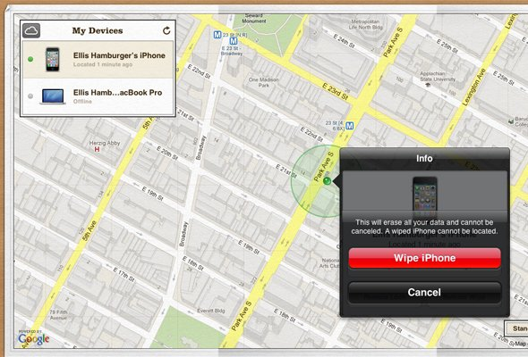
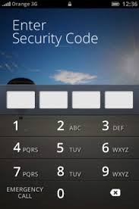
Examples of device Security

Slide 9
Device Security (cont.)
    Either sensitive data should be prohibited from storage on the mobile device or it should be encrypted.
    IT staff should also have the ability to remotely access devices, wipe the device of all data, and then disable the device in the event of loss or theft.
    The organization may prohibit all installation of third-party applications
    implement and enforce restrictions on what devices can synchronize and on the use of cloud-based storage
    Disable location services
    Employees training

Slide 10

2. Traffic Security
Traffic security is based on the usual mechanisms for encryption and authentication. All traffic should be encrypted and travel by secure means, such as SSL or IPv6. Virtual private networks (VPNs) can be configured so that all traffic between the mobile device and the organization’s network is via a VPN.

Slide 11
Traffic Security (Cont.)
A strong authentication protocol should be used to limit the access from the device to the resources of the organization. A preferable strategy is to have a two-layer authentication mechanism, which involves authenticating the device and then authenticating the user of the device.

Slide 12
Barrier Security
The organization should have security mechanisms to protect the network from unauthorized access. The security strategy can also include firewall policies specific to mobile device traffic.
Firewall policies can limit the scope of data and application access for all mobile devices. Similarly, intrusion detection (IDS) and intrusion prevention systems (IPS) can be configured to have tighter rules for mobile device traffic.

Slide 13
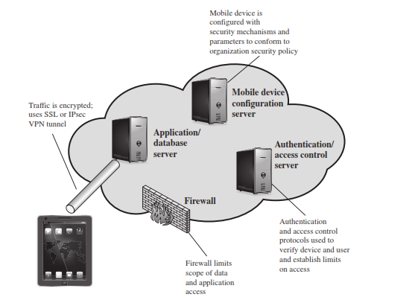
Mobile Device Security Strategy

Slide 14
Robust Security Network (RSN)
Wireless LAN are different from wired LAN in following ways:
    Physical connection acts as a form of authentication
    A wired LAN provides a degree of privacy, limiting reception of data to stations connected to the LAN. On the other hand, with a wireless LAN, any station within radio range can receive.

Slide 15
Robust Security Network (RSN)
These differences between wired and wireless LANs suggest the increased need for robust security services and mechanisms for wireless LANs.
The original 802.11 specification included a set of security features for privacy and authentication that were quite weak. For privacy, 802.11 defined the Wired Equivalent Privacy (WEP) algorithm. The privacy portion of the 802.11 standard contained major weaknesses.
Subsequent to the development of WEP, the 802.11i task group has developed a set of capabilities to address the WLAN security issues.

Slide 16
RSN
The final form of the 802.11i standard is referred to as Robust Security Network (RSN).
The 802.11i RSN security specification defines the following services.
    Authentication
    Access Control
    Privacy with message integrity

Slide 17
RSN Services
Authentication: A protocol is used to define an exchange between a user and an Authentication Server (AS) that provides mutual authentication and generates temporary keys to be used between the client and the AP over the wireless link.
Access control: This function enforces the use of the authentication function, routes the messages properly, and facilitates key exchange. It can work with a variety of authentication protocols.
Privacy with message integrity: MAC-level data such as frames are encrypted to ensure that the data have not been altered.

Slide 18
IEEE802.11i Five Phases of Operation
Discovery
Authentication
Key generation and distribution
Protected data transfer
Connection Termination

Slide 19
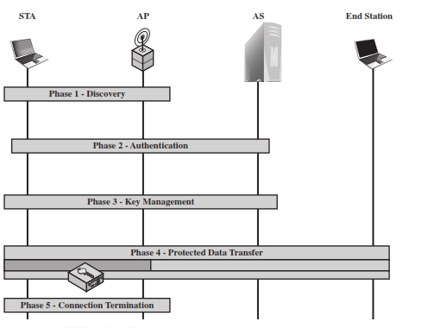
IEEE802.11i Five Phases of Operation

Slide 20
Network Security Model
Security aspects come into play when it is necessary or desirable to protect the information transmission from an opponent who may present a threat to confidentiality, authenticity, and so on. All the techniques for providing security have two components:
    A security-related transformation on the information to be sent. Examples include the encryption of the message, which scrambles the message so that it is unreadable by the opponent, and the addition of a code based on the contents of the message, which can be used to verify the identity of the sender.
    Some secret information shared by the two principals and, it is hoped, unknown to the opponent. An example is an encryption key used in conjunction with the transformation to scramble the message before transmission and unscramble it on reception

Slide 21
Model for Network Security
This general security model shows that there are four basic tasks in designing a particular security service:
  Design an algorithm for performing the security-related transformation. The algorithm should be such that an opponent cannot defeat its purpose.
  Generate the secret information to be used with the algorithm.
  Develop methods for the distribution and sharing of the secret information.
  Specify a protocol to be used by the two principals that makes use of the security algorithm and the secret information to achieve a particular security service.

Slide 22
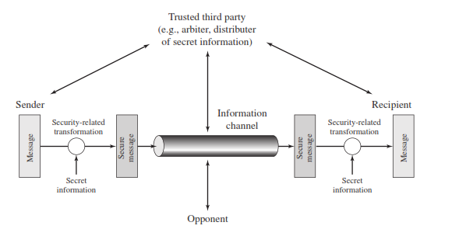
Model for Network Security

Slide 23
Summary of today’s lecture
We talked about different security measures that can be used to make a mobile network secure
We also talked about IEEE802.11i standard which ensures security in a WLAN by using different protocols
Lastly, we discussed network security model which provides detail of what need to be protected against whome.

Slide 24
Next lecture topics
Our discussion on Network security will continue and we will see some new paradigms of ensuring security
We will see some examples and protocols which are used to secure a communication in a practical fashion

Slide 25
The End

