Slide 1
Network Security
Lecture 8
Presented by: Dr. Munam Ali Shah

Slide 2
Summary of the previous lecture
We learnt why wireless networks are more prone to security threats and vulnerabilities.
We studied different 5 different ways to secure a WLAN, e.g., disabling the SSID, MAC filtration, applying security mode such as WEP or WPA etc.

Slide 3
Outlines
We will continue our discussion on:
Wireless Security
    Wireless Network Threats
    Wireless Security Measures
Mobile Device Security
    Security Threats

Slide 4
Objectives
You would be able to present an overview of security threats and countermeasures for wireless networks.
Understand the unique security threats posed by the use of mobile devices with enterprise networks.

Slide 5

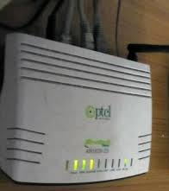
Did You..?
Did you practice applying different techniques to secure the WLAN in your home or office?

Slide 6
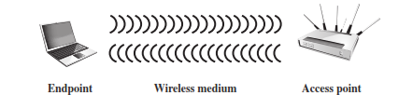
Wireless Networking Components

Slide 7
Wireless Security
Wireless networks, and the wireless devices that use them, introduce a host of security problems over and above those found in wired networks. Some of the key factors contributing to the higher security risk of wireless networks compared to wired networks include the following:
    Channel
    Mobility
    Accessibility
    Resources

Slide 8
Wireless Security
Channel:
  Wireless networking typically involves broadcast communications, which is far more susceptible to eavesdropping and jamming than wired networks. Wireless networks are also more vulnerable to active attacks that exploit vulnerabilities in communications protocols.

Slide 9
Wireless Security
Mobility:
Wireless devices are, in principal and usually in practice, far more portable and mobile than wired devices. This mobility results in a number of risks, described subsequently.
Resources:
Some wireless devices, such as smartphones and tablets, have sophisticated operating systems but limited memory and processing resources with which to counter threats, including denial of service and malware
Accessibility:
Some wireless devices, such as sensors and robots, may be left unattended in remote and/or hostile locations. This greatly increases their vulnerability to physical attacks.

Slide 10
Wireless Network Threats
Following are some of the security threats to a wireless network
    Accidental Association
    Malicious Association
    Ad Hoc Networks
    Nontraditional Networks
    Identity Theft
    Man-in-the middle attacks
    DoS
    Network Injection

Slide 11
    Accidental Association
Company wireless LANs or wireless access points to wired LANs in close proximity (e.g., in the same or neighboring buildings) may create overlapping transmission ranges.
A user intending to connect to one LAN may unintentionally lock on to a wireless access point from a neighboring network. Although the security breach is accidental, it nevertheless exposes resources of one LAN to the accidental user.

Slide 12
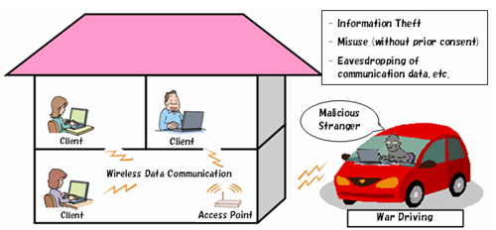
Malicious association and Wardriving
In this situation, a wireless device is configured to appear to be a legitimate access point, enabling the operator to steal passwords from legitimate users and then penetrate a wired network through a legitimate wireless access point.
Notes:
Ingress: the right or permission to enter.

Slide 13
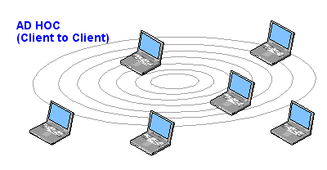
Ad hoc networks
These are peer-to-peer networks between wireless computers with no access point between them. Such networks can pose a security threat due to a lack of a central point of control.

Slide 14
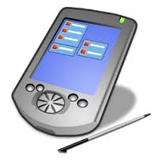

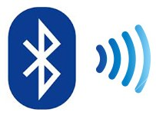

Nontraditional networks
Nontraditional networks and links, such as personal network Bluetooth devices, barcode readers, and handheld PDAs, pose a security risk in terms of both eavesdropping and spoofing.
Notes:
Manifestation is an indication of the existence.
US-CERT Established in 2003 to protect the nation's Internet infrastructure, US-CERT coordinates defense against and responses to cyber attacks across the nation.

Slide 15
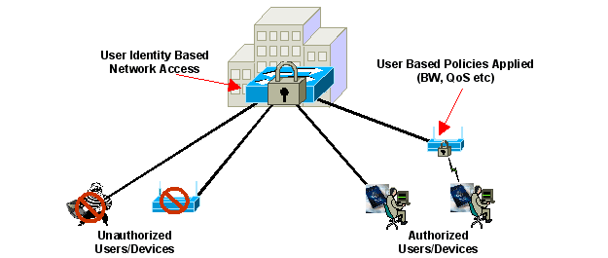
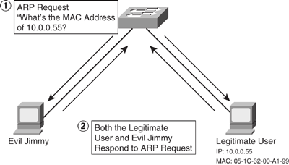
Identity theft (MAC spoofing):
This occurs when an attacker is able to eavesdrop on network traffic and identify the MAC address of a computer with network privileges.

Slide 16
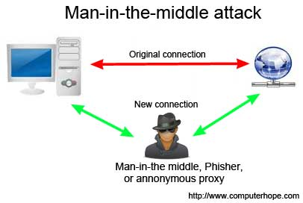
Man-in-the middle attacks
In a broader sense, this attack involves persuading a user and an access point to believe that they are talking to each other when in fact the communication is going through an intermediate attacking device. Wireless networks are particularly vulnerable to such attacks.

Slide 17
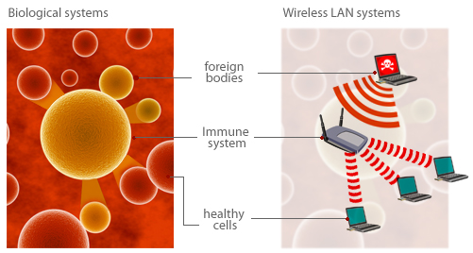
Denial of service (DoS)
In the context of a wireless network, a DoS attack occurs when an attacker continually bombards a wireless access point or some other accessible wireless port with various protocol messages designed to consume system resources.
The wireless environment lends itself to this type of attack, because it is so easy for the attacker to direct multiple wireless messages at the target.

Slide 18
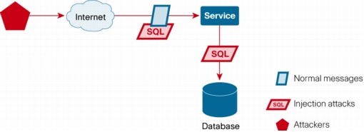
Network injection
A network injection attack targets wireless access points that are exposed to non-filtered network traffic, such as routing protocol messages or network management messages.
An example of such an attack is one in which bogus reconfiguration commands are used to affect routers and switches to degrade network performance.

Slide 19
Wireless Security Measures
Securing Wireless Transmission:
The principal threats to wireless transmission are eavesdropping, altering or inserting messages, and disruption. To deal with eavesdropping, two types of countermeasures are appropriate:
    Signal-hiding techniques
    Encryption

Slide 20
    Signal-hiding Techniques
Organizations can take a number of measures to make it more difficult for an attacker to locate their wireless access points, including:
    turning off service set identifier (SSID) broadcasting by wireless access points;
    assigning cryptic names to SSIDs
    reducing signal strength to the lowest level that still provides requisite coverage
    and locating wireless access points in the interior of the building, away from windows and exterior walls
Greater security can be achieved by the use of directional antennas and of signal-shielding techniques.

Slide 21
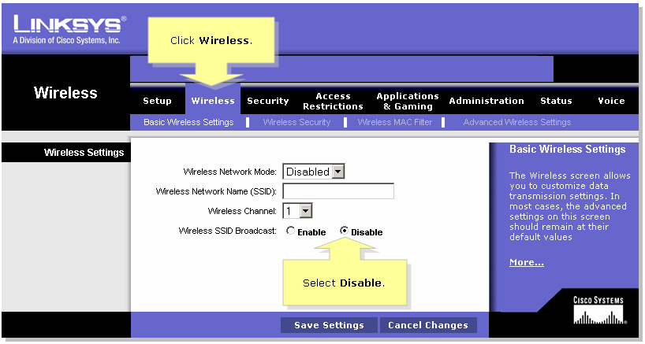
Disabling SSID Broadcast
One example of signal hiding

Slide 22

Encryption
Encryption of all wireless transmission is effective against eavesdropping to the extent that the encryption keys are secured. The use of encryption and authentication protocols is the standard method of countering attempts to alter or insert transmissions.

Slide 23
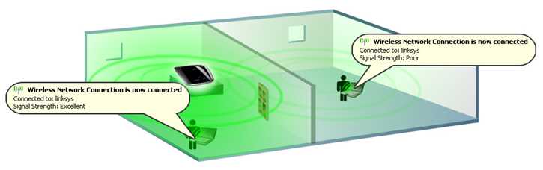
More techniques to Secure a Wireless Network
Use antivirus and antispyware
Change the default settings on wireless router or Access Point
Change default administrator password
Allow only approved devices to connect your wireless network
Limiting the wireless signal

Slide 24
Mobile Device Security
Prior to the widespread use of smartphones, the dominant paradigm for computer and network security in organizations was as follows.
    Corporate IT was tightly controlled.
    User devices were typically limited to Windows PCs.
    Business applications were controlled by IT and either run locally on endpoints or on physical servers in data centers.
    Network security was based upon clearly defined perimeters that separated trusted internal networks from the untrusted Internet.
Today, there have been massive changes in each of these assumptions. An organization’s networks must accommodate the following:

Slide 25
Mobile Device Security
Growing use of new devices
Cloud-based and Internet-based applications
    Dropbox, Facebook, Skype etc.
De-perimeterization
    New devices with new needs such as connecting to multiple networks, around devices, applications, user role, and data to be incorporated and addressed.
External Business Requirement
    Providing access to third-parties, contractors and business partners

Slide 26
Security Threats in Mobile devices Environment
Mobile Devices need additional, specialized protection measures beyond those implemented for other client devices, such as desktop and laptop devices that are only connected to organization’s network and are within physical premises of an organization.
Following are 7 different types of major security concerns for mobile devices

Slide 27
Security Threats in Mobile devices Environment
Lack of Physical security control
    User can use in different location other than organization premises
    Even if within organization, the user may move the device within secure and non-secured locations
    This can lead towards theft and tempering
    A malicious party attempt to recover sensitive data from the device itself
    May use the device to gain access to the organization’s resources

Slide 28
Security Threats in Mobile devices Environment
Use of untrusted mobile devices
Use of untrusted networks
Use of applications created by unknown parties
Interaction with other systems
    Automatically, synchronizing data with other computing or cloud storage devices
Use of untrusted content such as Quick Response Barcode
Use of location services
    GPS capability on mobile devices can be used to maintain a knowledge of the physical location of the device.

Slide 29
Summary of today’s lecture
In today’s lecture, we discussed how different security measures could be used to secure a wireless network
We talked about the nature of Mobile networks and new kind of threats that are imposed on mobile devices

Slide 30
Next lecture topics
We will continue our discussion on mobile device security strategy
Robust Security Network (RSN) and IEEE802.11i
Network Security Model

Slide 31
The End

