Slide 1
Network Security
Lecture 7
Presented by: Dr. Munam Ali Shah

Slide 2
Summary of the previous lecture
We learnt about different types of DoS attacks
We have seen how ICMP can be a victim of DoS attack
Some examples of ping to death and SYNC flood attacks were discussed in detail

Slide 3
Outlines
Some more discussion on DDoS attacks
Security in Wireless Networks
Types of WLAN and relevant security mechanism
Different ways to secure a WLAN

Slide 4
Objectives
To be able to understand why wireless LANs are more prone to security threats and vulnerabilities
To identify and classify among different solutions that can be used to secure a WLAN

Slide 5
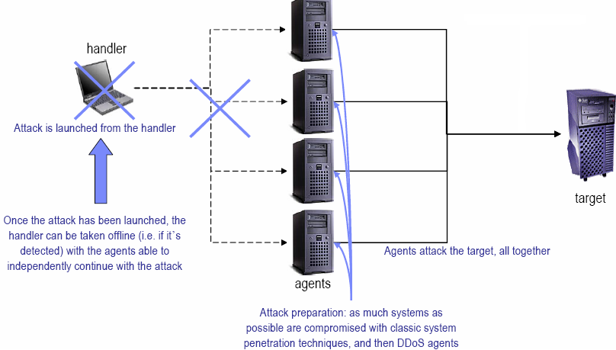
Distributed Denial of Service (DDoS)
The attacking host is replicated through an handler-agent distributed framework

Slide 6
Distributed Denial of Service
Cont.
Two kinds of victims:
  agents (compromised using common weaknesses to install DDoS agents code), likely to be identified guilty during the first stage of the investigation
  end targets (during the attack)

Slide 7
DDoS protection
Configure routers to filter network traffic
  Perform ingress filtering
  Configure traffic rate limiting (ICMP, SYN, UDP, etc)
Deploy firewalls at the boundaries of your network
  The filtering system must be able to distinguish harmful uses of a network service from legitimate uses.
Perform regular network vulnerability scans
  common and known vulnerabilities could be exploited to install DDoS agents.
  Identify the agents that are listening to the handler’s commands
Notes:
Ingress: the right or permission to enter.

Slide 8
DDoS protection
Cont.
Install IDS (Intrusion Detection Systems) capable of detecting
  DDoS handler-to-agent communication
  DDoS agent-to-target attacks

Slide 9
Manifestation of DoS Attacks
Unusually slow network performance (opening files or accessing web sites)
unavailability of a particular web site
inability to access any web site
dramatic increase in the number of spam emails received.
Notes:
Manifestation is an indication of the existence.
US-CERT Established in 2003 to protect the nation's Internet infrastructure, US-CERT coordinates defense against and responses to cyber attacks across the nation.

Slide 10

Security in Wireless Network
Due to its nature, wireless Networks are more prone to security threats and vulnerabilities.
Since, the medium is air (radio waves), it cannot be physically protected.

Slide 11

Wireless LANs
IEEE ratified 802.11 in 1997.
  Also known as Wi-Fi.
Wireless LAN at 1 Mbps & 2 Mbps.
WECA (Wireless Ethernet Compatibility Alliance) promoted Interoperability.
  Now Wi-Fi Alliance
802.11 focuses on Layer 1 & Layer 2 of OSI model.
  Physical layer
  Data link layer

Slide 12
802.11 Components
Two pieces of equipment defined:
  Wireless station
    A desktop or laptop PC or PDA with a wireless NIC.
  Access point
    A bridge between wireless and wired networks
    Composed of
      Radio
      Wired network interface (usually 802.3)
      Bridging software
    Aggregates access for multiple wireless stations to wired network.

Slide 13
802.11 modes
Infrastructure mode
  Basic Service Set
    One access point
  Extended Service Set
    Two or more BSSs forming a single subnet.
  Most corporate LANs in this mode.
Ad-hoc mode
  Also called peer-to-peer.
  Independent Basic Service Set
  Set of 802.11 wireless stations that communicate directly without an access point.
    Useful for quick & easy wireless networks.

Slide 14
Service Set Identifiers
The Service Set Identifier (SSID) is the name of the wireless network. A wireless router or access point broadcasts the SSID by default so that wireless devices can detect the wireless network.
To disable SSID broadcasting, use the following path, as shown in the figure:
Wireless > Basic Wireless Settings > select Disabled for SSID Broadcast > Save Settings > Continue
Disabling the SSID broadcast provides very little security. If the SSID broadcast is disabled, each computer user that wants to connect to the wireless network must enter the SSID manually. When a computer is searching for a wireless network, it will broadcast the SSID.
Notes:
10.2.4.2 Service Set Identifiers

Slide 15


Infrastructure mode
Access Point
Basic Service Set (BSS) –
Single cell
Station
Extended Service Set (ESS) –
Multiple cells
Notes:
Usual configuration for offices.

Slide 16
Ad-hoc mode
Independent Basic Service Set (IBSS)
Notes:
For meetings, conferences or other places where wireless infrastructure (access points) doesn’t exist.

Slide 17
Joining a BSS
When 802.11 client enters range of one or more APs
  APs send beacons.
  AP beacon can include SSID.
  AP chosen on signal strength and observed error rates.
  After AP accepts client.
    Client tunes to AP channel.
Periodically, all channels surveyed.
  To check for stronger or more reliable APs.
  If found, reassociates with new AP.
Notes:
Wireless NICs can measure strength of wireless signal.

Slide 18
Wireless Ethernet Standards
 | Bandwidth | Frequency | Range | Interoperability
802.11a | Up to 54 Mbps | 5 GHz band | 100 feet (30 meters) | Not interoperable with 802.11b, 802.11g, or 802.11n
802.11b | Up to 11 Mbps | 2.4 GHz band | 100 feet (30 meters) | Interoperable with 802.11g
802.11g | Up to 54 Mbps | 2.4 GHz band | 100 feet (30 meters) | Interoperable with 802.11b
802.11n | Up to 540 Mbps | 2.4 GHz band | 164 feet (50 meters) | Interoperable with 802.11b and 802.11g
802.15.1 Bluetooth | Up to 2 Mbps | 2.4 GHz band or 5 GHz band | 30 feet (10 meters) | Not interoperable with any other 802.11
Notes:
6.6.1.4 Explain wireless Ethernet standards

Slide 19
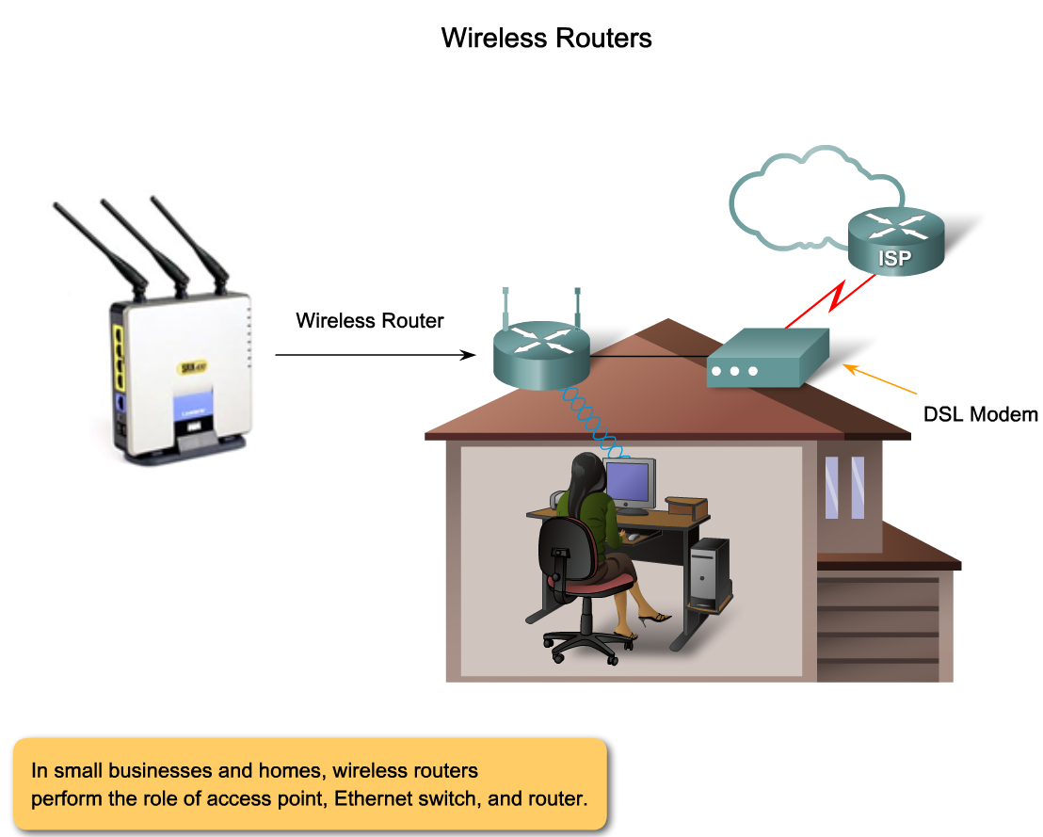
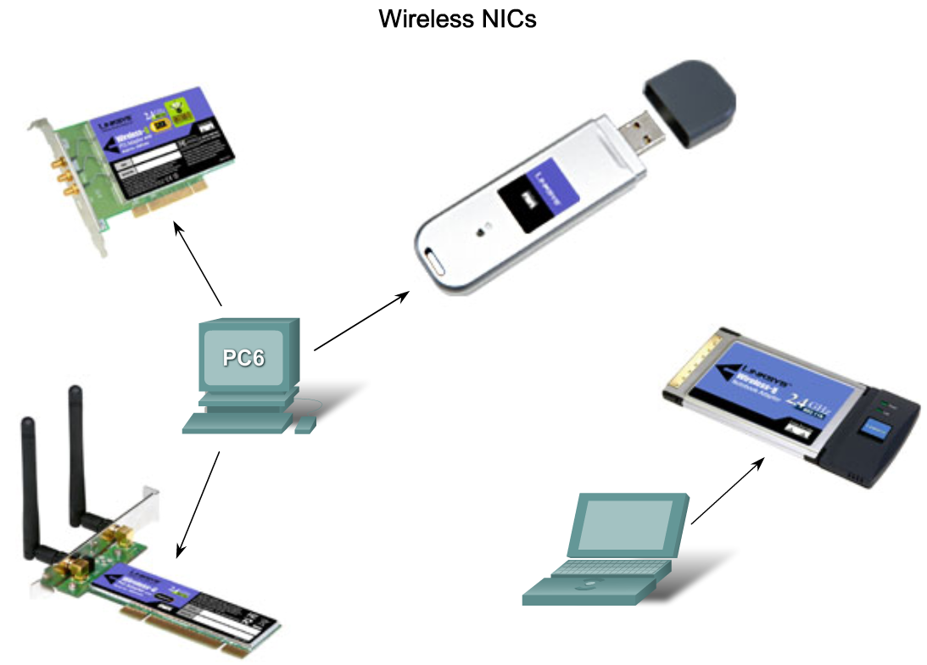
Components and Operations of Basic Wireless LAN Topologies
Components of a 802.11-based wireless infrastructure

Slide 20
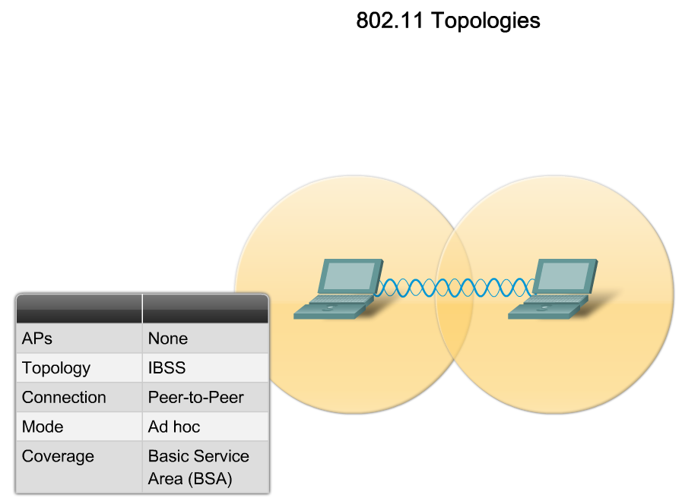
The Components and Operations of Basic Wireless LAN Topologies
How wireless networks operate

Slide 21
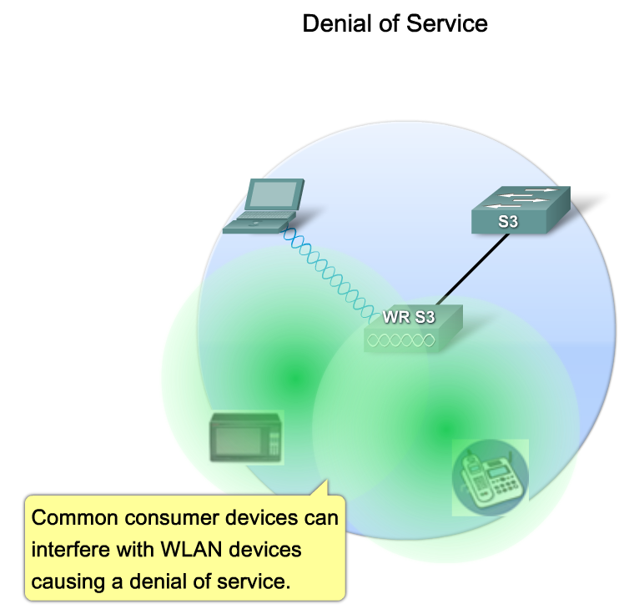
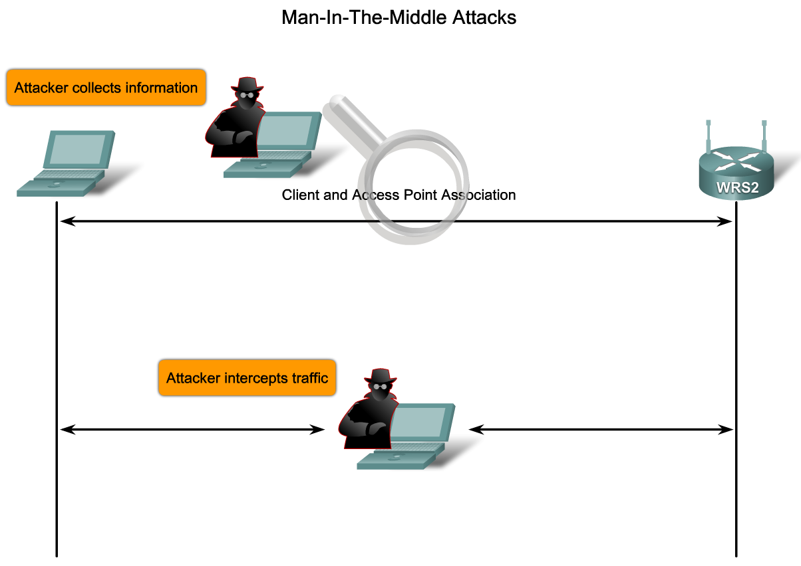
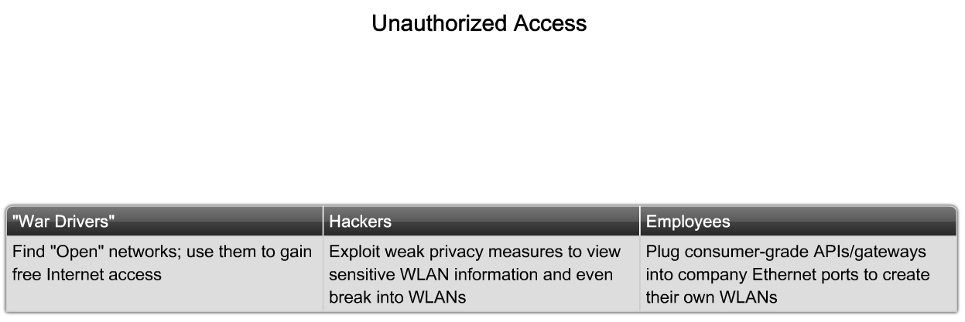
The Components and Operations of Basic Wireless LAN Security
The threats to wireless LAN security

Slide 22
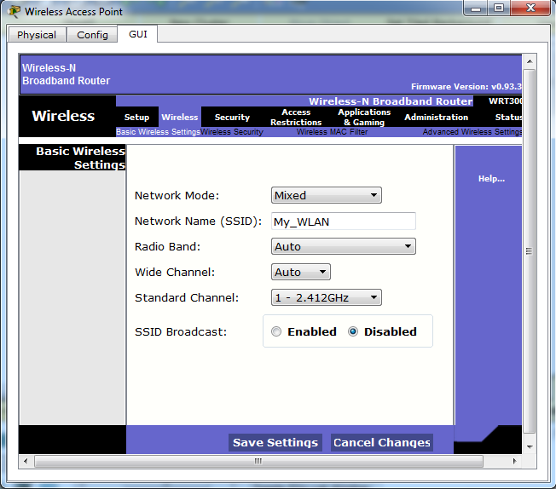
Security in a WLAN in 5 ways
Disabling the SSID

Slide 23
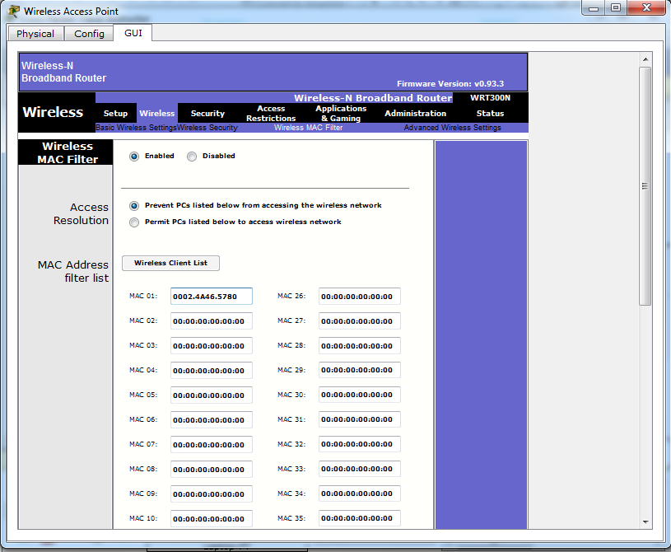
Security in WLAN
2. MAC address filtration

Slide 24
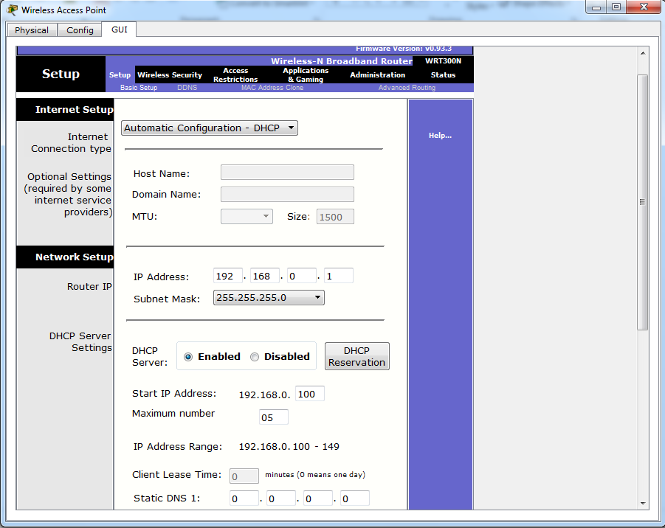
Security in WLAN
3. Limiting the number of IPs

Slide 25
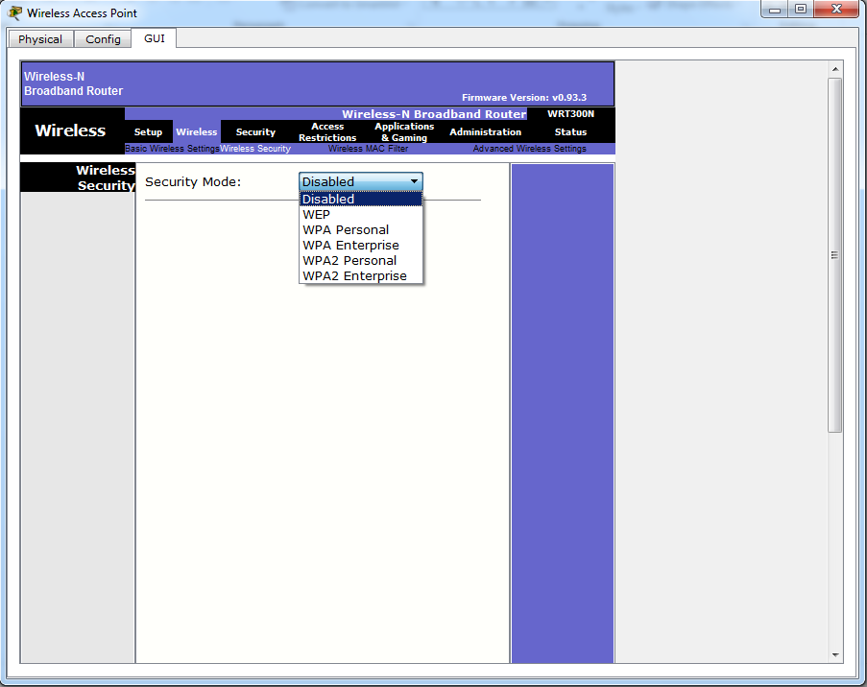
Security in WLAN
4. Enabling the Security mode

Slide 26
Security in WLAN
4. Wireless Security mode
Wired Equivalent Privacy (WEP) – The first generation security standard for wireless. Attackers quickly discovered that WEP encryption was easy to break.
Wi-Fi Protected Access (WPA) An improved version of WEP, uses much stronger encryption.
Wi-Fi Protected Access 2 (WPA2) WPA2 supports robust encryption, providing government-grade security.

Slide 27
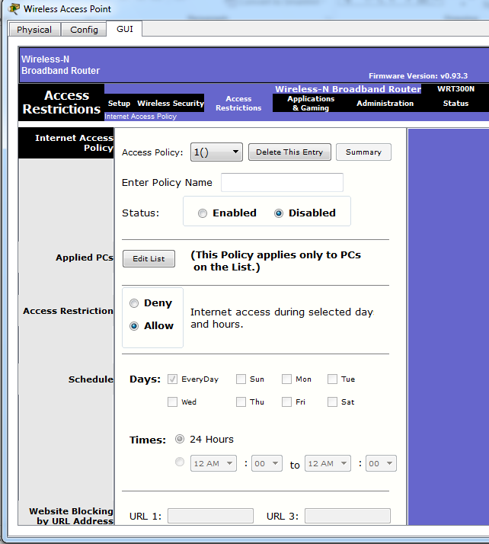
Security in WLAN
5. Internet Access
Policy

Slide 28
Wireless Access
More ways to secure a WLAN
Wireless Antennae
  Avoid transmitting signals outside of the network area by installing an antenna with a pattern that serves your network users.
Network Device Access
  On first connection to the network device, change the default username and password.
Wi-Fi Protected Setup (WPS)
  The user connects to the wireless router using the factory-set PIN that is either printed on a sticker or shown on a display.
  Software has been developed that can intercept traffic and recover the WPS PIN and the pre-shared encryption key. Disable WPS on the wireless router if possible.
Notes:
10.2.4.6 Wireless Access

Slide 29
Summary of today’s lecture
In today’s lecture, we discussed how DDoS can be harmful to a network and what countermeasures such as IDS can be used to stop DDoS attacks
We have seen that the nature of wireless network makes it vulnerable to security attacks
We also discusses different ways that can be used to make a WLAN secure

Slide 30
Next lecture topics
We will continue our discussion on WLAN
Wardriving, which is the act of searching for Wi-Fi wireless networks by a person in a moving vehicle, using a portable computer, smartphone, will also be discussed.
Discussion on different security attacks on WLAN

Slide 31
The End

