Slide 1
Network Security
Lecture 6
Presented by: Dr. Munam Ali Shah

Slide 2
Summary of the previous lecture
We discussed different types of security attacks
We looked how viruses, worms and Trojan can be harmful for a computing environment.

Slide 3
Outlines
Botnets
More discussion on DoS attacks
Cost of a DoS attacks
ICMP Echo Datagrams
TCP 3-Way Handshake
TCP SYNC Flood attack

Slide 4
Objectives
To be able to distinguish between different types of security attacks
To identify and classify which security attacks leads to which security breach category

Slide 5
Botnets
A virus or worm often doesn’t do any immediate damage
in order to stay invisible
  and spy on users (log keystrokes, steal serial numbers etc.)
  or add affected machine to a botnet (the machine becomes a bot)
Botnet – a network of “owned” machines (bots)
  controlled usually via IRC protocol or P2P network
  used to send spam, launch DDoS attacks; also phishing,
  click fraud, further spread of viruses and worms etc.
  size: 100, 1000, 10k … up to > 1M of nodes
  access to bots and botnets can be bought (from $0.01 per bot)

Slide 6
Logic Bomb
Logic Bomb
  Program that initiates a security incident under certain circumstances
  It waits for certain conditions to occur.
Stack and Buffer Overflow
  Exploits a bug in a program (overflow either the stack or memory buffers)
  Failure to check bounds on inputs, arguments
  Write pass arguments on the stack into the return address on stack
  When routine returns from call, returns to hacked address
    Pointed to code loaded onto stack that executes malicious code
  Unauthorized user or privilege escalation

Slide 7
Virus Dropper
Virus dropper inserts virus onto the system
Many categories of viruses, literally many thousands of viruses
  File / parasitic
  Boot / memory
  Macro
  Source code
  Polymorphic to avoid having a virus signature
  Encrypted
  Stealth
  Tunneling
  Multipartite
  Armored

Slide 8
Keystroke logger
Attacks still common, still occurring
Attacks moved over time from science experiments to tools of organized crime
  Targeting specific companies
  Creating botnets to use as tool for spam and DDOS delivery
  Keystroke logger to grab passwords, credit card numbers
Why is Windows the target for most attacks?
  Most common
  Everyone is an administrator
    Licensing required?
  Monoculture considered harmful

Slide 9
Definitions of DoS and DDoS attacks
A DoS (Denial of Service) attack aims at preventing, for legitimate users, authorised access to a system resource or the delaying of system operations and functions
DDoS are distributed Denial of Service attacks that achieve larger magnitude by launching coordinated attacks by using a framework of “handlers” and “agents”. A DDoS is innovative in the form of coordination of the attack.

Slide 10
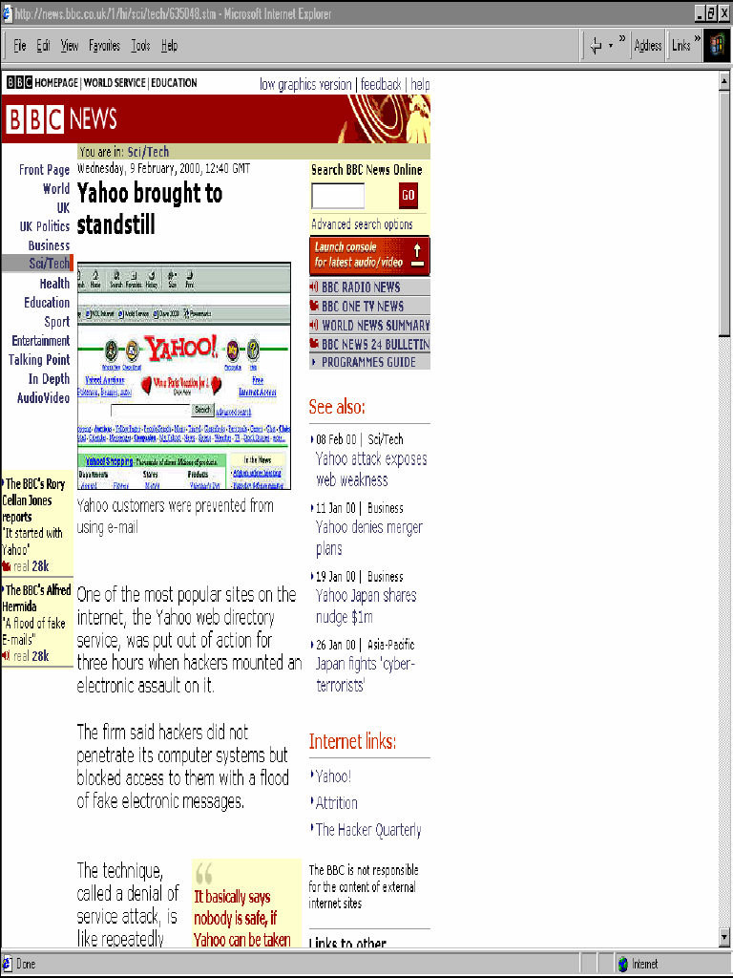
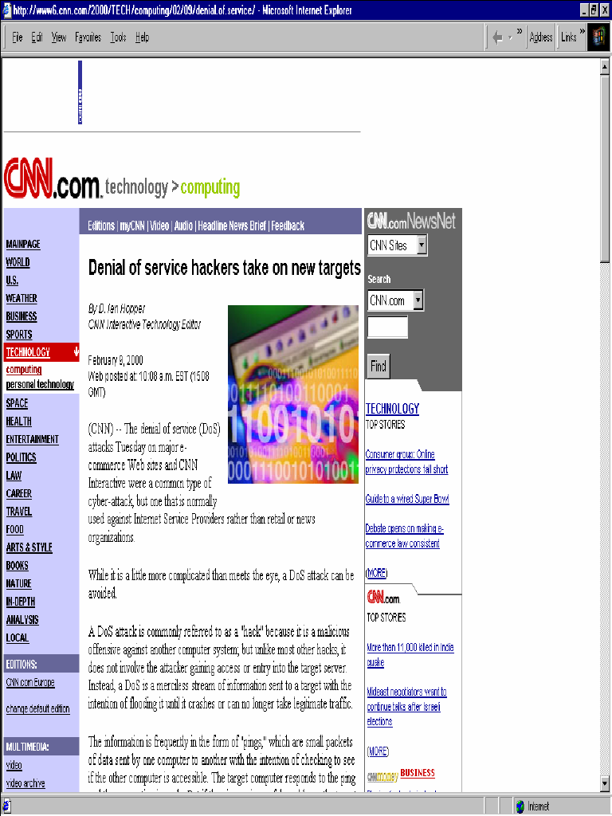
DoS attacks in the news
On February 2000, several serious DDoS attacks targeted some of the largest Internet web sites, including Yahoo, Buy.com, Amazon, CNN and eBay.

Slide 11
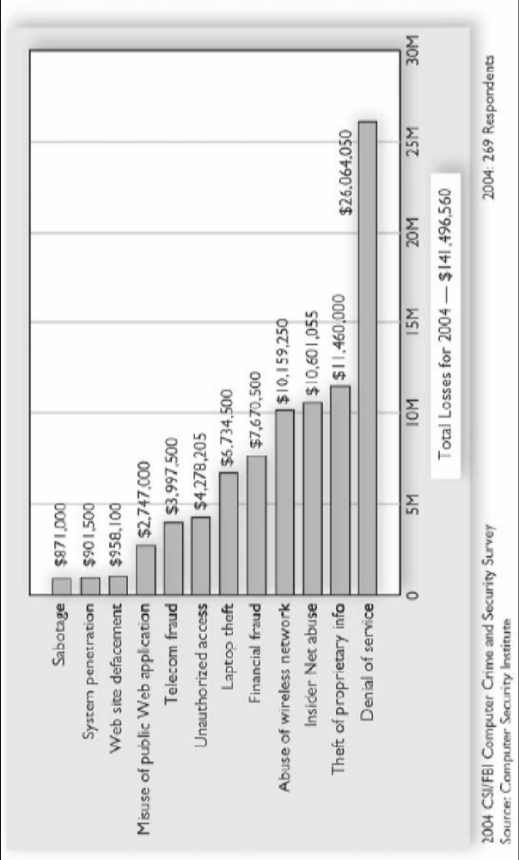
Costs of DoS attacks
Denial of Service is currently the most expensive computer crime for victim organisations:

Slide 12
Classification of DoS attacks
Bandwidth consumption
- Attacks will consume all available network bandwidth
2. Resource starvation
- Attacks will consume system resources (mainly CPU, memory, storage space)
3. Programming flaws
  - Failures of applications or OS components to handle exceptional conditions (i.e. unintended or unexpected data is sent to a vulnerable component)
- OS components’ crash

Slide 13
Modes of attacks
1. Network connectivity attacks
  Flooding
  malformed traffic
2. Consumption of resources
  Filling-up of data structures
  storage (i.e. intentionally generating errors that must be logged)
  side effect of other forms of attack
  from a virus (i.e. SQL slammer virus)
  accounts locked-out during a password cracking
Notes:
SQL slammer exploited a buffer overflow bug in Microsoft's flagship SQL Serve

Slide 14
ICMP “echo” datagrams
ICMP “echo” datagrams are typically used to test network connectivity.
A destination host is expected to respond with an
  ICMP ECHO_REPLY message when “pinged” with an ICMP ECHO_REQUEST message

Slide 15
Ping of death
In the IP specification, the maximum datagram size is 64 KB.
Some systems react in an unpredictable fashion when receiving oversized (>64 KB) IP datagrams, causing systems crashing, freezing or rebooting, and resulting in a denial of service.
Example of a DoS that exploits a programming flaw: the IP implementation is unable to deal with the exceptional condition posed by the oversized datagram.

Slide 16
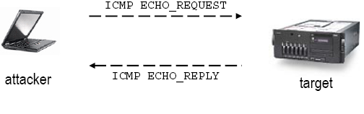
Yet another simple form of DoS: ICMP (ping) flood
Attackers flood a network link with ICMP ECHO_REQUEST messages using the “ping” command
Exploits a characteristic of the IP layer, that answers with ICMP ECHO_REPLY messages upon reception of ICMP ECHO_REQUEST messages
Notes:
The attack is successful only if the source host and the channel between source and target have enough network bandwidth to flood the target host

Slide 17
Directed broadcast addresses
The directed broadcast address is an IP address with all the host address set to 1s in host portion. It is used to simultaneously address all hosts within the same network.
i.e., the directed broadcast address for the network class B 151.100.0.0 has IP address 151.100.255.255
For subnetted networks, the directed broadcast address is an IP address with all the host address set to 1 within the same subnet.

Slide 18
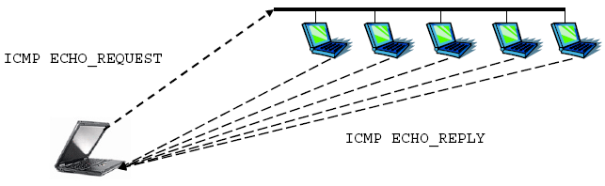
“ping” to a directed broadcast address
All hosts in the broadcast domain answer back
Network traffic “amplification”: 1 datagram generates n datagrams in response (where n is the number of systems replying to a broadcast ICMP ECHO_REQUEST)

Slide 19
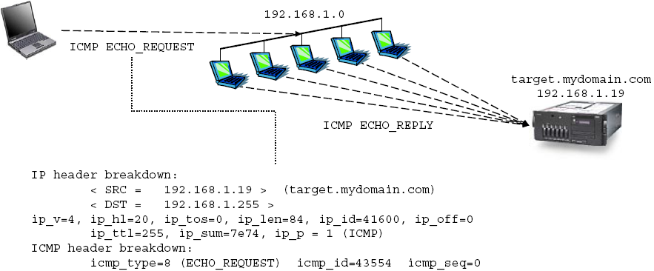
Smurf attack
In a Smurf attack, the attacker sends ping requests to a broadcast address, with the source address of the IP datagram set to the address of the target system under attack (spoofed source address)

Slide 20
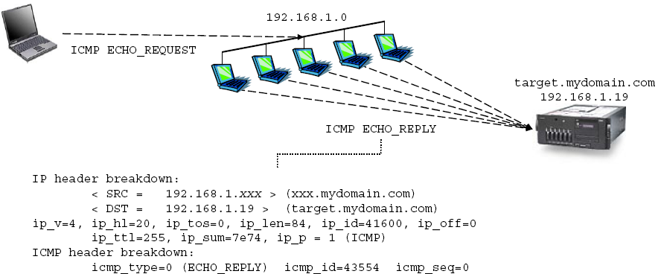
Cont.
Smurf attack
All systems within the broadcast domain will answer back to the target address, thus flooding the target system with ICMP traffic and causing network congestion => little or no bandwidth left for legitimate users

Slide 21
Smurf attack protection
Hosts can be configured not to respond to ICMP datagrams directed to IP broadcast addresses. Most OS have specific network settings to enable/disable the response to a broadcast ICMP ping message.
Disable IP-directed broadcasts at your leaf routers: to deny IP broadcast traffic onto your network from other networks (in particular from the Internet)
A forged source is required for the attack to succeed. Routers must filter outgoing packets that contain source addresses not belonging to local subnetworks.

Slide 22
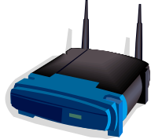

RFC 2827
Defeating DoS which employ IP Spoofing
Router can check any traffic it is passsing for the valid source addres
Network administrator log information on packet which provide basis for monitoring and suspicious activity.

Slide 23
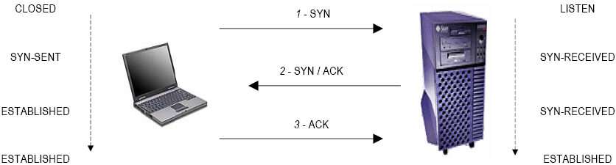
TCP’s three-way handshake
The "three-way handshake" is the procedure used to establish a connection.

Slide 24
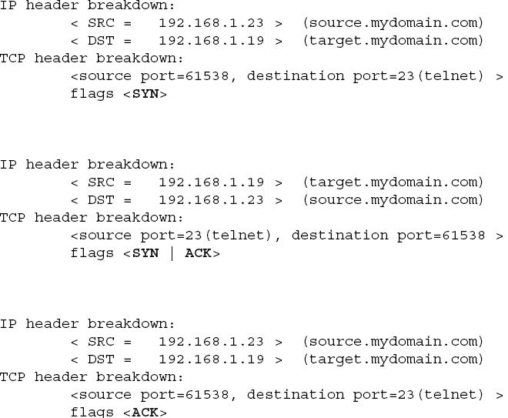
TCP’s three-way handshake
Cont.

Slide 25
TCP SYN flood
A TCP SYN flood is an attack based on bogus TCP connection requests, created with a spoofed source IP address, sent to the attacked system. Connections are not completed, thus soon it will fill up the connection request table of the attacked system, preventing it from accepting any further valid connection request.
The source host for the attack sends a SYN packet to the target host. The target hosts replies with a SYN/ACK back to the legitimate user of the forged IP source address. Since the spoofed source IP address is unreachable, the attacked system will never receive the corresponding ACK packets in return, and the connection request table on the attacked system will soon be filled up.

Slide 26
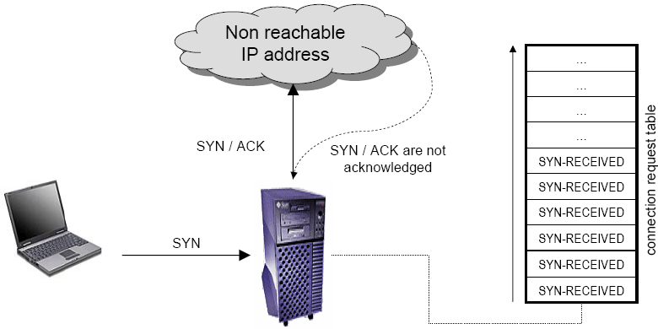
TCP SYN flood
Cont.

Slide 27
TCP SYN flood
Cont.
The attack works if the spoofed source IP address is not reachable by the attacked system. If the spoofed source IP address is reachable by the attacked system, then the legitimate owner of the source IP address would respond with a RST packet back to the target host, closing the connection and defeating the attack.
TCP SYN flood is a denial of service attack that sends a host more TCP SYN packets than the protocol implementation can handle.
This is a resource starvation DoS attack because once the connection table is full, the server is unable to service legitimate requests.

Slide 28
TCP SYN flood protection
Apply Operating System fixes:
  Systems periodically check incomplete connection requests,and randomly clear connections that have not completed a three-way handshake. This will reduce the likelihood of a complete block due to a successful SYN attack, and allow legitimate client connections to proceed.
Configure TCP SYN traffic rate limiting
Install IDS (Intrusion Detection Systems) capable of detecting TCP SYN flood attacks.

Slide 29
TCP SYN flood protection
Cont.
Filter network traffic:
  Static packet filtering – stateless IP filtering
    Static packet filtering is a firewall and routing capability that provides network packet filtering based only on packet information in the current packet and administrator rules.
    Stateless IP filters are very inexpensive
    A static IP filter does little more than simply route traffic, it is very good for traffic management.
    Static filters are vulnerable to IP spoofing attacks

Slide 30
Summary of today’s lecture
In today’s lecture, we discussed in detail about DoS attacks and its classification.
Ping of Death Attack
TCP datagram attack through SYN floods

Slide 31
Next lecture topics
How to secure a Wireless Network
How different mechanisms could be used to ensure security in a wireless network

Slide 32
The End

