Slide 1
Network Security
Lecture 5
Presented by: Dr. Munam Ali Shah

Slide 2
Summary of the previous lecture
In Previous lecture, we talked about security through obscurity
We have seen the X.800 Security architecture
We also learnt about active and passive attacks
And importantly, we discussed the difference between Security and Protection. How access matrix is used to classify objects, Domains and access-rights

Slide 3
Part 2(a)
Analysis of the N/W Security

Slide 4
Outlines
Different types of security attacks in a computing environment
Viruses, Worms, Trojan Horses
DoS attacks and its types

Slide 5
Objectives
To be able to distinguish between different types of security attacks
To identify and classify which security attacks leads to which security breach category

Slide 6
Different Types of Attacks and Threats
Virus
Worms
Trojan Horse
Botnet
Trap doors
Logic Bomb
Spyware

Slide 7
Viruses
A Virus infects executable programs by appending its own code so that it is run every time the program runs.
Viruses
  may be destructive (by destroying/altering data)
  may be designed to “spread” only
    Although they do not carry a dangerous “payload”, they consume resources and may cause malfunctions in programs if they are badly written and should therefore be considered dangerous!
Viruses have been a major threat in the past decades but have nowadays been replaced by self-replicating worms, spyware and adware as the no. 1 threat!

Slide 8
Virus Types
Boot Sector Virus
  Spreads by passing of floppy disks
  Substitutes its code for DOS boot sector or Master Boot Record
  Used to be very common in 1980ies and 1990ies

Slide 9
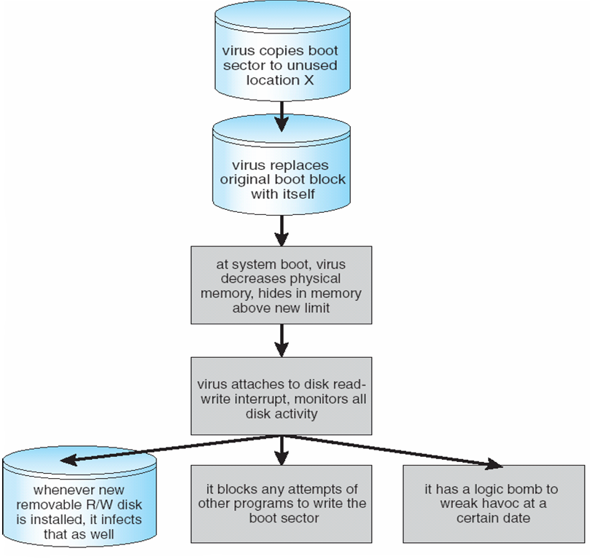
An Example of Boot Sector Virus

Slide 10
Polymorphic Virus
  Virus that has the ability to “change” its own code to avoid detection by signature scanners
Macro Virus
  Is based on a macro programming language of a popular application (e.g. MS Word/Excel, etc.)
Stealth Virus
  Virus that has the ability to hide its presence from the user. The virus may maintain a copy of the original, uninfected data and monitor system activity

Slide 11
Example of Macro Virus
Visual Basic Macro to reformat hard drive
      Sub AutoOpen()
      Dim oFS
      Set oFS = CreateObject(’’Scripting.FileSystemObject’’)
      vs = Shell(’’c:command.com /k format c:’’,vbHide)
      End Sub

Slide 12
Trap Door
Trap Door
    Trap doors, also referred to as backdoors, are bits of code embedded in programs by the programmer(s) to quickly gain access at a later time.
    A programmer may purposely leaves this code in or simply forgets to remove it, a potential security hole is introduced. Hackers often plant a backdoor on previously compromised systems to gain later access

Slide 13
Worms
A Worm is a piece of software that uses computer networks (and security flaws) to create copies of itself
First Worm in 1988: “Internet Worm“
  propagated via exploitation of several BSD and sendmail-bugs
  infected large number of computers on the Internet
Some “successful“ Worms
  Code Red in 2001
    Infected hundreds of thousands of systems by exploiting a vulnerability in Microsoft‘s Internet Information Server
  Blaster in 2003
    Infected hundreds of thousands of systems by exploiting a vulnerability in Microsoft‘s RPC service

Slide 14
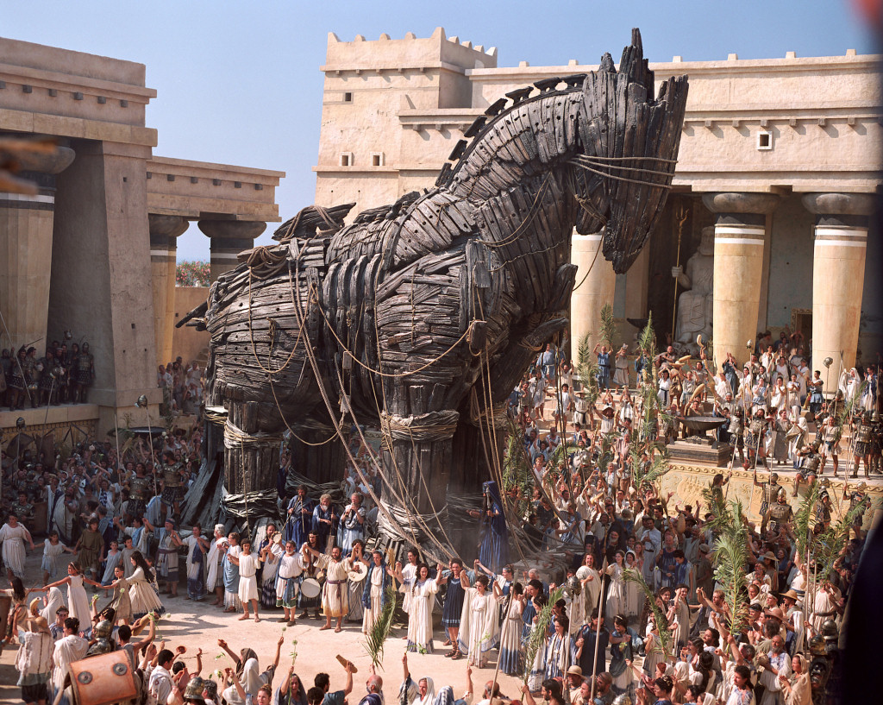
Trojan Horse

Slide 15
Trojan Horses
A Trojan is (non-self-replicating program) that appears to perform a desirable function for the user but instead facilitates unauthorized access to the user's computer system
It is embedded within or disguised as legitimate software
Trojans may look interesting to the unsuspecting user, but are harmful when actually executed
Two types of Trojan Horses
  Useful software that has been corrupted by an attacker to execute malicious code when the program is run
  Standalone program that masquerades as something else (like a game, or a neat little utility) to trick the user into running it
Trojan Horses do not operate autonomously

Slide 16
Types of Trojan Horses (1/2)
Remote Access Trojans / Remote Control Trojans
  Most dangerous types of trojans
  Enable the attacker to read every keystroke of the victim, recover passwords, etc.
  Examples: NetBus, Sub7, BackOrifice, BO2K, …
Proxy Trojans
  Provide a relay for an attacker so that he is able to disguise the origin of his activities
DDoS Zombies
  Are used for large-scale Distributed Denial of Service attacks

Slide 17
Types of Trojan Horses (2/2)
Data-Sending Trojans
  Are used by attackers to gather certain data
    Passwords
    E-banking credentials
  Gathered data is often transferred to a location on the Internet where the attacker can harvest the data later on
Destructive Trojans
  Trojans that perform directly harmful activity
    Altering data
    Encrypting files

Slide 18
Phishing
It is process of attempting to acquire sensitive information such as usernames, password and credit card details by masquerading as a trustworthy entity in an electronic communication
Defenses Against Phishing
  Number one defense is raising user awareness and user education
  Very few effective technical countermeasures to completely stop phishing

Slide 19
Denial of Service (DoS) Attacks
Denial of Service attacks are an attempt to make computer resources unavailable to their intended users
DoS attacks are (normally) not highly sophisticated, but merely bothersome
  Force administrator to restart service or reboot machine
DoS attacks are dangerous for businesses that rely on availability (e.g. Webshops, eGovernment platforms, etc.)

Slide 20
Categories of Denial of Service Attacks
 |  | Stopping services | Exhausting resources
Attack is Launch | Locally | - Process killing - System reconfiguring | - Forking process to fill process table - Filling up the file system
 | Remotely | - Malfunction packet attack | - Packet flood (e.g. SYN flood, Smurf )
Notes:
Smurf Attack - When a perpetrator sends a large number of ICMP echo (ping) traffic at IP broadcast addresses, using a fake source address
Ping of Death - When an attacker sends illegitimate, oversized ICMP (ping) packets. These attacks are targeted at specific TCP stacks that cannot handle this type of packet and overload the victim's servers.

Slide 21
DoS: Stopping Services (locally)
Easy if an attacker has already gained root-access, he could simply …
  shutdown the service
  reconfigure the service
If an attacker has a “normal“ account on the system, he could
  try to “become root“ using an exploit to perform any of the activities listed above

Slide 22
DoS: Exhausting Resources (Locally )
An attacker might try to run a program that grabs resources on the target machine itself
  Most operating systems attempt to isolate users to prevent one user from grabbing all system resources
  Intruders often find ways around these attempts (or may try to “become root“ by using an exploit)
Common methods of exhausting resources
– Filling up the process table
– Filling up the file system
– Sending traffic that fills up the communications list

Slide 23
DoS: Stopping Services (Remotely)
Much more popular than local DoS attacks, because the attacker does not need a local account on the target machine
Often a “malformed packet“ attack, that relies on errors in the TCP/IP stack or network protocol of an application and causes the remote machine (or just the application) to crash

Slide 24
DoS: Exhausting Resources (Remotely)
An attacker tries tying up all resources of the target system (particularly the communications link)
Popular example: SYN-Flood
  During a SYN-Flood an attacker will send a lot of SYN packets with a spoofed (and unresponsive) source address to the target and never complete the handshake to fill up the connection queue or the communication link (and cause a DoS)

Slide 25
DDoS
DDoS attack terminology
  Attacking machines are called daemons, slaves, zombies or agents.
  “Zombies” are usually poorly secured machines that are exploited (Also called agents)
  Machines that control and command the zombies are called masters or handlers.
  Attacker would like to hide trace: He hides himself behind machines that are called stepping stones.

Slide 26
Great Programming Required?
Remember !!
  The hackers and attackers are expert level programmers
  They now most of the programming concepts
  They simply find the loopholes in the system to exploit the opportunity to break-in the system.
  To become resilient against threats and to know the programming level of attackers, and to determine the bug,
  YES great programming is required.

Slide 27
Summary of today’s lecture
In today’s lecture, we discussed in detail about different types of security attacks that a computer system is/can be vulnerable to.
Our discussion included some famous attacks such as virus, worms, DoS, Trojan horse etc.

Slide 28
Next lecture topics
We will have our discussion continued on DoS attacks.
We will see how DoS attacks can cost million of $$$$ to a company
We will explore more types and sub-types of DoS attacks.

Slide 29
The End

